Slide 1

Subject : Business Finance II
Cost of Capital

Slide 2
Key Decision Making
How to raise money? – Financing Decision
What is the Mix of Raising Money? – Financing Decision (Define Capital Structure) → Cost of Capital
Where to Invest the money raised? – Investment Decision (Capital Budgeting Decision)
Cost of raising capital
Interest or allied payments to support the financing decision
Debt (Interest, )
Equity (Dividends, Residual Profits / Capital Appreciation)
Preference Shares (Dividends, )
Ignore this Cost that a business incurs to raise these capital (Agency Costs)
Weighted Average Cost of Capital (WACC) =

Slide 3
Capital Structure | Market Value | Cost of Capital
Equity | $ 100 million | Ke = 14% → 15% → 16% → 18%
Debt | $ 25 million | Kd = 9% → 10% → 11% → 12%
WACC = 13% |  | WACC = (100*14%) + (9%*25)/125 = 13% of full capital (125mm)
RoCE = EBIT / (D+E) = 16% > utilising are funds more effectively to ensure maximisation / create shareholder wealth | 14 + 2.25 = $ 16.25 mm 13% of 125 = $ 16.25 mm
WACC 13% > RoCE 10% → destroyed shareholder wealth
Investor Meeting Raising more capital Internal Targets for finance business

Slide 4

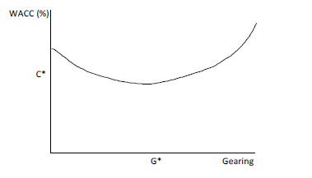

WACC
There are many methods of financing a company, they broadly fall into just the two camps of equity or debt.
Traditional View:
Kd = Interest Rate (1- Tax)
= 10% (1-30%)
=7%

Slide 5
Modigliani-Miller First Irrelevance Proposition (Idea behind the CAPM Model of calculating Ke)
The market value of any firm is independent of its capital structure
The expected rate of return on the common stock of a leveraged firm increases in proportion to the debt-equity ratio, expressed in market values
Modigliani and Miller argued that, under certain assumptions, gearing has no effect on the value of the company. Their view was that the value of the company lies in its ability to produce profits, not in the way that it is financed  in other words, that the market value of a company is determined primarily by its investment decisions and not by its financing decisions. This proposition allows complete separation of investment and financing decisions.
Assumptions:
No Taxes
Unlimited borrowing capacity
Debt is risk-free
No Agency Costs
No Information Asymmetry

Slide 6
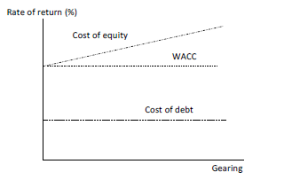
MM Graph
A more highly geared structure offers a higher return on equity, but it also offers a higher risk. These two features cancel out to leave the price of the shares, the value of the company and the WACC unchanged.

Slide 7
Later Theories
The effect of tax
The after-tax version examined the tax advantages of debt finance. Whereas the initial model suggested that the value of the pie is independent of how the pie is split (between debt and equity), the introduction of tax implies that there is a third slice, i.e. the government’s slice.
The tax system provides a debt tax shield (i.e. a reduction in tax) so that the value of the geared firm is the value of the ungeared firm plus the tax shield. This could suggest that firms should become 100% debt financed if we ignore other considerations
However, MM later found that when personal income taxes as well as corporate taxes are taken into account, the gain from a company increasing its gearing is reduced, eliminated or even negative.

Slide 8
Later Theories
The effect of different borrowing rates
If we allow for companies being able to borrow at lower rates of interest than individuals, then it means that individuals would not be able to replicate the returns from a more highly geared company by borrowing and buying more shares themselves (as MM assumed).
The effect of restricted debt capacity
The MM analysis assumed that increased debt can be raised at the same cost as before, but of course the debt is not risk-free. Loan capital providers would reassess the required return on the company’s debt given the new, more highly geared and risky structure, ie the credit rating of the company would decrease.

Slide 9
Cost of equity
The cost of equity represents the opportunity cost of capital – the rate foregone by shareholders investing in the project rather than investing in alternative securities.
Cost of Equity – Risk Free Rate + Equity Risk Premium
Points to check:
Choice of the historical period
Real and nominal rates - Real cashflows should be discounted at a real rate of return, while nominal cashflows will need a nominal rate for discounting

Slide 10
Capital asset pricing model (CAPM) and risk
The variance (or standard deviation) of the returns experienced by individual stocks are different to (and usually greater than) the market as a whole. This is a consequence of the fact that the individual stock returns are, typically, not perfectly correlated.
Specific Risk and Systematic Risk
Specific Risk can be diversified away
Systematic risk would be the risk of being exposed to the economy in general.
Sources of Systematic Risk:
Business Cycles
Interest Rates
Inflation
Tax
Currency
Global Events

Slide 11


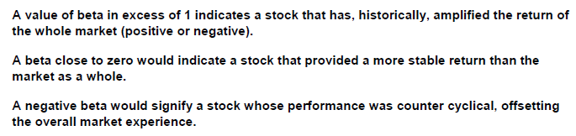
Beta a Measure of Systematic Risk
All companies are exposed to systematic risk because they are all exposed to the market. However, some companies are more exposed to the market than others and therefore are exposed to a greater proportion of the systematic risk in the market
OR

Slide 12
Beta in Practise
Beta – -0.8 (Correlation between the stock and the market is very low)
Market Return is 10%
Stock Return – -0.8 * 10% = -8%
Stock Price is very stable against the Market

Slide 13

CAPM (Ke)

Slide 14
WACC = Weighted Average Cost of Capital
WACC (Post Tax) = (Wd * Kd) + (We * Ke)
Equity Returns → (After Tax)
Debt → Pre-Tax
Cost of Debt → Interest Payments
Lower Credit Standing → Higher Cost of Debt
Higher Credit Rated → Lower Cost of Debt
Cost of Debt (A) = Interest Rate paid by the Company ( 1 – Tax Rate)
Account for the tax shield

Slide 15
Cost of Equity
Return Expectation for an Investor → Capital Appreciation and Dividends = Cost incurred by the Company
Expected Return (PoV – Investor) = Div Yield + Cap Appreciation
Reduced Div + Negative Returns on Cap Appre
Company’s Cost of Equity (Required Rate of Return) = Risk Free Rate + Equity Risk Premium
Risk Free Rate – Govt Bond Rate (Long Term – 10 years to be a proxy tenure)

Slide 16
CAPM – Calculation of Cost of Equity
Risk-Adjusted Returns
OR
Co wants to remunerate me in a just manner for the risk I take
Equity Risk Premium

Slide 17
Different Types of Risks
 | TCS | Tata Steel
Case 1: Invested (75%) | 100% (75%) | 0%
Case 2: Diversify your Investment (36%) | 40% (40% * 75%) | 60% (60% * 10%)
Risk of Cyber Fraud | 75% | 10%
Risk Classification
Specific / Unsystematic / Diversifiable Risk
Systematic Risk
Risk that an investor takes by investing in my company
Any risk that my company is specifically exposed to is known as Specific Risk
Risk that can be foregone by DIVERSIFYING your investments
E.g. Debt Structure; Volatile Market; Competitive Advantage; Level of Sophistication/ Stability; Loss Making Co; Factory Closures; Union Issues; Management Changes International Growth
They do not need to remunerate the investors for any Specific Risk because if they don’t want it they can easily diversify
Risk that an investor takes by investing by just investing in Equities
This is a risk that all companies in a Market will be exposed to
E.g. Business Cycle (Recession / Boom); Govt Policies; Global Inflation; Interest Rates; FX; International Trade Policies; Change in Standards; Tax

Slide 18
Beta – A Measure of Systematic Risk
Remunerate for the Systematic Risk → Covid-19
Positives – Pharma, Healthcare, Telecom, IT, Online Service, OTT
Negatives – F&B, Movie, Luxury, Tourism, Automobile, O&G
Market is created with all these type of companies
Beta calculates → measure of calculating systematic risk, Calculates the returns that you / company has made against the market

Slide 19
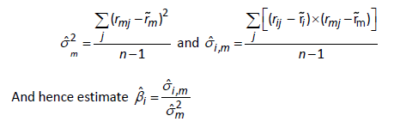
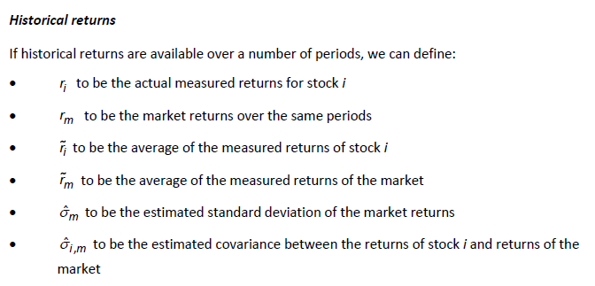
Measuring Beta – Historical Returns

Slide 20
Beta → Any company by comparing itself to the Market
For a given Capital Structure → I have no debt
As you start taking debt, the business becomes risky
Beta can start increasing
Market increases by 1%; 0.8%

Slide 21

Adjusting beta for gearing
The beta of a company’s shares, and hence the cost of equity, is affected by the company’s existing gearing (leverage / debt position)
The company’s current value of beta incorporates the effect of its current level of gearing. If the gearing changes, the new beta must be found in two stages:
find the ungeared beta first
then find the new beta for the new level of gearing

Slide 22
Suppose Led plc has debt to equity ratio of 2:3, a beta of 1.2 and is taxed at 30%.
(i) Calculate the beta of the company’s shares if the company repaid all its debt.
(ii) Calculate the beta if the debt to equity ratio increased to 3:2.
B(geared) = B(Ungeared) x (1+ D/E(1-t))
1.2 = B(ung) x (1+ 2/3(1-30%))
1.2 / 1.467 = B (Ung) = 0.81
2. B(geared) = B(Ungeared) x (1+ D/E(1-t))
= 0.81 x (1+ 3/2(1-30%))
= 1.66

Slide 23
.
Thank You

