Slide 1

Subject : Advanced Applications of Excel
Overview of Excel VBA+Macro Recording

Slide 2
Introduction to VBA
.
VBA – Visual Basic for Applications
Programming language by Microsoft
Automation is the theme
Inserting text
Repetitive tasks
Creative custom commands
Applications
Analyzing Data
Budgeting and Forecasting
Creating invoices and other forms
Developing charts from Data
Keeping lists of things
Used by governments, companies, municipalities
Also called “Debt”
Involves an entity borrowing money in exchange for promised payments
Debtholder obligations have priority over shareholders
Safer investment than stocks
Provide diversification benefits

Slide 3
VBA - Pluses and Minuses
.
Pluses
Consistency
Speed
Error-free
Minuses
Steeper learning curve
Need a copy of Excel
Moving target – newer versions of Excel

Slide 4
VBA in a Nutshell
.
Perform actions by writing/recording macros
VBA module consists of
sub procedures (does something)
function procedures (returns a value)
VBA manipulates Objects (workbook, worksheet, cell, range, chart, shape etc.)
Objects have a hierarchy
Objects of same type form a collection
An object is referred to by mentioning its position in hierarchy
Application. Workbooks(“Book1.xlsx),
Application.Workbooks(“Book1.xlsx”).Worksheets(“Sheet1”), Application.Workbooks(“Book1.xlsx”).Worksheets(“Sheet1”). Range(“A1)
If we omit specific references, Excel uses the active objects

Slide 5
VBA in a Nutshell
.
Objects have properties
(Property is like a setting, a Range object has such properties as Value and Address. Chart object has HasTitle and Type. VBA determines or changes properties)
We refer to a property be referring to the object name followed by dot followed by property
(e.g. Worksheets(“Sheet1”).Range(“A1”).Value)
We can assign values to variables
(e.g. Interest = Worksheets(“Sheet1”).Range(“A1”).Value)

Slide 6
VBA in a Nutshell
.
Objects have methods
Method is an action that Excel performs on an object
(e.g. – The object Range has a method ClearContents that does what it sounds like)
A method is specified by object name followed by dot followed by method name
e.g. Worksheets("Sheet1").Range("A1").ClearContents
VBA includes all the constructs of modern programming languages, including variables, arrays, and looping

Slide 7
My first Macro
.
Create a new, empty workbook.
Click the Developer tab, and enable the “Use Relative References” button in the Code group
Select a cell
Choose Developer ➪Code ➪Record Macro or click the macro recording button on the status bar
Enter a name for the macro
Click the Shortcut Key box, and enter Shift+N (for an uppercase N) as the shortcut key
Make sure the Store Macro In setting is This Workbook.
Enter some text in the Description box, if you like
Click Ok

Slide 8
My first Macro
.
Type your name in the active cell
Move the cell pointer to the cell below and enter this formula: =NOW()
Select the formula cell, and press Ctrl+C to copy that cell to the Clipboard.
Choose Home ➪Clipboard ➪Paste ➪Values (V).
With the date cell selected, press Shift+up arrow to select that cell and the one above it (which contains your name).
Use the controls in the Home ➪Font group to change the formatting to Bold and make the font size 16 point.
Choose Developer ➪Code ➪Stop Recording

Slide 9
Testing the Macro
.
To test your macro, move to an empty cell and press Ctrl+Shift+N (or whatever shortcut you assigned).
OR
Choose Developer➪Code➪Macros (or press Alt+F8) to display the Macros dialog box.
Select the macro from the list (in this case, NameAndTime), and click Run.
Make sure you select the cell that will hold your name before executing

Slide 10
Examining the Macro
.
Choose Developer ➪Code ➪Visual Basic (or press Alt+F11)
In the VBE window, locate the window called Project.
Select the project that corresponds to the workbook in which you recorded the macro.
Double-click Module1.

Slide 11
Modifying the Macro
.
Change the name that’s entered in the active cell.
Change the font name or size.
Figure out the appropriate location for this new statement that makes the cells italic:
Selection.Font.Italic = True

Slide 12
Saving Workbooks with Macros
.
If you store one or more macros in a workbook, the file must be saved as a macro-enabled file type.
In other words, the file must be saved with an XLSM extension rather than the normal XLSX extension.

Slide 13
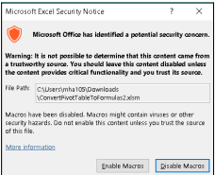
Macro Security
.
By default, Excel uses the Disable All Macros with Notification option.
With this setting in effect, if you open a workbook that contains macros (and the file is not digitally “signed” or stored in a trusted location), Excel displays a warning like
If you are certain that the workbook comes from a trusted source, click Enable Macros, and the macros will be enabled.

Slide 14
More Macro points
.
For the macro to work, its workbook must be open.
If you close the workbook, the macro isn’t available so it can’t work (and its shortcut keys have no effect).
As long as the workbook containing the macro is open, you can run the macro while any workbook is active.
The macro WILL overwrite existing text with no warning — and its effects can’t be undone.
You can create this macro manually rather than record it.
You can store this macro in your Personal Macro Workbook – then, the macro is available automatically whenever you start Excel.
You can also convert the workbook to an add-in file.

Slide 15
Exercise 1 – Elephant in a Cage
.
Open the “Elephant” sheet in the “Exercises-MacroRecording” Sheet
Write a macro to
Put an Elephant in a cell (Write "Elephant”)
Make the elephant bigger (increase the font size to 36)
Align it centrally horizontally and vertically
Give it a cage (put a border round the cell)
Make it the right colour (make the background grey)

Slide 16
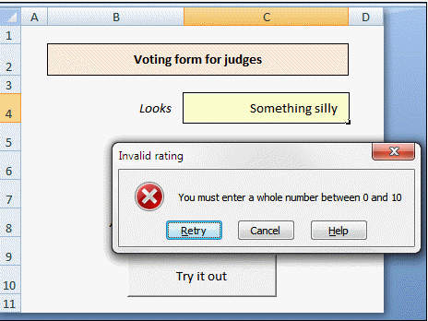
Exercise 2 – Voting Form
.
Open the “Voting Form” sheet in the “Exercises-MacroRecording” Sheet
Record a macro to apply the following to cell C4 (the first input cell):
Validation (so that you can only input a whole number between 0 and 10)
Protection (unlock the cell for editing)
Formatting (give the cell a yellow background)
This is the effect we are trying to achieve
Stop recording, and edit your macro to strip out all the redundant code. You should be able to reduce it to 5 lines.
Test your slimmed-down macro out to check that it works on the other two input cells.

Slide 17
Exercise 3 – Cheese
.
Before you start recording a macro, take a copy of the current sheet so you have a replica to test your macro on later.
Record a macro called FormatTable, with the shortcut CTRL + SHIFT + F, which will format the table and add a formula into column C to calculate the ratio of people who prefer each cheese.

Slide 18
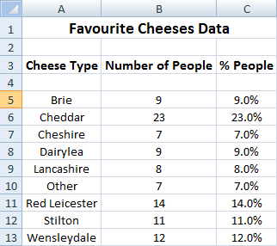
Exercise 3 – Cheese
The steps involved in this macro are:
In Cell C3 add in the header % People.
Highlight Columns A-C and centre the text within each column.
Align the main header Favourite Cheeses Data across Columns A-C.
Change the Font of the main header to Bold and Size 14pt.
Change the Font of the table headers in Row 3 to Bold and Size 12pt.
In Cell C5 type in a formula to calculate the ratio of the people who prefer that cheese.
AutoFill this down to the bottom of the list.
AutoSize the column widths.
.

Slide 19
.
Thank You

