Slide 1

Subject : Macro Economics
Demand Side Policy

Slide 2
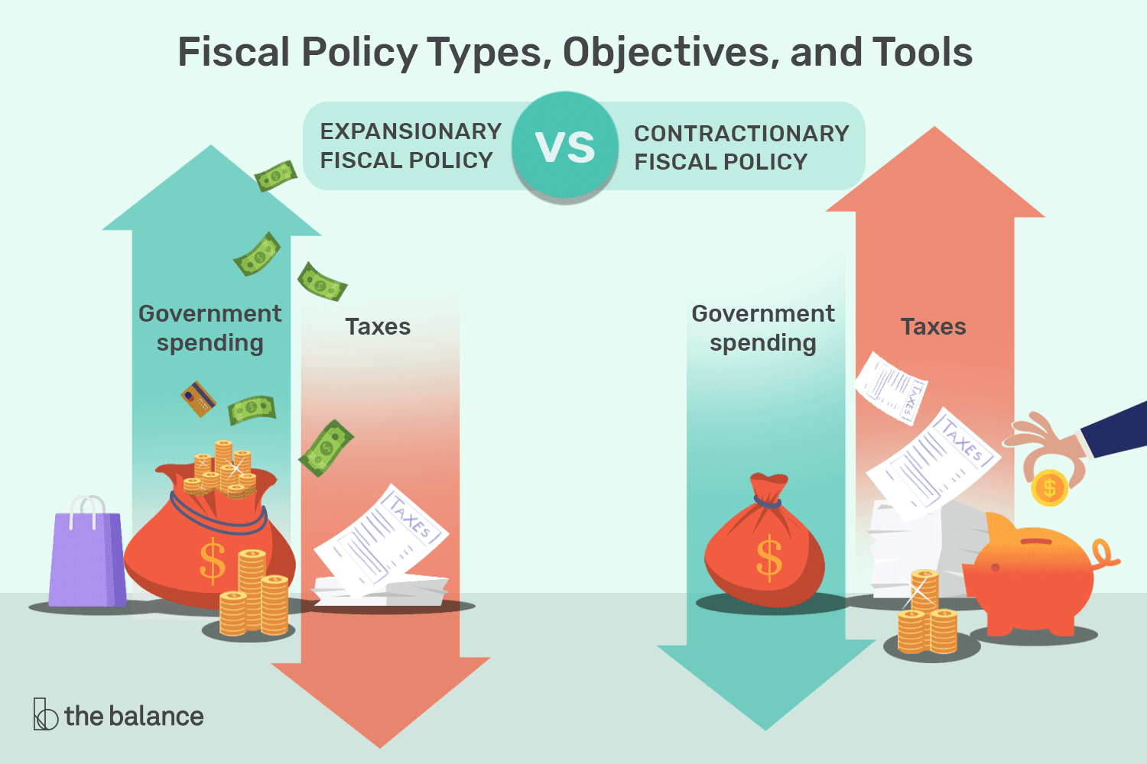
Fiscal Policy
Fiscal policy involves the government manipulating the level of government expenditure and/or rates of tax.
But why might government wish to change its fiscal position?
In other words, what are the roles for fiscal policy?

Slide 3
Roles for fiscal policy
Aggregate demand - Fiscal policy may be used to affect aggregate demand. There are two principal reasons for this:
Prevent the occurrence of fundamental disequilibrium in the economy. The government may wish to remove any severe deflationary or inflationary gaps. Hence, expansionary fiscal policy could be used to prevent an economy experiencing a severe or prolonged recession, likewise, deflationary fiscal policy could be used to prevent rampant inflation.
Stabilisation policies. The government may wish to smooth out the fluctuations in the economy associated with the business cycle. This involves reducing government expenditure or raising taxes when the economy begins to boom. This will dampen down the expansion and prevent ‘overheating’ of the economy. Conversely if a recession looms, the government should cut taxes or raise government expenditure in order to boost the economy.

Slide 4
Roles for fiscal policy
Aggregate supply - Fiscal policy can also be used to influence aggregate supply.
For example, government can increase its expenditure on education, training and infrastructure, or give tax incentives for investment and research and development. Such initiatives would be intended to increase the rate of growth of the economy’s potential output and reduce the natural rate of unemployment

Slide 5
Some terminology
When analysing government finances the term ‘government’ is often used interchangeably with that of ‘general government’. It is important to note that general government includes both central and local government.
The terms budget deficit and budget surplus are frequently used.
Budget deficit The excess of an organisation’s spending over its revenues. When applied to government it is the excess of its spending over its tax receipts.
Budget surplus The excess of an organisation’s revenues over its expenditures. When applied to government it is the excess of its tax receipts over its spending.
General government deficit (or surplus) The combined deficit (or surplus) of central and local government.
(Real Life Read - https://www.usatoday.com/in-depth/news/2020/05/08/national-debt-how-much-could-coronavirus-cost-america/3051559001/)

Slide 6
Deficits, debt and borrowing
To finance their deficits, governments will have to borrow (e.g. through the issue of bonds (gilts) or Treasury bills).
Deficits represent annual borrowing: a flow concept.
The accumulated deficits over the years (minus any surpluses) gives total debt: a stock concept. It is the total amount owed by the government.
National debt The accumulated deficits of central government. It is the total amount owed by central government, both domestically and internationally.
General government debt The accumulated deficits of central plus local government. It is the total amount owed by general government, both domestically and internationally.

Slide 7
Expenditures
Current and capital expenditures. In presenting the public finances, it has become the custom to distinguish between these two.
Current expenditure Recurrent spending on goods and factor payments.
Capital expenditure Investment expenditure; expenditure on assets.
Final expenditure and transfers. We can also distinguish between final expenditure on goods and services, and transfers.
Final expenditure Expenditure on goods and services. This is included in GDP and is part of aggregate demand.
Transfers Transfers of money from taxpayers to recipients of benefits and subsidies. They are not an injection into the circular flow but are the equivalent of a negative tax (i.e. a negative withdrawal).

Slide 8
Public-sector borrowing and debt
If the public sector spends more than it earns, it will have to finance the deficit through borrowing known as public-sector net borrowing (PSNB). The principal form of borrowing is through the sale of gilts (bonds).
The precise amount of money the public sector needs to borrow in any one year is known as the public-sector net cash requirement (PSNCR). It differs slightly from the PSNB because of time lags in the flows of public-sector incomes and expenditure.
Public-sector net debt Gross public-sector debt minus liquid financial assets which comprise official reserves and deposits held with financial institutions

Slide 9
Key fiscal indicators
We identify four measures which tell about prudence or sustainability of the public sector’s finances.
Public-sector net borrowing - The difference between the expenditures of the public sector and its receipts from taxation and the revenues from public corporations.
1
Public-sector net debt - Gross public-sector debt minus liquid financial assets.
2
Public-sector current budget deficit - The amount by which public-sector expenditures classified as current expenditures exceed public-sector receipts.
3
Primary surplus (or deficit) - The situation when the sum of public-sector expenditures excluding interest payments on public-sector debt is less than (greater than) public-sector receipts.
4

Slide 10
The business cycle and the public finances
When analysing the fiscal indicators, it is important to recognise that their values are affected by the state of the economy. In other words, there is both a structural and a cyclical component determining the path of our fiscal measures.
If the economy is booming, with people earning high incomes, the amount paid in taxes will be high and the amount paid out in unemployment benefits will also be low. The combined effect is to improve public-sector balances, such as public-sector net borrowing.
By contrast, if the economy were depressed, tax revenues would be low and the amount paid in benefits would be high. The public-sector deficit would thus be high.
Structural deficit (or surplus) - The public-sector deficit (or surplus) that would occur if the economy were operating at the potential level of national income: i.e. one where there is a zero output gap.

Slide 11
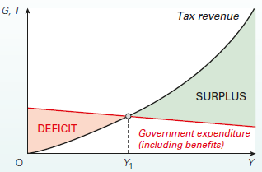
The business cycle and the public finances
This relationship between the public-sector deficit or surplus and the state of the economy is illustrated in Figure.
The tax revenue function is upward sloping. Its slope depends on tax rates.
The government expenditure function is drawn as downward sloping, showing that at higher levels of income and employment less is paid out in benefits
There is only one level of income (Y1) where there is a public-sector financial balance. Below this level of income there will be a public sector deficit. Above this level there will be a surplus. The further income is from Y1, the bigger will be the deficit or surplus.

Slide 12
The fiscal stance
The government’s fiscal stance refers to whether it is pursuing an expansionary or contractionary fiscal policy.
Would the mere existence of a surplus mean that the stance was contractionary? The answer is no. Whether the economy expands or contracts depends on the balance of total injections and total withdrawals.
What we need to focus on is changes in the size of the deficit or surplus. If the deficit this year is lower than last year, then (ceteris paribus) aggregate demand will be lower this year than last. The reason is that either government expenditure (an injection) must have fallen, or tax revenues (a withdrawal) must have increased, or a combination of the two.
To conclude, the size of the deficit or surplus is a poor guide to the stance of fiscal policy. A large deficit may be due to a deliberate policy of increasing aggregate demand, but it may be due simply to the fact that the economy is depressed.

Slide 13
Automatic fiscal stabilisers
We saw that the size of the public-sector surplus or deficit will automatically vary according to the level of national income.
Automatic fiscal stabilisers Tax revenues that rise and government expenditure that falls as national income rises. The more they change with income, the bigger the stabilising effect on national income.
The effectiveness of automatic stabilisers
Automatic stabilisers have the obvious advantage that they act instantly as soon as aggregate demand fluctuates. By contrast, it may take some time before the government can institute discretionary changes in taxes or government expenditure, especially if forecasting is unreliable.
Nevertheless, automatic stabilisers can never be the complete answer to the problem of fluctuations. Their effect is merely to reduce the multiplier – to reduce the severity of fluctuations, not to eliminate them altogether.

Slide 14
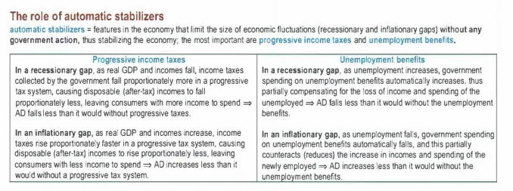
Automatic fiscal stabilisers

Slide 15
Automatic fiscal stabilisers
The problem of fiscal drag
Automatic stabilisers help to reduce upward and downward movements in national income. This is fine if the current level of income is the desirable level. But suppose that there is currently a deep recession in the economy, with mass unemployment. Who would want to stabilise the economy at this level?
In these circumstances, if the economy began to recover, the automatic stabilisers would act as a drag on the expansion. This is known as fiscal drag.
Fiscal drag The tendency of automatic fiscal stabilisers to reduce the recovery of an economy from recession.

Slide 16
Discretionary fiscal policy
Discretionary fiscal policy - Deliberate changes in tax rates or the level of government expenditure in order to influence the level of aggregate demand. It involves shifting the J and W lines.
Note that discretionary changes in taxation or government expenditure, as well as being used to alter the level of aggregate demand (fiscal policy), are also used for other purposes, including the following:
Altering aggregate supply - Examples include tax incentives to encourage people to work more, or increased government expenditure on training or on transport infrastructure (e.g. roads and railways
Altering the distribution of income - Taxation and benefits are the government’s major means of redistributing incomes from the rich to the poor.

Slide 17
Discretionary fiscal policy
Let us now compare the relative effects of changing government expenditure and changing taxes.
Discretionary fiscal policy: changing G - If government expenditure on goods and services (roads, health care, education, etc.) is raised, this will create a full multiplied rise in national income. The reason is that all the money gets spent and thus all of it goes to boosting aggregate demand.
Discretionary fiscal policy: changing T - Cutting taxes by £1 million will have a smaller effect on national income than raising government expenditure on goods and services by £1 million. The reason is that cutting taxes increases people’s disposable incomes, of which only part will be spent. Part will be withdrawn into extra savings, imports and other taxes. In other words, not all the tax cuts will be passed on round the circular flow of income as extra expenditure.
The required tax cut would be bigger than the required government expenditure increase.

Slide 18
The effectiveness of discretionary fiscal policy
How successful will discretionary fiscal policy be? Can it ‘fine-tune’ demand? Can it achieve the level of national income that the government would like it to achieve?
There are two main problem areas with discretionary fiscal policy.
The first concerns the magnitude of the effects. If G or T is changed, how much will total injections and withdrawals change? What will be the size of the multiplier? How much will a change in aggregate demand affect output and employment, and how much will it affect prices?
The second concerns the timing of the effects. How quickly can policy be changed and how quickly will the changes affect the economy?

Slide 19
Problems of magnitude
Before changing government expenditure or taxation, the government will need to calculate the effect of any such change on national income, employment and inflation. Predicting these effects, however, is often very unreliable for a number of reasons:
Predicting the effect of changes in government expenditure - Crowding out. If the government relies on pure fiscal policy – that is, if it does not finance an increase in the budget deficit by increasing the money supply – it will have to borrow the money from the non-bank private sector. It will thus be competing with the private sector for finance and will have to offer higher interest rates. This will force the private sector also to offer higher interest rates, which may discourage firms from investing and individuals from buying on credit. Thus government borrowing crowds out private borrowing.
Predicting the effect of changes in taxes - A cut in taxes, by raising people’s real disposable income, increases not only the amount they spend but also the amount they save. The problem is that it is not easy to predict the relative size of these two increases.
Predicting the resulting multiplied effect on national income - Even if the government could predict the net initial effect on injections and withdrawals, the extent to which national income will change is still hard to predict

Slide 20
Problems of timing
Fiscal policy can involve considerable time lags. If these are long enough, fiscal policy could even be destabilising. There are five possible lags associated with fiscal policy:
Time lag to recognition. Since the business cycle can be irregular and forecasting unreliable, governments may be unwilling to take action until they are convinced that the problem is serious.
Time lag between recognition and action. Most significant changes in government expenditure have to be planned well in advance. The government cannot increase spending on motorways overnight or suddenly start building new hospitals. Budgets normally occur annually, there could be a considerable time lag if the problems are recognised a long time before the Budget.
Time lag between action and changes taking effect. A change in tax rates may not immediately affect tax payments, as some taxes are paid in arrears and new rates may take a time to apply.

Slide 21
Problems of timing
Time lag between changes in government expenditure and taxation and the resulting change in national income, prices and employment. The multiplier round takes time. Accelerator effects take time. The multiplier and accelerator go on interacting. It all takes time.
Consumption may respond slowly to changes in taxation. The short-run consumption function tends to be flatter than the long-run function.
If the fluctuations in aggregate demand can be forecast, and if the lengths of the time lags are known, then all is not lost. At least the fiscal measures can be taken early and their delayed effects can be taken into account.

Slide 22
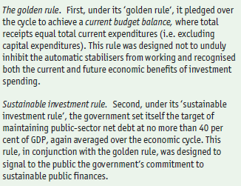
Fiscal rules
Fiscal rules prior to the financial crisis

Slide 23
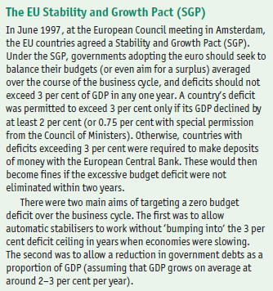
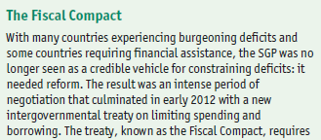

The evolving fiscal frameworks in the UK and the Eurozone

Slide 24
Up Next - Policy making environment
This section considers the relative merits of implementing macroeconomic policy, whether fiscal and/or monetary, by means of rules and discretion.
Both approaches have been used in practice and the choice between them depends upon a number of factors, including prevailing economic beliefs. It is therefore important to know and understand the advantages and disadvantages of each approach.

Slide 25
Arguments against discretionary policy and for rules
Political behaviour
Politicians may attempt to manipulate the economy for their own political purposes – such as the desire to be re-elected. After the election, the government strongly dampens the economy to deal with the higher inflation which is now beginning to accelerate, and to create enough slack for another boost in time for the next election.
It is argued that when politicians behave in this way, fiscal policy may exhibit a deficit bias.
Deficit bias The tendency for frequent fiscal deficits and rising debt-to-GDP ratios because of the reluctance of policy makers to tighten fiscal policy.
Time lags with discretionary policy
Both fiscal and monetary policies can involve long and variable time lags. These can make policy at best ineffective and at worst destabilising. We saw the various time lags earlier in detail.

Slide 26
The case for discretion
Keynesians typically reject the argument that rules provide the environment for high and stable growth.
Any change in injections or withdrawals will lead to a cumulative effect on national income via the multiplier and accelerator and via changing expectations. These endogenous effects take time and interact with each other, and so a process of expansion or contraction can last many months before a turning point is eventually reached.
What is more, the government may find it difficult to keep to its targets. This too may cause uncertainty and instability.

Slide 27
The case for discretion
Problems with targets
If an inflation target is chosen, then again the problem of Goodhart’s Law is likely to apply. If people believe that their central bank will be successful in achieving its inflation target, then those expectations will feed into their inflationary expectations, and not surprisingly the target will be met.
The problem with inflation targets therefore is that they can become consistent with both a buoyant and a depressed economy. In other words, the Phillips curve may become horizontal.
Thus achieving an inflation target may not tackle the much more serious problem of creating stable economic growth.

Slide 28
Central banks and a Taylor rule
Given the potential problems in adhering to simple inflation rate targets, many economists have advocated the use of a Taylor rule.
Taylor rule - A rule adopted by a central bank for setting the rate of interest. It will raise the interest rate if (a) inflation is above target or (b) real national income is above the potential level (or unemployment is below the natural rate). The rule states how much interest rates will be changed in each case.
The degree of importance attached to each of the two objectives can be decided by the government or central bank. The central bank adjusts interest rates when either the rate of inflation diverges from its target or the level of real national income.

Slide 29
Taylor rules and the DAD/DAS framework
We can illustrate the economic significance of the relative weights in the Taylor rule given by the central bank to inflation (b) and real national income (c) using the DAD/DAS framework.
Figure shows two alternative DAD (dynamic aggregate demand) curves. Assume that the economy is currently at point a, with inflation on target and real national income at YP, which happens to be the potential level. Now assume that inflation rises to p1. As this is above the target level, the central bank raises the rate of interest. This causes real national income to fall and is represented by a movement up along the DAD curve.
If the central bank puts a high weight on controlling inflation rather than on stabilising real national income around its potential level, the curve will be relatively flat, like DAD1.
If, however, it puts a relatively high weight on stabilising real national income around its potential level, the curve will be relatively steep, like DAD2.
The central bank has to trade off inflation stability against real income stability. Its Taylor rule shows its optimum trade-off and is illustrated by the slope of the DAD curve.

Slide 30
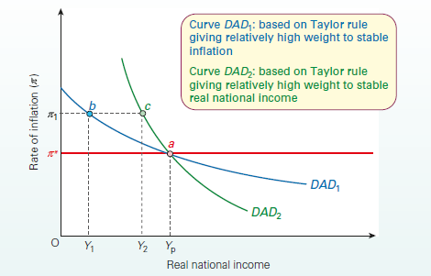
Taylor rules and the DAD/DAS framework

Slide 31
The five factors
The following factors provide us with a framework to help analyse the relative merits of rules or discretion:
The confidence of people in the effectiveness of either discretionary policies or rules: the greater the confidence, the more successful is either policy likely to be.
The degree of self-stabilisation of the economy (in the case of rules), or conversely the degree of inherent instability of the economy (in the case of discretion).
The size and frequency of exogenous shocks to demand: the greater they are, the greater the case for discretionary policy.
In the case of rules, the ability and determination of governments to stick to the rules and the belief by the public that they will be effective.
In the case of discretionary policy, the ability of governments to adopt and execute policies of the correct magnitude, the speed with which such policies can be effected and the accuracy of forecasting.

