Slide 1

Subject : Macro Economics
Supply-Side Policies

Slide 2
Supply-side policies
Supply-side policies - Government policies that attempt to influence aggregate supply directly, rather than through aggregate demand. These policies are designed to increase the quantity and/or productivity of the inputs used in production
Aims of Supply-side policies :
Supply-side policies may be directed at encouraging research and development.
Specific measures might include increasing incentives for firms to take advantage of new ideas and innovations by investing in new capital, new production processes and perhaps organisational structures.
Supply-side policies to encourage economic growth are likely to focus not just on research and development, but also on education and training, infrastructure, industrial organisation, work practices and the whole range of incentives that may be necessary to make the best use of new ideas and techniques

Slide 3
The new classical approach
New classical economists believe that supply-side policy is the appropriate policy to increase output and reduce the level of unemployment.
New classical economists advocate policies to ‘free up’ the market: policies that encourage private enterprise, or provide incentives and reward initiative.
Market-orientated supply-side policies - Policies to increase aggregate supply by freeing up the market.
Neo-Austrian/libertarian school - A school of thought that advocates maximum liberty for economic agents to pursue their own interests and to own property. Private property rights are a key element in neo-Austrian thought: the right to keep the fruits of innovation and investment, with minimum taxation.
The argument here is that a free market, with the absolute minimum of government interference, will provide the dynamic environment where entrepreneurs will be willing to take risks and develop new products and new techniques.

Slide 4
The Keynesian approach
Modern Keynesians do not just advocate the management of demand. They also advocate supply-side policies, but generally of a more interventionist nature.
Interventionist supply-side policies - Policies to increase aggregate supply by government intervention to counteract the deficiencies of the market.
In a recession, the immediate policy requirement is to increase aggregate demand rather than aggregate supply.
Over the long term, however, supply-side policies will be needed to increase potential output and to reduce equilibrium (structural and frictional) unemployment

Slide 5
‘Third Way’ supply-side policies
A ‘Third Way’ between the unfettered market system advocated by many of those on the right and the interventionist approach advocated by those on the left.
The Third Way borrows from the right in advocating incentives, low taxes and free movements of capital. It also borrows from the left in advocating means whereby governments can provide support for individuals in need while improving economic performance by investing in the country’s infrastructure, such as its transport and telecommunication systems, and in its social capital, such as schools, libraries and hospitals.
Its main thrust is the concept of helping people to help themselves.

Slide 6
The link between demand-side and supply-side policies
Policies can have both demand-side and supply-side effects.
For example, many supply-side policies involve increased government expenditure, whether on retraining schemes, on research and development projects, or on industrial relocation. They will therefore cause a rise in aggregate demand
Similarly, supply side policies of tax cuts designed to increase incentives will increase aggregate demand.
It is thus important to consider the consequences for demand when planning various supply- side policies.
Likewise, demand management policies often have supply-side effects. If a cut in interest rates boosts investment, there will be a multiplied rise in national income: a demand-side effect. But that rise in investment will also create increased productive capacity: a supply-side effect

Slide 7
Market-orientated supply-side policies
The essence of these policies was to encourage and reward individual enterprise and initiative, and to reduce the role of government; to put more reliance on market forces and competition, and less on government intervention Following are the market-orientated supply-side policies:
- reducing government spending
- reducing taxes to influence the labour market and investment
- reducing the power of labour
- reducing welfare
- privatisation
- deregulation
- introducing market relationships into the public sector
- public-private partnerships
- encouraging free trade and free capital movements

Slide 8

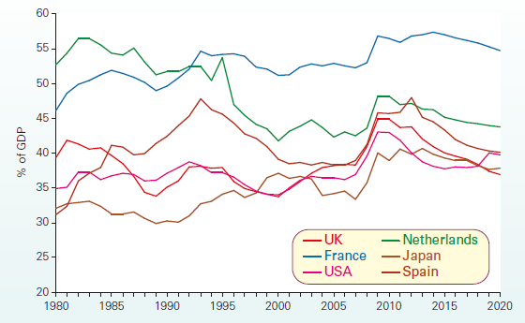
Government spending
The desire by many governments to cut government expenditure is not just to reduce the size of deficits and hence reduce the growth of money supply; it is also an essential ingredient of their supply-side strategy.
Two things are needed, it is argued: (a) a more efficient use of resources within the public sector and (b) a reduction in the size of the public sector. This would allow private investment to increase with no overall rise in aggregate demand.
Thus the supply-side benefits of higher investment could be achieved without the demand-side costs of higher inflation.

Slide 9
Taxes and the labour market
Over time, governments in many countries have cut the marginal rate of income tax.
Cuts in the marginal rate of income tax are claimed to have five beneficial effects:
People work longer hours - A cut in the marginal rate of income tax has a substitution effect inducing people to work more and also an income effect causing people to work less.
More people wish to work - This applies largely to second income earners in a family, mainly women. A rise in after-tax wages may encourage more women to look for jobs.
People work more enthusiastically - There is little evidence to test this claim. The argument, however, is that people will be more conscientious and will work harder if they can keep more of their pay.

Slide 10
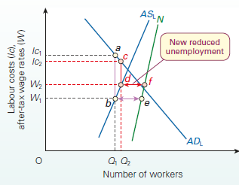
Taxes and the labour market
Employment rises - If wages are flexible, total employment will rise.
Unemployment falls - If income tax rates are cut, there will be a bigger difference between after-tax wage rates and unemployment benefit. More people will be motivated to ‘get on their bikes’ and look for work.

Slide 11
Taxes, business and investment
Market-orientated policies seek to reduce the general level of taxation on profits, or to give greater tax relief to investment.
A cut in taxes on business profits - A cut in corporation tax (the tax on business profits) will increase after-tax profits. This will leave more funds for ploughing back into investment. Also, the higher after-tax return on investment will encourage more investment to take place.
Tax relief or other incentives for investment - Another approach to increase investment is through the use of allowances or R&D expenditure credits. Investment allowances enable firms to offset the cost of investment against their pre-tax profit, thereby reducing their tax liability. R&D expenditure credits operate by providing firms with cash payments for a proportion of their R&D expenditure which, although subject to tax, nonetheless increase their net profit.

Slide 12
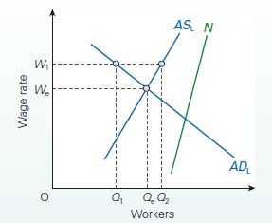
Reducing the power of labour
If the power of unions to push wage rates up to W1 were removed, then (assuming no change in the demand curve for labour) wage rates would fall to We. Disequilibrium unemployment (Q2 - Q1) would disappear. Employment would rise from Q1 to Qe.
If labour costs to employers are reduced, their profits will probably rise. This could encourage and enable more investment and hence economic growth.

Slide 13

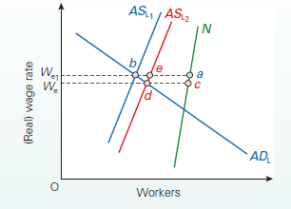
Reducing welfare
New classical economists claim that a major cause of unemployment is the small difference between the welfare benefits of the unemployed and the take-home pay of the employed. People are caught in a ‘poverty trap’: if they take a job, they lose their benefits
A dramatic solution to this problem would be to cut unemployment benefits. Unlike policies to encourage investment, this supply-side policy would have a very rapid effect. It would shift the effective labour supply curve to the right.
In figure, equilibrium unemployment would fall from a - b to c - d if real wage rates were flexible downwards; or from a - b to a - e if they were not flexible. In the case of non-flexible real wage rates, the reduction in equilibrium unemployment would be offset by a rise in disequilibrium unemployment (e - b).

Slide 14

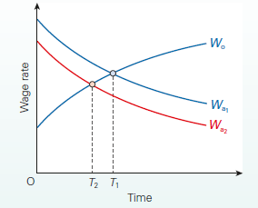
Reducing welfare
Also because workers would now be prepared to accept a lower wage, the average length of job search by the unemployed would be reduced.
What is more, the longer people are unemployed, the more demoralised they become. Employers would probably be prepared to pay only very low wage rates to such workers. To persuade these unemployed people to take these low-paid jobs, the welfare benefits would have to be slashed.
A ‘market’ solution to the problem, therefore, may be a very cruel solution. A fairer solution would be an interventionist policy: a policy of retraining labour.

Slide 15
Policies to encourage competition
If the government can encourage more competition, this should have the effect of increasing national output and reducing inflation. Five major types of policy have been pursued under this heading.
Privatisation – It can lead to increased efficiency, more consumer choice and lower prices. It can involve the introduction of private services into the public sector (e.g. private contractors providing cleaning services in hospitals). Private contractors may compete against each other for the franchise. This may well lower the cost of provision of these services, but the quality of provision may also suffer unless closely monitored.
Deregulation - This involves the removal of monopoly rights. In 1979, the UK’s National Bus Corporation lost its monopoly of long distance coach haulage. Private operators were now allowed to compete. This substantially reduced coach fares on a number of routes.

Slide 16
Policies to encourage competition
Introducing market relationships into the public sector - This is where the government tries to get different departments or elements within a particular part of the public sector to ‘trade’ with each other, so as to encourage competition and efficiency. The best-known examples are within health and education.
Public–private partnerships - Public–private partnerships (PPS) are a way of funding public expenditure with private capital. The PPI meant that a private company, after a competitive tender, would be contracted by a government department or local authority to finance and build a project, such as a new road or a prison. The government then pays the company to maintain and/or run it, or simply rents the assets from the company. The public sector thus becomes a purchaser of services rather than a direct provider itself.

Slide 17
Policies to encourage competition
Free trade and free capital movements - The opening up of international trade and investment is central to a market-orientated supply-side policy. One of the first measures was to remove all exchange controls, thereby permitting the free inflow and outflow of capital, both long term and short term.
Critics have claimed that in the short term industries may be forced to close by the competition from cheaper imported products, which can have a major impact on employment in the areas affected.
A major election promise of the Trump campaign was that ‘putting America first’ would involve a move away from free trade and giving specific protection to US industries, such as vehicles and steel.

Slide 18
The case for intervention
Many interventionist policies come under the general heading of industrial policy - Policies to encourage industrial investment and greater industrial efficiency.
The basis of the case for government intervention is that the free market is likely to provide too little research and development, training and investment.
Why there are low levels of investment, R&D, education and training?
There are potentially large external benefits from research and development. Investment that is privately unprofitable for a firm may therefore still be economically desirable for the nation.
Similarly, investment in training may continue yielding benefits to society that are lost to the firms providing the training when the workers leave.
Investment often involves risks. Firms may be unwilling to take those risks, since the costs of possible failure may be too high

Slide 19
Examples of interventionist supply-side policy
Nationalisation - This is the most extreme form of intervention, and one that most countries have in the past rejected, given the worldwide trend of privatisation. Nevertheless, many countries have stopped short of privatising certain key transport and power industries, such as the railways and electricity. Nationalisation may also be a suitable solution for rescuing vital industries suffering extreme market turbulence.
Direct provision - Improvements in infrastructure – such as a better motorway system – can be of direct benefit to industry. Alternatively, the government could provide factories or equipment to specific firms.

Slide 20
Examples of interventionist supply-side policy
Funding research and development (R&D) - To increase a country’s research and development, the government could fund universities or other research institutes through various grants, perhaps allocated by research councils. Alternatively, it could provide grants or tax relief to private firms to carry out R&D.
Training and education - It is generally recognised by economists and politicians alike that improvements in training and education can yield significant supply-side gains. The government may set up training schemes, or encourage educational institutions to make their courses more vocationally relevant, or introduce new vocational qualifications. Alternatively, the government can provide grants or tax relief to firms which themselves provide training schemes.

Slide 21
Examples of interventionist supply-side policy
Advice, information and collaboration - The government may engage in discussions with private firms in order to find ways to improve efficiency and innovation. It may bring firms together to exchange information and create a climate of greater certainty or it may bring firms and unions together to try to create greater industrial harmony. It can provide various information services to firms: technical assistance, the results of public research, information on markets, etc.

Slide 22
Regional and urban policy
Causes of regional imbalance
In addition to adopting supply-side measures that focus on the economy as a whole, governments may decide to target specific regions of the economy.
The regional and urban problems normally result from structural problems - the main one being the decline of certain industries. When an area declines, there will be a downward regional multiplier effect.
Regional multiplier effects - When a change in injections into or withdrawals from a particular region causes a multiplied change in income in that region. The regional multiplier (kr) is given by 1/mpwr, where the import component of mpwr consists of imports into that region either from abroad or from other regions of the economy.
In addition, labour may be geographically immobile. The regional pattern of industrial location may change more rapidly than the labour market can adjust to it. Thus jobs may be lost in the depressed areas more rapidly than people can migrate from them

Slide 23

Regional and urban policy
Policy approaches
State what kind of policies can the government use to bring about regional development of the depressed areas.

Slide 24
Regional and urban policy
Policy approaches
Policies targeted at specific regions (or sectors) tend to be more interventionist in nature. Interventionist policies involve encouraging firms to move. Such policies include the following.
Subsidies and tax concessions in the depressed regions - Businesses could be given general subsidies, such as grants to move, or reduced rates of corporation tax. Alternatively, grants or subsidies could be specifically targeted at increasing employment.
The provision of facilities in depressed regions - The government or local authorities could provide facilities, such as land and buildings at concessionary, or even zero, rents to incoming firms; or spend money on improving the infrastructure of the area.
The siting of government offices in the depressed regions - The government could move some of its own departments out of the capital and locate them in areas of high unemployment.

Slide 25
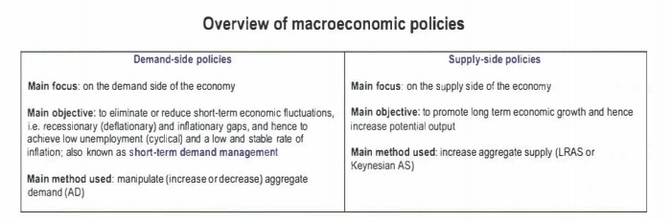
Summary of Policies

Slide 26
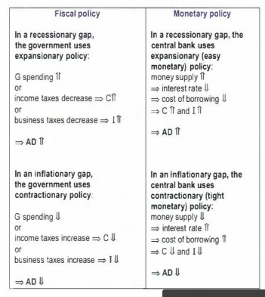
Summary of Policies

Slide 27
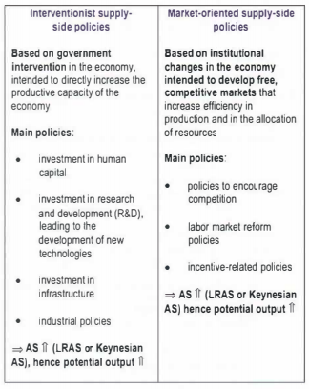
Summary of Policies

Slide 28
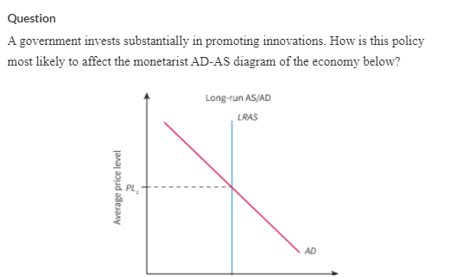
Test your understanding - Policies

Slide 29
Test your understanding - Policies
An outward shift of the AD curve and an outward shift of the LRAS curve, causing an increase in the real output level.
Answer explanation
An increase in investment, regardless of the destinations, increases aggregate demand because of the increased spending of firms. #1 and #3 explained the shift in AD curve correctly.
On the other hand, the investment may increase firms’ productivity in the long-run, resulting in an outward shift of LRAS. As a result, the real output tend to increase in the long-run. #1 and #2 explained the shift in LRAS correctly.

Slide 30
Test your understanding - Policies
What is the following news excerpt an example of?
The age of electric vehicles may arrive much earlier than expected
As car sales collapsed in Europe because of the pandemic, one category grew rapidly: electric vehicles. One reason is that purchase prices in Europe are coming tantalizingly close to the prices for cars with gasoline or diesel engines.
At the moment this near parity is possible only with government subsidies. A few years ago, industry experts expected 2025 would be the turning point. But technology is advancing faster than expected, and could be poised for a quantum leap. Elon Musk is expected to announce a breakthrough at Tesla’s “Battery Day” event that would allow electric cars to travel significantly farther without adding weight.
Sep 21, 2020 (Economic Times)

