Slide 1

Class: SY BSc
Subject : Business Economics - Micro
Chapter: Unit 4 Chapter 1
Chapter Name: Theory of Firm – 1

Slide 2
Today’s Agenda
Market structures
Market classification
Perfect Competition
Perfect Competition - Meaning
Features
Price Determination
Graphs
Profit Maximization
Short Run
Long run
Shut Down Rule
6. Supply Curve
Firm’s Short-run Supply Curve
Industry’s Short-run Supply Curve
Firm’s Long-run Supply Curve
Industry’s Long-run Supply Curve
7. Perfect Competition – Analysis
Economies of scale
Benefits of Perfect Competition
Disadvantages of Perfect Competition
8. Monopoly
Monopoly – Meaning
Features
9. Why Monopoly arises
Barriers to entry - Causes

Slide 3
Today’s Agenda
Curves and Graphs
Revenue
Costs
Profit maximization
Maximum Profit Equation – Short run
Maximum Profit Equation – Long run
Limit pricing
Evaluation of Limit pricing
Evaluation of Monopoly market
Disadvantages of Monopoly
Advantages of Monopoly
Evaluation of Pros & Cons of Monopoly
Why Government Tolerate Monopolies
Monopoly & Price Discrimination
The theory of contestable market
1. Perfectly contestable market
2. The importance of costless exit
3. Assessment of the theory
4. Contestable markets and the public interest

Slide 4

1
Market structures
Define market.
Market = Particular + Two Parties + Facilitate the Exchange place (Buyer & Seller) of Goods & Services

Slide 5
1
Market structures
Till now we have discussed firm’s production & price Firm’s production & price of product depends on market
Now its time to jump on market structure.
Forms of market depends on various factors such as:
Product is homogeneous or differentiated
Number of buyer & seller
Entry & Exit conditions etc

Slide 6







1.1
Market classification
Market Forms
Perfect Competition
Imperfect Competition
Monopoly
Oligopoly
Monopolistic Competition

Slide 7
2.1
Perfect Competition - Meaning
Large number of producer or sellers producing & selling
Homogeneous product
No barriers to entry or exit
Individual firms have no control over the market price.
The model of perfect competition plays a very important role in economic analysis and policy. Its major relevance is as an ‘ideal type’ for society.

Slide 8

2.1
Perfect Competition - Meaning
Guess real-life examples of perfect competition
Vegetable Market
Stock Market
Foreign Exchange Market

Slide 9
2.2
Features
Large number of buyers & sellers
Absence of selling & advertisement cost
Homogeneous Product
Firm is price taker
Perfect knowledge about market
Free entry & exit

Slide 10
2.2
Features
In connection with real life
As food is necessity there are Large number of buyer & seller of vegetable
Product are homogeneous so there is no need of advertisement cost
Vegetable are Homogeneous in nature
Price is decided by industry depending on demand & supply Firm is price taker
Anybody can enter into local market & take exit without any restriction
Everyone has Perfect knowledge about vegetable market

Slide 11
2.3
Price Determination
Firm and Industry
Firm
Industry
Single Organisation
Collection of Firms
Example
Indigo Airlines, Air India etc
Example
Airline Industry

Slide 12

2.3
Price Determination
An individual firm in a perfectly competitive market has no control over the price of its own output. This is because the price is determined based on market supply and market demand
The firm has no “price-making power” If firm raises price, output selling will go down. If firm lowers its price, it will not be able to cover its costs of production.
Demand for the individual firm’s output is perfectly elastic
Hence the firm is called price taker

Slide 13
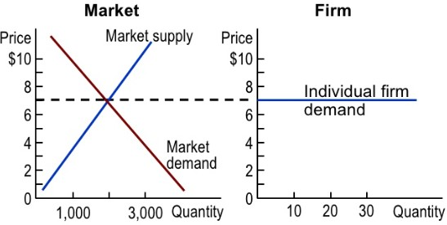
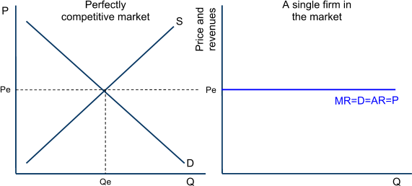
2.3
Price Determination

Slide 14
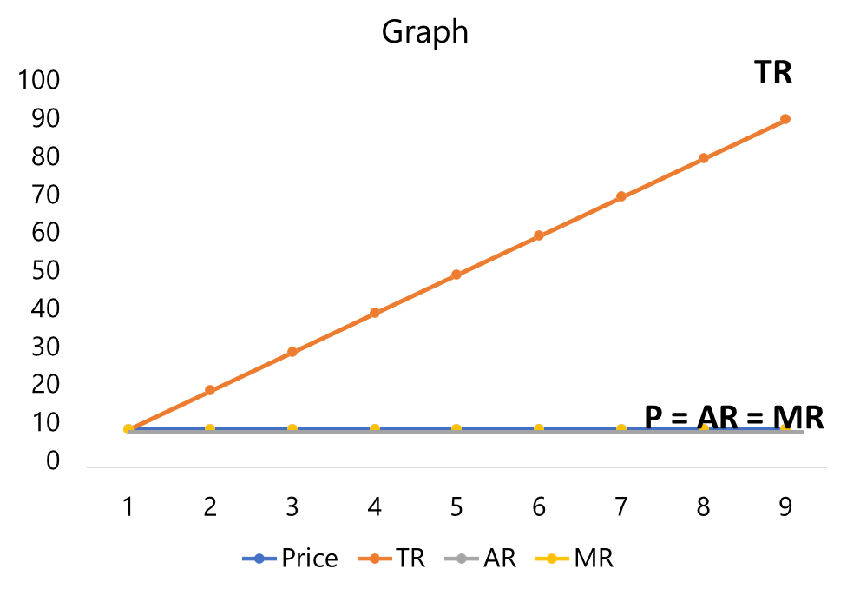
2.4
Graphs
Revenue
Output | Price | TR | AR | MR
1 | 10 | 10 | 10 | 10
2 | 10 | 20 | 10 | 10
3 | 10 | 30 | 10 | 10
4 | 10 | 40 | 10 | 10
5 | 10 | 50 | 10 | 10
6 | 10 | 60 | 10 | 10
7 | 10 | 70 | 10 | 10
8 | 10 | 80 | 10 | 10
9 | 10 | 90 | 10 | 10
Having a similar price for every commodity is reason behind the shape of graph

Slide 15
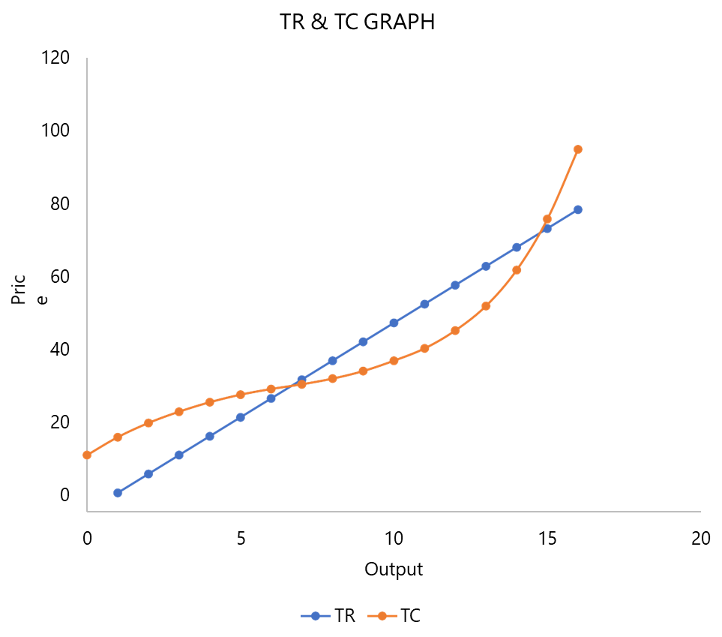
2.4
Graphs
Output | MR/P/AR | TR | TC | MC | AC | Profit
0 |  |  | 15 |  |  | -15
1 | 5 | 5 | 19.75 | 4.75 | 19.75 | -14.75
2 | 5 | 10 | 23.5 | 3.75 | 11.75 | -13.5
3 | 5 | 15 | 26.5 | 3 | 8.83 | -11.5
4 | 5 | 20 | 29 | 2.5 | 7.25 | -9
5 | 5 | 25 | 31 | 2 | 6.20 | -6
6 | 5 | 30 | 32.5 | 1.5 | 5.42 | -2.5
7 | 5 | 35 | 33.75 | 1.25 | 4.82 | 1.25
8 | 5 | 40 | 35.25 | 1.5 | 4.41 | 4.75
9 | 5 | 45 | 37.25 | 2 | 4.14 | 7.75
10 | 5 | 50 | 40 | 2.75 | 4.00 | 10
11 | 5 | 55 | 43.25 | 3.25 | 3.93 | 11.75
12 | 5 | 60 | 48 | 4.75 | 4.00 | 12
13 | 5 | 65 | 54.5 | 6.5 | 4.19 | 10.5
14 | 5 | 70 | 64 | 9.5 | 4.57 | 6
15 | 5 | 75 | 77.5 | 13.5 | 5.17 | -2.5
16 | 5 | 80 | 96 | 18.5 | 6.00 | -16
Total Revenue and Total Cost Graph

Slide 16
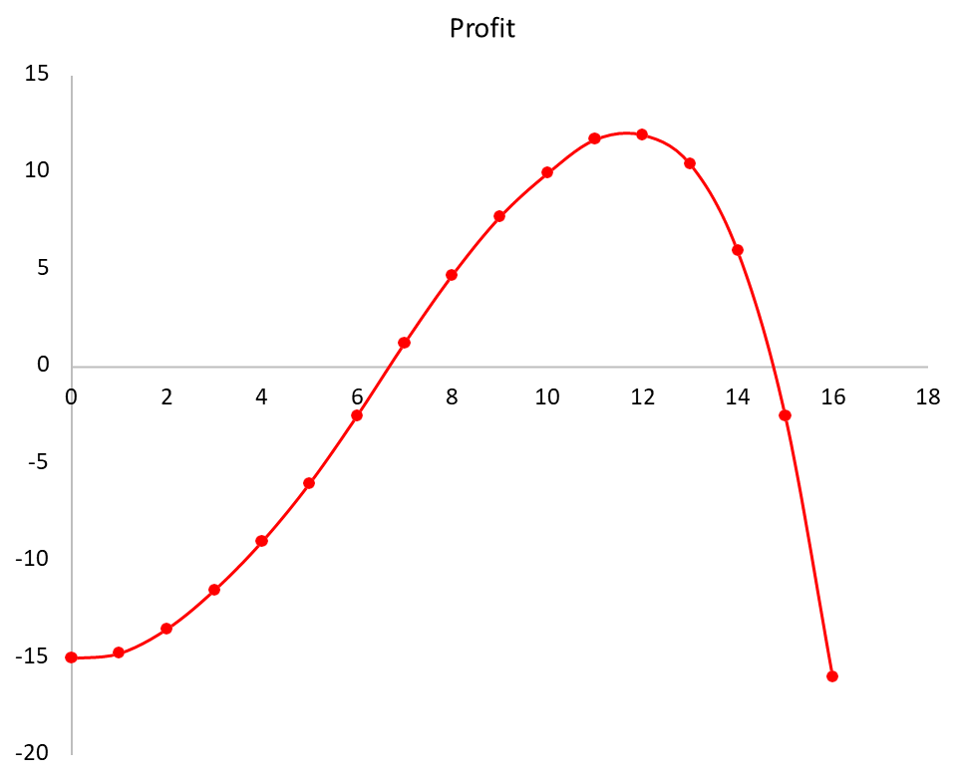
2.4
Graphs
Outpu. t | MR/P/AR | TR | TC | MC | AC | Profit
0 |  |  | 15 |  |  | -15
1 | 5 | 5 | 19.75 | 4.75 | 19.75 | -14.75
2 | 5 | 10 | 23.5 | 3.75 | 11.75 | -13.5
3 | 5 | 15 | 26.5 | 3 | 8.83 | -11.5
4 | 5 | 20 | 29 | 2.5 | 7.25 | -9
5 | 5 | 25 | 31 | 2 | 6.20 | -6
6 | 5 | 30 | 32.5 | 1.5 | 5.42 | -2.5
7 | 5 | 35 | 33.75 | 1.25 | 4.82 | 1.25
8 | 5 | 40 | 35.25 | 1.5 | 4.41 | 4.75
9 | 5 | 45 | 37.25 | 2 | 4.14 | 7.75
10 | 5 | 50 | 40 | 2.75 | 4.00 | 10
11 | 5 | 55 | 43.25 | 3.25 | 3.93 | 11.75
12 | 5 | 60 | 48 | 4.75 | 4.00 | 12
13 | 5 | 65 | 54.5 | 6.5 | 4.19 | 10.5
14 | 5 | 70 | 64 | 9.5 | 4.57 | 6
15 | 5 | 75 | 77.5 | 13.5 | 5.17 | -2.5
16 | 5 | 80 | 96 | 18.5 | 6.00 | -16
Total Profit Graph

Slide 17
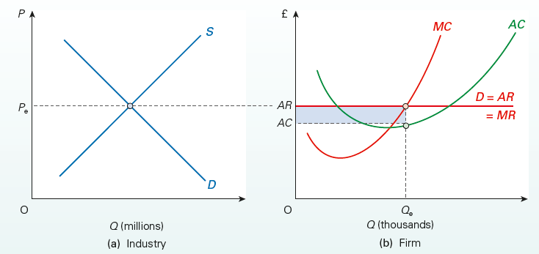

2.5
Profit Maximization
Thus the profit maximisation point is at MC = MR
Mc curve cuts MR from below (Because cost should be lower than revenue)
Based on its MC and MR, the firm will maximize its profits (or minimize its losses) by producing at Qf
‘Maximizing Profit Practice’ - Video

Slide 18
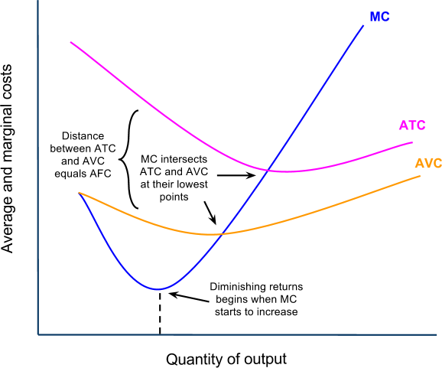
3
Short run
The number of firms is fixed.
Depending on its costs and revenue, a firm might be making large profits, small profits, no profits or a loss; and in the short run, it may continue to do so.
Recall from our earlier unit that a firm faces the following short-run production costs:
MC, which slopes upwards because of diminishing marginal returns
AVC, which is the per unit labor costs of production
ATC, which is the AVC plus the AFC (the per-unit costs of fixed capital resources)
Recall also that MC must intersect the average cost curves at their lowest points.

Slide 19
3
Short run
Explain why as quantity increases, the difference between Average Total Cost (ATC) and Average Variable Cost (AVC) keeps on reducing?

Slide 20
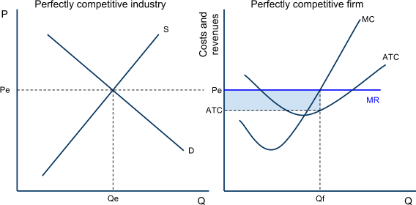
3
Short run
Super Normal Profit
The market demand is relatively high, presenting firms with a price that is greater than their ATC
The firm’s economic profits is the blue area (P-ATC) x Q.
The firm is maximizing its profits by producing where MR=MC.
Due to the absence of entry barriers, these profits will not be sustained in the long-run, as new firms will enter the market.

Slide 21
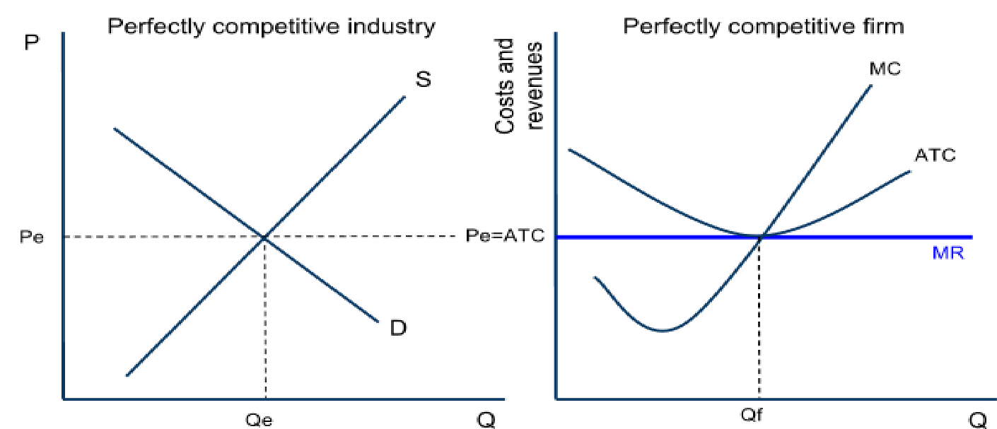
3
Short run
Normal Profit
The market demand and supply have set a price equal to the firm’s minimum average total cost.
The firm is just covering all its costs, meaning it is earning zero economic profits, but no losses
If the firm produced at any quantity other than Qf, it would earn economic losses. By producing at Qf, it is breaking even.
There is no incentive for firms to enter or exit this market.

Slide 22
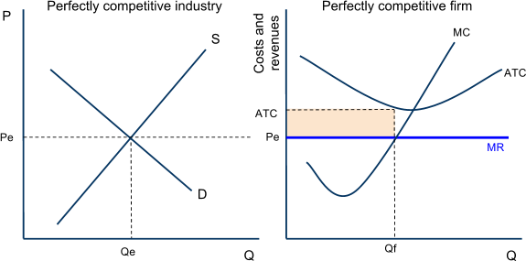
3
Short run
Loss
The market demand is relatively low, so the price the firm can sell its output for is below its average total cost
The firm’s economic losses are the yellow area (ATC-P) x Q.
The firm is minimizing its losses by producing where MR=MC.
Due to the absence of entry barriers, these losses will be eliminated in the long-run as firms exit the industry to avoid further losses.

Slide 23
4
Long run
The period of time over which firms can adjust their plant size in response to changes in the level of demand for their product. New firms can enter a market and existing firms can exit a market in the long-run. The long-run is the variable-plant period.
Entry and exit in the long-run: In perfectly competitive markets, firms can enter or exit the market in the long-run.
If economic profits are being earned, firms will be attracted to the profits and will want to enter the market
If economic losses are being earned, some firms will wish to minimize their losses by shutting down and leaving the market
Due to the entry and exit of firms in perfectly competitive markets, economic profits and losses will be eliminated in the long-run and firms will only BREAK EVEN.
When all the firms in a perfectly competitive market are breaking even, a market is in its long-run is in equilibrium state. No firms will wish to enter OR exit a market in which firms are breaking even!

Slide 24
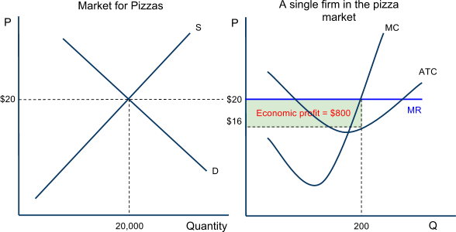
4
Long run
Consider the pizza market:
At the current level of demand and supply, the price ($20) per pizza is greater than the typical firm’s ATC ($16).
Pizza shops are making 200 pizzas each at a profit of $4 per pizza for a total profit of $800.
Due to the low entry barriers, sellers of other products will be attracted to and hence enter the pizza market, where easy profits can be earned.
The number of sellers is a determinant of supply, so the market supply will increase.
Entry Eliminates Profits

Slide 25
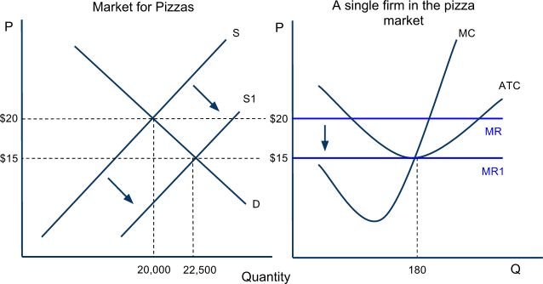
4
Long run
The price of pizza falls from $20 to $15.
MR falls, causing the firm to reduce its output to maintain its MR=MC level
Economic profit is eliminated, as the price falls to the firm’s minimum ATC
The firm output is reduced as it now faces more competition
The market is in equilibrium again when the individual firm is only breaking even
Entry Eliminates Profits

Slide 26
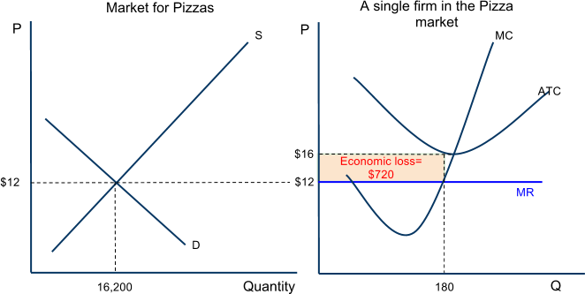
4
Long run
Consider the pizza market:
At the current level of demand and supply the market price ($12) is lower than the typical firm’s ATC ($16)
Pizza shops are making 180 pizzas each at a loss of $4 per pizza, for a total loss of $720
Due to the fact that it is easy to exit the market, some pizza shops will chose to shut down and seek profits elsewhere.
The number of sellers is a determinant of supply, so the market supply will decrease.
Exit Eliminates Losses

Slide 27
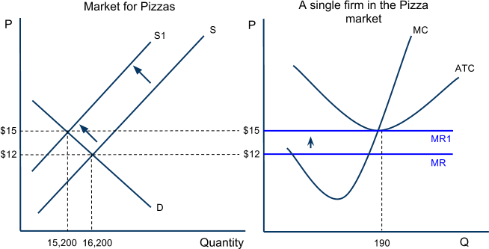
4
Long run
The price of pizza rises from $12 to $15
MR rises, causing the firm to increase its output to maintain its MR=MC level
Losses are eliminated, as the price rises to the firm’s minimum ATC
The firm’s output increases as it now faces less competition
Exit Eliminates Losses
The market is in equilibrium again when the individual firm is only breaking even

Slide 28
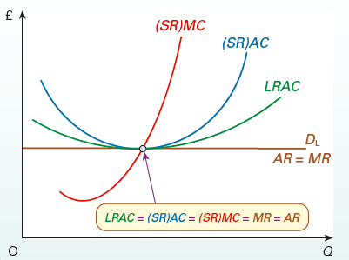
4
Long run
A perfectly competitive market is in its long-run equilibrium ONLY when the typical firm is breaking even.
Equilibrium is defined as “a state of balance”
If any profits or losses are being earned, a PC market is out of balance, and firms will enter or exit the market until equilibrium is restored.
Since the LRAC curve is tangential to all possible short-run AC curves, the full long-run equilibrium will be as shown in figure where LRAC = AC = MC = MR = AR

Slide 29
5
Shut Down Rule
So far we have said that “if losses are being earned, some firms will exit the market until the remaining firms are breaking even once again”. But this raises the question:
Which firms will exit the market, and which firms will stay?
Recall that we said that Perfectly Competitive firms face identical costs of production.
That is not 100% true, because one cost, the level of normal profit, can vary from seller to seller, even in PC.
Normal profit is the implicit, subjective value of each business owner’s skills and time. Some business owners will value their efforts more highly than others, even when all the other costs faced are identical to all other business owners’ costs.
For this reason, some sellers will be willing to tolerate greater losses for longer periods of time than other sellers.
In other words, among firms facing identical explicit costs (wages, interests, rents), some will shut down sooner when earning losses than others due to their different levels of implicit costs (normal profit)

Slide 30
5
Shut Down Rule
A firm facing economic losses has two choices:
Continue to operate your business, and hope that your average revenue (price) is at least high enough to cover your average variable costs (these are your operating costs in the short-run… you have to earn enough to pay your workers, at least!), OR…
Shut down and give up your fixed costs, which are those that must be paid EVEN if you shut your business down. A firm’s loss when it shuts down is its total fixed costs, those payments to owners of capital and land resources (rent for your landlord, interest owed to the bank on money you borrowed to buy capital).

Slide 31
5
Shut Down Rule
These tradeoffs give business owners a clear rule for WHEN TO SHUT DOWN:
If the price of your product is lower than a firm’s average variable cost OR …
If the firm’s total losses when continuing to operate are greater than its total fixed costs
If either of these criteria are true, then a firm can always minimize its losses by shutting down and leaving the market.
If neither is true, the firm should remain in the market and continue to produce, and hope that the price rises again in the future.

Slide 32
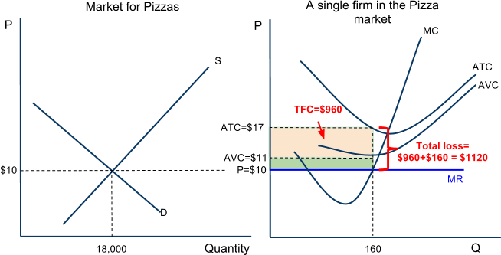
5
Shut Down Rule
A firm facing losses must compare its level of losses by continuing to operate to its level of losses if it shuts down.
Total losses if it continues to operate = (𝑨𝑹 − 𝑨𝑻𝑪) × 𝑸
Total losses if it shuts down = (𝑨𝑻𝑪 − 𝑨𝑽𝑪) × 𝑸
Consider the Pizza Market:
The demand for pizzas is so low that the price ($10) is lower than the firm’s AVC ($11). The firm cannot even afford to pay its workers.
The firm’s total losses (17-10) x 160, are greater than its total fixed costs (17- 11) x 160. The firm would minimize its losses by shutting down
This firm should exit the market

Slide 33
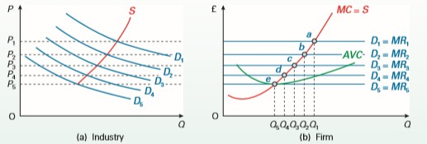
6.1
Firm’s Short-run Supply Curve
The firm’s short-run supply curve will be a section of its (short-run) marginal cost curve.
A supply curve shows how much will be supplied at each price: it relates quantity to price.
The marginal cost curve relates quantity to marginal cost. But under perfect competition, given that P = MR, and MR = MC, P must equal MC. Thus the supply curve and the MC curve will follow the same line.

Slide 34
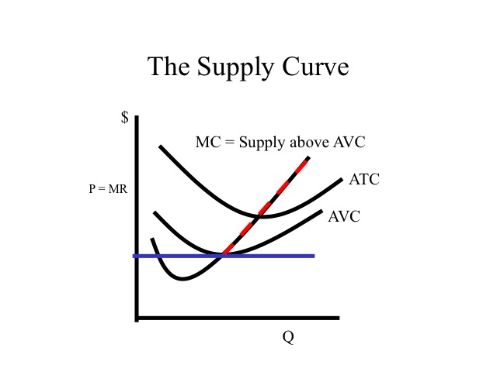
6.1
Firm’s Short-run Supply Curve
As we have just shown, if the price of a good ever falls below a firm’s AVC, the firm will no longer produce the good.
The MC increases as output increases because of diminishing marginal returns.
Since the MC increases at higher level of output, firms require a higher prices in order for them to increase output, so they can maintain the MR=MC level and maximize profits.
As price rises above AVC, the firm will increases its quantity in direct relationship with the price.
As price decreases, but remains above AVC, the firm will reduce its output.
In this regard, the firm’s MC above its AVC is similar to a firm’s supply curve. The quantity supplied by the firm reflects a direct relationship with the price of the good.

Slide 35
6.1
Firm’s Short-run Supply Curve
What would cause the firm's supply (MC) curve to shift?
Changes in the prices of variable inputs:
For example, a higher minimum wage will shift the cost curve of a firm employing minimum wage workers UP. This corresponds to a leftward shift of the firm's supply curve.
Improvements in technology will shift MC down:
Since better technology makes all workers more productive (shift the MP and AP curves up, thus the MC and AVC curves down). This corresponds with an outward shift of the firm's supply curve.

Slide 36
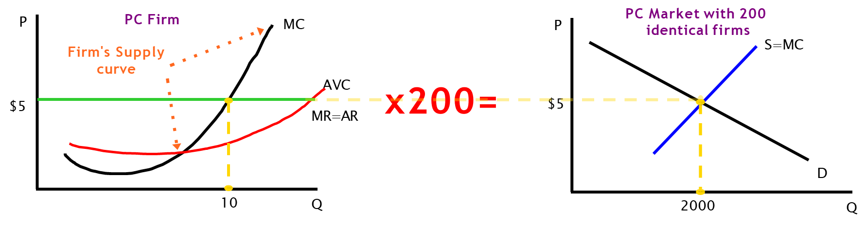
6.2
Industry’s Short-run Supply Curve
Since an individual firm’s MC curve is analogous to the firm’s supply, the sum of all the firms’ MC curves in a particular market should give us the market supply for a goods. Assume the following:
There are 200 identical firms making an identical product with identical costs
Each firm produces the profit maximizing level of output based on where the price equals its MC
Equilibrium output in the market is found at the intersection of market supply and market demand.
Total quantity supplied equals the product of the individual firms' output multiplied by the number of firms

Slide 37
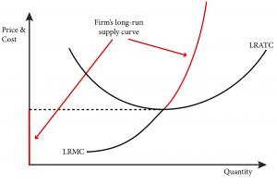
6.3
Firm’s Long-run Supply Curve
The firm’s long-run supply curve is derived in a very similar way to the firm’s short-run supply curve. The major difference is that, in the long-run, the firm can adjust all of its inputs.
This means that all of its costs are now variable and hence the long-run average cost curve is the same as long-run average variable cost curve.
Therefore, the firm’s long-run supply curve is the portion of its long-run marginal cost curve above the point where it is cut by the average cost curve. At prices below this level it would be loss minimizing for the firm to produce zero.

Slide 38
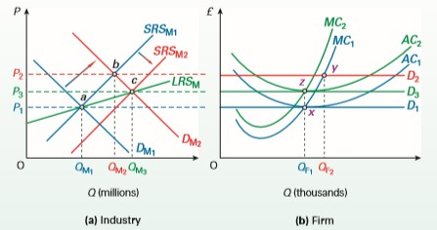
6.4
Industry’s Long-run Supply Curve
The long run industry supply curve cannot be derived in the same way as the short run industry supply curve: i.e. by horizontally summing all the individual firms’ supply curves. This is because, in the long run, the number of firms in the industry is no longer fixed and account has to be taken of the output produced by any new firms entering the industry. This has to be added to the quantity produced by existing firms.
The long run industry supply curve can be derived by analysing the impact of an increase in demand on a market that is initially in long run equilibrium.

Slide 39
6.4
Industry’s Long-run Supply Curve
Increasing Cost Industry – upward sloping long-run supply curve
The long-run market supply curve (LRSM) goes through points a and c: i.e. the two positions of long-run equilibrium.
In the example in figure, the long-run industry supply curve is upward sloping because the extra demand for factor inputs generated by new entrants puts upward pressure on their prices.
This is referred to as an increasing cost industry (i.e. where there are external diseconomies of scale).

Slide 40
6.4
Industry’s Long-run Supply Curve
Increasing Cost Industry – upward-sloping long-run supply curve
It is likely to occur when the demand for factor inputs from firms within one industry make up a relatively large proportion of the total demand for those inputs.
This is more likely when most of the factor inputs are industry specific: i.e. specialist capital equipment tailored to the production of a particular good.
In these circumstances, any increase in demand from new entrants will have a significant impact on the total demand for the inputs, making an increase in their price more probable.

Slide 41
6.4
Industry’s Long-run Supply Curve
Constant Cost Industry – horizontal long-run supply curve
In some industries the majority of factor inputs will be far less specialized.
Take the example of an input such as electricity. The demand for electricity from firms in a particular industry will be small relative to the total demand for electricity across the whole economy.
If the demand from new entrants in one industry increased, it is unlikely to affect the market price of electricity run industry supply curve.
If this was true for all factor inputs used by firms then it would be a constant cost industry. As new firms entered, the average total cost curve of the individual firms would remain unchanged. A constant - cost industry would have a horizontal long -run industry supply curve.

Slide 42
6.4
Industry’s Long-run Supply Curve
Decreasing Cost Industry – downward-sloping long-run supply curve
Another possibility is that increasing demand from new entrants within the industry causes the price of factor inputs to decrease. This is called a decreasing-cost industry.
It can occur when the increased demand for inputs enables the suppliers of these inputs to exploit internal economies of scale. It can also occur when firms in the industry share common transport, training or other infrastructure.
These external economies of scale cause the cost curves in figure to shift downwards. A decreasing cost industry will therefore have a downward sloping long - run industry supply curve.

Slide 43
7.1
Economies of Scale
In many industries, firms may have to be quite large if they are to experience the full potential economies of scale.
But perfect competition requires there to be many firms and that each one is a price taker.
Firms must therefore be small under perfect competition: too small in most cases for economies of scale.
Once a firm expands sufficiently to achieve economies of scale, it will usually gain market power.
It will be able to undercut the prices of smaller firms, which will thus be driven out of business.
Perfect competition is destroyed. Perfect competition could only exist in any industry, therefore, if there were no (or virtually no) economies of scale.

Slide 44
7.2
Benefits of Perfect Competition
P = MC
Price equals marginal cost has important implications for the allocation of resources between alternative products. Given that price equals marginal utility, marginal utility will equal marginal cost. This is argued to be an optimal position.
To demonstrate why, consider what would happen if they were not equal.
If price were greater than marginal cost, this would mean that consumers were putting a higher value (P = MU) on the production of extra units than they cost to produce (MC).Therefore, more ought to be produced.
If price were less than marginal cost, consumers would be putting a lower value on extra units than they cost to produce. Therefore, less ought to be produced.
When they are equal, therefore, production levels are just right. But, as we shall see later, it is only under perfect competition that MC = P.

Slide 45
7.2
Benefits of Perfect Competition
Long run equilibrium is at the bottom of the firm’s long-run AC curve. That is, for any given technology, the firm, in the long run, will produce at the least cost output.
Perfect competition is a case of ‘survival of the fittest’. Inefficient firms will be driven out of business, since they will not be able to make even normal profits. This encourages firms to be as efficient as possible.
The combination of (long run) production being at minimum average cost and the firm making only normal profit keeps prices at a minimum.
If consumer tastes change, the resulting price change will lead firms to respond (purely out of self interest). An increased consumer demand will result in extra supply with only a short run increase in profit.
Because of these last two points, perfect competition is said to lead to consumer sovereignty. Consumers, through the market, determine what and how much is to be produced. Firms have no power to manipulate the market. They cannot control price. The only thing they can do to increase profit is to become more efficient, and that benefits the consumer too.

Slide 46
7.3
Disadvantages of Perfect Competition
Even though firms under perfect competition may seem to have an incentive to develop new technology (in order to gain supernormal profits, albeit temporarily), the long-run normal profits they make may not be sufficient to fund the necessary research and development. Also, with complete information available, if they did develop new, more efficient methods of production, their rivals would merely copy them, in which case the investment would have been a waste of money.
Perfectly competitive industries produce undifferentiated products. This lack of variety might be seen as a disadvantage to the consumer. Under monopolistic competition and oligopoly there is often intense competition over the quality and design of the product. This can lead to innovation and improvements that would not exist under perfect competition.
There is no guarantee that the goods produced will be distributed to the members of society in the fairest proportions. There may be considerable inequality of income. What is more, a redistribution of income would lead to a different pattern of consumption and hence production. Thus there is no guarantee that perfect competition will lead to the optimum combination of goods being produced when society’s views on equity are taken into account.

Slide 47
8
Monopoly – Meaning
The word monopoly is a Latin term
‘Mono’ – Single
‘Poly’ – Seller
There is only single seller of commodity
No close substitute for commodity
Example –
Indian Railways
Hindustan Aeronautics Limited

Slide 48
8.1
Monopoly – Meaning
The Monopoly generally exist in government controlled market
Monopoly in private sector is rare
Private firm who have considerable market share can be considered as near monopoly
Guess real-life examples of private-sector monopoly
Notes:
Nestle – Cerelac
ITC
Pidilite – Fevicol
Xerox

Slide 49
8.1
Monopoly – Meaning
RBI has the sole authority to issue notes and coins in India. Hence it is a monopoly. Do you agree with the above statement or not? Discuss.

Slide 50
8.2
Features
Single seller & Large number of buyers
No close substitutes
Monopolist (Firm) is price maker
Downward sloping demand curve
Restriction on entry

Slide 51
8.2
Features
Indian Railways is Single
seller of Railway service & Indian population is consumer of that service
There is No close
Government is price
substitute of Indian
maker
Railways
Government has kept
Restriction on entry
This can occur due to
price change Downward
slopping demand curve

Slide 52
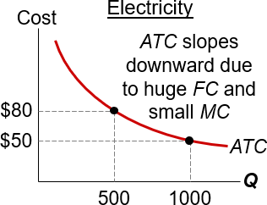
9
Why Monopoly arises
The main cause of monopolies is barriers to entry – other firms cannot enter the market.
Three sources of barriers to entry:
A single firm owns a key resource. E.g., DeBeers owns most of the world’s diamond mines
The govt gives a single firm the exclusive right to produce the good. E.g., patents, copyright laws
Natural monopoly: a single firm can produce the entire market Q at lower cost than could several firms. Example: 1000 homes need electricity
ATC is lower if one firm services all 1000 homes than if two firms each service 500 homes.

Slide 53
9
Why Monopoly arises
For each of the 3 sources, give examples other than those mentioned.
Notes:
1. – OPEC countries; 2. – Metro; 3. – Reliance industries (Jio)

Slide 54
9.1
Barriers to entry - Causes
Absolute cost advantage
Switching cost for consumers
Other causes
Superior Technology
Efficient production method
Control over input
Economies of scope
Searching cost
Contractual cost
Learning cost
Product uncertainty cost
Compatibility cost
Economies of scale
Product differentiation
Brand loyalty
Legal protection
Merger & Takeover
Aggressive technique
Intimidation

Slide 55
10.1
Revenue
What form of elasticity will the demand for a product of monopoly market follow?

Slide 56
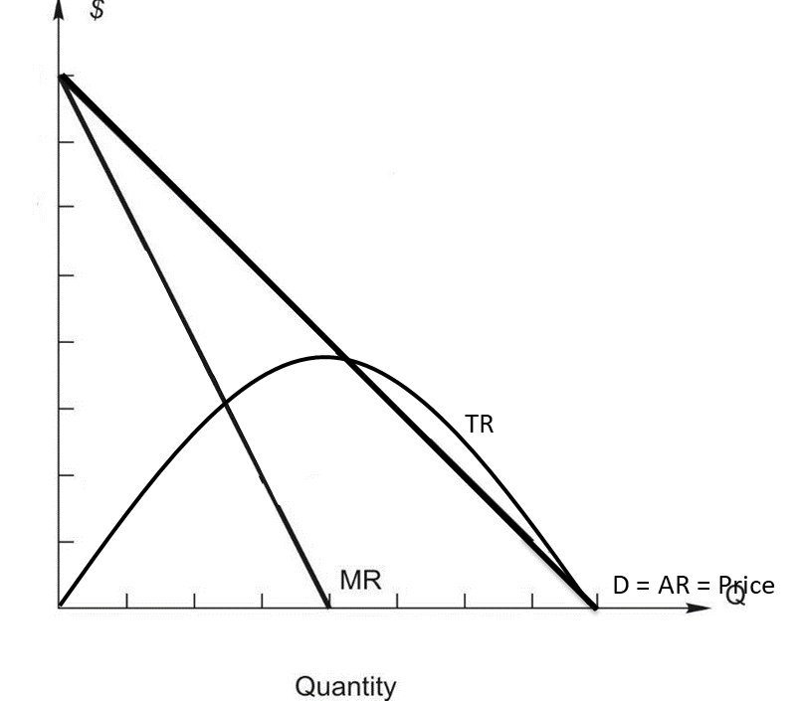
10.1
Revenue
Quantity | Price | TR | AR | MR
0 | 11 | 0 | - | -
1 | 10 | 10 | 10 | 19
2 | 9 | 18 | 9 | 8
3 | 8 | 24 | 8 | 6
4 | 7 | 28 | 7 | 4
5 | 6 | 30 | 6 | 2
6 | 5 | 30 | 5 | 0
7 | 4 | 28 | 4 | -2
8 | 3 | 24 | 3 | -4

Slide 57
10.1
Revenue
The demand curve is highly price inelastic because there is no close substitute & consumer have no or very little choice Indian Railways does not have any substitute therefore demand is highly inelastic
It is not perfectly inelastic because pure monopoly does not exists in real life If Railways increases price beyond a certain limit, then people can choose other mode
Hence it faces normal downward sloping demand (AR) curve

Slide 58
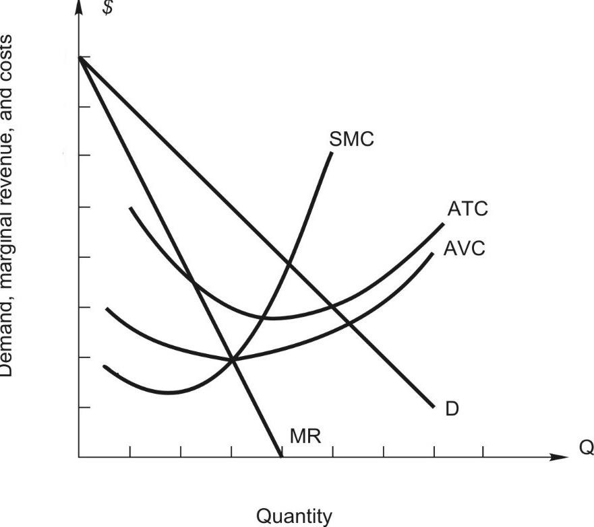
10.2
Cost
Quantity | AFC | AVC | ATC | TC | MC
0 | 60 | 0 | 60 | 60 | -
1 | 60 | 30 | 90 | 90 | 30
2 | 30 | 17 | 47 | 94 | 4
3 | 20 | 14 | 34 | 102 | 8
4 | 15 | 13 | 28 | 112 | 10
5 | 12 | 13 | 25 | 125 | 13
6 | 10 | 14 | 24 | 144 | 19
7 | 8 | 22 | 30 | 210 | 66
8 | 7 | 32 | 40 | 320 | 110

Slide 59
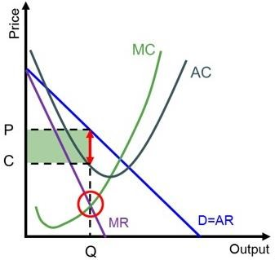
11.1
Maximum Profit Equation – Short run
Supernormal Profit
Firm Maximizes profit where,
MC = MR
MC curve cut MR curve from below
In this graph, Firm is making supernormal profit because
AC < AR (P)
Total Revenue = OPAQ Total Cost = OCBQ Profit = PCBA
A
B
O
Notes:
Where MR = MC

Slide 60
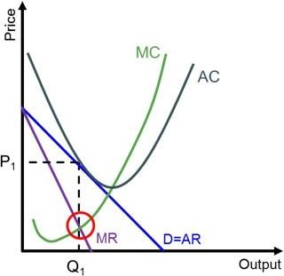
11.1
Maximum Profit Equation – Short run
Normal Profit
Firm Maximizes profit where,
MC = MR
MC curve cut MR curve from below
In this graph, Firm is making normal profit because
AC = AR (P)
Total Revenue = OPAQ Total Cost = OPAQ Total Revenue = Total Cost
A
O

Slide 61
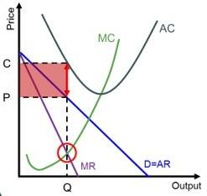
11.1
Maximum Profit Equation – Short run
Loss
Firm Minimizes loss where,
MC = MR
MC curve cut MR curve from below
In this graph, Firm is making loss because
AC > AR (P)
Total Revenue = OPBQ Total Cost = OCAQ Loss = PCAB
A
B
O

Slide 62
11.2
Maximum Profit Equation – Long run
Firm Maximizes profit where,
MC = MR
MC curve cut MR curve from below
In the long run, Firm only makes normal profit because
AC = AR (P)
Total Revenue = OPAQ Total Cost = OPAQ Total Revenue = Total Cost
In long run firm would at least try to earn normal profit & may earn supernormal profit due to entry restriction
To retain monopoly power, the firm may have to resort to low price & earn only normal profit
A
O

Slide 63
11.2
Maximum Profit Equation – Long run
Explain why a firm cannot make a supernormal profit in monopoly even though there are entry barriers.
Notes:
1. – OPEC countries; 2. – Metro; 3. – Reliance industries (Jio)

Slide 64
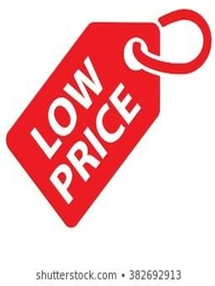
12
Limit Pricing
Limit Pricing is a pricing strategy a monopolist may use to discourage entry if the barriers to the entry of new firms are not total.
If a monopolist set its profit maximising price (where MR=MC) the level of supernormal profit would be so high it attracts new firms into the market.
Limit pricing involves reducing the price sufficiently to deter entry. Therefore, rather than encouraging a new firm to enter, the monopolist may decide to set a price below this profit maximizing level, but still high enough to enable it to make higher profits than in a competitive market. It leads to less profit than possible in short-term, but it can enable the firm to retain its monopoly position and long-term profitability.
For limit pricing to be effective, the monopolist needs to decrease the price to the point where a new firm will not be able to make any profit on entering the market.

Slide 65
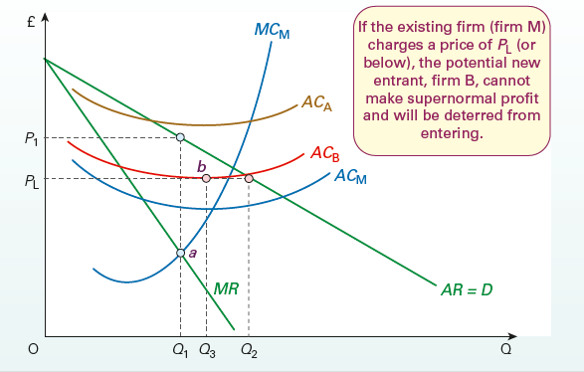
12
Limit Pricing
The short-run profit-maximizing position for the monopolist is to produce where MC = MR. This is illustrated at point a. The firm will produce an output of Q1 and charge a price of P1.
If it faces potential competition from a new entrant such as firm A, it can charge this price without any fear of entry. Firm A’s average costs are above this profit-maximizing price and so it would not be profitable to enter the market at this price or any level below it. The barriers to entry for firm A are total.

Slide 66
12
Limit Pricing
However, if a potential new entrant, such as firm B, had average costs below P1, it could make supernormal profits by entering at that price. In such a case, it is in the monopolist’s interests to charge the lower price of PL, and produce Q2, to deter firm B from entering the market. At a price of PL, the best firm B could do would be to make just normal profit by producing Q3 (point b).
However, if it did enter the market and the monopolist continued to produce Q2, the market price would fall below PL and the new entrant would make a loss at any output. Thus, PL can be seen as a limit price – a price ceiling, at or below which potential new entrants will be deterred from entering the industry.

Slide 67
12.1
Evaluation of Limit Pricing
A. large multinational may be willing to enter a market – even if it is unprofitable in the short-term. The large multinational can use its reserves and profit elsewhere to subsidies a loss-making entry. For example, Google entered the market for mobile phones – despite no experience. Limit pricing is not effective if new firms have the capacity to absorb losses.
Rather than limit pricing, a firm may set the profit maximising price, but then react when a new firm enters. If a new firm enters, it lowers price to make it difficult. It could go to an extreme and engage in predatory price – setting the price below average cost to force the rival out of business. Predatory pricing is illegal, which is a reason to choose limit pricing instead.
Limit pricing will be more effective in industries with substantial economies of scale – for example, industries, such as steel and aeroplane manufacture. It gives an advantage to the incumbent and disadvantage to potential new firms. For industries, with few economies of scale, such as restaurants and bars, limit pricing will not be effective

Slide 68
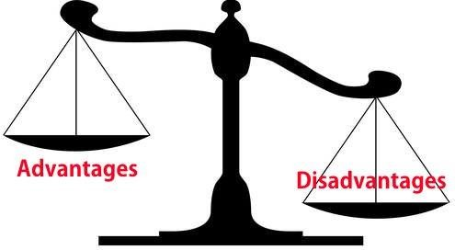
13
Evaluation of Monopoly market
Discuss the advantages and disadvantages of a monopoly market. Compare it with perfect competition

Slide 69
13.1
Disadvantages of Monopoly
Higher prices than in competitive markets Monopolies face inelastic demand and so can increase prices – giving consumers no alternative. For example, in the 1980s, Microsoft had a monopoly on PC software and charged a high price for Microsoft Office.
A decline in consumer surplus Consumers pay higher prices and fewer consumers can afford to buy. This also leads to allocative inefficiency because the price is greater than marginal cost.
Monopolies have fewer incentives to be efficient. With no competition, a monopoly can make profit without much effort, therefore it can encourage x-inefficiency (organisational slack)

Slide 70
13.1
Disadvantages of Monopoly
Possible diseconomies of scale.
A big firm may become inefficient because it is harder to coordinate and communicate in a big firm.
Monopsony power
Monopolies often have monopsony power in paying a lower price to suppliers. For example, farmers have complained about the monopsony power of large supermarkets – which means they receive a very low price for products. A monopoly may also have the power to pay lower wages to its workers.
Political power
Monopolies can gain political power and the ability to shape society in an undemocratic and unaccountable way – especially with big IT giants who have such an influence on society and people’s choices. There is a growing concern over the influence of Facebook, Google and Twitter because they influence the diffusion of information in society.

Slide 71
13.2
Advantages of Monopoly
Economies of scale In an industry with high fixed costs, a single firm can gain lower long-run average costs – through exploiting economies of scale. This is particularly important for firms operating in a natural monopoly (e.g. rail infrastructure, gas network). For example, it would make no sense to have many small companies providing tap water because these small firms would be duplicating investment and infrastructure. The large-scale infrastructure makes it more efficient to just have one firm – a monopoly.
Firms with monopoly power may be the most efficient and dynamic. Firms may gain monopoly power by being better than their rivals. For example, Google has monopoly power on search engines – but can we say Google is an inefficient firm who don’t seek to innovate?

Slide 72
13.2
Advantages of Monopoly
Innovation. Without patents and monopoly power, drug companies would be unwilling to invest so much in drug research. The monopoly power of patent provides an incentive for firms to develop new technology and knowledge, that can benefit society. Also, monopolies make supernormal profit and this supernormal profit can be used to fund investment which leads to improved technology and dynamic efficiency. For example, large tech monopolies, such as Google and Apple have invested significantly in new technological developments. However, this can also have downsides with drug companies able to charge excessively high prices for life-saving drugs. It also gives drug companies an incentive to push pharmaceutical treatments rather than much cheaper solutions to promoting good health and avoiding the poor health in the first place.

Slide 73
13.3
Evaluation of Pros & Cons of Monopoly
It depends whether market is contestable A contestable monopoly will face the threat of entry. This threat of entry will create an incentive to be efficient and keep prices low.
It depends on the ownership structure. Some former nationalised monopolies had inefficiencies, e.g. British Rail was noted for poor sandwich selection and some inefficiencies in running the network. However, this may have been partly monopoly power but also the lack of incentives for a nationalised firm.
It depends on management. Some large monopolies have successful management to avoid the inertia possible in large monopolies. For example, Amazon has grown by keeping small units of workers who feel a responsibility to compete against other units within the firm.

Slide 74
13.3
Evaluation of Pros & Cons of Monopoly
It depends on the industry In an industry like health care, there are different motivations to say banking. Doctors and nurses do not need a competitive market to offer good service, it is part of the job. If we take the banking industry, the economies of scale in offering a national banking network are limited. If it was a merger of two steel firms, which has much higher fixed costs, the economies of scale may be greater. If two pharmaceutical firms or aero plane manufacturers merged, there could be a good case to say they would use their combined profit for research and development.
It depends on government regulation If governments threaten price regulation or regulation of service, this can reduce the excesses of some monopolies.
Environmental factors A monopoly which restricts output may ironically improve the environment if it lowers consumption.
It depends on how you define the industry A domestic monopoly in steel may still face international competition – from foreign steel companies. Eurotunnel faces a monopoly on trains between the UK and France but it faces competition from other methods of transport – e.g. planes and boats.

Slide 75

13.4
Why Government Tolerate Monopolies
It is difficult to break up monopolies. The US government passed a lawsuit against Microsoft, suggesting it should be split up into three smaller companies but it was never implemented.
Governments can implement regulation of Monopolies E.g. OFWAT regulates the prices for water companies. In theory, regulation can enable the best of both worlds – economies of scale, plus fair prices. However, there is concern about whether regulators do a good job – or whether there is regulatory capture with firms gaining generous price controls.
‘Google’s Antitrust Cases: A Guide for the Perplexed - Wired’ - Article

Slide 76
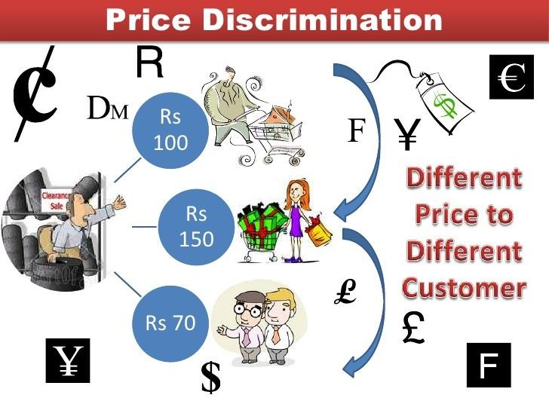
14
Monopoly & Price Discrimination
One further characteristic of monopoly is that it allows firms to price discriminate: to charge different prices either to all customers or to different groups of customers.
Firms undertake this as a way of further increasing profits.
The ability to price discriminate rests on the firm having some monopoly power, although this need not be a complete monopoly.

Slide 77
15
The theory of contestable markets
In recent years, economists have developed the theory of contestable markets. This theory argues that what is crucial in determining price and output is not whether an industry is actually a monopoly or competitive, but whether there is the real threat of competition.
As an example, consider a catering company engaged by a university to run its cafés and coffee bars. The catering company has a monopoly over the supply of food to the students at the university assuming there are no other eating places nearby. If, however, it starts charging high prices or providing a poor service, the university could offer the running of the cafés to an alternative catering company. This threat may force the original catering company to charge ‘reasonable’ prices and offer a good service.

Slide 78

15.1
Perfectly contestable markets
A market is perfectly contestable when potential rivals
face no costs of entry and exit
can rapidly enter the market before the monopolist has time to respond.
If the monopolist is unable to respond immediately, the new entrant sells to all of the customers in the market and makes supernormal profit. When the monopolist finally does respond by cutting its own prices, profits are driven back down towards their normal level. At that stage the new entrant is able to exit the market costlessly. This is known as ‘hit and run’.
The sheer threat of this happening, so the theory goes, will ensure that the firm already in the market will (a) keep its prices down, so that it just makes normal profits, and (b) produce as efficiently as possible, taking advantage of any economies of scale and any new technology. If it did not do this, rivals would enter, and potential competition would become actual competition.

Slide 79
15.2
The importance of costless exit
There is always an element of risk whenever a firm is thinking of entering an industry. It is often difficult to forecast its costs and future demand accurately and there is no guarantee these forecasts will prove to be correct.
Setting up in a new business often involves large expenditures on physical capital (plant and machinery), advertising and complying with government regulations. Once this money is spent, it may not be possible to recover.
The market is not perfectly contestable; the established firm can make supernormal profit. If, however, the capital equipment does generate the same return in alternative uses, the exit costs will be zero (or at least very low), and new firms will be more willing to make the necessary investment and take the risks of entry.
Costless exit, therefore, encourages firms to enter an industry, knowing that, if unsuccessful, they can always transfer their capital elsewhere. The lower the exit costs, the more contestable the market.

Slide 80
15.3
Assessment of the theory
The theory of contestable markets is an improvement on simple monopoly theory, which merely focuses on the existing structure of the industry and makes no allowance for potential competition. Perfectly contestable markets may exist only rarely. But, like perfect competition, they provide an ideal type against which to judge the real world.
It can be argued that they provide a more useful ideal type than perfect competition, since they provide a better means of predicting firms’ price and output behaviour than does the simple portion of the market currently supplied by the existing firm.
One criticism of the theory, however, is that it does not take sufficient account of the possible reactions of the established firm.
Perhaps the most important contribution of the theory is to help us focus on the importance of sunk costs when determining the threat of entry and performance of a market.

Slide 81
15.4
Contestable markets and the public interest
If a monopoly operates in a perfectly contestable market, it might bring the ‘best of both worlds’. Not only will it be able to achieve low costs through economies of scale, but also the potential competition will keep profits and hence prices down.
They argue that the theory vindicates the free market. There are two points in reply to this:
■ Few markets are perfectly contestable. If entry and exit are not costless, a monopoly can still make supernormal profits in the long run.
■ There are other possible failings of the market beside monopoly power (e.g. inequality, pollution).
Nevertheless, the theory of contestable markets has highlighted the importance of sunk costs in determining monopoly behavior. Monopolists may deliberately spend large amounts of money on advertising as they realize it increases the sunk costs of entry and hence deters new firms from entering its market.

