Slide 1

Class: FY BSc
Subject : Calculus
Chapter: Unit 2 Chapter 1
Chapter Name: Derivatives

Slide 2
Today’s Agenda
Derivatives
Derivatives Notation
Why to study derivatives?
Application of Derivatives in daily life
Differentiation Formulas
Higher Order Derivatives
Differentiation Rules
Chain Rule of Differentiation
Partial Differentiation

Slide 3



Derivative
1
Derivative, in mathematics is defined as the rate of change of a function with respect to a variable.
The derivative of a function of a single variable at a chosen input value, when it exists, is the slope of the tangent line to the graph of the function at that point.
The derivative is often described as the "instantaneous rate of change", the ratio of the instantaneous change in the dependent variable to that of the independent variable.
Let f(x) be a function defined in an open interval containing a. The derivative of the function f(x) at a, denoted by f′(a), is defined by :
f’(a)=
https://www.youtube.com/watch?v=rAof9Ld5sOg

Slide 4
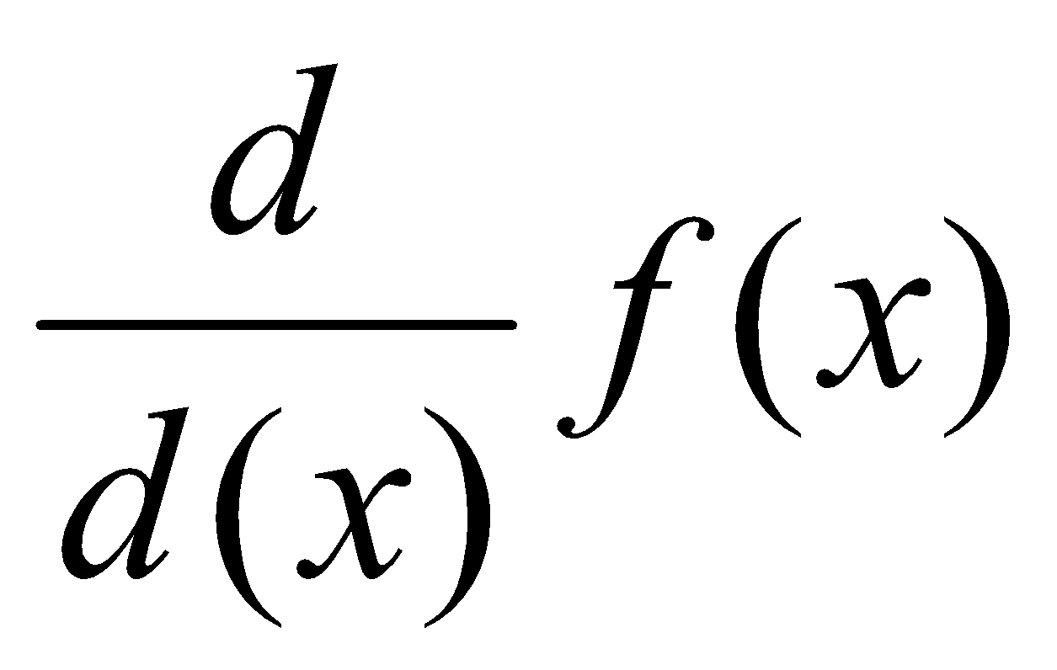
Derivatives notation
1.1
Derivatives are the result of performing a differentiation process upon a function or an expression. Derivative notation is the way we express derivatives mathematically.
1. Lagrange's notation :
In Lagrange's notation, the derivative of f is expressed as f' prime (pronounced "f prime" ).
This notation is probably the most common when dealing with functions with a single variable.
2. Leibniz's notation
In Leibniz's notation, the derivative of f is expressed as
This notation, becomes very useful when dealing with integral calculus, differential equations, and multivariable calculus.
3. Newton's notation
In Newton's notation, the derivative of f is expressed as and the derivative of y= f(x) is expressed as
This notation is mostly common in Physics and other sciences where calculus is applied in a real-world context.

Slide 5
Why to study derivatives ?
1.2
The original purpose of the derivative is to analyze the sensitivity or rate of change of a function with respect to its independent variable — that is, given a tiny change in the independent variable x, how much does the dependent variable, y, respond to that change. If the derivative of a function is high, it means that, for that function, the dependent variable responds greatly to that tiny change in its independent variable; if the derivative is low, the dependent variable changes a very small amount in response.
When taking the derivative of a function, you can find relative extrema, critical values, and where the function is increasing decreasing. Taking the derivative again, you can find the concavity of the function, and the points of inflection that exist on it.
Derivatives are used in velocity and acceleration in physics, marginal profit functions in business, and growth rates in biology.

Slide 6
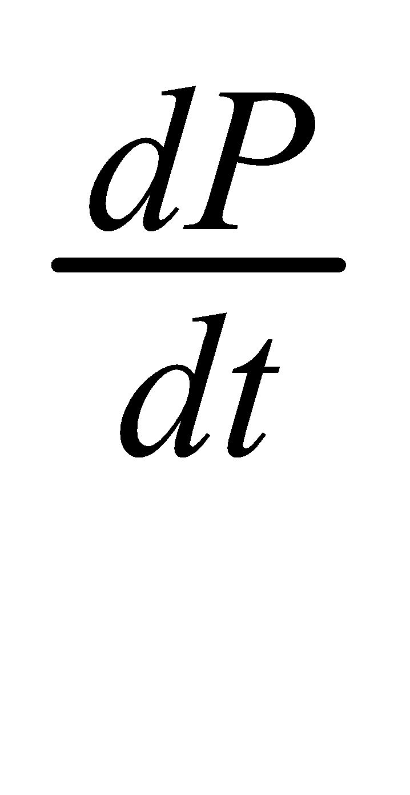
Application of derivatives in daily life
1.3
The derivative can be used for many other purposes, such as analyzing the increasing/decreasing behavior and concavity of a function.
Example:
Let’s say the population in an island at a certain time t can be modeled by the function P(t). If, say, the population is increasing, we know that after a tiny change in time can result in a tiny, positive change in population; if the population is decreasing, a tiny change in time results in a tiny, negative change in population.
Using what we discussed above, the derivative of P, can tell us the increasing / decreasing behavior of population with its sign.
If is positive, it means that a tiny change in time is accompanied by a tiny positive growth in
population; the same logic goes with negative.
Hence, if the derivative is positive, the original function is increasing; if the derivative is negative, the original function is decreasing.

Slide 7
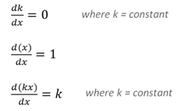
Differentiation Formulas
2
1.
2.
3.

Slide 8


Example
2
Example 1:
= 0
Example 2:
= 5(1) +0 = 5

Slide 9
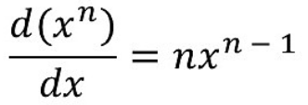
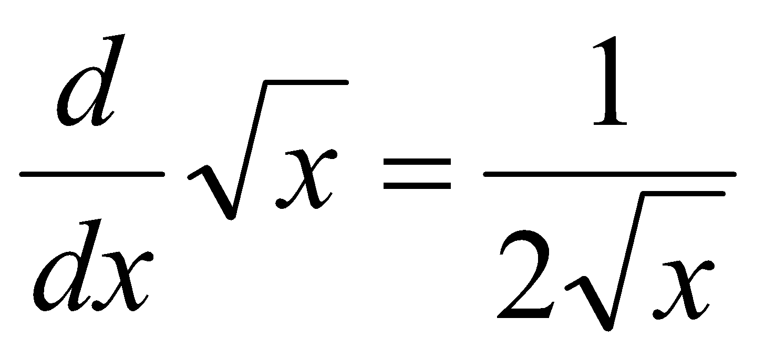
Differentiation Formulas
2
4.
5.

Slide 10


Example
2
Example 1:
= 8x⁷
Example 2:
= 6(-4) x⁻⁴⁻¹ = -24 x⁻⁵

Slide 11
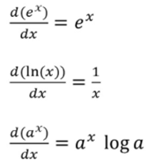
Differentiation Formulas
2
6.
7.
8.

Slide 12

Question
Find the derivative of the following functions:
f(x)= x³ + 9x² -48x +2
f(x) = y⁻⁴ -9y⁻³ +8y⁻² +12

Slide 13
Solution
f’(x) = 3x² +18x -48
= 3(x² +6x -16)
= 3(x+8)(x−2)
f’(x) = -4y⁻⁴⁻¹-9(-3)y⁻³⁻¹ +8(-2)y⁻²⁻¹+0
= -4y⁻⁵ +27y⁻⁴ -16y⁻³

Slide 14
Example
2
1. A toy company can sell x electronic gaming systems at a price of p=−0.01x+400 dollars per gaming system .The cost of manufacturing x systems is given by C(x)=100x+10,000 dollars .Find the rate of change of profit when 10,000 games are produced. Should the toy company increase or decrease production?
Solution :
The profit P(x) earned by producing x gaming systems is R(x)−C(x),
Where,
R(x) is the revenue obtained from the sale of x games. Since the company can sell x games at p=−0.01x+400 per game,
R(x)= x p
= x(−0.01x+400)
=−0.01 x²+400x.
Consequently,
P(x)=−0.01 x²+300x−10,000.

Slide 15
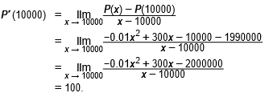
Example
2
Therefore, evaluating the rate of change of profit gives :
Since the rate of change of profit P′(10,000)>0 and P(10,000)>0, the company should increase production.

Slide 16
Higher-Order Derivatives
3
The second derivative of a function is just the derivative of its first derivative. The third derivative is the derivative of the second derivative, the fourth derivative is the derivative of the third, and so on
The derivative of f′( x), which is generally referred to as the second derivative of f(x) and written f“( x) or f ²( x).
For example,
The derivative of a position function is the rate of change of position, or velocity. The derivative of velocity is the rate of change of velocity, which is acceleration.

Slide 17
Example
3
1. f(x) = x³
Solution:
First derivative is
f'(x) = 3x²
Second derivative is
f’’(x) = 6x

Slide 18
Question
f(x) = (4x² +1)²
Find the second derivative of the following function:
1.

Slide 19
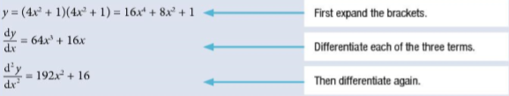
Solution

Slide 20

Differentiation rules
4
1. Sum rule:
f(x)=g(x)+h(x)
Then,
f'(x)=g'(x)+h'(x).

Slide 21
Example
4
1.f(x) = x + x³
Solution:
f’(x) = u’(x) + v’(x)
Now, differentiating the given function, we get;
f’(x) = d/dx (x + x³)
f’(x) = d/dx (x) + d/dx (x³)
f’(x) = 1 + 3x²

Slide 22
Differentiation rules
4
2.Product Rule:
f(x) = u(x)×v(x),
then:
f′(x) = u′(x) × v(x) + u(x) × v′(x)

Slide 23
Example
4
1.f(x)=x²(x+3)
Solution:
f′(x) = u′(x) × v(x) + u(x) × v′(x)
Here,
u(x) = x² and v(x) = x+3
Therefore, on differentiating the given function, we get;
f’(x) = d/dx [x²(x+3)]
f’(x) = d/dx (x²)(x+3)+x² d/dx (x+3)
f’(x) = 2x(x+3)+x²(1)
f’(x) = 2x²+6x+x²
f’(x) = 3x²+6x
f’(x) = 3x(x+2)

Slide 24
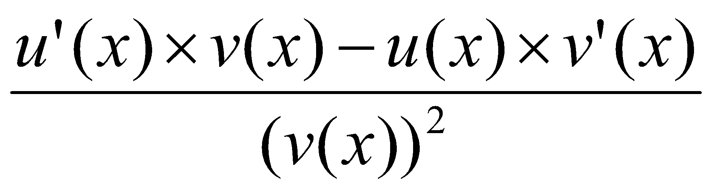
Differentiation rules
4
3. Quotient Rule:
f(x) = u(x)/v(x)

Slide 25



Example
4
1.
Solution:

Slide 26
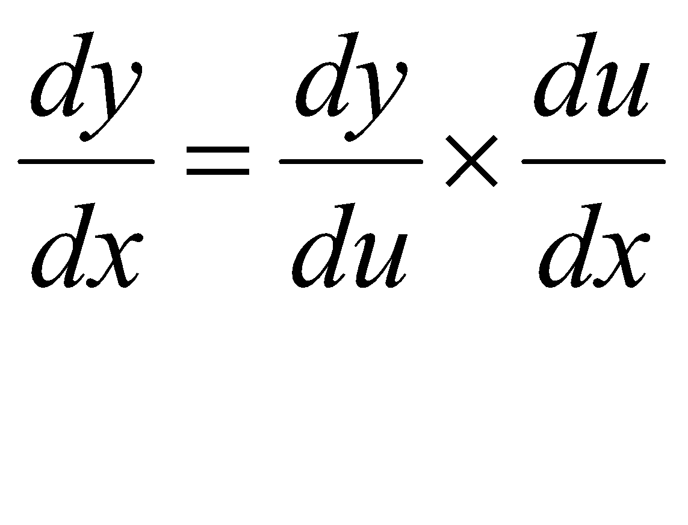

Chain Rule of Differentiation
If a function y = f(x) = g(u) and if u = h(x), then the chain rule for differentiation is defined as;
5
If a function y = f(x) = g(u) and if u = h(x), then the chain rule for differentiation is defined as;

Slide 27


Example
5
1.
Solution:
=

Slide 28

Question
Solve the following function and find its first derivative:
1.

Slide 29
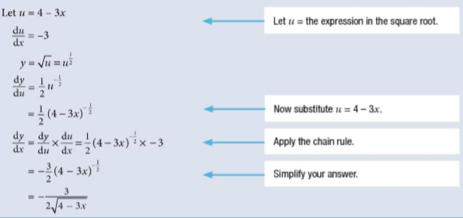
Solution

Slide 30
Partial Differentiation
6
The process of finding the partial derivative of a function is called partial differentiation. In this process, the partial derivative of a function with respect to one variable is found by keeping the other variable constant. A partial derivative is defined as a derivative in which some variables are kept constant and the derivative of a function with respect to the other variable can be determined.
The partial derivative of a function “f’ with respect to “x” is represented by f _{x} or ∂f/∂x.
The partial derivative of a function “f’ with respect to “y” is represented by f _{y} or ∂f/∂y.

Slide 31
Example
6
Determine the partial derivative of the function: f (x,y) = 3x + 4y.
Solution:
Given function: f (x,y) = 3x + 4y
To find ∂f/∂x, keep y as constant and differentiate the function:
Therefore, ∂f/∂x = 3
Similarly, to find ∂f/∂y, keep x as constant and differentiate the function:
Therefore, ∂f/∂y = 4

Slide 32
Question
Find the derivative of the following function with respect to x and y:
1. f(x, y) = x⁴ y³ +8x² y +y⁴ +5x

Slide 33

Solution

