Slide 1

Lecture
Class: MSc
Subject : Fixed Income Products
Subject Code: PUSASQF 404
Chapter: Unit 3 Chapter 1
Chapter Name: Fixed income risk and return – 1

Slide 2
Today’s Agenda
Introduction
Sources of return
1. Assumptions
2. Proving – Assumptions 1
3. Proving – Assumptions 2
4. Proving – Assumptions 3
5. Proving – Assumptions 4 & 5
Macaulay Duration
1. Modified duration
2. Approximate modified duration
3. Effective duration
Key rate duration
1. Factors affecting interest rate risk
2. Duration of portfolio
3. Money duration
4. Price value of a basis point
Convexity
1. Convexity impact on price
2. Effective convexity
3. Callable bond v/s Option free bond
4. Putable bond v/s Option free bond

Slide 3
Introduction
1
It is important for analysts to have a well-developed understanding of the risk and return characteristics of fixed-income investments.
The return on a fixed-rate bond is affected by many factors, the most important of which is the receipt of the interest and principal payments in the full amount and on the scheduled dates. It is also affected by changes in interest rates that affect coupon reinvestment and the price of the bond if it is sold before it matures.
Measures of the price change can be derived from the mathematical relationship used to calculate the price of the bond. The first of these measures (duration) estimates the change in the price for a given change in interest rates. The second measure (convexity) improves on the duration estimate by taking into account the fact that the relationship between price and yield-to-maturity of a fixed-rate bond is not linear.

Slide 4
Sources of Return
2
An investor in a fixed-rate bond has three sources of return:
Coupon and principal payments.
Interest earned on coupon payments that are reinvested over the investor’s holding period for the bond.
Any capital gain or loss if the bond is sold prior to maturity.
A discount bond offers the investor a “deficient” coupon rate, or one below the market discount rate. The amortization of the discount in each period brings the return in line with the market discount rate as the bond’s carrying value is “pulled to par.”
For a premium bond, the coupon rate exceeds the market discount rate and the amortization of the premium adjusts the return to match the market discount rate. Through amortization, the bond’s carrying value reaches par value at maturity.

Slide 5
Assumptions
2.1
An investor who holds a fixed-rate bond to maturity will earn an annualized rate of return equal to the YTM of the bond when purchased.
An investor who sells a bond prior to maturity will earn a rate of return equal to the YTM at purchase if the YTM at sale has not changed since purchase.
If the market YTM for the bond, our assumed reinvestment rate, increases (decreases) after the bond is purchased but before the first coupon date, a buy-and-hold investor’s realized return will be higher (lower) than the YTM of the bond when purchased.
If the market YTM for the bond, our assumed reinvestment rate, increases after the bond is purchased but before the first coupon date, a bond investor will earn a rate of return that is lower than the YTM at bond purchase if the bond is held for a short period.
If the market YTM for the bond, our assumed reinvestment rate, decreases after the bond is purchased but before the first coupon date, a bond investor will earn a rate of return that is lower than the YTM at bond purchase if the bond is held for a long period.

Slide 6
Proving – Assumption 1
2.2
A bond investor’s annualized holding period rate of return is calculated as the compound annual return earned from the bond over the investor’s holding period.
Example:
Consider a 6% annual-pay three-year bond is purchased at a YTM of 7% and held to maturity. With an annual YTM of 7%, the bond’s purchase price is:
N = 3; I/Y = 7; PMT = 60; FV = 1,000;
CPT → PV = –973.76
At maturity, the investor will have received coupon income and reinvestment income equal to the future value of an annuity of three $60 coupon payments calculated with an interest rate equal to the bond’s YTM.
This amount is: 60(1.07)² + 60(1.07) + 60 = $192.89
We can easily calculate the amount earned from reinvestment of the coupons as:
192.89 − 3(60) = $12.89

Slide 7
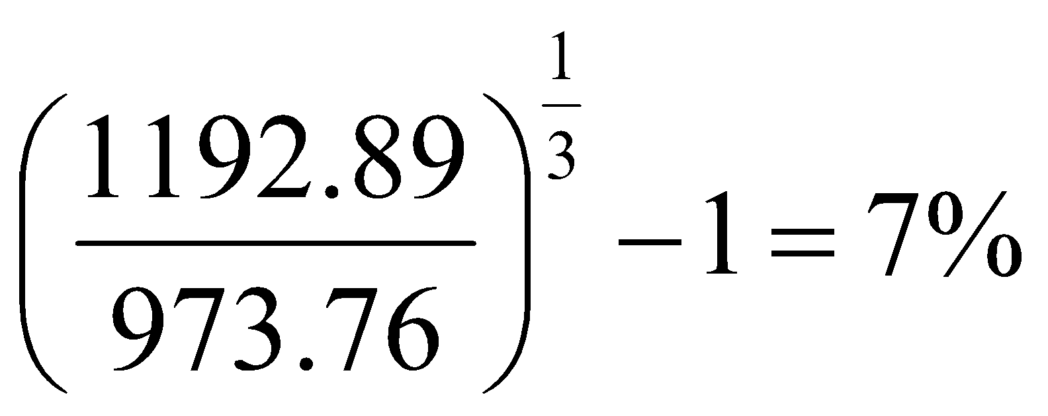

Proving - Assumption 1
2.2
Adding the maturity value of $1,000 to $192.89, we can calculate the investor’s rate of return over the three-year holding period as and demonstrate that $973.76 invested at a compound annual rate of 7% would return $1,192.89 after three years.
Hence proved,
That for a fixed-rate bond that does not default and has a reinvestment rate equal to the YTM, an investor who holds the bond until maturity will earn a rate of return equal to the YTM at purchase, regardless of whether the bond is purchased at a discount or a premium.

Slide 8
Proving - Assumption 2
2.3
An investor who sells a bond prior to maturity will earn a rate of return equal to the YTM as long as the YTM has not changed since purchase. For such an investor, we call the time the bond will be held the investor’s investment horizon. The value of a bond that is sold at a discount or premium to par will move to the par value of the bond by the maturity date. At dates between the purchase and the sale, the value of a bond at the same YTM as when it was purchased is its carrying value and reflects the amortization of the discount or premium since the bond was purchased.
Example:
Bonds held to maturity have no capital gain or loss. Bonds sold prior to maturity at the same YTM as at purchase will also have no capital gain or loss. Using the 6% three-year bond from our earlier examples, we can demonstrate this for an investor with a two-year holding period (investment horizon).
When the bond is purchased at a YTM of 7% (for $973.76), we have:
Price at sale (at end of year 2, YTM = 7%):
1,060 / 1.07 = 990.65

Slide 9
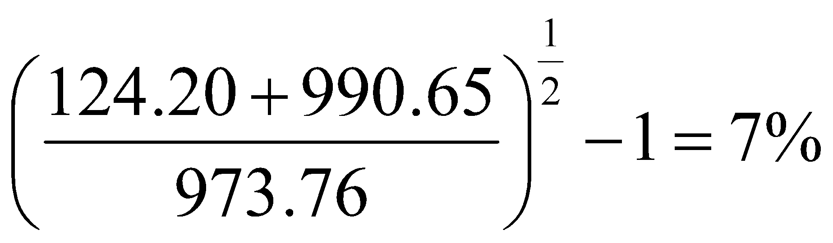
Proving - Assumption 2
2.3
Coupon interest and reinvestment income for two years:
60(1.07) + 60 = $124.20
Investor’s annual compound rate of return over the two-year holding period is:
Hence proved,
For a bond investor with an investment horizon less than the bond’s term to maturity, the annual holding period return will be equal to the YTM at purchase (under our assumptions), if the bond is sold at that YTM. The intuition here is that if a bond will have a rate of return equal to its YTM at maturity, which we showed, if we sell some of the remaining value

Slide 10
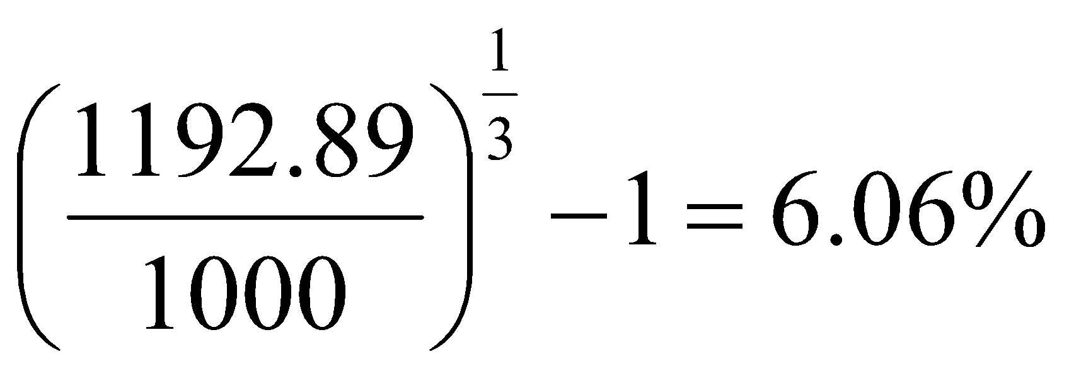
Proving - Assumption 3
2.4
If rates rise (fall) before the first coupon date, an investor who holds a bond to maturity will earn a rate
of return greater (less) than the YTM at purchase.
Example:
For a three-year 6% bond purchased at par (YTM of 6%), first assume that the YTM and reinvestment rate increases to 7% after purchase but before the first coupon payment date. The bond’s annualized holding period return is calculated as:
Coupons and reinvestment interest:
60(1.07)² + 60(1.07) + 60 = $192.89
Investor’s annual compound holding period return:
which is greater than the 6% YTM at purchase.

Slide 11
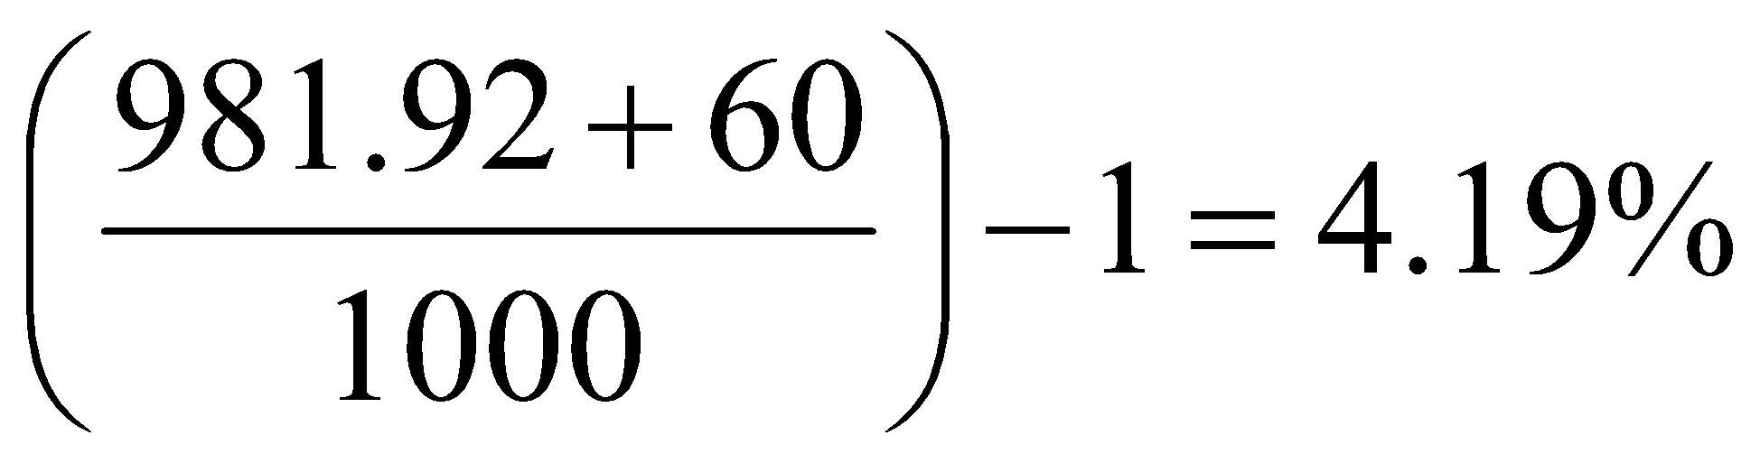
Proving - Assumption 4 & 5
2.5
Example:
Consider a three-year 6% bond purchased at par by an investor with a one-year investment horizon. If the YTM increases from 6% to 7% after purchase and the bond is sold after one year, the rate of return can be calculated as follows.
Bond price just after first coupon has been paid with YTM = 7%:
N = 2; I/Y = 7; FV = 1,000; PMT = 60; CPT → PV = –981.92
There is no reinvestment income and only one coupon of $60 received so the holding period rate of return is simply:
which is less than the YTM at purchase.

Slide 12
Proving - Assumption 4 & 5
2.5
The intuition of this result is based on the idea of a tradeoff between market price risk (the uncertainty about price due to uncertainty about market YTM) and reinvestment risk (uncertainty about the total of coupon payments and reinvestment income on those payments due to the uncertainty about future reinvestment rates).
Short investment horizon: market price risk > reinvestment risk
Long investment horizon: reinvestment risk > market price risk

Slide 13


Macaulay Duration
3
Duration is used as a measure of a bond’s interest rate risk or sensitivity of a bond’s full price to a change in its yield. The measure was first introduced by Frederick Macaulay and his formulation is referred to as Macaulay duration.
A bond’s (annual) Macaulay duration is calculated as the weighted average of the number of years until each of the bond’s promised cash lows is to be paid, where the weights are the present values of each cash low as a percentage of the bond’s full value.
Formula:

Slide 14

Example
3
Calculate the Macaulay duration of the 10-year, 8% annual payment bond is calculated by entering r = 0.1040, c = 0.0800, N = 10, and t/T = 0.
Solution:

Slide 15
Modified duration
3.1
Modified duration (ModDur) is calculated as Macaulay duration (MacDur) divided by one plus the bond’s yield to maturity.
Formula:
Mac. Duration / (1 + r) = Modified Duration
Modified duration provides an approximate percentage change in a bond’s price for a 1% change in yield to maturity.

Slide 16
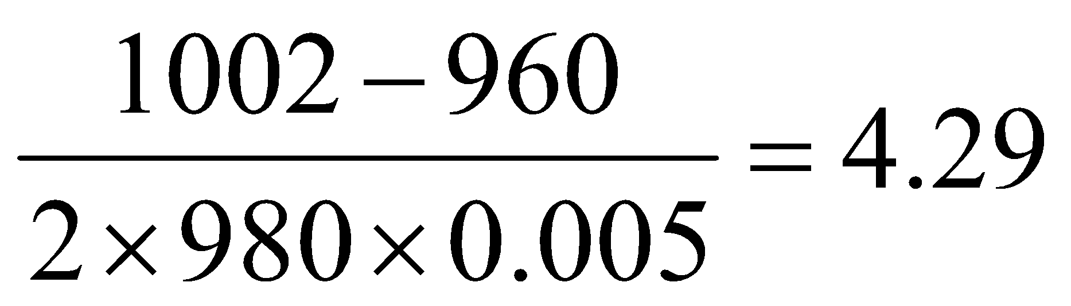
Example
3.1
A bond is trading at a full price of 980. If its yield to maturity increases by 50 basis points, its price will decrease to 960. If its yield to maturity decreases by 50 basis points, its price will increase to 1,002. Calculate the approximate modified duration.
Solution:
The approximate modified duration is:
The approximate change in price for a 1% change in YTM is 4.29%.

Slide 17

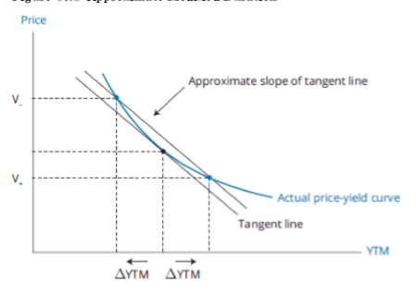
Approximate Modified duration*
3.2
Formula:
Notes:
Doubt

Slide 18

Effective duration
3.3
The pricing of bonds with embedded put, call, or prepayment options begins with the benchmark yield curve, not simply the current YTM of the bond. The appropriate measure of interest rate sensitivity for these bonds is effective duration.
Formula:
The difference between approximate modified duration and effective duration is in the denominator. Modified duration is a yield duration statistic in that it measures interest rate risk in terms of a change in the bond’s own yield-to-maturity (Δ Yield). Effective duration is a curve duration statistic in that it measures interest rate risk in terms of a parallel shift in the benchmark yield curve (ΔCurve).
Notes:
Doubt

Slide 19
Effective Duration
3.3
Effective duration is essential to the measurement of the interest rate risk of a complex bond, such as a bond that contains an embedded option.
The issuer’s decision to call the bond depends on the ability to refinance the debt at a lower cost of funds.
The option-pricing model inputs include:
the length of the call protection period,
the schedule of call prices and call dates,
an assumption about credit spreads over benchmark yields (which includes any liquidity spread as well),
an assumption about future interest rate volatility, and
the level of market interest rates (e.g., the government par curve).
The analyst then holds the first four inputs constant and raises and lowers the fifth input

Slide 20
Key Rate Duration
4
A key rate duration (or partial duration ) is a measure of a bond’s sensitivity to a change in the benchmark yield curve at a specific maturity segment.
e.g. Effective duration assumed a parallel shift of 25 bps at all maturities. However, the analyst may want to know how the price of the callable bond is expected to change if benchmark rates at short maturities (say up to 2 years) shifted up by 25 bps but longer maturity benchmark rates remained unchanged. This scenario would represent a flattening of the yield curve, given that the yield curve is upward sloping.

Slide 21
Factors affecting Interest rate risk
4.1
An increase in a bond’s maturity will (usually) increase its interest rate risk.
An increase in the coupon rate of a bond will decrease its interest rate risk.
An increase (decrease) in a bond’s YTM will decrease (increase) its interest rate risk.
Adding either a put or a call provision will decrease a straight bond’s interest rate risk as measured by effective duration.

Slide 22
Duration of a portfolio
4.2
There are two approaches to estimating the duration of a portfolio.
The first is to calculate the weighted average number of periods until the portfolio’s cash lows will be received.
The second approach is to take a weighted average of the durations of the individual bonds in the portfolio.

Slide 23
Duration of a portfolio
4.2
First approach : The first is to calculate the weighted average number of periods until the portfolio’s cash lows will be received.
The first approach is theoretically correct but not often used in practice. The yield measure calculating portfolio duration with this approach is the cash flow yield, the IRR of the bond portfolio. This is inconsistent with duration capturing the relationship between YTM and price.
Limitations:
This approach will not work for a portfolio that contains bonds with embedded options because the future cash flows are not known with certainty and depend on interest rate movements.

Slide 24
Duration of a portfolio
4.2
Second approach : The second approach is to take a weighted average of the durations of the individual bonds in the portfolio.
The second approach is typically used in practice. Using the durations of individual portfolio bonds makes it possible to calculate the duration for a portfolio that contains bonds with embedded options by using their effective durations. The weights for the calculation of portfolio duration under this approach are simply the full price of each bond as a proportion of the total portfolio value (using full prices).
Calculation:
These proportions of total portfolio value are multiplied by the corresponding bond durations to get portfolio duration.
Portfolio duration = W₁ D₁ + W₂ D₂ + … + W_{N} D_{N}
where:
W_{i} = full price of bond i divided by the total value of the portfolio
D_{i} = the duration of bond i
N = the number of bonds in the portfolio

Slide 25
Duration of a portfolio
4.2
Limitations:
One limitation of this approach is that for portfolio duration to “make sense” the YTM of every bond in the portfolio must change by the same amount. Only with this assumption of a parallel shift in the yield curve is portfolio duration calculated with this approach consistent with the idea of the percentage change in portfolio value per 1% change in YTM.

Slide 26
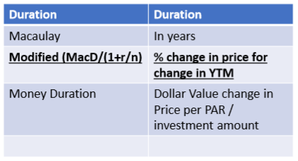
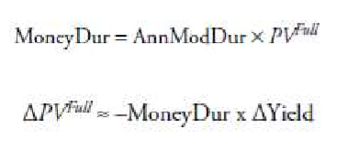
Money Duration
4.3
Modified duration is a measure of the percentage price change of a bond given a change in its yield-to-maturity. A related statistic is money duration.
The money duration of a bond is a measure of the price change in units of the currency in which the bond is denominated. The money duration can be stated per 100 of par value or in terms of the actual position size of the bond in the portfolio

Slide 27
Example
4.3
Calculate the money duration on a coupon date of a $2 million par value bond that has a modified duration of 7.42 and a full price of 101.32, expressed for the whole bond and per $100 of face value.
What will be the impact on the value of the bond of a 25 basis points increase in its YTM?
Solution:
1. The money duration for the bond is modified duration times the full value of the bond:
7.42 × $2,000,000 × 101.32% = $15,035,888
The money duration per $100 of par value is:
7.42 × 101.32 = $751.79
Or, $15,035,888 / ($2,000,000 / $100) = $751.792 .
2. $15,035,888 × 0.0025 = $37,589.72
The bond value decreases by $37,589.72.

Slide 28
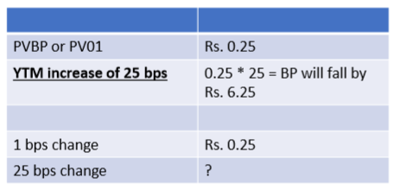

Price value of a basis point (PVBP / PV01)
4.4
Another version of money duration is the price value of a basis point (PVBP) for the bond. The PVBP is an estimate of the change in the full price given a 1 bp change in the yield-to-maturity. The PVBP can be calculated using a formula similar to that for the approximate modified duration.

Slide 29
Example
4.4
The current price of a $1,000, 7-year, 5.5% semiannual coupon bond is $1,029.23. Calculate the bond’s price value of a basis point.
Solution:
PVBP = initial price – price if yield is changed by 1 basis point.
First, we need to calculate the yield so we can calculate the price of the bond with a 1 basis point change in yield. Using a financial calculator:
PV = –1,029.23; FV = 1,000; PMT = 27.5 = (0.055 × 1,000) / 2;
N = 14 = 2 × 7 years; CPT → I/Y = 2.49998, multiplied by 2 = 4.99995, or 5.00%.
Next, compute the price of the bond at a yield of 5.00% + 0.01%, or 5.01%.
Using the calculator: FV = 1,000; PMT = 27.5; N = 14; I/Y = 2.505 (5.01 / 2); CPT → PV = $1,028.63.
Finally, PVBP = $1,029.23 – $1,028.63 = $0.60.

Slide 30
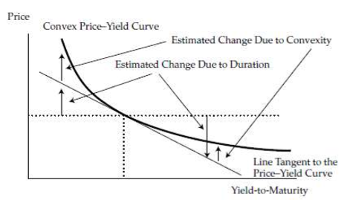
Convexity
5
The true relationship between the bond price and the yield-to-maturity is the curved (convex).
Duration (in particular, money duration) estimates the change in the bond price along the straight line that is tangent to the curved line. For small yield-to-maturity changes, there is little difference between the lines. But for larger changes, the difference becomes significant.

Slide 31
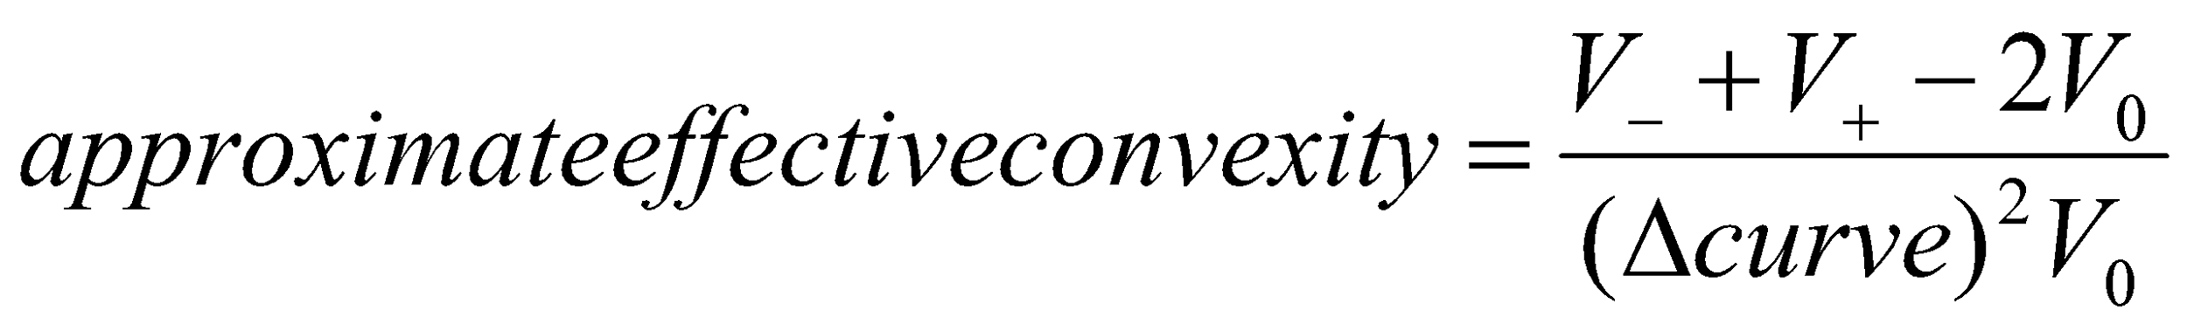
Effective Convexity
5.1
Effective convexity, like effective duration, must be used for bonds with embedded options. The calculation of effective convexity is the same as the calculation of approximate convexity, except that the change in the yield curve, rather than a change in the bond’s YTM, is used.

Slide 32
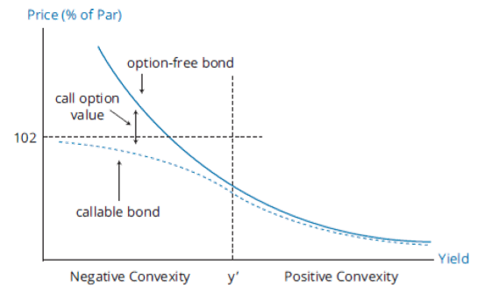
Callable bond v/s Option free bond
5.3
The convexity of any option-free bond is positive, the convexity of a callable bond can be negative at low yields.

Slide 33
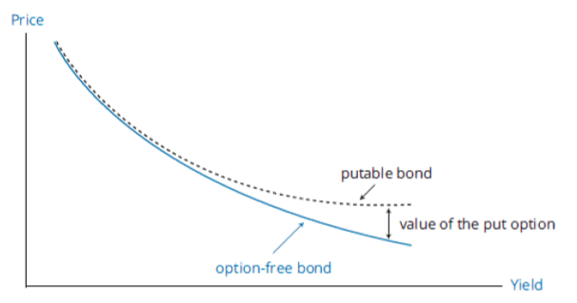
Putable bond v/s Option free bond
5.4
A putable bond has greater convexity than an otherwise identical option-free bond.

