Slide 1


Non-Life
Insurance
Health
Insurance

Slide 2
Health Insurance
Health insurance is a type of insurance coverage that pays for medical and surgical expenses incurred by the insured.
Health insurance can reimburse the insured for expenses incurred from illness or injury, or pay the care provider directly.
It is often included in employer benefit packages as a means of enticing quality employees, with premiums partially covered by the employer but often also deducted from employee paychecks.

Slide 3
Insurance benefits
Ambulatory patient services (outpatient care you get without being admitted to a hospital)
Emergency services
Hospitalization (like surgery and overnight stays)
Pregnancy, maternity, and newborn care (both before and after birth)
Mental health and substance use disorder services, including behavioral health treatment (this includes counseling and psychotherapy) (2017)
Prescription drugs
Rehabilitative and habilitative services and devices (services and devices to help people with injuries, disabilities, or chronic conditions gain or recover mental and physical skills)
Laboratory services
Preventive and wellness services and chronic disease management
Pediatric services, including oral and vision care (but adult dental and vision coverage aren’t essential health benefits)

Slide 4
What is not covered
elective or cosmetic procedures
beauty treatments
Fertility treatments
off-label prescriptions
New technology in product or services
These can be added as special add-ons as per consumer need.

Slide 5
A deductible is a set amount you pay each year for your healthcare before your plan starts to share the costs of covered services. For example, if you have a $3,000 deductible, you have to pay $3,000 before your insurance kicks in fully.
Copays (or copayments) are set amounts you pay to your medical provider when you receive services.Different copays usually apply to office visits, specialist visits, urgent care, emergency room visits, and prescriptions.
Your copay applies even if you haven't met your deductible yet.
Coinsurance is the percentage of covered medical expenses you pay after you've met your deductible. Your health insurance plan pays the rest. For example, if you have an "80/20" plan, it means your plan covers 80% and you pay 20%—up until you reach your maximum out-of-pocket limit.
Still, coinsurance only applies to covered services.
Once you reach your out-of-pocket maximum, your health insurance plan covers 100% of all covered services for the rest of the year. Any money you spend on deductibles, copays, and coinsurance counts toward your out-of-pocket maximum. However, premiums don't count

Slide 6
Health Insurance products
Classification – based on payout
Indemnity
Fixed benefit
Classification – based on segment
Retail
Group
Employer-employee
Other groups

Slide 7
Indemnity based products
An indemnity plan is a health insurance plan that reimburses the covered person for incurred medical expenses.
Indemnity plans may include a deductible that must be satisfied before claims can be paid.
Examples
Retail Health Insurance
Group Health Insurance products

Slide 8
Fixed Benefit based products
Lump sum is paid under the policy on occurrence of covered perils
No deduction/ deductible in claims payment
Examples
Personal Accident
Critical illness
Hospital Cashh

Slide 9
Health Insurance Policies
Various types of health insurance policies in India are :
Individual health insurance
family health insurance
Senior citizen health insurance
Critical illness insurance
Maternity Health insurance
Personal accident insurance cover
pre-existing disease cover
Preventive health care
Unit Linked Health plan

Slide 10
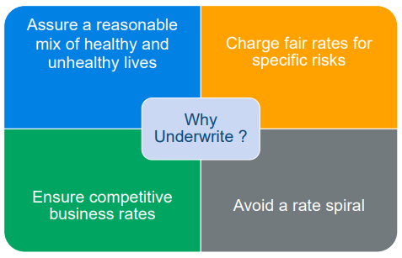
Underwriting
Risk Factors :
Factors which effect the Claim frequency or Severity
• Age
• Sum Insured
• Demography
• Medical Condition
• Gender
• Policy Type
Factors which are used in Rating are called Rating Factors.

Slide 11
Underwriting Process
Measure and quantify health risk of applicant in line with organizations risk appetite
Demographic :Gender, location, marital status, family size
Health Status
Lifestyle/ Habits
Claim History
Income
Objective
Information Sources
Proposal Form
Agents Report
Attending physician report
Full medical underwriting
Medical questionnaire
Medical tests
Approach

Slide 12
Health Insurance Frauds
According to a recent survey by insurance institute of India, it is estimated that the number of false claims in the Indian industry is approximately 15 per cent of total claims
The same report suggests that the healthcare industry in India is losing approximately Rs.600-Rs 800 crores incurred on fraudulent claims annually.
Soft Fraud:
• Exaggerating damages/loss
• Deliberate or subtle lagging of claims resolution
Hard Fraud:
• Staging the occurrence of incidents
• Medical claims fraud

Slide 13
Health Insurance Frauds
Fraud in India
Insurer : ICICI Lombard General Insurance Company
Insured : Darbari Lal Dhawan
Claim lodged on 11.08.2016
As per the claimant the Insured died on 25.07. 2016.
Period Of Insurance policy: from 2016-2021.
Detailed Description of the Death: Car accident.
After social media forensic analysis , it was found that the insured had died before July 2016.
The family’s facebook accounts were checked and they found posts indicating the loss of Darbari Lal on various dates before July 2016. One post also indicated his death in 2012.
ICICI detected the false claim and refused the payout.

Slide 14
Types of Claims
CASHLESS CLAIMS :
In this type of health insurance claim, the insurer settles all the hospitalization bills with the hospital directly. However, an insured needs to be hospitalized only at a network hospital to get the benefit of cashless hospitalization.
REIMBURSEMENT CLAIMS :
In this type of claim process, the policyholder pays for the hospitalization expenses upfront and requests for reimbursement by the insurance provider later. One can get reimbursement facility at both network and non-network hospitals in this case.

Slide 15
The Authorization Process for Health Insurance
As soon as an insurer receives the intimation from the attendant of the policyholder and is contacted by the hospital (network) about the same, the insurer verifies the validity of the policy and policy coverage of that policyholder. Then, a field doctor is assigned to facilitate the request for the pre-authorization document and to cross-check the claimed treatment. After verification, the medical team from the insurance company approves the cashless claim for the policyholder according to the terms and conditions of the policy.

Slide 16
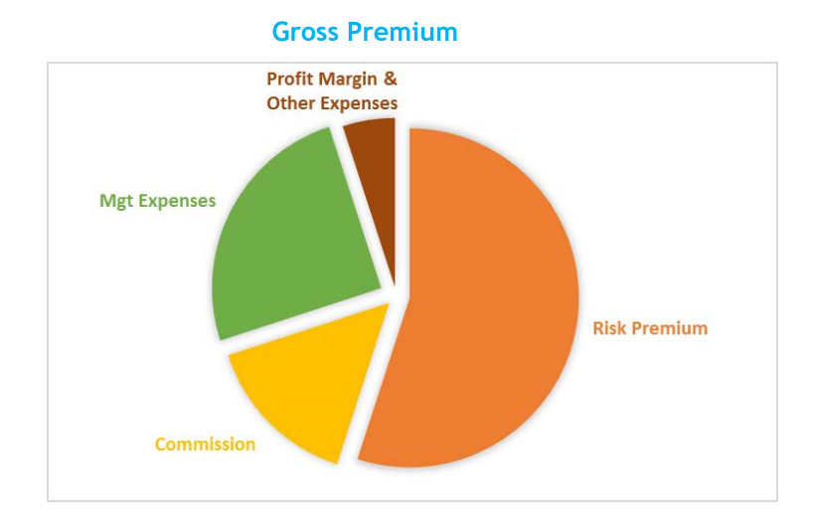
Health Insurance Premium break-up

Slide 17
Thank You

