Slide 1

Lecture 17
Mrs. Suchi Gupta (CA, CFA)
Class: TY BSc
Subject : Introduction to Derivatives and Financial Markets
Subject Code: PUSASQF302
Chapter: Unit 3 – Chapter 1
Chapter Name: Mechanics of Options Market

Slide 2
Precap
For most purposes, the futures price of a contract with a certain delivery date can be considered to be the same as the forward price for a contract with the same delivery date.
For the purposes of understanding futures (or forward) prices, it is convenient to divide futures contracts into two categories: those in which the underlying asset is held for investment by a significant number of investors and those in which the underlying asset is held primarily for consumption purposes.
In the case of investment assets, we have considered three different situations:
  1. The asset provides no income.
  2. The asset provides a known dollar income.
  3. The asset provides a known yield.
In the case of consumption assets, it is not possible to obtain the futures price as a function of the spot price and other observable variables. Here the parameter known as the asset’s convenience yield becomes important

Slide 3
Today’s Agenda
0. Introduction
Options
  Types of Options
Call and Put Option
  Call Option – Example
  Put Option – Example
Dividends and Stock Splits
Option Positions
  Options Payoffs – Call
  Options Payoffs – Put What
Underlying Asset
Specifications for Stock Options
Terminologies in Options market
Understanding Intrinsic value and Time Value
  Intrinsic Value
  Time Value
  Why it Matters
Options Trading
Margins
Options Clearing Corporation

Slide 4

Introduction
0
What are derivatives? Name the types of derivatives you know?
What are Options Contracts?
What are the terms associated with Options?

Slide 5

Options
1
An option gives the holder of the option the right to do something, but the holder does not have to exercise this right.
Options are fundamentally different from forward and futures contracts. It costs a trader nothing (except for the margin requirements) to enter into a forward or futures contract, whereas the purchase of an option requires an up-front payment.
This chapter explains how options markets are organized, what terminology is used, how the contracts are traded, how margin requirements are set, and so on.
When charts showing the gain or loss from options trading are produced, the usual practice is to ignore discounting, so that the profit is the final payoff minus the initial cost. This chapter follows this practice.

Slide 6
Types of Options
1.1
The date specified in the contract is known as the expiration date or the maturity date.
The price specified in the contract is known as the exercise price or the strike price.
There are two basic option contracts:
Call Option
A call option gives the holder of the option the right to buy an asset by a certain date for a certain price.
Put Option
A put option gives the holder the right to sell an asset by a certain date for a certain price.

Slide 7
Types of Options
1.1
Options can be differentiated on the basis of expiration.
Options can be either American or European, a distinction that has nothing to do with geographical location.
American options can be exercised at any time up to the expiration date, whereas European options can be exercised only on the expiration date itself.
Most of the options that are traded on exchanges are American. However, European options are generally easier to analyse than American options.

Slide 8
Call Option - Example
2.1
Consider the situation of an investor who buys a European call option with a strike price of $100 to purchase 100 shares of a certain stock. Suppose that the current stock price is $98, the expiration date of the option is in 4 months, and the price of an option to purchase one share is $5. The initial investment is $500.
Because the option is European, the investor can exercise only on the expiration date.
If the stock price on this date is less than $100, the investor will clearly choose not to exercise. (There is no point in buying for $100 a share that has a market value of less than $100.) In these circumstances, the investor loses the whole of the initial investment of $500.
If the stock price is above $100 on the expiration date, the option will be exercised. Suppose, for example, that the stock price is $115. By exercising the option, the investor is able to buy 100 shares for $100 per share. If the shares are sold immediately, the investor makes a gain of $15 per share, or $1,500, ignoring transactions costs. When the initial cost of the option is taken into account, the net profit to the investor is $1,000.

Slide 9
Call Option - Example
2.1
What do you think should the holder do in case suppose the stock price is $102 at the expiration of the option?

Slide 10

Call Option - Example
2.1
Figure below shows how the investor’s net profit or loss on an option to purchase one share varies with the final stock price in the example. It is important to realize that an investor sometimes exercises an option and makes a loss overall.
Suppose that, in the example, the stock price is $102 at the expiration of the option. The investor would exercise the option contract for a gain of 100 x ($102 - $100) = $200 and realize a loss overall of $300 when the initial cost of the option is taken into account. It is tempting to argue that the investor should not exercise the option in these circumstances. However, not exercising would lead to an overall loss of $500, which is worse than the $300 loss when the investor exercises.
In general, call options should always be exercised at the expiration date if the stock price is above the strike price.

Slide 11
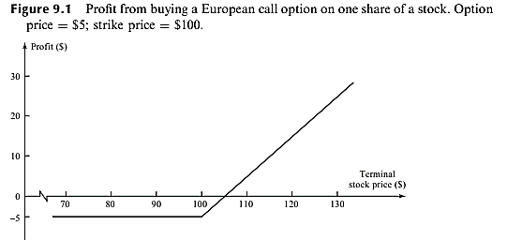
Call Option - Example
2.1

Slide 12
Put Option - Example
2.2
Consider an investor who buys a European put option with a strike price of $70 to sell 100 shares of a certain
stock. Suppose that the current stock price is $65, the expiration date of the option is in 3 months, and the price of an option to sell one share is $7. The initial investment is $700.
Because the option is European, it will be exercised only if the stock price is below $70 on the expiration date.
Suppose that the stock price is $55 on this date. The investor can buy 100 shares for $55 per share and, under the terms of the put option, sell the same shares for $70 to realize a gain of $15 per share, or $1,500. (Again, transactions costs are ignored.) When the $700 initial cost of the option is taken into account, the investor’s net profit is $800.
Whereas the purchaser of a call option is hoping that the stock price will increase, the purchaser of a put option is hoping that it will decrease.
There is no guarantee that the investor will make a gain. If the final stock price is above $70, the put option expires worthless, and the investor loses $700.

Slide 14
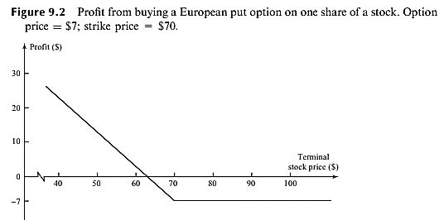
Put Option - Example
2.2
In general, put options should always be exercised at the expiration date if the stock price is below the strike price.

Slide 15
Question
1. Which of the following describes European options?
A. Sold in Europe
B. Priced in Euros
C. Exercisable only at maturity
D. Calls (there are no puts)
Answer:

Slide 16
Question
2. Which of the following is NOT true
A. A call option gives the holder the right to buy an asset by a certain date for a certain
price
B. A put option gives the holder the right to sell an asset by a certain date for a certain
price
C. The holder of a call or put option must exercise the right to sell or buy an asset
D. The holder of a forward contract is obligated to buy or sell an asset
Answer:

Slide 19
Dividends and Stock Splits
3
A stock dividend means dividend which is paid in the form of additional shares.
A stock split is a division of issued shares in the ratio as decided by Company.
In the Stock dividend, additional shares are given to shareholders whereas in stock split already issued shares are split in an agreed ratio.
A cash dividend is the distribution of funds or money paid to stockholders generally as part of the corporation's current earnings or accumulated profits. Cash dividends are paid directly in money, as opposed to being paid as a stock dividend

Slide 21
Dividends and Stock Splits
3
The early over-the-counter options were dividend protected. If a company declared a cash dividend, the strike price for options on the company’s stock was reduced on the ex-dividend day by the amount of the dividend.
Exchange-traded options are not usually adjusted for cash dividends. In other words, when a cash dividend occurs, there are no adjustments to the terms of the option contract.
Exchange-traded options are adjusted for stock splits. A stock split occurs when the existing shares are ‘‘split’’ into more shares.
For example, in a 3-for-1 stock split, three new shares are issued to replace each existing share. All else being equal, the 3-for-1 stock split should cause the stock price to go down to one-third of its previous value

Slide 22
Dividends and Stock Splits
3
In general, an n-for-m stock split should cause the stock price to go down to m/n of its previous value. The terms of option contracts are adjusted to reflect expected changes in a stock price arising from a stock split.
After an n-for-m stock split, the strike price is reduced to m/n of its previous value, and the number of shares covered by one contract is increased to n/m of its previous value.
If the stock price declines in the way expected, the positions of both the writer and the purchaser of a contract remain unchanged.

Slide 23
Dividends and Stock Splits
3
Stock options are adjusted for stock dividends. A stock dividend involves a company issuing more shares to its existing shareholders.
For example, a 20% stock dividend means that investors receive one new share for each five already owned. A stock dividend, like a stock split, has no effect on either the assets or the earning power of a company. The stock price can be expected to go down as a result of a stock dividend. The 20% stock dividend referred to is essentially the same as a 6-for-5 stock split. All else being equal, it should cause the stock price to decline to 5/6 of its previous value.
The terms of an option are adjusted to reflect the expected price decline arising from a stock dividend in the same way as they are for that arising from a stock split.

Slide 24

Question
Consider a call option to buy 100 shares of a company for $30 per share. Suppose the company makes a 2-for-1 stock split. Discuss how the terms of the option contract will change?
Consider a put option to sell 100 shares of a company for $15 per share. Suppose the company declares a 25% stock dividend. Discuss how the terms of the option contract will change?

Slide 25

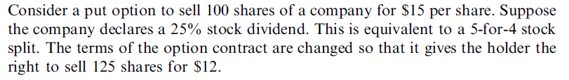
Solution

Slide 26
Option Positions
4
There are two sides to every option contract.
On one side is the investor who has taken the long position (i.e., has bought the option). On the other side is the investor who has taken a short position (i.e., has sold or written the option).
There are four types of option positions:
1. A long position in a call option
2. A long position in a put option
3. A short position in a call option
4. A short position in a put option.

Slide 28
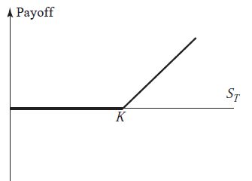
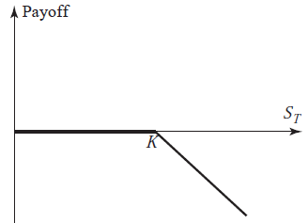
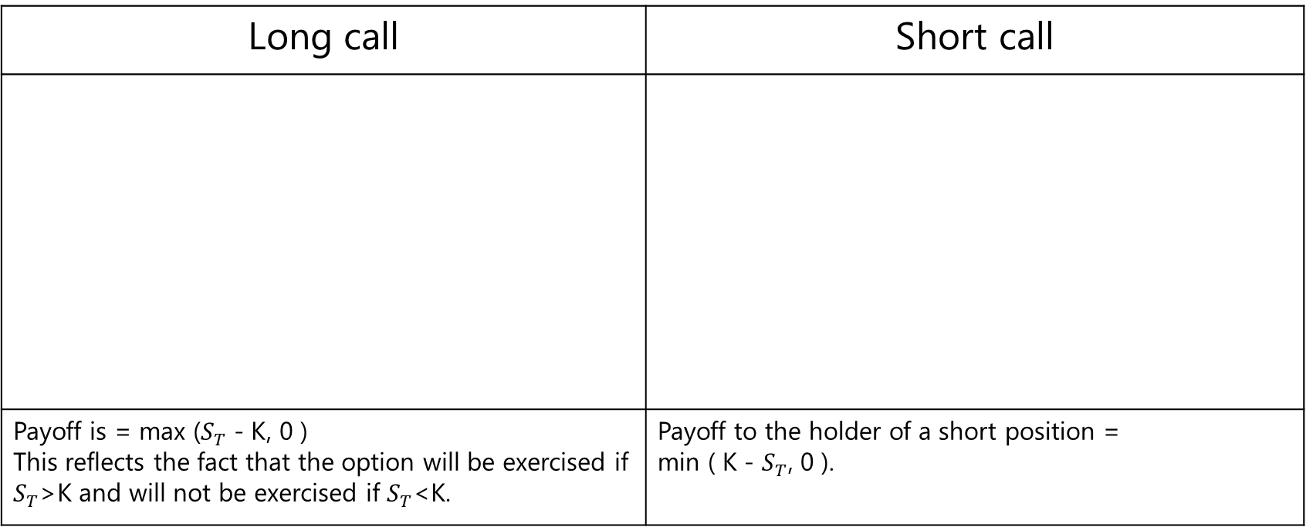
Option Payoffs - Call
4.1
Payoffs European options with Strike price = K; price of asset at maturity = $S_{T}$
Long call | Short call
Payoff is = max ($S_{T}$ - K, 0 ) This reflects the fact that the option will be exercised if $S_{T}$>K and will not be exercised if $S_{T}$<K. | Payoff to the holder of a short position = min ( K - $S_{T}$, 0 ).

Slide 29
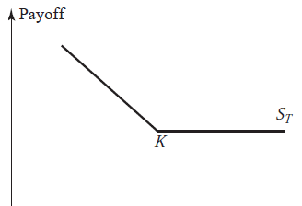
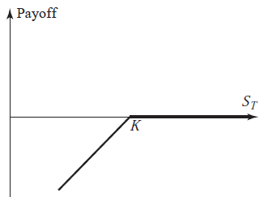
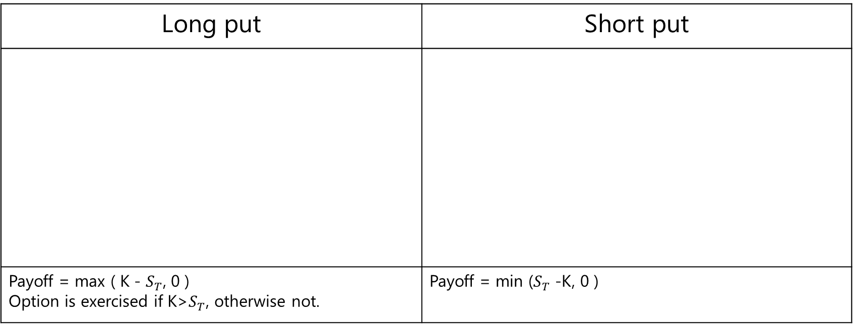
Option Payoffs - Put
4.2
Payoffs European options with Strike price = K; price of asset at maturity = $S_{T}$
Long put | Short put
Payoff = max ( K - $S_{T}$, 0 ) Option is exercised if K>$S_{T}$, otherwise not. | Payoff = min ($S_{T}$ -K, 0 )

Slide 30
Question
An investor buys a European put on a share for $3. The stock price is $42 and the strike
price is $40. Under what circumstances does the investor make a profit? Under what
circumstances will the option be exercised?
Draw a diagram showing the variation of the investor’s profit with the stock price at the maturity of the option.

Slide 31
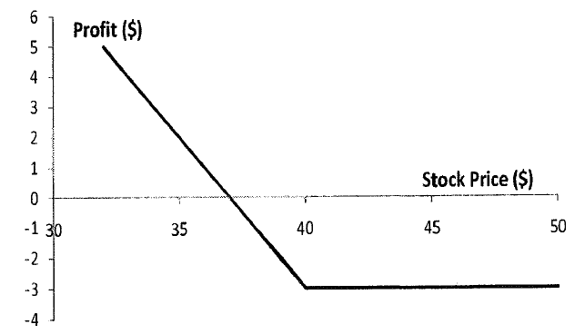
Solution

Slide 32
Question
Option buyers have the _____ to exercise their options. Options sellers have a(n) _____ to fulfil the terms of the option contract.
obligation; obligation
obligation; right
Right; right
Right; obligation
Answer:

Slide 33
Underlying Asset
5
What can be the different underlying assets for an option?

Slide 34
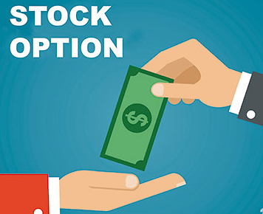

Underlying Asset
5
Options can have underlying assets like stocks, currencies, stock indices, and futures.
Stock Options
Most trading in stock options is on exchanges. Options trade on more than 2,500 different stocks. One contract gives the holder the right to buy or sell 100 shares at the specified strike price. This contract size is convenient because the shares themselves are normally traded in lots of 100.
2. Foreign Currency Options
A currency option refers to a derivative contract that gives the buyer the right but not the obligation to sell or buy currencies at a specified exchange rate within a specified time frame. They are useful for investors to hedge against unfavourable movements in exchange rates. Most currency options trading is now in the over-the-counter market, but there is some exchange trading.

Slide 35

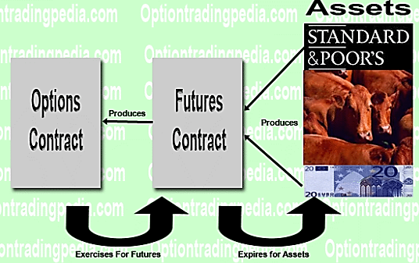
Underlying Asset
5
3. Index Options
An index option is a financial derivative that gives the holder the right (but not the obligation) to buy or sell the value of an underlying index, such as the S&P 500 index, at the stated exercise price. Many different index options currently trade throughout the world in both the over-the counter market and the exchange-traded market.
4. Futures Options
When an exchange trades a particular futures contract, it often also trades options on that contract. A futures option normally matures just before the delivery period in the futures contract. When a call option is exercised, the holder’s gain equals the excess of the futures price over the strike price. When a put option is exercised, the holder’s gain equals the excess of the strike price over the futures price

Slide 36
Specification on Stock Options
6
We will focus on stock options.
Expiration dates –
Expiration date for derivatives is the final date on which the derivative is valid. After that time, the contract has expired. The expiration time of an options contract is the date and time when it is rendered null and void. Before an option expires, its owners can choose to exercise the option, close the position to realize their profit or loss, or let the contract expire worthless.
Strike Prices –
A strike price is the set price at which a derivative contract can be bought or sold when it is exercised. Strike price is also known as the exercise price, being the most important factor affecting options. Strike prices are standardized, meaning they are at fixed dollar amounts, such as $31, $32, $33, $102.50, $105, and so on.

Slide 37
Question
Suppose that a European put option to sell a share for $60 costs $8 and is held until
maturity. Under what circumstances will the seller of the option (the party with the short
position) make a profit? Under what circumstances will the option be exercised? Draw a
diagram illustrating how the profit from a short position in the option depends on the
stock price at maturity of the option.

Slide 38
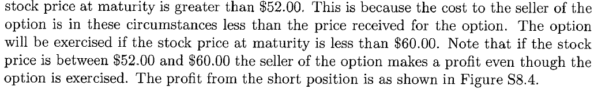
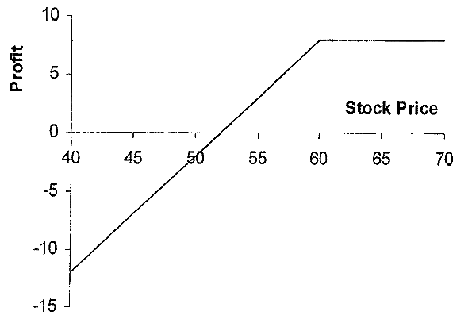
Solution

Slide 41
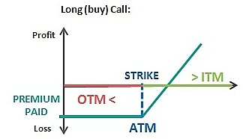
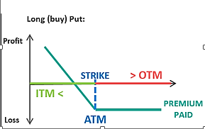
Terminologies in Options Market
7
In the money option (ITM)- If S is the stock price and K is the strike price, a call option is in the money when S > K. A put option is in the money when S < K.
At the money (ATM) – A call and a put option is at the money when S = K.
Out of money option (OTM) – Call option is out of money when K > S. A put option is out of money when S > K.

Slide 44
Understanding Intrinsic Value and Time Value
8
To buy an option, an investor must pay an option premium. The option premium can be thought as the sum of two different numbers that represent the value of the option.
The first is the current value of the option, known as the intrinsic value.
The second is the potential increase in value that the option could gain over time, known as the time value.

Slide 45
Intrinsic Value
8.1
The intrinsic value of an option represents the current value of the option, or in other words how much in the money it is. The intrinsic value of an option is defined as the maximum of zero and the value the option would have if it were exercised immediately.
Thus, the intrinsic value represents what the buyer would receive if he decided to exercise the option right now.
So for a call option, the intrinsic value is therefore max(S-K,0), where S is the stock price and K is the strike price.
What is the intrinsic value for a put option?
For a put option, it is max(K-S,0)

Slide 46
Time Value
8.2
The time value of an option is an additional amount an investor is willing to pay over the current intrinsic value.
Why do you think investors would be willing to pay over the current value of the option?

Slide 47
Time Value
8.2
The time value of an option is an additional amount an investor is willing to pay over the current intrinsic value. Investors are willing to pay this because an option could increase in value before its expiration date.
This means that if an option is months away from its expiration date, we can expect a higher time value on it because there is more opportunity for the option to increase or decrease in value over the next few months. If an option is expiring today, we can expect its time value to be very little or nothing because there is little or no opportunity for the option to increase or decrease in value.
Time value is calculated by taking the difference between the option’s premium and the intrinsic value, and this means that an option’s premium is the sum of the intrinsic value and time value:
Time Value = Option Premium - Intrinsic Value
Option Premium = Intrinsic Value + Time Value

Slide 48
Intrinsic Value & Time Value - Example
8
Consider the stock RIL.
Intrinsic Value –
If the stock price of RIL is currently $100, then the intrinsic value of a $85 call option on this stock is $15, which is the price of the RIL stock ($100) minus the strike price of the option ($85).
Time Value –
Let’s say our $85 call on RIL stock has a premium of $16. RIL stock is currently trading at $100, so our intrinsic value is $15 ($100 - $85). This means that our time value is $1 ($16 - $15).

Slide 49
Why Intrinsic and Time Value Matter
8.3
Intrinsic value and time value of an option help investors understand what they are paying for if they decide to purchase an option.
The intrinsic value of the option represents what it would be worth if the buyer exercised the option at the current point in time (this is not the same as the profit). The time value represents the possibility that the option will increase in value before its expiration date.
These two concepts can help investors understand the risk and reward of an option.
Profit = Intrinsic Value - Option Premium

Slide 50

Intrinsic and Time Value
8
Read Article - Understanding Intrinsic and Time Value
Video - Understanding Intrinsic and Time Value

Slide 51
Question
1. Explain why an American option is always worth at least as much as a European option on the same asset with the same strike price and exercise date.
2. Explain why an American option is always worth at least as much as its intrinsic value.

Slide 52
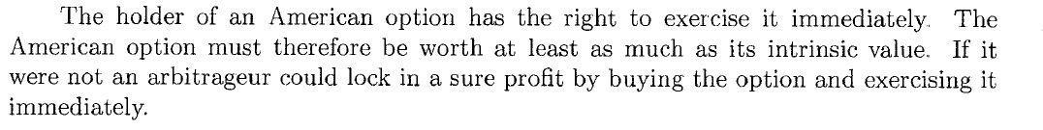
Solution

Slide 53
Options Trading
9
Market Makers
Most options exchanges use market makers to facilitate trading. A market maker for a certain option is an individual who, when asked to do so, will quote both a bid and an offer price on the option.
The bid is the price at which the market maker is prepared to buy, and the offer or asked is the price at which the market maker is prepared to sell. The offer is always higher than the bid, and the amount by which the offer exceeds the bid is referred to as the bid–offer spread.
The existence of the market maker ensures that buy and sell orders can always be executed at some price without any delays. Market makers therefore add liquidity to the market.

Slide 54
Options Trading
9
Offsetting Orders
An investor who has purchased options can close out the position by issuing an offsetting order to sell the same number of options. Similarly, an investor who has written options can close out the position by issuing an offsetting order to buy the same number of options.

Slide 55
Margins
10
In Options contracts, who do you think is required to pay the margin?

Slide 56
Margins
10
Writers of options have potential liabilities and are required to maintain margins with their broker.
A trader who writes options is required to maintain funds in a margin account. Both the trader’s broker and the exchange want to be satisfied that the trader will not default if the option is exercised. The amount of margin required depends on the trader’s position.
Holders of options do not pay margins as they have a right but not an obligation.

Slide 58
Margins - Example
10
Let's understand it with an example- Suppose stocks of ABC company is currently trading at Rs 48. You expect the price to go downwards and so decide to sell a Call Option at strike price 50. The premium for the contract is Rs 3 and lot size is 100 shares. For selling the Call option, you will receive a premium of 100 * 3 = Rs 300
Now let's discuss the possible scenarios:
1. When stock price remains unchanged at Rs 48
The Options expires worthless and you keep the premium received. The premium of Rs 300 is your profit.
2. When the stock price goes down to Rs 28
The Options expires worthless and you keep the premium received. The premium of Rs 300 is your profit.
3. When the stock price, against expectations, goes up to Rs 68
The Call contract would be exercised by the buyer and you have to pay Rs 68-Rs 50=Rs 18*100= Rs 1800. Taking into account Rs 300 you received as premium, your loss would be Rs 1500.
4. When the stock price, against expectations, goes up to Rs 88
The Call contract would be exercised by the buyer and you have to pay Rs 88-Rs 50=Rs 38*100= Rs 3800. Taking into account Rs 300 you received as premium, your loss would be Rs 3500.
So, Option sellers have a potential for unlimited loss and to cover this loss, they are asked to deposit margins.

Slide 59
Options Clearing Corporation
11
The Options Clearing Corporation (OCC) performs much the same function for options markets as the clearing house does for futures markets It guarantees that options writers will fulfil their obligations under the terms of options contracts and keeps a record of all long and short positions. The OCC has a number of members, and all option trades must be cleared through a member.
The funds used to purchase an option must be deposited with the OCC by the morning of the business day following the trade.
The writer of the option maintains a margin account with a broker, as described earlier. The broker maintains a margin account with the OCC member that clears its trades. The OCC member in turn maintains a margin account with the OCC.

Slide 60
Question
Explain carefully the difference between writing a put option and buying a call option.

Slide 61
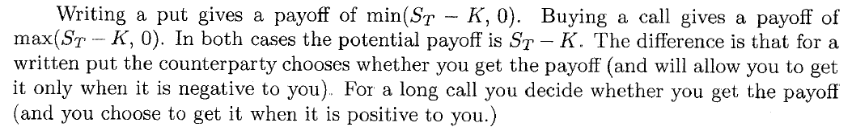
Solution

Slide 62
Recap
An option gives the holder of the option the right to do something, but the holder does not have to exercise this right.
A call option gives the holder of the option the right to buy an asset, whereas a put option gives the holder the right to sell an asset.
American options can be exercised at any time up to the expiration date, whereas European options can be exercised only on the expiration date itself.
Exchange traded options are adjusted for stock splits and stock dividends, but not for cash dividends.

Slide 63
Recap
Every option has two sides and there are four types of option positions possible.
Option payoffs can be plotted to understand profit and loss.
Options can have underlying assets like stocks, currencies, stock indices, and futures.
Expiration date for derivatives is the final date on which the derivative is valid
A strike price is the set price at which a derivative contract can be bought or sold when it is exercised.

Slide 64
Recap
Options can be in the money (ITM), at the money (ATM) and out of the money (OTM).
The option premium can be thought as the sum of two different numbers that represent the value of the option. The first is the current value of the option, known as the intrinsic value. The second is the potential increase in value that the option could gain over time, known as the time value.
Writers of options have potential liabilities and are required to maintain margins with their broker.

