Slide 1

Lecture
Mrs. Suchi Gupta (CA, CFA)
Class: TY BSc
Subject : Introduction to Derivatives and Financial Markets
Chapter: Unit 3 – Chapter 2 (PART 2)
Chapter Name: Properties of Stock options

Slide 2
Precap
There are two types of options: calls and puts. A call option gives the holder the right to buy the underlying asset for a certain price by a certain date. A put option gives the holder the right to sell the underlying asset by a certain date for a certain price.
There are four possible positions in options markets.
Options are currently traded on stocks, stock indices, foreign currencies, futures contracts, and other assets.
The terms of a stock option are not normally adjusted for cash dividends. However, they are adjusted for stock
dividends, stock splits, and rights issues.
Writers of options have potential liabilities and are required to maintain margins with their brokers.

Slide 3
Today’s Agenda
Factors affecting Stock Option Prices
  Stock Price
  Strike Price
  Time to Expiration
  Volatility
  Risk-free Interest Rate
  Amount of future Dividends
Pre-Requisites
  Assumptions
  Notations
Put-Call Parity (No dividends)
  Put-Call Parity with dividends
Bounds for Options
    Upper Bounds
    Lower Bounds
American calls on Non-Dividend Paying stocks
  Bounds
  American Puts on Non-Dividend Paying stocks
    Bounds
  Effect of Dividends

Slide 4

Factors affecting Stock Option Prices
1
Which factors do you think affect option prices?

Slide 5
Factors affecting Stock Option Prices
1
There are six factors affecting the price of a stock option:
The current stock price, 𝑆₀
The strike price, K
The time to expiration, T
The volatility of the stock price,
The risk-free interest rate, r
The dividends that are expected to be paid.
We consider what happens to option prices when there is a change to one of these factors, with all the other factors remaining fixed.

Slide 7
Stock Price (𝐒_{𝟎}) and Strike Price (K)
1.1
If a call option is exercised at some future time, the payoff will be the amount by which the stock price exceeds the strike price. Call options therefore become more valuable as the stock price increases and less valuable as the strike price increases.
Put options behave in the opposite way from call options: they become less valuable as the
stock price increases and more valuable as the strike price increases.

Slide 8
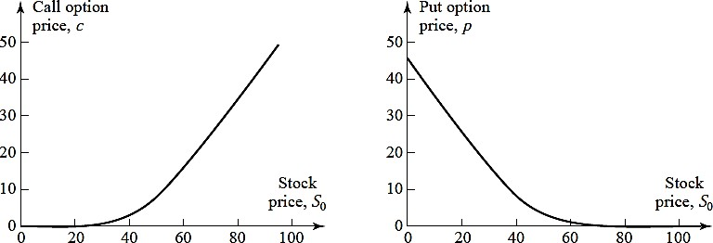
1.1
Stock Price (𝐒_{𝟎})
Effect of changes in stock price on option prices when 𝑆₀ = 50, K = 50, r = 5%, σ = 30%, and T = 1.

Slide 9
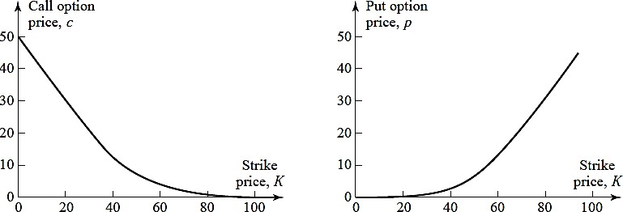
1.2
Strike Price (K)
Effect of changes in strike price on option prices when 𝑆₀ = 50, K = 50, r = 5%, σ = 30%, and T = 1.

Slide 10
Time to Expiration
1.3
Let’s consider the effect of the expiration date.
Both put and call American options become more valuable (or at least do not decrease in value) as the time to expiration increases.
Consider two American options that differ only as far as the expiration date is concerned. The owner of the long-life option has all the exercise opportunities open to the owner of the short-life option—and more. The long-life option must therefore always be worth at least as much as the short-life option.
What about European calls and puts?

Slide 11
Time to Expiration
1.3
Although European put and call options usually become more valuable as the time to expiration increases,
this is not always the case.
Consider two European call options on a stock: one with an expiration date in 1 month, the other with an expiration date in 2 months. Suppose that a very large dividend is expected in 6 weeks. The dividend will cause the stock price to decline, so that the short-life option could be worth more than the long-life option.

Slide 12
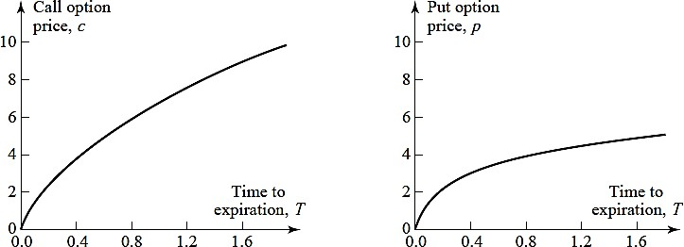
Time to Expiration
1.3
Effect of changes in expiration date on option prices when 𝑆₀ = 50, K = 50, r = 5%, σ = 30%, and T
= 1.

Slide 13
Volatility (σ)
1.4
The volatility of a stock price is a measure of how uncertain we are about future stock price movements.
As volatility increases, the chance that the stock will do very well or very poorly increases. For the owner of a stock, these two outcomes tend to offset each other.
However, this is not so for the owner of a call or put. The owner of a call benefits from price increases but has limited downside risk in the event of price decreases because the most the owner can lose is the price of the option. Similarly, the owner of a put benefits from price decreases, but has limited downside risk in the event
of price increases.
The values of both calls and puts therefore increase as volatility increases.

Slide 14
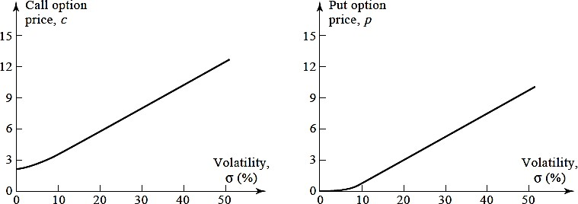
1.4
Volatility (σ)
Effect of changes in volatility on option prices when 𝑆₀ = 50, K = 50, r = 5%, σ = 30%, and T = 1.

Slide 15
Risk-Free Interest Rate (r)
1.5
The risk-free interest rate affects the price of an option in a less clear-cut way.
As interest rates in the economy increase, the expected return required by investors from the stock tends to increase. In addition, the present value of any future cash flow received by the holder of the option decreases. The combined impact of these two effects is to increase the value of call options and decrease the value of put options.
It is important to emphasize that we are assuming that interest rates change while all other variables stay the same.

Slide 16
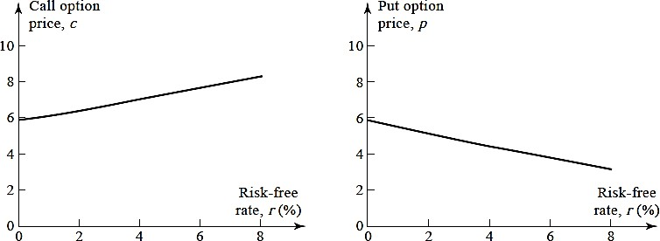
1.5
Risk-Free Interest Rate (r)
Effect of changes in risk-free interest rates on option prices when 𝑆₀ = 50, K = 50, r = 5%, σ = 30%, and T = 1.

Slide 17
Amount of future Dividends
1.6
Dividends have the effect of reducing the stock price on the ex-dividend date.
This is bad news for the value of call options and good news for the value of put
options.
Consider a dividend whose ex-dividend date is during the life of an option. The value of the option is negatively related to the size of the dividend if the option is a call and positively related to the size of the dividend if the option is a put.

Slide 18
Assumptions
2.1
We will make assumptions similar to those made when deriving forward and futures prices, in order to make
derivations for options.
We assume:
There are no transactions costs.
All trading profits (net of trading losses) are subject to the same tax rate.
Borrowing and lending are possible at the risk-free interest rate.
We also assume that the market participants are prepared to take advantage of arbitrage opportunities as they arise.. For the purposes of our analysis, it is therefore reasonable to assume that there are no arbitrage opportunities
4

Slide 19
Notations
2.2
We will use the following notation:
𝑆₀ : Current stock price K: Strike price of option
T : Time to expiration of option
𝑆_{𝑇}: Stock price on the expiration date
r: Continuously compounded risk-free rate of interest for an investment maturing in time T. (r>0) C: Value of American call option to buy one share
P: Value of American put option to sell one share
c: Value of European call option to buy one share p: Value of European put option to sell one share
5

Slide 22
Put – Call Parity
3
We now derive an important relationship between the prices of European put and call options that have the
same strike price and time to maturity. Consider the following two portfolios:
Portfolio A: one European call option plus a zero-coupon bond that provides a payoff of K at time T Portfolio C: one European put option plus one share of the stock.
We assume that the stock pays no dividends. The call and put options have the same strike price K and the same time to maturity T.
What is the value/ worth of the two portfolios at time T?
7

Slide 23
Put – Call Parity
3
Portfolio A
The zero-coupon bond in portfolio A will be worth K at time T. If the stock price ST at time T proves to be above K, then the call option in portfolio A will be exercised. This means that portfolio A is worth ( S_{T} - K) + K
= S_{T} at time T in these circumstances. If S_{T} proves to be less than K, then the call option in portfolio A will expire worthless and the portfolio will be worth K at time T.
Portfolio C
The share will be worth S_{T} at time T. If S_{T} proves to be below K, then the put option in portfolio C will be exercised. This means that portfolio C is worth (K - S_{T}) + S_{T} = K at time T in these circumstances. If S_{T} proves to be greater than K, then the put option in portfolio C will expire worthless and the portfolio will be worth S_{T} at time T.
In other words, both are worth max (S_{T} , K ) when the options expire at time T.
10

Slide 24
Put – Call Parity
3
In other words, both are worth max (S_{T} , K ) when the options expire at time T. Because they are European, the options cannot be exercised prior to time T. Since the portfolios have identical values at time T, they must have identical values today. If this were not the case, an arbitrageur could buy the less expensive portfolio and sell the more expensive one.
The components of portfolio A are worth c and K𝑒^{−𝑟𝑇} today, and the components of portfolio C are worth p
and 𝑆₀ today.
Hence,
c + K𝒆^{−𝒓𝑻} = p + 𝑺_{𝟎}
This relationship is known as put–call parity. It shows that the value of a European call with a certain exercise price and exercise date can be deduced from the value of a European put with the same exercise price and exercise date, and vice versa.
Note: This relation holds only for European options.
11

Slide 25
Question
The price of a non-dividend-paying stock is $19 and the price of a 3-month European call option on the stock with a strike price of $20 is $1. The risk-free rate is 4% per annum. What is the price of a 3-month European put option with a strike price of $20?
13

Slide 26
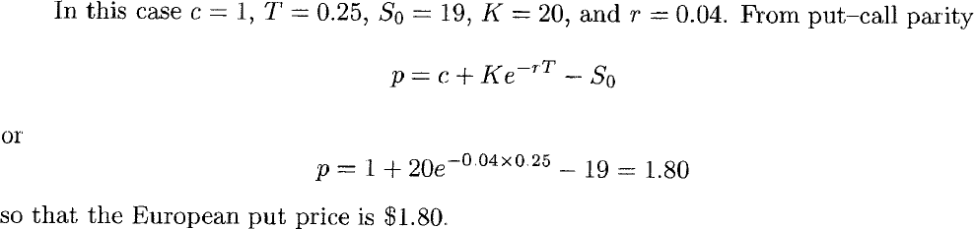
Solution
13

Slide 27
Put – Call Parity – with Dividends
3.1
The results produced so far in this chapter have assumed that we are dealing with options on a non-dividend- paying stock. In this section, we examine the impact of dividends. We assume that the dividends that will be paid during the life of the option are known.
We will use D to denote the present value of the dividends during the life of the option. In the calculation of D, a dividend is assumed to occur at the time of its ex-dividend date.
We redefine the two portfolios as:
Portfolio A: one European call option plus an amount of cash equal to D + K𝑒^{−𝑟𝑇}. Portfolio C: one European put option plus one share of the stock.
Using the same method of analysis as before, the put-call parity equation thus becomes,
c + D + K𝒆^{−𝒓𝑻} = p + 𝑺_{𝟎}
14

Slide 28
Question
The price of a European call that expires in 6 months and has a strike price of $30 is $2. The underlying stock price is $29, and a dividend of $0.50 is expected in 2 months and again in 5 months. The term structure is flat, with all risk-free interest rates being 10%. What is the price of a European put option that expires in 6 months and has a strike price of $30?
17

Slide 29
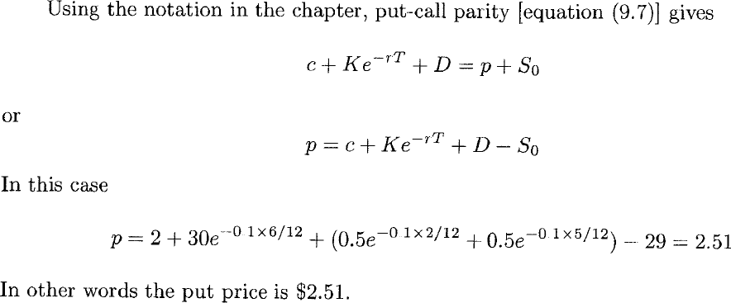
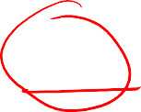
Solution
16

Slide 30
Question
Explain the arbitrage opportunities in previous problem if the European put price is $3.
17

Slide 31
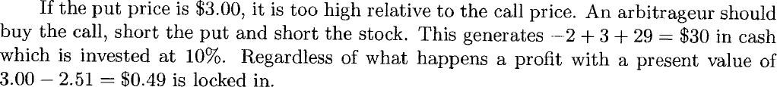
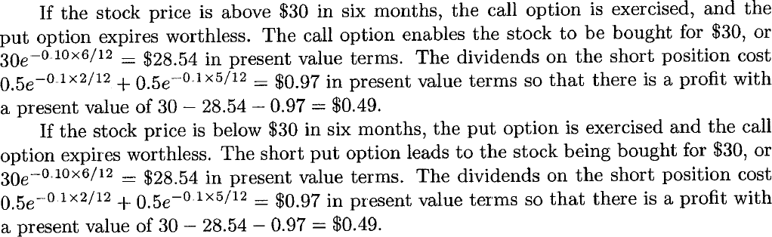
Solution
18

Slide 32

Bounds for Options
4
In this section we derive upper and lower bounds for option prices. If an option price is above the upper bound or below the lower bound, then there are profitable opportunities for arbitrageurs.
4.1 Upper Bounds – Call Option
An American or European call option gives the holder the right to buy one share of a stock for a certain
price. No matter what happens, the option can never be worth more than the stock.
Hence, the stock price is an upper bound to the option price:
c ≤ 𝑆₀ and C ≤ 𝑆₀
If these relationships were not true, an arbitrageur could easily make a riskless profit by buying the stock and selling the call option.

Slide 33
Bounds for Options
4
4.2 Upper Bounds – Put Options
An American put option gives the holder the right to sell one share of a stock for K. No matter how low the
stock price becomes, the option can never be worth more than K.
Hence,
P ≤ K
For European put options, we know that at maturity the option cannot be worth more than K. It follows that it cannot be worth more than the present value of K today:
p ≤ K𝑒^{−𝑟𝑇}
If this were not true, an arbitrageur could make a riskless profit by writing the option and investing the
proceeds of the sale at the risk-free interest rate

Slide 34

Bounds for Options
4
4.3 Lower Bounds – Call Options
A lower bound for the price of a European call option on a non-dividend-paying stock is
𝑺_{𝟎} - K𝒆^{−𝒓𝑻}
We consider the following two portfolios:
Portfolio A: one European call option plus a zero-coupon bond that provides a payoff of K at time T.
Portfolio B: one share of the stock.
What will be the value of both these portfolios at time T?

Slide 35
Bounds for Options
4
4.3 Lower Bounds – Call Options
In portfolio A, the zero-coupon bond will be worth K at time T. If 𝑆_{𝑇} > K, the call option is exercised at maturity and portfolio A is worth 𝑆_{𝑇}. If 𝑆_{𝑇} < K, the call option expires worthless and the portfolio is worth K. Hence, at time T, portfolio A is worth max(𝑆_{𝑇}, K).
Portfolio B is worth 𝑆_{𝑇} at time T. Hence, portfolio A is always worth as much as, and can be worth more than, portfolio B at the option’s maturity. It follows that in the absence of arbitrage opportunities this must also be true today. The zero-coupon bond is worth K𝑒^{−𝑟𝑇} today.
Hence,
c + K𝑒^{−𝑟𝑇} ≥ 𝑆₀
i.e. c ≥ 𝑺_{𝟎} - K𝒆^{−𝒓𝑻}
Because the worst that can happen to a call option is that it expires worthless, its value cannot be negative.
This means that c ≥ 0 and therefore c ≥ max(𝑺_{𝟎} - K𝒆^{−𝒓𝑻}, 0)

Slide 36

Question
Consider a European call option on a non-dividend-paying stock when the stock price is $51, the strike price is $50, the time to maturity is 6 months, and the risk-free interest rate is 12%per annum.
What is the lower bound for the call option price?

Slide 37

Solution

Slide 38
Bounds for Options
4
4.4 Lower Bounds – Put Options
For a European put option on a non-dividend-paying stock, a lower bound for the price is K𝒆^{−𝒓𝑻} - 𝑺_{𝟎}
Consider the following two portfolios:
Portfolio C: one European put option plus one share
Portfolio D: a zero-coupon bond paying off K at time T.
If 𝑆_{𝑇} < K, then the option in portfolio C is exercised at option maturity and the portfolio becomes worth K. If
𝑆_{𝑇} > K, then the put option expires worthless and the portfolio is worth 𝑆_{𝑇} at this time. Hence, portfolio C is worth max(𝑆_{𝑇}, K). in time T.
Portfolio D is worth K in time T. Hence, portfolio C is always worth as much as, and can sometimes be worth more than, portfolio D in time T. It follows that in the absence of arbitrage opportunities portfolio C must be worth at least as much as portfolio D today. Hence, p + 𝑆₀ ≥ K𝑒^{−𝑟𝑇}
i.e. p ≥ K𝒆^{−𝒓𝑻} - 𝑺_{𝟎}

Slide 39
Bounds for Options
4
4.4 Lower Bounds – Put Options
Because the worst that can happen to a put option is that it expires worthless, its value cannot be negative.
This means that
p ≥ max( K𝒆^{−𝒓𝑻} - 𝑺_{𝟎}, 𝟎 )

Slide 40
Question
What is a lower bound for the price of a 1-month European put option on a nondividend-
paying stock when the stock price is $12, the strike price is $15, and the riskfree
interest rate is 6% per annum?

Slide 41
Solution

Slide 42
Question
A 1-month European put option on a non-dividend-paying stock is currently selling for $2:50. The stock price is $47, the strike price is $50, and the risk-free interest rate is 6% per annum. What opportunities are there for an arbitrageur?

Slide 43
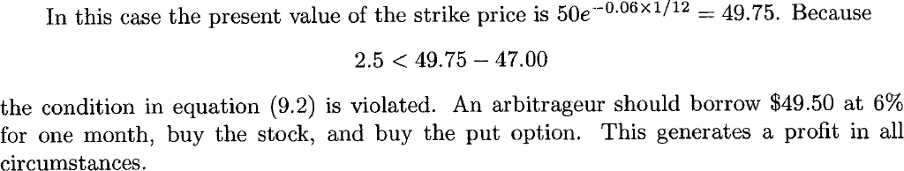
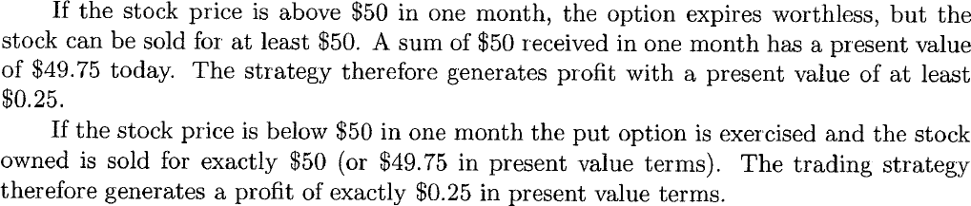
Solution

Slide 45
Homework
Think!!
American options can be exercised any time on or before expiration. What do you think is it optimal to exercise an American call or an American put before expiration?

Slide 46
American Calls on Non-Dividend Paying Stocks
5
In this section, we first show that it is never optimal to exercise an American call option on a non-dividend- paying stock before the expiration date.
To illustrate the general nature of the argument, consider an American call option on a non-dividend-paying stock with one month to expiration when the stock price is $70 and the strike price is $40. The option is deep in the money, and the investor who owns the option might well be tempted to exercise it immediately.
However, if the investor plans to hold the stock obtained by exercising the option for more than one month, this is not the best strategy. A better course of action is to keep the option and exercise it at the end of the month.
The $40 strike price is then paid out one month later than it would be if the option were exercised immediately, so that interest is earned on the $40 for one month. Because the stock pays no dividends, no income from the stock is sacrificed.
A further advantage of waiting rather than exercising immediately is that there is some chance (however remote) that the stock price will fall below $40 in one month. In this case the investor will not exercise in one month and will be glad that the decision to exercise early was not taken!

Slide 47
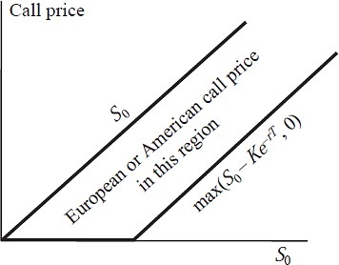
Bounds
5.1
Because American call options are never exercised early when there are no dividends, they are equivalent to European call options, so that C = c. From equations derived earlier, it follows that upper and lower bounds are given by
max(𝑺_{𝟎} - K𝒆^{−𝒓𝑻}, 0) ≤ c, C ≤ 𝑺_{𝟎}
Bounds for European and American call options
when there are no dividends.
6

Slide 48
American Puts on Non-Dividend Paying Stocks
6
It can be optimal to exercise an American put option on a non-dividend-paying stock early. Indeed, at any given time during its life, a put option should always be exercised early if it is sufficiently deep in the money.
To illustrate, consider an extreme situation. Suppose that the strike price is $10 and the stock price is virtually zero. By exercising immediately, an investor makes an immediate gain of $10. If the investor waits, the gain from exercise might be less than $10, but it cannot be more than $10, because negative stock prices are impossible.
Furthermore, receiving $10 now is preferable to receiving $10 in the future. It follows that the option should be exercised immediately.
In general, the early exercise of a put option becomes more attractive as 𝑆₀ decreases, as r increases, and as the volatility decreases.
7

Slide 49
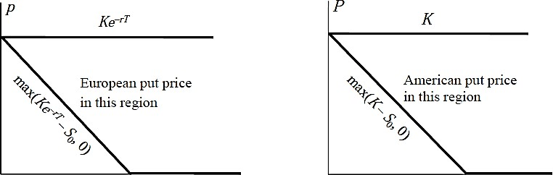
Bounds
6.1
For an American put option on a non-dividend-paying stock, the condition
P ≥ max( K - 𝑺_{𝟎}, 0)
must apply because the option can be exercised at any time. This is a stronger condition than the one for a European put option.
Bounds for an American put option on a non-dividend-paying stock are
max( K - 𝐒_{𝟎}, 0) ≤ P ≤ K
Bounds for European and American put options when there are no dividends.
19

Slide 50
Effect of Dividends
7
In case of dividends the bounds are
c ≥ max(𝑺_{𝟎} - D - K𝒆^{−𝒓𝑻}, 0)
And
p ≥ max(D + K𝒆^{−𝒓𝑻} - 𝑺_{𝟎}, 0)
9

Slide 51
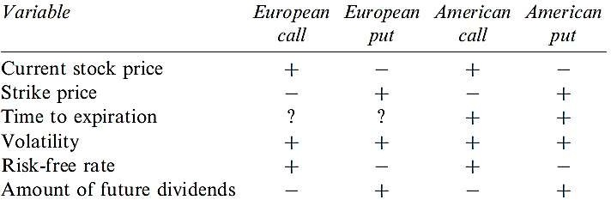
Recap
Summary of the effect on the price of a stock option of increasing one variable while keeping all others fixed
+ indicates that an increase in the variable causes the option price to increase;
- indicates that an increase in the variable causes the option price to decrease;
? indicates that the relationship is uncertain.

Slide 52
Recap
Put–call parity shows that the value of a European call with a certain exercise price and exercise date can be deduced from the value of a European put with the same exercise price and exercise date, and vice versa.
The equation is:
No Dividends
c + K𝒆^{−𝒓𝑻} = p + 𝑺_{𝟎}
With Dividends
c + D + K𝒆^{−𝒓𝑻} = p + 𝑺_{𝟎}
19

Slide 53
Recap
For American and European call, the stock price is an upper bound to the option price: c ≤ 𝑆₀ and C ≤ 𝑆₀ .
For an American put, P ≤ K.
For European put options, p ≤ K𝑒^{−𝑟𝑇}.
A lower bound for the price of a European call option on a non-dividend-paying stock is 𝑺_{𝟎} - K𝒆^{−𝒓𝑻}.
For a European put option on a non-dividend-paying stock, a lower bound for the price is K𝒆^{−𝒓𝑻} - 𝑺_{𝟎}

Slide 54
Recap
It is never optimal to exercise an American call option on a non-dividend-paying stock before the expiration date.
It can be optimal to exercise an American put option on a non-dividend-paying stock early. Indeed, at any given time during its life, a put option should always be exercised early if it is sufficiently deep in the money.
For American options, S₀ - K ≤ C - P ≤ S₀ - Ke^{−rT}.
10

