Slide 1

Lecture
Mrs. Suchi Gupta (CA, CFA)
Class: SY BSc
Subject : Introduction to Derivatives and Financial Markets
Subject Code: PUSASQF302
Chapter: Unit 4
Chapter Name: Alternative Investments 1 & 2

Slide 2
Precap
Trading Strategies Involving Options
Principal-protected notes can be created from a zero-coupon bond and a European call option. They are attractive to some investors because the issuer of the product guarantees that the purchaser will be receive his or her principal back regardless of the performance of the asset underlying the option.
A number of common trading strategies involve a single option and the underlying stock.
For example, writing a covered call involves buying the stock and selling a call option on the stock; a protective put involves buying a put option and buying the stock. The former is similar to selling a put option; the latter is similar to buying a call option.

Slide 3
Precap
Spreads involve either taking a position in two or more calls or taking a position in two or more puts.
A bull spread can be created by buying a call (put) with a low strike price and selling a call (put) with a high strike price.
A bear spread can be created by buying a put (call) with a high strike price and selling a put (call) with a low strike price.
A butterfly spread involves buying calls (puts) with a low and high strike price and selling two calls (puts) with some intermediate strike price.
A calendar spread involves selling a call (put) with a short time to expiration and buying a call (put) with a longer time to expiration.
A diagonal spread involves a long position in one option and a short position in another option such that both the strike price and the expiration date are different.

Slide 4
Precap
Combinations involve taking a position in both calls and puts on the same stock.
A straddle combination involves taking a long position in a call and a long position in a put with the same strike price and expiration date.
A strip consists of a long position in one call and two puts with the same strike price and expiration date.
A strap consists of a long position in two calls and one put with the same strike price and expiration date.
A strangle consists of a long position in a call and a put with different strike prices and the same expiration date.
There are many other ways in which options can be used to produce interesting payoffs. It is not surprising that option trading has steadily increased in popularity and continues to fascinate investors.

Slide 5
Today’s Agenda
Alternative Investments
Traditional vs Alternative Investments
Various Alternative Investments
Strategy for Alternative Investments
Why invest in Alternative Investments
Benefits of Alternative Investments
Potential Risks with Alternative Investments
Alternative Investments – Types
Hedge Funds
Private Equity
Real Estate
Commodities
Infrastructure

Slide 6


Alternative Investments
1
What do you understand by alternative investments?

Slide 7

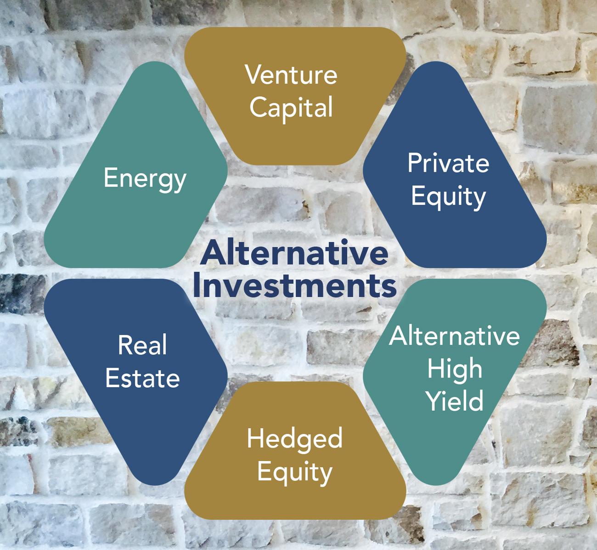
Alternative Investments
1
An alternative investment is a financial asset that does not fall into one of the conventional equity/income/cash categories.
Private equity or venture capital, hedge funds, real property, commodities, and tangible assets are all examples of alternative investments.

Slide 8
Traditional vs Alternative Investments
1.1
What is the difference between traditional/conventional investments and alternative investments?
State the basis of the difference.

Slide 9
Traditional vs Alternative Investments
1.1
Traditional Investments | Alternative Investments
Liquid investments | Largely illiquid investments
Numerous and passive owners | Active owners
Highly regulated | Less regulated
Extremely correlated with, and sensitive to, market movements | Low correlation to public markets
Generally do not use leverage | Use of leverage
Positions are typically held long-only by retail investors, meaning that investors profit when prices rise, though many investors can short traditional investments | Can take short positions, allowing investors to profit when prices decline
Open to general public and accredited investors | Only open to accredited investors
Low investment amounts allowed | High minimum investment requirements

Slide 10

Question
Which of the following would you describe as a traditional investment?
The loose change in your pocket
A promise to buy GM stock at a fixed price one month from today
Starry Night by Vincent Van Gogh
Solution
The correct answer is A.
Only cash, publicly-traded stocks, and publicly-available bonds are available to investors in traditional investments.

Slide 11
Various Alternative Investments
1.2
Private equity - consists of large-scale private investments into unlisted companies in return for equity. Private funds are typically formed by combining funds from institutional investors such as high-net-worth individuals, insurance companies, university endowment funds and pension funds.
Venture Capital - consists of private investments made into young start-up companies in exchange for equity. Venture capital funds are typically formed by drawing capital from seed money, or angel investors.
Real Assets - are physical or tangible assets that have intrinsic value such as real estate, oil, precious metal commodities, and agriculture land. Luxury and collectable goods also fall into this category, including wine, art, jewellery, rare coins, and baseball cards.

Slide 12
Various Alternative Investments
1.2
Hedge Funds - These are pooled investment funds that are formed to invest in a variety of strategies and asset types. Hedge fund managers raise funds and invest with a variety of styles and financial instruments.
Fund of Funds. These are large vehicles that form funds to invest in other alternative investment funds. Investors inherently gain diversification by investing in multiple managers, strategies or asset classes.
Antiques, Art collections, Stamps, Vintage cars etc.

Slide 13
Strategy for Alternative Investments
1.3
Why do you think does anyone include alternative investments into their portfolio or their investment strategy?

Slide 14
Strategy for Alternative Investments
1.3
Alternative investments become an attractive investment option to be included in the portfolio due to various decorating benefits that it holds.
Alternative investments typically have a low correlation with those of standard asset classes. This low correlation means they often move counter—or the opposite—to the stock and bond markets. This feature makes them a suitable tool for portfolio diversification.
Investments in hard assets, such as gold, oil, and real property, also provide an effective hedge against inflation, which hurts the purchasing power of paper money.
Because of this, many large institutional funds such as pension funds and private endowments often allocate a small portion of their portfolios—typically less than 10%—to alternative investments such as hedge funds.

Slide 15
Strategy for Alternative Investments
1.3
Alternative assets can be categorized as either ‘return enhancers’ or ‘return diversifiers’:
A return enhancer refers to an asset added to a portfolio with the expectation of a higher average return.
A return diversifier refers to an asset added to a portfolio because of its low correlation to other assets, with the aim of reducing risk across the overall portfolio.
High risk and high minimum investments mean that alternative assets typically appeal to long-term investors, rather than those that prefer to use short-term investments to profit from the volatility in stock markets. That said, more and more investors are choosing to add alternatives exposure to their portfolios to take advantage of the benefits outlined above.

Slide 16
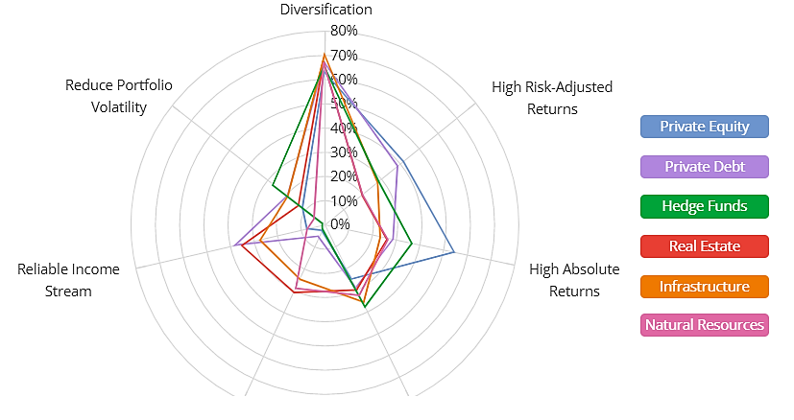
Why Invest in Alternative Investments?
1.4
Reasons for investing in alternatives vary across asset classes The chart below shows why investors allocate to each alternative asset class.
Institutional Investors’ Main Reasons for Investing in Alternative Assets
Source: Preqin

Slide 17
Benefits of Alternative Investments
1.5
1. Generally Uncorrelated to the Stock Market -
When you think about these investments in the context of total portfolio, you will find that many types of alternative assets have great diversification potential.
Alternative investments typically don't correlate to the stock market, which means they add diversification to a portfolio. This way, when the stock market drops significantly, they have a hedge of protection and not all of their investment portfolio will be affected.
The stock market is famously unpredictable, even in a stable economy, and alternatives are largely shielded from the unpredictable swings in the public markets.
A great example is in real estate. Let’s say you are invested in mortgage notes or have a rental property. Even though the stock market has fluctuated significantly over the last few months, your borrower or tenant is going to keep paying their mortgage or rent.

Slide 18
Benefits of Alternative Investments
1.5
2. Less Volatility –
Many alternative investments are less volatile than stocks, making them a good choice for investors in search of portfolio stability.
3. Alternative Investments as a Hedge against Inflation –
Some alternative asset classes are a good inflation hedge (their returns are highly correlated to inflation). Infrastructure investments provide a low, yet stable long-term real return.
4. New Exposures and Opportunities –
Because alternative investments are so diverse, you have plenty of opportunities to find new exposures, which are not accessible with traditional investments.
5. Higher Returns on Alternative Investments –
Some kinds of alternative investments are very risky on a standalone basis, but investors are rewarded for this risk by higher returns. Like those of traditional investments, returns of alternative investments vary over time depending on market conditions and economic cycle.

Slide 19
Benefits of Alternative Investments
1.5
6. Direct Tax Benefits –
Alternative investments can also provide compelling tax benefits. With many alternative investments you get to keep more of your profit because of the structure. In many private alternative investments, you become a part-owner of the fund or syndication and as such the tax benefits get directly passed on to you.
7. Passive Investments –
Most busy investors place a high value on their time, and actively managing an asset or portfolio requires an enormous amount of work. However, certain alternative investments, say Funds, are completely passive and don’t require any ongoing management from investors.
The other advantage of truly passive funds or syndications is that you can leverage the expertise, team, and relationships of experienced operators.

Slide 20
Potential risks with Alternative Investments
1.6
While private alternatives have many benefits, there are a few drawbacks.
The most common roadblock for investors looking to get into alternatives is liquidity. If you’re investing into a private fund, most will have a lockup period anywhere from 3-10 years before you can withdraw your initial investment.
Another disadvantage, is that many alternative investments require investors to be accredited (hyperlink to definition), i.e. a high net worth investor. However, changes to regulation continue to open up more options to non-accredited investors.
Asymmetric risk and return profiles, along with limited liquidity, low information, and regulatory/governance complexity, are a hurdle for investors.
These securities often have counterparty risk, liquidity risk, compliance issues, and difficult forecasting potential. However, they do offer a savvy investor a chance to balance their portfolio and seek higher returns with lower risk if used correctly.

Slide 21
Alternative Investments - Types
2
We now move ahead to look at the various alternative investments, their structures, benefits and issues associated.
We broadly look at:
Hedge Funds
Private Equity
Real Estate
Commodities
Infrastructure

Slide 22
Hedge Funds
2.1
Hedge funds are investment funds that trade relatively liquid assets and employ various investing strategies with the goal of earning a high return on their investment. Hedge fund managers can specialize in a variety of skills to execute their strategies, such as long-short equity, market neutral, volatility arbitrage, and quantitative strategies.
So why are they called Hedge Funds in the first place?
These funds derived this name due to their core idea to generate a consistent return and preserve capital, instead of focusing on the magnitude of returns.
With minimal co-relation to equity markets, most hedge funds have been able to diversify portfolio risks and reduce volatility.

Slide 23
Hedge Funds
2.1
Hedge funds are best known for investments in risky assets and derivatives. When it comes to investment techniques, hedge funds prefer to take a more high-end complex approach calibrated to varying levels of risk and return.
Many of them also resort to “Leveraged” investment, which means using borrowed money for investment.
One factor that distinguishes Hedge Funds from other alternative investments is its liquidity quotient. These funds can take as low as a few minutes for sell-off due to increased exposure to liquid securities.

Slide 24

Management and Incentive Fees
2.1
Funds are generally structured with a management fee based on assets under management (sometimes called the base fee) plus an incentive fee (or performance fee) based on realized profits.
Sometimes, the fee structure specifies that the incentive fee is earned only after the fund achieves a specified return known as a hurdle rate.
Many alternative investment funds, including hedge funds, use this basic partnership and fee structure.
A common fee structure in the hedge fund market was once “2 and 20,” which reflects a 2% management fee and a 20% incentive fee; both fees are paid by Limited Partners/Investors. The average industry fee is now closer to a 1.6% management fee and 17.75% incentive fee.
The incentive fee may be calculated on profits net of management fees or on profits before management fees (in other words, the incentive fee is calculated independent of management fees).

Slide 25
Fees & Returns - Calculations
2.1
AWJ Capital is a hedge fund with $100 million of initial investment capital. It charges a 2% management fee based on year-end AUM and a 20% incentive fee. In its first year, AWJ Capital has a 30% return. Assume management fees are calculated using end-of- period valuation
Question - What are the fees earned by AWJ if the incentive and management fees are calculated independently? What is an investor’s effective return given this fee structure?

Slide 26
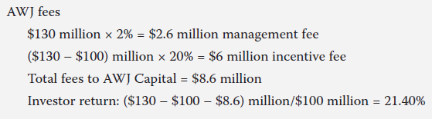
Solution

Slide 27
Pros and Cons of Hedge Funds
2.1
Hedge funds offer some worthwhile benefits over traditional investment funds. Some notable benefits of hedge funds include:
Investment strategies that can generate positive returns in both rising and falling equity and bond markets
The reduction of overall portfolio risk and volatility in balanced portfolios
An increase in returns
A variety of investment styles that provide investors the ability to precisely customize an investment strategy
Access to some of the world's most talented investment managers
Hedge funds, of course, are not without risk as well:
Concentrated investment strategy exposes them to potentially huge losses.
Hedge funds tend to be much less liquid than mutual funds.
They typically require investors to lock up money for a period of years.
The use of leverage or borrowed money can turn what would have been a minor loss into a significant loss.

Slide 28
Private Equity (PE)
2.2
A private equity fund is a collective investment scheme used for making investments in various equities and debt instruments. They are usually managed by a firm or a limited liability partnership.
The tenure (Investment horizon) of such funds can be anywhere between 5-10 years with an option of annual extension.
One key feature of private equity funds is that the money which is pooled in for the purpose of fund investment is not traded in the stock market and is not open to every individual for subscription.
Since private equity funds are not available to everyone, the money is usually raised from institutional investors (HNIs & Investment Banks) who can afford to invest large sums of money for longer time periods.
A team of investment professionals from a particular private equity firm raise and manage the funds, where they utilise this money for raising new capital, future acquisitions, funding start-ups or new technology, investing in other private companies or making the existing fund stronger.
Private equity funds represent an excellent opportunity for a high rate of return.

Slide 29
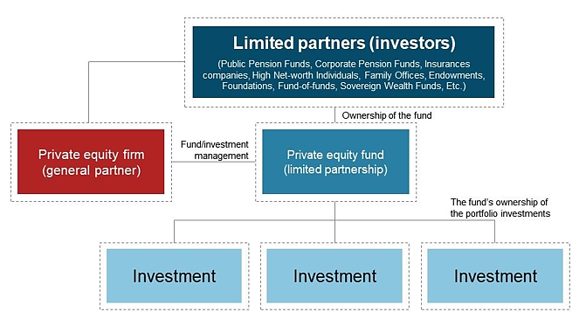
How does PE Work?
2.2

Slide 30

How big is Private Equity?
2.2
Check Out – The World’s Largest 25 Equity Firms
https://www.visualcapitalist.com/25-largest-private-equity-firms-chart/

Slide 31
Types of Equity Funds
2.2
Venture Capital or VCs
Venture capital refers to the fund which further invests in small young companies and start-ups who have limited or no access to the outside financial markets. These young companies are usually in their initial stage of formation but have a high growth potential in the near future.
Buyout or Leveraged Buyout (LBO)
A leveraged buyout takes place when a company borrows a large amount of money in the form of loans and bonds to facilitate its acquisition of another company. The purpose of having a major stake holding in a company for a long period of time is to manage the funds within the company in order to generate a sizeable value. Once a significant value has been created, the PE firms dilute their stake and exit the company.
Real Estate
Private equity real estate funds invest capital in ownership of various real estate properties.

Slide 32
Types of Equity Funds
2.2
Growth Capital
Private equity growth capital funds invest in mature corporates with a successful business model to enable them to expand or restructure their operations, enter new markets, or finance a major acquisition. It is usually a small investment as the company which requires growth capital is generally a large profit generating enterprise.
Fund of Funds
A ‘fund of funds’ (FoF) is an investment strategy whereby investments are made in other funds rather than directly in securities, stocks, or bonds. A fund of funds is advantageous for investors as their money is invested in various fund strategies which diversify risk.

Slide 33
Pros and Cons of Private Equity
2.2
Advantages of Investing in Private Equity Funds
Large amounts of funding: Private Equity Funds are an excellent source of capital as they are free of debts. An emerging business can tap large amounts for seed funding via Private Equity.
Untapped Potential: Private equity is a vastly untapped market with great potential. From unicorn start-ups to unlisted private companies and much more, there are a wide range of options available in the market.
Active Involvement: As a shareholder, you can hold the professional management PE team completely accountable for protecting your shareholding interests.
Incentives and Returns: PE Firms which hold and manage private equity funds are highly selective and spend a considerable amount of resources to assess the potential companies which they could invest in. This also involves an understanding of the risks involved and how to ease the same.

Slide 34
Pros and Cons of Private Equity
2.2
Disadvantages of Investing in Private Equity Funds
Private equity has unique challenges.
First, it can be difficult to liquidate holdings in private equity because, unlike public markets, a ready-made order book that matches buyers with sellers is not available. A firm has to undertake a search for a buyer in order to make a sale of its investment or company.
Second, pricing of shares for a company in private equity is determined through negotiations between buyers and sellers and not by market forces, as is generally the case for publicly-listed companies.
Third, the rights of private equity shareholders are generally decided on a case-by-case basis through negotiations instead of a broad governance framework that typically dictates rights for their counterparts in public markets.

Slide 35

Real Estate
2.3
Real estate is considered an alternative asset among investors who purchase investment properties such as office buildings, residential apartments, or vacation housing.
Money may be gained from rental income, wholesaling, or house flipping.
If an investor is not interested in being a landlord, they can use a broker to invest in real estate investment trusts or REITs.

Slide 36
Real Estate
2.3
Types of Real Estate Investments
Residential Real Estate – (This includes single-family homes, duplexes, multifamily properties, and vacation homes.)
Commercial Real Estate – (The best commercial properties to invest in include industrial, office, retail, hospitality, and multifamily projects.)
Raw Land & New Construction – (Raw land refers to any vacant land available for purchase and is most attractive in markets with high projected growth. New constructions have properties already been built on the land. Investing in new construction is also popular in rapidly growing markets.)
Real Estate Investment Trusts (REITs) – Real estate investment trusts or REITs are companies that own different commercial real estate types, such as hotels, shops, offices, malls, or restaurants. You can invest in shares of these real estate companies on the stock exchange.

Slide 37
Pros and Cons of Real Estate
2.3
Advantages of real estate investing
Real Estate Appreciates Over Time - Well-chosen real estate appreciates over time, generally at a rate that far outpaces annual inflation
Real Estate Has Unique Tax Benefits - Real estate's unique tax benefits allow investors to grow their wealth over time. Rental income is not subject to self-employment tax, and the government offers tax benefits to real estate investors
Real Estate Provides a Steady Cash Flow - Rental properties can provide a steady flow of monthly income called “cash flow.” This is the extra money that is left after all the bills have been paid.
Real Estate Provides a Hedge Against Inflation - Real estate investments keep pace with inflation. As the price of a loaf of bread goes up, so do rents and property values. The one thing that doesn't increase is the monthly cost of a fixed-rate mortgage payment. So as your annual rental income increases, your cost of ownership doesn't.

Slide 38
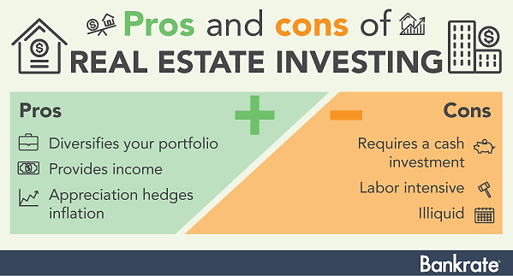
Pros and Cons of Real Estate
2.3

Slide 39
Pros and Cons of Real Estate
2.3
Disadvantages of real estate investing
Real Estate Requires Money - To get started, you'll need a down payment plus closing costs and money to repair and update the property to maximize rental income. And once you own the property, there will be ongoing expenses like property taxes, insurance, mortgage payments, and property maintenance.
Real Estate Takes a Lot of Time - You need to spend time learning and managing your real estate investments
Real Estate Is a Long-term Investment - Real estate should always be bought with a longer-term strategy. You're buying a tangible asset that you can't quickly liquidate for cash if you need emergency funds.
Buying the wrong property at the wrong time

Slide 40
Commodities
2.4
Commodities are physical products. Commodities include precious and base (i.e., industrial) metals, energy products, and agricultural products.
Returns on commodity investments are based on changes in price rather than on an income stream such as interest, dividends, or rent.
In fact, holding commodities (i.e., the physical products) incurs costs for transportation and storage. Thus, most commodity investors do not trade actual physical commodities but rather trade commodity derivatives. The underlying for a commodity derivative may be a single commodity or an index of commodities.

Slide 41
Activity
Different sectors are mentioned below. State the type of commodities belonging to each of the sectors in which you are ready to invest.
Sector | Commodities
Energy
Base metals
Precious metals
Agriculture
Other

Slide 42
Pros and Cons of Commodity trading
2.4
Advantages of commodity trading
Protection against inflation - As the demand for goods and services rise, it leads to an increase in the price of the goods and services as the cost of the raw materials i.e. commodity increases. investors flee to commodity futures to protect their capital from the effects of inflation and maintain their value.
High leverage facility - Commodity derivatives like futures and options provide an exceptionally high degree of leverage. You can control a big position by paying only 5% to 10% of the contract value as upfront margin.
Diversification - If you’re looking to hedge against your stock and bond investments, investing in commodities can be the right option for you manage risk in the stock market.
Protection against Geo-political issues

Slide 43
Pros and Cons of Commodity trading
2.4
Disadvantages of commodity trading
Volatility
The prices of commodities are highly volatile and depend on demand and supply factors. The supply and demand of commodities are price inelastic. kind of sluggish response to demand and supply means supply and demand shocks like adverse natural disasters or inconsistent rainfall can have a huge impact on the prices of these commodities. This makes, commodities highly vulnerable to anomalies resulting in highly volatile financial instruments based on these commodities.
Commodities failed the litmus test of being effective diversifiers in a portfolio during the 2008 financial crisis, as commodities along with equities plummeted in the market.

Slide 44

Infrastructure
2.5
The assets underlying infrastructure investments are real, capital intensive, long-lived assets, which are intended for public use and provide essential services.
Investing in infrastructure may enable investors to add a steady income stream, to further diversify their portfolio by adding an asset class with low correlation to other investments, and to gain some protection against inflation.
Most infrastructure assets are financed, owned, and operated by governments, but increasingly, infrastructure assets are being financed privately.

Slide 45
Infrastructure
2.5
Forms of Infrastructure Investment
The investment form potentially affects the investment’s liquidity as well as the cash flows and income streams to the investor.
An investor may invest directly in the underlying assets, but most investors invest indirectly. Investing directly in infrastructure provides control over the asset and the opportunity to capture the asset’s full value. But it entails a large investment, resulting in concentration and liquidity risks, and the assets must be managed and operated.
Indirect investment vehicles include shares of companies, ETFs, listed funds, private equity funds, and unlisted mutual funds that invest in infrastructure. Investors concerned about liquidity may choose to invest through publicly traded infrastructure securities and/or master limited partnerships.

Slide 46
Risks and Returns Overview
2.5
Returns
The lowest-risk infrastructure investments have more-stable cash flows and higher dividend payout ratios but also typically have fewer growth opportunities and lower expected returns compared with higher-risk infrastructure investments.
Risks
Risks include revenues being different than expected, leverage creating financing risk, operational risk, and construction risk.
An inherent risk for many infrastructure investments is regulatory risk. Because essential services are often being provided, governments typically regulate many aspects of infrastructure investments, including the sale of the underlying assets, operations of the assets including service quality, and prices/profit margins.
Global infrastructure investing introduces additional risks, such as currency, political, and profit repatriation risks.

Slide 47
Recap
An alternative investment is a financial asset that does not fall into one of the conventional equity/income/cash categories.
Alternative investments become an attractive investment option to be included in the portfolio due to various decorating benefits that it holds.
Alternative Investments hold various benefits but they are also accompanied with certain risk factors.
Alternative Investment – Types
Hedge funds are investment funds that trade relatively liquid assets and employ various investing strategies with the goal of earning a high return on their investment.
A private equity fund is a collective investment scheme used for making investments in various equities and debt instruments. They are usually managed by a firm or a limited liability partnership.
Real estate is considered an alternative asset among investors who purchase investment properties such as office buildings, residential apartments, or vacation housing.

Slide 48
Recap
Alternative Investment – Types
Commodities are physical products. Commodities include precious and base (i.e., industrial) metals, energy products, and agricultural products.
The assets underlying infrastructure investments are real, capital intensive, long-lived assets, which are intended for public use and provide essential services.
All the Alternative investments have various pros and cons of investing.

