Slide 1

NON LIFE INSURANCE – PRINCIPLES, PRODUCTS, PRICING
UNIT 1: CHAPTER 2: MOTOR INSURANCE
CONTENT: PRESENTATION

Slide 2
General Insurance Industry
The overall market for insurance is expected to be $ 280 bn by 2020.
Gross premiums in India reached $ 94.48 bn in FY 18. Of this number, the split between life
insurance and non-life insurance was as follows:
Life insurance: $ 71.1 bn
Non-life insurance: $ 23.38 bn
Gross premiums written in India reached Rs 5.53 trillion (US$ 94.48 billion) in FY18, with Rs
4.58 trillion (US$ 71.1 billion) from life insurance and Rs 1.51 trillion (US$ 23.38 billion) from
non-life insurance. Overall insurance penetration (premiums as % of GDP) in India reached
3.69 per cent in 2017 from 2.71 per cent in 2001.
In FY19 (up to October 2018), premium from new life insurance business increased 3.66 per cent year-on-year to Rs 1.09 trillion (US$ 15.46 billion). In FY19 (up to October 2018), gross direct premiums of non-life insurers reached Rs 962.05 billion (US$ 13.71 billion), showing a year-on-year growth rate of 12.40 per cent.

Slide 3
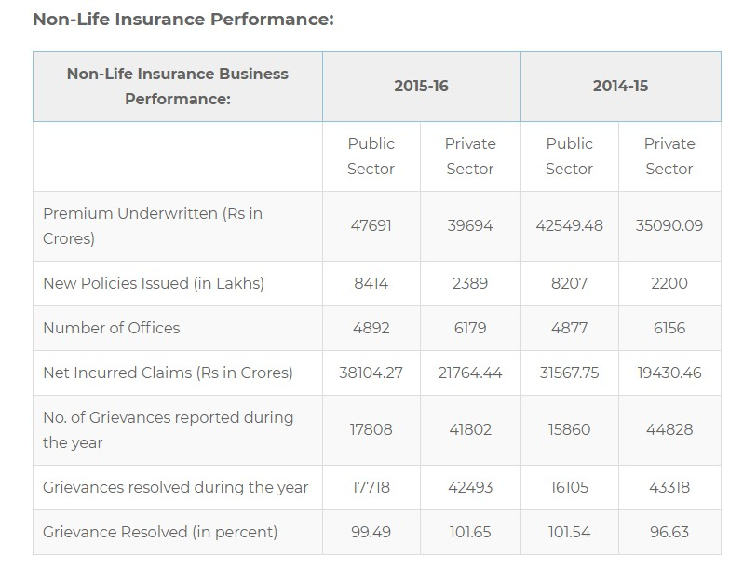

Slide 4
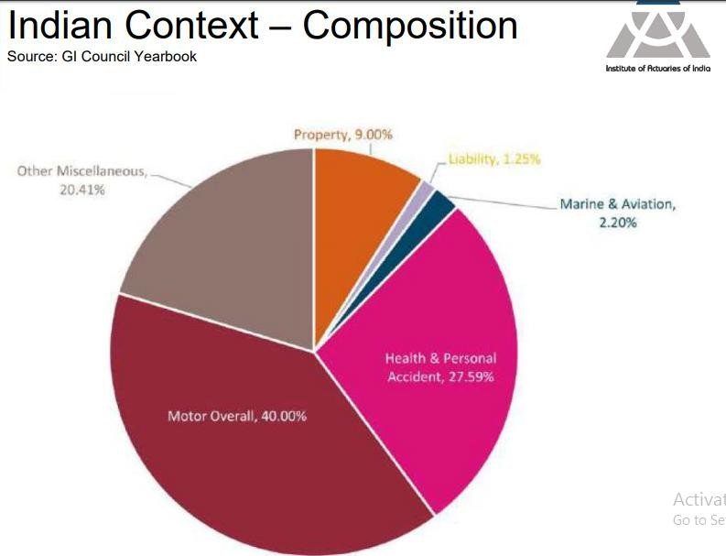

Slide 5
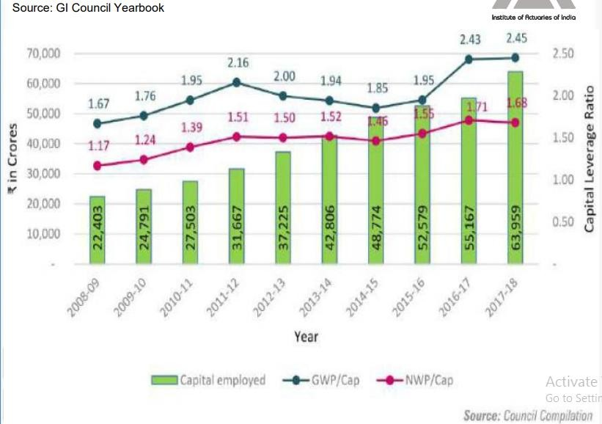
Capital Base

Slide 6
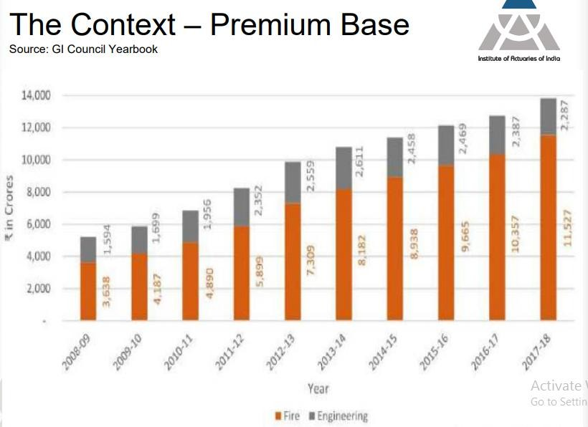

Slide 7
MOTOR INSURANCE
Motor insurance gives complete protection against physical damage or loss from natural and man-made calamities.
It broadly covers
Injuries/death to person or persons
Damage to property
Damage to the vehicle itself
Thefts of parts or the theft of the vehicle itself

Slide 8
Motor Vehicles
Commerc ial Vehicles
Private Vehicles
Passeng er carrying
Two- wheelers
Private cars
Goods carrying
Misc. vehicles
Motor trade

Slide 9
TYPES OF MOTOR INSURANCE
Own damage cover : This simply means cover against damages to your own car.
Third party liability cover : When the policyholder collides with the car of a third party leading to death or bodily injury to the third party, your liability to the third party is covered by the insurer.
It also covers damage to property of third party caused by policyholder’s car .
In case of absence of personal cover, damage to self can be also be added as an add-on in the
third party cover.
Damages to own car is not covered under third party cover.
Comprehensive policy : covers damage to your own vehicle and other people's property, as well
as theft and some other risks, plus legal costs. It is third party cover + own damage cover.
Insured Declared Value : Insured Declared Value is the maximum Sum Assured fixed by the insurer which is provided on theft or total loss of vehicle. Basically, IDV is the current market value of the vehicle

Slide 10
MOTOR INSURANCE – perils covered
Own Damage policy covers damage to own car due to either of following reasons :
By fire explosion self ignition or lightning
By burglary housebreaking or theft
By riot and strike
By earthquake (fire and shock damage)
By flood typhoon hurricane storm tempest inundation cyclone hailstorm frost
By accidental external means
By malicious act
By terrorist activity
Whilst in transit by road rail inland-waterway lift elevator or air
By landslide rockslide
Subject to a deduction for depreciation

Slide 11
UNDERWRITING
Underwriting is a critical process . It is necessary to avoid anti-selection.
The factors to consider are :
Age of the proposer
Sex
Marital status
Driving history of the proposer
Address of the proposer
Proposer’s history involving insurance in general
Ownership of or financial interest in the motor vehicle
Description of use and distance to be covered by the motor vehicle
Particulars of the motor vehicle

Slide 12
MOTOR INSURANCE ADD-ONS
Add-ons – extended coverage
Common add-ons:
Zero-depreciation / Bumper-to-Bumper cover / Nil-Depreciation – Depreciation not deducted from claim amount i.e. paid by the insurer in case of any claim
Engine protection cover – engine repair charges & replacement cost covered
Consumables cover - pays for the cost of consumables ,like engine oil, gear oil, nuts and bolts, lubricants and similar items except for fuel, required to be refilled or replaced because of the accident.
Return to invoice – original value of the car at time of purchase and registration charges & road tax at the time of purcase can be claimed in case of complete damage of car.

Slide 13
MOTOR INSURANCE ADD-ONS
No-claim Bonus (NCB) protection cover – Bonus, in the from of discount on premium, is given if no
claim is made during the policy year. It has variants and discount rates vary from insurer to insurer.
Roadside assistance – In case of damage while driving, mechanic will be arranged by the insurer. Towing charges if any will also be covered. A ride for you might also be arranged.
Other add-ons
Loss of personal belongings – cost of personal belongings lost in a car accident can be claimed.
Key replacement- It covers the cost of replacing the car keys. If you need to replace the lock, the add-
on pays for that as well.
You can buy motor insurance add on covers only with a Comprehensive policy and not with Third-party car insurance. The terms and conditions of add-on vary from one insurer to another.

Slide 14
MOTOR INSURANCE FRAUD
Since this policy requires to be renewed yearly, many frauds arise like
Case 1: Policy was in operation in 2017 but failed to renew in 2018. The car was involved in an accident in 2018 . Now, the policyholder who relapsed in an attempt to get money from the insurer claims that car accident happened in 2017 and claims the expenses.
Case 2: underwriting fraud
While getting the policy transferred from one insurer to another , the policyholder might try to withhold relevant information that can get him the policy at cheaper premium.
Case 3 : Death caused due to other reasons like critical-illness but claimed as death in motor
accident or road accident .
Reference to Haryana Scam that got unveiled in 2019.
https://www.hindustantimes.com/india-news/haryana-scam-cashes-in-on-the-terminally-ill/story- Nr5HHN4jsWC5gUwA6sqGMK.html

Slide 15
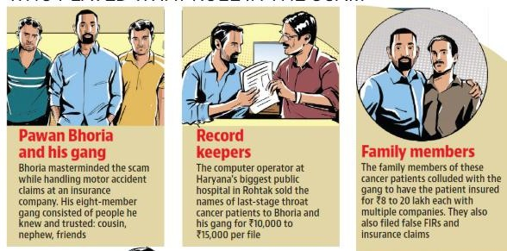
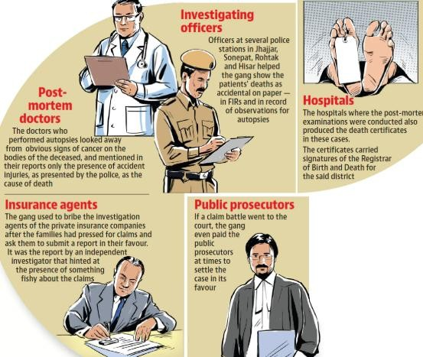
Haryana Insurance Scam

Slide 16
CLAIM SETTLEMENT PROCEDURE
Intimation by Insured for accidental loss to subject matter of Insurance
Registration of Claim by Insurer
Deputation of Surveyor / Investigator for assessment of liability of Insurer
Assessment and submission of Survey report by Surveyor
Scrutiny of Claim file
Letter to Insured regarding assessment of loss and to submit required information / papers.
Approval of Claim by the Competent Authority, after receiving the complete information /
papers
Settlement of Claim

Slide 17
CLAIM DOCUMENTS
Apart from claim form and Survey report the other documents required for processing the claim
are:
Driving Licence
Registration Certificate Book
Fitness Certificate (Commercial Vehicles)
Permit (Commercial Vehicles)
Police Report (Taxis, commercial Vehicle need F.I.R./ spot survey if loss is heavy or T.P. loss occurs)
Final Bill from repairers
Satisfaction Note from the insured
Receipted bill from the repairer, if paid by insured.
Discharge voucher (full and final payment)

Slide 18
Thank You!

