Slide 1

Class: MSc
Subject : Non-Life Insurance – Principles, Products and Practices
Chapter Name: Basic Terminology, Profitability and Reinsurance

Slide 2
Today’s Agenda
Introduction
Terminology in GI
What is an insurance product?
Why is there need for modernizing?
Five essential ingredients of product development
Factors
Profitability
Marketability
Competitiveness
Financing requirements
Risk characteristics
Onerousness of any guarantees
Sensitivity of profits
Extent of cross subsidies
Administration system
Consistency with other product
Regulatory requirement
Reinsurance
1. Terminology with Reinsurance
Profitability

Slide 3

Introduction
1
All insurance excluding life insurance falls under general insurance. Non-life insurance is a broad category,
including protection on both people and things. Non-life insurance is also called General Insurance.
We will now look at the various terms involved in the general insurance industry.
We will look into the concept of profitability, reinsurance and profitability after reinsurance.

Slide 4
Terminology in GI
1.1
Premium - Premium is an amount paid periodically to the insurer by the insured for covering his risk.
Insurance claim - A claim is a formal notice to an insurance company that you have suffered a loss that you
believe entitles you to compensation.
Items in Balance Sheet
GWP - Gross written Premium - Gross written premiums are the total revenue from a contract expected to
be receivedby an insurer before deductions for reinsurance or ceding commissions.
GIC: Gross Incurred Claim - Gross claims incurred comprise all payments made in respect of the financial
yearplus the provision for the claims but minus the provision for claims for the preceding financial year.

Slide 5
Terminology in GI
1.1
Expenses : incurred by the company like renewal, claim settlement expense, underwriting cost.
Expense ratio = ^{𝑬𝒙𝒑𝒆𝒏𝒔𝒆𝒔}
𝑮𝑾𝑷
Commission : agent’s commission
Commission ratio = ^{𝑪𝒐𝒎𝒎𝒊𝒔𝒔𝒊𝒐𝒏}
𝑮𝑾𝑷

Slide 6
Terminology in GI
1.1
Underwriting Profit - It consists of the earned premium remaining after losses have been paid and administrative expenses have been deducted. It does not include any investment income earned on held premiums.
Underwriting profit = GWP- GIC- Expenses- commission
Loss Ratio =
𝐺𝐼𝐶
𝐺𝑊𝑃
Combined Ratio : is a measure of profitability used by an insurance company to gauge how well it is
performing in its daily operations.
•
_{Combined Ratio =} 𝐺𝐼𝐶+𝑒𝑥𝑝𝑒𝑛𝑠𝑒𝑠+𝑐𝑜𝑚𝑚𝑖𝑠𝑠𝑖𝑜𝑛
𝐺𝑊𝑃
GWP is earned throughout the period.

Slide 7
What is an Insurance product?
2
Insurance Products means any product provided by an insurer or service contract provider in its insurance or warranty business whereby such insurer or service contract provider undertakes to pay or indemnify another as to loss from certain specified contingencies or perils called “risks” or to pay or grant a specified amount or determinable benefit in connection with ascertainable risk contingencies or to act as a surety.

Slide 8
Why is there need for modernizing?
2.1
At a time when exceptional client experience is pervasive throughout most other industries, customer-
centricity, speed, and flexibility are becoming necessities in insurance product development.
Many insurers are reconsidering outdated product-driven business models to meet customer
experience–driven market expectations.
With new risks emerging, and traditional coverage requiring updates to stay relevant in the evolving landscape, the need for more rapid product development transformation seems to be intensifying.
Insurers will likely be tasked with eliminating or minimizing friction throughout their business models,
processes, and infrastructure.
insurers should evolve toward creating a more seamless, customer-driven experience that incorporates
tailored options and services, which is already table stakes for most other industries.
https://www2.deloitte.com/us/en/insights/industry/financial-services/insurance-product-development-
capabilities-modernization.html

Slide 9
Five Essential Ingredients of Product Development
2.2
Understanding Client's requirements
Product Development Dynamics
Analyzing Costs and Benefits
Accumulating Reinsurance Support
Continuous Value Addition/ Technological Upgrades to the Product
https://www.linkedin.com/pulse/five-essential-ingredients-product-development-insurance-rizvi

Slide 10
Factors in Product Design
3
Financing requirement
Onerousness of any guarantees
Risk characteristics
Competitiveness
Extent of cross-subsidies
Sensitivity of profit
Consistency with other products
Regulatory requirements
Administration systems
Marketability
Profitability

Slide 11
Profitability
3.1
A company will want to ensure that the premiums charged for non-linked contracts will be sufficient to cover the benefits to be provided and the expenses in most foreseeable circumstances, and provide a profit margin.
At a general level, a life insurance product can be broken down into three components: savings, protection and administration.
For unit-linked contracts it will want to ensure that overall the charges will be sufficient to cover the
expenses to be incurred, and provide a profit margin.

Slide 12
Marketability
3.2
The benefits offered need to be attractive to the market in which the contract will be sold.
Innovative design features may make a contract more attractive as may the addition of options
and guarantees.
In the context of marketability, one would consider how understandable the product is.
The distribution channel involved will have a fundamental influence on what product is required, how it should be structured, and how it should be priced.

Slide 13
Competitiveness
3.3
The prime influence on competitiveness will be the level of the expense charges.
Competitive markets ensure lower profit margin, as earning lower profit will be better then earning
NO profits. (Focus on volumes)
In Low competitive markets, higher per policy margin is possible.

Slide 14
Financing requirement
3.4
This is a particularly important criterion for new insurance companies because of the small
amount of free assets that they have available to finance new business.
As a result, these new companies often sell just unit-linked products.
The actuary will use model office techniques to project the financial situation with and without the new product under sensible sales assumptions to assess the company’s ability to finance the product, and whether the return on capital is adequate.

Slide 15
Risk characteristics
3.5
The level of risk that may be acceptable will depend upon the company’s ability or willingness either to absorb risk internally or to reinsure or hedge it.
For a company entering a new market for that company (perhaps using a new distribution channel) the mortality parameter risk would still be relatively large.
If the company is faced with a large parameter risk it could do one or several of:
offer the contract in unit-linked and/or reviewable form to avoid a long-term rate guarantee
reinsure a large part of the risk
incorporate very ample margins in the premium rates
offer the contract as an additional “rider” benefit rather than stand-alone.
The ability to hedge investment risk will be an important consideration in the design of financial
guarantees.

Slide 16
Onerousness of any Guarantees
3.6
The company will need to consider the onerousness of any guarantees, for example the level of any guaranteed surrender values under a non -linked contract.
Offering guarantees results in two problems:
Possibly having to suffer a cost that you did not fully expect; and,
Probably (depending on the supervisory reserving regime) having to reserve for this
possibility from the outset – thereby increasing the capital strain of the product.

Slide 17
Sensitivity of Profit
3.7
Products are more likely to be sensitive to particular types of risk the more onerousness the guarantees
are.
The important variables that might impinge on profitability are:
investment return
mortality, or other contingency if relevant
expenses, including expense inflation
withdrawal rates.

Slide 18
Extent of Cross-subsidies
3.8
A company needs to decide on the extent of any cross-subsidies between, for example, large and small
contracts.
Ideally, even small policies should cover their own administrative cost and sales cost.
However, cross subsidies could be used at product level or SA level to compensate for smaller polices.

Slide 19
Administration system
3.9
The system requirements of a new product may limit either the benefits to be provided or the charging structure to be adopted.
The issue of compatibility with the administration system can also be extended to cover the aspect of simplicity: it is in the interests of the administration system, policyholders, agents / brokers and the company’s staff that the product be simple.
Thus any complications must be warranted by some significant advantage in terms of the factors
discussed.

Slide 20
Consistency with other product
3.10
The company may wish to ensure that the charging and benefit structures of a new policy are at least
similar to any existing business.
The key reason is that a major change will result in significant systems development, which will
take time.
There are benefits in terms of saving time and cost with such things as training administration and sales
staff, printing marketing literature and so on.

Slide 21
Regulatory requirement
3.11
A company must adhere to any regulatory requirements, Eg maximum (capped) charges, treating customers fairly.
These should be taken into account in product design.

Slide 22


What is Reinsurance?
4
What do you understand
by reinsurance?
Why is there a need of
reinsurance?

Slide 23
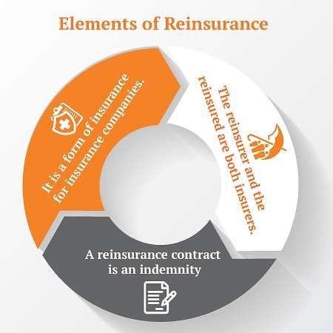
Reinsurance
4
Reinsurance is a form of insurance purchased by insurance companies in order to mitigate risk. With reinsurance, the company passes on some part of its own insurance liabilities to the other insurance company.
Insurers purchase reinsurance for four reasons: To limit liability on a specific risk, to stabilize loss experience, to protect themselves and the insured against catastrophes, and to increase their capacity

Slide 24
Terminology with Reinsurance
4.1
NWP: Net Written Premium - Net premiums written is the sum of premiums written by an insurance company over the course of a period of time, less premiums ceded to reinsurance companies, plus any reinsurance assumed.
Earned Premium - The premium collected by an insurance company for the portion of a policy that has expired. In other words, the earned premium is what the insured party has paid for a portion of time in which the insurance policy was in effect, but has since expired.
Net Earned Premium - means the Net Written Premiums recorded during the Experience Period, plus the unearned premium reserves at the beginning of the period, minus the unearned premium reserves at the end of the period.

Slide 25
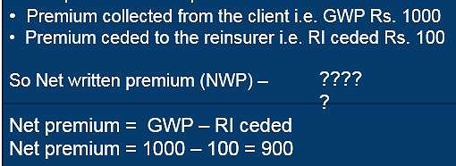
Terminology with Reinsurance
4.1
NWP: Net Written Premium - Net premiums written is the sum of premiums written by an insurance company over the course of a period of time, less premiums ceded to reinsurance companies, plus any reinsurance assumed.
Example

Slide 26
Profitability
5
Profit & Loss (P&L) statement indicates the profitability of an organization
Profitability states the surplus or deficit as generated by an entity by its various activities.
Surplus indicates the excess of gross inflow (income) over gross outflow (expenses) & deficit indicates vice versa.
Main purpose of P&L:
Monitor & measure the profits of a unit
Help to understand the functioning & business performance
Understand the impact on product profitability, vertical or channel profitability
Decision making & implementation

Slide 27








Operating cycle of non-life industry
5.1
Income spread over policy period to cover claims
Earnings
for the period
Reinsurance support with GIC, Swiss re, Scor etc
Payments made to clients for Fire, Marine, Motor, Health etc
Claims net
of reinsurance
Reinsurance
U/W result
Total expenses
Brokers, Agents, Online,
Direct sales etc
Underwriting
(GWP)
Net
Commissions
Comm. paid to channels for procuring business less comm. received on reinsurance cededv
Operating
expenses
Expenses of employees,
Infra, Sales & Marketing etc

Slide 28
GWP – Sharing (Example)
5.2
Client has paid Rs 1000 as premium for risk & following mandate is provided for sharing the risk by the client.
Scenario 1
100% mandate with
XYZ Insurance.
Scenario 2
XYZ Insurance as leader with 70% share & Oriental as 30% share as follower.
Scenario 3
XYZ Insurance as follower with 30% share & Oriental as 70% share as leader.
Ans. :- Rs. 1000
premium will be part
of XYZ Insurance GWP
Ans. :- Rs. 700 premium will be part of XYZ Insurance GWP & rest will be part of oriental.
Ans. :- Rs. 300 premium will be part of XYZ Insurance GWP & rest will be part of oriental.

Slide 29
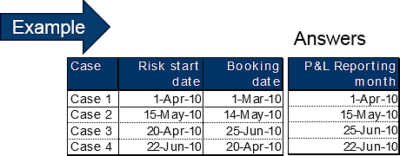
5.2
GWP
Premium is accounted on the basis of risk start date & policy / endorsement booking date whichever is later.

Slide 30
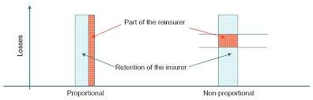
Premium Ceded
5.3
Reinsurance premium ceded (RI ceded) represents portion of the gross written premium payable to reinsurance entities based on “reinsurance arrangements”. Reinsurance arrangement helps an insurance company to spread risk & expand capacity.
Proportional ceding – indicates premium & claims shared in same ratio between insurance company & reinsurance company as per the arrangements
Non proportional ceding - indicates where the claims is shared in excess of specified amount by reinsurance company

Slide 31
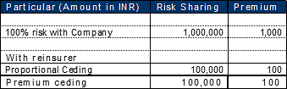
Premium Ceded - Example
5.3
Example - Premium received from client – INR 1000 for Sum insured INR 1,000,000
Reinsurance arrangement
Proportional treaty – GIC Quota Share arrangement - 10% of risk

Slide 32
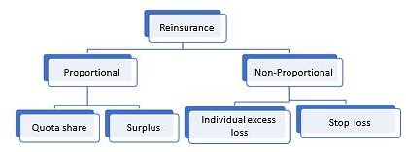
Reinsurance – In depth

Slide 33
Reinsurance – In depth
Proportional Reinsurance : the direct writer (original insurance company) & the reinsurer share the cost of all claims . This is of two types –
1. Quota share reinsurance – Reinsurer and writer share all premiums and losses according to a fixed
percentage.
For example, Bajaj Allianz enters into a reinsurance contract with Munich Re with retained proportion of 80%. This means Bajaj Allianz pays 80% of the claim amount and gets to keep 80% of the premium received. Munich Re has to pay 20% of the claim amount and receives 20% of the premium.
Retained Proportion denotes by α. Let X be the gross claim amount, Y be the net claim amount paid by the
insurer and Z be the claim amount paid by the reinsurer. Y = α X and Z= (1- α) X

Slide 34
Reinsurance – In depth
2. Surplus share reinsurance: A surplus share treaty is a reinsurance treaty in which the ceding insurer retains a fixed amount of policy liability and the reinsurer takes responsibility for what remains. Surplus share treaties are considered pro-rata treaties and are most commonly used with property insurance.
For example: HDFC Ergo forms a surplus share reinsurance contract with Swiss Re and underwrites policies with a coverage of Rs 50,00,000 with retention of Rs 20,00,000 . The remaining 30,00,000 are ceded to reinsurer.

Slide 35
Reinsurance – In depth
Non-Proportional Reinsurance : Under a non-proportional reinsurance arrangement, the direct writer pays a fixed premium to the reinsurer. The reinsurer will only be required to make payments where part of the claim amount falls in a particular reinsurance layer.
1. Individual excess loss : reinsurer makes a payment when the claim amount for an individual claim
exceeds a specified excess point or retention.
For example: Apollo enters into a reinsurance treaty with Swiss Re and reinsurance layer is fixed at 50 lac to 1 crore.
Y = X | ; X < 50 lac | Z= X – 50 lac | ; 50 lac < X < 1 crore
Y = 50 lac | ; 50 lac < X < 1 Crore | Z = 50 lac | ; X > 1 crore
Y = X – 50 Lac | ; X > 1 crore

Slide 36
Reinsurance – In depth
2. Stop Loss Reinsurance : The reinsurer is liable for the insured's losses incurred over a certain period that exceed a specified amount or percentage of some business measure, such as earned premiums written, up to the policy limit. Under this kind of policy, the direct writer (insurance company) agrees to carry the full burden of the loss up to a limit, L and claim amount exceeding L is paid by the reinsurer.
For example : Acko enters into a reinsurance contract with Munich Re and the contract indicates that the insurance company , Acko is responsible for losses up to $500,000, but that the reinsurance company, Munich Re is responsible for anything above that limit.
Y = X ; X < L Z = X - L ; X > L
Y = L ; X > L

Slide 37
Understand the following Terminology
Start date - the date the policy is activated.
End date - the date at which the policy term ends.
Accident year - A policy year is based on policies with effective dates in a twelve month period. So, policy year 2019 data are those policies with effective dates between 1/1/19 and 12/31/19.
Financial year - Accident year data is based on accidents that occur within a twelve month period. Thus, accident year 2019 is based on those accidents that occurred between 1/1/19 and 12/31/19.
Reporting year : The year in which claim incurred before is reported to the insurance company.
Net claims incurred : The amount of claims incurred during an accounting period
after deducting reinsurance recoveries.
Claims Reported : Claims reported to the company.

Slide 38
Understand the following Terminology
Incurred But Not Reported (IBNR) is a type of reserve account used in the insurance industry as the provision for claims and/or events that have transpired, but have not yet been reported to an insurance company.
Incurred Loss Ratio - The percentage of losses incurred to premiums earned.
Reinstatement Clause - When the amount of reinsurance coverage provided under a treaty is reduced by the payment of a reinsurance loss as the result of one catastrophe, the reinsurance cover is automatically reinstated usually by the payment of a reinstatement premium.
Reinstatement Premium - A pro rata reinsurance premium is charged for the reinstatement of the amount of reinsurance coverage that was reduced as the result of a reinsurance loss payment under a catastrophe cover

Slide 39
Unexpired Risk Reserve
5.4
Unexpired risk reserve (URR) is the net written premium attributable to succeeding accounting period for
unexpired portion of the risk.
Basis
Over the contract period ( 1/365 days basis or 1/12 basis)
Period of risk (where risk pattern is not uniformly spread between over the contract period)
It is bifurcated under 3 head in P&L
URR charge
Previous year release
Current year release

Slide 40
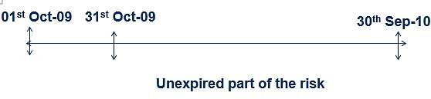
URR – Case study
5.4
GWP = Rs 1,400
RI Ceded = Rs 200 NWP = Rs 1,200
Policy Period = Oct 01, 2009 to Sep 30, 2010
Case 1 :- at the end of the date
One date is expired so
URR Charge = NWP * Unexpired period / Policy period So, URR Charge = 1,200 * 11 / 12 = 1,100
The charge as created above will be reserve as future income which will be converted to URR release as
income over the policy period.
In above example every date Rs 100 will be released as URR Release over next 11 dates

Slide 41
Net earned Premium
5.5
Net earned premium (NEP) indicates the difference between the written premium & unexpired portion of the
risk
Earned premium = Net premium - URR

Slide 42
Reinsurance Commission
5.6
Reinsurance commission (RI Comm.) reinsurance company compensates some portion of acquisition cost & administrative expenses as incurred by insurance company. The compensation as paid by the reinsurance company is called reinsurance commission.
Example
Premium ceded to the reinsurer i.e. RI ceded Rs. 100
Reinsurer is paying 10% as RI commission as reinsurance premium ceded So RI commission (RI Comm.) = ?
RI commission = RI ceded * Commission rate RI commission = 100 * 10% = 10

Slide 43
Acquisition Cost
5.7
Acquisition cost / Commission paid indicate the cost paid to various channel as a percentage to premium for
acquiring the business.
Example
Premium collected from the client i.e. GWP Rs. 1000
Lets assume that business is sourced through agents & Acquisition cost is 10%
Acquisition cost - ?
Acquisition cost = GWP * Acquisition cost Acquisition cost = 1000 * 10% = 100

Slide 44
Claims
5.8
Claims - is the demand made by insured under the policy issued by the company in the event of loss. It
comprises the following:
Claims incurred
Claims paid – These are the claims paid to the client for the period for which p&l statement is drawn
Claims settlement cost – Insurance company may appoint surveyor, to assess the loss as reported by the client. The cost/ fees paid to surveyor or lawyer is called claims settlement cost. It is also included as part of claims part if settled to the client for P&L statement period.
Salvage - In insurance circles, this term commonly refers to the scrap value of damaged property. In
property insurance, salvage value.

Slide 45
Claims
5.8
P&L statement is prepared for a given period. Sometime it is possible that claims reported may not get paid to the client / insured. In such a situation insurance company creates the reserve as claims reserve or provision for claims settlement cost , any increase or decrease in the reserve for the period for which P&L statement is drawn is reported as provision for reserve or provision for claims settlement cost.
Claims incurred but not reported (IBNR) & incurred but not enough reported (IBNER) provision. It is
estimated by actuary.
Gross claims incurred = Summation of Claims paid + Survey fees paid + reserve + IBNR – Salvage is called Gross claims incurred.
Net claims incurred = Net claims incurred is arrived after deducting the claims recovery from reinsurer under various proportional as well as non proportional arrangement. It indicates the loss retained by the company

Slide 46
Underwriting Result & Profit
5.9
Underwriting result (U/w result) indicates the surplus / deficit from the insurance business without
considering the investment income
U/w result = Earned premium – Claims – Cost of acquisition + Reinsurance commission - operating expenses
Profit
Profit before tax (PBT) = Underwriting result + Investment income
Profit after tax (PAT) = PBT – Tax %

Slide 47
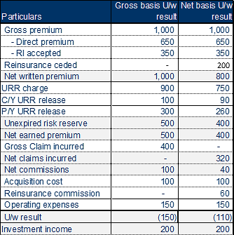
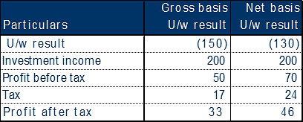
Underwriting Result & Profit - Example
5.9

Slide 48
Combined Ratio
5.10
Combined ratio - indicates the profitability of an insurance company from its insurance business. It does not include the impact of investment income impact. Following is the formula for the calculation of the combined ratio.
Combined ratio = Loss ratio +net commission ratio + expense ratio
A value greater than 100% means the company is paying out more than what it is taking in and a value less
than 100% means it is taking more than it is paying out.

Slide 49
Loss Ratio
5.11
Loss ratio - The percentage of losses (claims) incurred to premium earned during the period. It is indicator of
as insurer’s underwriting discipline and skill at mitigating risk
Loss ratio = Incurred losses / Earned premium
Example: Calculate the loss ratio ??
Par t i cu l ar s | Net b asi s U/w r esu l t
Gr o ss p r em i u m | 1 ,0 0 0
Reinsurance ceded | 200
Net w r i t t en p r em i u m | 800
Unexpired risk reserve | 400
Net ear n ed p r em i u m | 400
Gross Claim incurred | -
Net claims incurred | 300
Net commissions | 60
Acquisition cost | 100
Reinsurance commission | 40
Operating expenses | 150
U/w r esu l t | (1 1 0 )

Slide 50
Loss Ratio
5.11
Loss ratio = 75.00%
What does it indicate ????
Interpretation
Net basis - It indicate that company is paying back 75% of earned premium meet the net acquisition cost & other operating expenses.
to its client & only 25% is left to

Slide 51
Net Commission Ratio
5.12
Net commission ratio – represent the cost of obtaining the insurance business. It includes the intermediaries'
commission net of reinsurance commission other related expenses which relates to acquisition of business
Net commission ratio = (Acquisition cost – RI commission ) / NWP
Example: Calculate the net commission ratio?
Par t i cu l ar s | Net b asi s U/w r esu l t
Gr o ss p r em i u m | 1 ,0 0 0
Reinsurance ceded | 200
Net w r i t t en p r em i u m | 800
Unexpired risk reserve | 400
Net ear n ed p r em i u m | 400
Gross Claim incurred | -
Net claims incurred | 300
Net commissions | 60
Acquisition cost | 100
Reinsurance commission | 40
Operating expenses | 150
U/w r esu l t | (1 1 0 )

Slide 52
Net Commission Ratio
5.12
Net commission ratio = 7.50%
What does it indicate ???? Interpretation
Net basis - It indicate that company is incurring the Rs 7.5 of every Rs 100 retained premium as net cost to
acquire the business. Higher reinsurance commission indicates efficiency in ratio.

Slide 53
Expense Ratio
5.13
Expense ratio – It is calculated as underwriting expenses divided by net written premiums, the expense
ratio measures an insurer's efficiency
Operating exp ratio = Operating expenses / NWP
Example: Calculate the expense ratio ??
Par t icular s | Net basis U/w r esult
Gr oss pr em ium | 1 ,000
Reinsurance ceded | 200
Net w r i t t en pr em ium | 800
Unexpired risk reserve | 400
Net ear ned pr em ium | 400
Gross Claim incurred | -
Net claims incurred | 300
Net commissions | 60
Acquisition cost | 100
Reinsurance commission | 40
Operating expenses | 150
U/w r esult | (110 )

Slide 54
Expense Ratio
5.13
Expense ratio = 18.75%
What does it indicate ???? Interpretation
Net basis - It indicate that company is spending the Rs 18.75 of every Rs 100 of written premium. Lower the
ratio higher the efficiency. Some company has low expense ratio due to economies of scale.

Slide 55
Combined ratio vs U/w result
Particulars in Rs. | Policy inception | Month 2 | Month 3 to 12 | Policy end
Premium | 120 | - | - | 120
NEP | 10 | 10 | 100 | 120
Claims (60% ) | (6) | (6) | (60) | (72)
Commissions | (18) | 0 | 0 | (18)
Operating expenses | (24) | 0 | 0 | (24)
U/w result | (38) | 4.00 | 40.00 | 6
Combined ratio | 95% |  |  | 95%
Combined ratio of 95% with negative underwriting at policy inception will result in underwriting surplus of Rs. 5 with 95% combined ratio at the end of policy

