Slide 1

Lecture
Class: FY BSc
Subject : Non-Life Insurance – Products, Principles and Practice
Subject Code: PUSASQF2.5
Chapter: Chapter 9
Chapter Name: Other General Insurance

Slide 2
Topics to be covered
Fire insurance
Engineering
Aviation
Marine Cargo/Hull
Liability

Slide 3
Today’s Agenda
What is Fire Insurance?
What is covered?
What is not covered?
Add on covers
Types of Fire Insurance policies
Premium calculation
What is Engineering Insurance?
What is covered?
What is not covered?
Add on covers
Types of Engineering Insurance policies
Who should buy?
Claim settlement Process
3. What is Aviation Insurance?
What is covered?
What is not covered?
Types of Aviation Insurance
Policy claim process
4. What is Marine Insurance?
What is covered?
What is not covered?
Types of Marine Insurance
Types of Marine Insurance policies
Claim process

Slide 4
Today’s Agenda
5. What is Liability Insurance?
What is covered?
What is not covered?
Types of Liability Insurance policies
Claim Process

Slide 5

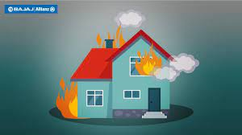
What is Fire Insurance?
1
A fire insurance policy involves an insurance company agreeing to pay a certain amount equivalent to the estimated loss caused by fire to the insured, within the time specified in the contract.
The policy pays the policyholder back on either a replacement-cost basis or an actual cash value basis for damages.

Slide 6

What is covered ?
1.1
Lightning
Explosion/implosion
Aircraft damage
Riot, Strike
Terrorism
Storm, flood , inundation
impact damage
Subsidence and landslide
Bushfire
https://securenow.in/insuropedia/what-is-covered-under-a-fire-insurance-policy/

Slide 7
What is not covered ?
1.2
Loss, destruction, or damage caused by war, and kindred perils.
Loss, destruction, or damage directly or indirectly caused to the insured property by nuclear peril.
Loss, destruction, or damage caused to the insured property by pollution or contamination.
Loss of earnings, loss by delay, loss of market or other consequential or indirect loss or damage of any kind or disruption whatsoever.
Earthquake Volcanic eruption: Earth Quake can be covered under the fire policy but by paying additional premium,
Loss or damage by spoilage resulting from the retardation or interruption or cessation of any process or operation caused by operation of any of the perils covered.
Loss by theft during or after the occurrence of any insured peril except as provided under Riot, Strike, Malicious and Terrorism Damage cover.
Loss or damage to property insured if removed to any building or place other than in which it is herein stated to be insured, except machinery and equipment temporarily removed for repairs, cleaning, renovation, or other similar purposes for a period not exceeding 60 days

Slide 8
Add on covers:
1.3
Combustion (by Fire Only)
Earthquake (Fire and Shock)
Forest Fire
Impact damage due to Insured’s Own Vehicle and the articles dropped from them.
Deterioration of Stocks in Cold Storage premises due to accidental power failure consequent to damage at the premises of Power Station due to an insured Peril. (Applicable only when stock is covered)
Deterioration of Stocks in Cold Storage premises due change in temperature arising out of loss or damage to the cold storage machinery (ies)in the Insured’s premises due to operation of an insured Peril. (Applicable only when stock is covered)
Architects etc. fees (more than 3%), Debris Removal (more than 1%)
Spoilage Material Damage Cover (applicable to stock and machinery containers only)
Leakage and Contamination Cover
Temporary Removal of Stocks Clause

Slide 9
Types of Fire Insurance policies
1.4
Valued Policy - The value of the insured property is pre-determined at the inception of the policy. In case of loss suffered by the insured, a fixed compensation amount is paid by the insurer irrespective of the actual amount of financial loss suffered by the insured. The claim amount may be less or greater than the market value of the property and will not include renovations made in the property
Valuable Policy - The value of the insured property is determined at the time of loss and claim is paid depending on the market value of the property at the time of damage.
Specific Policy - In this policy, a specific policy coverage amount is mentioned which is not the market value of the property and is for a specific period of time for a particular property. The compensation paid will not exceed the policy coverage value.
Floating Policy - In this type, a single policy covers two or more properties present at different locations for an insured. A single premium is paid by the insured, providing him convenience against buying multiple policies.

Slide 10
Types of Fire Insurance policies
1.4
5. Average Policy - It is that policy in which the Insured doesn’t take insurance policy which covers the total value of the property. The loss is shared by both the insured and the Insurance Company in pre decided proportion. For example, Rama took an Insurance policy of 7, 00,000 for her house which value is 4 00,000. In case of a fire, her house is 50 percent damaged, and then she will receive compensation of 3, 50,000 from the Insurance Company which is 50 percent of her Insurance coverage value.
6. Adjustable Policy - There may be change in the value of stocks; hence it becomes difficult for the insured to determine what coverage amount of insurance policy should be purchased. In this case Adjustable policy is taken where insurance amount and premium is calculated on the existing value of the stock initially and the later is adjusted depending on the change in value of the stock which is regularly provided by the insured. The premium changes on a pro rata basis.
7. Reinstatement Policy -Here, the Insurance Company replaces or reinstates the insured property in case of damage of fire instead of providing monetary compensation.

Slide 11
Types of Fire Insurance policies
1.4
Declaration Policy - The Insured takes insurance policy for the maximum value of the stock and regularly (particular date of the month) declares to the Insurance Company the change in value of the stock. The insured pays 75 percent of the premium before in advance and remaining depends on the premium so calculated after one year on average of the value declared by the insured in that year
Excess Policy -This policy is for those people, whose stock value keeps on fluctuating. In this scenario, insured purchases two policies:- First loss policy (for the minimum stock value) and Excess Policy (for the excess value of the stock.) The minimum value for the stock is calculated on the past experience and excess value of the stock is informed by the insured to the insurer every month. The premium is not high in this case.
Comprehensive Policy - It is that one which Insured gets coverage from not only loss by the fire but also from theft, war, riot, strike and etc. The premium charged for such a policy is very high but it provides security to insured against many risks.

Slide 12

Types of Fire Insurance policies
1.4
11. Consequential loss Policy - It covers the consequential loss as well loss by fire, suffered by the insured. As discussed in comprehensive scope, consequential loss is loss suffered by the insured in terms of loss in profit, salary, inflation incidental to the occurrence of the fire.

Slide 13
Premium calculation
1.5
Factors that impact the indemnity principle of fire insurance:
1. Market Value of the subject:
For expensive items such as jewelry, imports, exports, electronics, chemicals etc., the valuation of the subject is higher at all times. Under such circumstances, the fire insurance needs to offer a higher coverage or indemnity limit, and thus, a higher premium is needed from the consumer.
2. Depreciation value:
In most cases, once an item is bought, its value starts depreciating. Across the various kinds of fire insurances, depreciating market valuation of goods plays a huge role in deciding what will be the coverage amount.
3. Risk involved:
Certain goods are more prone to catching fire, such as alcohol and combustible chemicals. The maintenance of these goods requires a non-volatile surrounding, thus making them highly sensitive to fire related hazards. This also leads to a hike in their premiums for the right protection against fire.

Slide 14
Premium of Fire Insurance
1.5
4. Pre-determined value: In some cases, irrespective of all the above factors, the insurer fixes an indemnity amount, beyond which the losses aren’t reimbursed or compensated. In such cases, the insurance company makes it clear from the beginning that they shall not be liable to reimburse for losses beyond indemnity.
These are some of the most important factors that play a role in determining the premium to be paid for any fire insurance policy; however, factors such as the legal liabilities of the owners, manufacturing costs, the kind of organization, and the location among others, also play a role in premium calculation.

Slide 15

What is Engineering Insurance?
2
Engineering insurance refers to the insurance that provides economic safeguard to the risks faced by the ongoing construction project, installation project, and machines and equipment in project operation.
Engineering Insurance caters to the varying forms of uncertainties affiliated with on-site construction, including machinery and plant usage.

Slide 16
What is covered?
2.1
Fire, lightning, explosion, aircraft damage
Riot, strike, malicious acts
Flood, inundation, storm, cyclone and allied perils
Landslide, subsidence and rockslide
Burglary and theft
Faults in erection
Human errors, negligence
Short circuiting, arcing, excess voltage
Electrical and mechanical breakdown
Collapse, damage due to foreign objects, impact damages
Any other sudden, unforeseen, accidental damages not explicitly excluded

Slide 17
What is not covered?
2.2
War Invasion
Nuclear Reaction Nuclear Radiation or Radioactive Contamination
Insured's Contribution - Deductible
Willful Act or Willful Negligence of the Insured
Cessation of Work
Defective Material or Bad workmanship
Wear Tear Corrosion Oxidation Deterioration
Breakage of Glass
Disappearance or Shortage (Inventory Losses)
Design Defects
Loss of files, drawings, cash, cheque etc,.
Consequential Loss
Terrorism

Slide 18
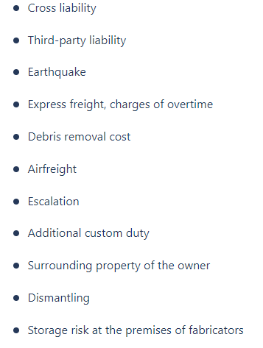

Add – on covers
2.3

Slide 19
Types of Engineering Insurance policy
2.4
1. Plant All Risk Insurance
This insurance policy is streamlined to cater to loss and unforeseen damages of operational tools.
Construction equipment and operational machinery are susceptible to wear and tear due to their exposure to extreme environmental conditions.
2. Machine Breakdown Policy
The Machine Breakdown Policy provides cover losses for sudden or unexpected damage of equipment – especially while they’re still in use. Both internal and external damages are covered in the Machine Breakdown Policy. Some of these internal damages could include lubrication defects, electrical damage, overheating, and the like.
3. Electronic Equipment Policy
This policy covers systems and devices that attract low voltage and power. Therefore, the insurer will be responsible for the cost of replacement or repairs necessary to reinstate the former state of electronic equipment and devices.

Slide 20

Types of Engineering Insurance policy
2.4
4. Contractor’s All Risk Cover
It covers contractors and provides financial protection against damage or loss incurred during construction projects. The Contractor’s All Risk Cover provides cover against loss or damage to plants and equipment. This policy resonates with our reference to on-site construction uncertainties. It is peculiar to civil engineering projects like buildings, flyovers, airports, and the like.
5. Erection All Risk
This policy offers comprehensive cover by covering risks which may arise during erection or testing period. It gives financial protection to the engineering contracts in the event of any accident. The Erection All Risk policy is for erection and testing of Manufacturing units or individual machineries.

Slide 21

Who should buy?
2.5
General contractors
Subcontractors
Consulting engineers
Architects
Those funding construction projects
Suppliers and manufacturers of machinery

Slide 22
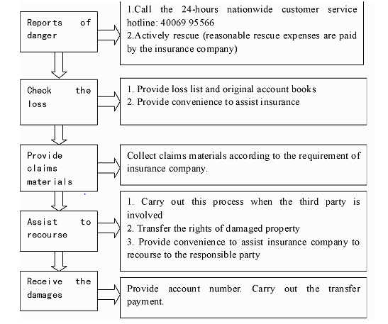
Claim settlement process
2.6

Slide 23

What is Aviation Insurance?
3
Aviation insurance is insurance coverage geared specifically to the operation of aircraft and the risks involved in aviation.
Aviation insurance provides coverage for hull losses as well as liability for passenger injuries, environmental and third-party damage caused by aircraft accidents.

Slide 24

What is covered?
3.1
1. In-flight coverage
This provides coverage against damages that can happen to the aircraft while it is mid-air (in motion).
2. Hull all risk
This coverage is ideal for flying clubs which operate small planes, private jets belonging to celebrities/politicians/business tycoons, aircrafts used for agricultural praying, etc. The policy covers any physical loss/damage faced by the insured plane. It also protects the plane against total loss and disappearance.
3. Hull/Spares War Risk
Protection is provided to the insured plane and its spares in case of loss or damage resulted by anti-social activities like war, invasion, riots, hostilities, martial law, strikes, civil commotion, malicious activities and sabotage.

Slide 25
What is covered?
3.1
4. Loss of License
It is a mandate for every aircraft crew member to hold a valid license. A license can be suspended on medical grounds leading to a financial loss for the crew member. This cover takes care of the financial loss incurred. The crew member can get the coverage in case of permanent total disablement or temporary total disablement due to bodily injury or illness.
5. Spares All Risk Insurance Policy
If any loss/damage is incurred to the spares, tools, equipment and supplies of the insured aircraft or any damages caused to a property by the aircraft, it is covered.
6. Aviation Personal Accident (crew member)
This is usually granted annually and protects the insured crew member against injury, disablement or death as a result of an aircraft accident/mishap.

Slide 26
What is not covered?
3.2
Coverage is not provided if the insured aircraft is operated without a proper airworthiness certificate or is operated outside of parameters set by regulations.
If the aircraft is operated by a pilot who is unlicensed or not licensed to operate the particular type of aircraft or by a pilot whose medical clearance has not been properly maintained.
If an aircraft is operated in violation of a regulation
Operation of an aircraft in violation of safety or other regulatory requirements may not be a basis for denial of coverage required under regulations issued by the Secretary of Transportation pursuant to the statute
https://www.hansonmolloy-law.com/insurance-law/exclusions-in-aviation-insurance/

Slide 27
Types of Aviation Insurance
3.3
1. Public liability insurance
This coverage, often referred to as third party liability covers aircraft owners for damage that their aircraft does to third party property, such as houses, cars, crops, airport facilities and other aircraft struck in a collision. It does not provide coverage for damage to the insured aircraft itself or coverage for passengers injured on the insured aircraft.
2. Passenger liability insurance
Passenger liability protects passengers riding in the accident aircraft who are injured or killed. In many countries this coverage is mandatory only for commercial or large aircraft. Coverage is often sold on a "per-seat" basis, with a specified limit for each passenger seat.
3. Combined Single Limit (CSL)
CSL coverage combines public liability and passenger liability coverage into a single coverage with a single overall limit per accident. This type of coverage provides more flexibility in paying claims for liability, especially if passengers are injured, but little damage is done to third party property on the ground.

Slide 28
Types of Aviation Insurance
3.3
4. Ground risk hull insurance not in motion
This provides coverage for the insured aircraft against damage when it is on the ground and not in motion. This would provide protection for the aircraft for such events as fire, theft, vandalism, flood, mudslides, animal damage, wind or hailstorms, hangar collapse or for uninsured vehicles or aircraft striking the aircraft. The amount of coverage may be a blue book value or an agreed value that was set when the policy was purchased.
5. Ground risk hull insurance in motion (taxiing)
This coverage is similar to ground risk hull insurance not in motion, but provides coverage while the aircraft is taxiing, but not while taking off or landing. Normally, coverage ceases at the start of the take-off roll and is in force only once the aircraft has completed its subsequent landing.

Slide 29

Types of Aviation Insurance
3.3
6. In-flight insurance
In-flight coverage protects an insured aircraft against damage during all phases of flight and ground operation, including while parked or stored. Naturally, it is more expensive than not-in-motion coverage, since most aircraft are damaged while in motion.

Slide 30
Policy Claim Process:
3.4
The claim process for aviation insurance is quick and hassle free. You need to provide the following valid documents –
Aircraft details document
Flight details document
Details of the crew members
Documented proof of the accident
Information on aircraft’s maintenance and engineering
Documents of operational manual passenger

Slide 31
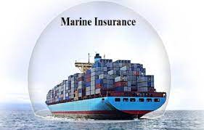
What is Marine Insurance?
4
Marine Insurance is a contract whereby the insurer undertakes to indemnify the assured, in manner and to the extent thereby agreed, against marine losses, i.e. the losses incident to marine adventure. It covers the loss or damage of ships, cargo, terminals, and any transport by which the property is transferred, acquired, or held between the points of origin and the final destination.

Slide 32
Types of cover
4.1
1. Hull
It covers physical damage to vessels including machinery and fuel but not their cargo. Hull insurance is an insurance policy especially designed for covering ship damage expenses where the 'Hull' refers to the main body of the ship. Hull insurance can be understood like a car insurance, with a difference of being for a water faring vehicle instead of land.
2. Cargo
It covers physical damage or loss of goods while in transit Cargo Insurance provides coverage against all risks of physical loss or damage to freight during the shipment from any external cause during shipping, whether by land, sea or air.

Slide 33
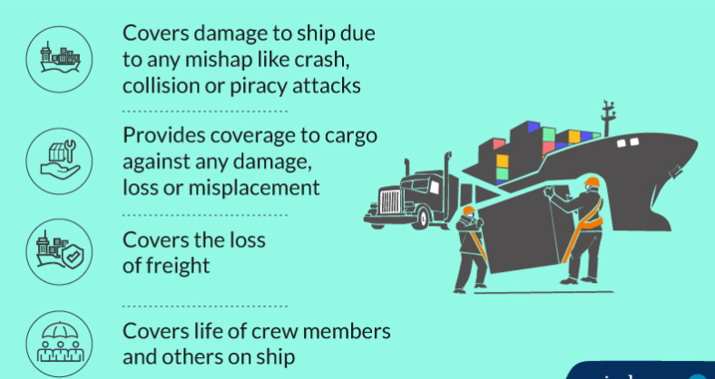
What is covered?
4.1
Total loss coverage
Sinking, stranding, fire, explosion
Loss in loading or unloading cargo
Earthquake or lightning
Unforeseeable administrative expenses
Jettison or washing overboard
Collision, overturning, derailment, accident
Natural calamities
General average

Slide 34
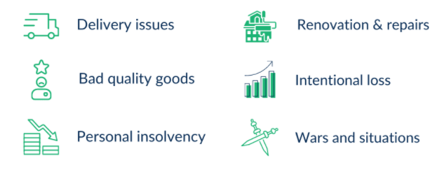
What is not covered?
4.2

Slide 35

What is not covered?
4.2
Willful, planned or intentional misconduct
Strike, rioting, war
Poor packaging quality of the cargo
General leakage or wear and tear of the cargo
Financial distress or insolvency of the shipping line
Removal of wreck

Slide 36
Types of Marine Insurance
4.3
1. Freight Insurance
In freight insurance, for example, if the goods are damaged in transit, the operator would lose freight receivables & so the insurance will be provided on compensation for loss of freight.
2. Liability Insurance
Marine Liability insurance is where compensation is bought to provide any liability occurring on account of a ship crashing or colliding.
3. Hull Insurance
Hull Insurance covers the hull & torso of the transportation vehicle. It covers the transportation against damages and accidents.
4. Marine Cargo Insurance
Marine cargo policy refers to the insurance of goods dispatched from the country of origin to the country of destination.

Slide 37
Types of Marine Insurance policies
4.4
Voyage Policy: A voyage policy is that kind of marine insurance policy which is valid for a particular voyage.
Time Policy: A marine insurance policy which is valid for a specified time period – generally valid for a year – is classified as a time policy.
Mixed Policy: A marine insurance policy which offers a client the benefit of both time and voyage policy is recognized as a mixed policy.
Open (or) Unvalued Policy: In this type of marine insurance policy, the value of the cargo and consignment is not put down in the policy beforehand. Therefore reimbursement is done only after the loss of the cargo and consignment is inspected and valued.
Valued Policy: A valued marine insurance policy is the opposite of an open marine insurance policy. In this type of policy, the value of the cargo and consignment is ascertained and is mentioned in the policy document beforehand thus making clear about the value of the reimbursements in case of any loss to the cargo and consignment.

Slide 38
Types of Marine Insurance policies
4.4
6. Port Risk Policy: This kind of marine insurance policy is taken out in order to ensure the safety of the ship while it is stationed in a port.
7. Wager Policy: A wager policy is one where there are no fixed terms for reimbursements mentioned. If the insurance company finds the damages worth the claim then the reimbursements are provided, else there is no compensation offered. Also, it has to be noted that a wager policy is not a written insurance policy and as such is not valid in a court of law.
Floating Policy: A marine insurance policy where only the amount of claim is specified and all other details are omitted till the time the ship embarks on its journey, is known as a floating policy. For clients who undertake frequent trips of cargo transportation through waters, this is the most ideal and feasible marine insurance policy.
Single Vessel Policy: This policy is suitable for small ship owner having only one ship or having one ship in different fleets. It covers the risk of one vessel of the insured.

Slide 39

Types of Marine Insurance policies
4.4
10. Fleet Policy: In this policy, several ships belonging to one owner are insured under the same policy.
11. Block Policy: This policy also comes under maritime insurance to protects the cargo owner against damage or loss of cargo in all modes of transport through which his/her cargo is carried i.e. covering all the risks of rail, road, and sea transport

Slide 40
Claim Process
4.5
After purchasing the marine insurance, in case there arises a situation when you need to make a claim under the policy, you can follow the below mentioned steps:
In case of loss or damage to the cargo or the ship, you need to immediately inform the insurance provider
A surveyor will assess the damage or loss mentioned
All the proofs and witnesses need to be submitted along with the duly filled in claim form
For a missing package, the insured must lodge file a monetary claim with the insurance provider and get an acknowledgement for it
If the provider finds the case fit, it would approve the claim, else it would reject it
In case you are not satisfied with the case, you can approach the court of law

Slide 41
Documents Required for Claim Process
4.5
To make the claims under marine insurance and be able to reap the benefits, the correct documents should be submitted. In case of any lapse, there is a chance of the risk being rejected. Some of the documents are:
Duly filled in claim form
Original insurance certificate with the policy number
Copy of Billing Lading
Survey report or missing certificate
Original invoice, packing list, shipping specification
Copies of correspondence exchanged

Slide 42
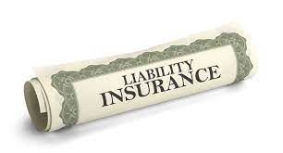
What is Liability Insurance?
5
The term liability insurance refers to an insurance product that provides an insured party with protection against claims resulting from injuries and damage to other people or property.
Liability insurance policies cover any legal costs and payouts an insured party is responsible for if they are found legally liable. Intentional damage and contractual liabilities are generally not covered in liability insurance policies.
https://www.paisabazaar.com/commercial-insurance/liability-insurance-policy/

Slide 43
What is covered?
5.1
What Personal Liability Insurance Covers? The policy comes into effect if you or one of your insured housemates is found responsible for another party's injury or damage to their property. Your personal liability coverage is in effect whether you or your insured housemates are at home or away. Your policy may also include legal representation so that the insurance company pays for your legal defense in a lawsuit.
What Professional Liability Insurance Covers Professional liability insurance typically covers claims of negligence; misrepresentation of goods or services; inaccurate or harm-causing counsel; and violation of the “good faith” terms of an agreement or contract.
What Business Liability Insurance Covers Business liability insurance typically covers claims of physical injury, including medical bills; damages to property; and harm from false or misleading advertising. Business liability insurance covers the cost of legal defense and, if a firm is successfully sued, any settlement or award like compensatory damages, nonmonetary losses, and punitive damages. Even as a corporation or an LLC, a business owner may be financially liable for claims. If a business already has professional liability or business owner insurance, the business should structure its business liability insurance policy to avoid costly duplications.

Slide 44
What is not covered?
5.2
Intentional damage
Lacking contractual obligations. For example, the company might reject the claim for damage due to fire, if you have not kept fire extinguishers in your factory, which is mandatory as per the law.
Injuries caused due to mental loss, loss of reputation, defamation and other similar matters
Costs due to recall of any product
Liability due to pollution
Illegal personal profit
Dishonest acts

Slide 45
Types of Liability Insurance Plan:
5.3
1. Public liability insurance policy
It covers sum which the Insured becomes legally liable to pay as damages to the third party in respect of accidental death/bodily injury/disease and loss of or damage to property
2. Product Liability
The product liability insurance covers any legal liabilities to third party arising out of injury or harm due to a product sold by a business .This is procured by companies whose products are widely used such as chemicals, tobacco, medical products, food, recreational products and others.
3. Employers' Liability Insurance
Employers' liability insurance covers companies against costs and claims by employees that are not covered by workers' compensation. Employers' liability insurance is an insurance policy that handles claims from workers who have suffered a job-related injury or illness not covered by workers' compensation
4. Trade credit insurance:
This insurance helps the business owners to protect their accounts receivable from loss due to credit risks such as protracted default, insolvency or bankruptcy.

Slide 46
Types of Liability Insurance Plan:
5.3
5. Directors and Officers liability insurance:
It is a type of liability insurance which covers the directors and officers against the claims made by Employees, Suppliers , Competitors , Regulators , Customers , Shareholders and Other stakeholders .
6. Professional indemnity insurance:
A Professional Indemnity Insurance is a type of liability insurance that covers the businesses or individuals who provide advice or a professional service to clients. It covers the compensation claims when the business is sued by its clients for making a mistake.
7. Cyber risk insurance:
A cyber insurance policy is designed to help an organization or business to cover against the liability and property losses arising due to any electronic activity that the business engages in. This policy helps to offset the risk involved with recovery, after a cyber-related security breach.

Slide 47
Types of Liability Insurance Plan:
5.3
8. Commercial crime insurance:
A Commercial Crime Insurance policy offers to protect the businesses against the losses due to third-party fraud or employee fidelity. It protects the business against:
Employee dishonesty
Theft of money
Burglary
Robbery
Forgery
Computer fraud
9. Carrier legal liability insurance:
Carrier legal liability insurance covers the insured for the physical loss or damage to goods or merchandise directly caused by fire or/and accident to the vehicle while such goods or merchandise are in transit. It covers for the losses of the goods or merchandise when they are in the custody of the insured.

Slide 48
Claim Process
5.4
In case any business or organization needs to make a claim under liability insurance, you can follow the below mentioned steps:
Read your policy documents to understand whether you can be compensated and, if yes, then how can it be done
Inform the provider about the problem either by calling them, mailing them or visiting the nearest branch office
Report the concern or the issue to the authority concerned, for instance the police in case of a theft or death. You need to submit this report to the insurance company along with the claim form and other required documents
Arrange for the evidence
A supervisor appointed by the provider will scrutinize the case and accordingly will give a nod or a rejection for it. He/she will also decide the compensation amount accordingly
Don’t forget to follow up regularly to know the status of your claim

