Slide 1

Lecture
Class: FY BSc
Subject : Non-Life Insurance – Products, Principles and Practice
Subject Code: PUSASQF2.5
Chapter: Chapter 5
Chapter Name: Personal Accident Insurance

Slide 2
Today’s Agenda
What is Personal Accident Insurance?
  Common terms used
  Why to buy
  Accidents in India
  Inclusions
  Exclusions
Types of Personal Accident Insurance
Accidental Insurance Coverage
Benefits of Personal Accident Insurance Policy
1. Additional benefits
How is premium calculated?
How to File an Accidental Insurance Claim?

Slide 3

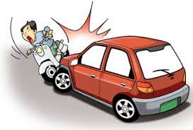
What is Personal Accident Insurance?
1
Personal Accident Insurance policy provides complete financial protection to the insured members against uncertainties such as accidental death, accidental bodily injuries, and partial/total disabilities, permanent as well as temporary disabilities resulting from an accident.

Slide 4
Common terms used:
1.1
Accident: an undesirable or unfortunate happening that occurs unintentionally and usually results in harm, injury, damage, or loss; casualty; mishap.
Accidental death : An event that strictly occurs as a result of an accident like from car crashes, and any other situations that can't be controlled are deemed accidental.
Bodily injury : it means physical bodily injury directly caused by external, violent visible cause.
Permanent disability : A condition in which an individual is no longer able to work due to injuries or may never be able to work again.
Temporary disability : The injury that prevents you from engaging in your occupation for a period not exceeding 104 weeks since the day of injury .

Slide 5
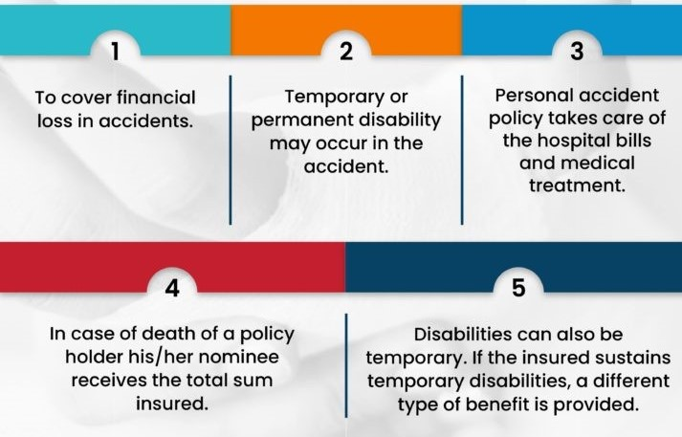
Why do we need Personal Accident Insurance?
1.2

Slide 6
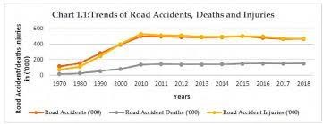
Accidents in India
1.3
Road accidents have been a major cause for concern across the Indian subcontinent. In 2019 alone, the country reported over 151 thousand fatalities due to road accidents. Each year, about three to five percent of the country’s GDP was invested in road accidents. Notably, while India has about one percent of the world’s vehicle population, it also accounted for about six percent of the global road traffic incidents. Almost 70 percent of the accidents involved young Indians.

Slide 7
Inclusions
1.4
Accidental death
Permanent total/partial disability
Accidental dismemberment
Medical expenses/ hospitalization charges
Child education support
Life support benefit
Burns, broken bones and Ambulance
Daily allowance

Slide 8
Exclusions
1.5
Natural death
Pre-existing disability or injury
Self-inflicted injuries sustained due to suicide attempt is not covered
Non-allopathic treatments
Driving under the influence of drugs or alcohol is not covered.
Committing a criminal act or being involved in war activities, suffering from a mental disorder
Participating in the naval, military, air force, adventurous or sports activities

Slide 9
Types of Personal Accident Insurance
2
Individual Accident Insurance:
This type of policy guards an individual in case of any accidental damage. It covers accidental death, loss of limbs or sight, or other permanent disabilities resulting due to an accident.
Group Accident Insurance:
Group Accident Insurance is taken by employers to get coverage for their employees. Depending on the group size, some insurers also provided a discount on the premium. It is a good incentive/ value-added advantage for small organizations as it is available at low cost. However, this is a very basic plan and may offer limited benefits compared to an individual plan.

Slide 10
Accidental Insurance Coverage
3
Accidental Death Cover
An accident can be both emotionally and financially devastating for the dependent family members. In case of fatal injuries, the entire sum assured is paid to the nominee as mentioned in the policy document.
Permanent/Total Disability Cover
In case an accident results in permanent disabilities or lifelong total impairment such as loss of both the limbs, then a specified sum insured amount is paid to the policyholder.
Permanent Partial Disability Cover
If bodily injuries, resulting in permanent partial disabilities, then a certain percentage (up to 100%) of the benefit is paid to the insured.
Temporary Total Disability
In case the insured meets with temporary total disabilities and is bedridden, then the insurer will provide a weekly allowance to recompense the loss of income. The insured can also utilize this claim amount to pay the EMIs, in case there is a loss of earnings.

Slide 11
Benefits of Personal Accident Insurance Policy
4
Provides financial security to your family and loved ones.
There no external tests and documents needed over and above the current condition.
Extensive coverage at much affordable rates.
Plans available in two categories, self and family.
It offers worldwide coverage.
Easy and seamless claim process.
Support centres available on all days and around the clock.
You can customise the policy to suit your specific needs.

Slide 12
Additional Benefits
4.1
Expenses incurred for carriage of dead body of insured (death due to accident only) to place of residence subject to a maximum of 2% of capital sum insured or Rs. 1,000/- , whichever is lower.
Medical expenses arising out of an accident upto 10% of Capital Sum Insured or 40% of the admissible claim whichever is lower at an additional premium of 20% of basic premium.
Education fund for the dependent children of the insured following death or permanent total disablement as detailed below :
If the insured has one dependent child below the age of 23 years, an amount equal to 10% of the Capital Sum Insured subject to a maximum of Rs.5,000/-
If the insured has more than one dependent child below the age of 23 years, an amount equal to 10% of Capital Sum Insured subject to a maximum of Rs.10,000/-

Slide 13

Who Should Buy Personal Accident Insurance?
5
Should you buy personal accident insurance ? Discuss

Slide 14
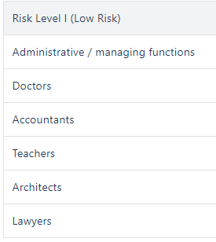
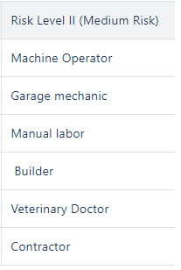
How is Premium Calculated?
5
In case of personal accident policies, coverage and premium depends on the current level of income and nature of the applicant’s occupation. If you are a teacher living in Delhi, then your chance of meeting an accident is less than a miner.

Slide 15
How to File an Accidental Insurance Claim?
6
To initiate the claim process, you need to inform the insurance provider within the specified time frame. You might be provided with a claim reference number. The following information is required to be submitted to the provider while intimating a claim-
Your contact number
Policy number
Date and time of the accident
Name and contact details of the insured person who is injured
Location of the incident
A brief description of how the accident/ loss took place with its location details
Extent of the loss

Slide 16
How to File an Accidental Insurance Claim?
6
In case of an Accidental death/ impairment claim, following documents are required to be submitted-
Death certificate
Post-mortem report
FIR report
Medical certificate
Medicine bills

