Slide 1

Subject : Numerical Methods
Inequalities and Modulus

Slide 2
Introduction to Inequalities
.
Inequality tells us about the relative size of two values.
Mathematics is not always about "equals", sometimes we only know that something is greater or less than.
We call things like that inequalities (because they are not "equal").
We use inequalities because there are things we do not know exactly but can still say something about them.

Slide 3
The 4 Inequalities
.
Symbol | Words | Example
> | Greater than | x+3>2
< | Less than | 7x<28
≥ | Greater than or equal to | 5≥x-1
≤ | Less than or equal to | 2y+1≤7

Slide 4
Strict and Weak Inequalities
.
Strict Inequality | Weak Inequality
A strict inequality is an inequality where the inequality symbol is either < (greater than) or > (less than). That is, a strict inequality is an inequality which has no equality conditions. The variable isn't allowed to equal the number to which it's being compared. Example: If x < 3, then x can be 2.9, 2.99, 2.999, and so on, but x can't equal 3. | The inequalities "≤" and "≥" allow the variable to equal the number to which it's being compared. These are known in the math world as non-strict inequalities or weak inequalities. We might also call them "lenient inequalities." Example: Two is less than or equal to x" can be written in symbols as 2 ≤ x. In other words, x must be at least 2.

Slide 5
Solving the Inequalities
.
Solving inequalities is very like solving equations - we do most of the same things, but we must also pay attention to the direction of the inequality. There are certain operations that can change the direction of the inequality.
Operations that do not affect the direction of the inequality): | Operations that change the direction of the inequality):
Add (or subtract) a number from both sides Multiply (or divide) both sides by a positive number Simplify a side | Multiply (or divide) both sides by a negative number Swapping left and right hand sides

Slide 6

Examples
Example 1: Solve: $3y < 15$
If we divide both sides by 3 we get: $\frac{3y}{3}<\frac{15}{3}$i.e $y < 5$
And that is our solution: $y < 5$
Example 2: Solve: $−2y<−8$
Let us divide both sides by −2 ... and reverse the inequality
$−2y < −8$i.e $−2y/−2 > −8/−2$i.e $y > 4$. And that is the correct solution: $y > 4$
Example 3: Solve: $\frac{x−3}{2}<−5$
First, let us clear out the "/2" by multiplying both sides by 2. Because we are multiplying by a positive number, the inequalities will not change.
$\frac{x−3}{2} ×2 < −5 ×2$i.e $x−3<−10$
Now add 3 to both sides:
$x−3 + 3 < −10 + 3$i.e $x < −7$. And that is our solution:$x < −7$
.

Slide 7

Two Inequalities At Once
.
Solve: $−2<\frac{6−2x}{3}<4$
First, let us clear out the "/3" by multiplying each part by 3. Because we are multiplying by a positive number, the inequalities will not change:
$$−6 < 6−2x < 12$$
Now subtract 6 from each part:
$$−12 < −2x < 6$$
Now multiply each part by −(1/2). Because we are multiplying by a negative number, the inequalities change direction.
$$6 > x >−3$$
And that is the solution! But for clarity it is better to have the smaller number on the left, larger on the right.:
$−3 < x < 6$

Slide 8
Word Problem
.
Sam and Alex play in the same football team. Last Saturday Alex scored more goals than Sam, but together they scored less than 9 goals.
What are the possible number of goals scored by Sam?

Slide 9

Word Problem
.
Solution
Let the number of goals Alex scored be a, the number of goals Sam scored be s
We know that Alex scored 3 more goals than Sam did, so:$a=s+3$. And we know that together they scored less than 9 goals: $s+a<9$. We are being asked for how many goals Alex might have scored: a
$$s+a<9$$
Since a=s+3, we get $s+s+3<9$
$$2s+3<9$$
$$2s+3−3<9−3$$
$$2s<6$$
$$\frac{2s}{2}<\frac{6}{2}$$
$$s<3$$
s can be 0, 1 or 2, therefore a can be 3,4 or 5
Alex could have scored 3, 4 or 5 goals

Slide 10
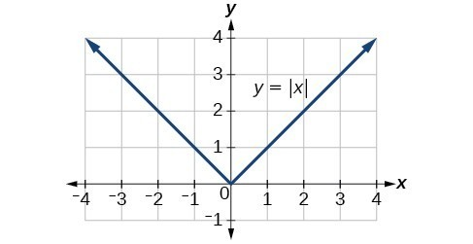
Modulus Function
.
A modulus function is a function which gives the absolute value of a number or variable. It produces the magnitude of the number of variables.
It is also termed as an absolute value function. The outcome of this function is always positive, no matter what input has been given to the function.
It is represented as y = |x|. The plotting of such graphs is also an easy method where the domain will be all values of input say x (all real numbers) and range will be all values of function (y = f(x) = all positive real numbers and 0).

Slide 11
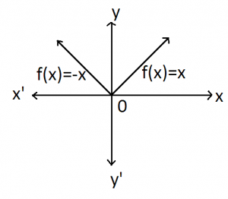

Modulus Function Definition
.
The modulus function f(x) of x is defined as;
$$f(x) = |x| Or y = |x|$$
Where f:R→R and x ∈ R. And |x| means modulus or mod of x.
If x is positive then the output of the function f(x) will be x only.
If x is negative, then the output of x will be the magnitude of x. Hence, we can redefine the modulus function as:
$$f\left(x\right)=\left\{\begin{matrix} x, if x≥0 \\ −x, if x≤0\end{matrix}\right\}$$
According to the above statement, if the value of x is greater or equal to 0, then the modulus function takes the actual value. But if the value of x is less than 0, then the function takes minus of the actual values. Let us see some examples to understand it: If x = -5, then y = f(x) = – (-5) = 5, since x is less than zero. If x = 10, then y = f(x) = 10, since x is greater than zero

Slide 12
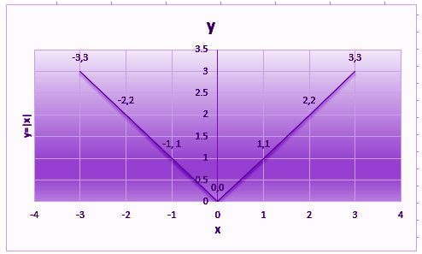
Modulus Function Graph
.
The graph of modulus function is continuous having a corner at x=0.
Since graph is symmetric about y-axis, the modulus function is an even function. Because of how absolute values behave, it is important to include negative inputs when graphing absolute-value functions.
Let x be variable (modulus function as mentioned in the previous slide) whose values lies from -3 to 3, which is the domain of the graph.
Suppose x-axis shows the value of variable x and the y-axis shows the value of function y, then we can plot the graph as per the given values in the table here.
 | x<0 |  |  | x≥0
x | -3 | -2 | -1 | 0 | 1 | 2 | 3
y | 3 | 2 | 1 | 0 | 1 | 2 | 3

Slide 13

Modulus and Inequality
.
Absolute Value Inequalities
In the previous section we solved equations that contained inequalities and absolute values separately. In this section we want to look at inequalities that contain absolute values. We will need to examine two separate cases.
1) Inequalities Involving < and ≤
Let’s start off by looking at a fairly simple case. $|p|≤4$This says that no matter what p is, it must have a distance of no more than 4 from the origin. This means that p must be somewhere in the range, $−4≤p≤4$. We could have a similar inequality with the < and get a similar result.
In general, we have the following formulas to use here,
$$if \left|p\right|≤b, b>0 then −b≤p≤b$$
$$if \left|p\right|<b, b>0 then −b<p<b$$
Notice that this does require b to be positive.

Slide 14

Example
.
Solve each of the following.
$|2x−4|<10$
As with equations p simply represents whatever is inside the absolute value bars. So, with this first one we have,
$$−10<2x−4<10.$$
Now, this is nothing more than a fairly simple double inequality to solve so let’s do that. $−6<2x<14 i.e. −3<x<7$. The interval notation for this solution is (−3,7).
2. $|9m+2|≤1$
$$−1≤9m+2≤1$$
$$−3≤9m≤−1$$
$$−\frac{1}{3}≤m≤−\frac{1}{9}$$
The interval notation is $\left[−\frac{1}{3}, −\frac{1}{9}\right]$

Slide 15

Modulus and Inequality
.
Inequalities Involving > and ≥
Once again let’s start off with an example. |p|≥4. This says that whatever p is it must be at least a distance of 4 from the origin and so p must be in one of the following two ranges, p≤−4 or p≥4.
Before giving the general solution we need to address a common mistake with these types of problems. Many students try to combine these into a single double inequality as follows, −4≥p≥4. In a double inequality we require that both of the inequalities be satisfied simultaneously. The double inequality above would then mean that p is a number that is simultaneously smaller than -4 and larger than 4. This just doesn’t make sense. There is no number that satisfies this. These solutions must be written as two inequalities.
Here is the general formula for these.
$$if \left|p\right|≥b, b>0 then p≤−b or p≥b$$
$$if \left|p\right|>b, b>0 then p<−b<p>b$$

Slide 16

Example
.
Solve the following
$|2x−3|>7$
Again, p represents the quantity inside the absolute value bars so all we need to do here is plug into the formula and then solve the two linear inequalities,
$$2x−3<−7 or 2x−3>7$$
$$2x<−4 or 2x>10$$
$$x<−2 or x>5$$
The interval notation for these are$(−∞,−2) or (5,∞).$
|6t+10|≥3
Let’s just plug into the formulas and go here, that is
$$6t+10≤−3 or 6t+10≥3$$
$$6t≤−13 or 6t≥−7$$
$$t≤−\frac{13}{6}or t≥−\frac{7}{6}$$
The interval notation for these are $\left(−∞, −\frac{13}{6}\right] or \left[−\frac{7}{6},∞\right)$

Slide 17
Special Cases
Solve each of the following.
|3x+2|<0.
Now we know that |p|≥0 and so can’t ever be less than zero. Therefore, in this case there is no solution since it is impossible for an absolute value to be strictly less than zero (i.e. negative).
|x−9|≤0.
We still can’t have absolute value be less than zero, however it can be equal to zero. So, this will have a solution only if |x−9|=0 and we know how to solve this. i.e. x−9=0 ⇒ x=9
|2x−4|≥0.
In this case again no matter what p is we are guaranteed to have |p|≥0. This means that no matter what x is we can be assured that |2x−4|≥0 will be true since absolute values will always be positive or zero. The solution in this case is all real numbers, or all possible values of xx. In inequality notation this would be −∞<x<∞.
|3x−9|>0.
This one is nearly identical to the previous part except this time note that we don’t want the absolute value to ever be zero. So, we don’t care what value the absolute value takes as long as it isn’t zero. This means that we just need to avoid value(s) of x for which we get, |3x−9|=0 ⇒ 3x−9=0 ⇒ x=3. The solution in this case is all real numbers except x=3.
.

Slide 18
Negative Values
.
Problem Statement
|4x+15|<−2 and |4x+15|≤−2|
Okay, if absolute values are always positive or zero there is no way they can be less than or equal to a negative number.
Therefore, there is no solution for either of these.
|2x−9|≥−8 and |2x−9|>−8
In this case if the absolute value is positive or zero then it will always be greater than or equal to a negative number.
The solution for each of these is then all real numbers.

