Slide 1

Subject : Numerical Methods
Sequences and Series Part 1

Slide 2
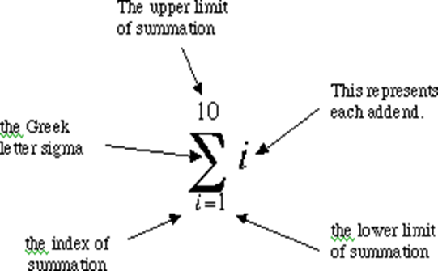

Notation of Sums
.
Many statistical formulas involve repetitive summing operations. Consequently, we need a general notation for expressing such operations
The general form for sums is $\sum_{i=1}^{N}{x_{i}}$
In the above expression, $x_{i}$ are the numbers that are to be summed up, $i$ is the summation index, $1$ is the start value, $N$ is the stop value.

Slide 3

Example
.
Question: Suppose our list has just 5 numbers, and they are 1,3,2,5,6. Evaluate $\sum_{i=1}^{5}{x_{i}^{2}}$
Solution
In this case, we begin by setting $i$ equal to $1$, and evaluating
Since $x_{1} = 1,$our first evaluation produces a value of 1. Next, we set i equal to 2, and evaluate $x_{2}^{2}$ obtaining 9, which we add to the previous result of 1. We continue in this manner, obtaining $\left[1^{1}+3^{2}+2^{2}+5^{2}+6^{2}\right]=75$
The order of operations is as important in summation expressions as in other mathematical notation.

Slide 4
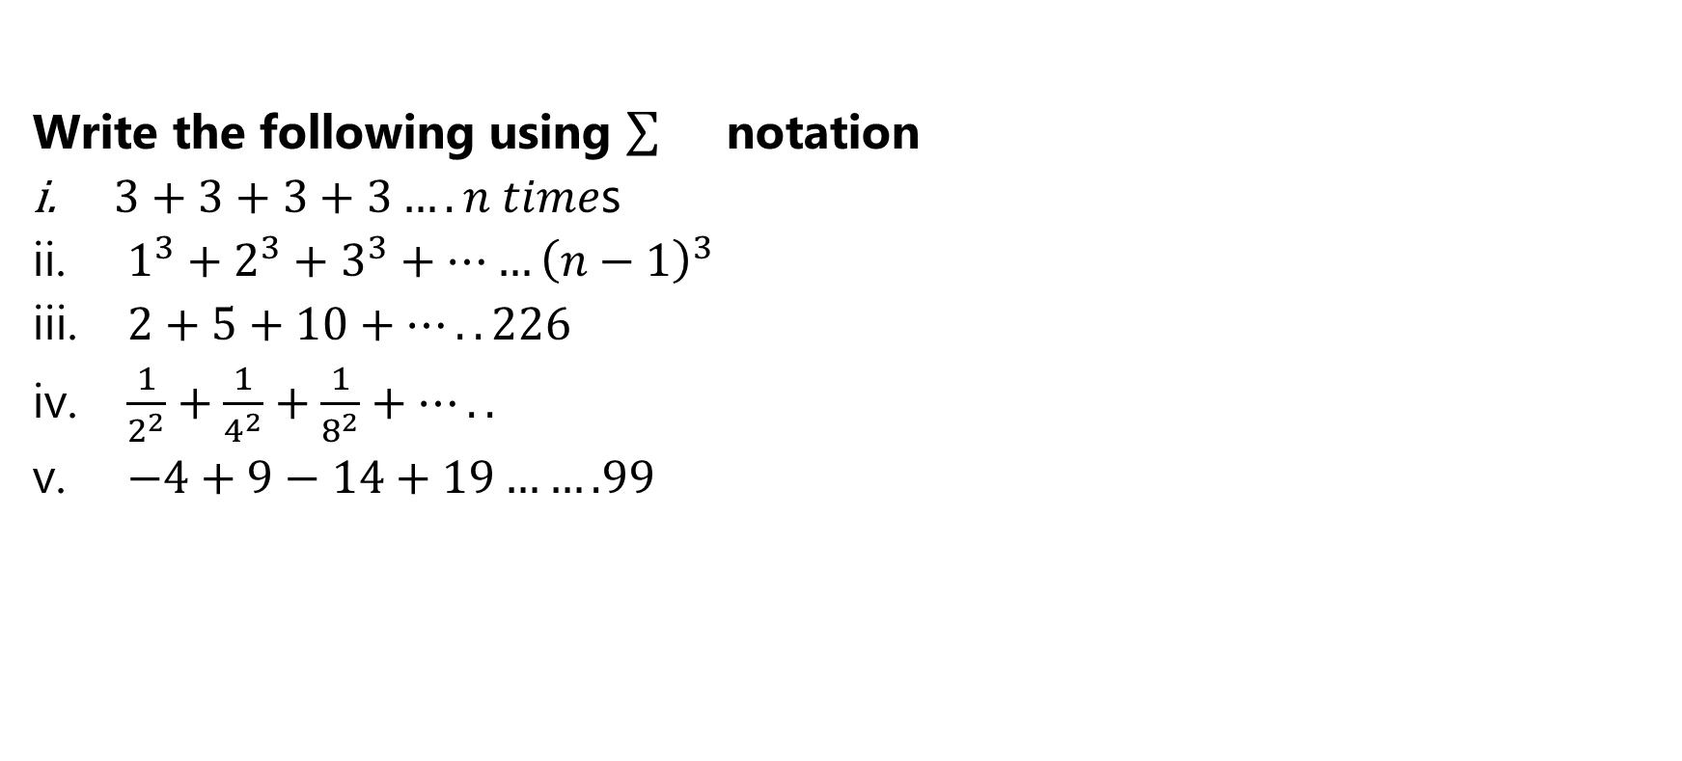
Exercise
.
Write the following using notation
$3+3+3+3….n time$s
$1^{3}+2^{3}+3^{3}+……{\left(n−1\right)}^{3}$
$2+5+10+…..226$
$\frac{1}{2^{2}}+\frac{1}{4^{2}}+\frac{1}{8^{2}}+…..$
$−4+9−14+19…….99$

Slide 5
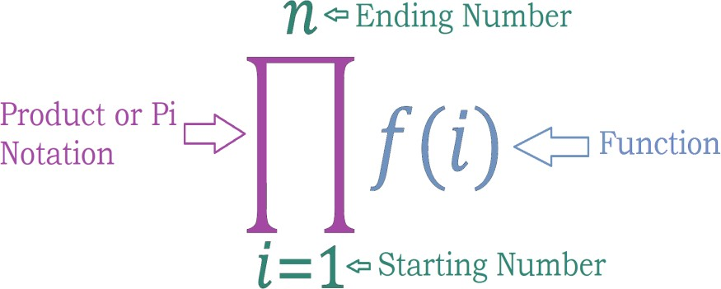
Product
.
The product of a series of numbers is written using the ∏ (pi) notation as an abbreviation.

Slide 6
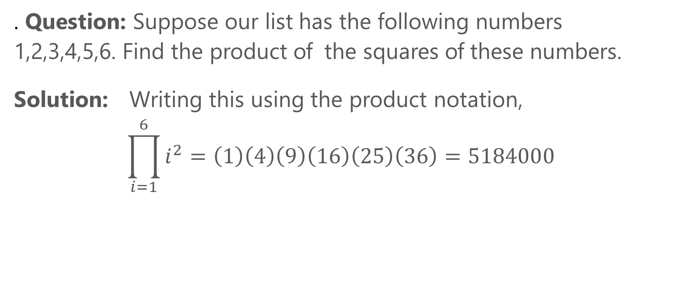
Example
. Question: Suppose our list has the following numbers 1,2,3,4,5,6. Find the product of the squares of these numbers.
Solution: Writing this using the product notation,
$$\prod_{i=1}^{6}{i^{2}}=\left(1\right)\left(4\right)\left(9\right)\left(16\right)\left(25\right)\left(36\right)=5184000$$

Slide 7
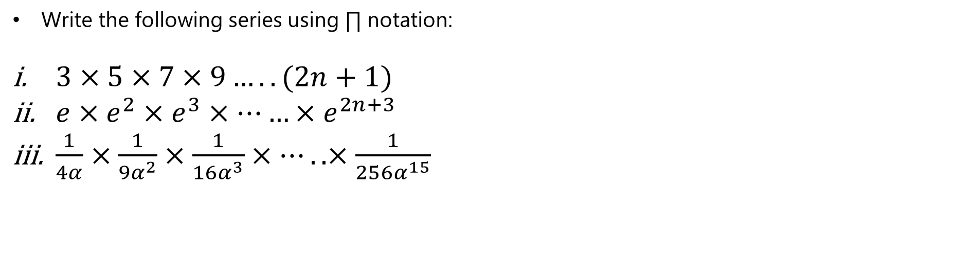
Exercises
.
Write the following series using ∏ notation:
$3×5×7×9…..(2n+1)$
$e×e^{2}×e^{3}×……×e^{2n+3}$
$\frac{1}{4α}×\frac{1}{9α^{2}}×\frac{1}{16α^{3}}×…..×\frac{1}{256α^{15}}$

Slide 8

Arithmetic Progression
.
An arithmetic progression (AP) is a sequence of numbers such that the difference between the consecutive terms is constant. For instance, the sequence 5, 7, 9, 11, 13, 15, . . . is an arithmetic progression with common difference of 2.
Nth term of A.P: Since the numbers go up by the same amount each time we can use this to determine future terms. In general, using a to stand for the first term and d for the common difference then the nth term is $= a + (n −1)d.$
Sum of A.P: We can find the sum of the n terms of an arithmetic progression using the formula:
$$S_{n}=\frac{1}{2}n[2a+\left(n−1\right)d]$$

Slide 9
Properties of an A.P.
.
If a constant number is added or subtracted from each term of an A.P, then the resulting term in the sequence are also in A.P with the same common difference.
If each term in an A.P is divided or multiply with a constant non-zero number, then the resulting sequence is also in an A.P
Three number x, y and z are in an A.P if 2y = x + z
A sequence is an A.P if its nth term is a linear expression.
If we select terms at regular interval from an A.P, these selected terms will also be in AP.
If the difference between all the consecutive terms of a sequence is the same, then the sequence is an A.P.

Slide 10

Examples
.
Is the sequence 1,11,21,31... an arithmetic progression?
Solution:
Yes, it is an arithmetic progression. Its first term is 1 and the common difference is 10.
Find the sum of the first 10 numbers of this arithmetic series: 1, 11, 21, 31...
Solution:
we can use this formula $S =\frac{1}{2}n\left(2a + d\left(n−1\right)\right) S =\frac{1}{2}(2×1 + 10(10−1))10$= 5(2 + 90) = 5.92 = 460
A clock strikes the number of times of the hour. How many strikes does it make in one day?
Solution:
For the first 12 hours of the day, the clock will strike 1+ 2+ 3+ …..+ 12 times
= 12(1+12)/2 = 78 times
For the next 12 hours, there will be another 78 times, so in one day, the clock will strike 156 times.

Slide 11
Exercise
.
A piece of equipment cost a certain factory Rs 600,000. If it depreciates in value, 15% the first year, 13.5 % the next year, 12% the third year, and so on, what will be its value at the end of 10 years, all percentages applying to the original cost?

Slide 12
Solution
.
Let the cost of an equipment be Rs. 100.
Now the percentages of depreciation at the end of 1st, 2nd, 3rd years are 15, 13.5, 12,
which are in A.P., with a = 15 and d = - 1.5.
Hence, percentage of depreciation in the tenth year = a + (10-1) d
= 15 + 9 (-1.5) = 1.5
Also total value depreciated in 10 years = 15 + 13.5 + 12 + ... + 1.5 = 82.5 Hence, the value of equipment at the end of 10 years=100 - 82.5 = 17.5.
The total cost being Rs. 6,00,000/100 * 17.5 = Rs. 1,05,000.

Slide 13
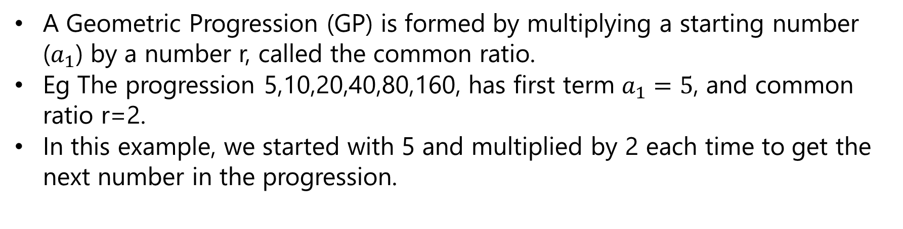
Geometric Progression ( G.P. )
.
A Geometric Progression (GP) is formed by multiplying a starting number ($a_{1}$) by a number r, called the common ratio.
Eg The progression 5,10,20,40,80,160, has first term $a_{1}=5$, and common ratio r=2.
In this example, we started with 5 and multiplied by 2 each time to get the next number in the progression.

Slide 14

Formulae
.
The n-th term of a geometric progression is given by $a_{n}=a_{1}r^{n−1}$
The first term is $a_{1}$
The second term is obtained by multiplying the first by r : $a_{1}r$
The third term is obtained by multiplying the second by r : $a_{1}r^{2}$
The fourth term is obtained by multiplying the third by r : $a_{1}r^{3}$
We continue this pattern and the general term, the n-th term is $a_{1}r^{n−1}$
The sum to n terms of a GP means: $a_{1}+a_{1}r+a_{1}r^{2}+a_{1}r^{3}+……a_{1}r^{n−1}$
This can be solved using the formula
$$S_{n}=\frac{a_{1}\left(1−r^{n}\right)}{1−r} \left(r≠1\right)$$

Slide 15
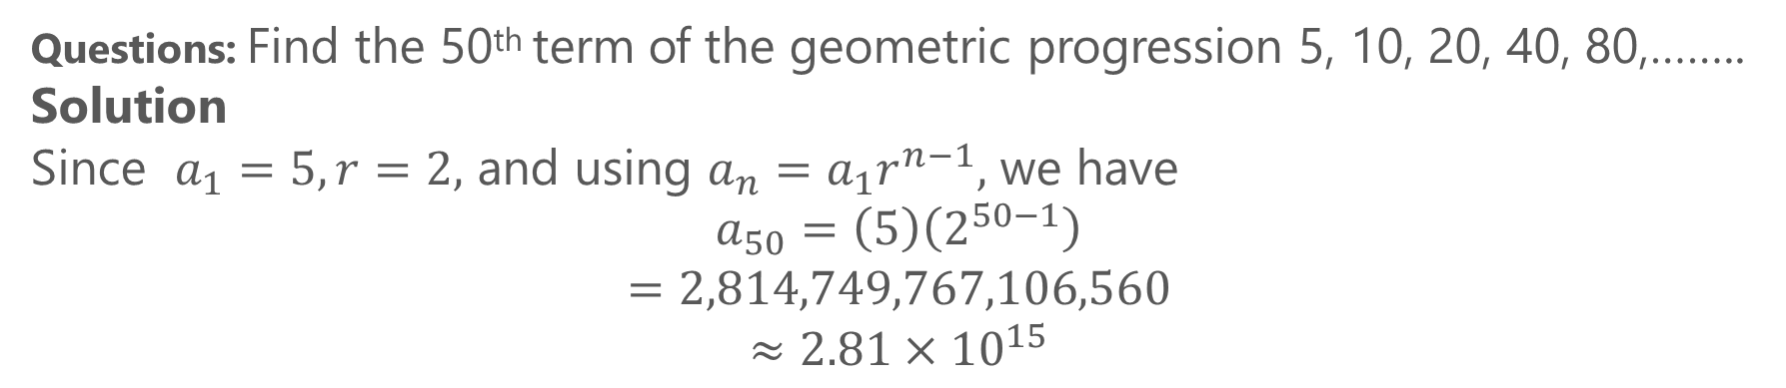
Example
.
Questions: Find the 50th term of the geometric progression 5, 10, 20, 40, 80,…….. Solution
Since $a_{1}=5, r=2,$ and using $a_{n}=a_{1}r^{n−1},$ we have
$$a_{50}=\left(5\right)\left(2^{50−1}\right)$$
$$=2,814,749,767,106,560$$
$$≈2.81×{10}^{15}$$

Slide 16

Exercise
.
Evaluate
$$\sum_{k=1}^{10}{\frac{5}{{1.06}^{k}}}$$

Slide 17

Infinite Geometric Series
.
An infinite geometric series is the sum of an infinite geometric sequence. This series would have no last term
The general form of the infinite geometric series is $a+ar+ar^{2}+ar^{3}+….$
Where a is the first term and r is the common ratio
Example
$$−\frac{5}{4},\frac{5}{16},−\frac{5}{64},\frac{5}{256}…….$$
This is an infinite geometric series

Slide 18

Sum of an infinite G.P.
.
We can find the sum of all finite geometric series.
But in the case of an infinite geometric series when the common ratio is greater than one, the terms in the sequence will get larger and larger and if we add the larger numbers, we won't get a final answer. The only possible answer would be infinity. So, we don't deal with the common ratio greater than one for an infinite geometric series.
If the common ratio r lies between −1−1 to 11 , we can have the sum of an infinite geometric series. That is, the sum exits for | r |<1| r |<1 .
The sum S of an infinite geometric series with −1<r<1−1<r<1 is given by the formula, $S=\frac{1}{1−r}$
An infinite series that has a sum is called a convergent series and the sum Sn is called the partial sum of the series.

Slide 19

Example
.
Question: Work out the following sum :
$\sum_{r=1}^{∞}{{\left(\frac{1}{3}\right)}^{r}}$
Solution: $\sum_{r=1}^{∞}{{\left(\frac{1}{3}\right)}^{r}={\left(\frac{1}{3}\right)}^{1}+{\left(\frac{1}{3}\right)}^{2}+{\left(\frac{1}{3}\right)}^{3}+….+{\left(\frac{1}{3}\right)}^{n}}$
$$r=\frac{a_{2}}{a_{1}}=\frac{{\left(\frac{1}{3}\right)}^{2}}{{\left(\frac{1}{3}\right)}^{1}}=\frac{1}{3}$$
$$S_{∞}=\frac{\frac{1}{3}}{1−\frac{1}{3}}=\frac{\frac{1}{3}}{\frac{2}{3}}=\frac{1}{2}$$

