Slide 1

Lecture 5
Nisha Kapadia
Class: TY BSc
Subject : Pricing and Reserving for Life Insurance Products
Subject Code: PUSASQF506A
Chapter: Unit 4
Chapter Name: Multiple life models

Slide 2
Today’s Agenda
0. Multiple lives - Introduction
Joint Life Functions
Last Survivor Functions
Present values involving two lives
Calculations
Contingent and Reversionary Assurances and Annuities
Annuities payable m times per year

Slide 3








Slide 4

















Slide 5

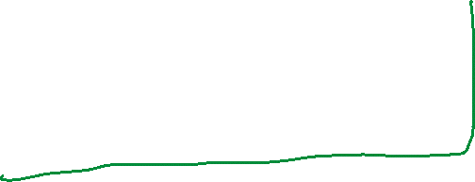












Slide 6














Slide 7






Slide 8
Multiple lives - Motivation
0
Till now we have touched upon assurance functions, annuity functions, premiums and reserves for a single life.
But an actuary sometimes has to deal with collections of lives, multiple lives. The valuation of benefits and premiums for an insurance policy where the payments depend on the survival or death of two lives. Such policies are very common.
Some examples are:
A whole life insurance policy may pay a benefit at the second death of a husband and a wife.
A whole life annuity immediate may pay a fixed amount per month, such as 1000, to a set of two people (such as husband and wife) until they are both dead.
Complicated estate provisions may involve several lives. For example, a will may call for the payment after death of the parent of 1000 per month to each of the children until they turn 18.

Slide 9
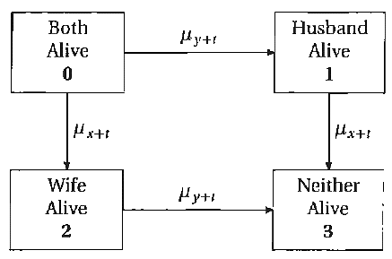
Multiple lives
0
We will only discuss a two-life model.
We use a double subscript on the forces: x is the age oft the husband and y is the age of the wife. Assuming that the two lives are independent, the survival of one life does not depend on whether the other one is alive or not.
This can be shown by the following Markov chain diagram:

Slide 10
Introduction
0
Two lives can be modelled using joint life functions or last survivor functions.
This chapter covers the following topics:
random variables describing basic joint life and last survivor functions
determining simple joint life and last survivor probabilities
present values of simple joint life and last survivor policies
calculating premiums and reserves for policies based on two lives.
What does joint life mean?
What does last survivor mean?

Slide 11
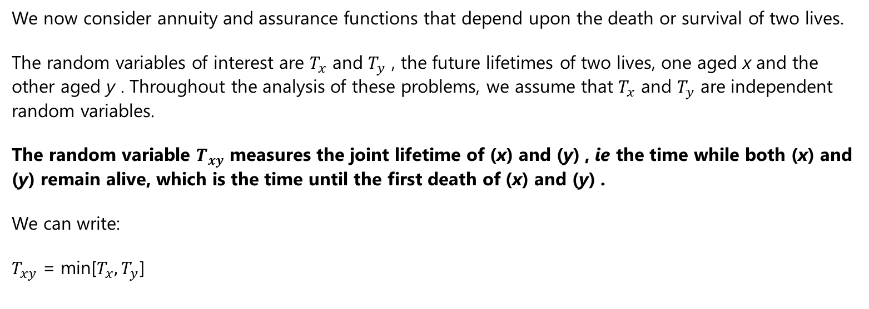

Joint life functions
1

Slide 12
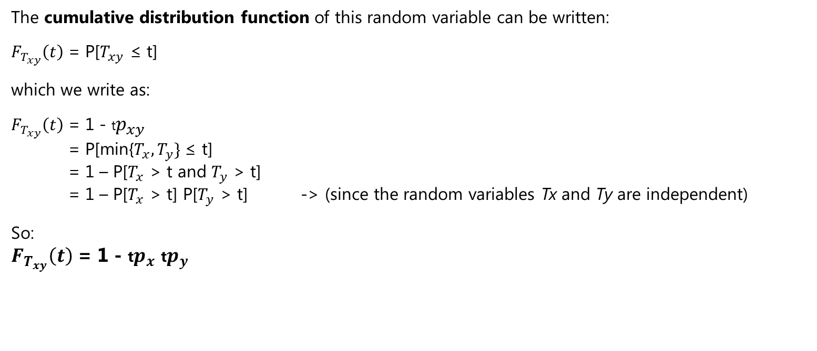
Joint life functions
1

Slide 13
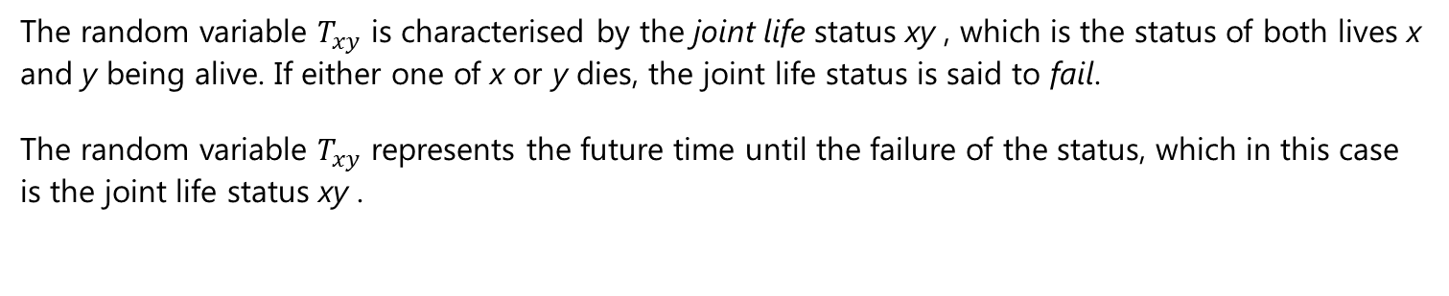

Joint life status
1

Slide 14
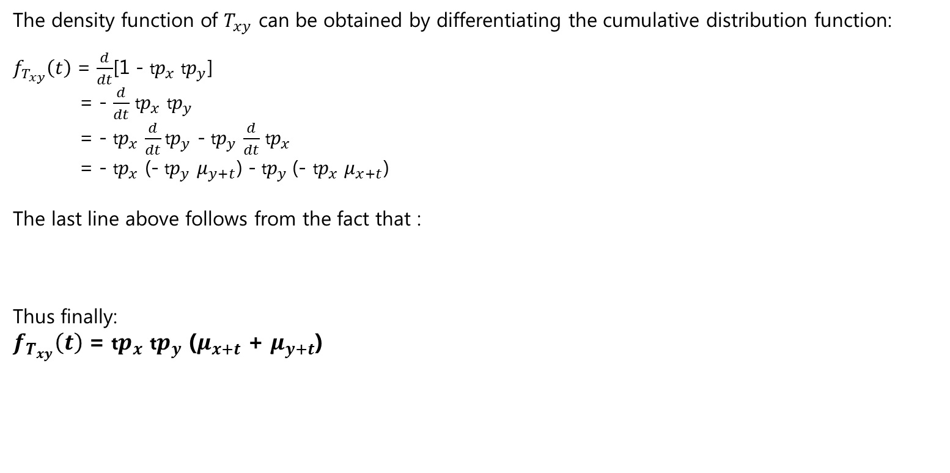

Joint life functions
1

Slide 15
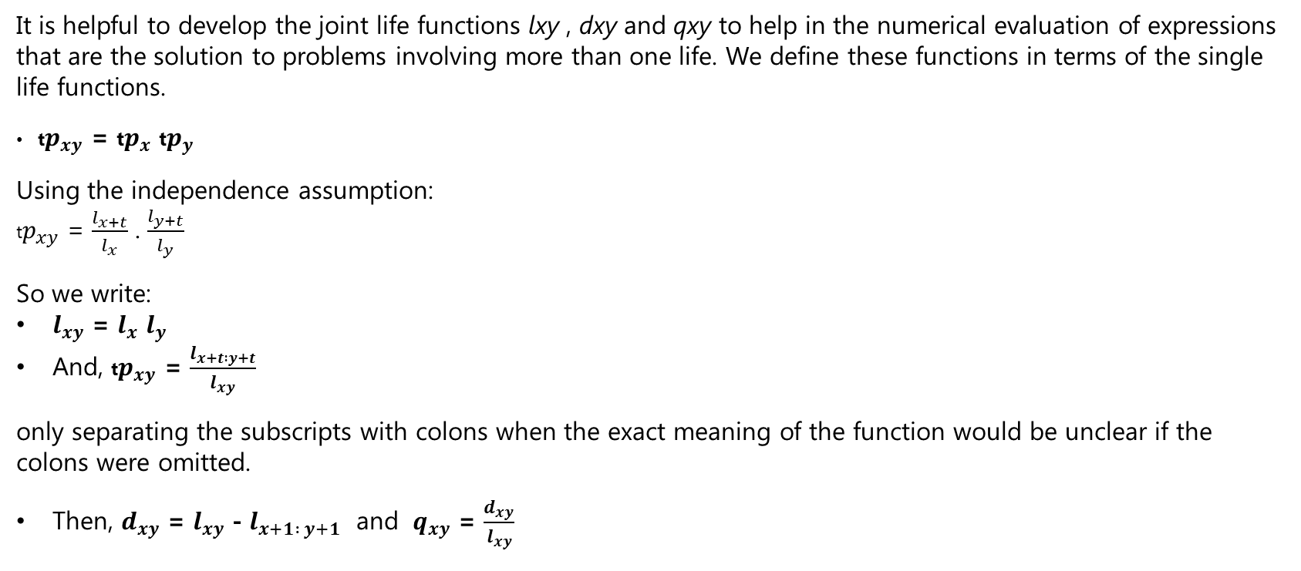
Joint life table functions
1

Slide 16
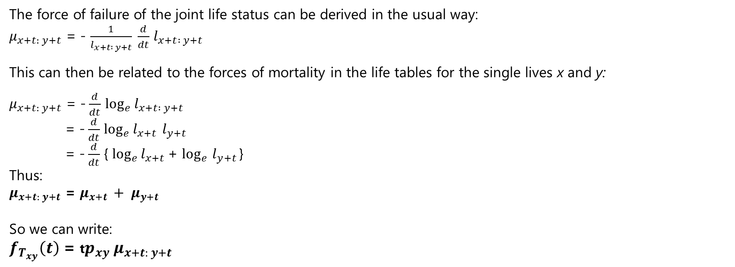
Joint life table functions
1

Slide 17

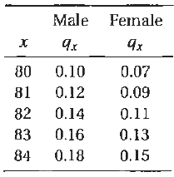
Question
You are given the following mortality table:
Kevin and Kira are a couple. Kevin, a male, is age 82, and Kira, a female is age 80. Kevin and Kira have independent future lifetimes.
Calculate the probability that the first death for this couple will occur within the third year from the current date.

Slide 18
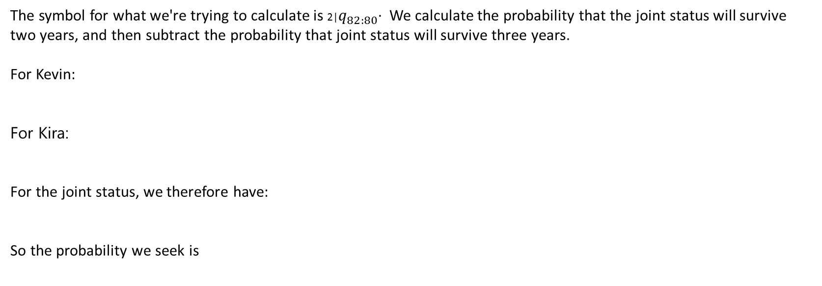




Solution

Slide 19
Last Survivor Functions
2
Sometimes we are interested in the time when the last life of a set of lives fails.
To study this situation, we define the last survivor status as a status that fails only when every member of the status fails.
State two examples of last survivor policies, i.e. (payment contingent on the death of the second life)

Slide 20













Slide 21





















Slide 22



Slide 23





Slide 24
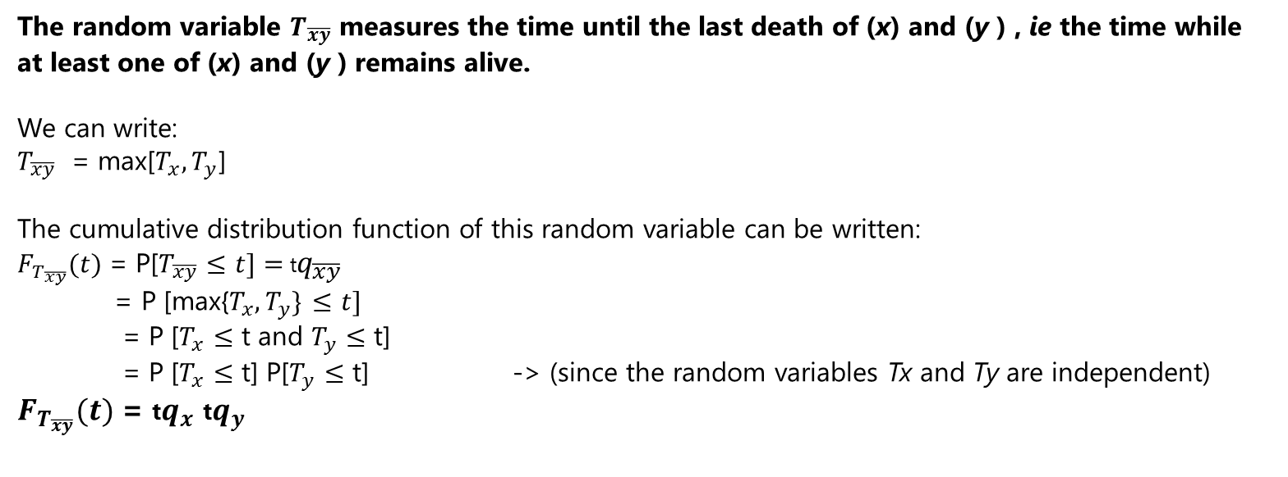
Last Survivor Functions
2

Slide 25
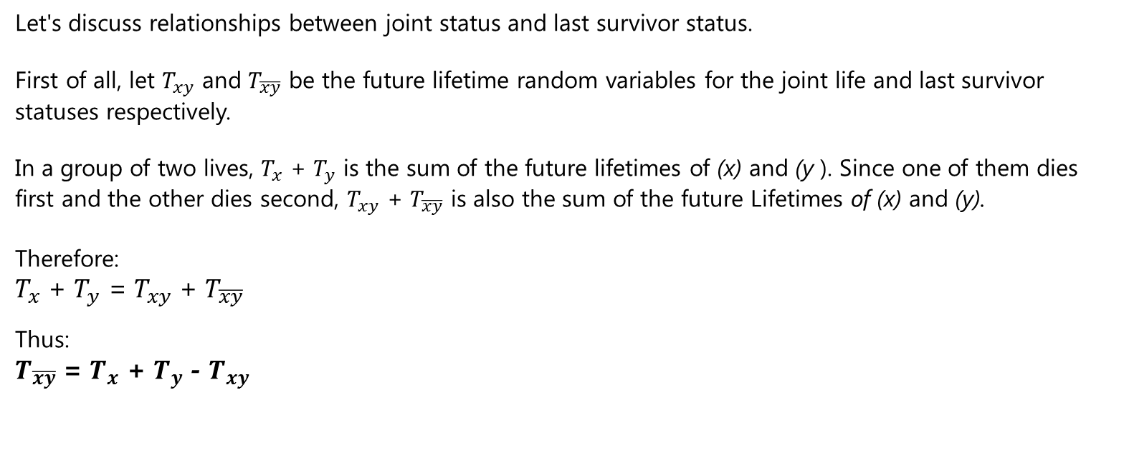
Last Survivor & Joint life Functions
2

Slide 26
Last Survivor & Joint life Functions
2
Relationship between joint status and last survivor status.
Important result
Function of single life status x
Function of single life status y
Function of joint life status xy
Function of last survivor status

Slide 27
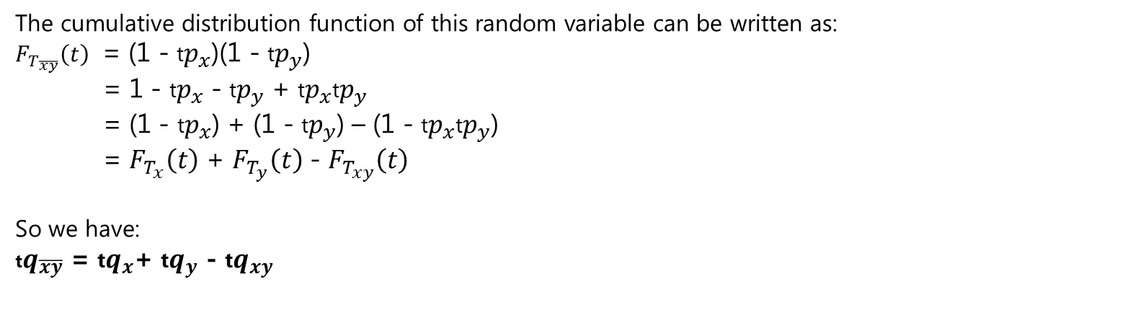
Last Survivor Functions
2

Slide 28
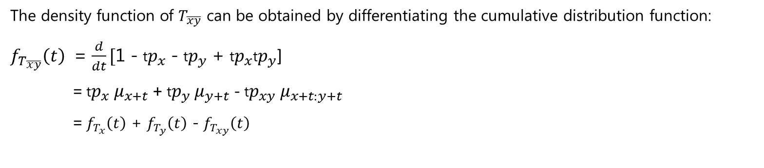
Last Survivor Functions
2

Slide 29
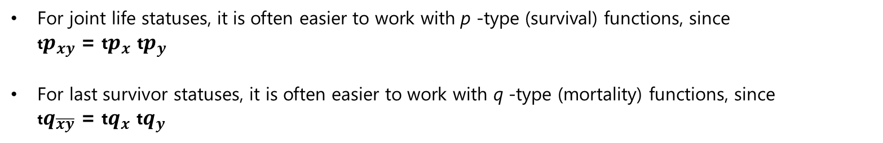
Tip

Slide 30
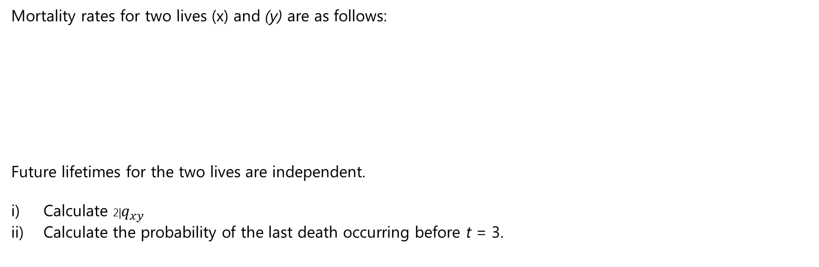
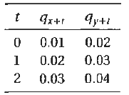

Question

Slide 31
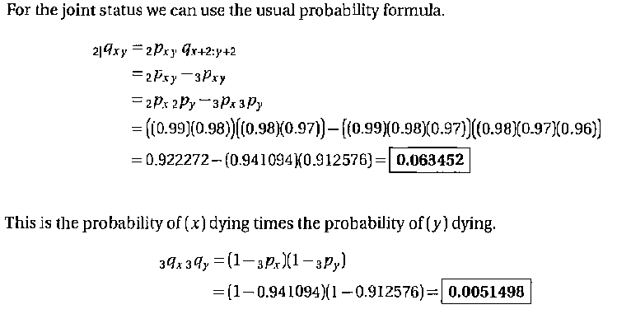
Solution

Slide 32












Slide 33













Slide 34















Slide 35



Slide 36
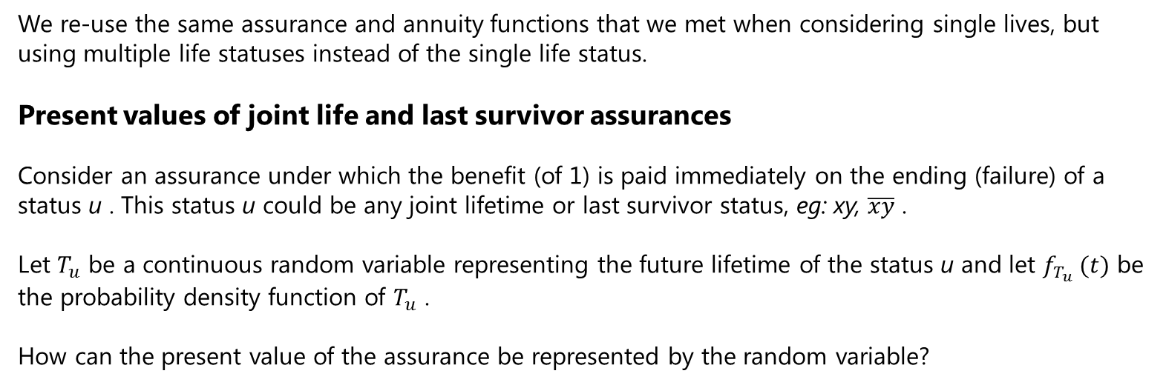
Present Values involving Two lives
3

Slide 37
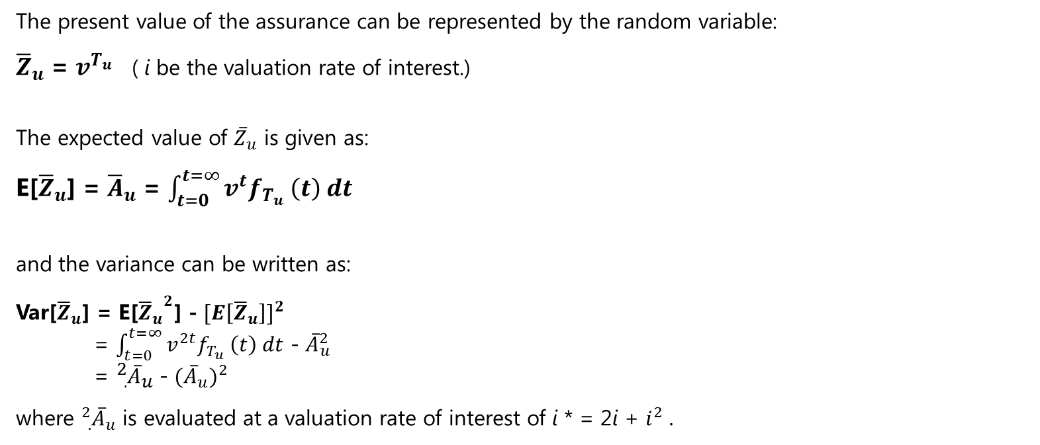
Present Values involving Two lives
3

Slide 38
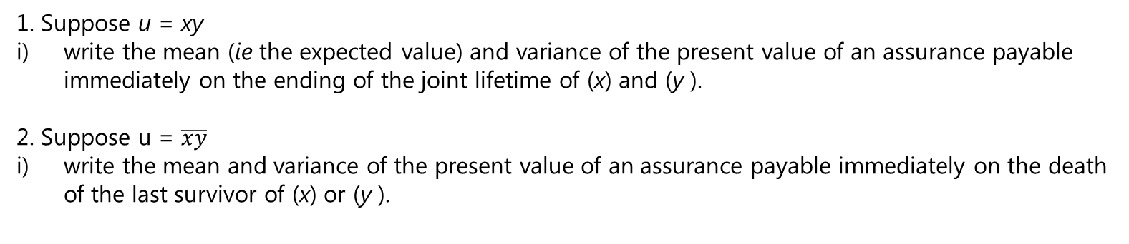
Question

Slide 39
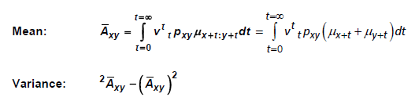
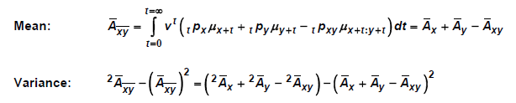
Solution
1.
2.

Slide 40
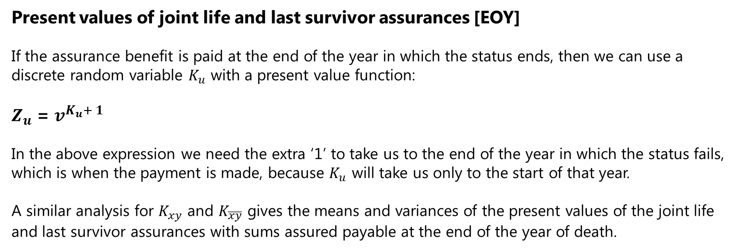
Present Values involving Two lives
3

Slide 41
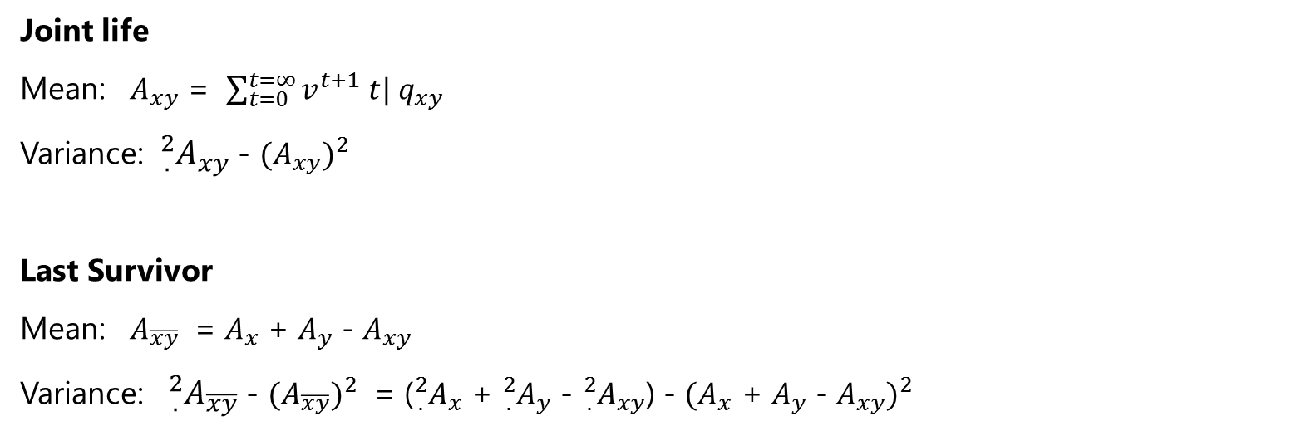
Present Values involving Two lives
3

Slide 42
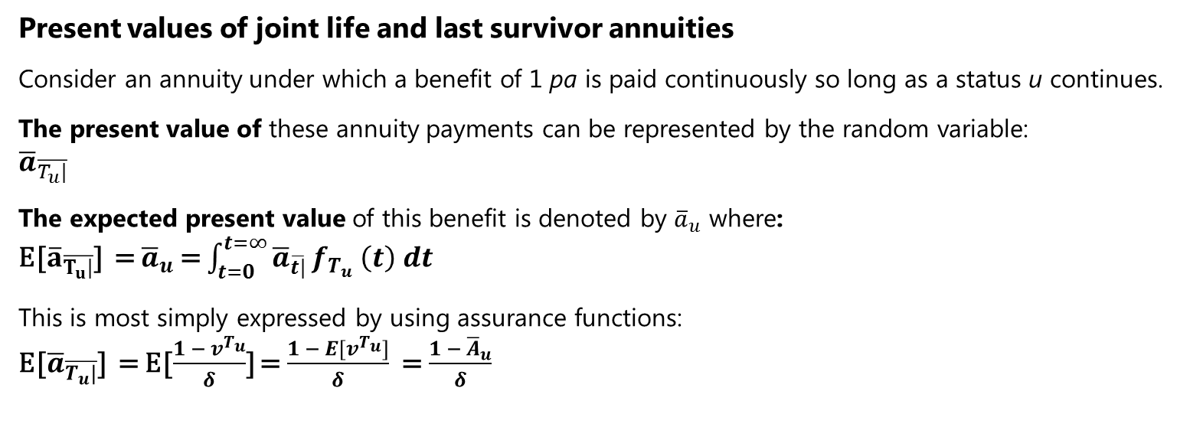
Present Values involving Two lives
3

Slide 43
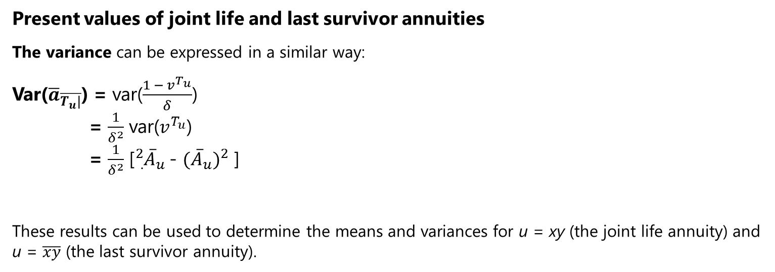
Present Values involving Two lives
3

Slide 45



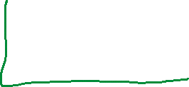




Slide 46
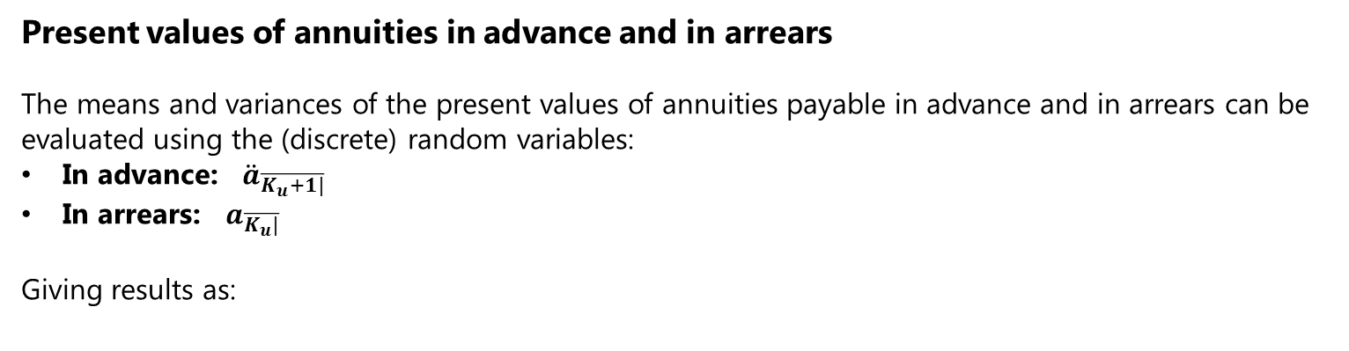
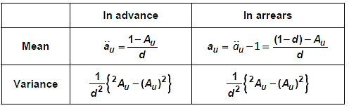
Present Values involving Two lives
3

Slide 47
Question

Slide 48
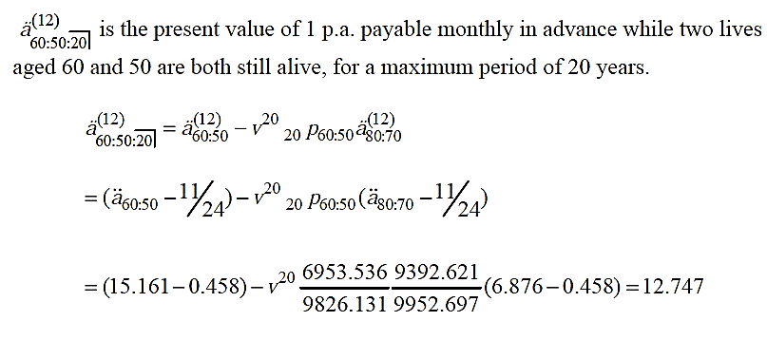
Solution

Slide 49



Question
A reversionary continuous annuity begins on the death of life x, if a second life y is then alive. Payment continues during the lifetime of y.
State, using random variables, the present value of this annuity.
Give an expression for the expected present value of this annuity in terms of assurance functions.

Slide 50
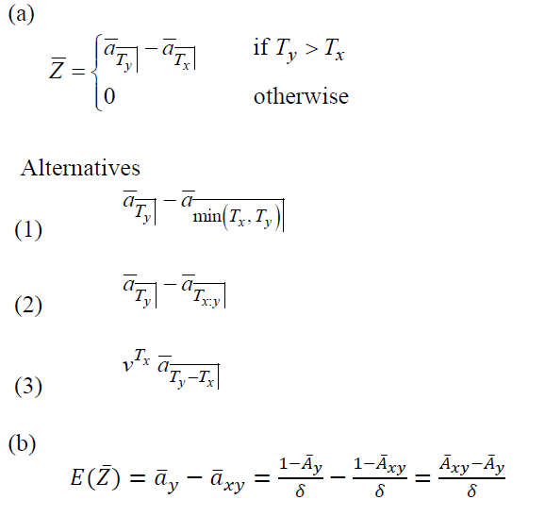
Solution

Slide 51
Calculations
4
We are now in a position to calculate numerical values for two lives. Once we have done this, we can apply the equivalence principle to calculate premiums for policies involving more than one life. In addition, we will adapt the techniques we have covered in earlier chapters for calculating reserves. This will enable us to calculate reserves for these types of policy.

Slide 52
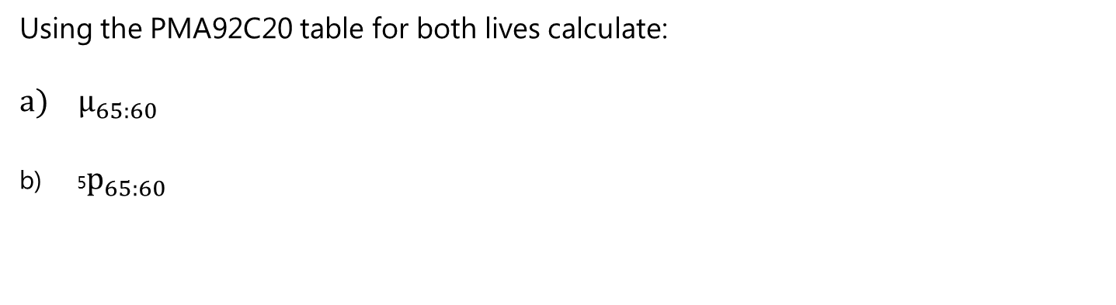

Question

Slide 53
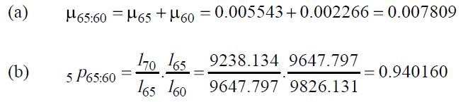
Solution

Slide 54
Question
Evaluating Premiums
William, aged 75, and Laura, aged 80, are the guardians of a child. They take out a life assurance policy that provides a payment of £25,000 immediately when the second of them dies. Level annual premiums are payable in advance whilst the policy is in force.
(i) Calculate the annual gross premium, using the basis given below.
Basis: Mortality: PMA92C20 for William, PFA92C20 for Laura
Interest: 4% pa effective
Expenses: Initial: £250
Renewal: 5% of each premium, excluding the first

Slide 55
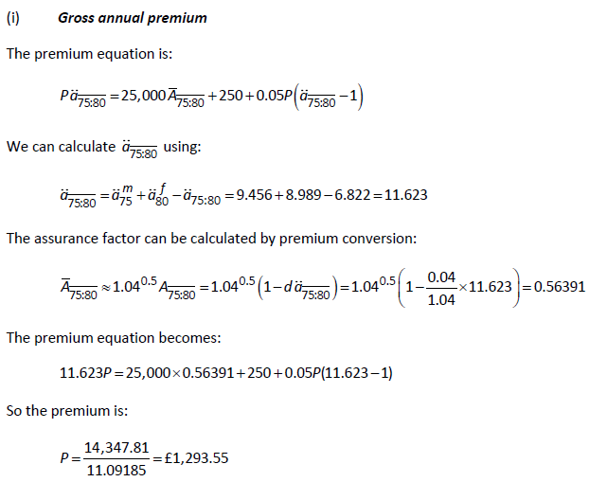
Solution

Slide 56
Calculating Reserves
4.1
We can calculate reserves for policies based on two lives, again adapting the methods we have met earlier for reserve calculations for single life policies. The prospective calculation involves calculating the EPV of the future benefits and expenses (if appropriate), and subtracting the EPV of any future premiums.
It is important when calculating a reserve for a last survivor assurance to remember that it would be necessary to establish whether both lives remain alive or one has already died. This is because, of course, the contract still remains in force whether one or two lives remain alive. The premium being paid will still be the original premium calculated on a last survivor basis.

Slide 57
Question
William, aged 75, and Laura, aged 80, are the guardians of a child. They take out a life assurance policy that provides a payment of £25,000 immediately when the second of them dies. Level annual premiums are payable in advance whilst the policy is in force.
(i) Calculate the annual gross premium, using the basis given below. (Solved earlier P = 1293.55)
(ii) Calculate the gross premium prospective reserve just before the sixth premium is paid, using the basis given below, assuming that both William and Laura are still alive at that time.
Basis: Mortality: PMA92C20 for William, PFA92C20 for Laura
Interest: 4% pa effective
Expenses: Initial: £250
Renewal: 5% of each premium, excluding the first

Slide 58











Slide 59
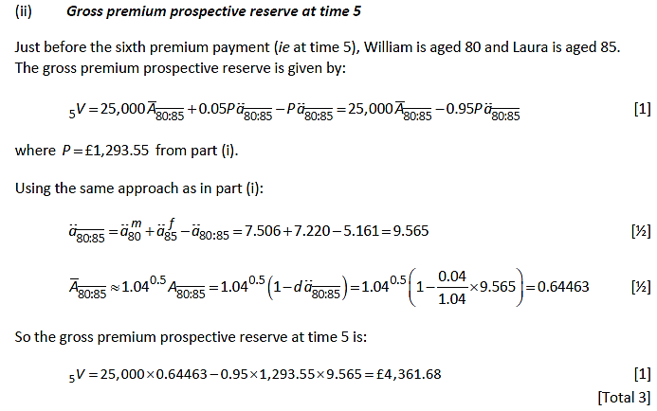
Solution

Slide 60
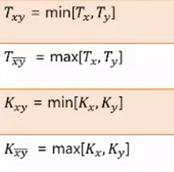
Recap
We summarize all the functions and models developed for two lives:
Random Variable | Modelling
 | Time to failure of the joint life status xy , ie the time until the first death of x and y
 | Time to failure of the last survivor status , ie time until the second death of x and y
 | Curtate time to failure of the joint life status xy , ie the curtate time until the first death of x and y
 | Curtate time to failure of the last survivor status , ie curtate time until the second death of x and y

Slide 61
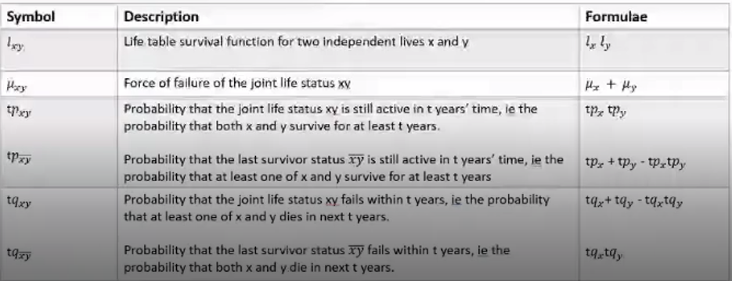
Recap
We have also developed the following notation, with associated formulae:

Slide 62
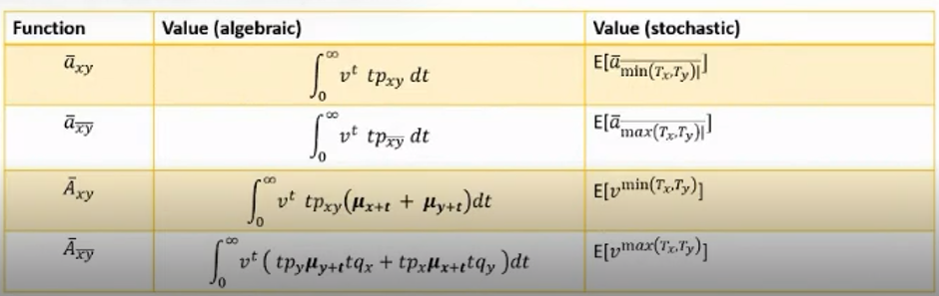
Recap
The most common benefits, and their values, are:

Slide 63
Contingent and Reversionary Benefits
5
We will now consider the implication of specifying the order in which the two lives die, which leads to the two types of benefit:
Contingent assurances
These are payable on the death of one life, contingent upon another life being in a specified state (alive or dead)
Reversionary annuities
These are payable to one life following the death of another life.

Slide 64
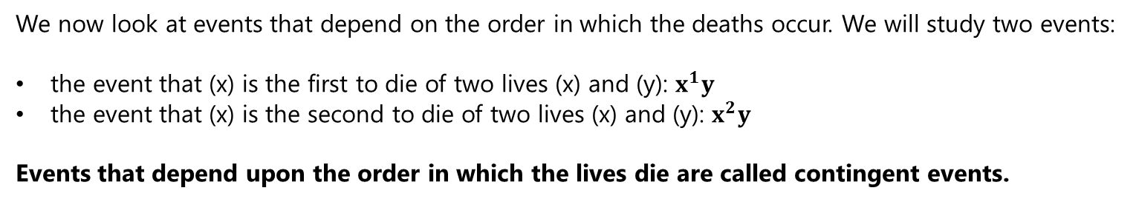
Contingent Probabilities of death
5.1

Slide 65
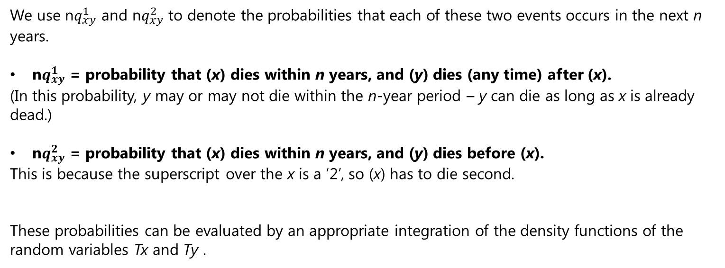
Contingent Probabilities of death
5.1

Slide 66
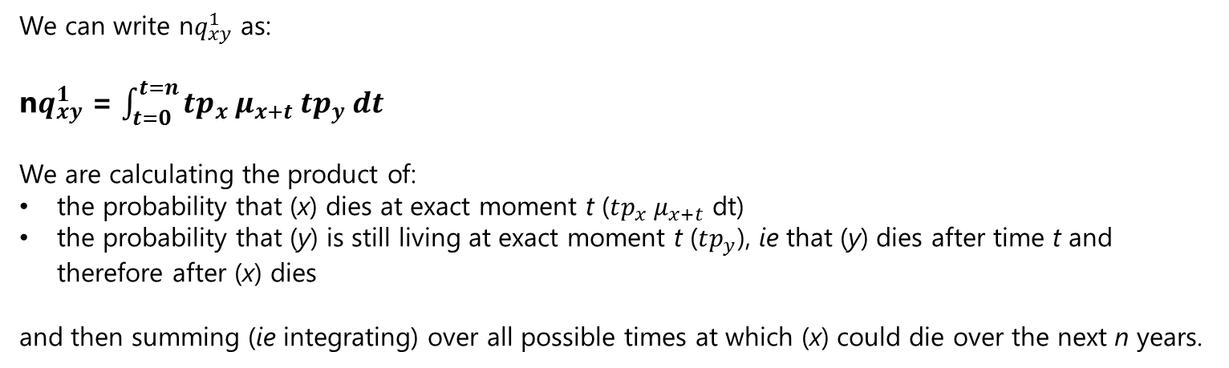
Contingent Probabilities of death
5.1

Slide 67
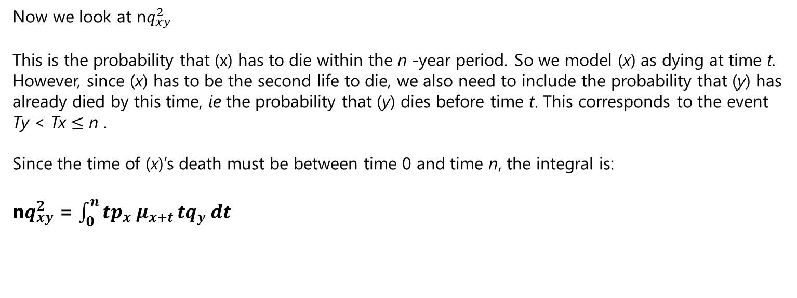
Contingent Probabilities of death
5.1

Slide 68
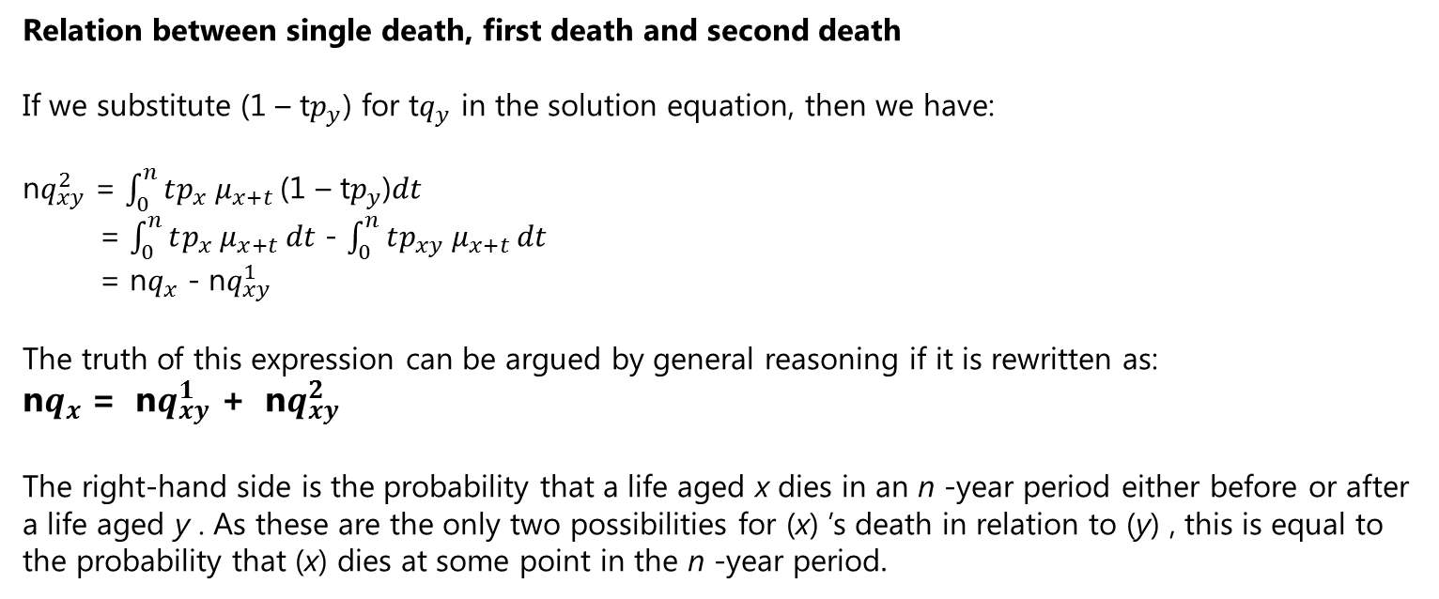
Contingent Probabilities of death
5.1

Slide 69
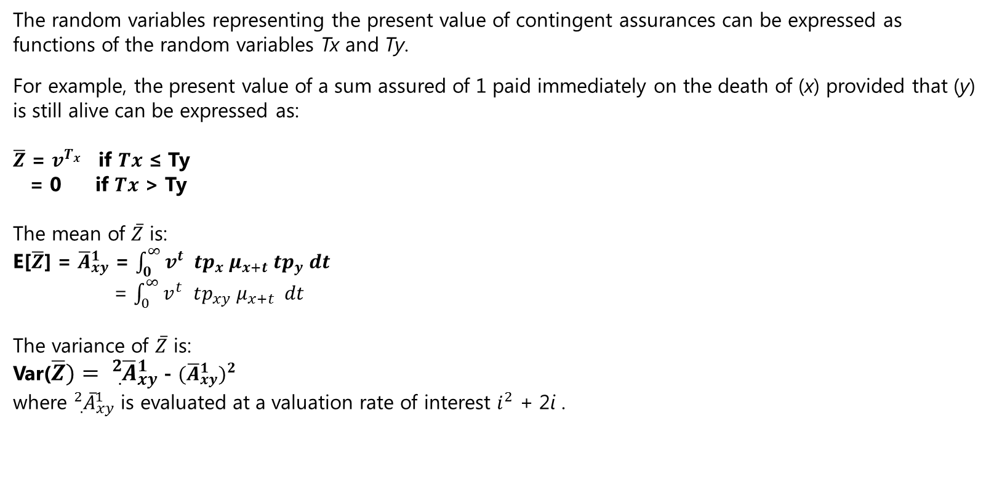
Contingent Assurances
5.1

Slide 70
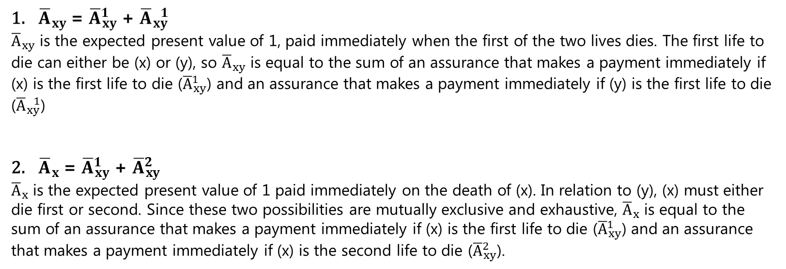
Certain Results
5.1

Slide 71
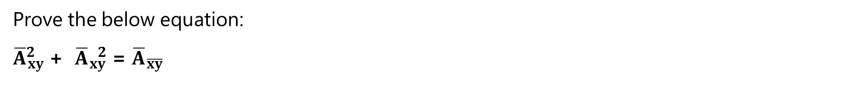
Question

Slide 72

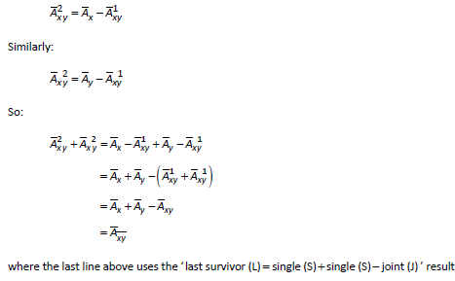
Solution
We know that:
Rearranging this equation gives us:

Slide 73
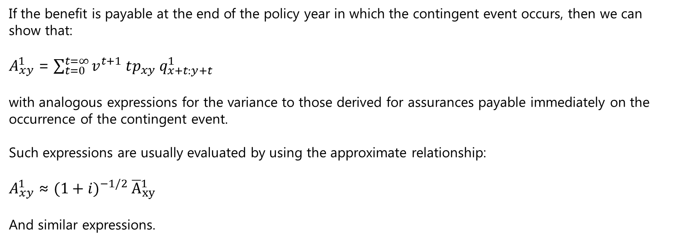
Benefits payable EOD
5.1

Slide 74
Question
CT5 September 2007 Q10
A policy provides a benefit of £500,000 immediately on the death of (y) if she dies after (x).
(i) Write down an expression in terms of Tx and Ty (random variables denoting the complete future lifetimes of (x) and (y) respectively) for the present value of the benefit under this policy. [2]
(ii) Write down an expression for the expected present value of the benefit in terms of an integral. [2]
(iii) Suggest, with a reason, the most appropriate term for regular premiums to be payable under this policy. [2]
[Total 6]

Slide 75
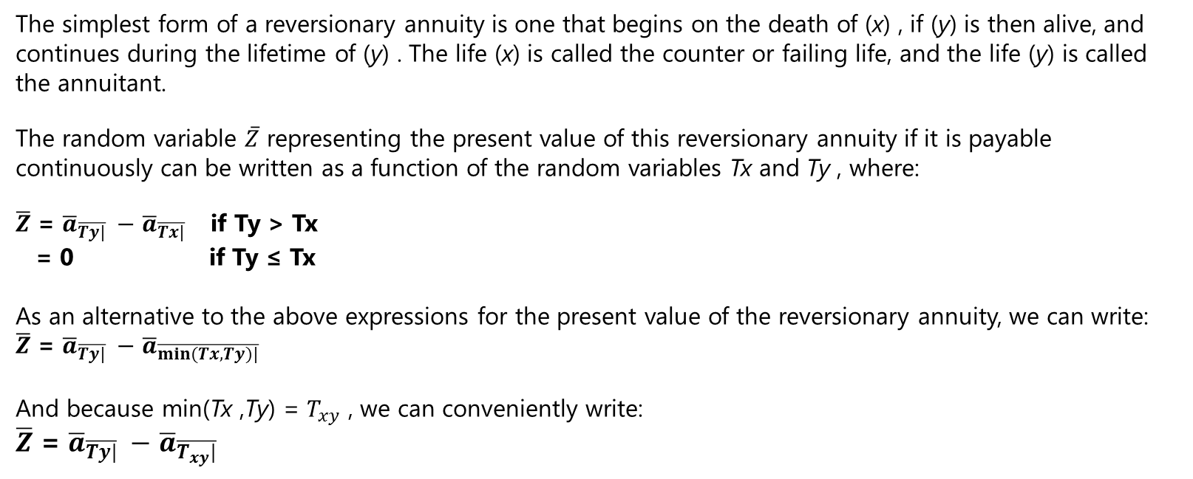
Reversionary Annuities
5.2

Slide 76

Reversionary Annuities
5.2

Slide 77


Reversionary Annuities
5.2

Slide 78

Joint Life functions dependent on term
5.3
EPV of joint life assurances and annuities which also depend upon term

Slide 79

Joint Life functions dependent on term
5.3
EPV of joint life assurances and annuities which also depend upon term

Slide 80

Joint Life functions dependent on term
5.3
EPV of last survivor assurances and annuities that also depend upon term

Slide 81

Reversionary annuities dependent on term
5.4
Type 1 – an annuity payable after a fixed term has elapsed

Slide 82


Reversionary annuities dependent on term
5.4
Type 2 - an annuity payable to (y) on the death of (x), but ceasing at time n

Slide 83

Reversionary annuities dependent on term
5.4
Type 3 – an annuity payable to (y) on the death of (x) provided that (x) dies within n years

Slide 84
Question
CT5 September 2010 Q3
Calculate the single premium payable for a temporary reversionary annuity of £12,000 per annum payable monthly in arrear to a female life currently aged 55 exact on the death of a male life currently aged 50 exact. No payment is made after 20 years from the date of purchase.
Basis:
Rate of interest 4% per annum
Mortality of male life PMA92C20
Mortality of female life PFA92C20
Expenses Nil

Slide 85

Reversionary annuities dependent on term
5.4
Type 4 – an annuity payable to (y) on the death of (x) for a maximum of n years

Slide 86

Reversionary annuities dependent on term
5.4
Type 5 – an annuity payable to (y) on the death of (x) and guaranteed for n years

Slide 87

Reversionary annuities dependent on term
5.4
Type 6 – an annuity payable to (y) on the death of (x) and continuing for n years after (y)’s death

Slide 88
Question
CT5 September 2006 Q4
A life insurance company issues a reversionary annuity contract. Under the contract an annuity of £20,000 per annum is payable monthly for life, to a female life now aged 60 exact, on the death of a male life now aged 65 exact. Annuity payments are always on monthly anniversaries of the date of issue of the contract.
Premiums are to be paid monthly until the annuity commences or the risk ceases.
Calculate the monthly premium required for the contract.
Basis: Mortality: PFA92C20 for the female
PMA92C20 for the male
Interest: 4% per annum
Expenses: 5% of each premium payment
1.5% of each annuity payment

Slide 89

Annuities payable m times a year
6

Slide 90

Annuities payable m times a year
6

Slide 91


Question 1 - HW

Slide 92

Solution 2 – HW

Slide 93
Question 2 - HW
(i) Calculate the expected present value of an annuity-due of 1 per annum payable annually in advance until the death of the last survivor of two lives using the following basis:
First life: male aged 70, mortality table PMA92C20
Second life: female aged 67, mortality table PFA92C20
Rate of interest: 4% per annum
(ii) Give an expression for the variance of the annuity-due in terms of annuity functions.

Slide 94

Solution 2 - HW

Slide 95

Solution 2 – HW Cont

Slide 96

Question 3 - HW

Slide 97

Solution 3 - HW

Slide 98


Solution 3 - HW

