Slide 1

Class: MSc
Subject : Statistical and Risk Modelling - 3
Chapter: Unit 4 Chapter 1 (Part 1)
Chapter Name: Markov process (Time-homogeneous)

Slide 2
Today’s Agenda
Time-homogeneous Markov Jump Process
Notations
The Chapman-Kolmogorov Equations
Transition Matrix
Transition Rates
The time-homogeneous health-sickness-death model
Kolmogorov’s differential equations
Forward
Backward
Poisson Process
The Jump chain
Maximum Likelihood Estimators

Slide 3

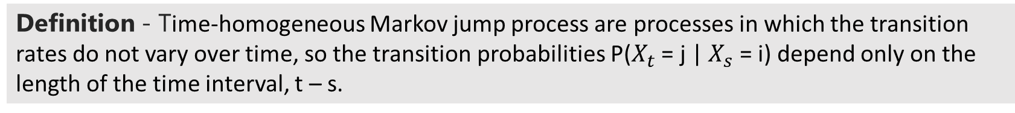
Time homogeneous Markov Jump Process
1
Definition - Time-homogeneous Markov jump process are processes in which the transition rates do not vary over time, so the transition probabilities P($X_{t}$ = j | $X_{s}$ = i) depend only on the length of the time interval, t – s.

Slide 4
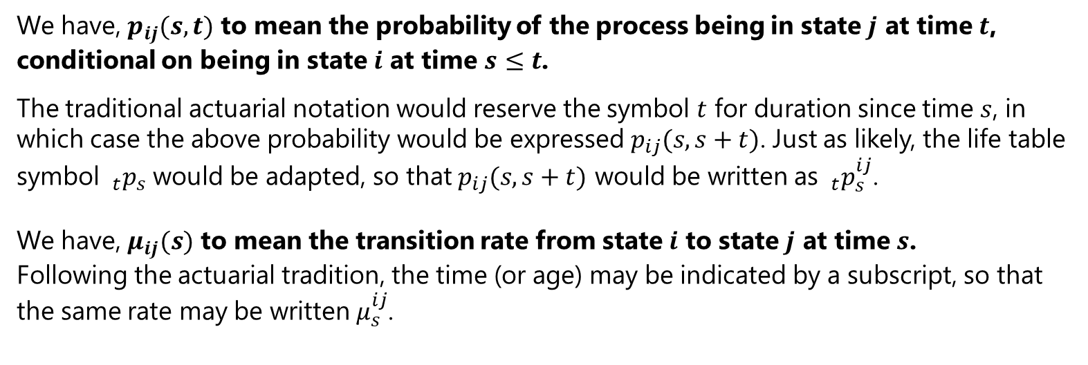
Notations
1.1
The non-homogeneous (i.e., time-inhomogeneous) Markov model offers particularly rich, and potentially confusing, opportunities to invent different notations for the same quantities. To try to limit any such confusion, we make the following remarks.
We have, $p_{ij}(s,t)$ to mean the probability of the process being in state $j$ at time $t$, conditional on being in state $i$ at time $s≤t$.
The traditional actuarial notation would reserve the symbol $t$ for duration since time $s$, in which case the above probability would be expressed $p_{ij}(s,s+t)$. Just as likely, the life table symbol $_{t}p_{s}$ would be adapted, so that $p_{ij}(s,s+t)$ would be written as $_{t}p_{s}^{ij}$.
We have, $μ_{ij}(s)$ to mean the transition rate from state $i$ to state $j$ at time $s$. Following the actuarial tradition, the time (or age) may be indicated by a subscript, so that the same rate may be written $μ_{s}^{ij}$.

Slide 5
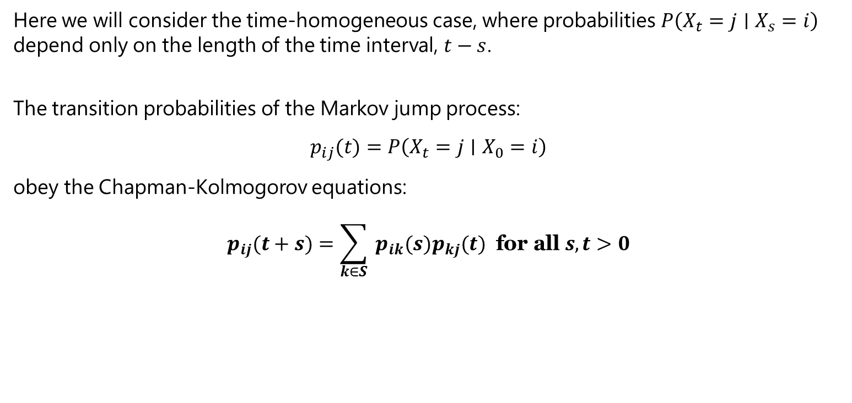
The Chapman-Kolmogorov equations
2
Here we will consider the time-homogeneous case, where probabilities $P\left(X_{t}=j∣X_{s}=i\right)$ depend only on the length of the time interval, $t−s$.
The transition probabilities of the Markov jump process:
$$p_{ij}(t)=P\left(X_{t}=j∣X_{0}=i\right)$$
obey the Chapman-Kolmogorov equations:
$$p_{ij}(t+s)=\sum_{k∈S}{ }p_{ik}(s)p_{kj}(t) \text{for} \text{all} s,t>0$$

Slide 6
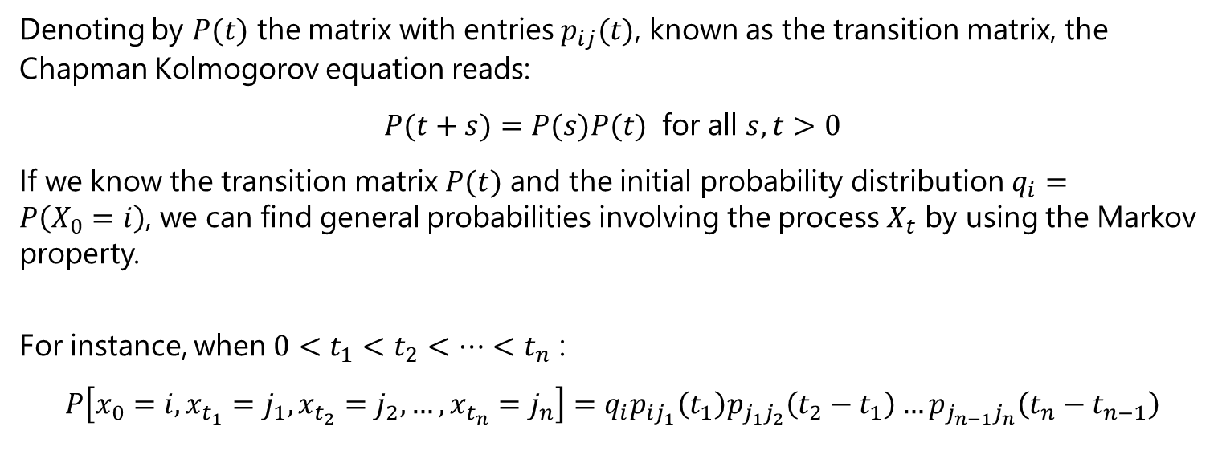
The transition Matrix
3
Denoting by $P(t)$ the matrix with entries $p_{ij}(t)$, known as the transition matrix, the Chapman Kolmogorov equation reads:
$$P(t+s)=P(s)P(t) \text{for} \text{all} s,t>0$$
If we know the transition matrix $P(t)$ and the initial probability distribution $q_{i}=P\left(X_{0}=i\right)$, we can find general probabilities involving the process $X_{t}$ by using the Markov property.
For instance, when $0<t_{1}<t_{2}<…<t_{n}$ :
$$P\left[x_{0}=i,x_{t_{1}}=j_{1},x_{t_{2}}=j_{2},…,x_{t_{n}}=j_{n}\right]=q_{i}p_{ij_{1}}\left(t_{1}\right)p_{j_{1}j_{2}}\left(t_{2}−t_{1}\right)…p_{j_{n−1}j_{n}}\left(t_{n}−t_{n−1}\right)$$

Slide 7
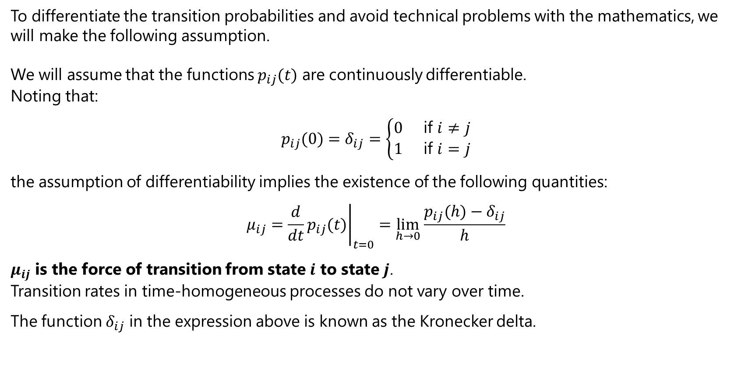
Transition Rates
3.1
To differentiate the transition probabilities and avoid technical problems with the mathematics, we will make the following assumption.
We will assume that the functions $p_{ij}(t)$ are continuously differentiable. Noting that:
$$p_{ij}(0)=δ_{ij}=\left\{\begin{matrix}0 & \text{if} i≠j \\ 1 & \text{if} i=j\end{matrix}\right.$$
the assumption of differentiability implies the existence of the following quantities:
$$μ_{ij}={\left.\frac{d}{dt}p_{ij}(t)\right|}_{t=0}=\lim_{h→0} \frac{p_{ij}(h)−δ_{ij}}{h}$$
$μ_{ij}$ is the force of transition from state $i$ to state $j$. Transition rates in time-homogeneous processes do not vary over time.
The function $δ_{ij}$ in the expression above is known as the Kronecker delta.

Slide 8
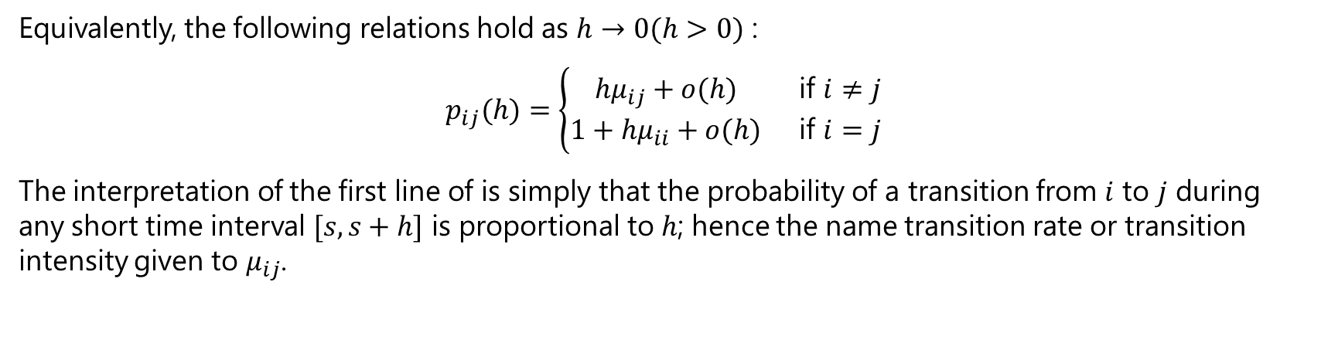
Transition Rates
3.1
Equivalently, the following relations hold as $h→0(h>0)$ :
$$p_{ij}(h)=\left\{\begin{matrix}hμ_{ij}+o(h) & \text{if} i≠j \\ 1+hμ_{ii}+o(h) & \text{if} i=j\end{matrix}\right.$$
The interpretation of the first line of is simply that the probability of a transition from $i$ to $j$ during any short time interval $[s,s+h]$ is proportional to $h$; hence the name transition rate or transition intensity given to $μ_{ij}$.

Slide 9
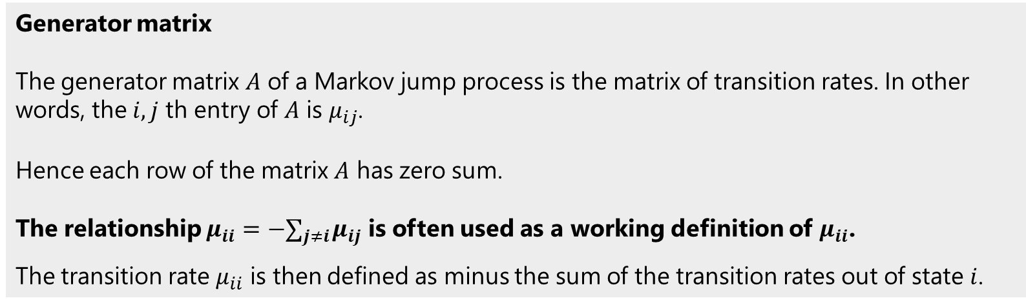
Transition Rates
3.1
Generator matrix The generator matrix $A$ of a Markov jump process is the matrix of transition rates. In other words, the $i,j$ th entry of $A$ is $μ_{ij}$. Hence each row of the matrix $A$ has zero sum. The relationship $μ_{ii}=−∑_{j≠i} μ_{ij}$ is often used as a working definition of $μ_{ii}$.
The transition rate $μ_{ii}$ is then defined as minus the sum of the transition rates out of state $i$.

Slide 10
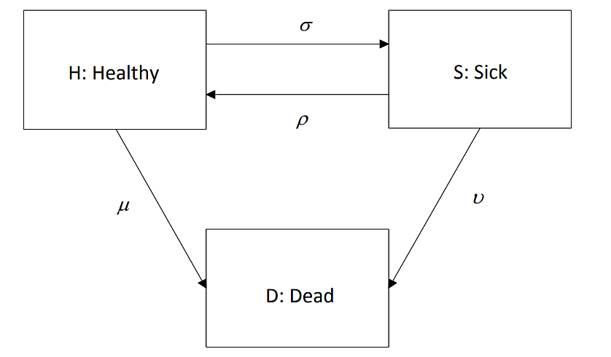
The time-homogeneous health-sickness-death model
4
What will be the transition matrix for the above diagram?

Slide 11
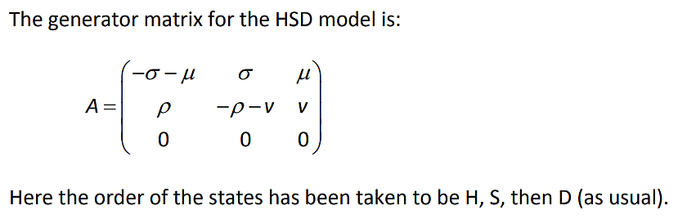
The time-homogeneous health-sickness-death model
4

Slide 12
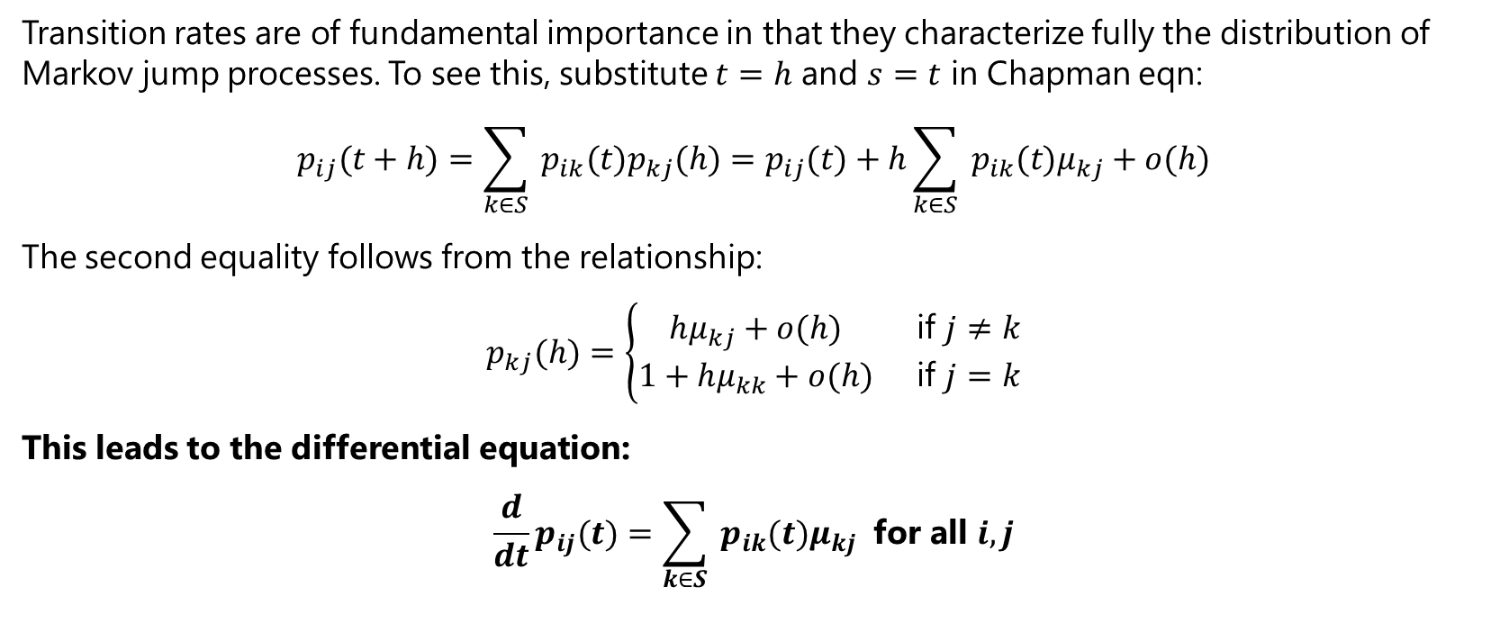
Kolmogorov’s forward differential equations
5.1
Transition rates are of fundamental importance in that they characterize fully the distribution of Markov jump processes. To see this, substitute $t=h$ and $s=t$ in Chapman eqn:
$$p_{ij}(t+h)=\sum_{k∈S}{ }p_{ik}(t)p_{kj}(h)=p_{ij}(t)+h\sum_{k∈S}{ }p_{ik}(t)μ_{kj}+o(h)$$
The second equality follows from the relationship:
$$p_{kj}(h)=\left\{\begin{matrix}hμ_{kj}+o(h) & \text{if} j≠k \\ 1+hμ_{kk}+o(h) & \text{if} j=k\end{matrix}\right.$$
This leads to the differential equation:
$$\frac{d}{dt}p_{ij}(t)=\sum_{k∈S}{ }p_{ik}(t)μ_{kj} \text{for} \text{all} i,j$$

Slide 13
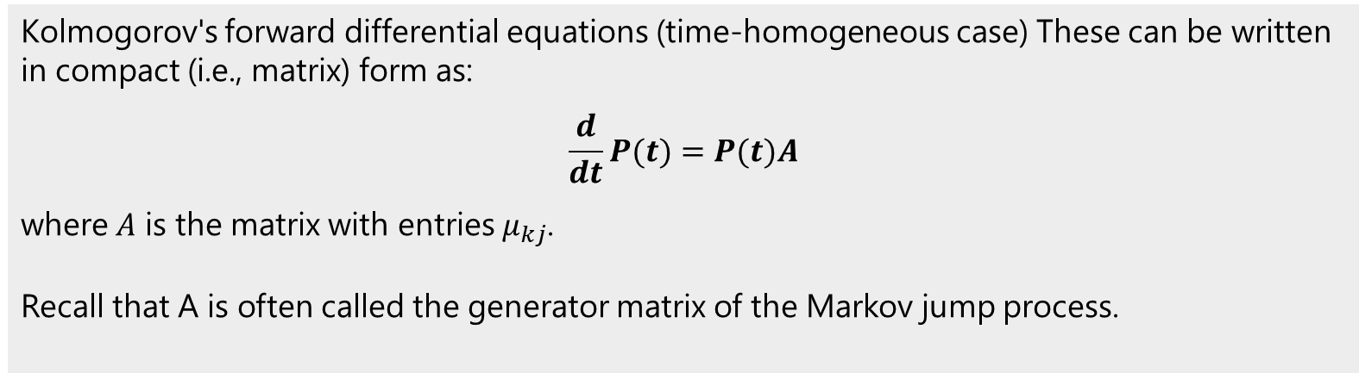
Kolmogorov’s forward differential equations
5.1
Kolmogorov's forward differential equations (time-homogeneous case) These can be written in compact (i.e., matrix) form as:
$$\frac{d}{dt}P(t)=P(t)A$$
where $A$ is the matrix with entries $μ_{kj}$. Recall that A is often called the generator matrix of the Markov jump process.

Slide 14
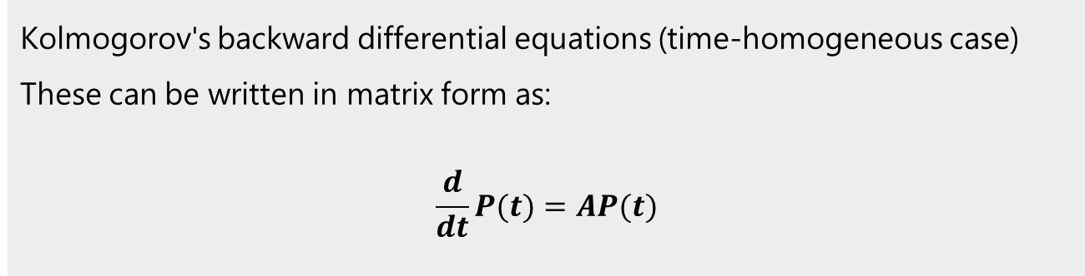
Kolmogorov’s backward differential equations
5.2
Kolmogorov's backward differential equations (time-homogeneous case) These can be written in matrix form as:
$$\frac{d}{dt}P(t)=AP(t)$$

Slide 15
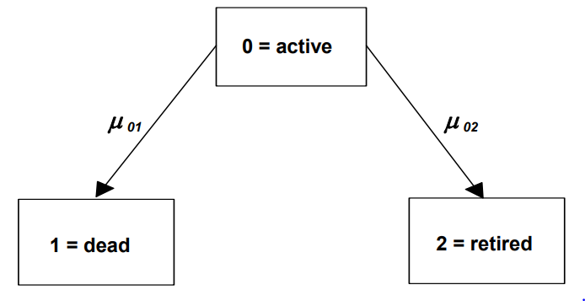
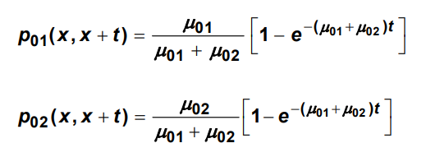
Kolmogorov’s differential equations
5.3
Elementary Cases
For example, consider the two-decrement model, in which the transition intensities are constant.
The Solution to the Kolmogorov equation can be given as:

Slide 16
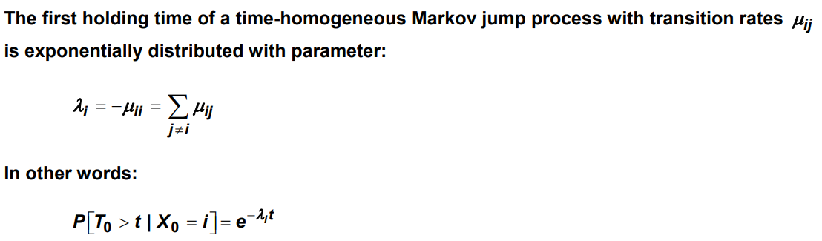
Poisson Process
6
Holding times and occupancy probabilities
Distribution of the first holding time

Slide 17

Poisson Process
6
Holding times and occupancy probabilities
Probability that the process goes into state j when it leaves state I
Given that a time-homogeneous Markov jump process is currently in state i , the probability that it moves into state j when it leaves state i is given by:
Also, given a jump has occurred, the time at which it took place does not affect the probability of the jump being to a particular state.

Slide 18
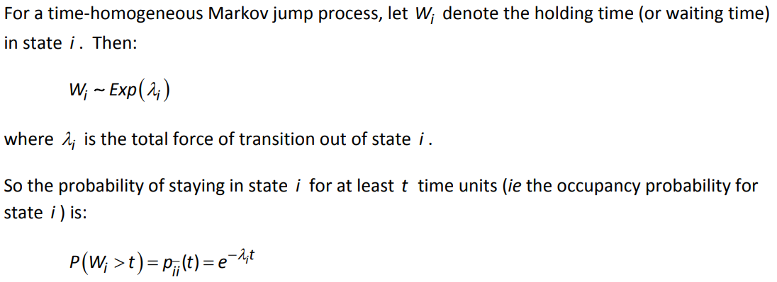
Poisson Process
6
Holding times and occupancy probabilities
Distribution of holding time random variables and occupancy probabilities

Slide 19
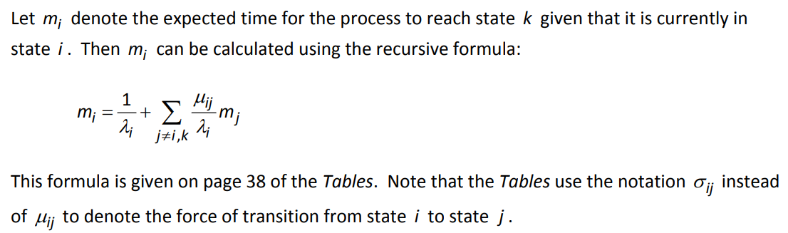
Expected time to reach state k starting from state i
6

Slide 20
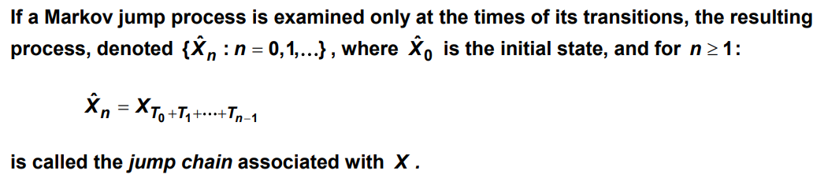
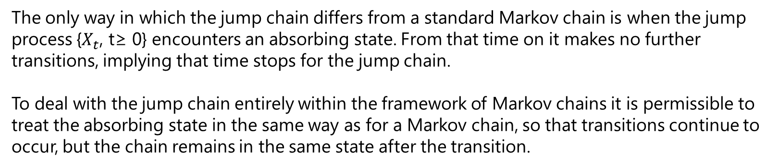
The Jump Chain
7
The only way in which the jump chain differs from a standard Markov chain is when the jump process {$X_{t}$, t≥ 0} encounters an absorbing state. From that time on it makes no further transitions, implying that time stops for the jump chain.
To deal with the jump chain entirely within the framework of Markov chains it is permissible to treat the absorbing state in the same way as for a Markov chain, so that transitions continue to occur, but the chain remains in the same state after the transition.

Slide 21
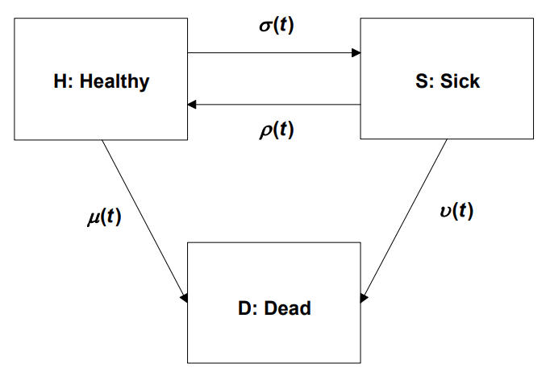
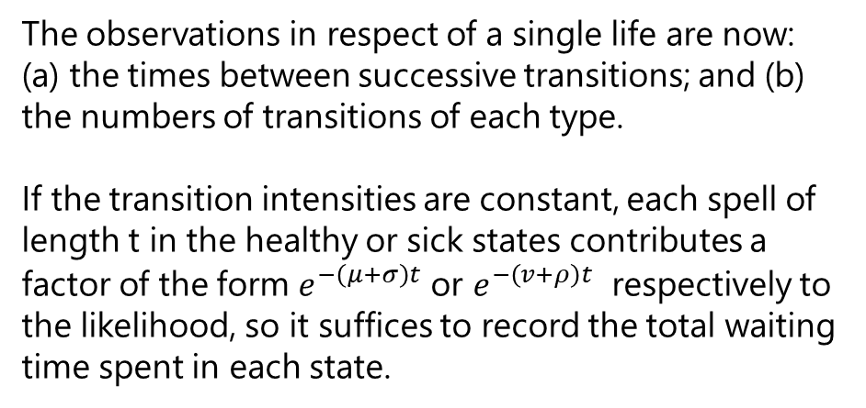
Maximum Likelihood Estimators
8
Consider the illness-death model, which has three states: healthy (H), sick (S) and dead (D):
The observations in respect of a single life are now: (a) the times between successive transitions; and (b) the numbers of transitions of each type.
If the transition intensities are constant, each spell of length t in the healthy or sick states contributes a factor of the form $e^{−\left(μ+σ\right)t}$ or $e^{−\left(v+ρ\right)t}$ respectively to the likelihood, so it suffices to record the total waiting time spent in each state.

Slide 22
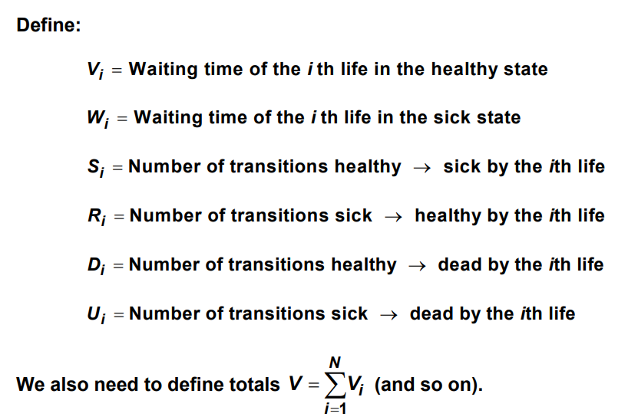
Maximum Likelihood Estimators
8

Slide 23

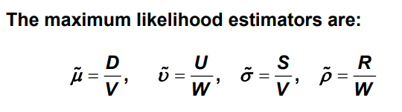
Maximum Likelihood Estimators
8
Using lower case symbols for the observed samples as usual, it is easily shown that the likelihood for the four parameters, μ, σ, v, ρ, given the data is proportional to:
Solving the above likelihood, gives the estimators as:

Slide 24
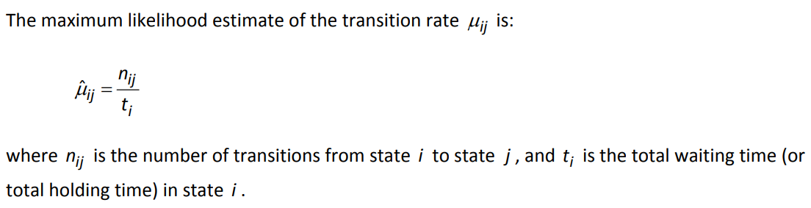
Maximum Likelihood Estimators
8
Estimating transition rates in a time-homogeneous Markov jump process

Slide 25
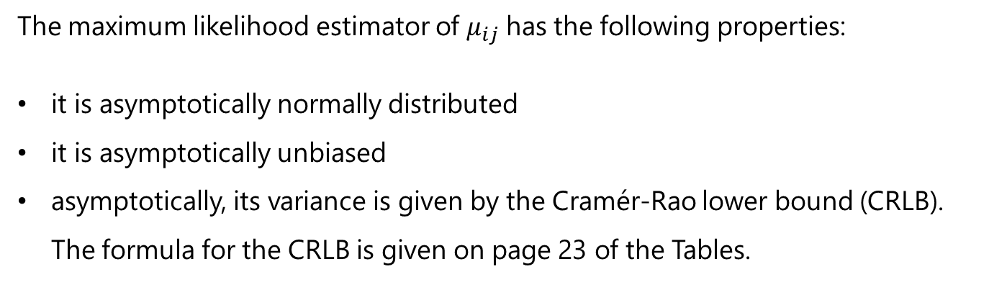
Maximum Likelihood Estimators
8
The maximum likelihood estimator of $μ_{ij}$ has the following properties:
it is asymptotically normally distributed
it is asymptotically unbiased
asymptotically, its variance is given by the Cramér-Rao lower bound (CRLB). The formula for the CRLB is given on page 23 of the Tables.

