Slide 1

Class: MSc
Subject : Statistical and Risk Modelling - 3
Chapter: Unit 4 Chapter 1 (Part 2)
Chapter Name: Markov process (Time-inhomogeneous)

Slide 2
Today’s Agenda
Time-inhomogeneous Markov Jump process
Chapman-Kolmogorov Equations
Transition Rates
Kolmogorov’s Differential Equations
Forward
Backward
Probability
Integrated form of the Kolmogorov equations
Backward
Forward

Slide 3

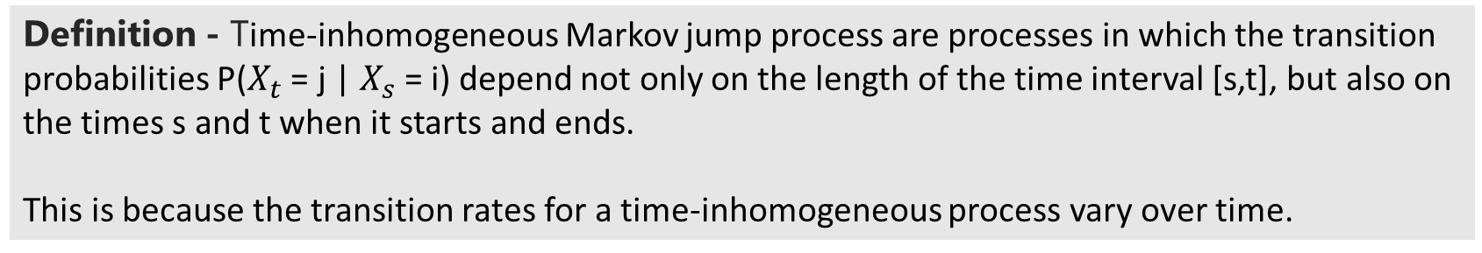
Time inhomogeneous Markov Jump Process
1
Definition - Time-inhomogeneous Markov jump process are processes in which the transition probabilities P($X_{t}$ = j | $X_{s}$ = i) depend not only on the length of the time interval [s,t], but also on the times s and t when it starts and ends.
This is because the transition rates for a time-inhomogeneous process vary over time.

Slide 4
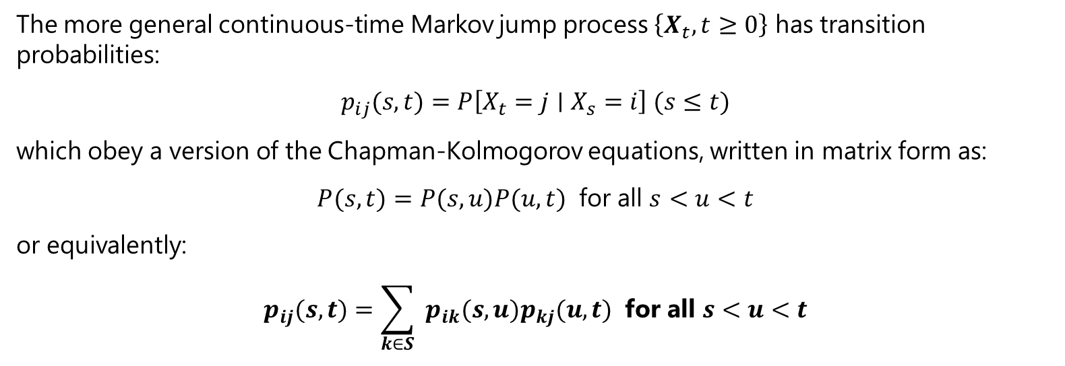
The Chapman-Kolmogorov equations
2
The more general continuous-time Markov jump process $\left\{X_{t},t≥0\right\}$ has transition probabilities:
$$p_{ij}(s,t)=P\left[X_{t}=j∣X_{s}=i\right] (s≤t)$$
which obey a version of the Chapman-Kolmogorov equations, written in matrix form as:
$$P(s,t)=P(s,u)P(u,t) \text{for} \text{all} s<u<t$$
or equivalently:
$$\begin{matrix}p_{ij}(s,t)=\sum_{k∈S}{ } p_{ik}(s,u)p_{kj}(u,t) \text{for} \text{all} s<u<t \\ \end{matrix}$$

Slide 5
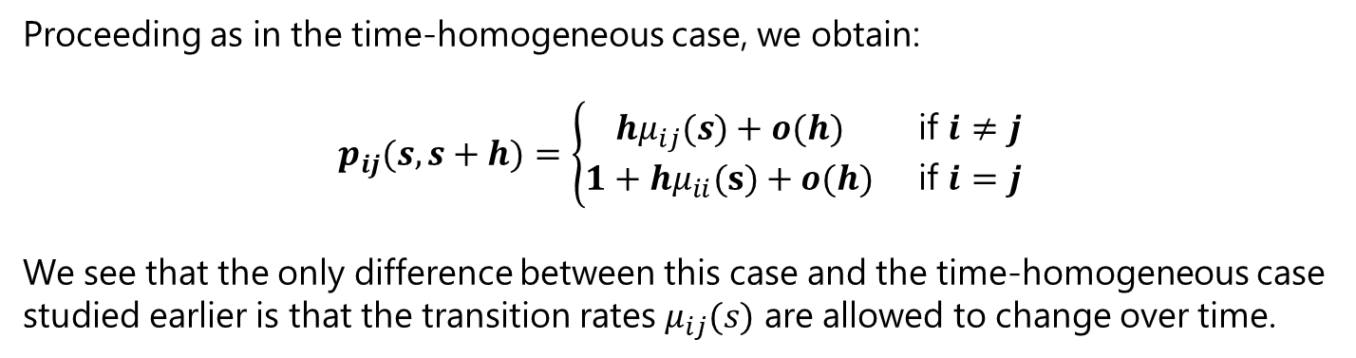
Transition Rates
3
Proceeding as in the time-homogeneous case, we obtain:
$$p_{ij}(s,s+h)=\left\{\begin{matrix}hμ_{ij}(s)+o(h) & \text{if} i≠j \\ 1+hμ_{ii}(s)+o(h) & \text{if} i=j\end{matrix}\right.$$
We see that the only difference between this case and the time-homogeneous case studied earlier is that the transition rates $μ_{ij}(s)$ are allowed to change over time.

Slide 6
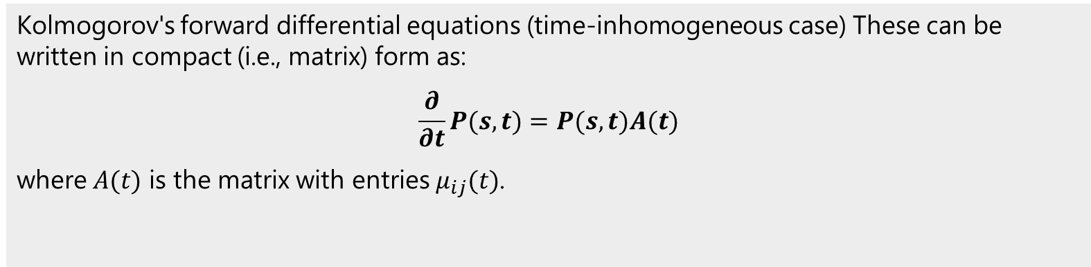
Kolmogorov’s forward differential equations
4.1
Kolmogorov's forward differential equations (time-inhomogeneous case) These can be written in compact (i.e., matrix) form as:
$$\frac{∂}{∂t}P(s,t)=P(s,t)A(t)$$
where $A(t)$ is the matrix with entries $μ_{ij}(t)$.

Slide 7
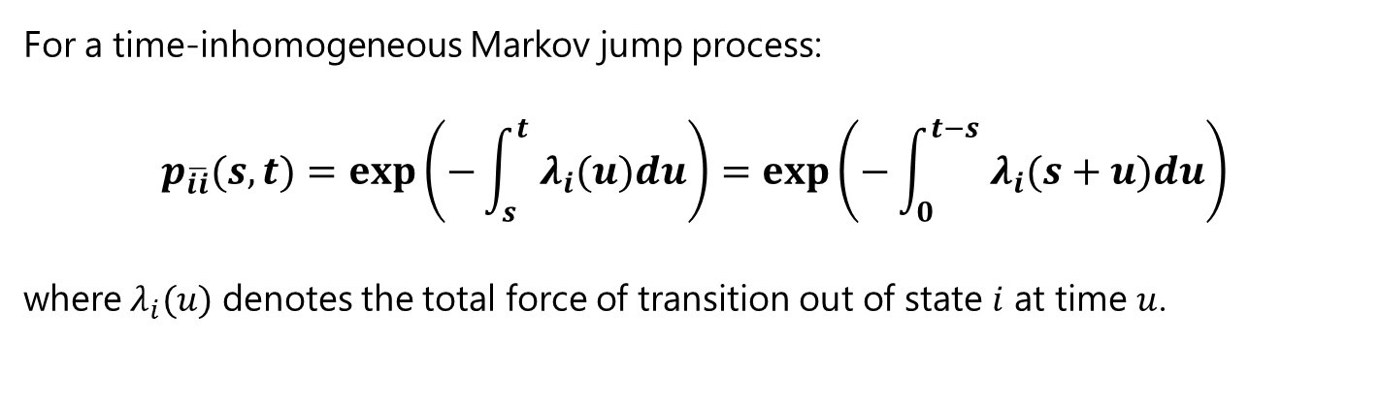
Occupancy Probabilities
For a time-inhomogeneous Markov jump process:
$$p_{\overline{ii}}(s,t)=exp⁡\left(−\int_{s}^{t}{ } λ_{i}(u)du\right)=exp⁡\left(−\int_{0}^{t−s}{ } λ_{i}(s+u)du\right)$$
where $λ_{i}(u)$ denotes the total force of transition out of state $i$ at time $u$.

Slide 8
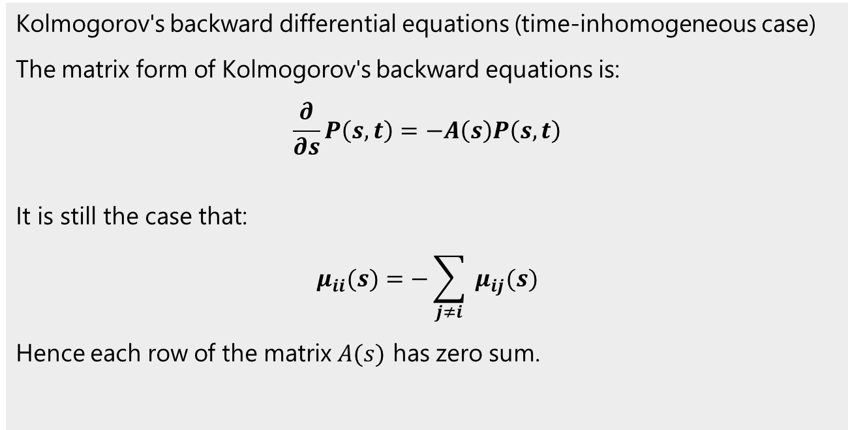
Kolmogorov’s backward differential equations
4.2
Kolmogorov's backward differential equations (time-inhomogeneous case)
The matrix form of Kolmogorov's backward equations is:
$$\frac{∂}{∂s}P\left(s,t\right)=−A\left(s\right)P\left(s,t\right)$$
It is still the case that:
$$μ_{ii}(s)=−\sum_{j≠i}{ }μ_{ij}(s)$$
Hence each row of the matrix $A(s)$ has zero sum.

Slide 9
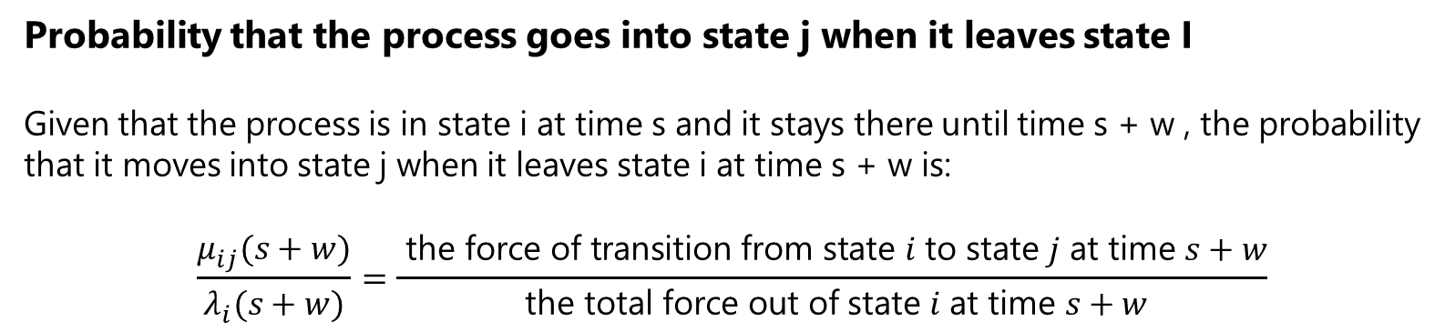
Probability
5
Probability that the process goes into state j when it leaves state I
Given that the process is in state i at time s and it stays there until time s + w , the probability that it moves into state j when it leaves state i at time s + w is:
$$\frac{μ_{ij}(s+w)}{λ_{i}(s+w)}=\frac{ \text{the} \text{force} \text{of} \text{transition} \text{from} \text{state} i \text{to} \text{state} j \text{at} \text{time} s+w}{ \text{the} \text{total} \text{force} \text{out} \text{of} \text{state} i \text{at} \text{time} s+w}$$

Slide 10
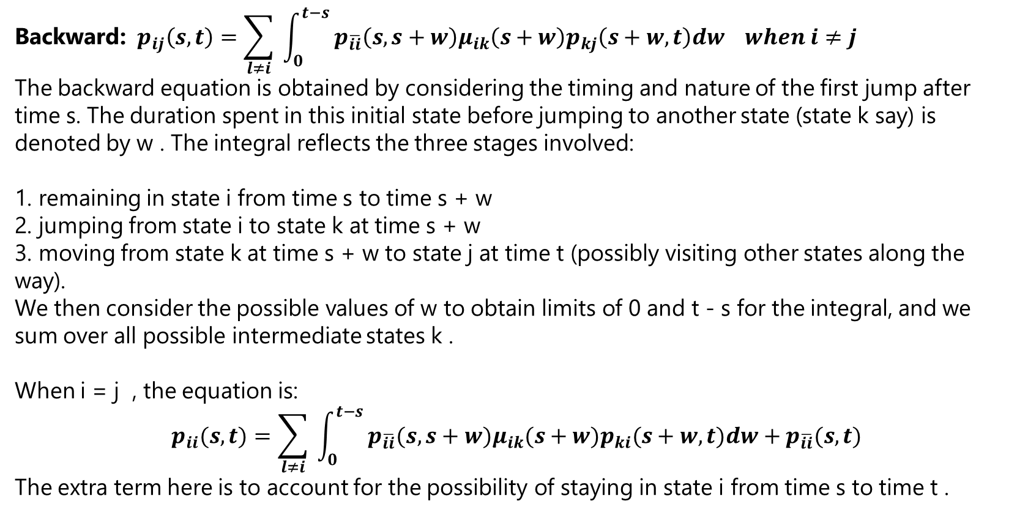
Integrated form of the Kolmogorov backward equations
6.1
$$\text{Backward}\text{:} p_{ij}\left(s,t\right)=\sum_{l≠i}{ }\int_{0}^{t−s}{ }p_{\overline{ii}}\left(s,s+w\right)μ_{ik}\left(s+w\right)p_{kj}\left(s+w,t\right)dw when i≠j$$
The backward equation is obtained by considering the timing and nature of the first jump after time s. The duration spent in this initial state before jumping to another state (state k say) is denoted by w . The integral reflects the three stages involved:
1. remaining in state i from time s to time s + w
2. jumping from state i to state k at time s + w
3. moving from state k at time s + w to state j at time t (possibly visiting other states along the way).
We then consider the possible values of w to obtain limits of 0 and t - s for the integral, and we sum over all possible intermediate states k .
When i = j , the equation is:
$$p_{ii}(s,t)=\sum_{l≠i}{ }\int_{0}^{t−s}{ }p_{\overline{ii}}(s,s+w)μ_{ik}(s+w)p_{ki}(s+w,t)dw+p_{\overline{ii}}(s,t)$$
The extra term here is to account for the possibility of staying in state i from time s to time t .

Slide 11
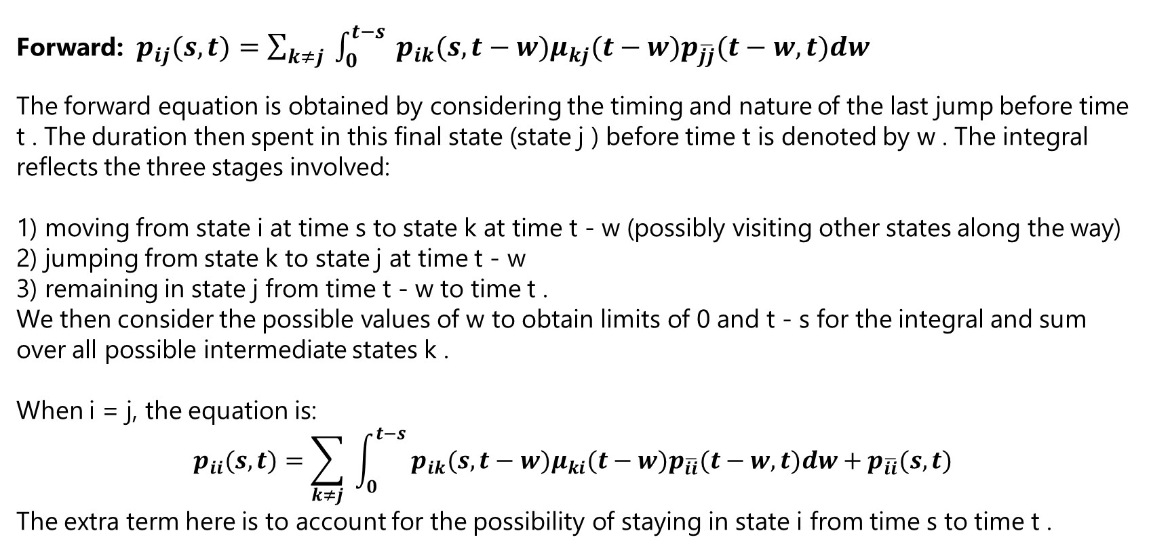
Integrated form of the Kolmogorov forward equations
6.2
Forward: $p_{ij}(s,t)=\sum_{k≠j}{ }\int_{0}^{t−s}{ }p_{ik}(s,t−w)μ_{kj}(t−w)p_{\overline{jj}}(t−w,t)dw$
The forward equation is obtained by considering the timing and nature of the last jump before time t . The duration then spent in this final state (state j ) before time t is denoted by w . The integral reflects the three stages involved:
1) moving from state i at time s to state k at time t - w (possibly visiting other states along the way)
2) jumping from state k to state j at time t - w
3) remaining in state j from time t - w to time t .
We then consider the possible values of w to obtain limits of 0 and t - s for the integral and sum over all possible intermediate states k .
When i = j, the equation is:
$$p_{ii}(s,t)=\sum_{k≠j}{ }\int_{0}^{t−s}{ }p_{ik}(s,t−w)μ_{ki}(t−w)p_{\overline{ii}}(t−w,t)dw+p_{\overline{ii}}(s,t)$$
The extra term here is to account for the possibility of staying in state i from time s to time t .

