Slide 1

Subject : Statistical & Risk Modelling - 3
Time Inhomogeneous Markov Jump

Slide 2
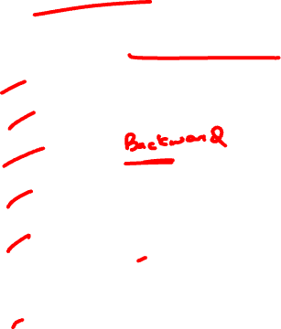
Agenda
Time In-homogenous Markov jump process
Chapman Kolmogorov equation
Kolmogorov Forward differential equations
Kolmogorov Forward differential equations
Occupancy probability
Probability of going to another state
Integrated form of KFD and KBD
Applications

Slide 3
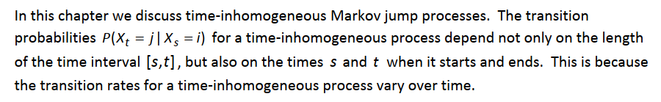
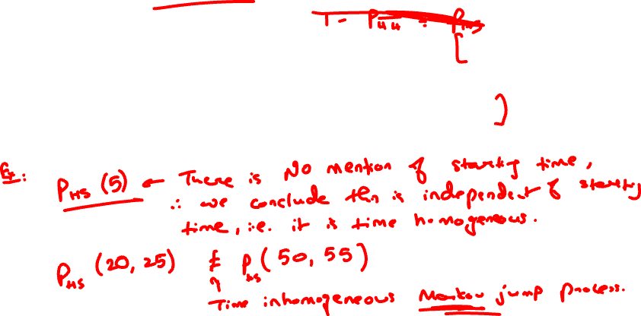
Time Inhomogeneity

Slide 4
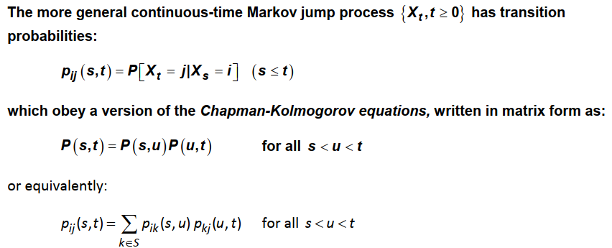
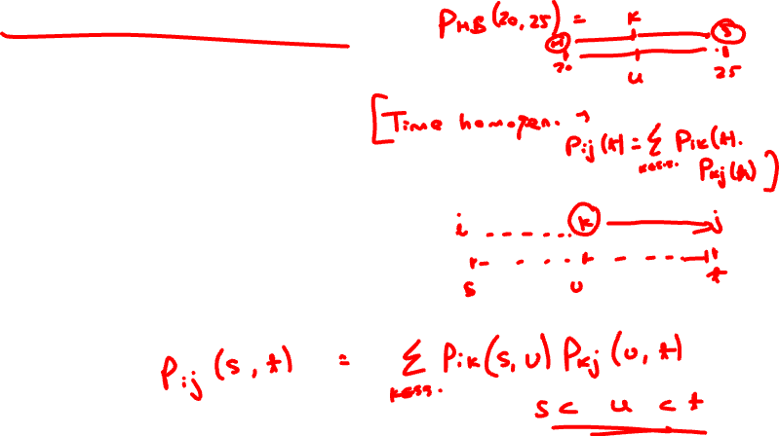
Chapman Kolmogorov Eqns
.

Slide 5
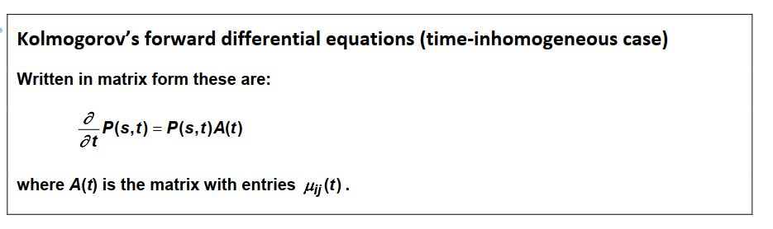
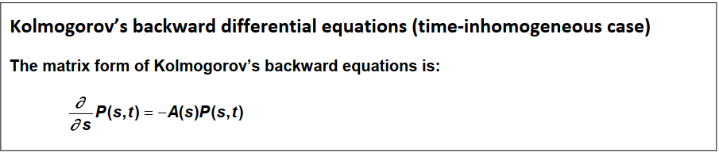


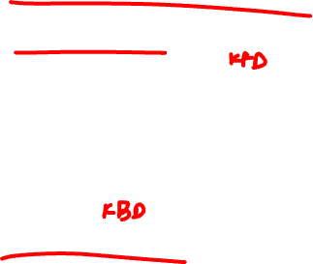
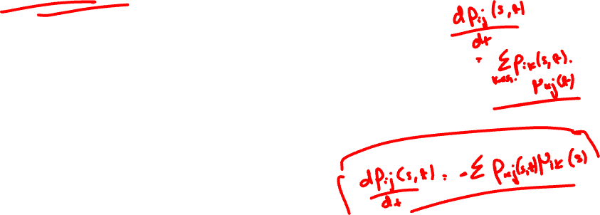
Kolmogorov Eqns updated
.
Prove using Chapman Kolmogorov equation

Slide 6
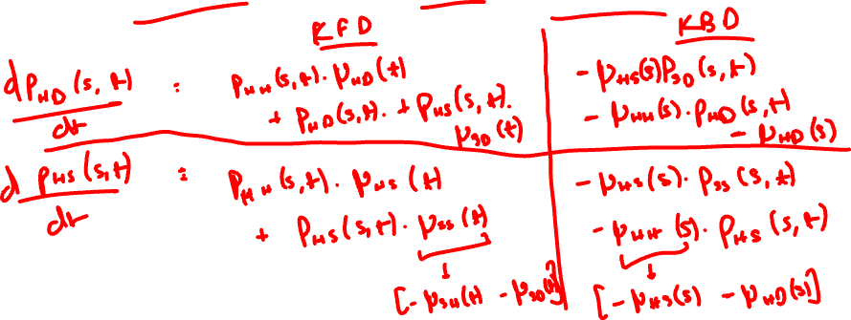
Kolmogorov Eqns updated
.
Question
Write down Kolmogorov’s forward and backward differential equation for p_{HD}(s,t) & p_{Hs}(s,t).

Slide 7
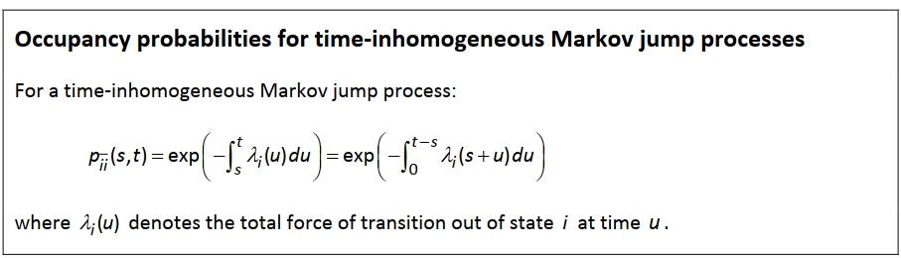
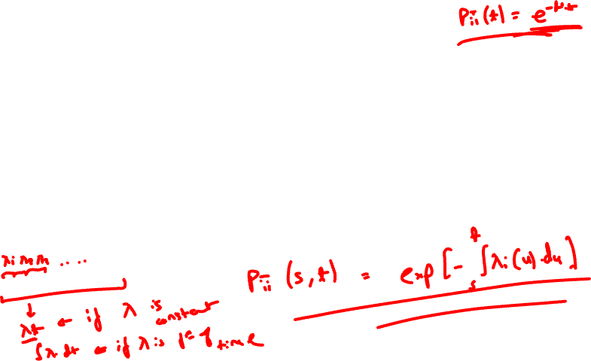

Other probabilities
.
Prove using Chapman Kolmogorov equation

Slide 8
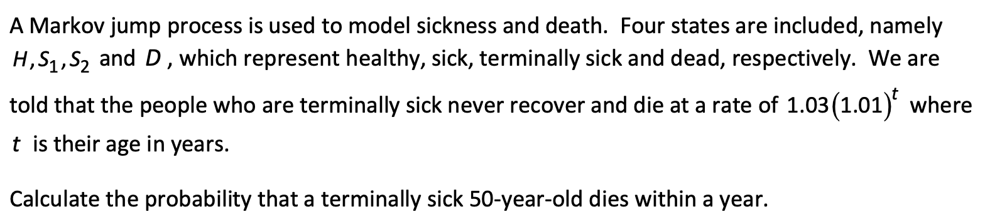
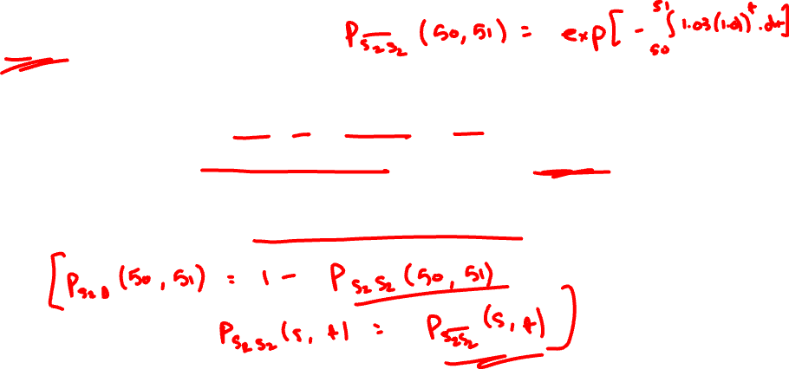
Other probabilities
Question
.

Slide 9
Other probabilities
Question
.

Slide 10
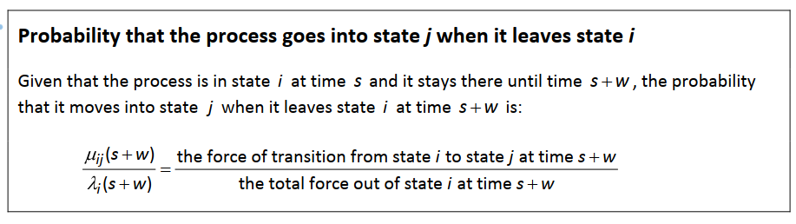
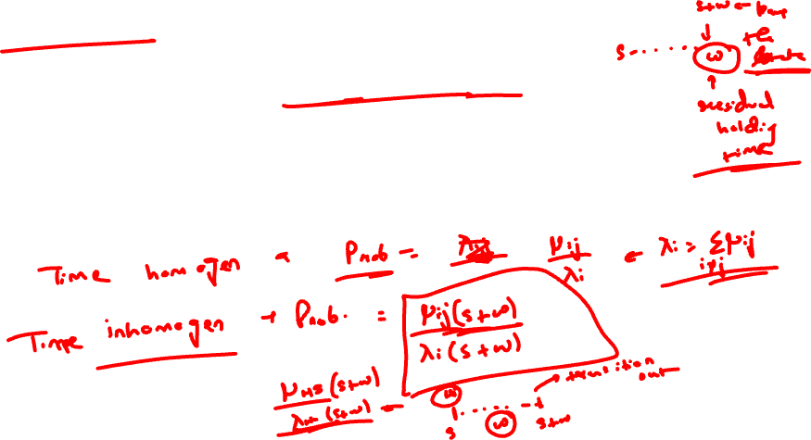
Other probabilities
.

Slide 11
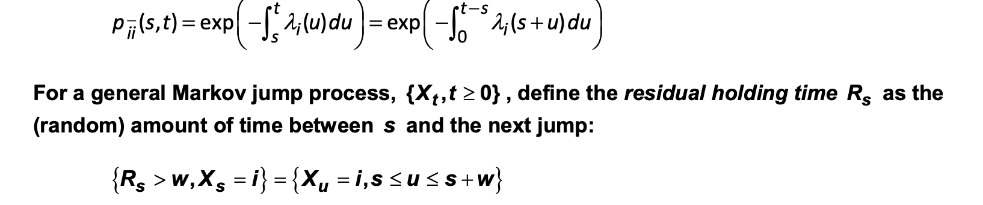

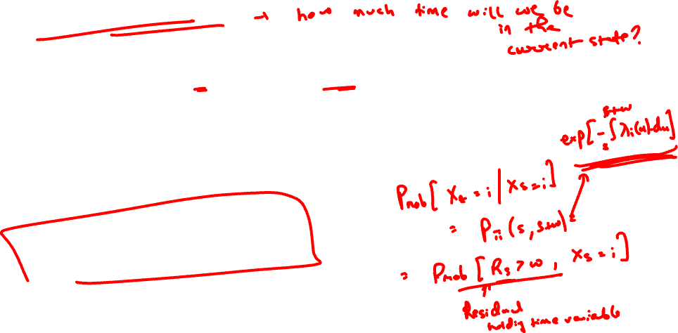
Residual Holding time
.

Slide 12
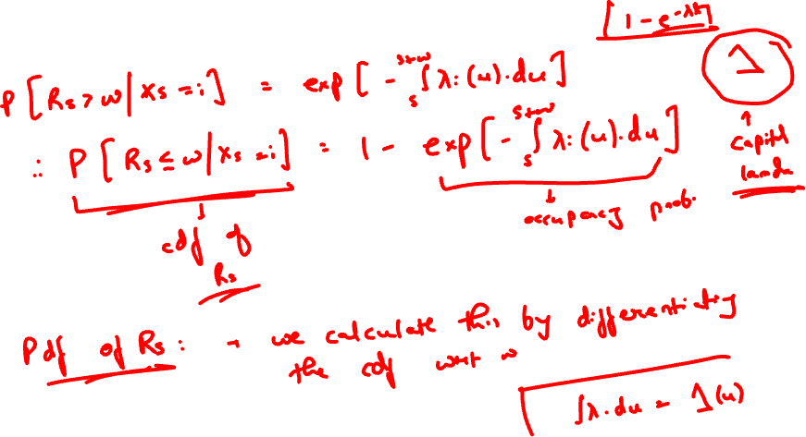
Residual Holding time
.

Slide 13
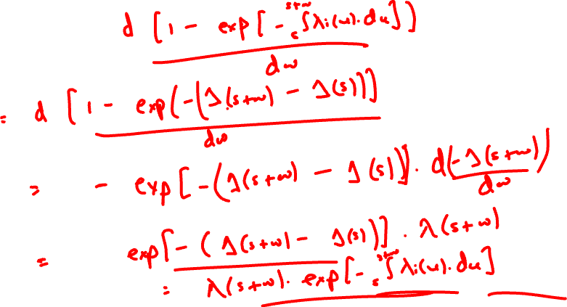
Residual Holding time
.

Slide 14
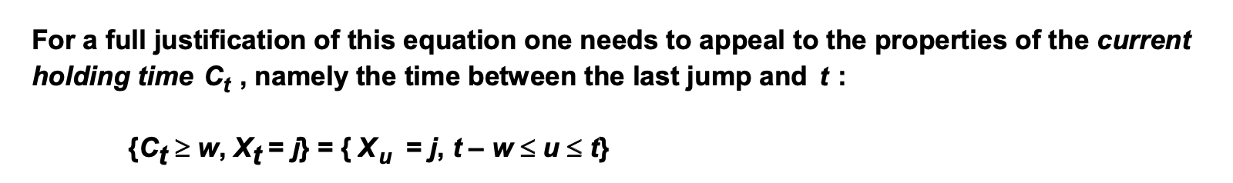
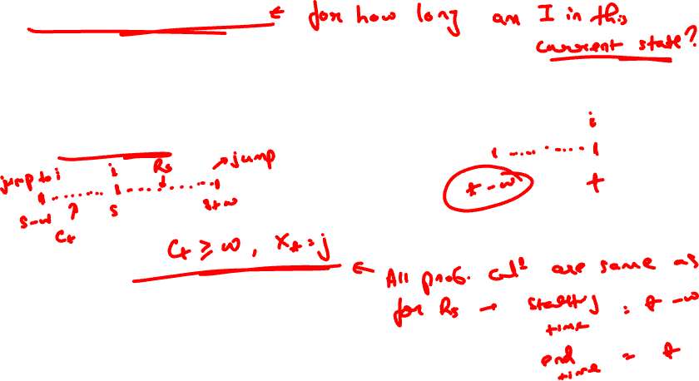
Current Holding time
.

Slide 15
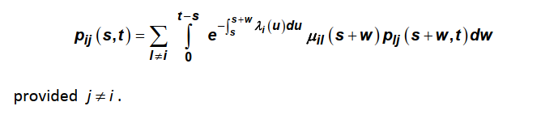
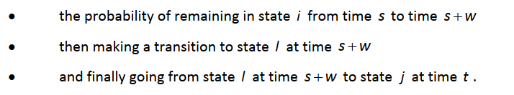
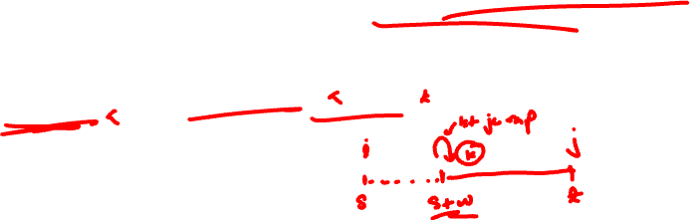
Integrated form of Kolmogorov Backward Eqn
.

Slide 16
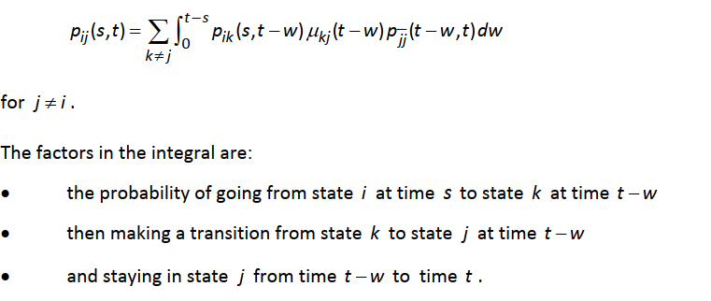
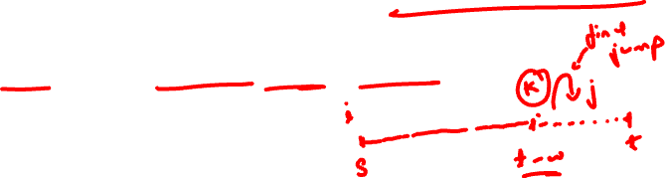
Integrated form of Kolmogorov Forward Eqn
.

Slide 17
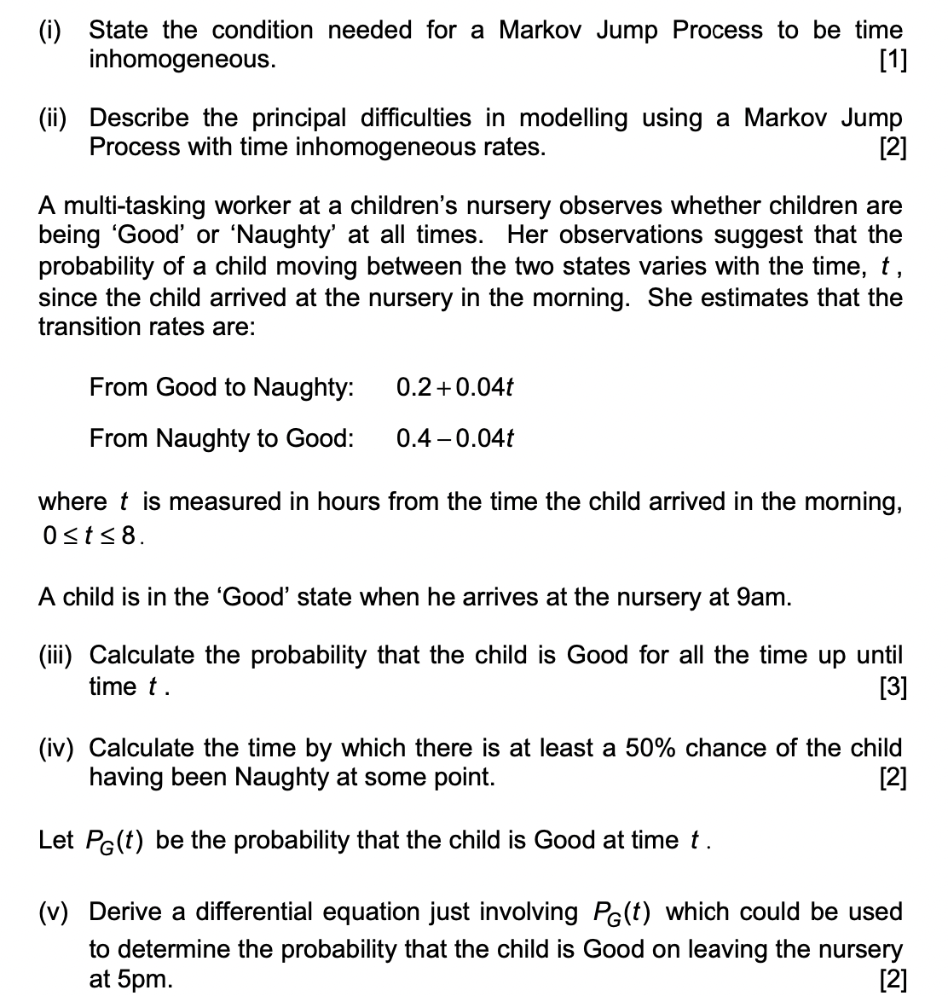
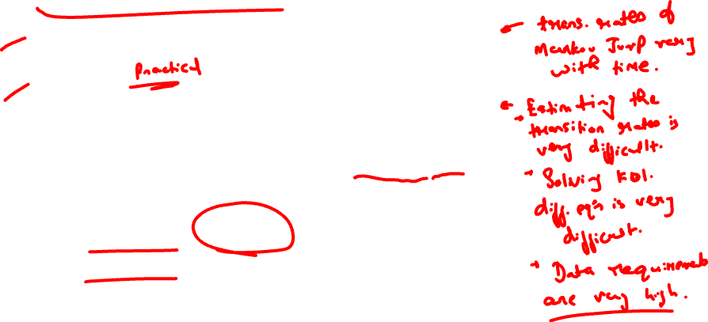
Exam style question
.

Slide 18

Exam style question
.

Slide 19
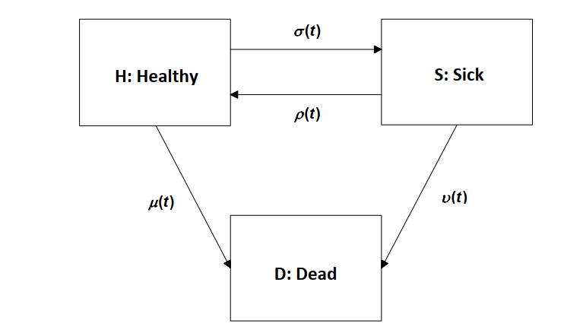
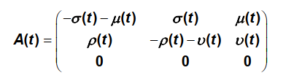
Sickness and Death Model
.

Slide 20
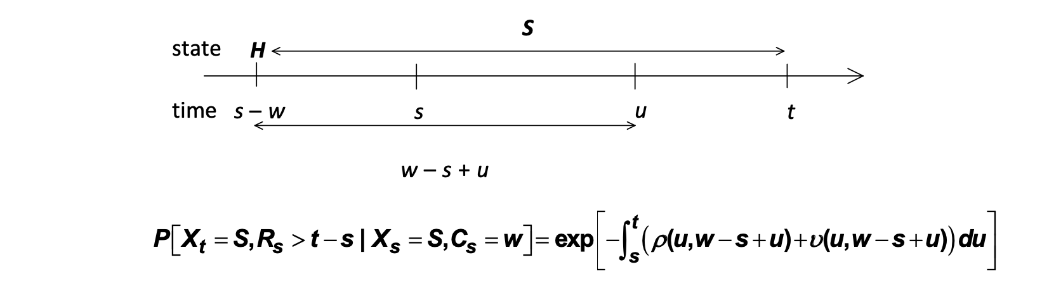
Sickness and Death with Duration
.
To calculate the probability of remaining continuously sick during [s,t] given a current illness period [s – w , s], one needs to update the values of $ρ$ and $ν$ as the illness progresses

Slide 21
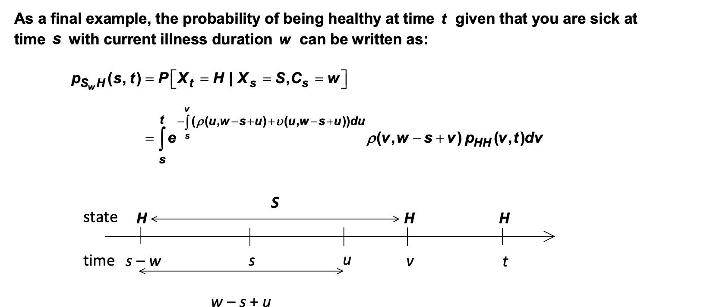
Sickness and Death with Duration
.

Slide 22
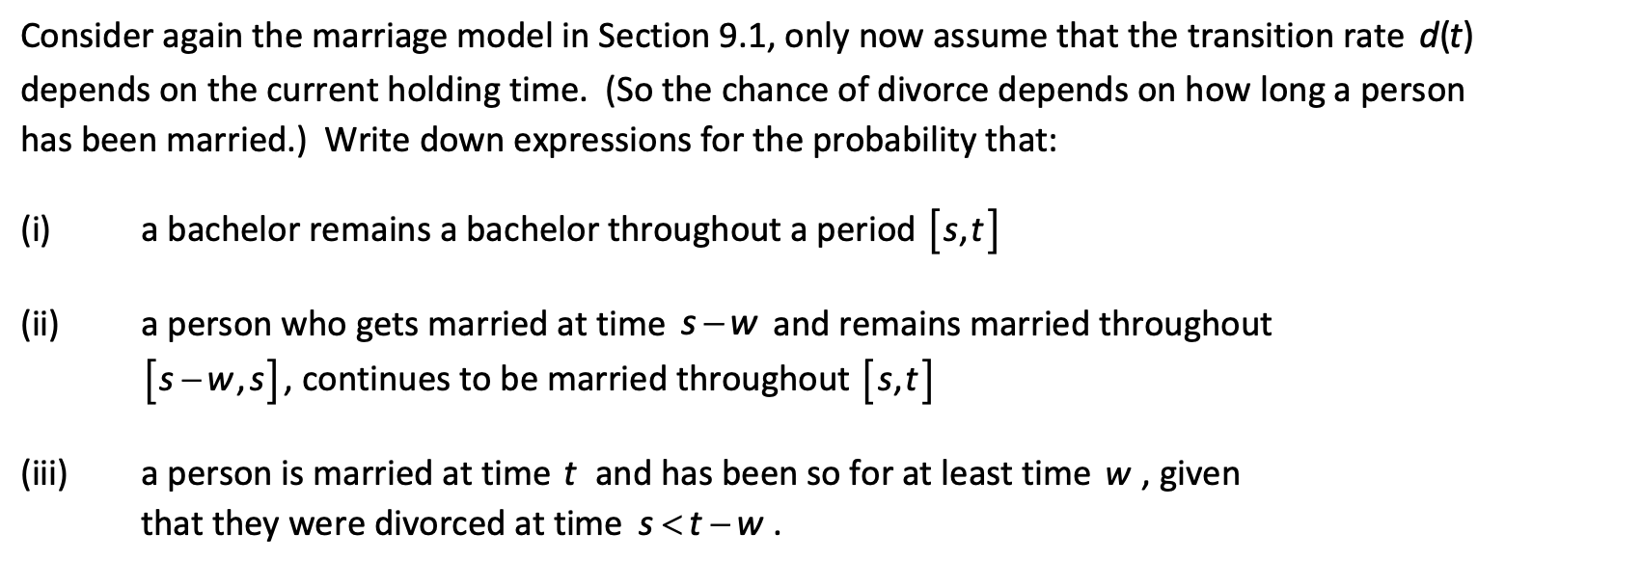
Sickness and Death with Duration
.
above

Slide 23
.
Thank You

