Slide 1

Class: SY BSc
Subject : Statistical Risk Modelling 1
Chapter: Unit 4 Chapter 1
Chapter Name: Mortality Projection
1

Slide 2
Today’s Agenda
Introduction
Methods of Mortality Projection
Methods based on Expectation
Methods based on Extrapolation
  Lee-Carter Model
  Age Period Cohort Model
  P-Splines
Methods based on Explanation
Sources of Errors in Mortality Projection

Slide 3
1
Introduction
Why do we project future mortality?
The projection of future mortality rates is vital for many actuarial purposes, most obviously life insurance and pensions.
If its estimates of future mortality are too low, a life insurance company may run into financial difficulties. On the other hand, a company offering pensions and annuities could become uncompetitive
If estimates of future mortality are too high, on the other hand, the opposite problems may arise: the financial commitments of a pension scheme may outweigh its resources, but a life insurance company may offer uncompetitive rates and lose business.
Governments, too, need accurate forecasts of future mortality rates. The future population of a country, especially the older age population, depends very much on future mortality trends

Slide 4
2
Methods of Mortality Projection
Three methods used to project future mortality are:
Methods based on expectation
Methods based on extrapolation
Methods based on explanation

Slide 5
3
Methods based on Expectation
In the past, mortality projections generally relied on an expectation that previous trends in mortality improvements would continue, accompanied by consultation with demographers and other experts.
For much of the twentieth century this proved reasonably satisfactory.
However, more recently these methods have generally underestimated improvements in mortality, particularly in the period 1990-2010.
An alternative approach along these lines is to suppose that, by some future date, mortality will have reached some target level, and to examine different ways in which the schedule of age-specific mortality rates might move from their present pattern in order to achieve that target.

Slide 6
3
Methods based on Expectation
Official statistical agencies have traditionally based their mortality projections on simple expectations (for example a continued exponential decline in age-specific mortality rates).
The parameters of the future evolution of mortality have been set either by fitting deterministic functions to recent mortality trends, or by inviting experts to indicate how far and fast they anticipate mortality to fall, and to set ‘targets’.

Slide 7
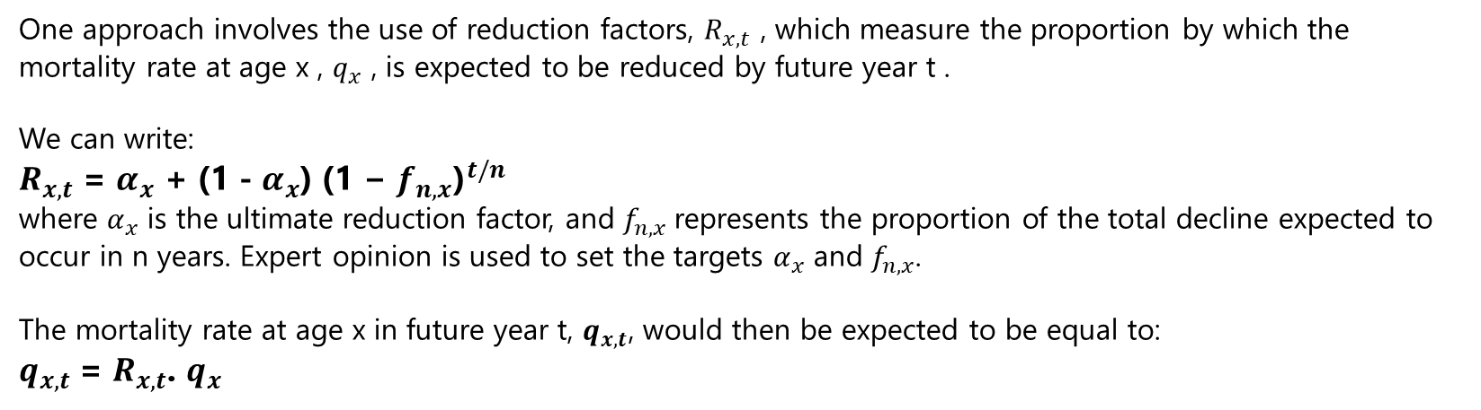
3
Methods based on Expectation

Slide 8
3
Methods based on Expectation
Methods based on expectation have been widely used in the past and have the advantage of being straightforward and easy to implement. However, in recent decades they have tended to underestimate improvements, especially for male mortality. One reason for this is that progress on reducing male mortality was slow during the 1950s, 1960s and 1970s because of lifestyle factors such as cigarette smoking.
There are theoretical problems, too, with targeting. The setting of the ‘target’ is a forecast, which implies that the method is circular; and setting a target leads to an underestimation of the true level of uncertainty around the forecast.
An alternative approach to generating expectations is to ask the population as a whole about its health status and general well-being. Self-reported health status has been found to be a good way of identifying ‘healthy’ and ‘unhealthy’ individuals, but it is not clear that it can provide useful information on future longevity at the population level.

Slide 9
4
Methods based on Extrapolation
Stochastic models
Deterministic approaches based on expectation have been largely superseded, other than for short-term forecasting. More advanced approaches use stochastic forecasting models.
In this section we describe some commonly used models, but we start with a discussion of the factors that apply in forecasting mortality.

Slide 10
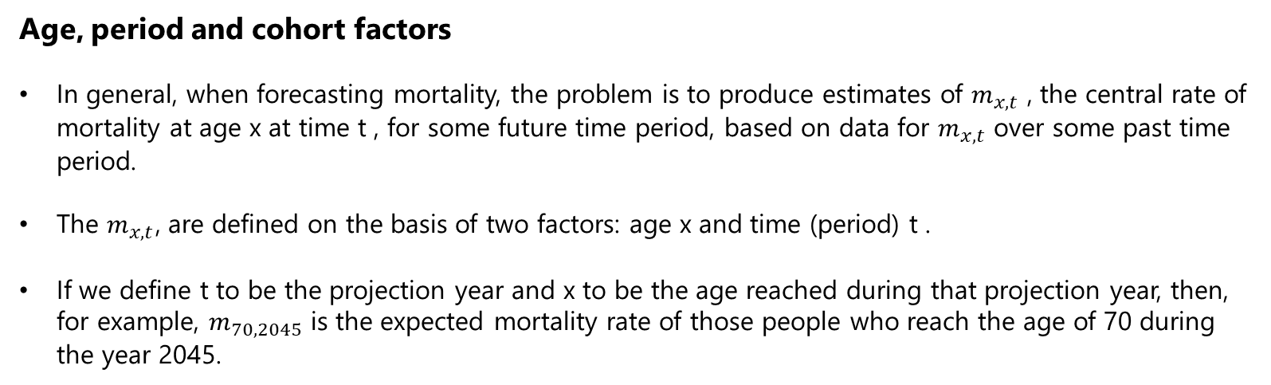
4
Methods based on Extrapolation

Slide 11
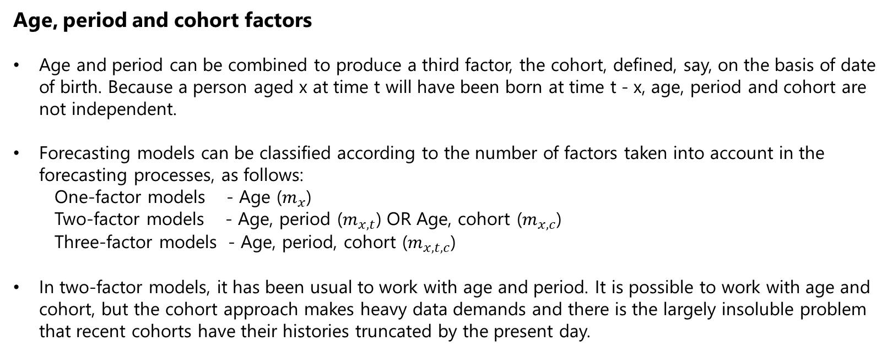
4
Methods based on Extrapolation

Slide 12
4
Methods based on Extrapolation
Age, period and cohort factors
In general, most research has found that cohort effects are smaller than period effects, though cohort effects are non-negligible.
Three-factor models also have the logical problem that each factor is linearly dependent on the other two. Various approaches have been developed to overcome this problem, though none are entirely satisfactory because the problem is a logical one not an empirical one.

Slide 13
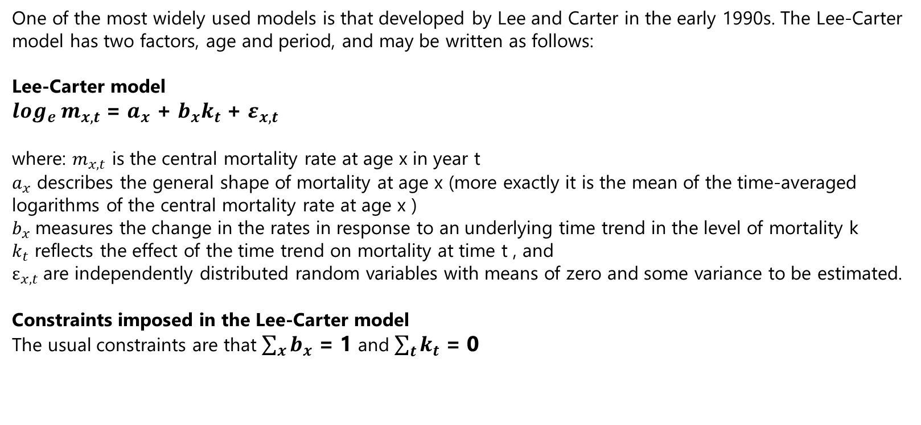
4.1
The Lee-Carter Model

Slide 14
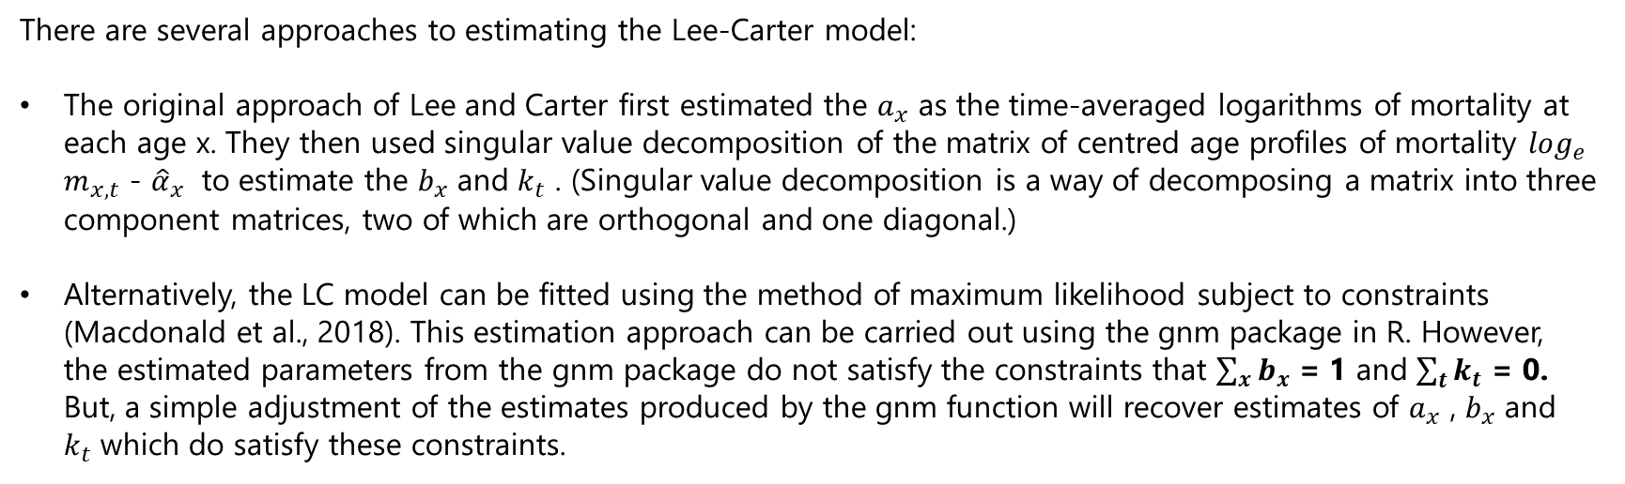
4.1
Estimation of the Lee-Carter Model

Slide 15
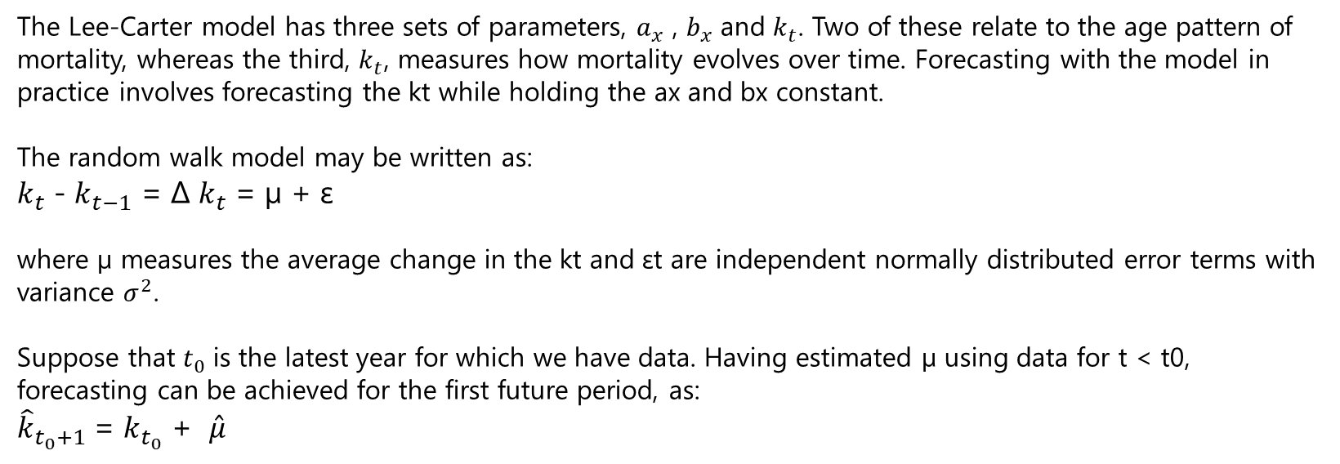
4.1
Forecasting with the Lee-Carter Model

Slide 16
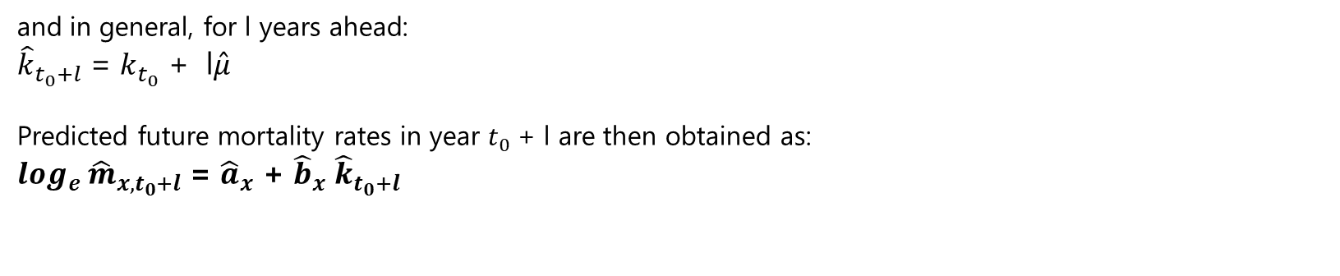
4.1
Forecasting with the Lee-Carter Model

Slide 17
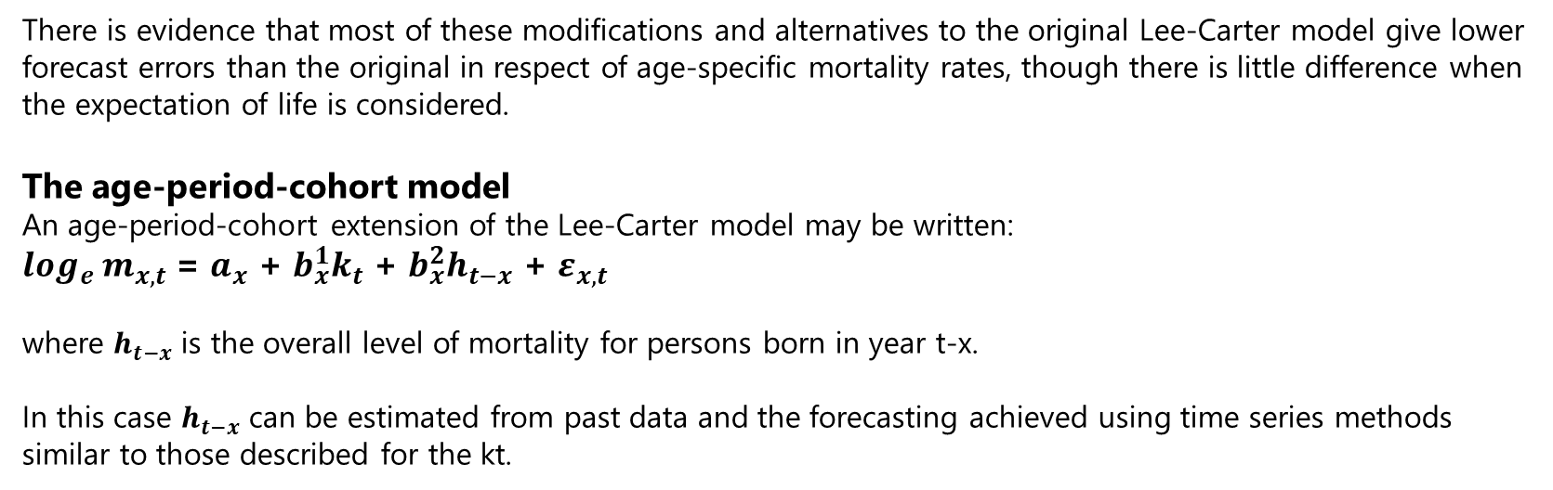
4.1
Extensions to The Lee-Carter Model

Slide 18
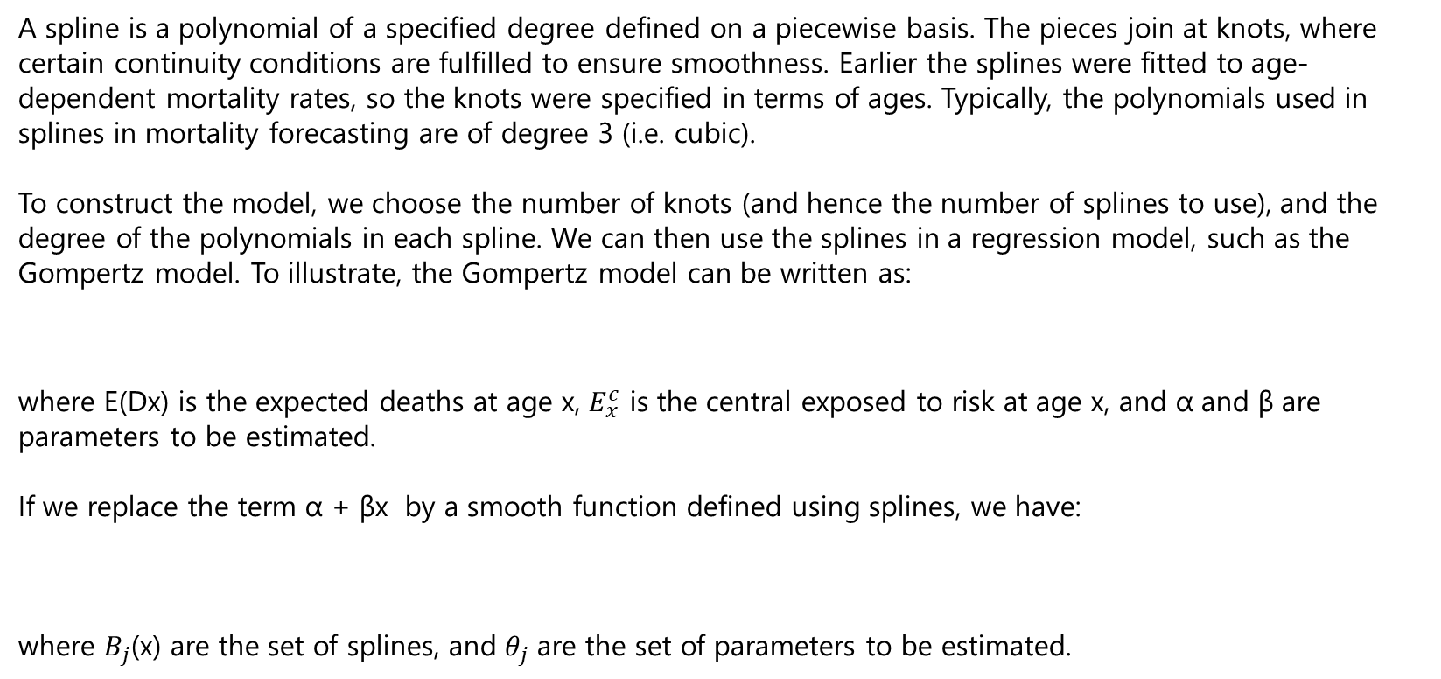


4.1
Splines

Slide 19
4.1
p-Splines
Spline models will adhere more closely to past data if the number of knots is large and the degree of the polynomial in the spline function is high. For forecasting, we ideally want a model which takes account of important trends in the past data but is not influenced by short-term “one-off” variations.
This is because it is likely that the short-term variations in the past will not be repeated in the future, so that taking account of them may distort the model in a way which is unhelpful for forecasting.
On the other hand, we do want the model to capture trends in the past data which are likely to be continued into the future.
Models which adhere too closely to the past data tend to be “rough” in the sense that the coefficients for adjacent years do not follow a smooth sequence.
The method of p-splines attempts to find the optimal model by introducing a penalty for models which have excessive “roughness”.

Slide 20
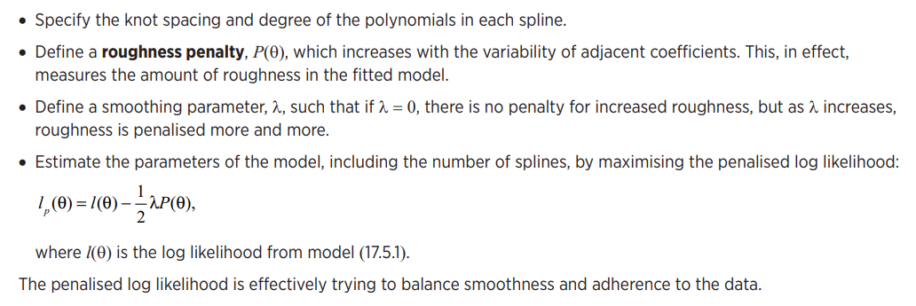
4.1
p-Splines
The method may be implemented as follows

Slide 21
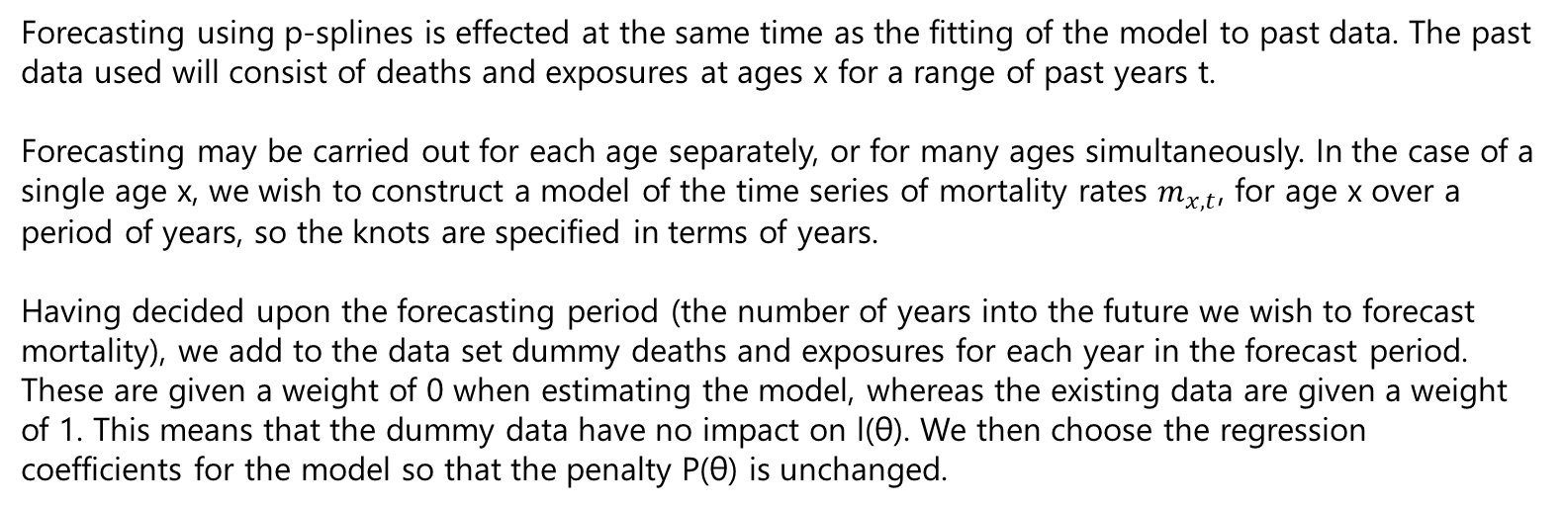
4.1
Forecasting using p-Splines

Slide 22
4.1
Advantages & Disadvantages of p-Splines
The p-spline approach has the advantages that it is a natural extension of methods of graduation and smoothing, and it is relatively straightforward to implement in R.
It has the following disadvantages:
When applied to ages separately, mortality at different ages is forecast independently so there is a danger that there will be roughness between adjacent ages. This can be overcome by fitting the model and forecasting in two dimensions (age and time) simultaneously.
There is no explanatory element to the projection (in the way that time-series methods use a structure for mortality and an identifiable time series for projection).
p-splines tend to be over-responsive to an extra year of data (though this can be ameliorated by increasing the knot spacing)

Slide 23
Question
CS2A April 2022
(i) Write down the two-factor Lee–Carter model, clearly defining each of the terms you use. [3]
A statistician is using the two-factor Lee–Carter model to project future mortality rates and has fitted the model to a set of mortality data. The statistician has observed that the fitted forces of mortality do not vary regularly with each calendar year but vary more regularly with age.
Therefore, the statistician suggests that, before projecting future mortality rates, the k parameters in the Lee–Carter model should be smoothed using penalised regression splines, but the a and b parameters should be kept as separate, unsmoothed parameters for each age.
(ii) Discuss the statistician’s suggestion by considering each of the three parameters of the Lee–Carter model, k, a and b, in turn. [3]
[Total 6]

Slide 24
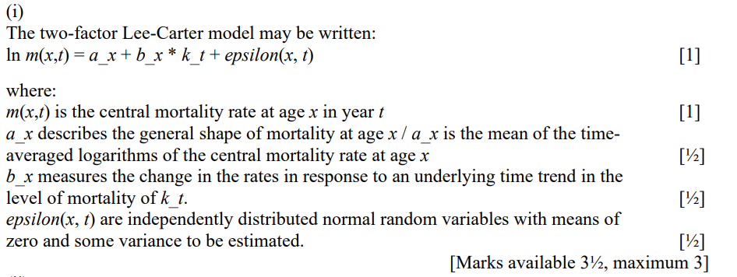
Solution

Slide 25
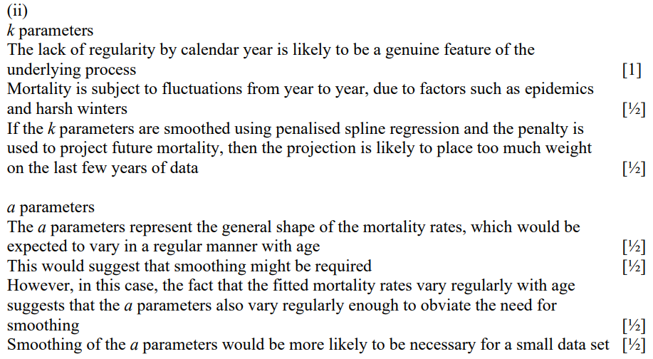
Solution

Slide 26
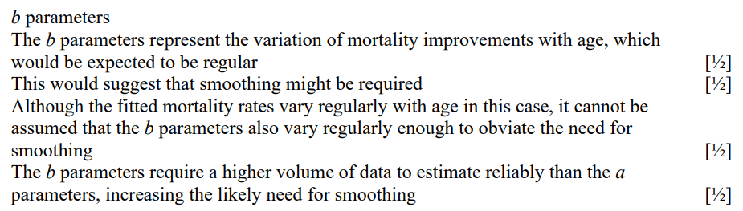
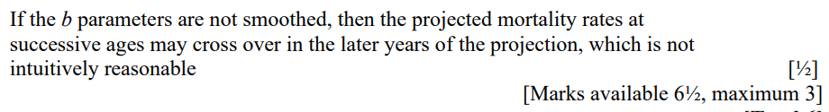
Solution

Slide 27
5
Methods based on Explanation
The previous approaches take no, or only limited, cognisance of the causal factors underlying mortality. Since causal factors are quite well understood, at least at a general level, it might be thought sensible to use this knowledge in forecasting.
For example, if cancer is a leading cause of death in a country, and if it seems likely that a significant breakthrough in the treatment of cancer is likely, this could be explicitly taken account of in mortality projections for that country. It might seem surprising that progress in this direction has been limited.
However, the methods require either that long lags are specified between changes in the risk factors and changes in mortality, or that the risk factors themselves be forecasted, and forecasting developments in the risk factors is almost as difficult as forecasting mortality.

Slide 28
5
Methods based on Explanation
Decomposition of mortality by cause of death is an integral part of the explanatory approach. However, in practice it is difficult to achieve successfully.
The reasons include:
cause of death reporting is unreliable, especially at older ages (where an increasing proportion of deaths occur);
causes of death often act synergistically, so it is not realistic to posit a single cause of death;
elimination of one cause of death might “unmask” another cause that would not have been identified previously;
the time series of data are often rather short.

Slide 29
6
Sources of error in mortality forecasts
Mortality forecasts are always wrong. It is of interest to know how wrong they are likely to be, and what the main sources of error are. The latter is important not so much because it will help to eliminate errors (this is not possible) but so effort can be focused on the areas most likely to cause the forecasts to be at variance with reality, or on the elements of the process to which the sensitivity of the outcome is greatest.
Alho, J.M. (1990) ‘Stochastic methods in population forecasting’, International Journal of Forecasting 6, pp. 521-30, classified sources of error as follows:
Model mis-specification. We might have the wrong parameterisation function, or the wrong model.
Uncertainty in parameter estimates.
Incorrect judgement or prior knowledge. The data set we use as the basis may not accurately reflect the mortality we wish to model.
Random variability, including the randomness in the process generating the mortality, short term variation due to severe winters or hot summers.
Errors in data (for example age-misstatement).

Slide 30
Question
CS2A September 2019 Q2
The government of a small country is interested in projecting mortality over the next 20 years. Life tables are available by single years of age for each calendar year for the past 10 years. The country has a new Chief Statistician who suggests fitting an exponential curve to the time trend in mortality at each age x and forecasting mortality separately at each age using the parameters estimated for that age.
Comment on this suggestion. [3]
Suggest an alternative approach which may be more suitable for projecting mortality in this country. [1] [Total 4]

Slide 31
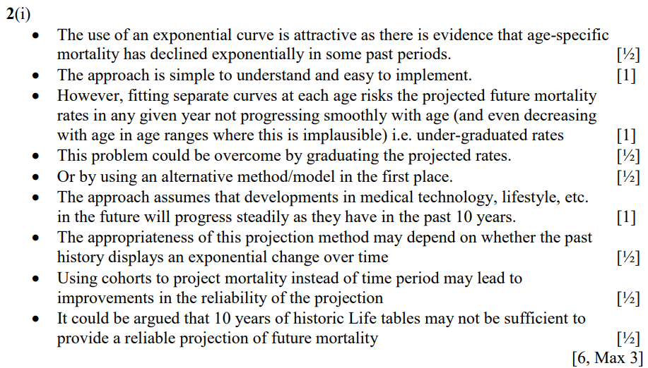
Solution

Slide 32
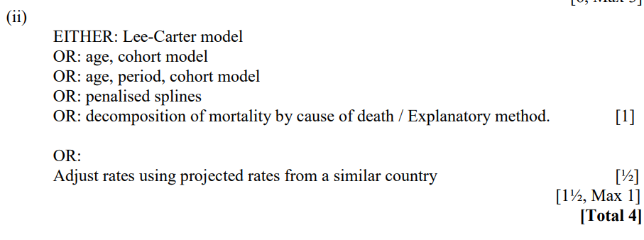
Solution

