Slide 1

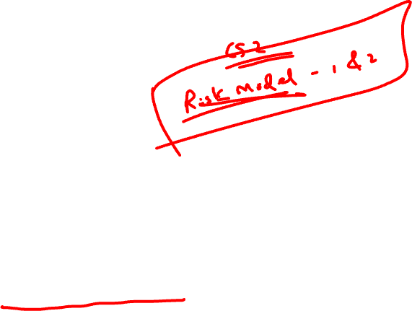
Lecture 1
Class: TY BSc
Subject : Statistical & Risk Modelling - 3
Subject Code:
Chapter: Unit 1 Chapter 2
Chapter Name: Application of compound distribution in risk modelling

Slide 2
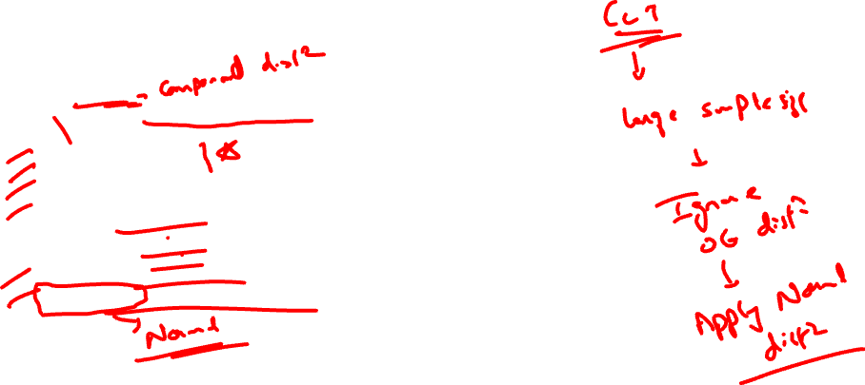
Agenda
Introduction
Models for short-term insurance contracts
Features
Collective Risk Models
Individual Risk Models
Moments Of S
Compound Distributions
Compound Poisson Distribution
Compound Binomial Distribution
Compound Negative Binomial Distribution
6. Parameter variability and uncertainty
7. Approximation of Aggregate Distribution

Slide 3
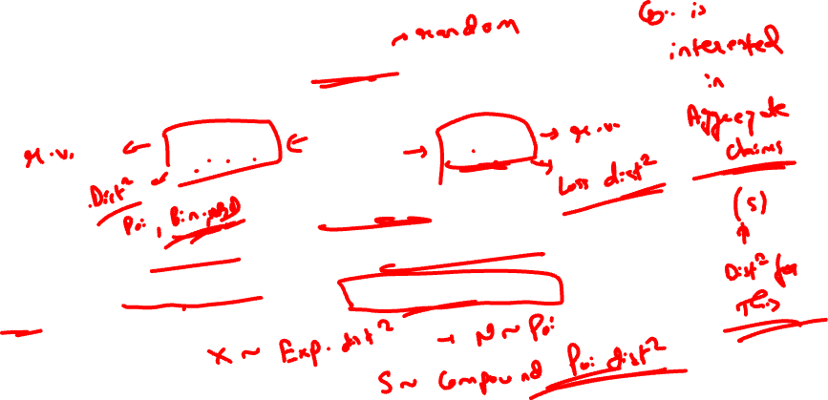

Introduction
1.0
CLAIMS
FREQUENCY AMOUNT
Both are random and
have a unique distribution
Therefore, to model aggregate claims, we deal with two distributions at the same time.
By combining these two distributions, we define a unique aggregate distribution known as Compound Distribution.

Slide 4

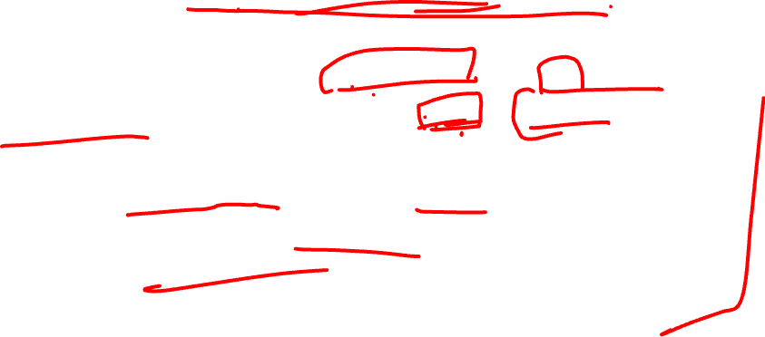
Models for short-term insurance contracts
2.0
Many forms of non-life insurance can be regarded as short-term contracts, for example motor insurance.
Some forms of life insurance also fall into this category, for example group life and one-year term assurance policies.
A short-term insurance contract can be defined as having the following attributes:
• The policy lasts for a fixed, and relatively short, period of time, typically one year.
• The insurance company receives from the policyholder(s) a premium.
• In return, the insurer pays claims that arise during the term of the policy.

Slide 5

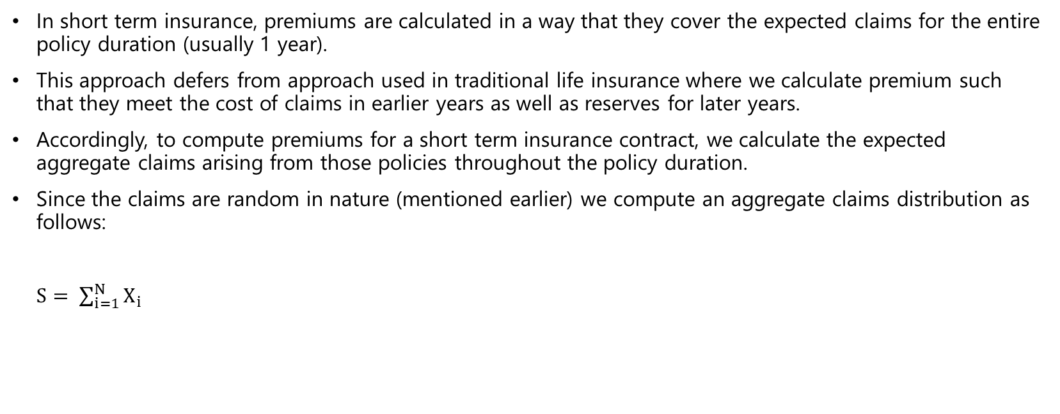
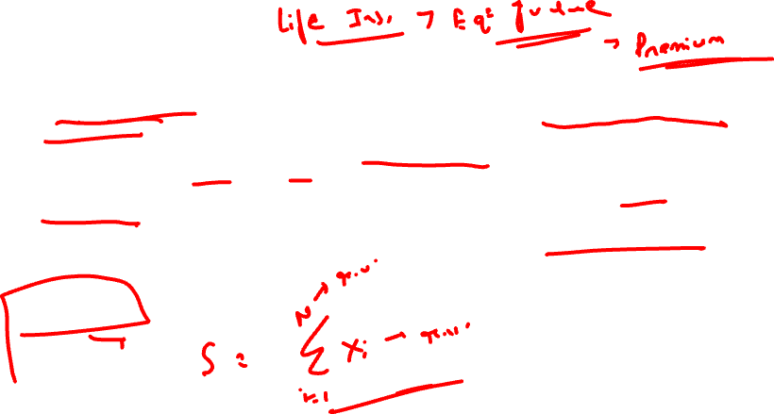
Features
2.1
In short term insurance, premiums are calculated in a way that they cover the expected claims for the entire policy duration (usually 1 year).
This approach defers from approach used in traditional life insurance where we calculate premium such that they meet the cost of claims in earlier years as well as reserves for later years.
Accordingly, to compute premiums for a short term insurance contract, we calculate the expected aggregate claims arising from those policies throughout the policy duration.
Since the claims are random in nature (mentioned earlier) we compute an aggregate claims distribution as follows:
$S= \sum_{i=1}^{N}{X_{i}}$

Slide 6
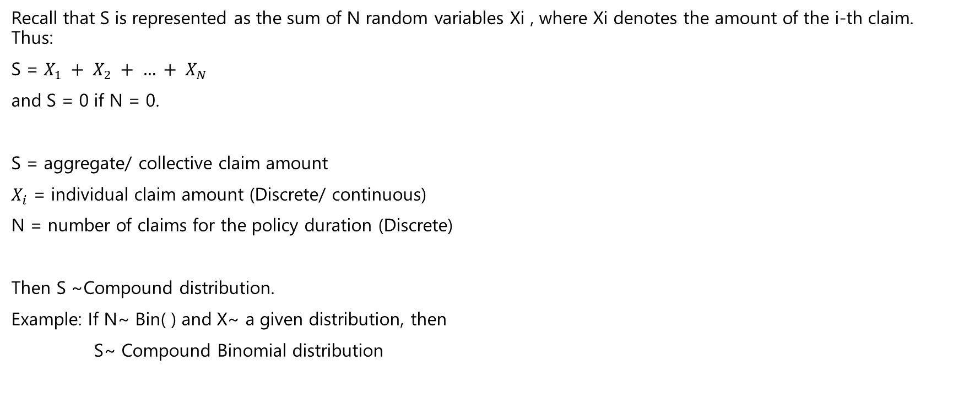
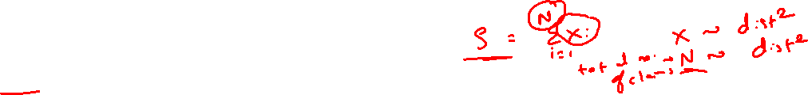
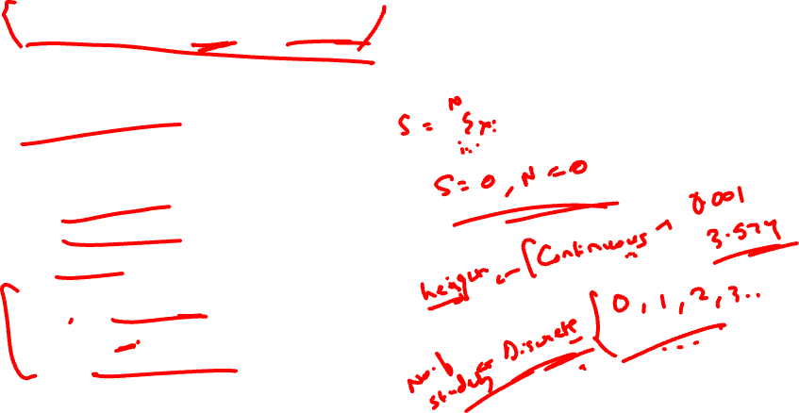
Collective Risk Model
3.0
Recall that S is represented as the sum of N random variables Xi , where Xi denotes the amount of the i-th claim. Thus:
S = $X_{1} + X_{2} + … + X_{N}$
and S = 0 if N = 0.
S = aggregate/ collective claim amount
$X_{i}$ = individual claim amount (Discrete/ continuous)
N = number of claims for the policy duration (Discrete)
Then S ~Compound distribution.
Example: If N~ Bin( ) and X~ a given distribution, then
S~ Compound Binomial distribution

Slide 7

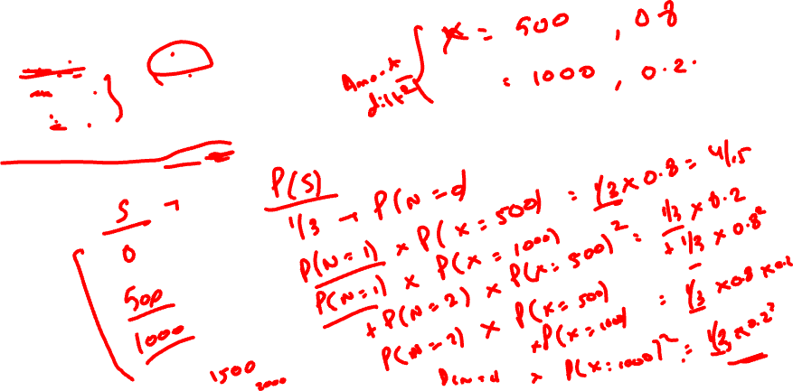
Collective Risk Model
3.0
N= 0, 1, 2 with prob=1/3
X= 500 ; 0.8
1000 ; 0.2
Find probability distribution of S.

Slide 8
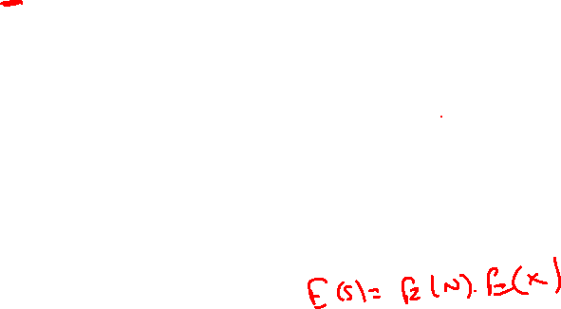
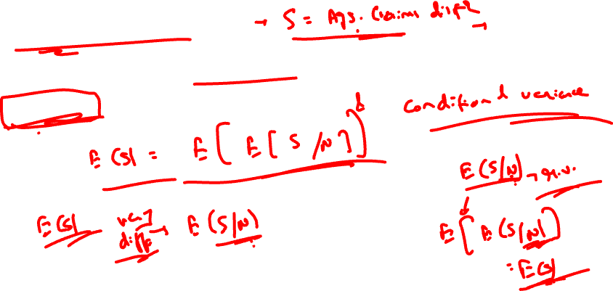
Moments of S
4.0
To calculate the moments of S, conditional expectation results are used, conditioning on the number of claims, N. To find E[S], apply the identity:
E[S] = E[E[S|N]].
Formula has a very natural interpretation. It says that the expected aggregate claim amount is the product of the expected number of claims and the expected individual claim amount.

Slide 9

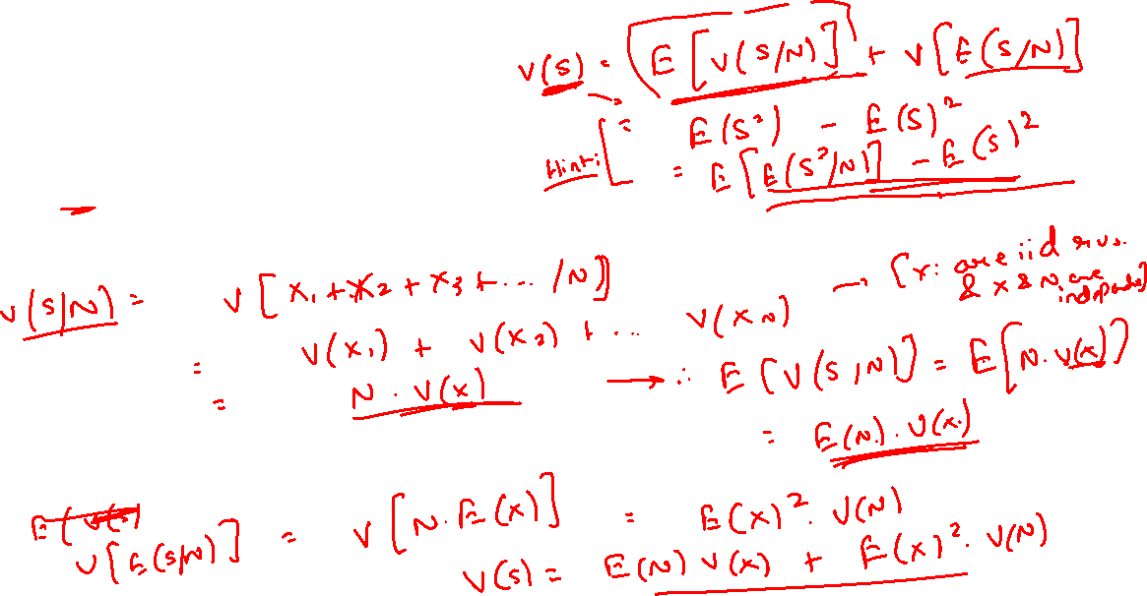
Moments of S
4.0
To find an expression for var[S], apply the identity:
var[S] = E[var[S|N]] + var[E[S|N]]
var(S|N) can be found by using the fact that individual claim amounts are independent.

Slide 10
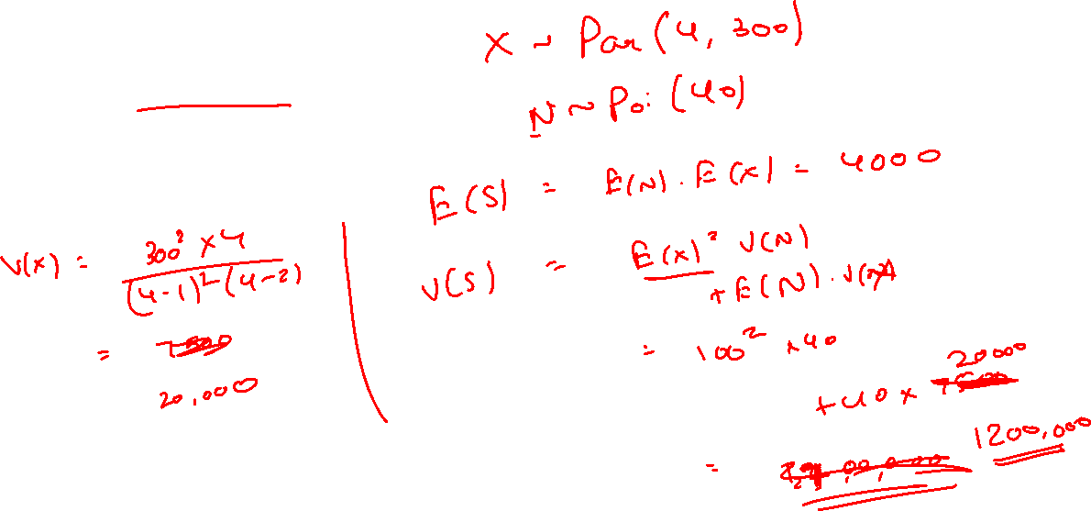
Moments of S
4.0
If X~ Par(4,300) and N~ Poi(40).
Find E(S) and Var(S).

Slide 11
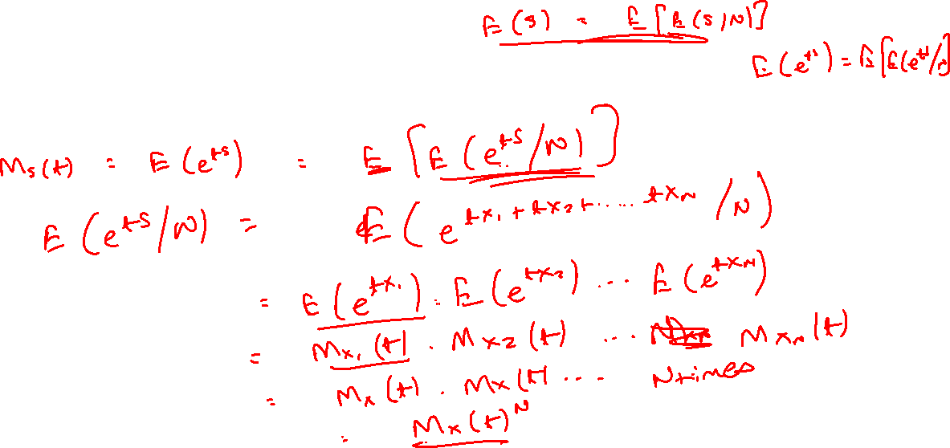
Moments of S
4.0
To find an expression for MGF of S,

Slide 12
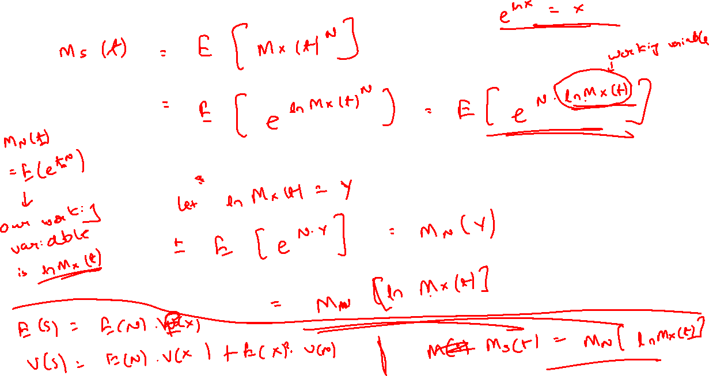

Slide 13
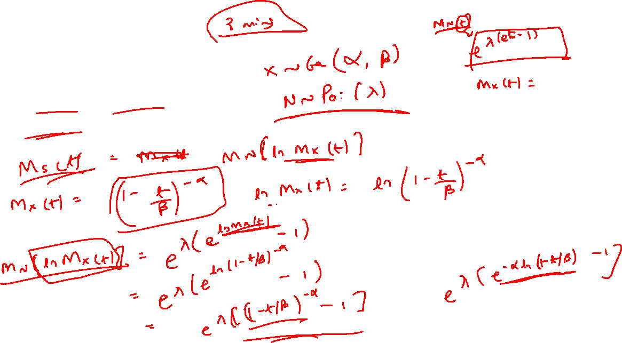
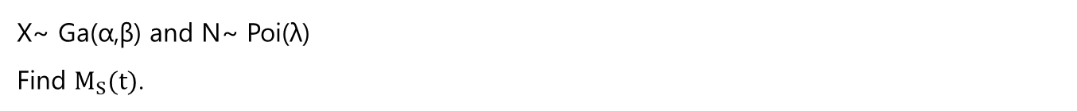
Moments of S
4.0
X~ Ga(α,β) and N~ Poi(λ)
Find $M_{S}(t)$.

Slide 14

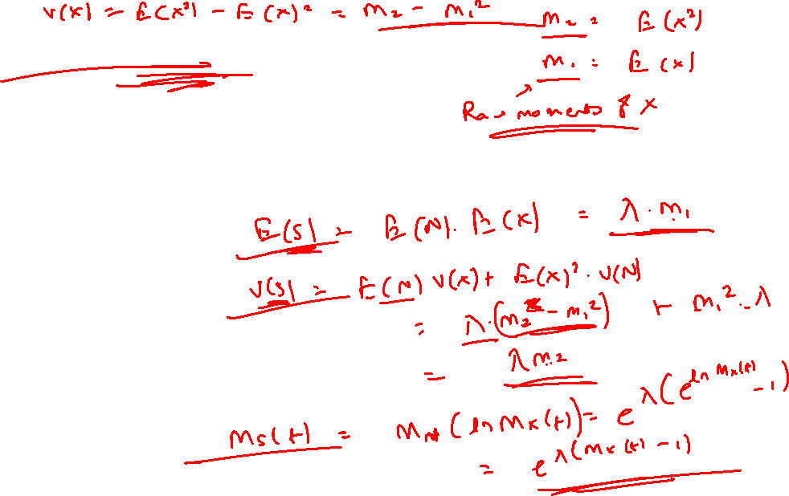
Compound Poisson distribution
5.0
N ~ Poi(λ)
S then has a compound Poisson distribution with parameter λ, and F(x) is the CDF of the individual claim amount random variable. The results required for this distribution for N are:
E[N] = var[N ] = λ
$M_{N}$(t) = exp{λ($e^{t}$ − 1)}
E[S] = λm1
var[S] = λm2
$M_{S}$(t) = exp{λ($M_{X}$(t) − 1)}

Slide 15
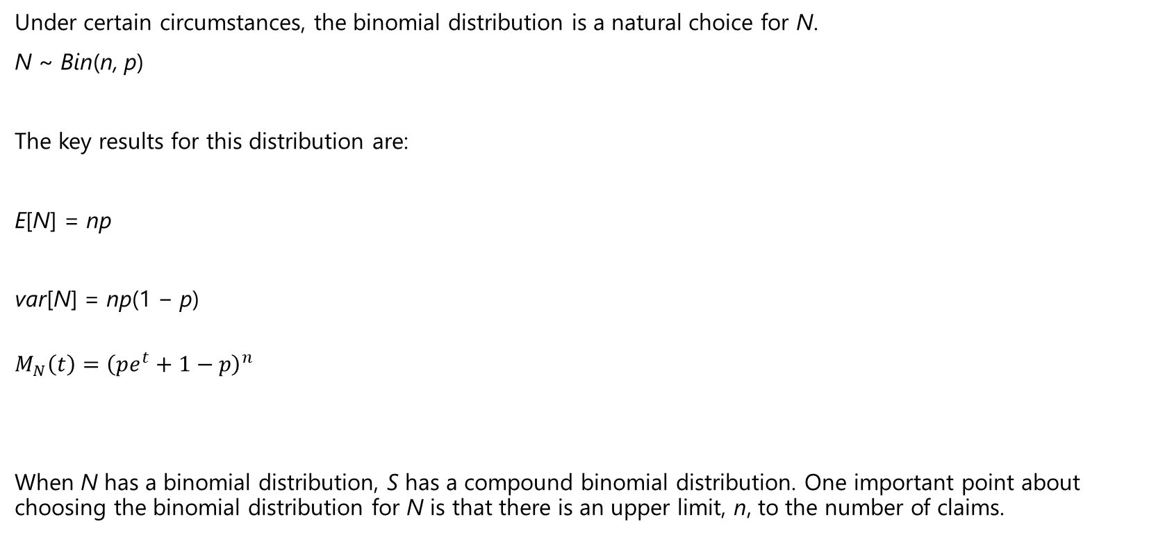
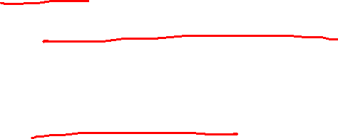
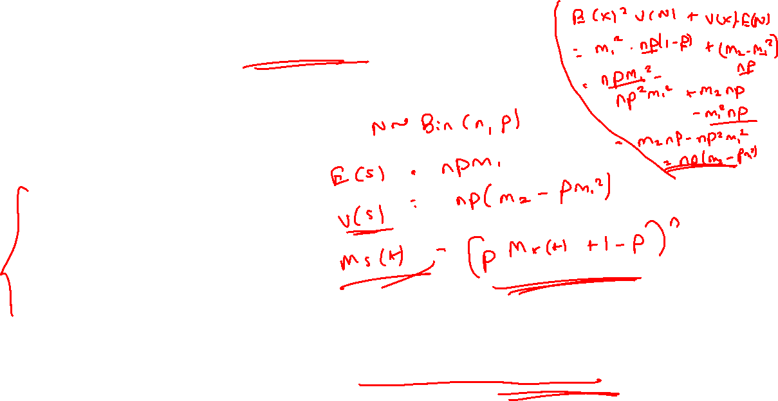
Compound Binomial distribution
5.1
Under certain circumstances, the binomial distribution is a natural choice for N.
N ~ Bin(n, p)
The key results for this distribution are:
E[N] = np
var[N] = np(1 − p)
$$M_{N}\left(t\right)={\left(pe^{t}+1−p\right)}^{n}$$
When N has a binomial distribution, S has a compound binomial distribution. One important point about choosing the binomial distribution for N is that there is an upper limit, n, to the number of claims.

Slide 16

Compound Binomial distribution
5.1
Accordingly, the moments of S are:
E[S] = np$m_{1}$
Var[S] = np$\left(m_{2}−m_{1}^{2}\right)+np\left(1−p\right)m_{1}^{2}$
$=npm_{2}−np^{2}m_{1}^{2}$
$M_{S}$(t) = ${\left(pM_{X}\left(t\right)+1−p\right)}^{n}$
Use of Compound Binomial Distribution:
A group life insurance policy covering n lives with the same mortality rate, the distribution of the number of deaths in a year is binomial.

Slide 17

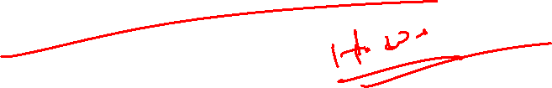
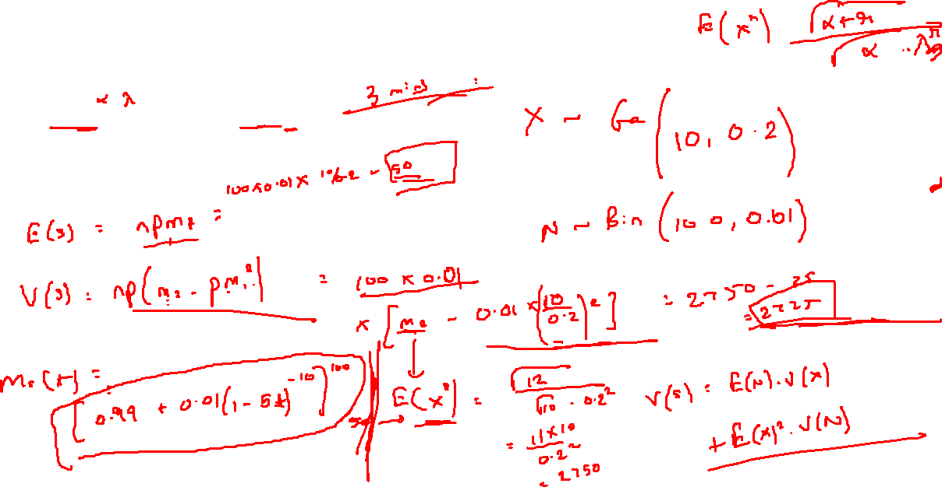
Compound Binomial distribution
5.1
X~ Ga(10,0.2) and N~ Bin(100,0.01)
Find E(S), Var(S) and $M_{S}(t)$.

Slide 18

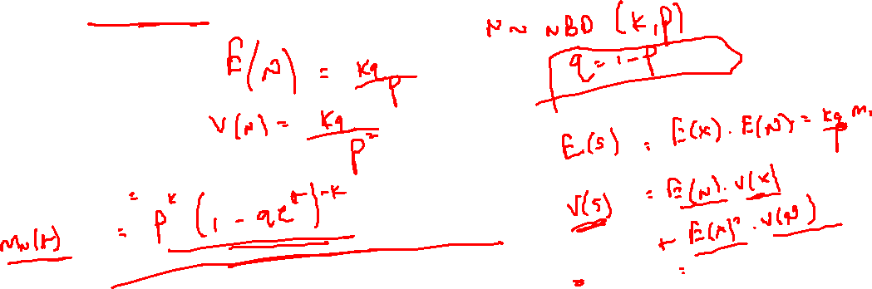

Compound Negative Binomial distribution
5.2
The final choice of distribution for N is the negative binomial distribution, which has probability function:
P(N = n) = $\frac{Γ\left(k+n\right)}{Γ(n+1)Γ(k)}p^{k}q^{n}$ for n = 0, 1, 2, ....
The parameters of the distribution are k (> 0) and p, where p + q = 1 and 0 < p < 1. This distribution is denoted by NB(k, p). When N ~ NB(k, p):
E[N] = kq / p
var[N] = kq / $p^{2}$
$M_{N}$(t) = $p^{k}{\left(1−qe^{t}\right)}^{−k}$

Slide 19


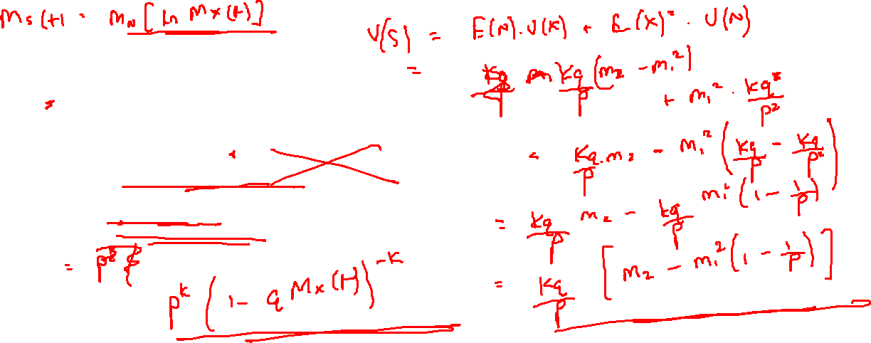
Compound Negative Binomial distribution
5.2
Accordingly, the moments of S are:
E[S] = $\frac{kq}{p}m_{1}$
Var[S] = $\frac{kq}{p}\left(m_{2}−m_{1}^{2}\right)+\frac{kq^{2}}{p^{2}}m_{1}^{2}=\frac{kq}{p}m_{2}+\frac{kq^{2}}{p^{2}}m_{1}^{2}$
$M_{S}$(t) = $p^{k}$ / (1 − q$M_{X}$(t)$)^{k}$

Slide 21
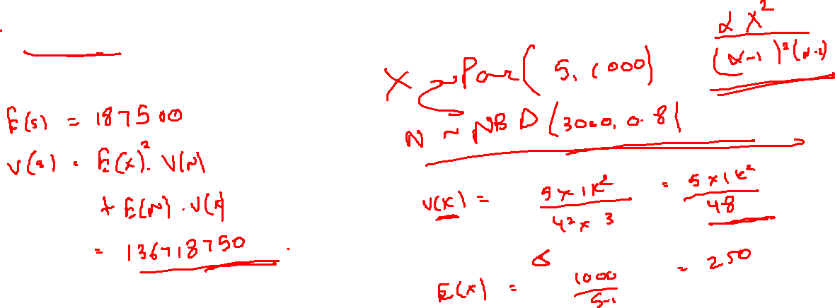
Compound Negative Binomial distribution
5.2
X~ Par(5,1000) and N~ NBD(3000,0.8).
Find E(S) and Var(S).

Slide 22

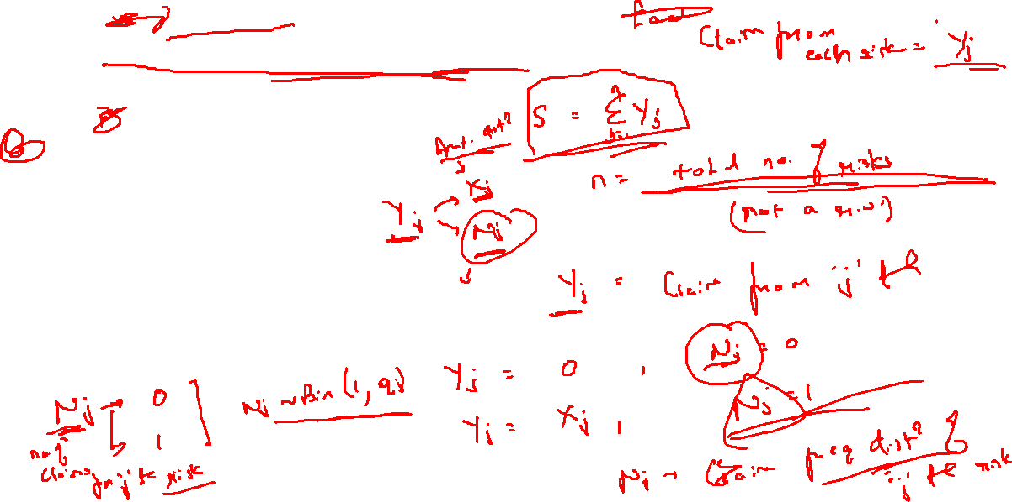
Individual Risk Model
6.0
Claims arising from each individual risk/ policy.
S = $Y_{1} +Y_{2} + … +Y_{n} = \sum_{i=1}^{n}{Y_{j}}$
$Y_{j}=N_{j}$. $X_{j}$
$$N_{1}=0 or 1 , N_{2}=0 or 1$$
$Y_{j}$ = Claim amount under j^{th} risk
j = 1, 2, 3, … n
n = number of risk/ policies

Slide 23
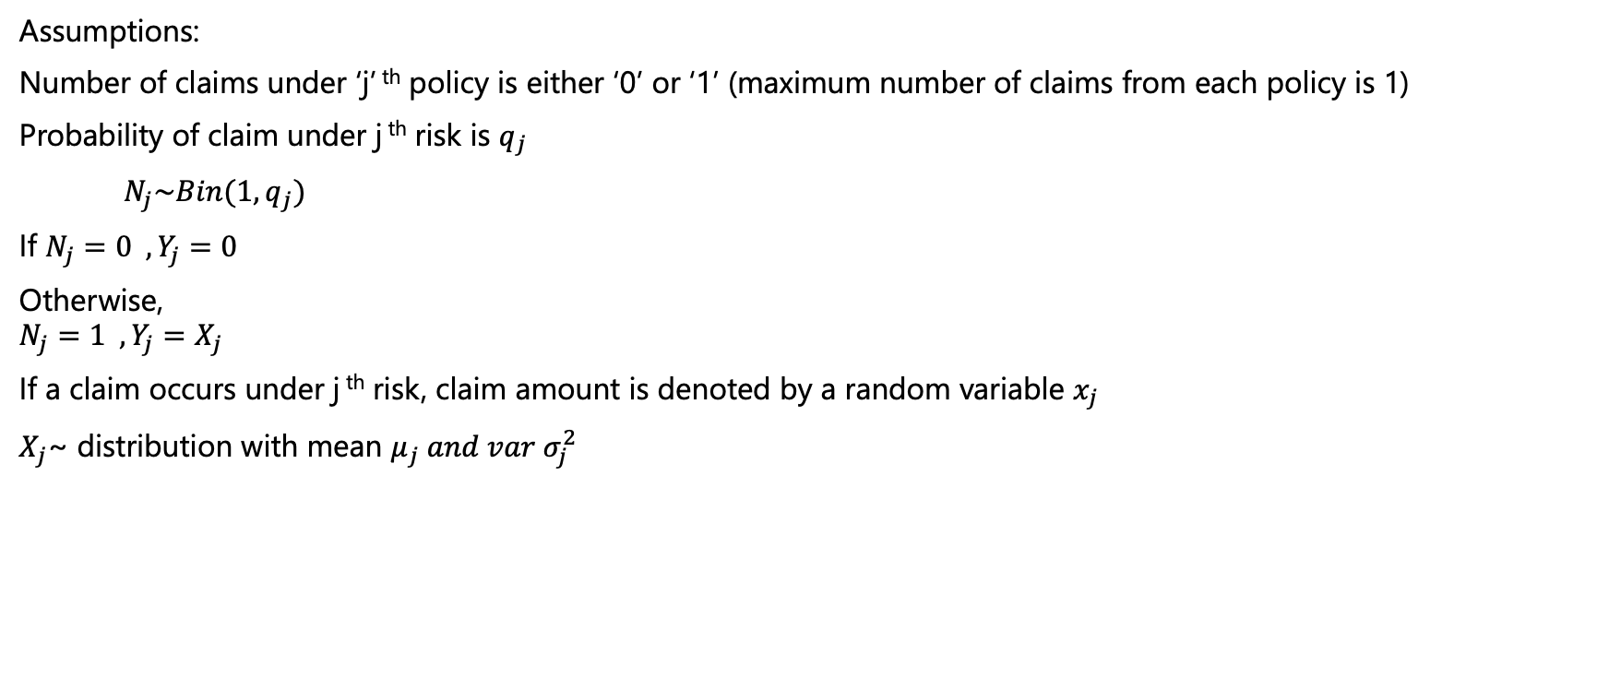
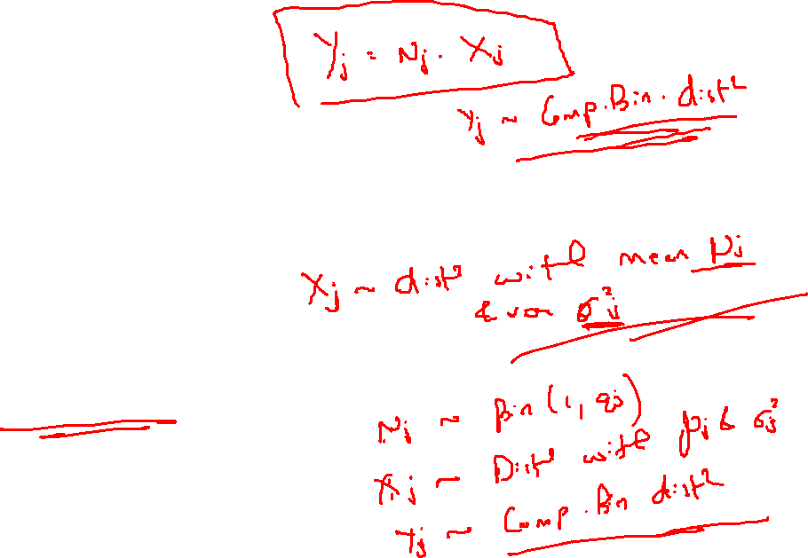
Individual Risk Model
6.0
Assumptions:
Number of claims under ‘j’ ^{th} policy is either ‘0’ or ‘1’ (maximum number of claims from each policy is 1)
Probability of claim under j ^{th} risk is $q_{j}$
$N_{j}\sim Bin(1, q_{j})$
If $N_{j}=0 , Y_{j}=0$
Otherwise,
$$N_{j}=1 , Y_{j}=X_{j}$$
If a claim occurs under j ^{th} risk, claim amount is denoted by a random variable $x_{j}$
$X_{j}$~ distribution with mean $μ_{j} and var σ_{j}^{2}$

Slide 24
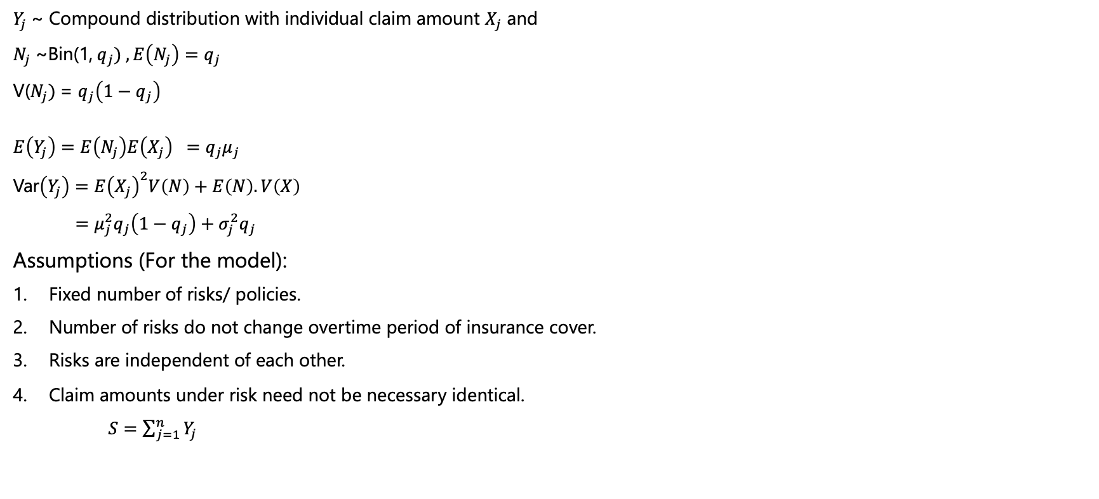
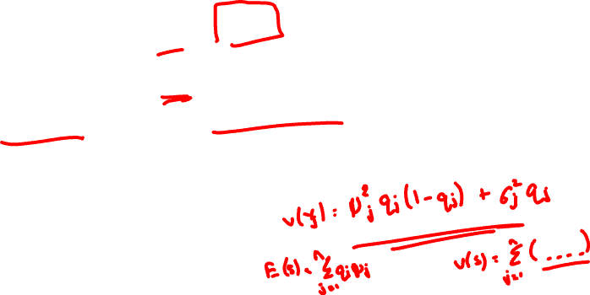
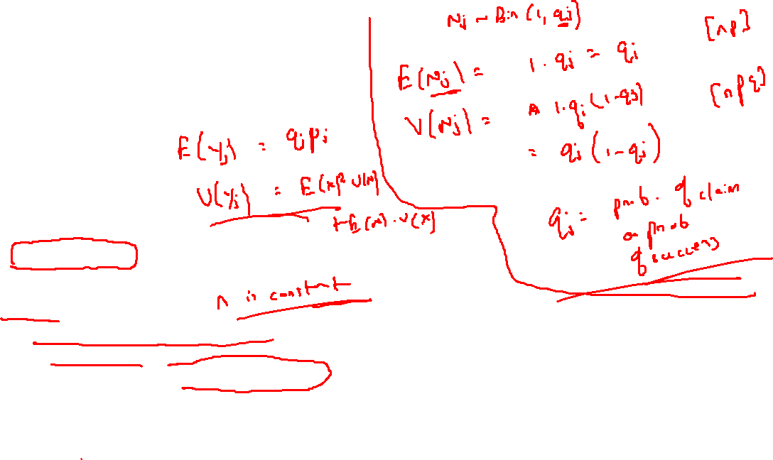
Individual Risk Model
6.0
$Y_{j}$~ Compound distribution with individual claim amount $X_{j}$ and
$N_{j}$~Bin(1, $q_{j}) , E\left(N_{j}\right)=q_{j}$
V($N_{j})$= $q_{j}\left(1−q_{j}\right)$
$$E\left(Y_{j}\right)=E\left(N_{j}\right)E\left(X_{j}\right) =q_{j}μ_{j}$$
Var$\left(Y_{j}\right)=E{\left(X_{j}\right)}^{2}V\left(N\right)+E\left(N\right).V\left(X\right)$
$=μ_{j}^{2}q_{j}\left(1−q_{j}\right)+σ_{j}^{2}q_{j}$
Assumptions (For the model):
Fixed number of risks/ policies.
Number of risks do not change overtime period of insurance cover.
Risks are independent of each other.
Claim amounts under risk need not be necessary identical.
$S=\sum_{j=1}^{n}{Y_{j}}$

Slide 25

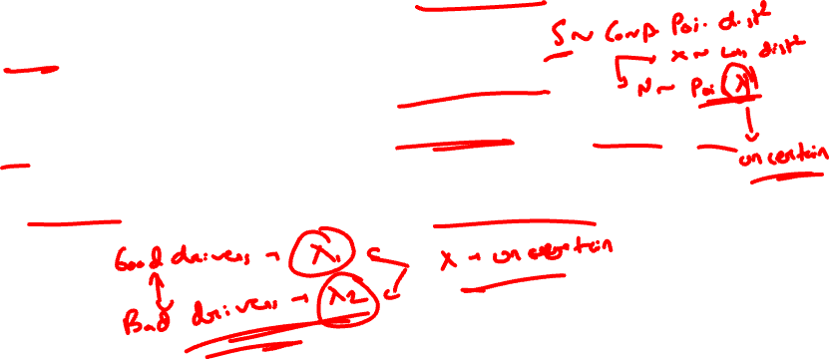
Parameter variability and uncertainty
7.0
Introduction
In some cases, parameters of the assumed distributions may also be uncertain.
Example: Poisson parameter for claims arising out of a motor insurance policy for a good driver and a bad driver.
In such cases, the resultant compound distribution for aggregate claims will need to take into account this parameter uncertainty, by usually modelling the parameter using a known distribution.

Slide 26
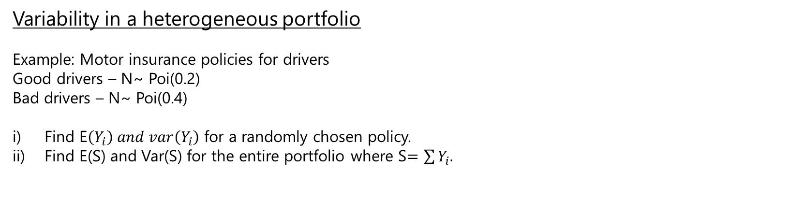
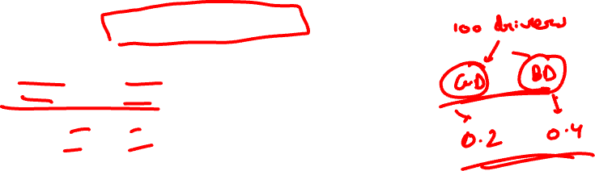
Parameter variability and uncertainty
7.0
Variability in a heterogeneous portfolio
Example: Motor insurance policies for drivers
Good drivers – N~ Poi(0.2)
Bad drivers – N~ Poi(0.4)
Find E$\left(Y_{i}\right) and var\left(Y_{i}\right)$ for a randomly chosen policy.
Find E(S) and Var(S) for the entire portfolio where S$=\sum{Y_{i}.}$

Slide 27
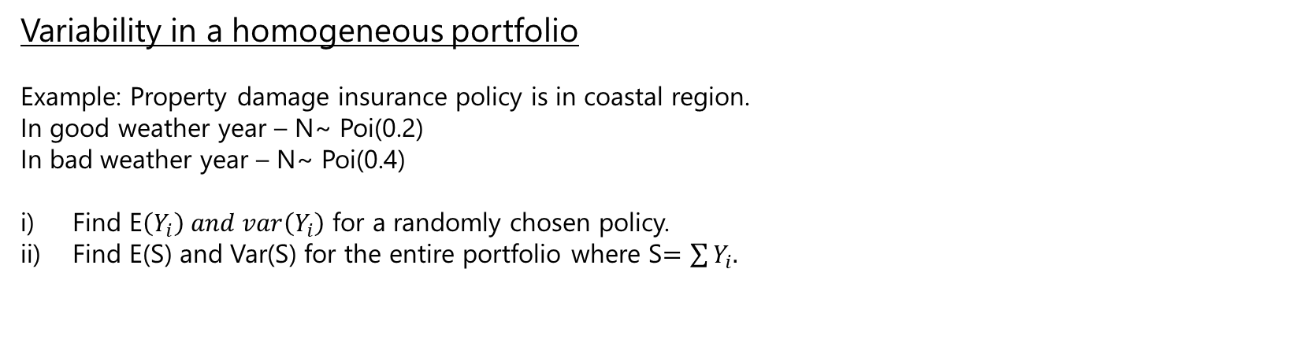
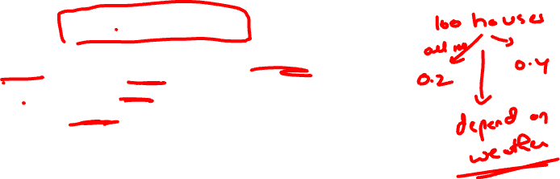
Parameter variability and uncertainty
7.0
Variability in a homogeneous portfolio
Example: Property damage insurance policy is in coastal region.
In good weather year – N~ Poi(0.2)
In bad weather year – N~ Poi(0.4)
Find E$\left(Y_{i}\right) and var\left(Y_{i}\right)$ for a randomly chosen policy.
Find E(S) and Var(S) for the entire portfolio where S$=\sum{Y_{i}.}$

Slide 28
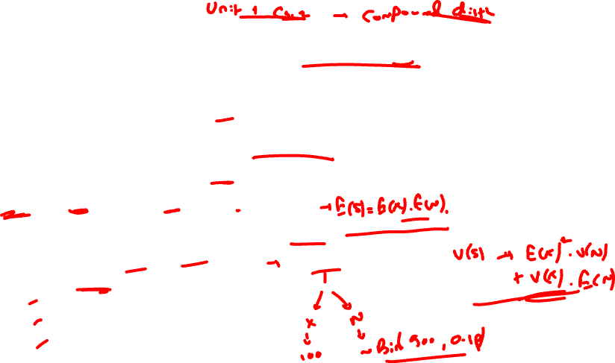
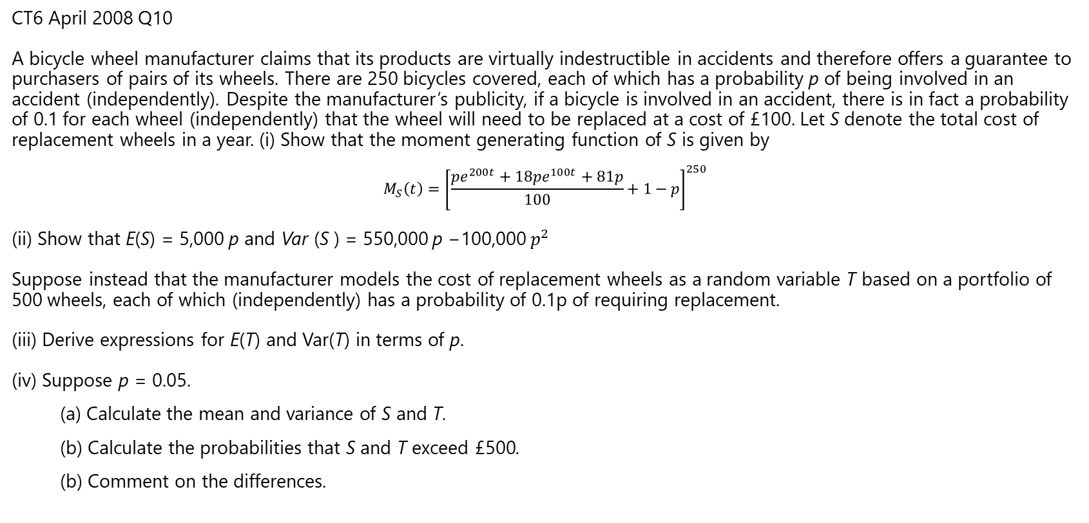
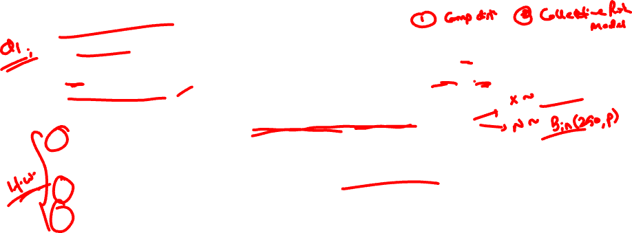
Approximation of Aggregate Distribution
8.0
CT6 April 2008 Q10
A bicycle wheel manufacturer claims that its products are virtually indestructible in accidents and therefore offers a guarantee to purchasers of pairs of its wheels. There are 250 bicycles covered, each of which has a probability p of being involved in an accident (independently). Despite the manufacturer’s publicity, if a bicycle is involved in an accident, there is in fact a probability of 0.1 for each wheel (independently) that the wheel will need to be replaced at a cost of £100. Let S denote the total cost of replacement wheels in a year. (i) Show that the moment generating function of S is given by
$$M_{S}\left(t\right)={\left[\frac{pe^{200t}+18pe^{100t}+81p}{100}+1−p\right]}^{250}$$
(ii) Show that E(S) = 5,000 p and Var (S ) = 550,000 p −100,000 $p^{2}$
Suppose instead that the manufacturer models the cost of replacement wheels as a random variable T based on a portfolio of 500 wheels, each of which (independently) has a probability of 0.1p of requiring replacement.
(iii) Derive expressions for E(T) and Var(T) in terms of p.
(iv) Suppose p = 0.05.
(a) Calculate the mean and variance of S and T.
(b) Calculate the probabilities that S and T exceed £500.
(b) Comment on the differences.

Slide 29
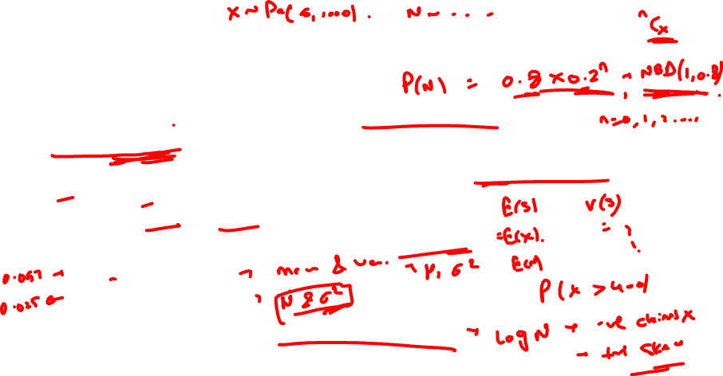
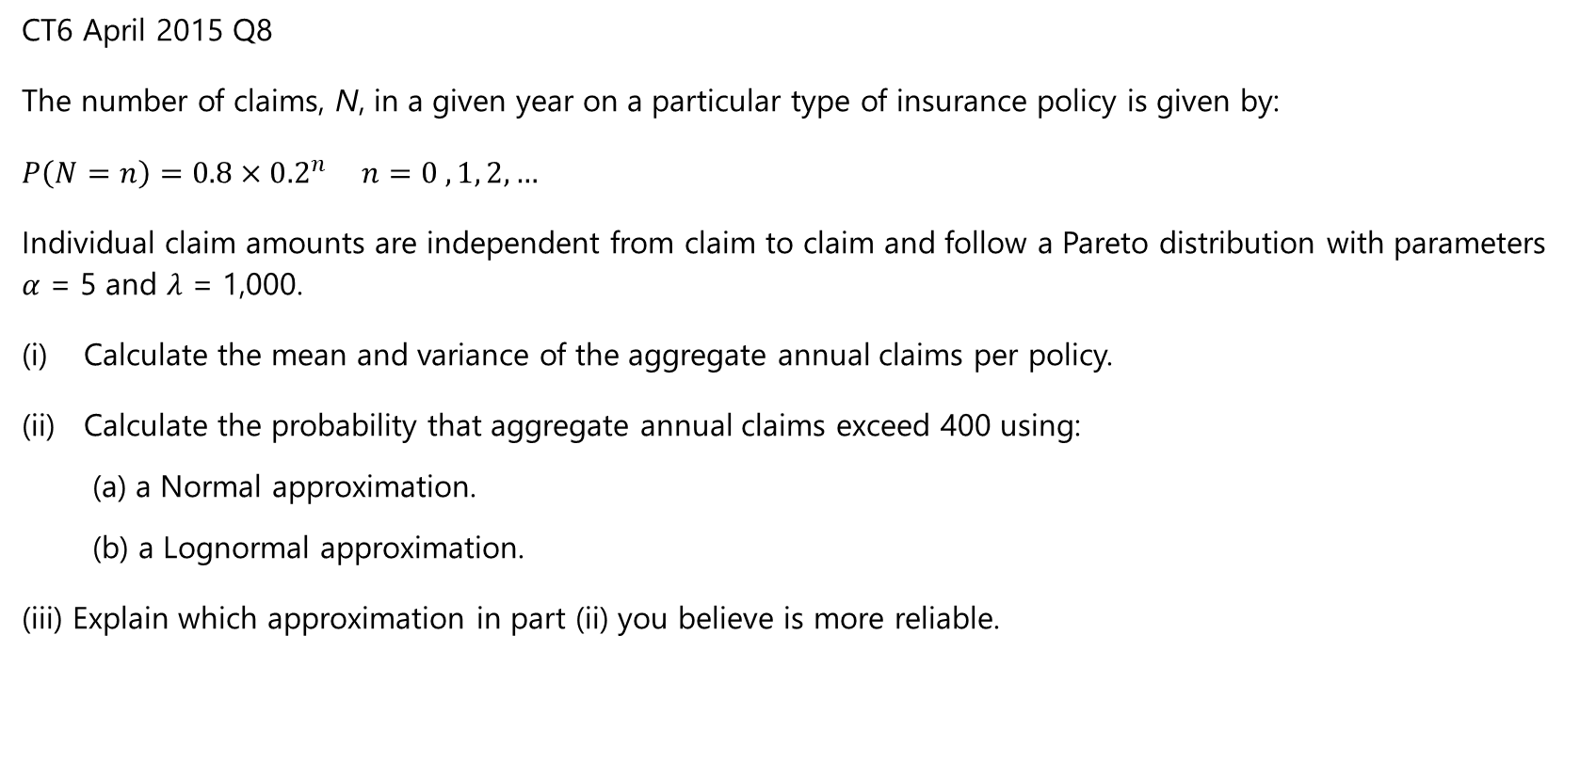
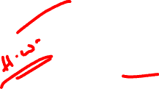
Approximation of Aggregate Distribution
8.0
CT6 April 2015 Q8
The number of claims, N, in a given year on a particular type of insurance policy is given by:
$P\left(N=n\right)=0.8×{0.2}^{n} n=0 , 1, 2,…$
Individual claim amounts are independent from claim to claim and follow a Pareto distribution with parameters $α$ = 5 and $λ$ = 1,000.
Calculate the mean and variance of the aggregate annual claims per policy.
Calculate the probability that aggregate annual claims exceed 400 using:
(a) a Normal approximation.
(b) a Lognormal approximation.
(iii) Explain which approximation in part (ii) you believe is more reliable.

Slide 30


Approximation of Aggregate Distribution
8.0
CT6 April 2012 Q4
Claims on a particular type of insurance policy follow a compound Poisson process with annual claim rate per policy 0.2. Individual claim amounts are exponentially distributed with mean 100. In addition, for a given claim there is a probability of 30% that an extra claim handling expense of 30 is incurred (independently of the claim size). The insurer charges an annual premium of 35 per policy.
Use a normal approximation to estimate how many policies the insurer must sell so that the insurer has a 95% probability of making a profit on the portfolio in the year.

Slide 31



Approximation of Aggregate Distribution
8.0
CT6 Sept 13 Q7
An insurance company offers dental insurance to the employees of a small firm. The annual number of claims follows a Poisson process with rate 20. Individual loss amounts follow an exponential distribution with mean 100. In order to increase the take-up rate, the insurance company has guaranteed to pay a minimum amount of £50 per qualifying claim. Let S be the total claim amount on the portfolio for a given year. (i) Show that the mean and variance of S are 2,213.06 and 413,918.40 respectively.
$\text{[}\text{You} \text{may} \text{use} \text{without} \text{proof} \text{the} \text{result} \text{that} \text{if}$ $I_{n}= \int_{M}^{∞}{y^{n}λe^{−λy}dy}$ then $I_{n}=M^{n}e^{−λM}+\frac{n}{λ}I_{n−1}$]
(ii) (a) Fit a log-normal distribution for S using the method of moments.
(b) Estimate the probability that S is greater than 4,000.
Sarah, the insurance company’s actuary, has instead approximated S by a Normal distribution. (iii) Explain, without performing any further calculations, whether the probability that she calculates that S exceeds 4,000 will be greater or smaller than the calculation in part (ii).

