Slide 1

Lecture 1
Class: TY BSc
Subject : Statistical & Risk Modelling - 3
Subject Code:
Chapter: Unit 3 Chapter 6
Chapter Name: Theory of Decision Making

Slide 2
Agenda
1.0 Introduction
1.1 Zero-Sum 2 player games
1.2 Strategy
1.3 Statistical Game
1.4 Decision criteria

Slide 3

Introduction
1.0
In complex choices and games, it is not always straightforward to make decisions .
We will use game theory and statistical criterion to make these decisions.

Slide 4
Zero-Sum 2 player games
1.1
Example:
 | A
B |  | H | T
 | H | +1 | -1
 | T | -1 | +1

Slide 5
Strategies
1.2
Domination:
(in Rs. 100 Crores)
 | Investor
Government |  | RIL | TCS | HUL | HDFC BANK
 | Remove | 2 | 0 | 1 | 4
 | Reduce | 1 | 2 | 2 | 3
 | Maintain | 4 | 1 | 3 | 2

Slide 6
Strategies
1.2
2) Minimax Strategies:
Strategy that minimizes max loss and maximizes minimum gain.
Example:
 | Player A
Player B |  | I | II | III
 | 1 | 6 | 2 | 1
 | 2 | 4 | 3 | 5
 | 3 | -3 | 1 | 6

Slide 7
Strategies
1.2
3) Saddle Points:
Equilibrium point in a strategy.
Element that is the largest in its column and smallest in its row.
If saddle point exists, minimax strategy is spy-proof.
Example:
If B decides to switch to Strategy I
Not all matrices have saddle points.
 | I | II | III
1 | 4 | 1 | -4
2 | 3 | 2 | 3
3 | -4 | 1 | 4

Slide 8

Question
For what values of x and y does the matrix:
2 7 x
y 3 1
6 8 5
Have a saddle point?

Slide 9
Strategies
1.2
3) Randomized strategy:
Example:
Assign a probability to every case and minimize the total max loss.
 | I | II
1 | 7 | -6
2 | 1 | 5

Slide 10
Statistical games
1.3
Game between nature - that controls features of a population, and a statistician, trying to make a decision about the population
Example:
Coin is either balanced or two- headed.
1 coin toss will be done.
Statistician has to decide whether it is balanced or 2 headed.
If correct then no reward, but if incorrect then a penalty of 1.
Consider all types of decisions and calculate Expected loss for both scenarios A & B.
 | X (2 H) | Y (H T)
A (2 H) | 0 | 1
B (H T) | 1 | 0

Slide 11
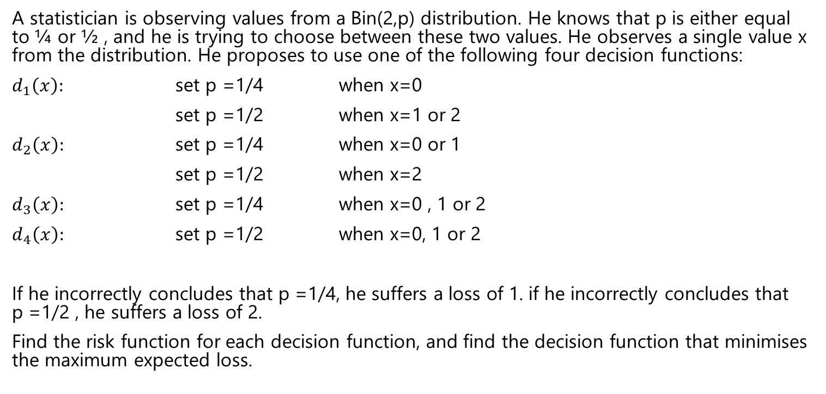
Question
A statistician is observing values from a Bin(2,p) distribution. He knows that p is either equal to ¼ or ½ , and he is trying to choose between these two values. He observes a single value x from the distribution. He proposes to use one of the following four decision functions:
$d_{1}\left(x\right):$ set p =1/4 when x=0
set p =1/2 when x=1 or 2
$d_{2}\left(x\right):$ set p =1/4 when x=0 or 1
set p =1/2 when x=2
$d_{3}\left(x\right):$ set p =1/4 when x=0 , 1 or 2
$d_{4}\left(x\right):$ set p =1/2 when x=0, 1 or 2
If he incorrectly concludes that p =1/4, he suffers a loss of 1. if he incorrectly concludes that p =1/2 , he suffers a loss of 2.
Find the risk function for each decision function, and find the decision function that minimises the maximum expected loss.

Slide 12
Decision criteria
1.4
Minimax criteria:
Seen earlier.
Bayes criteria:
Decision making using additional knowledge of prior distributions.
Example:
If probability of 2H is 2/3, 1/6, 1/3, then which is the most optimal strategy as per Bayes criterion?

Slide 13
Question
The statistician in the previous example has a prior feeling that it is about equally likely that p will be equal to ¼ or ½. Calculate the Bayes risk for each of the four decision functions. Which decision function has the smallest Bayes risk?

Slide 14
Question
A consumer has to decide whether to take out a travel insurance policy which covers him for all trips over the next year or to purchase a separate policy each time he makes a trip. He isn't sure how many trips we will make.
An annual policy would cost 95.
A separate policy for each trip cost 30.
He estimates that the probability distribution of the number of trips he will take over the next year, X, is as follows:
Determine the minimax and Bayes decision.
Number of trips, x | P(X=x)
1 | 0.1
2 | 0.2
3 | 0.3
4 | 0.3
5 | 0.1

