Slide 1

Lecture 1
Class: TY BSc
Subject : Statistics and Risk Modelling - 3
Subject Code:
Chapter: Unit 4 Chapter 1
Chapter Name: Methods and Models of Loss reserving

Slide 2
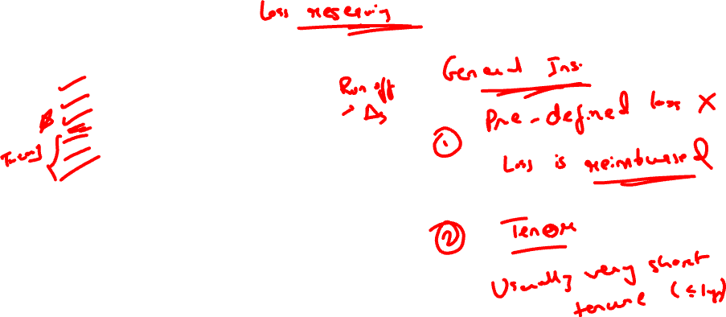
Agenda
1.1 Introduction
1.2 Types of Reserves
1.3 Techniques for estimating unpaid losses
1.4 Introduction to rate making
1.5 Objectives of rate making
1.6 Calculating Premium

Slide 3
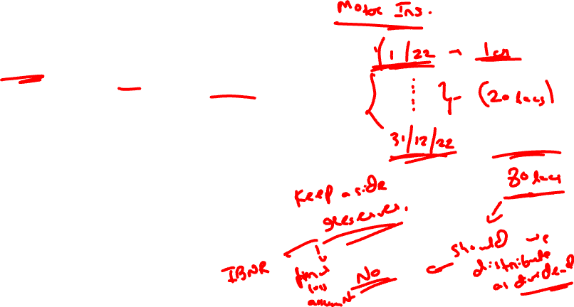

Introduction
1.1
General Insurance Company:
Sells policies and collects premiums
(-) Pays claims
= Surplus Cash
Should we distribute this as profit?
NO
Reason: A delay in claims settlement or claims reporting.
For this we need to maintain reserves.

Slide 4
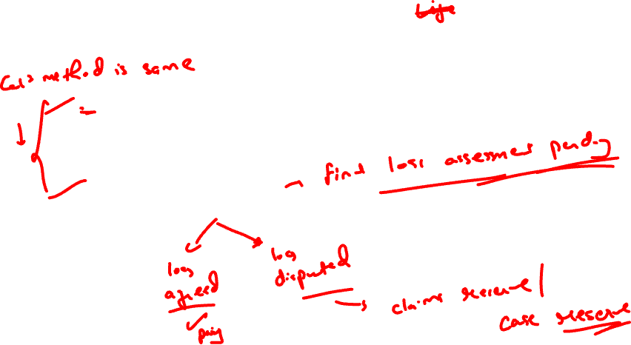

1.2
Types of Reserves
1) IBNR : Incurred But Not Reported Reserves
Example: Accident has occurred but have not yet been reported to the insurance company due to lack of awareness.
2) Outstanding Reported Claims Reserves
Example: Claim is reported but settlement is fully or partially delayed due to final loss assessment pending.

Slide 5
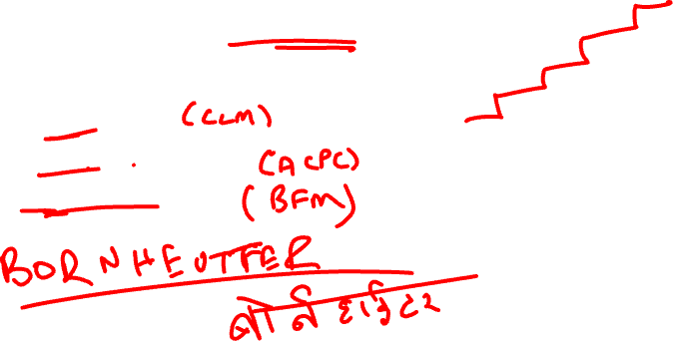

1.2
Types of Reserves
To calculate these reserves, we use run off triangles.
Methods:
Chain-ladder Method
Average cost per claim Method
Bornheutter Ferguson Method

Slide 6
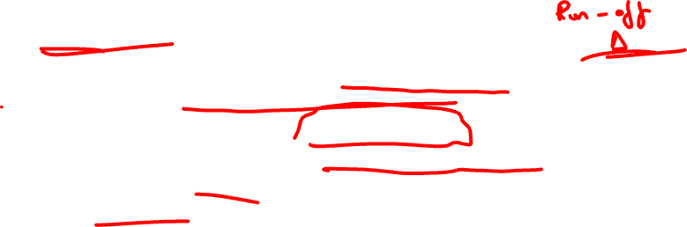
1.3
Techniques for estimating unpaid losses
1) The chain-ladder or loss development triangle method
In the chain-ladder method, the actuary estimates the age-to-age development factors based on history, and uses these to develop immature claims to their ultimate cost.
The chain-ladder method projects future payments purely off past payments.
For a claim with a long time to settlement, the cumulative amount paid usually grows from year to year. This growth is called loss development.
An age-to-ultimate development factor is the ratio of the ultimate payment to the cumulative payment at any age.

Slide 7
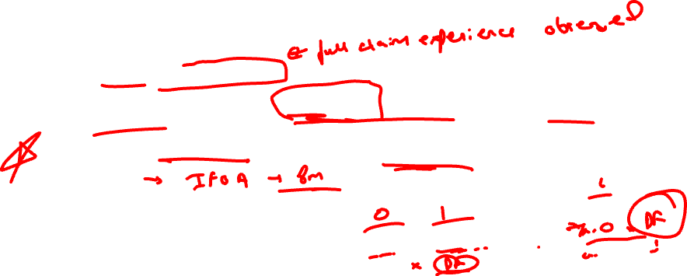

1.3
Techniques for estimating unpaid losses
The chain-ladder or loss development triangle method
ASSUMPTIONS
The first accident year is fully run off.
Claims in each development year are a constant proportion in monetary terms of total claims for each accident year.
Inflation is not allowed for explicitly, rather it is allowed for implicitly as a weighted average of past inflation.

Slide 8


1.3
Techniques for estimating unpaid losses
The chain-ladder or loss development triangle method
STEPS
Write down the cumulative claims paid/ incurred in a triangle format.
Calculate development factors using the data.
Estimate future claims amount using development factors.

Slide 9

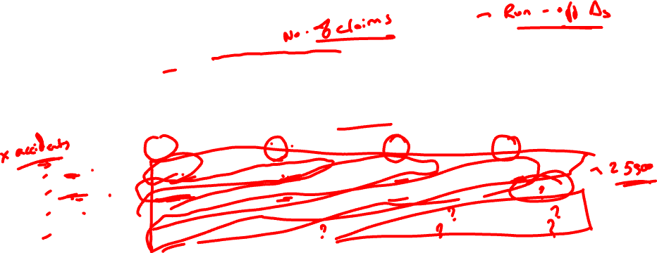
1.3
Techniques for estimating unpaid losses
EXAMPLE:
The table below shows the household insurance claims reported in each development year for accident years from 2009 to 2012. Use the basic chain ladder method to estimate the total ultimate claims arising from accidents occurring between 1 January 2009 and 31 December 2012.
Number of claims reported | Development Year
 | 0 | 1 | 2 | 3
2009 | 17500 | 5000 | 2250 | 750
2010 | 21000 | 6200 | 2750
2011 | 18800 | 5500
2012 | 21300

Slide 10
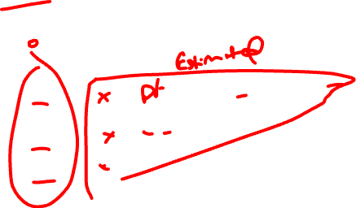
1.3
Techniques for estimating unpaid losses
The chain-ladder method
MODEL CHECK:
To check whether estimated claims figures using development factors are appropriate to given data.

Slide 11
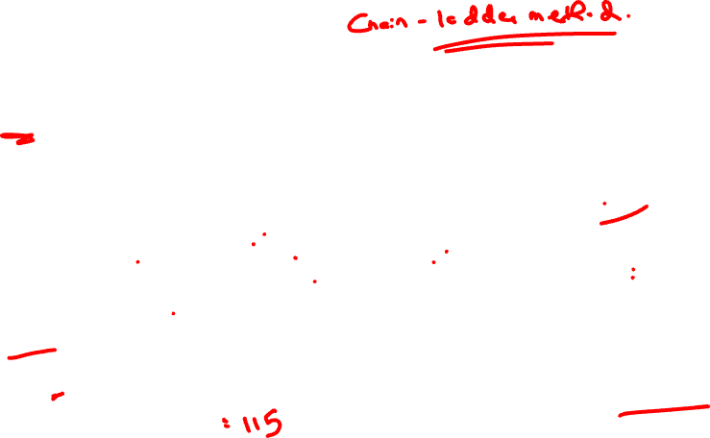
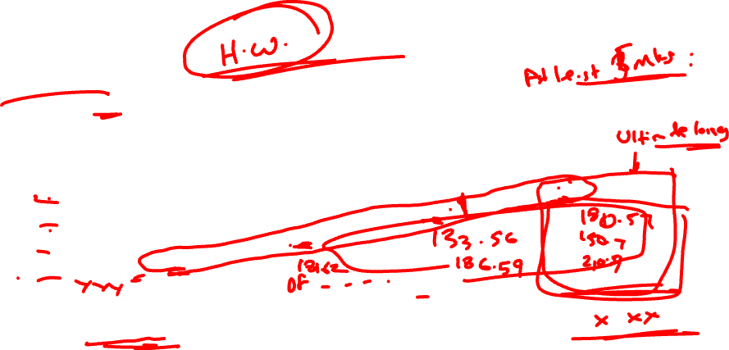
Question
CT6 Sept 2009 Q8
The cumulative incurred claims for an insurance company for the last four accident years are given in the following table:
It can be assumed that claims are fully Run off after three years.
Calculate the reserves at the end of year 2008 using basic chain ladder method.
Accident Year | Development Year
 | 0 | 1 | 2 | 3
2005 | 96 | 136 | 140 | 158
2006 | 100 | 156 | 160
2007 | 120 | 130
2008 | 136

Slide 12
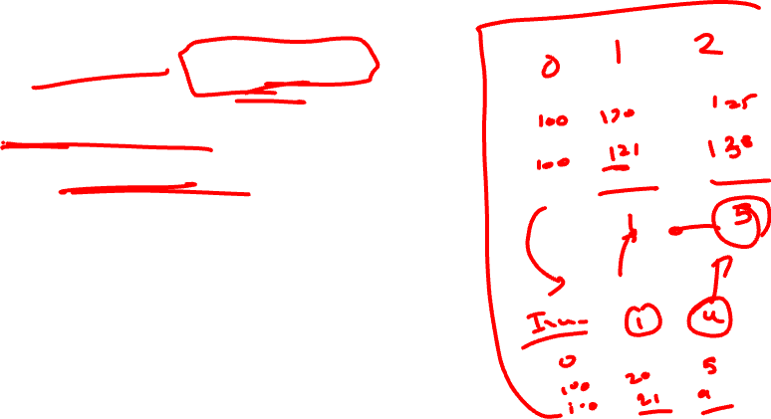
1.3
Techniques for estimating unpaid losses
The chain-ladder method – Adjusted for Inflation
Past inflation to adjust given data.
Future inflation to get more accurate reserves.

Slide 13
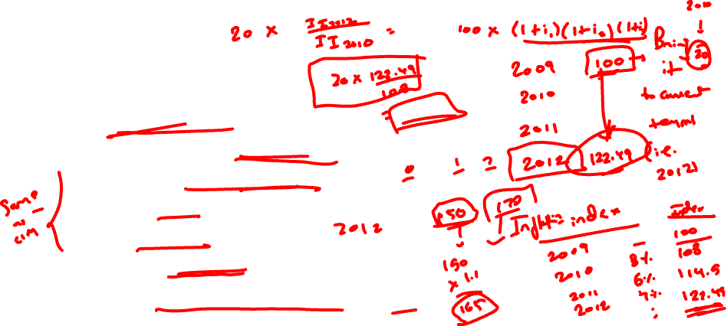
1.3
Techniques for estimating unpaid losses
The chain-ladder method – Adjusted for Inflation
STEPS
Incremental claims paid/ incurred.
Multiply past data with relevant inflation index to adjust to real terms.
Write down inflation adjusted cumulative claims data.
Calculate development factors.
Estimate future claims amount.
Write down incremental claims paid/ incurred.
Calculate future incremental claims amount using inflation index.

Slide 14
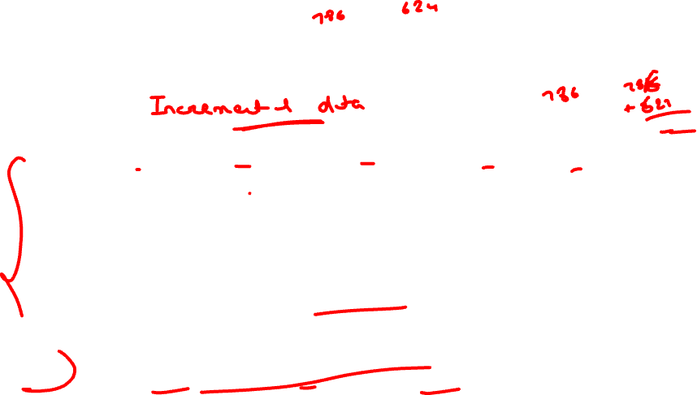
1.3
Techniques for estimating unpaid losses
EXAMPLE:
Accident Year | Development Year
 | 0 | 1 | 2 | 3 | 4
2008 | 786 | 624 | 806 | 224 | 79
2009 | 904 | 671 | 904 | 281
2010 | 995 | 819 | 1066
2011 | 1220 | 922
2012 | 1182
Suppose that the annual claim payments inflation rates over the 12 months up to the middle of the given year are as follows:
2009 | 2010 | 2011 | 2012
5.1% | 6.4% | 7.3% | 5.4%

Slide 15
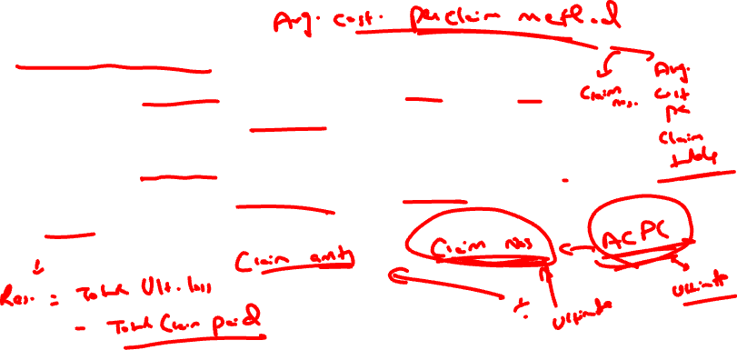

1.3
Techniques for estimating unpaid losses
2) Average cost per claim method
This method requires development tables for both total claim amounts and claim numbers.
A third development table, of the average claim amounts, is then formed by dividing the figures in the corresponding cells of the first two tables.
Finally, the projected ultimate claims can be calculated by multiplying together for each accident year the projected figures for the average claim amounts and claim numbers.
A reserve can then be calculated by subtracting all payments to date in respect of claims relating to the data in the table.

Slide 16
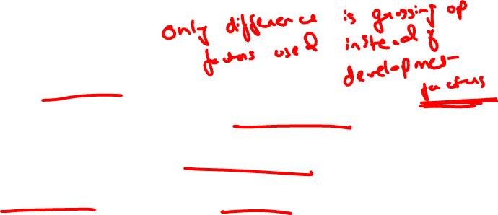
1.3
Techniques for estimating unpaid losses
2) Average cost per claim method
ASSUMPTIONS
The first accident year is fully run off.
The average cost per claim in each development year is a constant proportion in monetary terms of the ultimate average cost per claim for each accident year.
The number of claims in each development year is a constant proportion in of the ultimate number of claims for each accident year.
Inflation is not allowed for explicitly, rather it is allowed for implicitly as a weighted average of past inflation.

Slide 17

1.3
Techniques for estimating unpaid losses
2) Average cost per claim method
STEPS
Write down cumulative average claims incurred/ paid.
Using grossing up factors, calculate estimated ultimate average claim and ultimate claim numbers.
Future claim amount by multiplying the above 2.

Slide 18
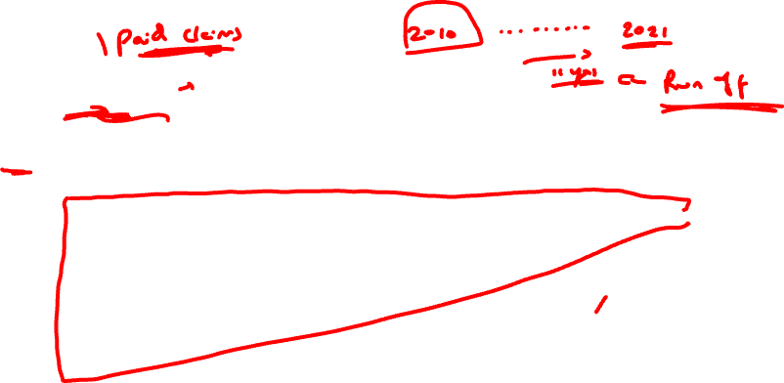

1.3
Techniques for estimating unpaid losses
EXAMPLE:
Cumulative incurred claims data, by year of accident and reporting development.
Accident Year | Development Year
 | 0 | 1 | 2 | 3 | 4 | 5 | Ult
1 | 2777 | 3264 | 3452 | 3594 | 3719 | 3717 | 3717
2 | 3252 | 3804 | 3973 | 4321 | 4319
3 | 3725 | 4404 | 4779 | 4946
4 | 4521 | 5422 | 5676
5 | 5369 | 6142
6 | 5818

Slide 19
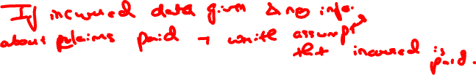
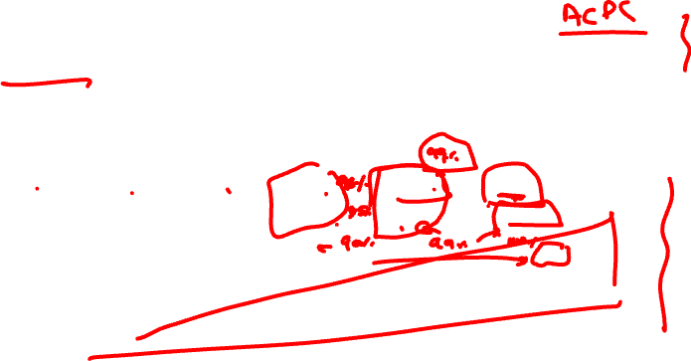
1.3
Techniques for estimating unpaid losses
EXAMPLE:
Cumulative Number of claims reported, by year of accident and reporting development.
Accident Year | Development Year
 | 0 | 1 | 2 | 3 | 4 | 5 | Ult
1 | 414 | 460 | 482 | 488 | 492 | 494 | 494
2 | 453 | 506 | 526 | 536 | 539
3 | 494 | 548 | 572 | 582
4 | 530 | 588 | 615
5 | 545 | 605
6 | 557

Slide 20
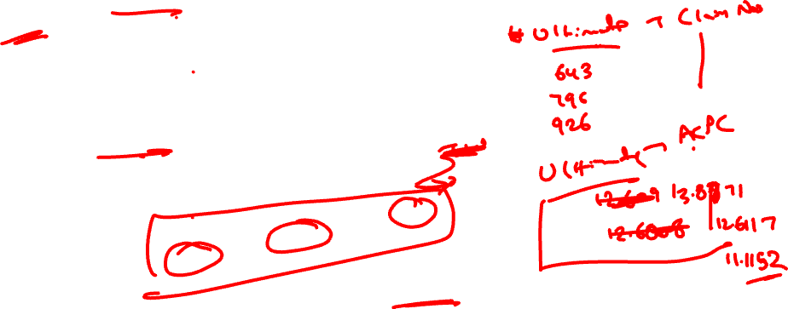
Question
The number of claims settled
The cost of settled claims during each year (in 000’s):
Claims are fully runoff after year 2. Calculate the outstanding claims reserve using the average cost per claim method with grossing up factors. Inflation can be ignored.
Accident Year | Development Year
 | 0 | 1 | 2
2006 | 442 | 151 | 50
2007 | 623 | 111
2008 | 681
Accident Year | Development Year
 | 0 | 1 | 2
2006 | 6321 | 1901 | 701
2007 | 7012 | 2237
2008 | 7278

Slide 21
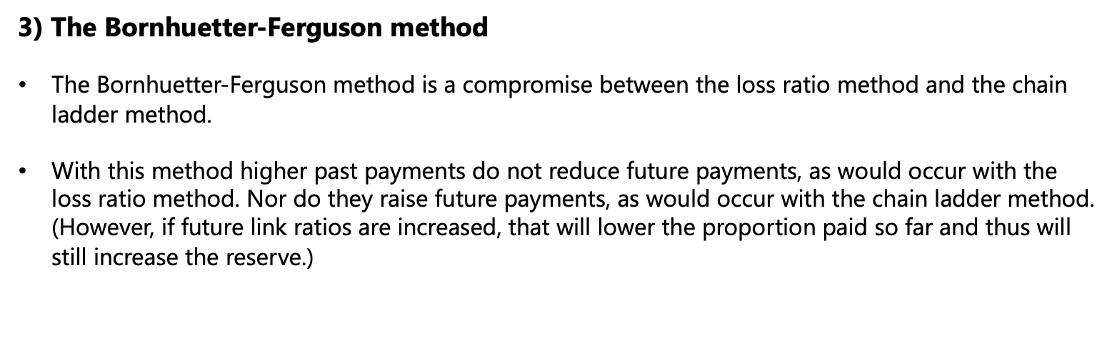
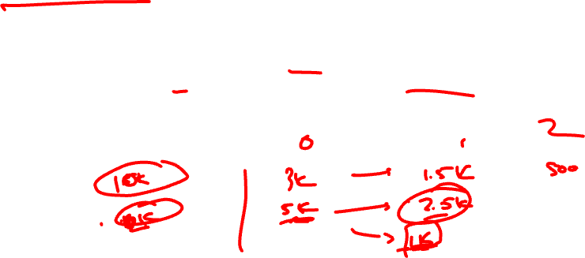

Techniques for estimating unpaid losses
1.3
3) The Bornhuetter-Ferguson method
The Bornhuetter-Ferguson method is a compromise between the loss ratio method and the chain ladder method.
With this method higher past payments do not reduce future payments, as would occur with the loss ratio method. Nor do they raise future payments, as would occur with the chain ladder method. (However, if future link ratios are increased, that will lower the proportion paid so far and thus will still increase the reserve.)

Slide 22

Techniques for estimating unpaid losses
1.3
3) The Bornhuetter-Ferguson method
ASSUMPTIONS
The first accident year is fully run off.
The loss ratio is correct.
Claims in each development year are a constant proportion in monetary terms of total claims for each accident year.
Inflation is not allowed for explicitly, rather it is allowed for implicitly as a weighted average of past inflation.

Slide 23
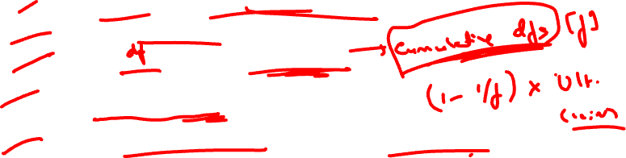

Techniques for estimating unpaid losses
1.3
3) The Bornhuetter-Ferguson method
STEPS
Calculate ultimate claims using loss ratio and earned premium.
Write down cumulative claims paid/ incurred.
Calculate the ratio (r) and then development factors (f).
Estimate future claims liability using the formula:
Ultimate Claim * (1 -1/ f)
5. Calculate revised ultimate claims using given data and estimated future liability.

Slide 24
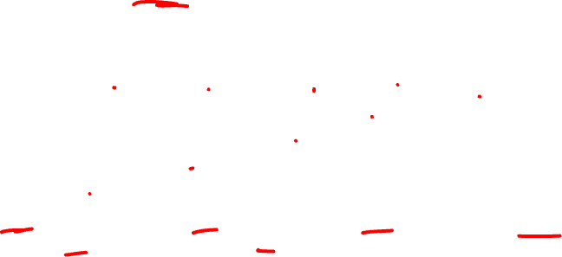
Techniques for estimating unpaid losses
1.3
EXAMPLE
An insurance company has paid the following claim amounts (in £000s):
Accident Year | Development Year
 | 1 | 2 | 3 | 4 | 5
1 | 2800 | 1400 | 987 | 322 | 57
2 | 3260 | 2004 | 1017 | 421
3 | 3854 | 1978 | 857
4 | 3722 | 2114
5 | 4627
The earned premium in each year is 6,727 for Accident Year 1, 8,289 for Accident Year 2, 9,627 for
Accident Year 3, 9,928 for Accident Year 4 and 10,004 for Accident Year 5.
Apply the Bornhuetter-Ferguson method to estimate the amount of claims yet to be paid, stating
any assumptions that you make.

Slide 25

Question
The table below shows the cumulative costs of incurred claims. The claims are assumed to be
fully run-off by the end of Development Year 2.
£000s Development Year
Accident Year 0 1 2
2011 2,670 3,290 4,310
2012 2,850 3,420
2013 3,030
Annual premiums written were:
The ultimate loss ratio has been estimated at 80% and the total amount of claims paid to date is
£5,720,000. Calculate the outstanding claims reserve using the Bornhuetter-Ferguson
method.
Year | Premiums (£000s)
2011 | 5390
2012 | 5600
2013 | 6030

Slide 26
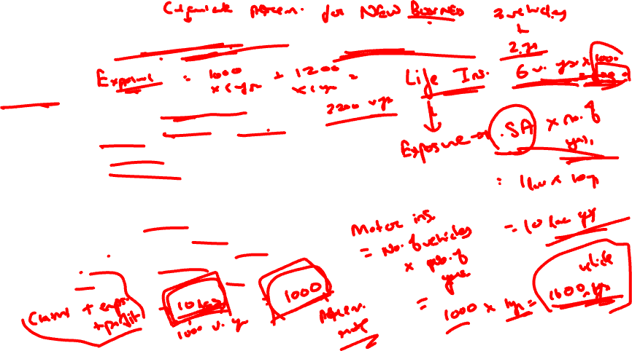
Role of Rating factor & exposure
1.4
Exposure
Indication of measure of risk present in the policy.
- It should allow for both frequency and severity of claims.
- It should be practical.
- Not open to manipulation.
- Used in calculation of premium.
Example:
Life Insurance - Sum assured years
Employers liability insurance - Payroll
Motor third party liability insurance - Vehicle year
Aviation liability - Passenger kilometers
Public liability/ Product liability - Turnover

Slide 27

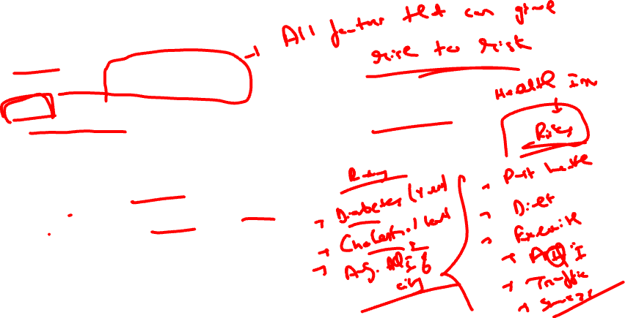
Definitions
1.5
Risk factors:
Factors that have bearing on and of risk.
Rating factors:
Objectively measurable risk factors or factors that can be used as reliable proxies for risk factors.
They are used to classify risk into homogenous groups
Since exposure measure cannot generally account for all the factors determining risk.
Example:
Employer liability - Type of industry
Property damage insurance – Location/ Age of building
Motor Insurance – Number of miles driven

Slide 28
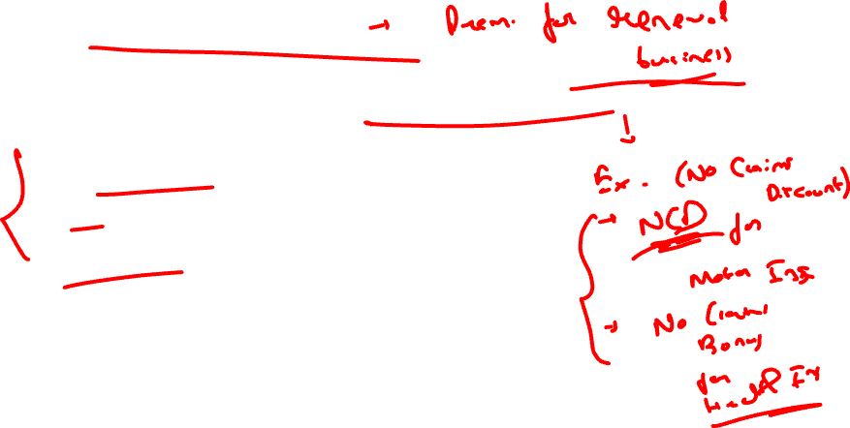
Experience Rating
1.6
Rating system in which premium depends on post actual claims experience.
Types:
Prospective versus retrospective basis
Number based
Cost based

Slide 29
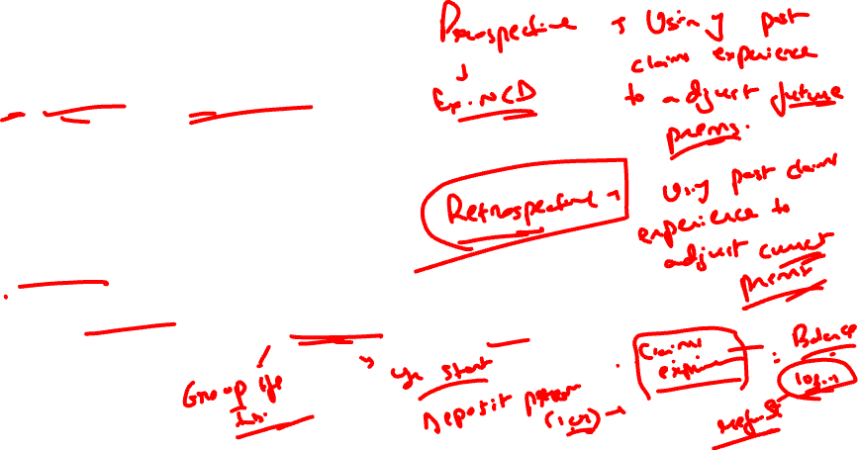
Experience Rating
1.6
1) Prospective versus retrospective
Prospective uses past claim experience to calculate future premiums
Example –
NCD system in motor insurance
Retrospective uses current period claim experience to adjust current policy premium
Example –
Employer liability/ Product liability - Deposit premium is paid at start of period and then it is adjusted/ refunded based on claim experience.

Slide 30

Experience Rating
1.6
2) Number based
Premium adjustments are made based on number of claims and not amount of claims (for small individual risk).
Example - No claim bonuses in Health insurance.
3) Cost based system
Premium adjustments are made based on amount of claims in the policy period.
Example – Employers liability, Marine fleet insurance

Slide 31
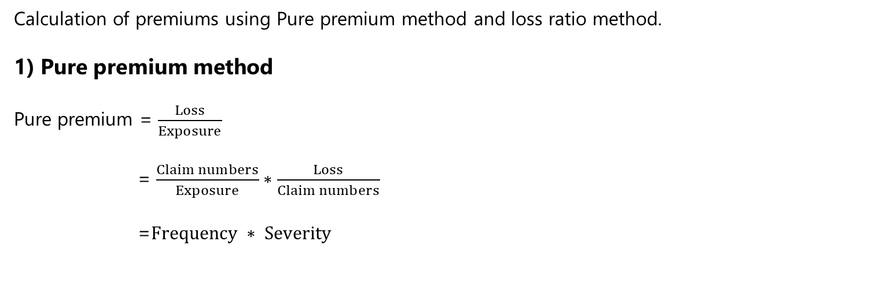
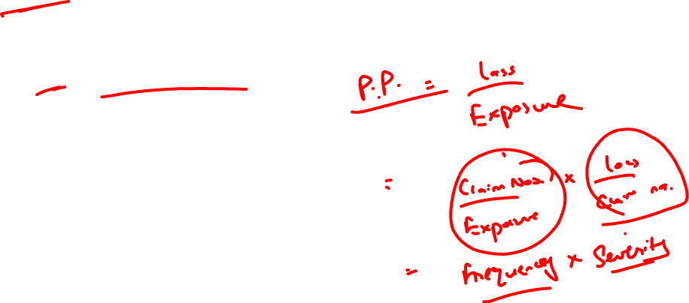
Premium Calculation
1.7
Calculation of premiums using Pure premium method and loss ratio method.
1) Pure premium method
Pure premium = $\frac{Loss}{Exposure}$
= $\frac{Claim numbers}{Exposure}∗\frac{Loss}{Claim numbers}$
=$Frequency ∗ Severity$

Slide 32
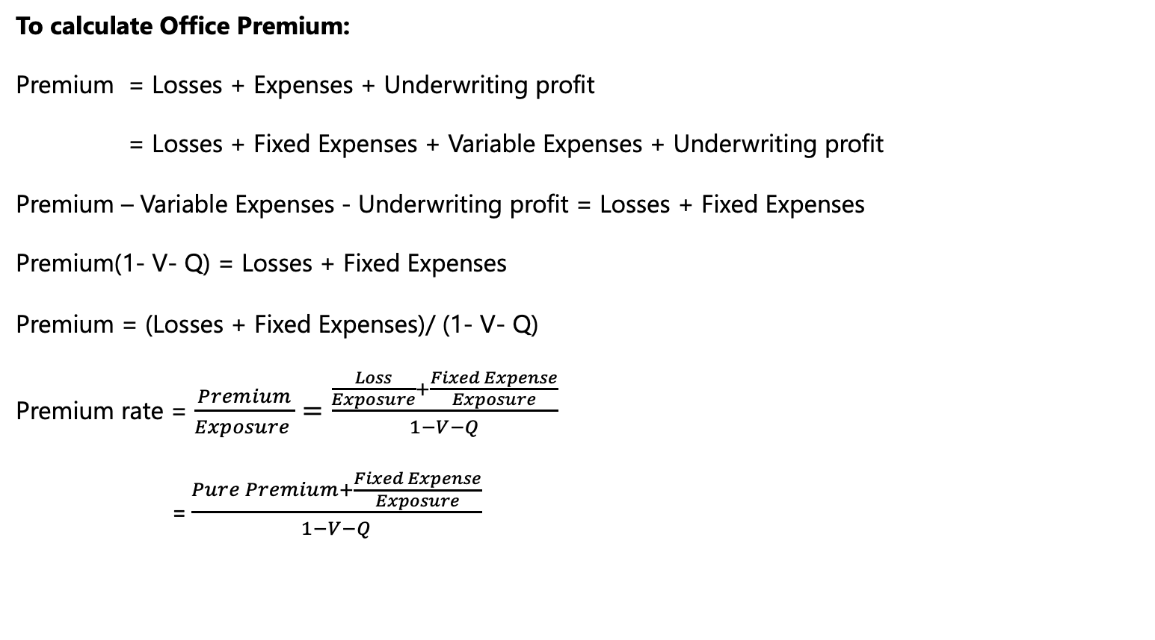
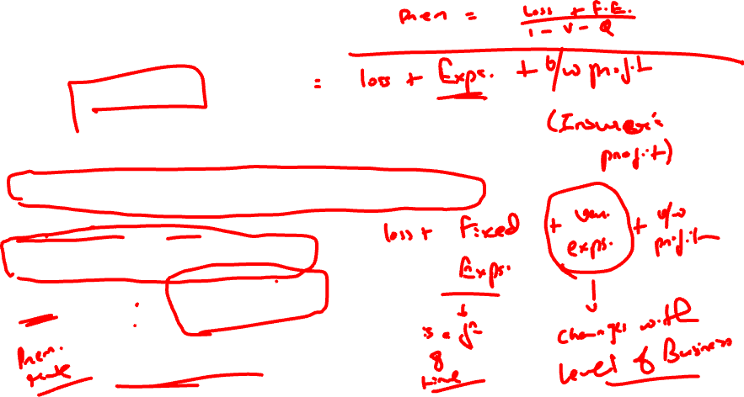
Premium Calculation
1.7
To calculate Office Premium:
Premium = Losses + Expenses + Underwriting profit
= Losses + Fixed Expenses + Variable Expenses + Underwriting profit
Premium – Variable Expenses - Underwriting profit = Losses + Fixed Expenses
Premium(1- V- Q) = Losses + Fixed Expenses
Premium = (Losses + Fixed Expenses)/ (1- V- Q)
Premium rate = $\frac{Premium}{Exposure }=\frac{\frac{Loss}{Exposure}+\frac{Fixed Expense}{Exposure}}{1−V−Q}$
= $\frac{Pure Premium+\frac{Fixed Expense}{Exposure}}{1−V−Q}$

Slide 33
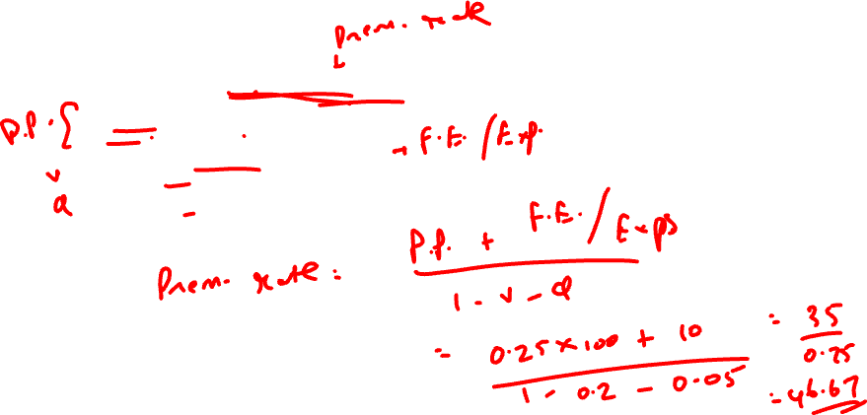
Question
Determine the indicated rate per exposure unit, given in the following information:
Frequency per exposure unit = 0.25
Severity = $100
Fixed expense per exposure unit = $10
Variable expense factor = 20%
Profit and contingencies factor = 5%

Slide 34
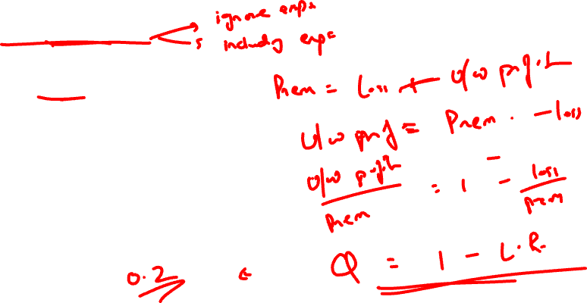

Premium Calculation
1.7
2) Loss Ratio method
Used to calculate change in rates instead of setting rates.
i. (Ignoring Expenses)
Premium = Losses + Underwriting profit
Underwriting profit = Premium - Losses
(Underwriting profit)/ Premium = 1 – Losses/ Premium
Q = 1- Loss Ratio

Slide 35


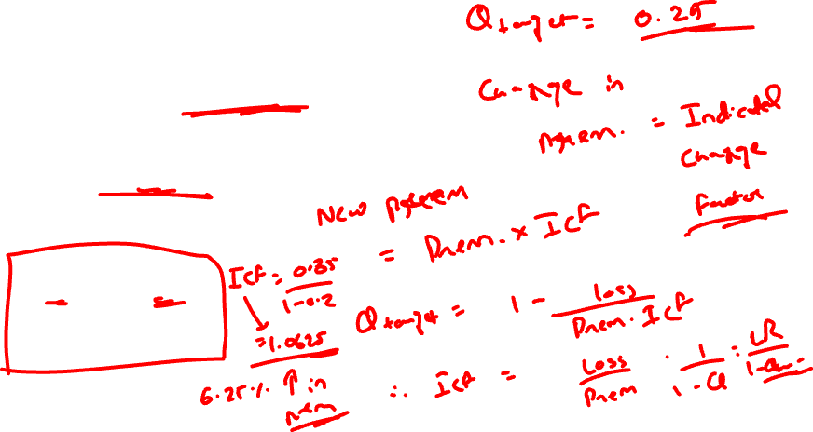
Premium Calculation
1.7
For a new target Underwriting profit: $Q_{target}$
$Q_{target}$= 1- Loss/ (ICF * Premium)
(ICF = Indicated Change Factor)
ICF = $\frac{Loss Ratio}{1−Q_{target}}$
Example-
LR = 85% , $Q_{target}$= 20%
ICF = 0.85/(1-0.2) = 1.0625
ie. 6.25% increase in premiums.

Slide 36
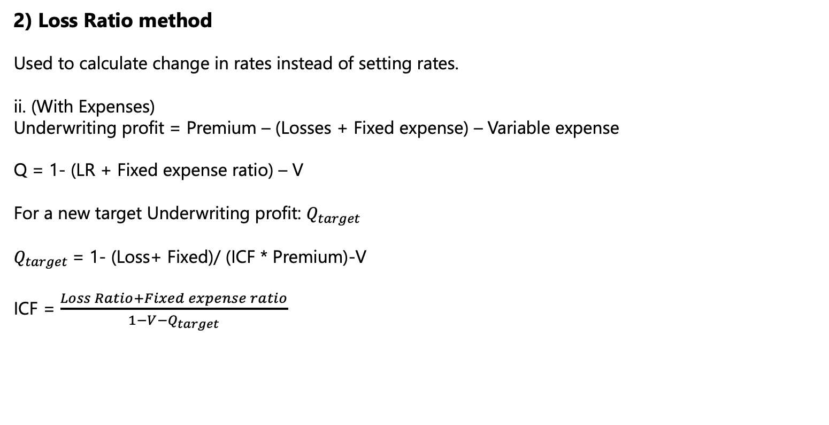
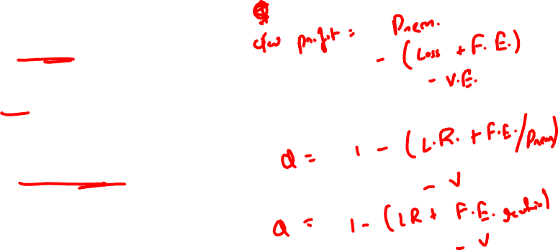
Premium Calculation
1.7
2) Loss Ratio method
Used to calculate change in rates instead of setting rates.
ii. (With Expenses)
Underwriting profit = Premium – (Losses + Fixed expense) – Variable expense
Q = 1- (LR + Fixed expense ratio) – V
For a new target Underwriting profit: $Q_{target}$
$Q_{target}$= 1- (Loss+ Fixed)/ (ICF * Premium)-V
ICF = $\frac{Loss Ratio+Fixed expense ratio}{1−{V−Q}_{target}}$

Slide 37
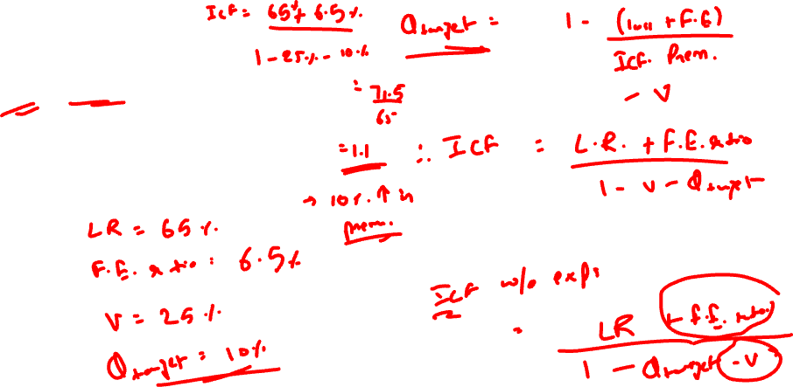
Question
Loss ratio ICF. Assume the following information:
Projected ultimate loss ratio = 65%
Projected fixed expense ratio = 6.5%
Variable expense = 25%
Target UW profit = 10%

