Slide 1

Lecture
Class: TY BSc
Subject : Statistical and Risk Modelling - 3
Subject Code: PUSASQF506B
Chapter: Unit 1 Chp 3
Chapter Name: Applying Bayesian Modelling and Credibility Theory

Slide 2
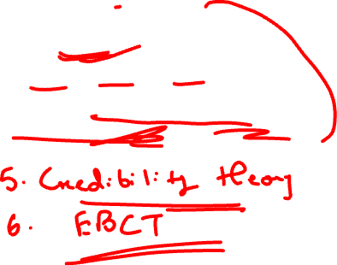

Topics to be covered
Introduction
Bayes theorem
Prior, posterior and likelihood
Bayesian estimation using loss functions
Bernoulli Random Variable

Slide 3
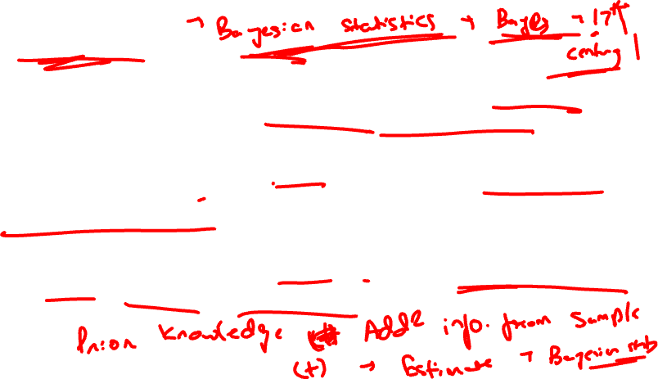
Introduction
1
Bayesian statistics is an approach to data analysis based on Bayes’ theorem, where available knowledge about parameters in a statistical model is updated with the information in observed data.
The background knowledge is expressed as a prior distribution and combined with observational data in the form of a likelihood function to determine the posterior distribution. The posterior can also be used for making predictions about future events.
This Primer describes the stages involved in Bayesian analysis, from specifying the prior and data models to deriving inference, model checking and refinement.

Slide 4

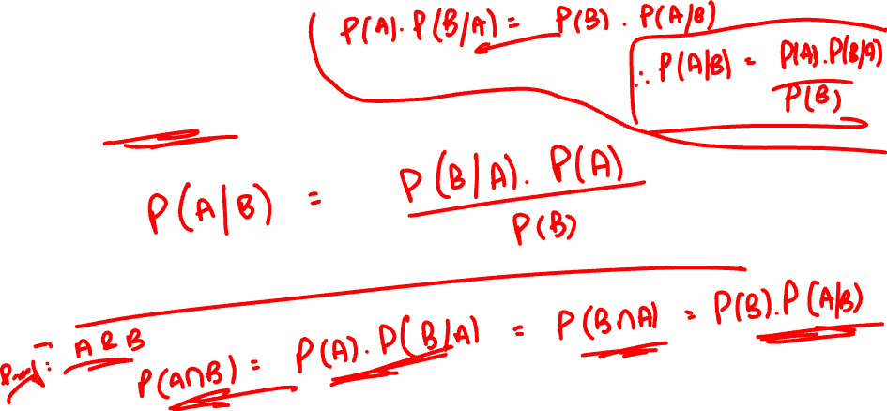
Introduction
1
Bayes theorem –

Slide 5
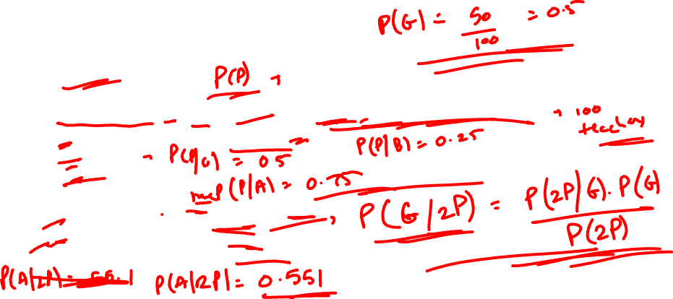
Introduction
1
Example -
3 types of teachers – Bad, good, awesome (B,G,A) – 20 bad, 50 good and 30 awesome teachers.
Bad – 25% chance that all students will pass – P(P) = 0.25
Good – 50%
Awesome – 75%
If all students of a teacher has passed in last 2 years, find:
Probability of teacher being good
Probability of teacher being awesome
Probability that all students will pass next year

Slide 6
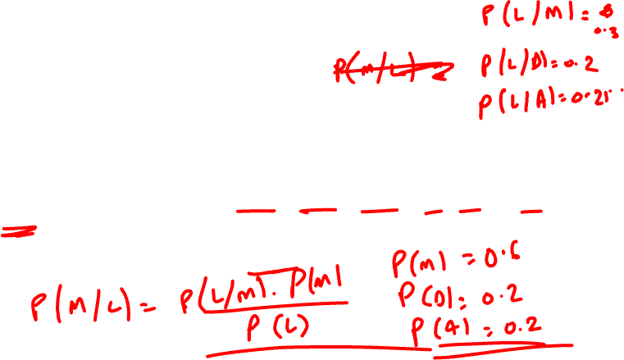
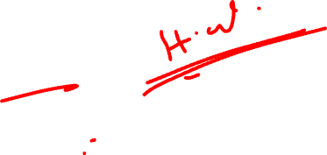
Introduction
1
Practice 1
The punctuality of trains has been investigated by considering a number of train journeys. In the sample, 60% of trains had a destination of Mumbai, 20% Dadar and 20% Andheri.
The probabilities of a train arriving late in Mumbai, Dadar or Andheri are 30%, 20% and 25%, respectively.
A late train is picked at random from the group under consideration.
Calculate the probability that it terminated in Mumbai.

Slide 7

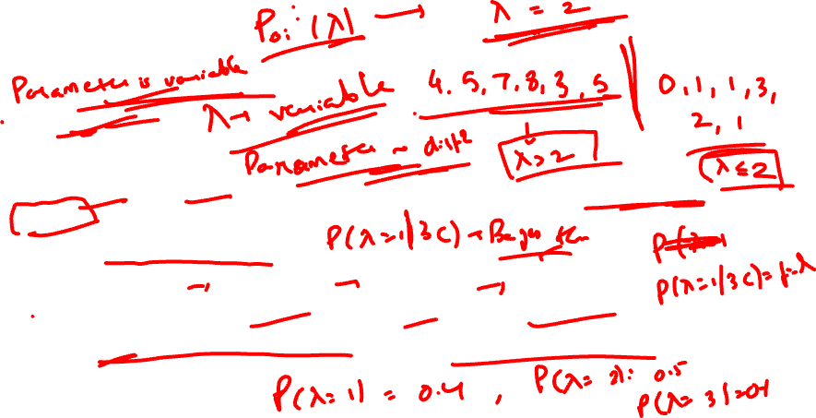
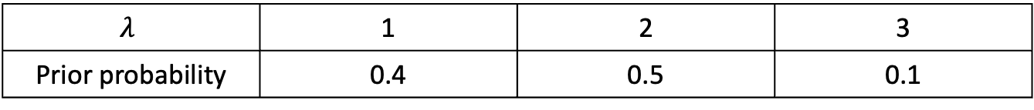
Introduction
1
Practice 2
Example –
The number of warranty claims received per week in an electronics shop has a Poisson distribution with mean $λ$ .
The prior distribution of $λ$is as follows:
Given that 3 claims were received last week, determine the posterior distribution of $λ$ .
$$λ$$ | 1 | 2 | 3
Prior probability | 0.4 | 0.5 | 0.1

Slide 8

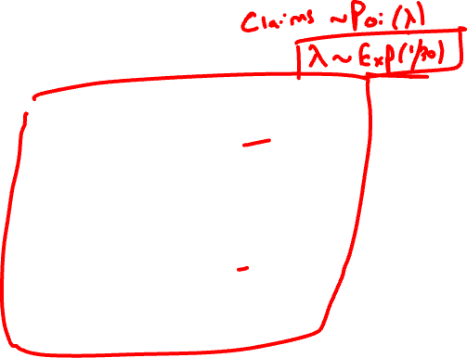
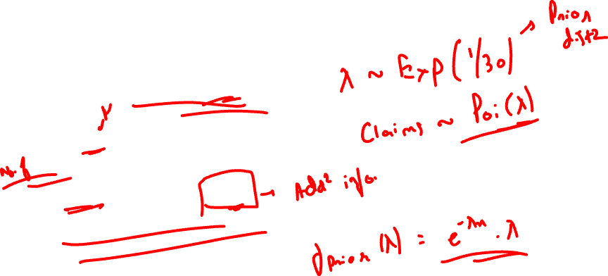
Introduction
1
If the prior distribution is continuous
Example –
$λ$ ~ Exp(1/30)
Claims ~ Poi ($λ$)
In last 2 years, no. of claims were 27 & 26
Find posterior distribution of $λ$.

Slide 9

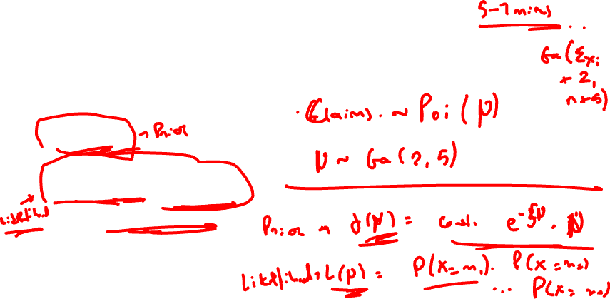

Introduction
1
If the prior distribution is continuous
Practice question –
$μ$~ Ga(2,5)
Annual claims ~ Poi($μ$)
Claim nos. of past are x₁, x₂, x₃,…. x_{n}
Find posterior distribution of $μ$.

Slide 10
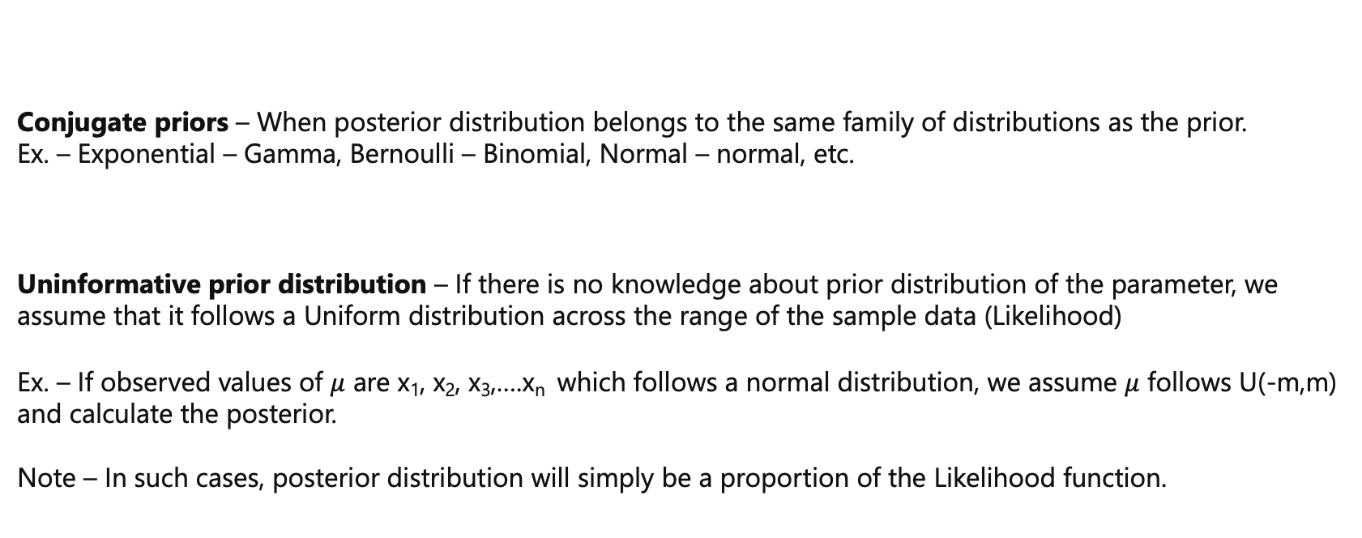
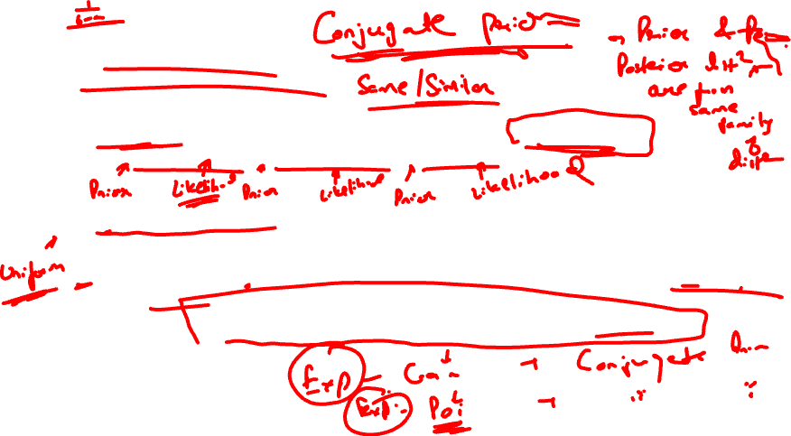
Introduction
1
Conjugate priors – When posterior distribution belongs to the same family of distributions as the prior.
Ex. – Exponential – Gamma, Bernoulli – Binomial, Normal – normal, etc.
Uninformative prior distribution – If there is no knowledge about prior distribution of the parameter, we assume that it follows a Uniform distribution across the range of the sample data (Likelihood)
Ex. – If observed values of $μ$ are x₁, x₂, x₃,….x_{n} which follows a normal distribution, we assume $μ$ follows U(-m,m) and calculate the posterior.
Note – In such cases, posterior distribution will simply be a proportion of the Likelihood function.

Slide 11
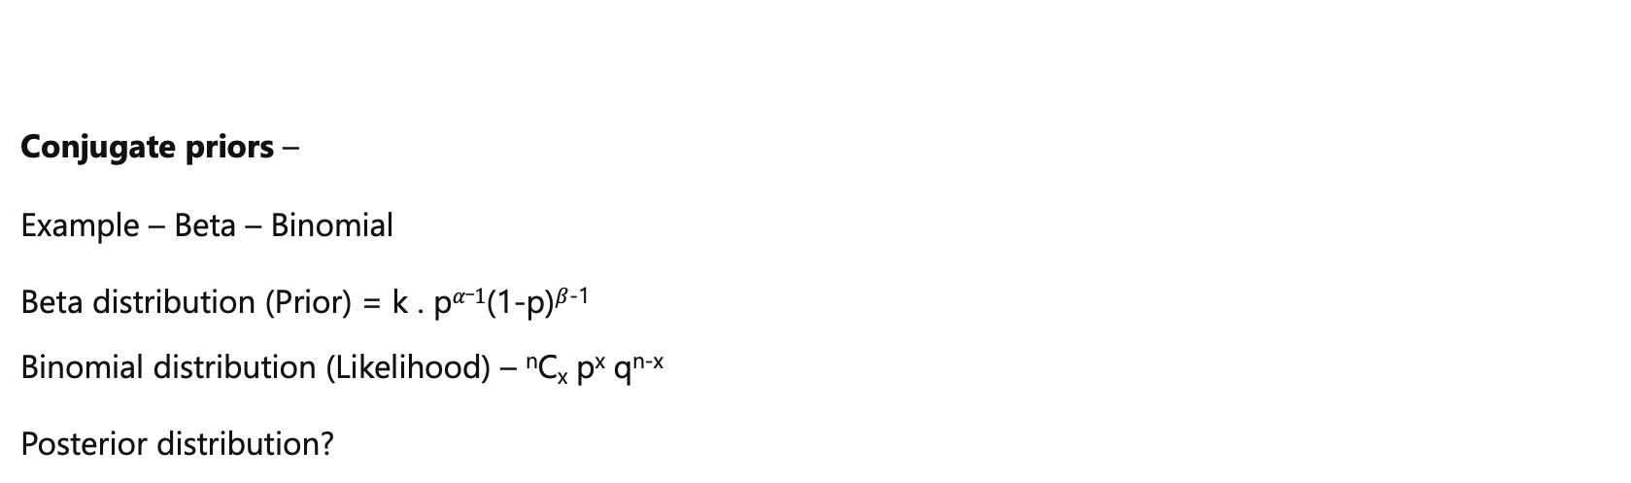
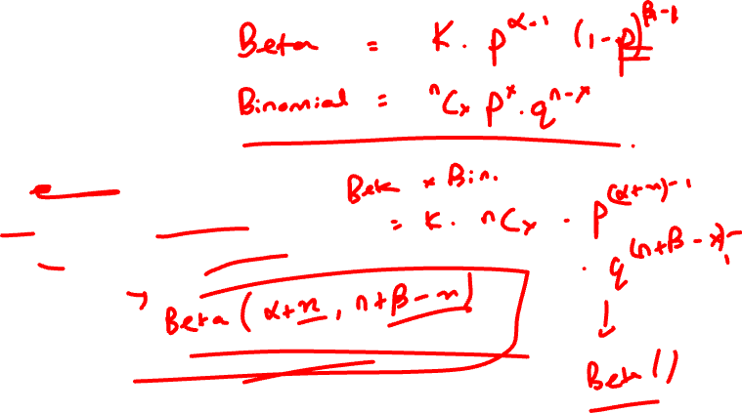
Introduction
1
Conjugate priors –
Example – Beta – Binomial
Beta distribution (Prior) = k . p$α_1$(1-p)$β$⁻¹
Binomial distribution (Likelihood) – ^{n}C_{x} p^{x}q^{n-x}
Posterior distribution?

Slide 12
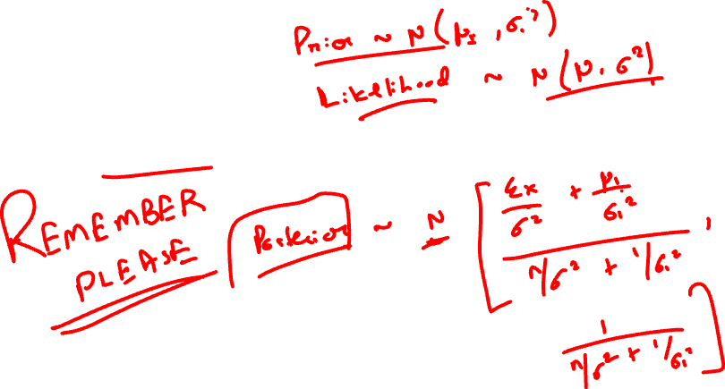
Introduction
1
Conjugate priors –
Example – Normal - Normal

Slide 13
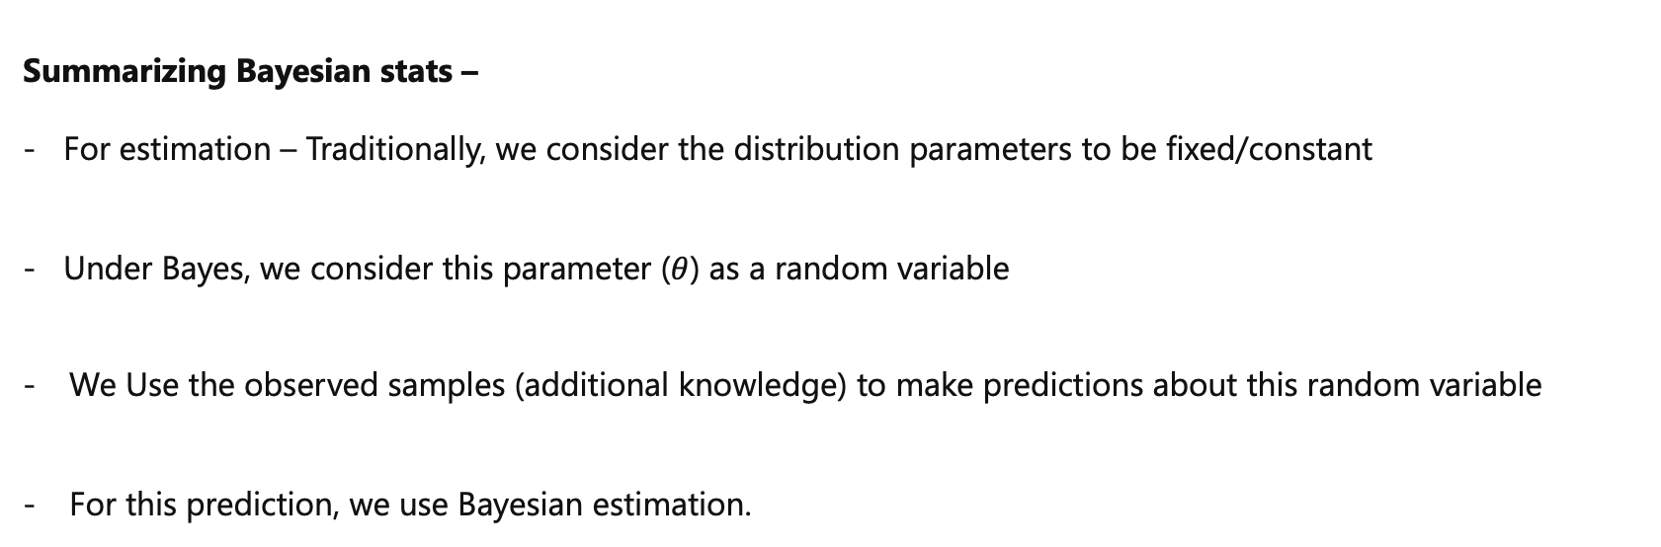

Introduction
1
Summarizing Bayesian stats –
- For estimation – Traditionally, we consider the distribution parameters to be fixed/constant
- Under Bayes, we consider this parameter ($θ$) as a random variable
We Use the observed samples (additional knowledge) to make predictions about this random variable
For this prediction, we use Bayesian estimation.

Slide 14
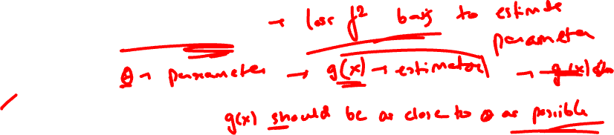
Bayesian Estimate
2
The Bayesian estimate of the risk parameter under the squared-error loss function is the mean of the posterior distribution.
Under absolute loss function, Bayesian estimate is the median of the posterior distribution.
Under all or nothing loss function, it is the mode of the posterior distribution
Likewise, the Bayesian estimate of the mean of the random loss is the posterior mean of the loss conditional on the data.
In general, the Bayesian estimates are difficult to compute, as the posterior distribution may be quite complicated and intractable. There are, however, situations where the computation may be straightforward, as in the case of conjugate distributions.

Slide 15

Bayesian Estimate
2
Loss functions
Quadratic loss - $\int{(g − θ})2$f($θ\left|x\right)dθ$
Absolute loss - $\int{|(g − θ})|$f($θ\left|x\right)dθ$
All or nothing loss - L(g|$θ$) = 0 , if g = $θ$
= 1, if g ≠ $θ$

Slide 16
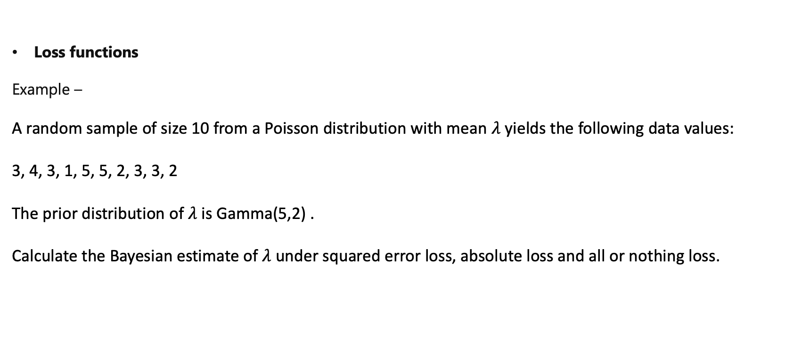
Bayesian Estimate
2
Loss functions
Example –
A random sample of size 10 from a Poisson distribution with mean $λ$ yields the following data values:
3, 4, 3, 1, 5, 5, 2, 3, 3, 2
The prior distribution of $λ$ is Gamma(5,2) .
Calculate the Bayesian estimate of $λ$ under squared error loss, absolute loss and all or nothing loss.

Slide 17
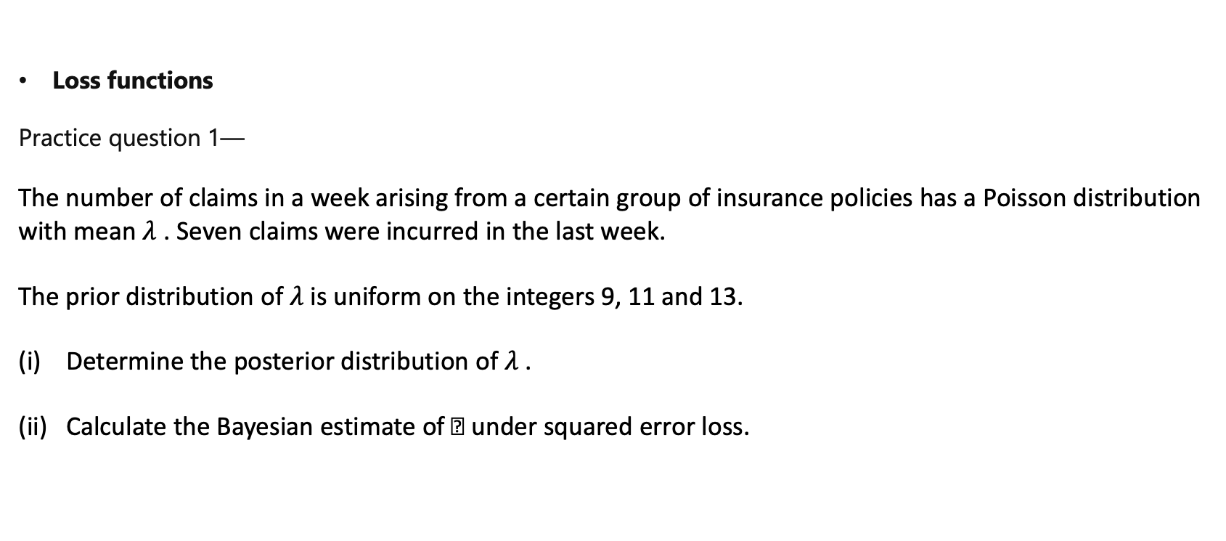
Bayesian Estimate
2
Loss functions
Practice question 1—
The number of claims in a week arising from a certain group of insurance policies has a Poisson distribution with mean $λ$ . Seven claims were incurred in the last week.
The prior distribution of $λ$ is uniform on the integers 9, 11 and 13.
Determine the posterior distribution of $λ$ .
Calculate the Bayesian estimate of  under squared error loss.

Slide 18
Bayesian Estimate
2
Loss functions
Practice question 2—
For the estimation of a population proportion p , a sample of n is taken and yields x successes.
A suitable prior distribution for p is beta with parameters 4 and 4.
Show that the posterior distribution of p given x is beta and specify its parameters.
(ii) Given that 11 successes are observed in a sample of size 25, calculate the Bayesian estimate under all-or-nothing (0/1) loss.

Slide 19
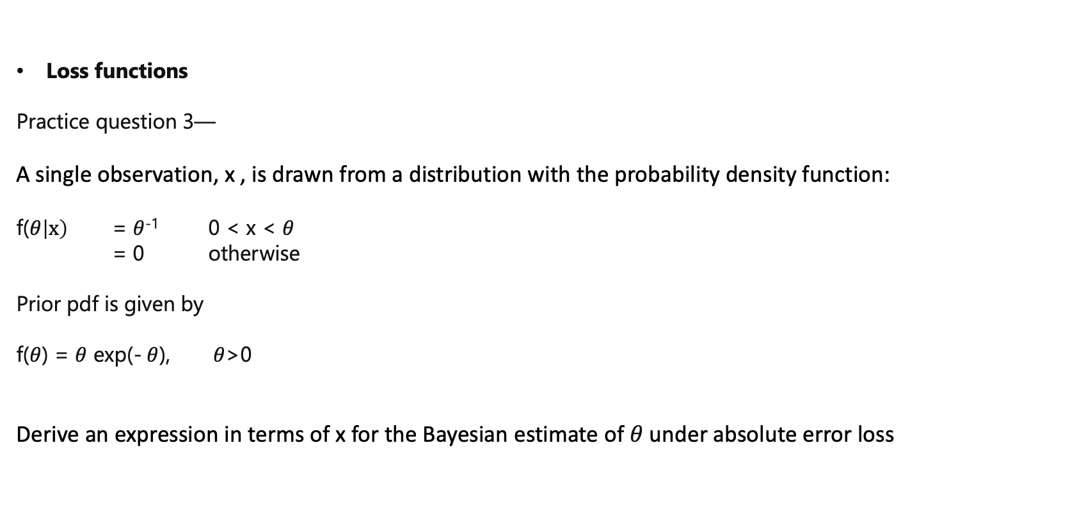
Bayesian Estimate
2
Loss functions
Practice question 3—
A single observation, x , is drawn from a distribution with the probability density function:
f($θ\left|x\right)$ = $θ$⁻¹ 0 < x <$θ$
= 0 otherwise
Prior pdf is given by
f($θ$) = $θ$ exp(-$θ$), $θ$>0
Derive an expression in terms of x for the Bayesian estimate of $θ$ under absolute error loss

Slide 20
Credibility theory
3
In case of estimating parameters/distributions, if we have both – Observed data as well as other information,
We make use of both by giving appropriate weightings to both the sets of data.
This weighting depends upon the ‘credibility’ of the datasets.
Ex. In a small town (Bhayander) - For the past five years for this fleet of buses the average cost of claims per annum (for ten buses) has been 1,600.
The average cost of claims per annum for a fleet of ten buses all over the country is 2,500.
What should be considered as the expected cost of claims?

Slide 21
Credibility theory
3
Credibility premium = Z . x̄ + (1-Z) . μ
x̄ - Depends on observed data
μ – Depends on other info. Like prior information, industry stats, etc
Accordingly, Z measures how much weight we are putting on the observed data

Slide 22
Credibility theory
3
Practice question
An insurer is setting the premium rate for the buildings in an industrial estate.
Past experience for the estate indicates that a premium rate of £3 per £1,000 sum insured should be charged.
The past experience of other similar estates for which the insurer provides cover indicates a premium rate of £5 per £1,000 sum insured.
If the insurer uses a credibility factor of 75% for this risk, calculate the premium rate per £1,000 sum insured.

Slide 23
Bayesian Credibility
4
The Bayesian approach to credibility involves the same steps as Bayesian estimation.
1. Prior distribution for the unknown parameter under consideration (eg the claim frequency) is derived, which depends upon prior knowledge
2. We then collect relevant data and use these values to obtain the likelihood function. The prior distribution and likelihood function are combined to produce the posterior distribution.
3. A loss function is specified to quantify how serious misjudging the parameter value would be. This will be used to assess financial impact of choosing a wrong parameter.
The Bayesian estimate of the parameter value is then calculated.

Slide 24
Bayesian Credibility
4
We consider 2 models to understand the Bayesian approach to credibility theory
Poisson – gamma model (for claim frequencies)
Normal – normal model (for claim amounts)

Slide 25
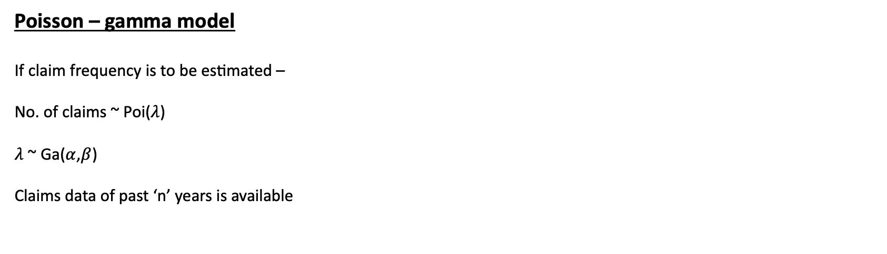
Bayesian Credibility
4
Poisson – gamma model
If claim frequency is to be estimated –
No. of claims ~ Poi($λ$)
$λ$ ~ Ga($α$,$β$)
Claims data of past ‘n’ years is available

Slide 26
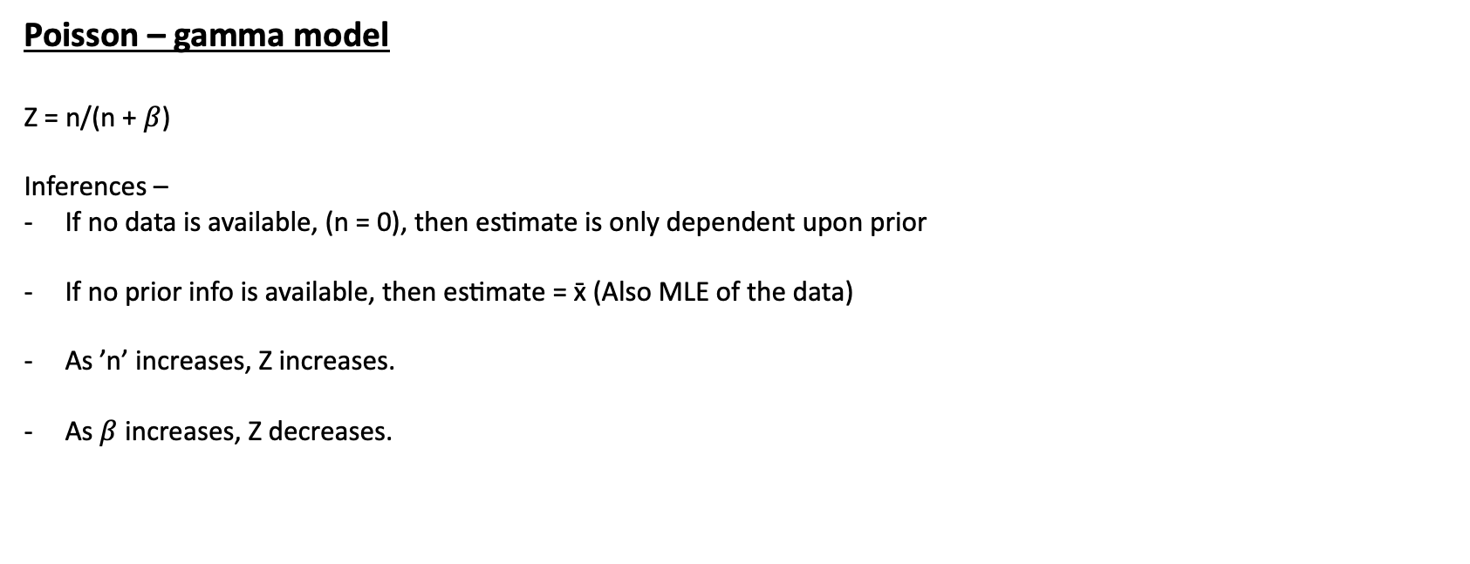
Bayesian Credibility
4
Poisson – gamma model
Z = n/(n + $β$)
Inferences –
If no data is available, (n = 0), then estimate is only dependent upon prior
If no prior info is available, then estimate = x̄ (Also MLE of the data)
As ’n’ increases, Z increases.
As $β$ increases, Z decreases.

Slide 27
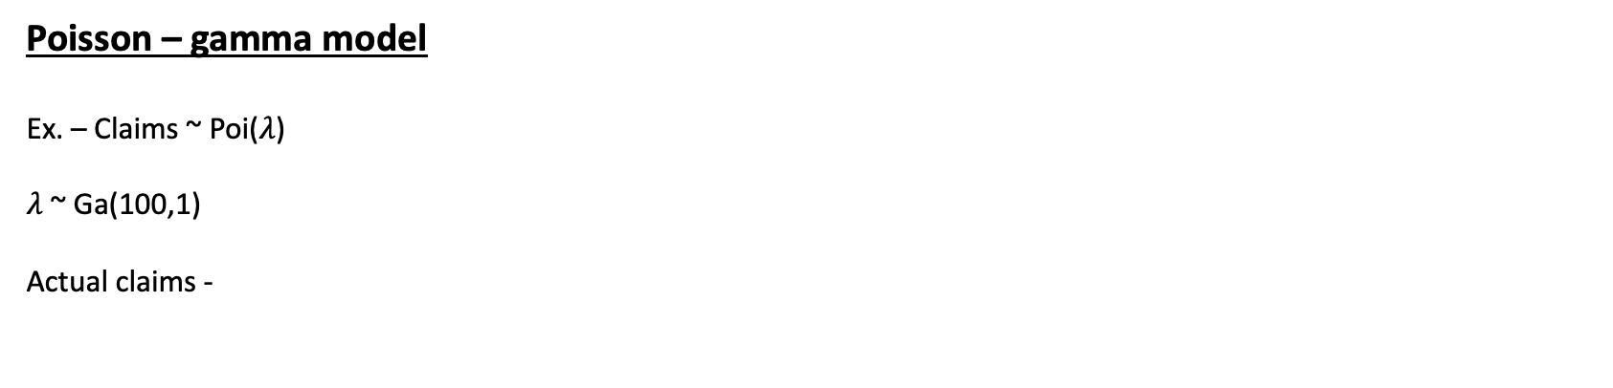
Bayesian Credibility
4
Poisson – gamma model
Ex. – Claims ~ Poi($λ$)
$λ$~ Ga(100,1)
Actual claims -
Year | No. of claims
1 | 144
2 | 144
3 | 176
4 | 155
5 | 156
6 | 152
7 | 169
8 | 144
9 | 137
10 | 160

Slide 28
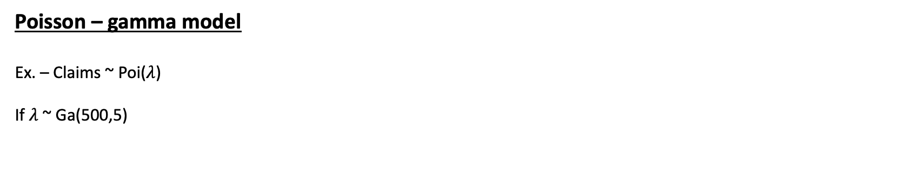
Bayesian Credibility
4
Poisson – gamma model
Ex. – Claims ~ Poi($λ$)
If $λ$~ Ga(500,5)

Slide 29
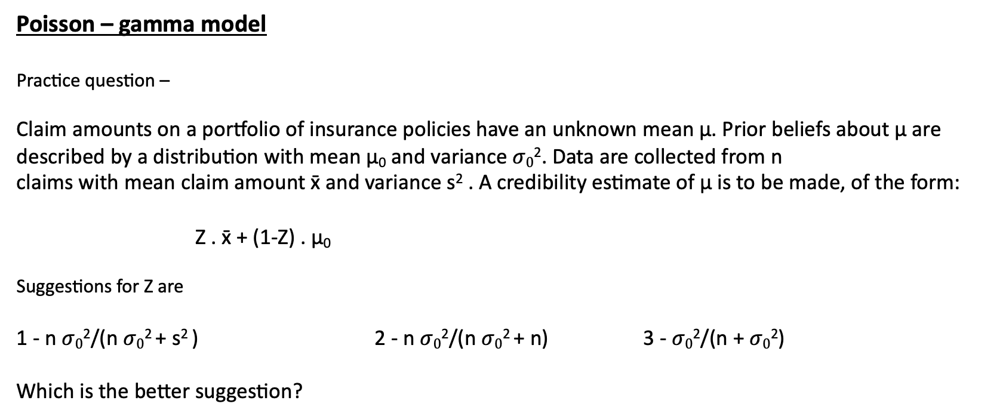
Bayesian Credibility
4
Poisson – gamma model
Practice question –
Claim amounts on a portfolio of insurance policies have an unknown mean μ. Prior beliefs about μ are described by a distribution with mean μ₀ and variance $σ0$². Data are collected from n
claims with mean claim amount x̄ and variance s² . A credibility estimate of μ is to be made, of the form:
Z . x̄ + (1-Z) . μ₀
Suggestions for Z are
1 - n$σ0$²/(n$σ0$² + s² ) 2 - n$σ0$²/(n$σ0$² + n) 3 - $σ0$²/(n +$σ0$²)
Which is the better suggestion?

Slide 30
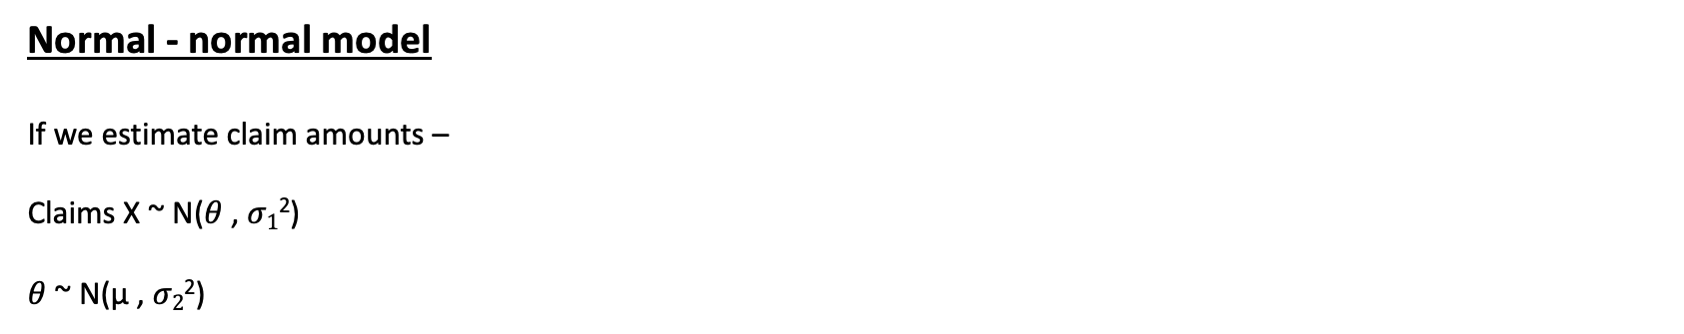
Bayesian Credibility
4
Normal - normal model
If we estimate claim amounts –
Claims X ~ N($θ$ , $σ1$²)
$θ$ ~ N(μ , $σ2$²)

Slide 31
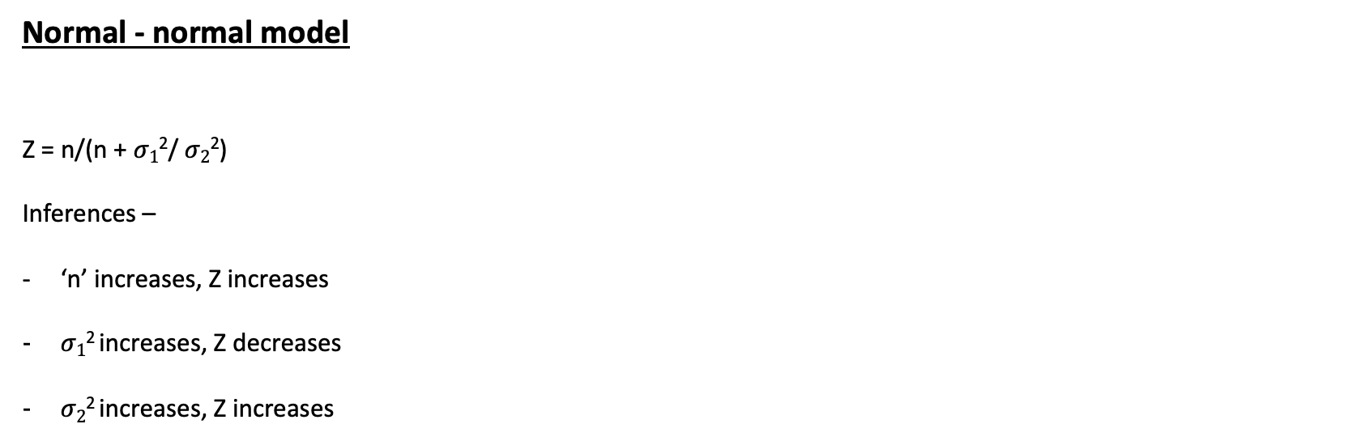
Bayesian Credibility
4
Normal - normal model
Z = n/(n + $σ1$²/$σ2$²)
Inferences –
‘n’ increases, Z increases
$σ1$² increases, Z decreases
$σ2$² increases, Z increases

Slide 32
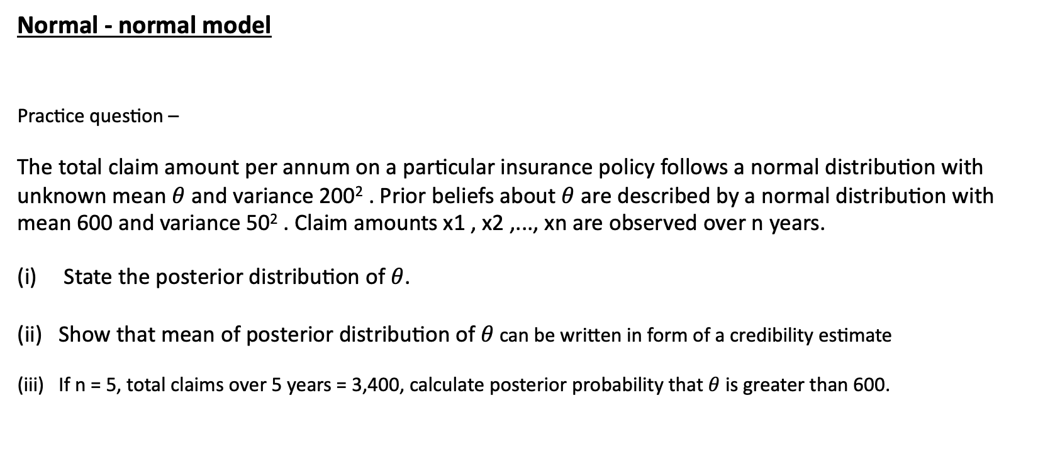
Bayesian Credibility
4
Normal - normal model
Practice question –
The total claim amount per annum on a particular insurance policy follows a normal distribution with unknown mean $θ$ and variance 200² . Prior beliefs about $θ$ are described by a normal distribution with mean 600 and variance 50² . Claim amounts x1 , x2 ,..., xn are observed over n years.
State the posterior distribution of $θ$.
Show that mean of posterior distribution of $θ$ can be written in form of a credibility estimate
If n = 5, total claims over 5 years = 3,400, calculate posterior probability that $θ$ is greater than 600.

Slide 33
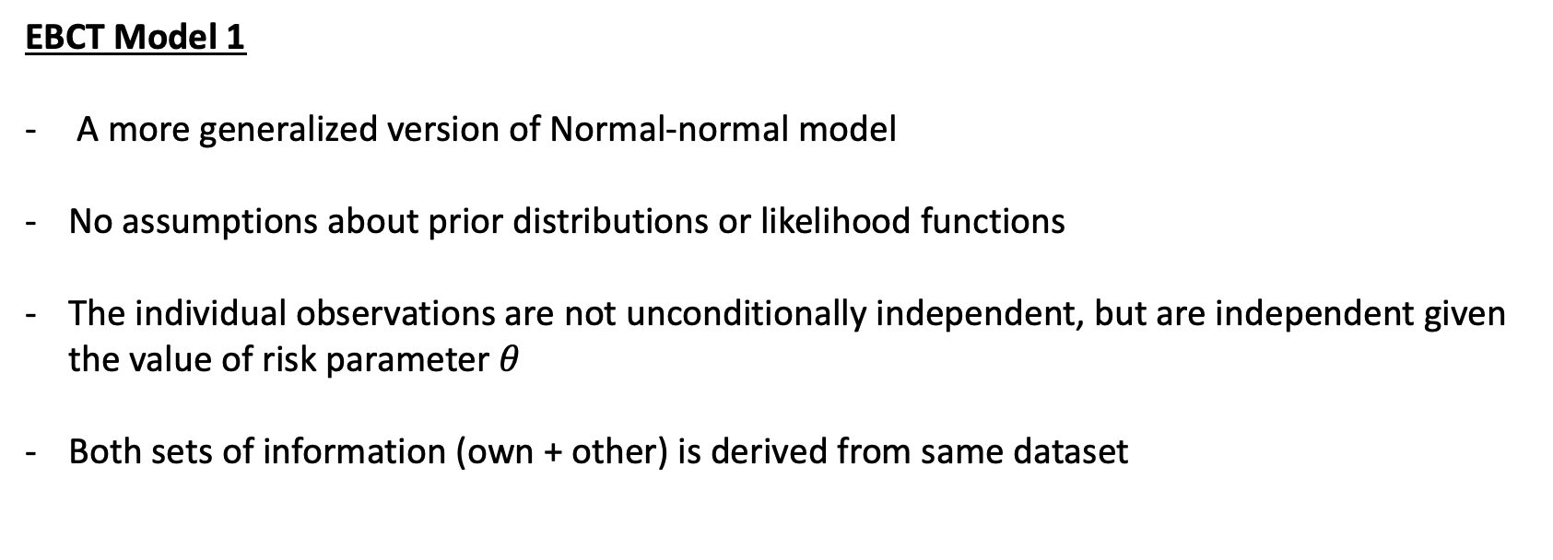
Empirical Bayesian Credibility Theory
5
EBCT Model 1
A more generalized version of Normal-normal model
No assumptions about prior distributions or likelihood functions
The individual observations are not unconditionally independent, but are independent given the value of risk parameter $θ$
Both sets of information (own + other) is derived from same dataset

Slide 34
Empirical Bayesian Credibility Theory
5
EBCT Model 1
Example – Data of claims from buses in 5 small towns over 6 years is available as follows:
Estimate claims for 7th year for all the towns.
 | 1 | 2 | 3 | 4 | 5 | 6
Town A | 1240 | 980 | 1800 | 2040 | 1090 | 1170
B | 1700 | 3080 | 1700 | 2800 | 5620 | 3450
C | 2050 | 3650 | 2800 | 1600 | 4200 | 2650
D | 4690 | 4370 | 4800 | 9720 | 3700 | 5250
E | 7150 | 3470 | 5790 | 4810 | 8770 | 7200

Slide 35

Empirical Bayesian Credibility Theory
5
EBCT Model 1
Parameter estimation:
E[m($θ$)] =
E[s²($θ)$] =
Var[m($θ$)] =

Slide 36
Empirical Bayesian Credibility Theory
5
EBCT Model 2
Main difference from Model 1 is that data observations will be weighted
An extra parameter will be involved – P_{j} to represent ‘amount of business’
Accordingly, instead of modeling claim estimations, we will model claim per unit of business estimations
The rest logic is same as EBCT 1 with changes in formulas

Slide 37
Empirical Bayesian Credibility Theory
5
EBCT Model 2
Main difference from Model 1 is that data observations will be weighted
An extra parameter will be involved – P_{j} to represent ‘amount of business’
Accordingly, instead of modeling claim estimations, we will model claim per unit of business estimations
The rest logic is same as EBCT 1 with some changes in formulas

Slide 38
Empirical Bayesian Credibility Theory
5
EBCT Model 2
The data of claim from buses (as before) along with number of buses in each year for each town.
Estimate the claim per bus for Year 7 for all the towns
 | 1 | 2 | 3 | 4 | 5 | 6
Town A | 1240 , 5 | 980 , 5 | 1800 , 4 | 2040 , 6 | 1090 , 5 | 1170 , 5
B | 1700 , 11 | 3080 , 13 | 1700 , 10 | 2800 , 12 | 5620 , 15 | 3450 , 14
C | 2050 , 3 | 3650 , 4 | 2800 , 4 | 1600 , 3 | 4200 , 3 | 2650 , 2
D | 4690 , 9 | 4370 , 9 | 4800 , 8 | 9720 , 8 | 3700 , 9 | 5250 , 10
E | 7150 , 7 | 3470 , 7 | 5790 , 8 | 4810 , 8 | 8770 , 9 | 7200 , 10

Slide 39

Empirical Bayesian Credibility Theory
5
EBCT Model 2
Parameter estimation:
E[m($θ$)] =
E[s²($θ)$] =
Var[m($θ$)] =
P*

