Slide 1

Lecture
Class: TY BSc
Subject : Business Communication
Subject Code: PUSASQF 501
Chapter: Unit 3 - Chapter 3
Chapter Name: Business Letters & Report Writing

Slide 2
Today’s Agenda
Business letters
1. Functions of Business Letters
2. Types of Business Letters
3. Structure of Business Letter
4. Form of Layout
5. Form of Letters
Memorandums
1. Purpose of writing memorandums
2. Advantages of memorandums
3. The Memorandum Format
Report Writing
1. Types of Business Reports
2. Characteristics of a good report
3. Purpose of a good report
4. Guiding Principles of Writing a Report
5. Preparing a Report
6. Structure of a Report

Slide 3

Business Letters
1
A business letter is a formal document often sent from one company to another or from a company to its clients, employees, and stakeholders
Need of a Business Letter
We need to write a business letter to maintain contacts with the external world including other businessmen, customers and government departments.
We need to write a business letter for the internal purpose like office orders, circulars, memorandums etc.

Slide 4
Functions of a Business Letter
1.1
Record for future reference
Durable impression
Widen the area of operations
Legal document
Build goodwill

Slide 5
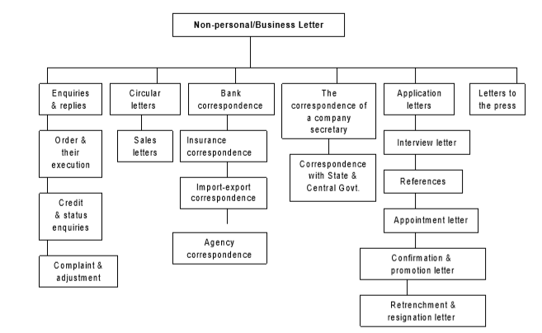
Types of Business Letter
1.2

Slide 6
Types of Business Letter
1.2
Business letter
Official letters
Demi-official letters
Internal or memos
Form letter

Slide 7
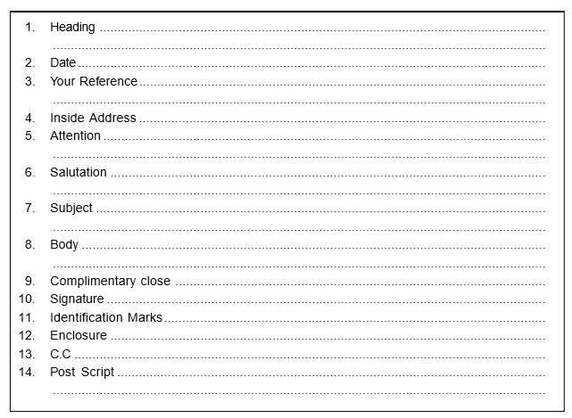
Structure of Business Letter
1.3
ELEMENTS OF STRUCTURE OR PARTS OF A LETTER
Heading
Date
Reference
Inside address
Attention lines
Salutation
Subject
Body
Complimentary close
Signature
Identification marks
Enclosure
Copy to
Postscript

Slide 8
Form of Layout
1.4
Stationary
Typing
Margins
Envelope

Slide 9
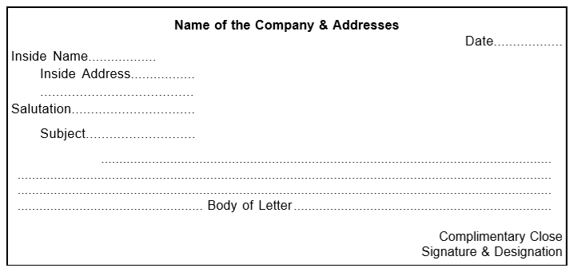
Form of Letters
1.5
1. Indented form

Slide 10
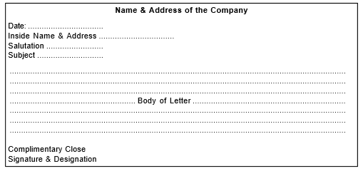
Form of Letters
1.5
2. Full blocked form

Slide 11
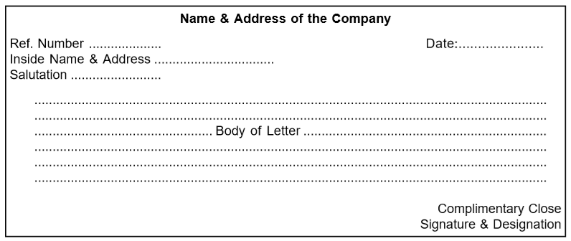
Form of Letters
1.5
3. Modified blocked form

Slide 12
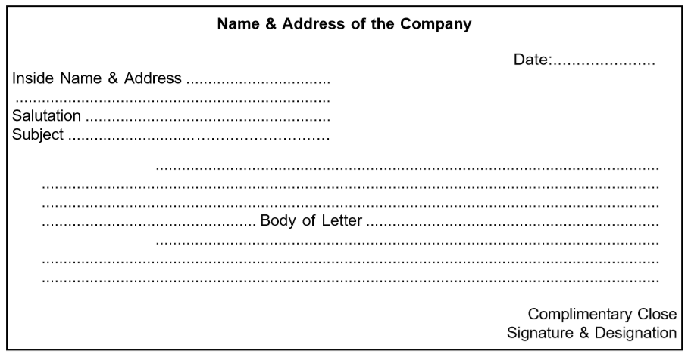
Form of Letters
1.5
4. Semi-intended/Semi-blocked form

Slide 13
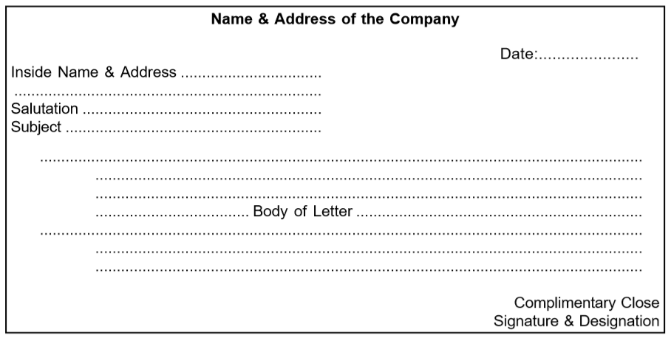
Form of Letters
1.5
5. Hanging indention form

Slide 14
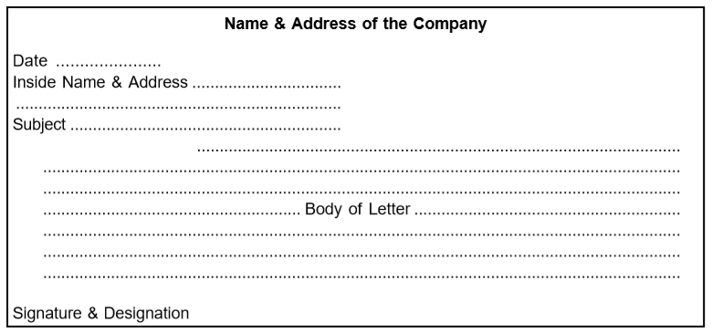
Form of Letters
1.5
6. NOMA form

Slide 15
Memorandums
2
A memorandum is short piece of writing used by an officer of an organization to communicate within the organization.

Slide 16
Purpose of Writing Memorandums
2.1
For conveying schedule message.
For communicating changes in organization.
For issuing instruction to the staff.
For submitting periodical reports.
For conforming a decision made at phone.
For asking certain special information.
For writing suggestions.

Slide 17
Advantages of Memorandums
2.2
Inexpensive
Convenient
Future reference
Quick
Fixing accountability

Slide 18
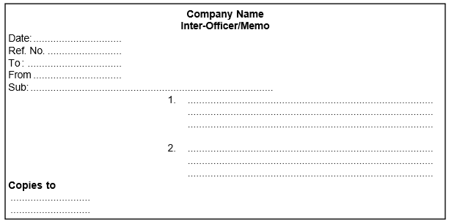
The Memorandum Format
2.3
The three factors to be kept in mind while considering the tone are:
Who is going to read the memo?
The subject-matter of the memo, and
The company in house style.

Slide 19
Report Writing
3
A report is a form of systematic presentation of information relating to an event, progress of action or some business activity. It is a written statement of results, events, qualities, conditions, progress or interpretation of records.
Why are written reports preferred?
An oral report can be denied at any time. But written report is a permanent record.
An oral report tends to be vague. In written report, the writer tries to be accurate and precise.
A written report can be referred to again and again.
Distortion during transmission reduces.

Slide 20
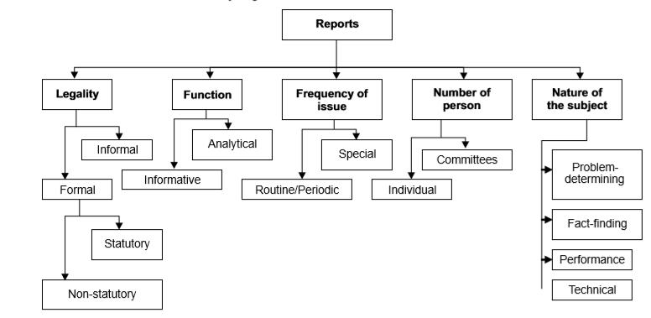
Types of Business Reports
3.1

Slide 21
Characteristics of a good report
3.2
Precise and brief
Accuracy
Clarity
Relevant
Reader-oriented

Slide 22
Purpose of a good report
3.3
It records fact and results of investigation or survey for future references.
It provides useful information to shareholders, customers, creditors and general public.
It presents factual information to management.
It makes recommendation for future use.

Slide 23
Guiding Principles of Writing a Report
3.4
The report should be addressed to some definite authority, i.e. the Managing Director or Board of Directors.
It should contain a short and clear title to know about the report at a glance.
As the report is generally drafted on the advice or request of some reader, it should quote the term of reference so that it should be clear why the report is required.
The body of the report should be planned and should be logical in sequence preferably with headed paragraph.
The recommendations, if any, should be boldly marked so as to invite immediate attention. It may be signed by the officer responsible for it and it should be dated.

Slide 24
Preparing a Report
3.5
Investigating the source of information
Making an outline
Writing the report
Taking notes
Analyzing the data

Slide 25
Structure of a Report
3.6
Organization of a report
Letter form
Memorandum
Letter-text combination form

Slide 26
Letter-text combination form
3.6.1
Introductory Parts
■ Letter of transmittal or letter of presentation
■ Cover page
■ Title page
■ Preface
■ Acknowledgement
■ Table of contents
■ List of illustrations
■ Abstract/summary or synopsis
(II) Body of the Report
■ Introduction
■ Research methodology
■ Analysis/ Discussion or description
■ Finding
■ Conclusions
■ Recommendations
(III) End Matters
■ List of references
■ Glossary
■ Bibliography
■ Appendices
■ Index

