Slide 1
Life insurance -project
Name- Devyani Bharat Chaudhari
Date- 25-12-2021
Class- A

Slide 2

UNEMPLOYMENT POLICY
POLICY FOR COMMON PEOPLE
This Photo by Unknown Author is licensed under CC BY

Slide 3
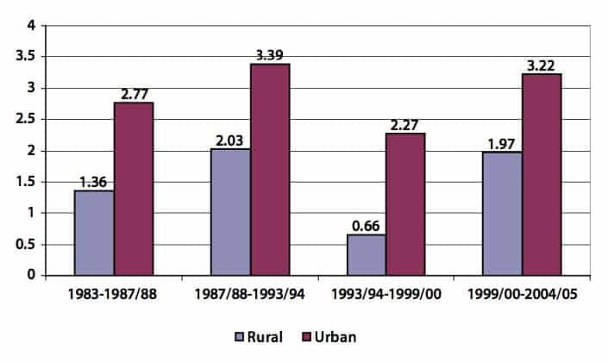
As of December 2021, the average unemployment rate in India is 7.7% with urban 9.1% and rural 7.1%. Represented on the graph below.
This Photo by Unknown Author is licensed under CC BY-NC

Slide 4
PRODUCT-
an a country like India where most of the families are dependent on sole earners unemployment of the sole earner creates a major problem for the sole earner as well as the dependents.
To tackle this problem here I have new sustainable insurance products the unemployment policy. Under this policy, if the insured loses his job in the term of policy he will can claim a amount that will help him and his dependents until the insurer gets employed again.
In the policy there will be 2 options for the claim settlement:
Insured can either go for lump sum amount of claim.
Or insured can opt for a monthly installment until he gets employed
Also, this term product will be linked with a ulip policy making it a fair chance of saving or investment where the premium paid by the insured will be invested in a particular fund. And if during the term of the policy if the insured doesn’t lose his job he will receive the lump sum amount of interest earned during the term of the policy.
The second option will be continuity of the policy where if the insured wishes to continue his policy for another term no premium will be charged instead the accumulated value earned during the term of policy on interest will be reinvested.
Premium will be charged partly or yearly hence saving the time value of money for the company as well as the insured.
The minimum term will be 12 months(that is 1 year) and there will be no maximum term.
The amount can be claimed only if the insured loses due to no fault of their own.
Premium will be charged averagely depending upon a person’s background and ability to earn.

Slide 5
Life happens
In the table below there are specific details of things happened to Jamie this year

Slide 6
month | What happened | Which insurance could cover this | Did Jamie had coverage | How much will Jamie have to pay? (if she has insurance what is her deductibles)
january | Jamie got sick and visited the doctor without insurance the appointment cost rs 120 and the antibiotics cost rs 110 | Medical insurance | Yes | For doctors visit Jamie has to pay 120-30 = 90 For antibiotics Jamie has to pay 110-10=100
march | Jamie fell on ice while hiking and had to get stiches in the emergency room without insurance the procedure costs rs 250 | Medical insurance | Yes | For emergency room cost Jamie has to pay 250-50=200
july | A kitchen fire in the apartment next door caused the sprinkle system to activate in Jamie’s apartment as well her couch her television her computer and the bookcase were ruined the cost of damage was rs 2500 | Renter’s insurance | No | Since Jamie does not have a renter’s insurance she has to pay whole of 2500
september | Jamie hit a deer when driving home from work she wasn’t hurt but the damage to her car was 3400 | Auto insurance | Yes | Jamie has to pay 3400-300=3100
october | Jamie got dirt in her eye while picking fruit at a local farm she went to the eye doctor when her eye became red and swollen the doctor prescribed eye drops without insurance the appointment cost rs 150 and the eye drop cost re 90 | Vision insurance | Yes | Appointment cost Jamie has to pay is 150-30=120 Eye drop cost Jamie has to pay is 90-10=80

Slide 7
1. Summarize the costs
Based on the insurance coverage Jamie had In place how much did she have to pay herself that year? How much more it would have been if she didn’t have any insurance (including copays deductibles and premiums)?
Ans- Jamie had to pay a total of 7,149 which included:
Rs 959 paid for premiums
Rs 6190 for other expenxes
If there were no insurance Jamie would had to pay rs 6,620. Jamie saved rs 430 by purchasing insurance.

Slide 8
2. Consider insurance in your life
Life is full of surprises insurance is there to help us when things go wrong what types of unexpected life events (illness accident surgery natural disaster dental emergency etc) have happened to you or your family or your friends in past that may have cause a financial burden which type of insurance coverage would be most helpful to protect people in this instances ?
Ans- according to me a health insurance and renter’s insurance would be most helpful to protect people in this instances because a health insurance helps you pay your medical fees in any emergency circumstances. And renter’s insurance protects your house from any damage or loss occurred due to any unexpected life events.

Slide 9
3. Jamie gives advice
An within Jamie’s cousin is getting ready to graduate and start his first job in a new town after meeting with his new employer he’s asked Jamie for advice on whether insurance is worth the cost or not prepare a response as if you are Jamie giving general advice about the important role of insurance can have on a person’s financial life include at least two examples from Jamie’s experiences
Ans – dear cousin,
I am glad you reached out to me for advice for insurance I would love to help you on that first of all I would like to tell you how important insurance is in our lives which is full of surprises I would say insurance is a protection that protects us from any unexpected financial losses. There are various insurances such as medical insurance auto insurance renter’s insurance etc. I would love to share my experience with you last year I got into an accident while skiing and got stitches in the emergency room which cost me rs 250 but thanks to the medical insurance I had which had a copay of rs 50 and hence I save rs 50 by only paying rs 200. also if you remember last year I hit a deer accident and damaged my car again thank god that I had auto insurance and to pay only rs 3100 of 3400 there are a lot of examples where I have saved due to insurance I would strongly advise you to buy at least basic insurances which would protect you from unexpected financial circumstances

