Slide 1
Numerical Methods of Algebra Project
Topic : Application of vector algebra in understanding the flow of water in a river , specially during high tides / tsunami
ROLL NO : 64 , 65 , 66 , 67 , 68

Slide 2
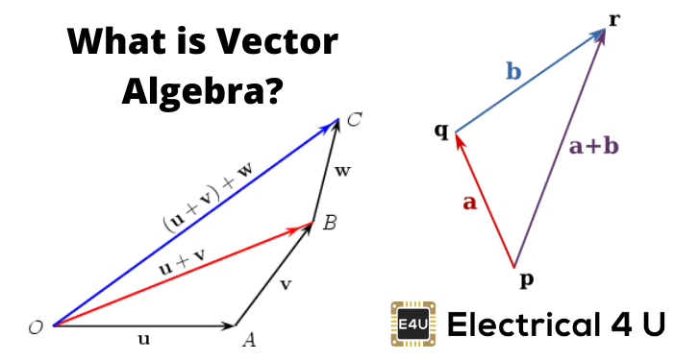
What is Vector Algebra?
Vector Algebra is an algebra where the essential elements usually denote vectors.
Vector Algebra involves algebraic operations across vectors.
The algebraic operations involving the magnitude and direction of vectors is performed in vector algebra.

Slide 3
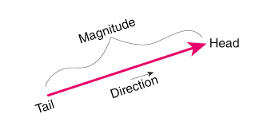
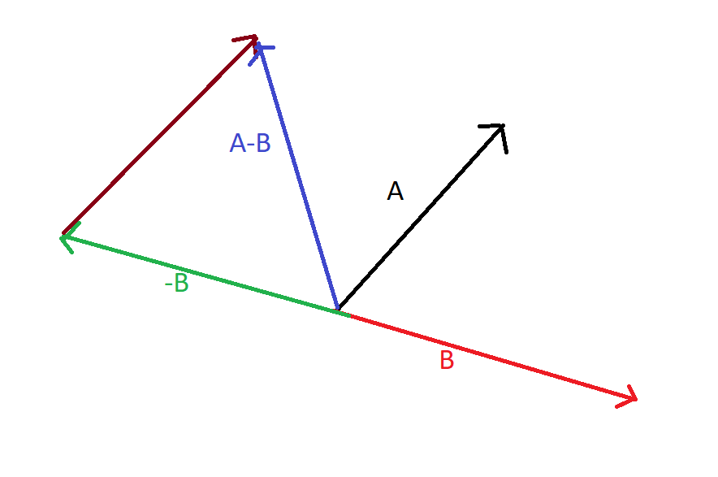
Introduction
Vector Algebra is used to perform many algebraic operations which involves vectors.
Vector Algebra has different types of vectors that are used for different algebraic.
The vectors are termed as different types based on their magnitude, direction, and their relationship with other vectors.

Slide 4
Uses of Vector Algebra
Vectors are used in physics and engineering
Find the component of the force in a particular direction.
Find the interplay of two or more quantities in physics.
Find the work done and torque in mechanics
Find Curl and Divergence which are used in the study of electromagnetism, hydrodynamics, blood flow, rocket launching, and the path of a satellite.
Find the distance between two aircrafts in the space and the angle between their paths
Vector Algebra is used in deciding tilt of the roof and the direction of the Sun for Solar Panels.
Find the amount of solar power generated by a solar panel by using vector algebra.

Slide 5
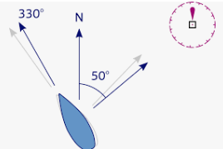
Advantages of Vector
Vector algebra is more easier to apply than geometry and requires knowledge of the fewer rules.
We can picture the vector as line segment.
It became easier to calculate the flow of water as it has direction.
Also the properties of the vector gives benefit in study of the flow of water.

Slide 6

Advantages of vector (continue)
Also to use the vector Algebra in calculating is length of the tides is useful and gives the accurate result as we can calculate it in 3 dimensional space.
We can also convert vector form into the matrix. So it became easy to calculate the required results.

Slide 7
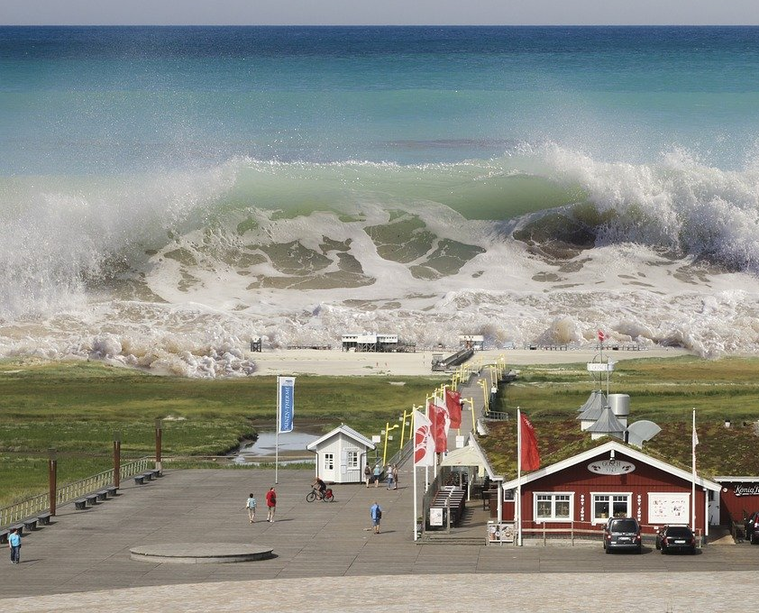
Understanding factors involved modelling of tsunami
Waves at the surface of a liquid can be generated
by various mechanisms: wind blowing on the free surface, wavemaker,
moving disturbance on the bottom or the surface, or even inside the liquid,
fall of an object into the liquid, liquid inside a moving container, etc.
There are different natural phenomena that can lead to a tsunami. For example, one can mention submarine slumps, slides, volcanic explosions, etc. In this chapter we use a submarine faulting generation mechanism as tsunami source. The resulting waves have some well-known features. For example, characteristic wavelengths are large and wave amplitudes are small compared with water depth.
Two factors are usually necessary for an accurate modelling of tsunamis: information on the magnitude and distribution of the displacements caused by the earthquake, and a model of surface gravity waves generation resulting from this motion of the seafloor.

Slide 8
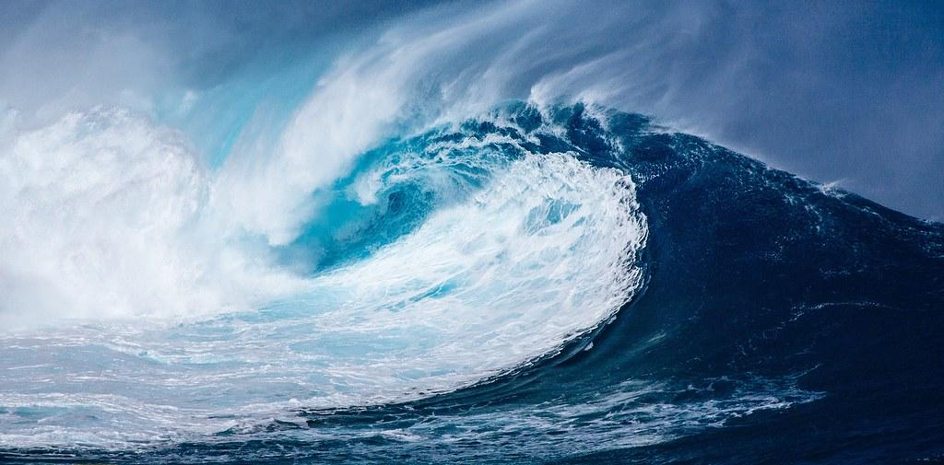
Understanding factors involved
modelling of tsunami (continued)
The fracture zones, along which the foci of
earthquakes are to be found, have been described
in various papers. For example, it has been suggested
that Volterra’s theory of dislocations might be the proper
tool for a quantitative description of these fracture zones
If the mechanism involved in earthquakes and the fracture zones is indeed one of fracture, discontinuities in the displacement components across the fractured surface will exist. As dislocation theory may be described as that part of the theory of elasticity dealing with surfaces across which the displacement field is discontinuous, the suggestion makes sense.

Slide 9
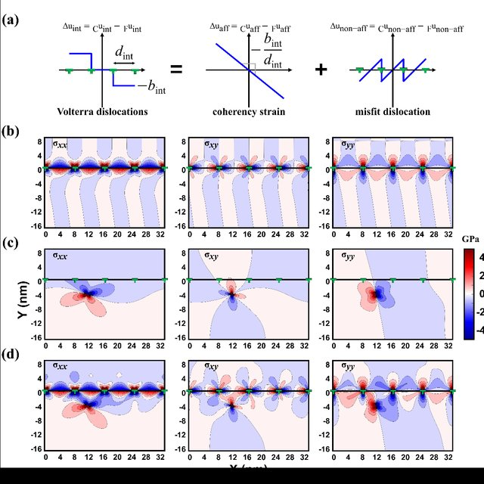
What does volterra dislocation’s equation include?

Slide 10


Volterra’s theory of dislocations
Let O be the origin of a Cartesian coordinate system in an infinite elastic medium, xi the Cartesian coordinates (i = 1, 2, 3), and ei a unit vector in the positive xi−direction. A force at O generates a displacement field at point P, which is determined by the well-known Somigliana tensor
In this relation δik is the Kronecker delta, λ and µ are Lamé’s constants, and r is the distance from P to O. The coefficient α can be rewritten as α = 1/2(1 − ν), where ν is Poisson’s ratio.

Slide 11
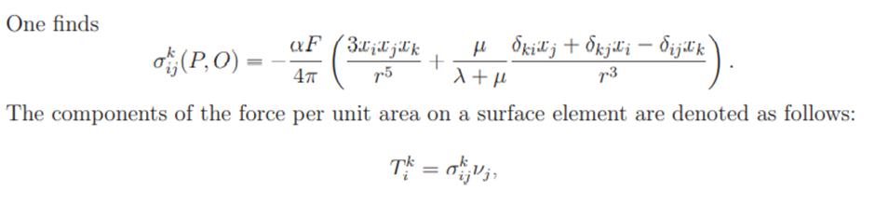
Volterra’s theory of dislocations (continued)
where the νj ’s are the components of the normal to the surface element. A Volterra dislocation is defined as a surface Σ in the elastic medium across which there is a discontinuity ∆ui in the displacement fields of the type

Slide 12

Volterra’s theory of dislocations (continued)
Equation in which Ui and Ωij are constants is the well-known Weingarten relation which states that the discontinuity ∆ui should be of the type of a rigid body displacement, thereby maintaining continuity of the components of stress and strain across Σ. The displacement field in an infinite elastic medium due to the dislocation is then determined by Volterra’s formula

Slide 13
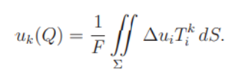
Volterra’s theory of dislocations (continued)
It is clear from the above equation that the computation of the displacement field uk(Q) is performed as follows. A force Fek is applied at Q, and the stresses σ k ij (P,Q) that this force generates are computed at the points P(xi) on Σ. In particular the components of the force on Σ are computed. After multiplication with prescribed weights of magnitude ∆ui these forces are integrated over Σ to give the displacement component in Q due to the dislocation on Σ.

Slide 14
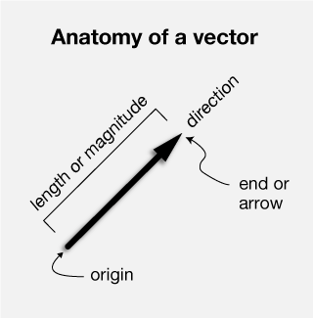
Disadvantage/Limitations of vectors
Flow in fractured rocks and granular media - the rocks and few particles may alter the calculations of the flow.
Long calculations are poorly represented because they have poor similarity values (a small scalar product and a large dimensionality)
It is time consuming and subjected to human error.

Slide 15
ACKNOWLEDGEMENTS
https://byjus.com/maths/vector-algebra/
https://www.cuemath.com/algebra/vector-algebra/
https://www.brainkart.com/article/Introduction_39178/
Mathematical Modelling of Tsunami Waves - ResearchGate
Advantages of vector space - Quora
VISHWA’S SOUCE

