Slide 1

Predictive Modelling
Application of econometric models in baking in industry

Slide 2

Index
Collecting data
Data cleaning
Correlation Analysis
Analyse data using central tendency
Linear Regression
Statistical Testing
Performance Testing
Forecast

Slide 3
Data Collection
There are three datasets that have been provided by data
collection team.
1) Historical Time Series of Bank's Equity Portfolio data contains
portfolio values for each quarters from 2005 to 2017
2) Historical macro economic data contains historical values of 25
macro economic indicators for each quarters from 2000 to 2017
3) Forecast for macro economic variables contains forecasted values of
each macroeconomic indicators for next 13 quarters after 2017

Slide 4
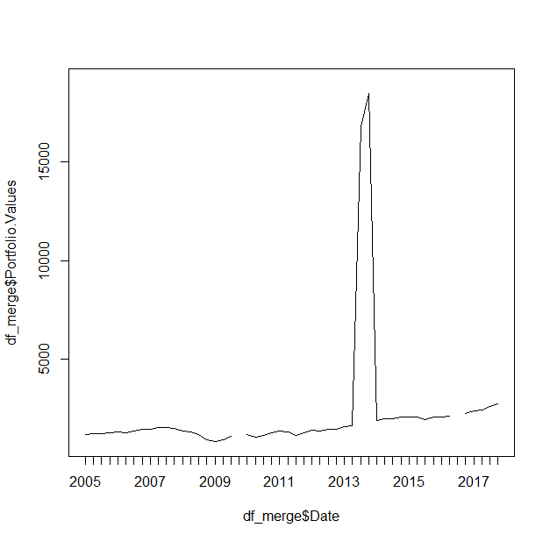
Data cleaning
Data Sorting steps
Changing column names into Date and Portfolio values in portfolio data
Merging portfolio data with macro economic data.
df_merge <- merge(df_macro,df_portfolio,by.x = "Date",by.y = "Date")
Sorted data according to date by using separate function. Added year to
each quarter.
The plot of date and portfolio values after sorting the data.

Slide 5
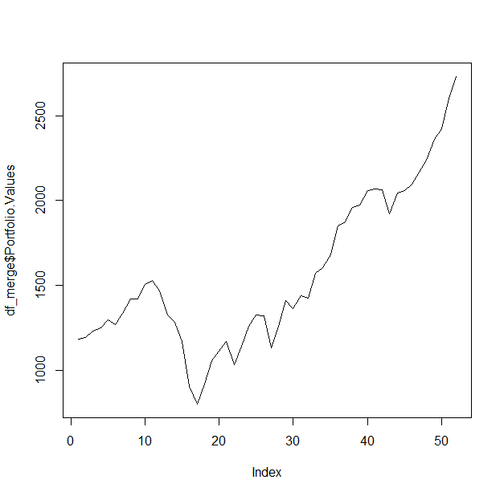
Data cleaning
Data Cleaning
Data contains two outliers at Q3 2013 and Q4 2013. The values are
16000 and 18000. Fixed them by shifting decimal place to left.
Also there are two missing values at Q4 2009 and Q3 2016. I filled these
NA values by taking average of value above and below these NA values.
Graph of completely cleaned dataset

Slide 6
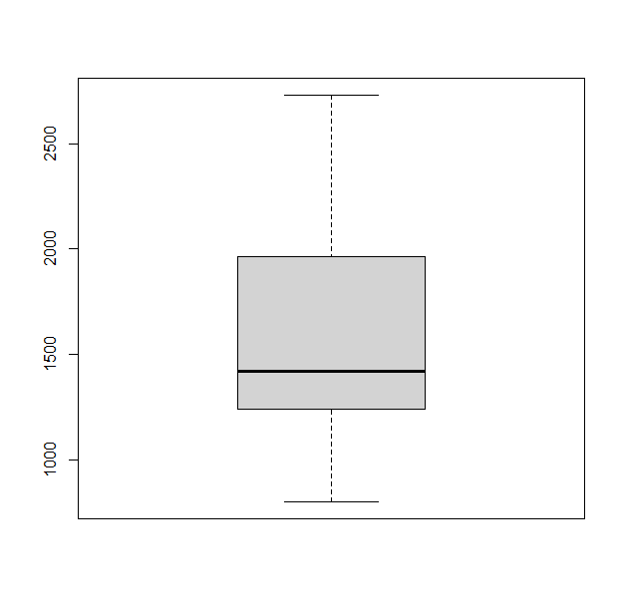
Analyse data using central tendency
1) Mean of the portfolio values in given data is1562.934
2) Median portfolio value in data is 1419.58
3) Mode of the portfolio values in given data is 1180.59
Boxplot of portfolio data looks like this.

Slide 7
Correlation analysis
I found correlation between portfolio values and each historical macro indicators.
Selected only parameters whose absolute value of correlation is more than 0.6.
Sr No | Parameters | Correlation | P value
1 | BBB Corporate yield | -0.72499409 | 1.218829e-09
2 | Commercial Real Estate price index | 0.78270769 | 7.155848e-12
3 | Money Supply | 0.86038352 | 2.993546e-16
4 | consumer confidence Index | 0.80824174 | 4.351883e-13
5 | Business Confidence Index | 0.63483382 | 4.316238e-07
6 | X.USD.Euro | -0.61541133 | 1.203141e-06
Also, p values of every parameters are less than 0.01. Therefore, we can conclude that correlations of all parameters are significant so we can include all parameters in the regression model.

Slide 8
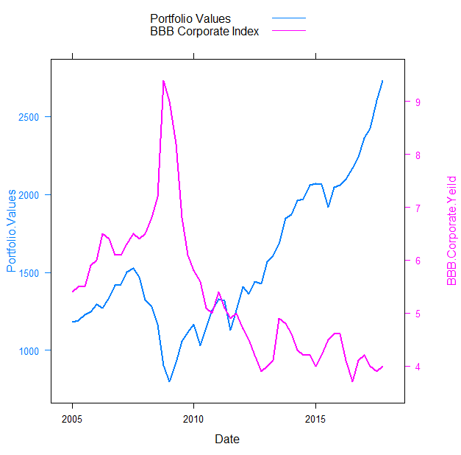
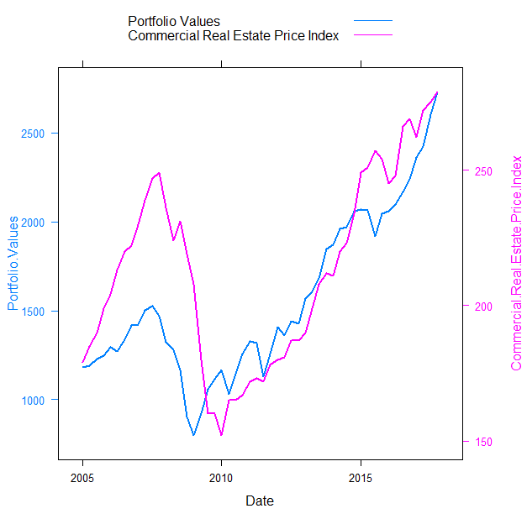
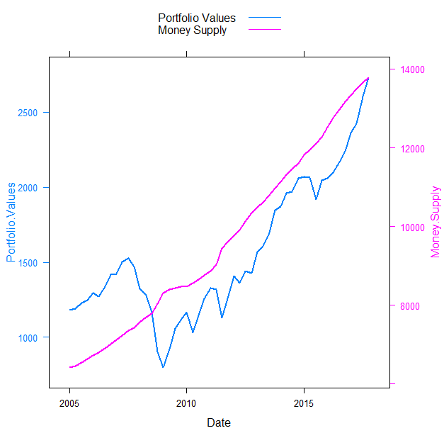
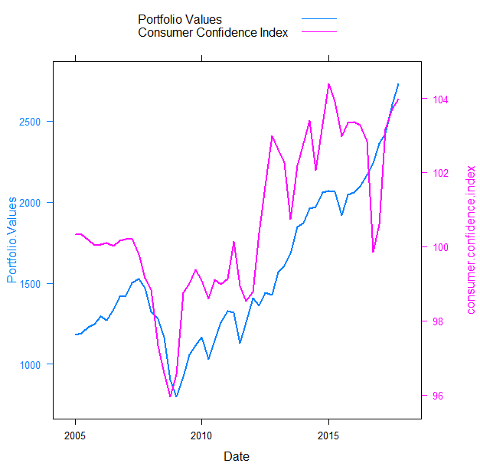
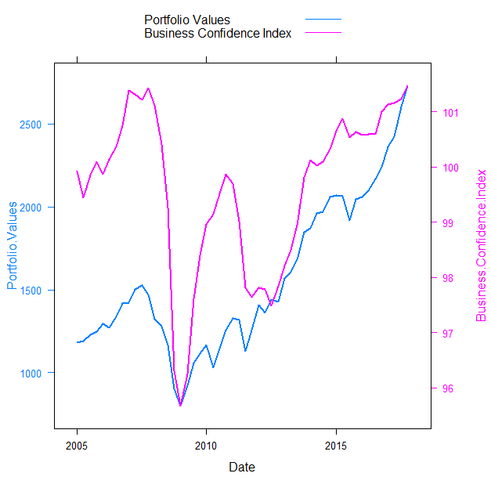
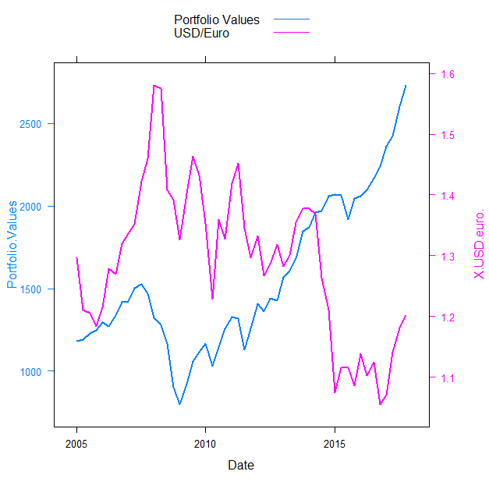
Correlation analysis
We exclude money supply from our model cause it shows multicollinearity
with other variable and from graph we can see that it is not moving with
portfolio values.

Slide 9
Linear Regression
1. Iteration 1
Code : model1 <- lm(df_merge$Portfolio.Values~df_merge$BBB.Corporate.Yeild+
df_merge$Commercial.Real.Estate.Price.Index+df_merge$consumer.confidence.index+
df_merge$Business.Confidence.Index+df_merge$X.USD.euro.)
summary(model1)
From summary of the model, we get p value of each parameter
df_merge$BBB.Corporate.Yeild 8.94e-08 ***
df_merge$Commercial.Real.Estate.Price.Index 1.08e-12 ***
df_merge$consumer.confidence.index 0.0463 *
df_merge$Business.Confidence.Index 0.5027
df_merge$X.USD.euro. 0.5520
Adjusted R square = 0.917
As parameters business.Confidence.Index have p value higher than 5%,
We are going tp remove these two variables.

Slide 10
Linear Regression
2) Iteration 2
Code : model2 <- lm(df_merge$Portfolio.Values~df_merge$BBB.Corporate.Yeild+
df_merge$Commercial.Real.Estate.Price.Index+df_merge$consumer.confidence.index)
summary(model2)
From summary of the model, we get p value of each parameter
df_merge$BBB.Corporate.Yeild 2.9e-08 ***
df_merge$Commercial.Real.Estate.Price.Index < 2e-16 ***
df_merge$consumer.confidence.index 0.0441 *
Adjusted R square Value = 0.9193
Adjusted R square value increased suggesting that removing two parameters
Was right decision. Here, p value of consumer confidence index is close to 5%
Lets try removing it in next iteration.

Slide 11
Linear Regression
1. Iteration 3
Code : model3 <- lm(df_merge$Portfolio.Values~df_merge$BBB.Corporate.Yeild+
df_merge$Commercial.Real.Estate.Price.Index)
summary(model3)
From summary of the model, we get p value of each parameter
df_merge$BBB.Corporate.Yeild < 2e-16
df_merge$Commercial.Real.Estate.Price.Index < 2e-16
Adjusted R square value = 0.9139
Adjusted R square value reduced slightly but we can ignore that as p value
look better.

Slide 12
Linear Regression
After using reset test of linearity, model3 fails the test.
> resettest(model3)
RESET test
data: model3
RESET = 12.574, df1 = 2, df2 = 47, p-value = 4.228e-05
Therefore, we are going to use log transformation on dependant and
independent variable in iteration 4.
4) Iteration 4
Code : model4 <- lm(log(Portfolio.Values)~log(BBB.Corporate.Yeild)+
log(Commercial.Real.Estate.Price.Index), data = df_merge)
summary(model4)
log(BBB.Corporate.Yeild) < 2e-16 ***
log(Commercial.Real.Estate.Price.Index) < 2e-16 ***
Adjusted R square value = 0.9252
There is significant increase in r value suggesting it was right decision. Also this
model passes linearity test.

Slide 13
Statistical testing
1) Quantitative Tests
Condition | Test Name | P- Value | Result
Stationarity | Phillips Peron Test | 0.7943 | Not Stationary
 | Kwiatkowski–Phillips–Schmidt–Shin (KPSS) test | 0.01 | Stationary
 | ADF Test | 0.5592 | Not Stationary
Linearity | Ramsay-Reset Test | 0.5181 | Linear
Multicollinearity | Variance Inflation factor | - | No multicollinearity
Normality | Jarque Bera Test | 0.4481 | Normal
 | Shapiro Wilk Test | 0.7 | Normal
 | Kolmogrov-Smirnov Test | 2.2e-16 | Not Normal
Heteroskedasticity | Breush Pagan Test | 0.113 | Homoskedastic
Auto-correlation of errors | Durbin-Watson Test | 0.0002312 | autocorrelation between residuals
 | BG Test | 0.001055 | autocorrelation between residuals

Slide 14
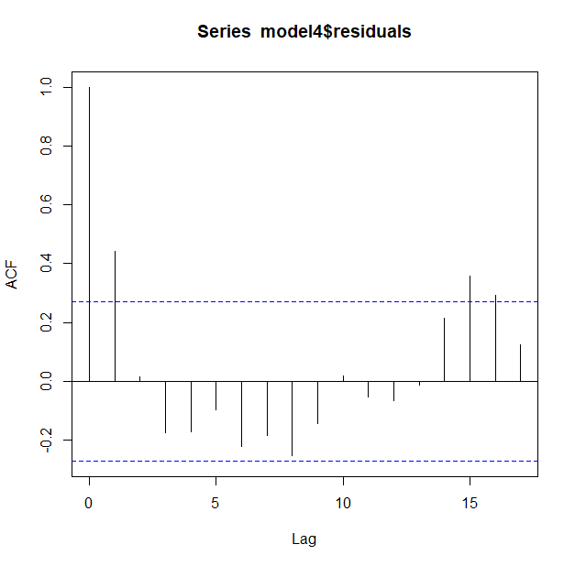
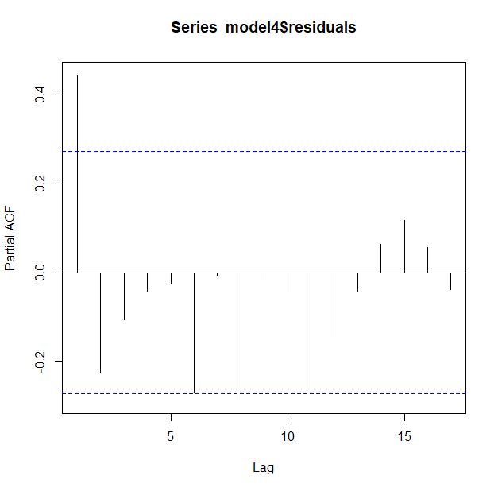
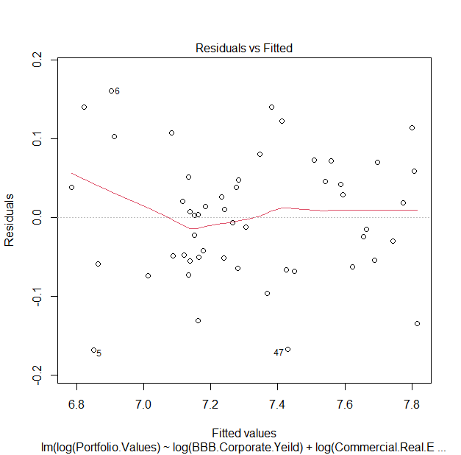
Statistical Testing
2) Qualitative Tests
i)ACF:
ACF value die out at lag 2
ii)PACF:
ACF value die out at lag 2
iii)Residual vs Fitted
The relationship between the fitted
values and residuals is largely a
straight line indicating a linear
relationship between dependent and
independent variables.

Slide 15
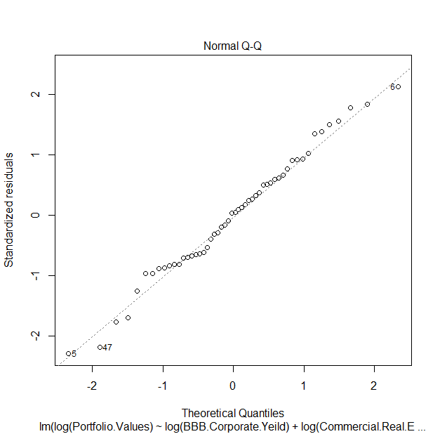
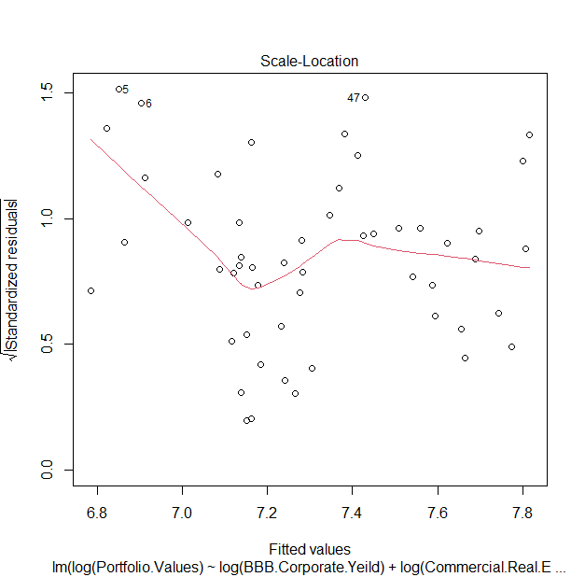
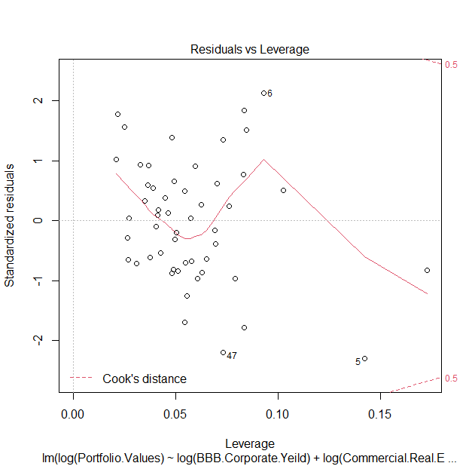
Statistical Testing
iv)Normal Q-Q Plot:
Model residuals have passed the test
of Normality.
v)Scale Location :
Shows presence of
heteroscedasticity
vi)Residual vs Leverage :
No significant outliers

Slide 16
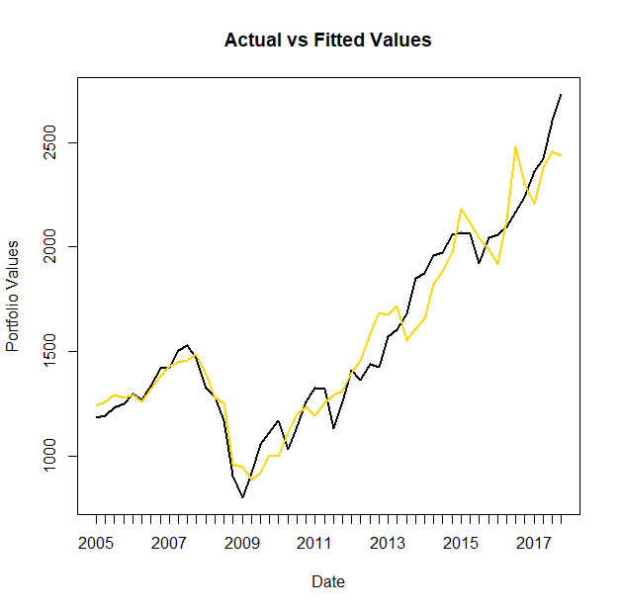
Performance Testing
1)In sample Analysis
Residual Analysis
MSE | 14491.13
RMSE | 120.45
MAPE | 6.28%
The Chart above shows close approximation of the movements in Portfolio Values. The fitted values is moving along with general trend of the actual data. Additionally the MAPE is less than 10%. This indicates an acceptable in-sample fit

Slide 17
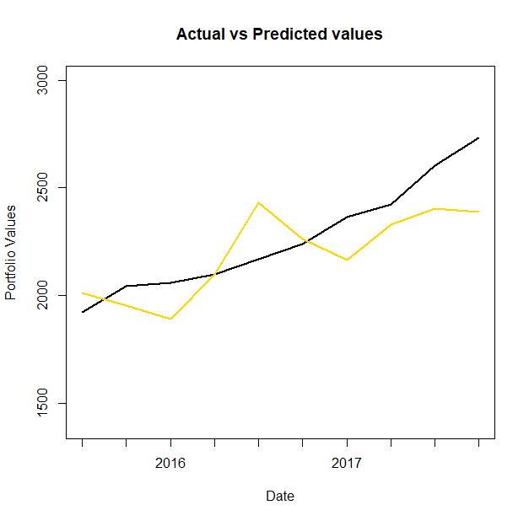
Performance Testing
2)Out sample Analysis
Residual Analysis
MSE | 32352.5
RMSE | 179.868
MAPE | 6.3226%
The chart above shows that on an average the fitted value revolves around the actual portfolio value indicating that the model is able to predict the actual value closely and will in general predict the value correctly. Additionally the MAPE is below 10%. Hence the out sample analysis also looks to be acceptable

Slide 18
Forecast
Sr. No. | Quarter | Baseline | Adverse | Severely Adverse
1 | Q1 2018 | 2,415.13 | 2,481.02 | 1,435.27
2 | Q2 2018 | 2,355.04 | 2,204.24 | 1,203.13
3 | Q3 2018 | 2,334.83 | 2,058.86 | 1,070.11
4 | Q4 2018 | 2,323.25 | 1,932.08 | 976.32
5 | Q1 2019 | 2,312.24 | 1,829.22 | 898.79
6 | Q2 2019 | 2,294.32 | 1,807.12 | 877.81
7 | Q3 2019 | 2,284.48 | 1,823.49 | 884.92
8 | Q4 2019 | 2,275.10 | 1,855.82 | 925.46
9 | Q1 2020 | 2,215.86 | 1,855.82 | 970.37
10 | Q2 2020 | 2,236.75 | 1,932.38 | 1,038.29
11 | Q3 2020 | 2,215.24 | 1,977.09 | 1,108.02
12 | Q4 2020 | 2,228.95 | 2,023.69 | 1,200.03
13 | Q1 2021 | 2,249.50 | 2,123.11 | 1,325.95

Slide 19
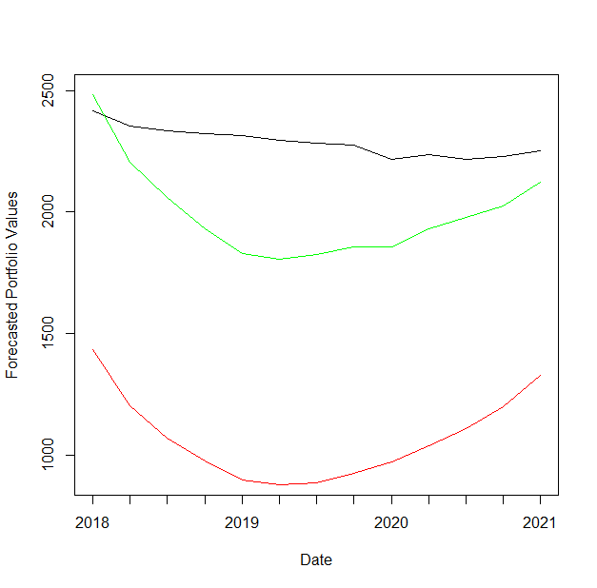
forecast
Required Capital we calculated from the formula is 146.44

Slide 20

Thank you

