Slide 1
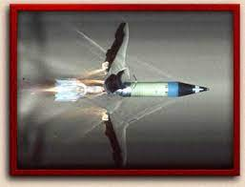
Use of Calculus in Warfare
Calculus is the most powerful weapon of thought yet devised by the wit of man.

Slide 2
INTRODUCTION
Success in a tank battle is often determined by the superiority of the weaponry involved. The increased lethality of modern tanks is due to the effectiveness of armor piercing projectiles, such as that shown in Figure 1. Army research laboratories continue to improve performance of armor penetrators. At the foundation of the research are mathematical models involving vector calculus.
We describe the use of vector calculus to model armor piercing tank rounds. Along the way, we review mathematical operations with vectors, as familiarity with the mathematics is prerequisite to understanding the application. Mathematical coverage begins with the basic operations of vector arithmetic and continues with exercises applying the dot product, cross product, and gradient.

Slide 3
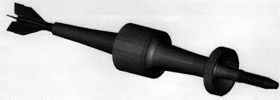
Vector calculus is specifically applied to the modeling of sabot rounds, a type of tank ammunition described in the following paragraphs. In order to discover the connection between the mathematics and the application, it is important that you do the Exercise Sets. You may have to refer to your multivariable calculus text to do the exercises. For this reason, keeping your textbooks for future references is probably a good idea.
To penetrate the massive armor plating protecting the crew of modern tanks, a projectile must be fast-moving, aerodynamic, and have massive momentum. The sabot round pictured in Figure 2 is
such a projectile. Do not let the
slim 54 profile mislead. The
projectile is made of extremely
dense materials and propelled
to achieve incredible speeds,
giving the penetrator the
momentum necessary to puncture protective armor tens of
centimeters thick.
Figure 2. Computer model of penetrator with sabot

Slide 4
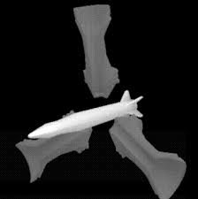
The slender penetrator must be guided down the greater diameter tank main gun barrel. The guiding sleeve, or sabot, consists of petals which break apart upon exit from the gun tube, as in Figure 3. Optimal design of the sabot round must ensure the sleeve separates from the penetrator without interfering with the flight dynamics of the penetrator, which will speed to a target. Testing the design by repeated firing of the very expensive rounds is cost ineffective. Computer simulations are an efficient alternative to the destructive and costly trial-and-error methods. Programmed into the simulations are algorithms implementing applications of the vector calculus.
The computer models are quite sophisticated and
well-developed. Finite element (meshing)
methods are used to discretize and model the
sabot round. Each of the apparent rectangles
are in fact quadrilaterals. Each quadrilateral is
the external face of a finite element brick. The
bricks are the building blocks of the model of
the sabot round. Depending on the details
required in the simulations, the sabot round
model can be divided into thousands of these bricks by computer.
Figure 3. Model of sabot petal separation, courtesy of ARL

Slide 5
THE MODEL
In the milliseconds after the explosion which propels the sabot
round out the tube of the tank cannon, the round is subject to
intense heat and pressure. In order to model the influence of
the heat and fluid pressure on the flight dynamics of the
projectile, millions of computations are performed in the
process of the computer simulation. The effects of heat and
pressure on the blocks are simulated using vectors.
The pressure field affecting the sabot round is modeled with a vector-valued function. As an example, the function
p(x,y, z) = p1 ( x,y,z )i+p2 (x,y,z) j+p1 (x,y,z)k
represents the pressure field that exists in the gun tube. The component of the pressure in the x, y and z directions are p1, p2 and p3, respectively. To be specific with an example, suppose p(x,y,z) = 2xy i + xz j + 3y k is the pressure field function. Then the pressure in the tube at the point A(1,2,3) would be p(x,y,z) = 4 i + 3 j + 5k . Obviously, this pressure field has an influence on the motion of the projectile. With mathematical models of the pressure influence, engineers can determine the flight characteristics of the penetrator.

Slide 6
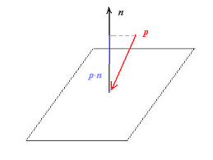
One mathematical tool used to model the influence of the pressure field on the sabot round is to apply the dot product operation. By calculating the dot product of the pressure field with a unit vector normal to the surface of the projectile, we can pinpoint the pressure at that point on the sabot round. Figure 5 is a vector representation of the dot product computation. Prior to doing that calculation, we review the process of finding a unit vector normal to a surface and the process of evaluating the dot product.
Let's begin by working toward finding the
vector normal to the surface of the projectile.
Before we do the three-dimensional problem, we
start with the simplest two-dimensional
case: finding the normal vector to a line.
One representation of a line l1 is the
equation ax + by + c = 0 . Recall the slope
intercept form of the equation of the line, y = -a/b(x)-c/b.
From this form we see that the slope m1 of l1 is m1 = -a/b .
A second line, perpendicular to l1 would have slope m2 =a/b , the
negative reciprocal of m1 .
Figure 5. Dot product of p and n is the influence of the vector p on the planar surface.

Slide 7
CONCLUSION
The last exercise and this chapter have demonstrated the applicability of elementary vector calculus operations in understanding modern tank munitions from an engineer’s perspective. Engineers at the Weapons Technology Directorate of the Army Research Laboratory design and test prototype projectiles using sophisticated supercomputing facilities. Vector calculus computations are coded into those computer simulations; programs used to design and evaluate present and proposed penetrators. Cadets and faculty from the United States Military Academy have participated in the research effort in conjunction with the ARL scientists. The success of future weapons development is contingent on the ability of civilian and military researchers to effectively use mathematical tools.

Slide 8
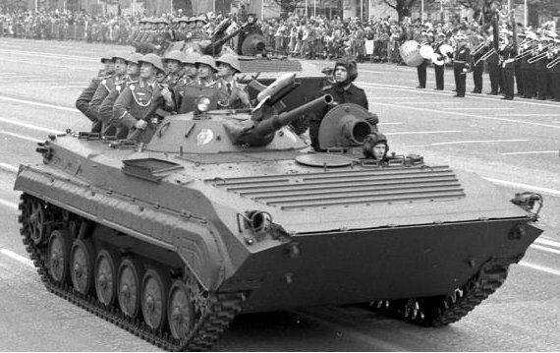
References –
The effect of sabot front borerider stiffness on the launch dynamics of fin-stabilized kinetic energy ammunition, P. Plostins, I. Celmins,
and J. Bornstein,
AIAA 28th Aerospace
Sciences Meeting,
January 8-11, 1990, `
Reno, Nevada.
DYNA-3D,
A non-linear, explicit,
three-dimensional
finite element code
for solid and structural
mechanics – User Manual, R.G. Whirley, UCRL-MA-107254, Lawrence Livermore National Laboratory, 1991. Calculus, 2nd Ed., R. Finney and G.Thomas, Addison-Wesley, New York, 1994. https://www.westpoint.edu/sites/default/files/inline-images/academics/academic_departments/mathematical_sciences/Math/C4.pdf

Slide 9
Division-B
THANK YOU!
Name | Roll No.
Uddhav Jadhav | 91
Niranjan Shevde | 92
Pranav Vaswani | 93
Bhavya Gupta | 94
Sarthak Sogani | 95
Aanchal Sharma | 96
Shagun Alag | 97
Aditya Panchal | 98
Akanksha Kulkarni | 99

