Slide 1

A MARKOV MODEL FOR COVID-19

Slide 2
Defining the model
Assumption 1
Assumption 2
Markov property
Transition probabilities
We are assuming that the process is a Markov. The Markov property of the underlying jump chain can be tested using a chi-squared test based on triplets of successive observations. A chi-squared test can also be used to test whether the waiting times are exponentially distributed with constant parameter.
We are assuming that the transition probabilities depend only upon the individual’s current state. They do not depend upon the previous transitions for the individual, so we are assuming that the Markov property holds.
Markov Inhomogeneous Jump Process
For a time-inhomogeneous Markov jump process, the transition probabilities cannot simply be denoted by p_{ij} because they will depend on the absolute values of time, rather than just the time difference.
A continuous time process
Assumption 3
Assumption 4
A continuous-time Markov jump process is a continuous stochastic process in which, for each state, the process will change state according to an exponential random variable and then move to a different state as specified by the probabilities of a stochastic matrix.
The Origin
The Distribution
Although the first case in India was observed on March 9, 2020, for the purposes of our model, we have assumed a start from March 22-23, 2020 when the lockdown was imposed in Maharashtra as a result of rising cases.
It is assumed that from the date of confirmation of COVID-19, the deaths and recoveries follow a Poisson distribution.

Slide 3




The model: Transition Graph
Susceptible
Infected
Death by disease
Vaccinated
Recovered

Slide 4
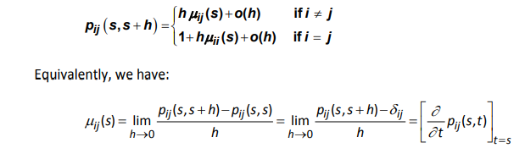

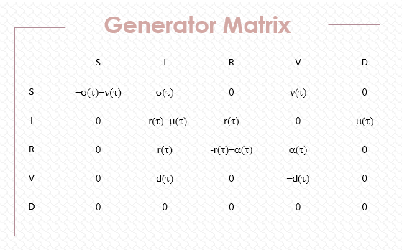
Transition Rates
Factors affecting transition rates
Formula for transition rates
Income
Lockdown & Variant
Healthcare
Generator Matrix
 | S | I | R | V | D
S | −σ(τ)−ν(τ) | σ(τ) | 0 | ν(τ) | 0
I | 0 | −r(τ)−μ(τ) | r(τ) | 0 | μ(τ)
R | 0 | r(τ) | -r(τ)−α(τ) | α(τ) | 0
V | 0 | d(τ) | 0 | −d(τ) | 0
D | 0 | 0 | 0 | 0 | 0
Government Policy
Outlook – Mindset
Demographics

Slide 5
Data and more
Data sources
Challenges
Granularity
Ministry of Health and Family Welfare
Hospitals
Multiple third party sources including WHO
State and local agencies
Inaccurate data
Biased data
Missing data
Division based on Age
Division based on Vaccine
Division based on Gender
Division based on Pre - existing diseases

Slide 6





Constraints
Data updating
in real time
Reliability
Lack of
vaccination
People not
testing on time
Reproducibility

Slide 7
Scenario Testing
Severely Adverse | Adverse | Baseline
When the lockdown was eased the transition rates started to increases again | When the lockdown were eased but only for essential service workers the transition rates were not increasing drastically but there were yet in control | When the lockdown were imposed and they were being followed the transition rates reduced severely
When vaccine were not available or were in the first stage of trials we were phasing very high transition rates | When vaccines were being provided to the essential staff the transition rates started to drop | When vaccines are starting to be applied to the mass public now we are seeing the transition rates starting to drop again
Areas in the state which are densely populated social distancing was really tough to manage so these places so a surge in the virus | Areas where social distancing could be moderately managed saw a spike in the cases but not a lot | Those areas where not many people lived saw a very few or next to no cases
When essential service shops stopped the coupon system we saw a drastic rise in the transmission rates | When the coupon system had stopped but yet the 6 feet distance policy was maintained in shops caused the cases to not spread drastically | When there was a coupon system to visit essential service shops we were seeing the cases to fall and improvement in the conditions of people
OIL PRICS

Slide 8




Model Validation
Train-Test
Split
Sensitivity Analysis
Model Alignment
Cross Validation
Testing on a
new dataset

Slide 9

By-
Ujjawal Goyal
Richa Rane
Kareena Tated
Dharini Shah
Atharva Padwal
THANK YOU!

