Slide 1
Calculus Project
FY.BSc. Sem I
Roll no. 45-51

Slide 2
Group Details
Name | Roll No.
Amalu Manu Punnoose | 45
Roshan Mehta | 46
Vishvavardhan Mertiya | 47
Jatin Modi | 48
Mucharla Harsha Vardhan | 49
Vedika Mundra | 50
Tanishka Singh | 51

Slide 3

CALCULUS
Adding to the world of mathematics, here comes calculus, a branch that deals with the study of rate of change!
Calculus is everywhere. The differentiation and integration of calculus have many real world application from sports to engineering to astronomy and space travel.

Slide 4

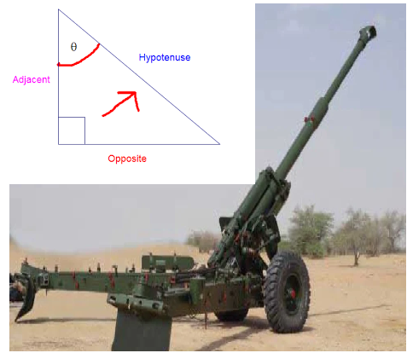
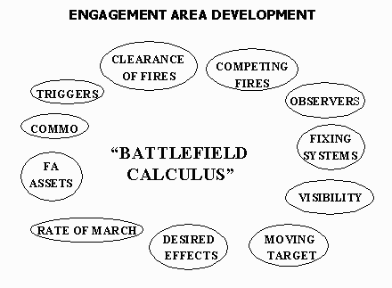

What can you use calculus for?
Is trigonometry used in artillery?
Is calculus used in the military?
Did ancient people do differentiation in weaponry? Is calculus used in war?

Slide 5
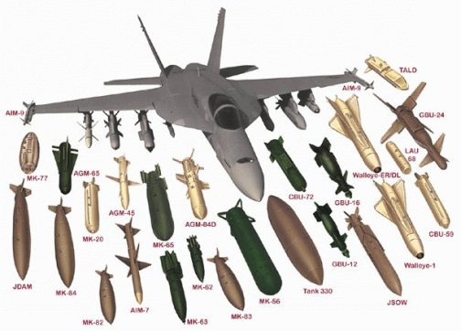
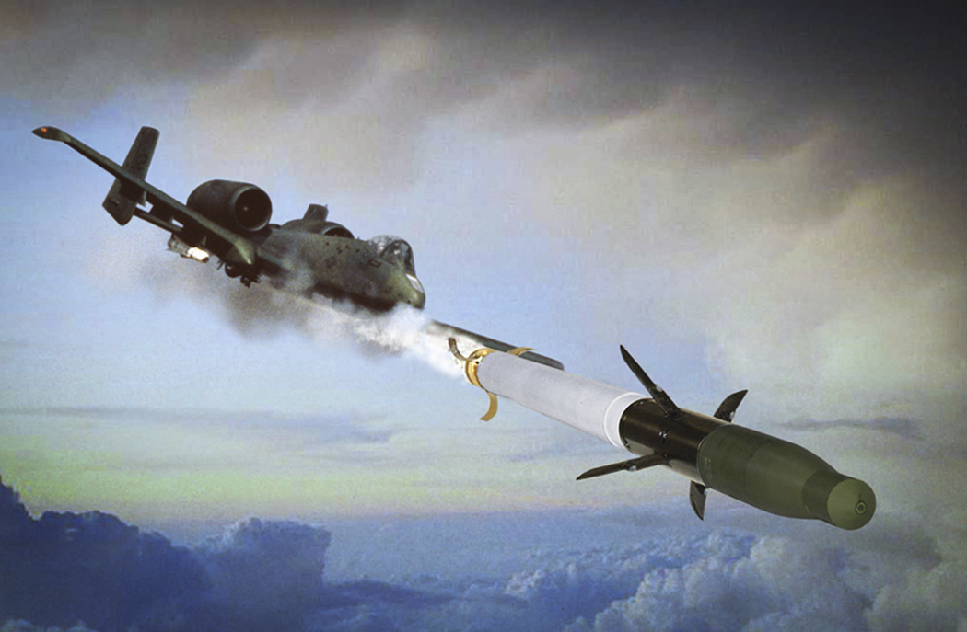
Aircraft weaponry
The calculus of variations has become increasingly popular in applied aerodynamics through the study of the optimum shapes of aircraft and missile components and flight mechanics through the study of the optimum trajectories of aircraft, missiles, and spaceships. The most general problems of the calculus of variations in one independent variable are the problems of Bolza, Mayer, and Lagrange. This chapter discusses the indirect methods of the calculus of variations with particular emphasis on the problems of Bolza, Mayer, and Lagrange. After the Euler-Lagrange equations, the corner conditions, the transversality condition, the Legendre-Clebsch condition, and the Weierstrass condition are reviewed, and the difficulties inherent to the
solution of the mixed boundary-value problem are discussed.

Slide 6
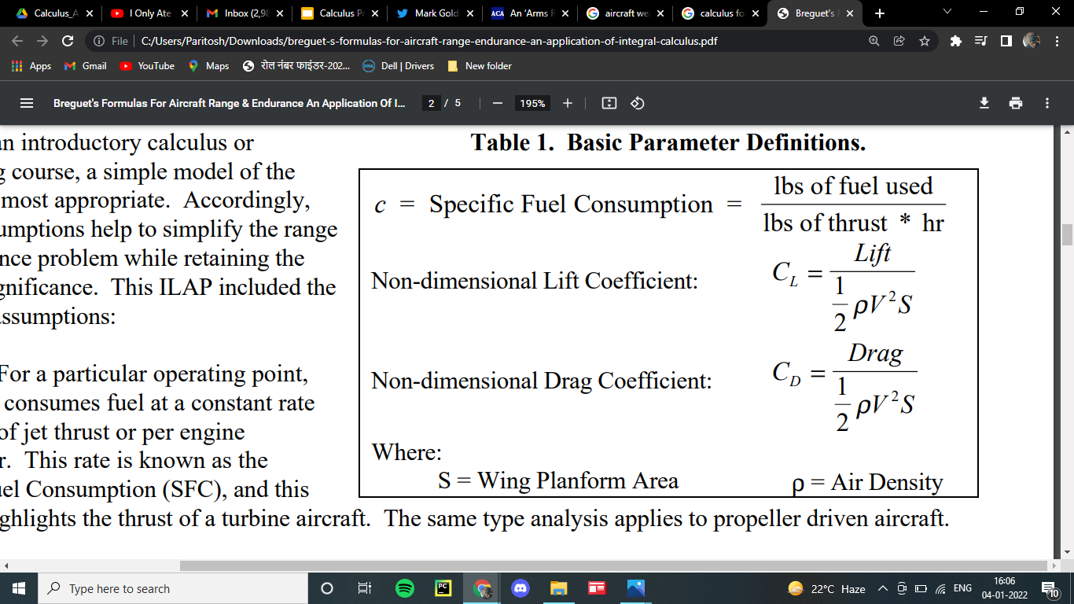
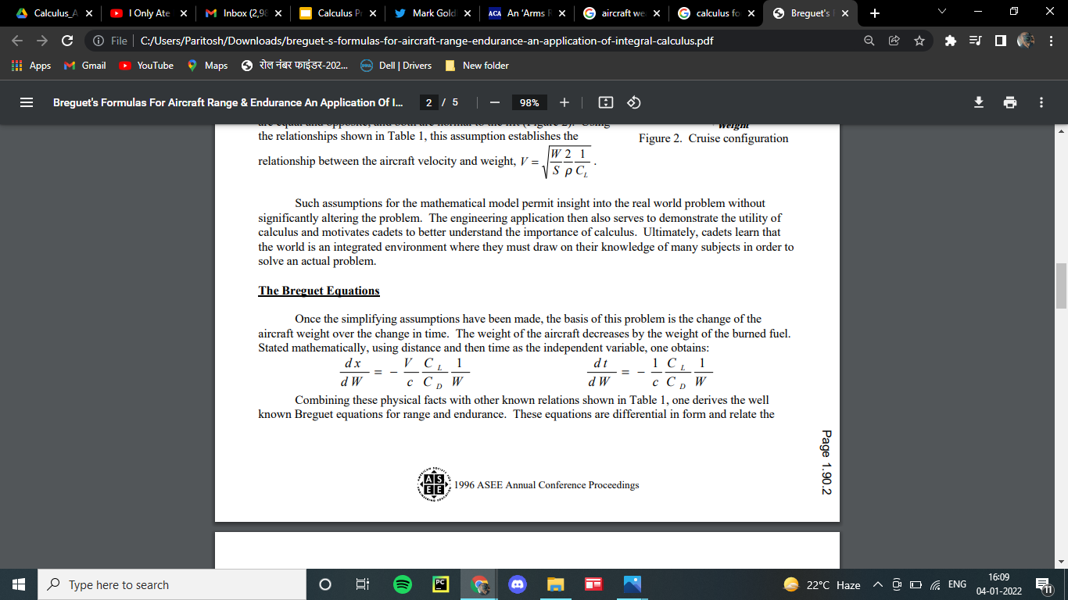
Equations and Parameters
Once the simplifying assumptions have been made, the basis of this problem is the change of the aircraft weight over the change in time. The weight of the aircraft decreases by the weight of the burned fuel. Stated mathematically, using distance and then time as the independent variable, one obtains:

Slide 7
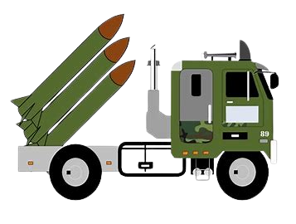
Missiles
Variational calculus are used to achieve the optimal design of the open-loop control law in the process of anti-ballistic missile interception task.Calculation of interception trajectories is usually performed off-line by using two-point boundary-value problem formulation. The calculus of perturbations, as commonly used in exterior ballistics, is modified for application to rocket missiles, that is, to projectiles which experience thrust and lift forces. In this form, the calculus can be used as in conventional ballistics, to investigate the effect of disturbing factors upon a trajectory. In addition to this, it is of considerable value in establishing analytically certain principles of guidance and control.

Slide 8
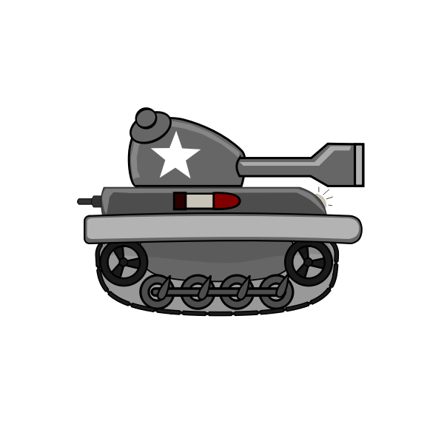
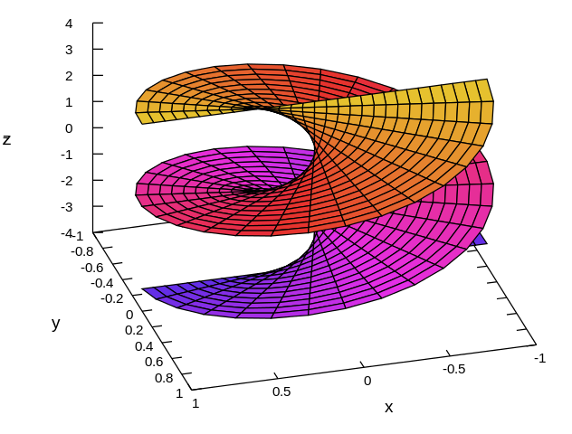
Tanks
Success in a tank battle is often determined by the superiority of the weaponry involved. The increased lethality of modern tanks is due to the effectiveness of armor piercing projectiles. Army research laboratories continue to improve performance of armor penetrators. At the foundation of the research are mathematical models involving vector calculus.

Slide 9
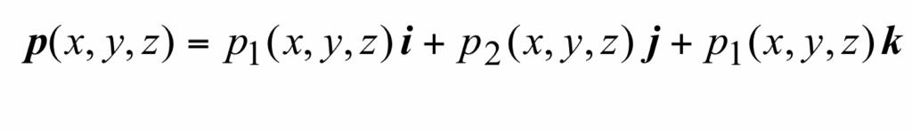
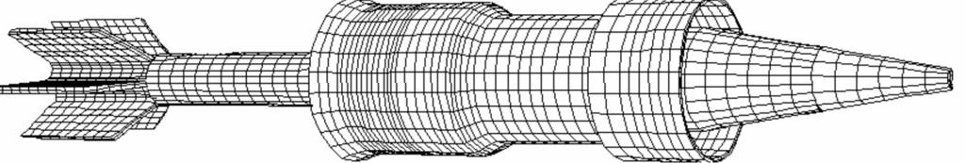
The Model
In the milliseconds after the explosion which propels the sabot round out the tube of the tank cannon, the round is subject to intense heat and pressure. In order to model the influence of the heat and fluid pressure on the flight dynamics of the projectile, millions of computations are performed in the process of the computer simulation. The effects of heat and pressure on the blocks are simulated using vectors.
The pressure field affecting the sabot round is modeled with a vector-valued function. As an example, the function.

Slide 10
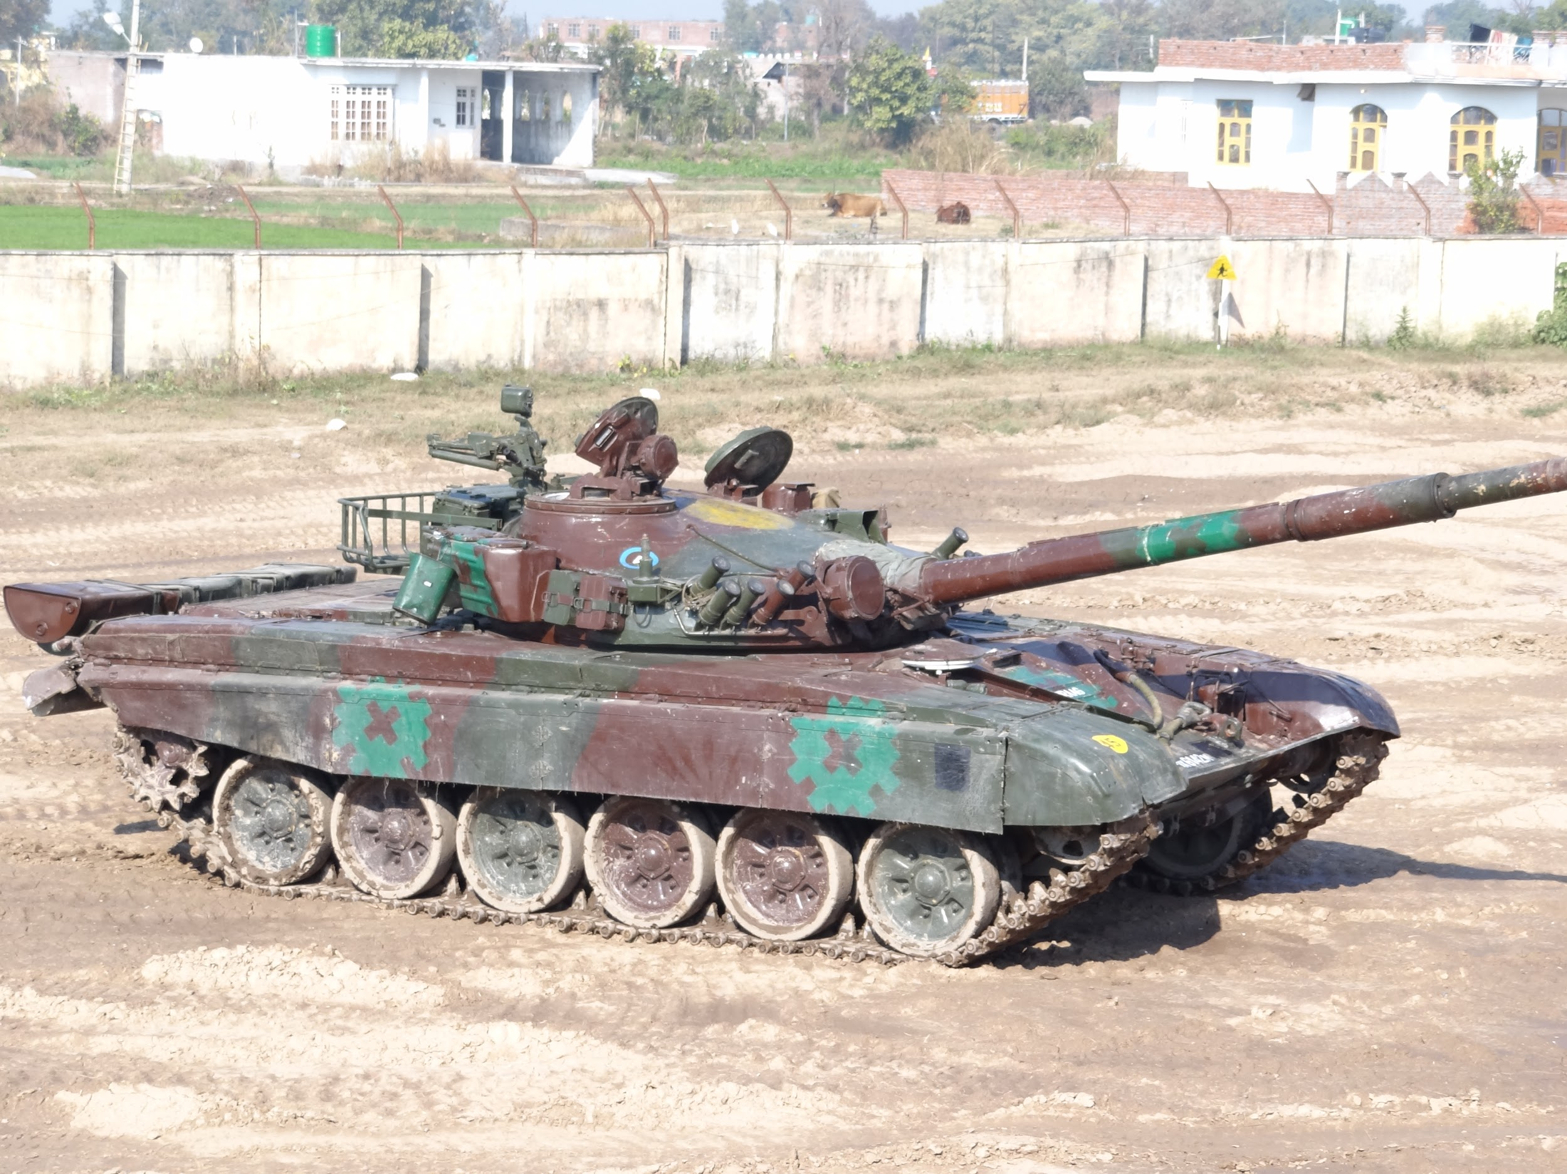
Overview
Engineers design and test prototype projectiles using sophisticated supercomputing facilities. Vector calculus computations are coded into those computer simulations; programs used to design and evaluate present and proposed penetrators. The success of future weapons development is contingent on the ability of civilian and military researchers to effectively use mathematical tools.
References
The effect of sabot front borerider stiffness on the launch dynamics of fin- stabilized kinetic energy ammunition, P. Plostins, I. Celmins, and J. Bornstein, AIAA 28th Aerospace Sciences Meeting, January 8-11, 1990, Reno, Nevada.
www.westpoint.edu

Slide 11
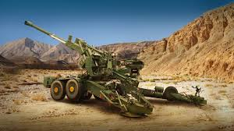
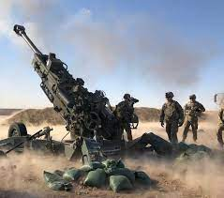
Artillery
Artillery is a class of heavy military ranged weapons built to launch munitions far beyond the range and power of infantry firearms. Early artillery development focused on the ability to breach defensive walls and fortifications during sieges, and led to heavy, fairly immobile siege engines. As technology improved, lighter, more mobile field artillery cannons developed for battlefield use.

Slide 12
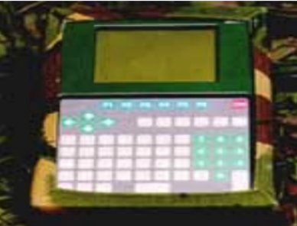
Calculus behind Artillery
A surprisingly huge amount of math is used today in artillery branch of service. More so than in the past but most of today’s is done with the help of computers on the artillery pieces or in the Fire Direction Center.
Everything from the shape of the bullet to the speed at which it is shot out is determined by complex math calculations. Now these calculations can either be done by manually or by a computer, the latter being more prevalent.
This is a GUNZEN Mk3. It can be used for all calibre of guns
or howitzers as well as multi barrel rocket launchers and
ground to ground missile systems.
GUNZEN Mk3 is used as a primary prediction system or as
a back up to C3/C4 systems.

Slide 13
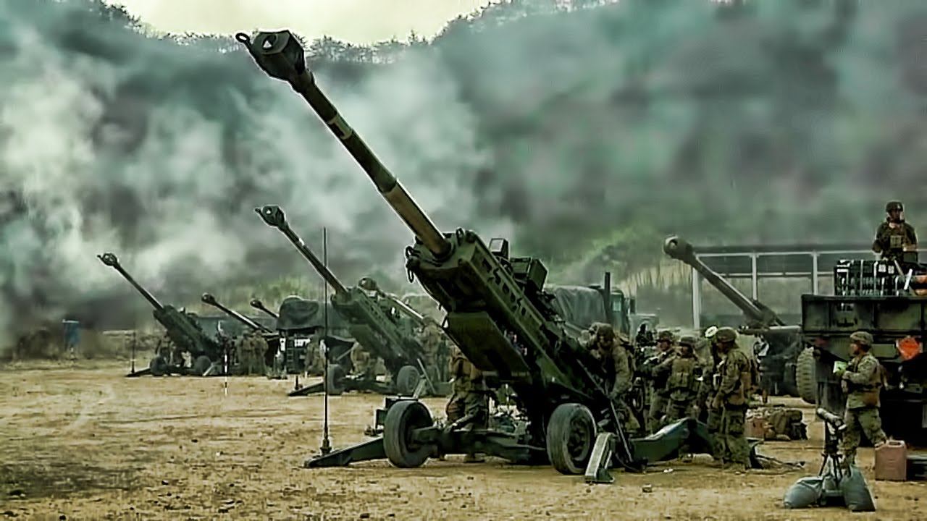
Technically, to calculate artillery system, you need two kinds of data :
Asset position, artillery system’s coordinate, acquired through onboard system.
Target position, target coordinate and elevation, acquired by observer.
Then, calculate both coordinate to acquire horizontal distance and heading. Then artillery system will adjust it's barrel position to make a shot based on distance and heading (major adjustment). Assuming CEP (circular error probability) already known, then officer can make a shot. Observe the first shot and if necessary, make a few correction by adjusting it's barrel position (minor adjustment).

Slide 14
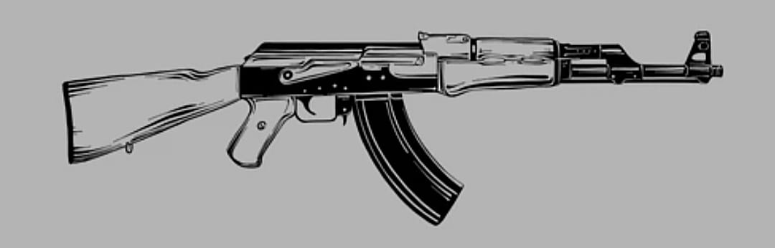
Rifles
A rifle is a long-barrelled firearm designed for accurate shooting, with a barrel that has a helical pattern of grooves (rifling) cut into the bore wall. In keeping with their focus on accuracy, rifles are typically designed to be held with both hands and braced firmly against the shooter's shoulder via a buttstock for stability during shooting. Rifles are used extensively in warfare, self defense.
The trajectory of a bullet is the path of flight it follows from being fired to reaching its target. The range of the trajectory is the total distance the bullet travels in a horizontal direction, that is, the distance between the riffle and its target.

Slide 15
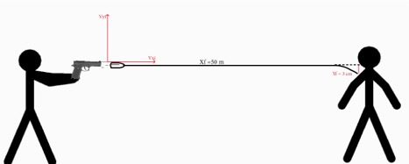
Velocity of Rifle (Bullet):
Calculate the velocity of a bullet we’ll use some mathematical concepts in this case we’ll separate the components of the speed of this bullet to the x-axis and the y-axis.
The horizontal bullet trajectory :
Xf = Xi + Vxi t + 1/2axt2 (on the x-axis)
Yf = Yi + Vyi t + 1/2axt2 (on the y-axis)
Starting with the first equation:
Xf = Xi + Vxi t + 1/2axt2
By substituting the values:
Xf = 0 + Vxi t + 0
The final equation is: Xf = Vxi t
Moving on to the second equation:
Yf = Yi + Vyi t + 1/2axt2
By substituting the values:
Yf = 0 + 0+ 1/2(-g)t2
Yf = - 1/2gt2
In order to find Xf , we need to find the time t .
t = √((-2yf)/g)
The speed of the bullet is:
Vxi = xf/t .

Slide 16
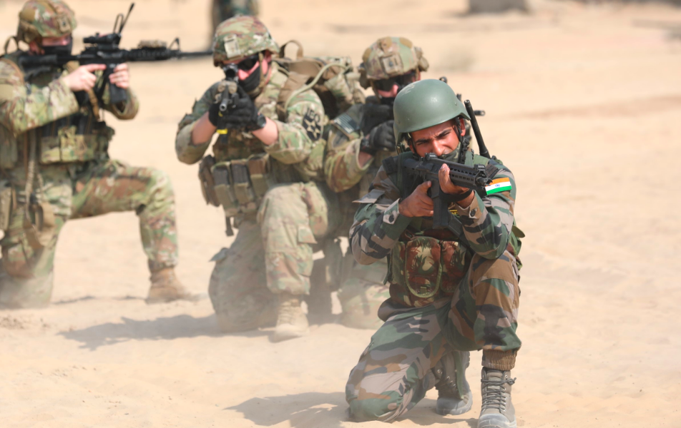
SYNOPSIS
Weapons have a lot more training in math than most people are led to believe.
When a bullet leaves the barrel on target, it's still affected by air resistance and gravity. As such, it will drift with the wind and start falling down the moment it leaves the barrel. There will often also be a difference in altitude between the rifle and the target. At very short distances, these effects can be ignored. At longer distances, they cannot be.
Hence, there is lot of calculations and calculus theories behind creating the perfect weaponry.
The minimum requirement for a government artillery programme was
Set at 90%, much higher than the regular government requirement
Of 60%, because of the advance math and stochastic calculations.

