Slide 1
Application of Matrices in Robotics
Group: 90 - 99

Slide 2
Group Members-
Kartik Sundrani (90) | How Transformation Works In Robotics And its explanation.
Pranav Vaswani (93) | Robot Kinematics and its utility.
Bhavya Gupta (94) | Example problem 1 and its geometric and algebraic approach
Shagun Alag (97) | Forward Transformation for Rotation in Robotics.
Aditya Panchal (98) | Frame interpretation of Homogeneous Transformation in Robotics.
Aakanksha Kulkarni (99) | Computation of instantaneous velocity In matrix theory,application of jacobian matrices in robotics.

Slide 3
How Transformation Works In Robotics
Kartik Sundrani (90)
Transformation Matrices can be used to describe that at what angle the servos need to be to reach the desired position in space or maybe an underwater autonomous vehicle needs to reach or align itself with several different obstacles inside the water.
In other words, the transformation helps us to determine the movement of the parts of the objects or robots with respect to one another.

Slide 4
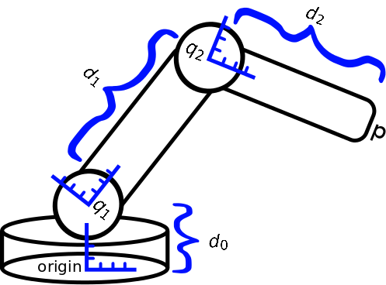
Theoretical Explanation
Kartik Sundrani (90)
The Homogeneous Transformation effectively merges a frame orientation matrix, and frame translation vector into one frame.
The order of the operation should be
viewed as Rotation First, then translation.

Slide 5
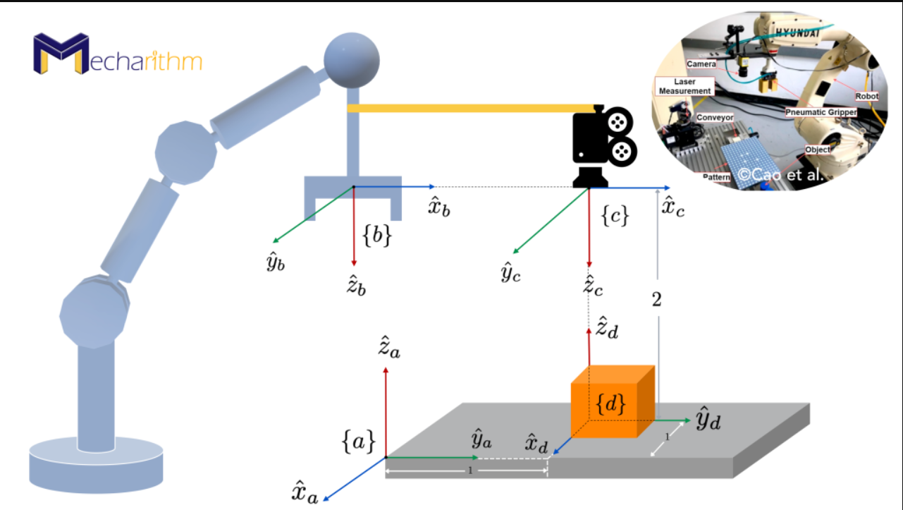
Theoretical Explanation
Kartik Sundrani (90)
It can be interpreted as frame a described relative to the first or base frame while frame B described relative to frame A.
It can be viewed as position or orientation
relationship of one frame relative to another
frame called the reference frame.

Slide 6
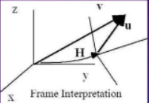
Frame Interpretation of Transformation
Aditya Panchal (98)
Here we have been given with the vector u and its Transformation is represented by :
V = Hu
Now this vector has components as
Ux , Uy , Uz in a column and it has to
Expanded to 4*1

Slide 7
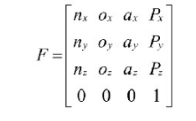
Homogeneous Transformation of matrices
Aditya Panchal (98)
A transformation matrix must be in square form .
It is much easier to calculate the inverse of a square matrix.
In order to multiply the dimensions of matrices must match.

Slide 8
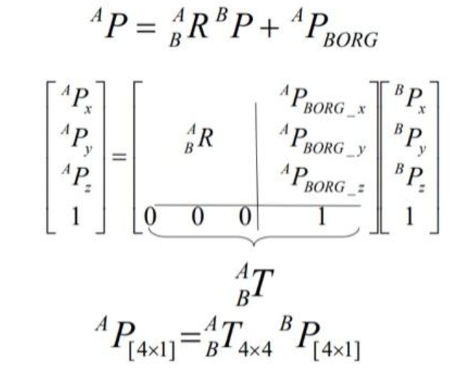
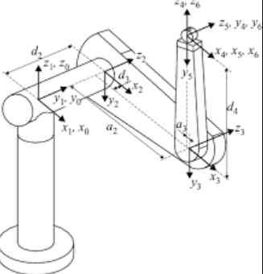
Graphical Representation of homogeneous transformation
Aditya Panchal (98)

Slide 9
Forward Transformation in Robotics
Shagun Alag (97)
Forward transformation matrices capture the relationship between the reference frames of different links of the robot.
A reference frame is basically the point of view of each of the robotic links, where if you were an arm joint yourself what you would consider ‘looking forward’.

Slide 10
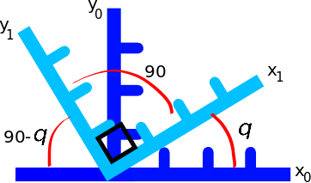
Forward Transformation for Rotation (1)
Shagun Alag (97)
The total contributions of a point defined in the (x1,y1) axes to the x0 axis are,
Similarly for the y0 axis contributions we have

Slide 11

Forward Transformation for Rotation (2)
Shagun Alag (97)
Rewriting the above equations in matrix form gives:
where is called a rotation matrix.

Slide 12
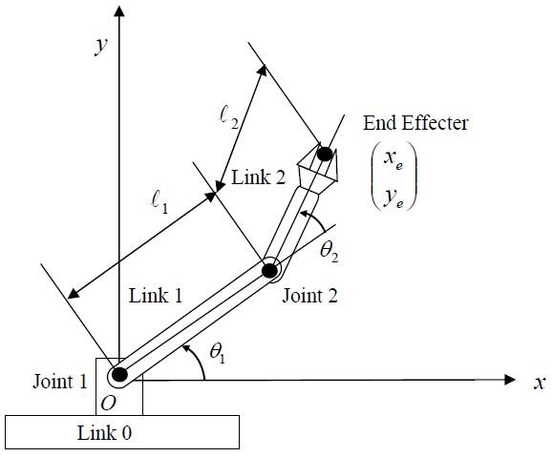
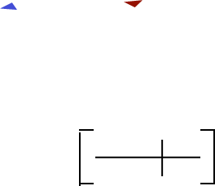
Differential Kinematics
Aakanksha Kulkarni (99)
Robotic arm:
Instantaneous velocity mappings can be obtained through time derivation of the direct kinematics function.
It states the relationship between joint velocities & end-effector velocities of a robot manipulator.

Slide 13


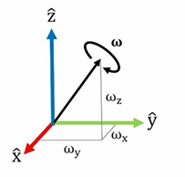

Returning to the time derivative…..
Aakanksha Kulkarni (99)
The time derivative of a rotation matrix is defined as a skew symmetric matrix as:
And
Thus, we get the relationship:

Slide 14
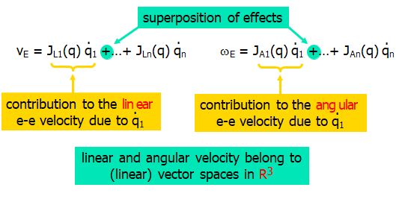

Jacobian matrix theory applied to robotics:
Aakanksha Kulkarni (99)
When jacobian matrices are applied to robotics and automation, then we get a 6 x n matrix of form:
We see that the derived 6 x n matrix calculates end effector instantaneous linear and angular velocity of a robotic arm.

Slide 15
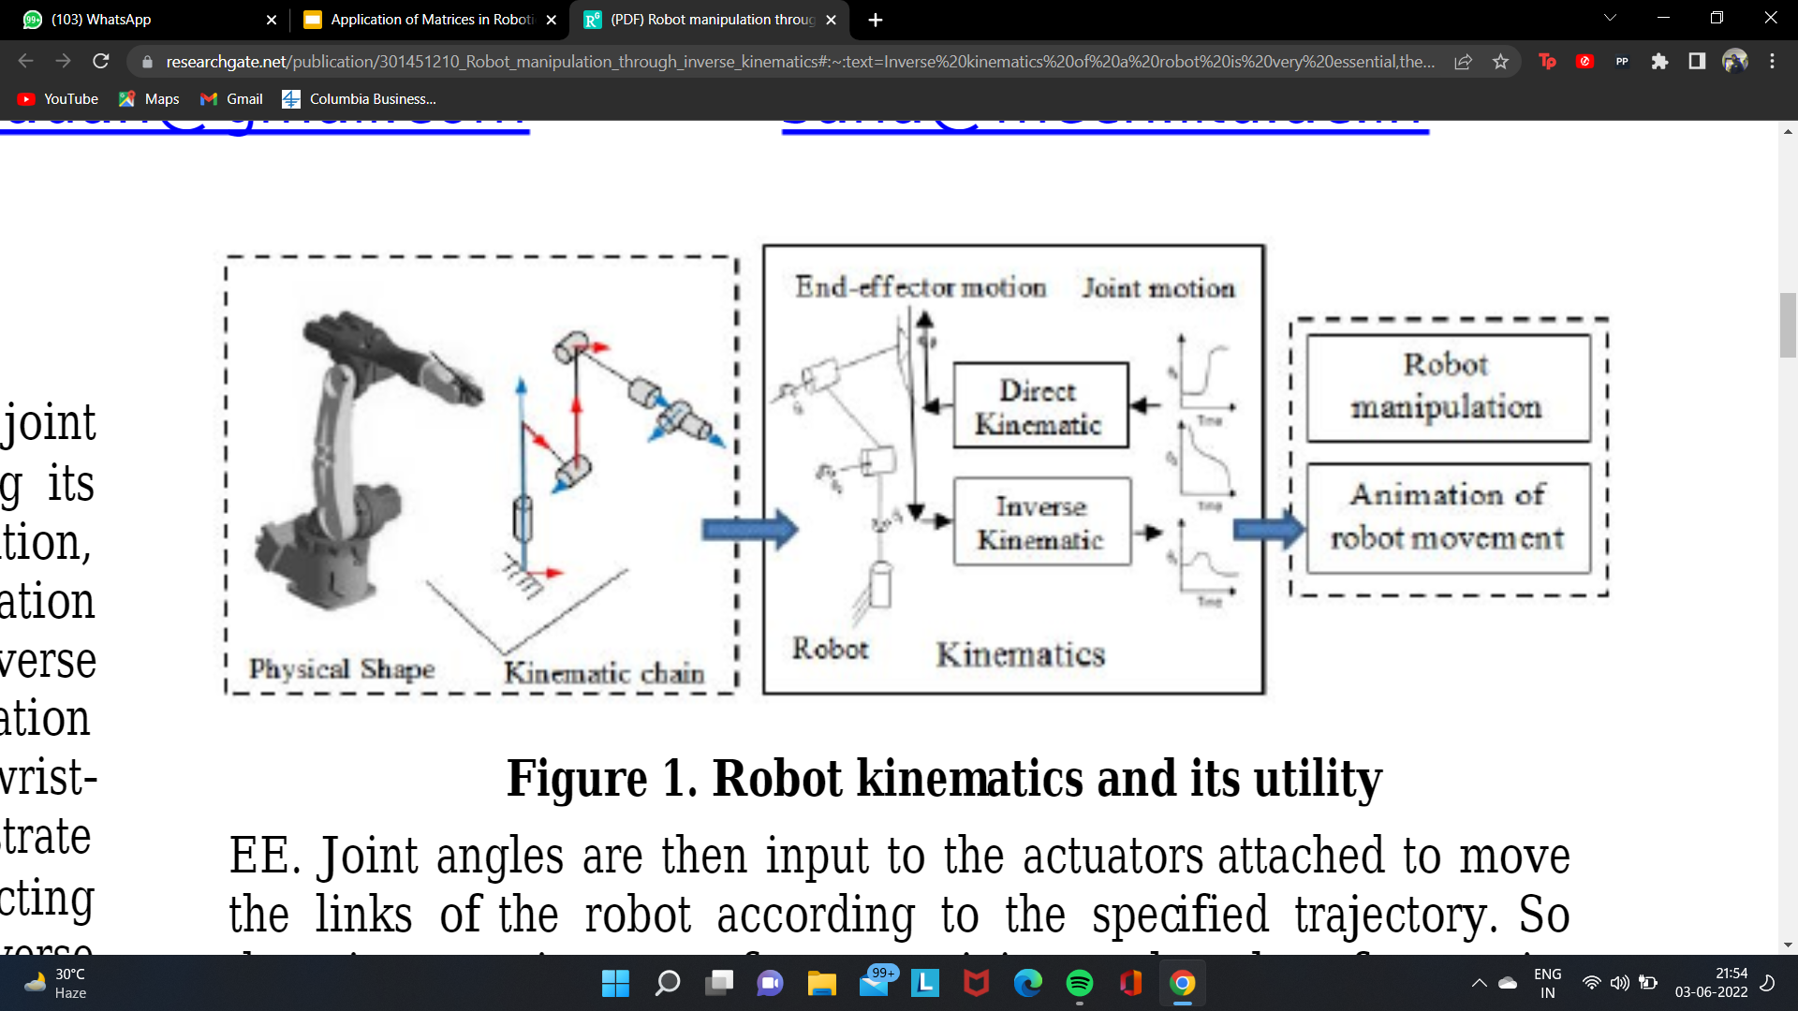
Robot kinematics and its utility.
Pranav Vaswani (93)
The goal of a robot controller is to generate an acceptable motion of the end-effector by precisely actuating its joints for a specified task.

Slide 16
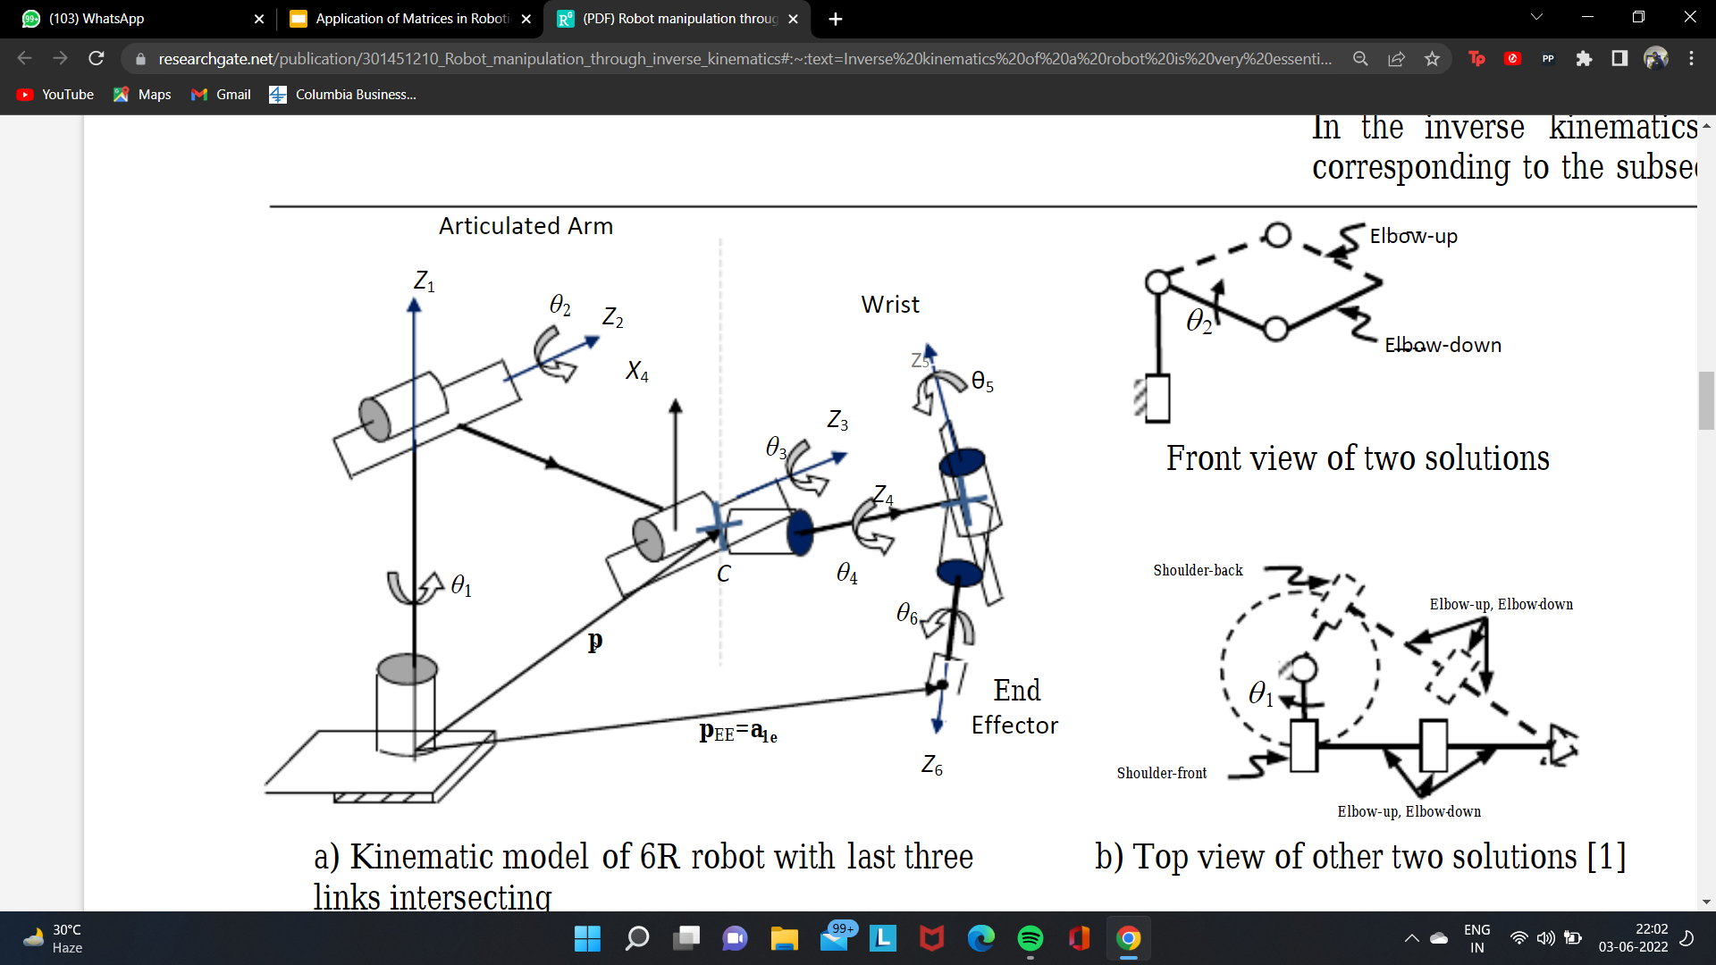
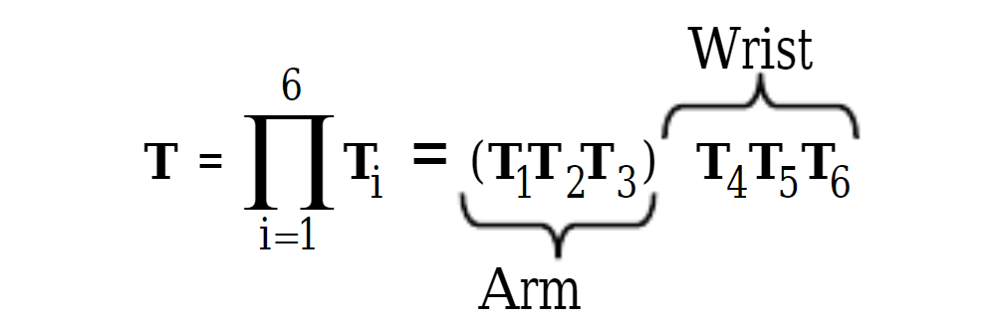
Kinematic model of 6R robot with last three links intersecting
Pranav Vaswani (93)
The net transformation matrix to obtain the position and orientation of the End Effector can be given as:-

Slide 17
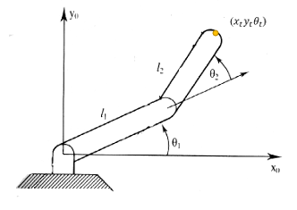
Example Problem 1
Bhavya Gupta (94)
Set up:-
You have an RR robotic arm with base at the origin.- The first link moves th1 with respect to the x-axis. The second link moves th2 with respect to the first link.
Question-
What is the position and orientation of the end effector of the robotic arm?

Slide 18
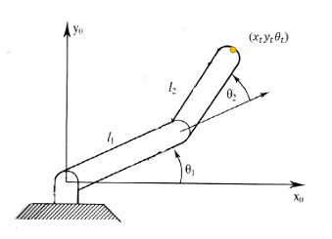
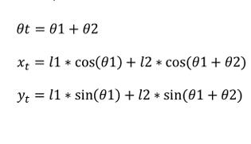
Geometric Approach-
Bhavya Gupta (94)

Slide 19
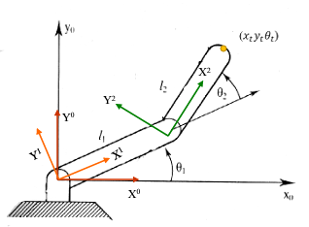


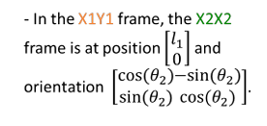



Algebraic Approach-
Bhavya Gupta (94)

Slide 20
Bibliography
The homogeneous transformation matrix (uiuc.edu)
Homogeneous Transformation Matrices - ppt download (slideplayer.com)
graphical representation of homogeneous transformation in robotics - Google Search
https://studywolf.wordpress.com/2013/08/21/robot-control-forward-transformation-matrices
https://www.google.com/search?q=transformation+matrix+in+robotics+with+examples

