Slide 1
Quantitative Modeling (R)
Case Study - Econometric models in the Banking industry
Jash Dattani
Roll No.: 27

Slide 2
Introduction
An econometric model specifies the statistical relationship that is believed to hold between the various economic quantities pertaining to a particular economic phenomenon.

Slide 3
Packages
dplyr
tidyverse
readxl
ggplot2
zoo
imputeTS
caTools
car
corrplot
lmtest
tseries
quantmod
scales

Slide 4
Initial Steps
Identify Raw Data
Importing Raw Data into Data Frames
Analyse, Clean and Aggregate Data

Slide 5
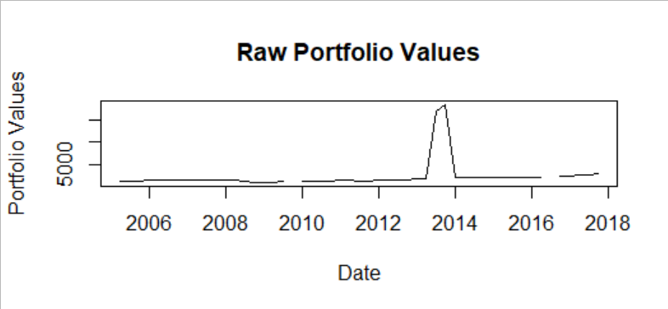
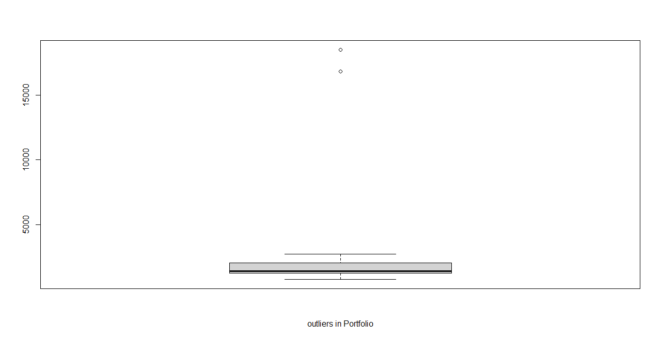
Orignal Data

Slide 6
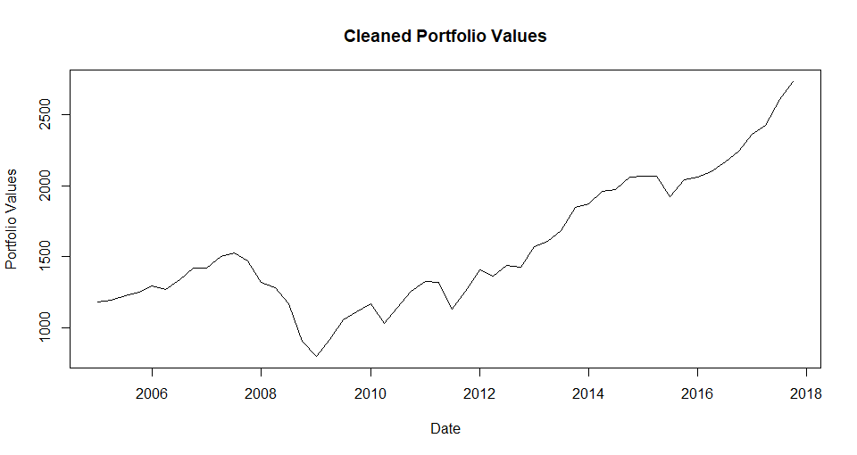
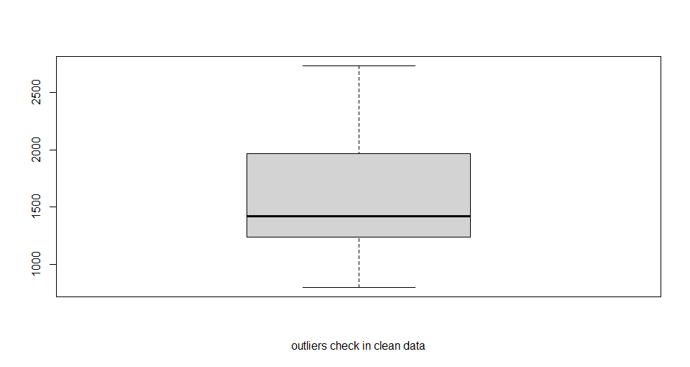
Cleaned Data

Slide 7
Correlation Analysis Using Graphs

Slide 8
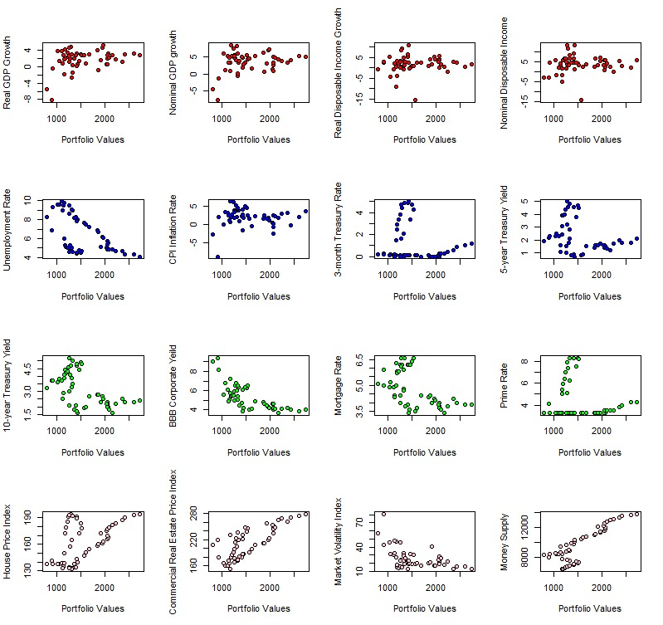

Slide 9
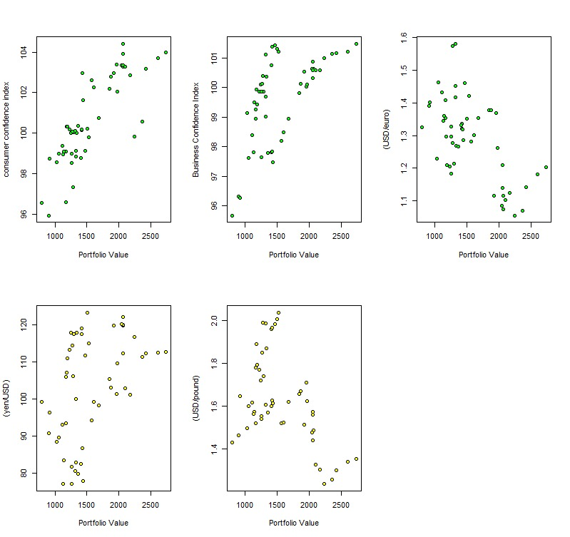

Slide 10
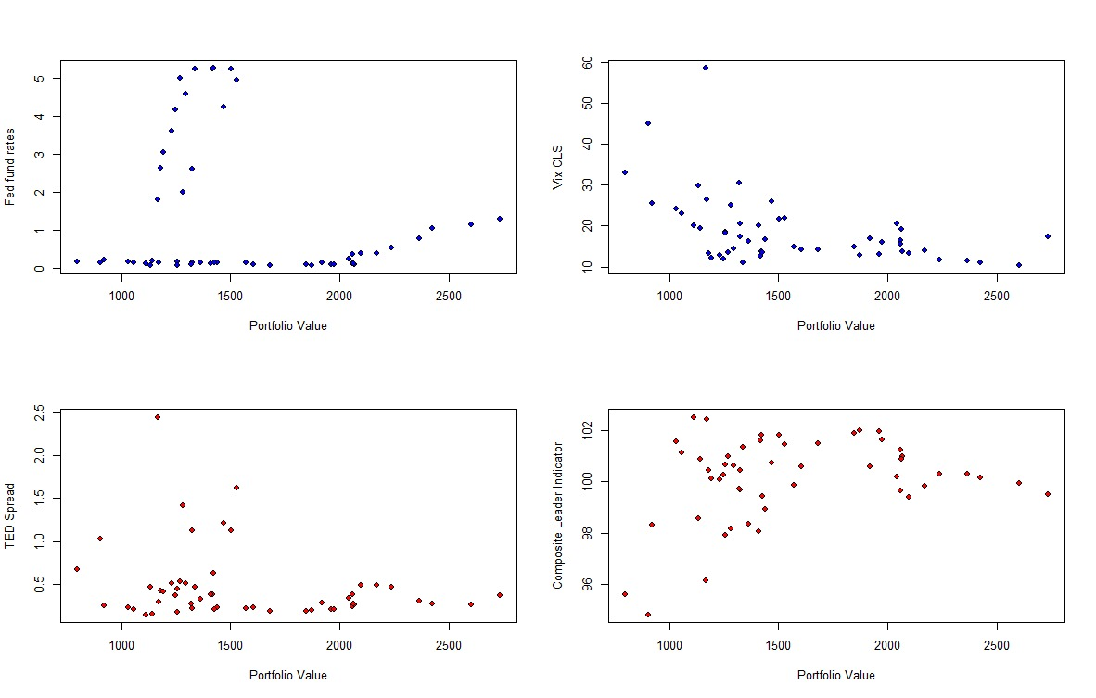

Slide 11
Correlation Test
> ifelse(c(NDI,BBC,CREPI,MS,CCI,BCI,Exchange)>0.6 | c(NDI,BBC,CREPI,MS,CCI,BCI,
+ Exchange)< -0.6 , "pass", "fail")
[1] "fail" "pass" "pass" "pass" "pass" "pass" "pass"

Slide 12
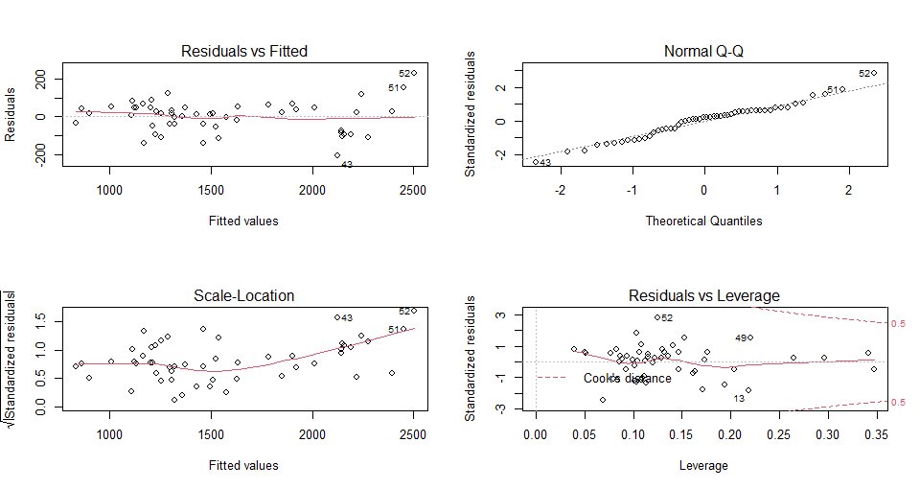
Model 1
model_01 = lm(`Portfolio Values` ~ `BBB.Corporate.Yeild`+`Commercial.Real.Estate.Price.Index`+`Money.Supply`+`consumer.confidence.index`+`Business.Confidence.Index`+`X.USD.euro.`,data = df_1)

Slide 13
Multi-collinearity Matrix

Slide 14
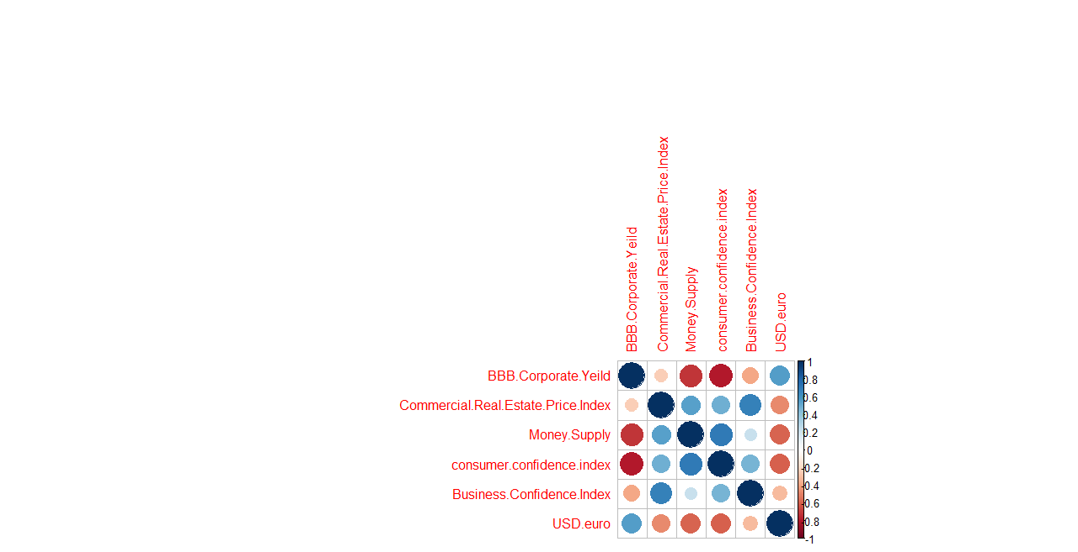
Multi-collinearity Plot

Slide 15
Model Iteration
Model 1
We eliminate money supply, consumer confidence index and BBB corparate yield due to very high correlation between them
Model 2
We eliminate USD/euro and business confidence index have a very high p value
Model 3
We eliminate Consumer Confidence Index for better $R^{2}$ value
We eliminate Consumer Confidence Index for better 𝑅^2 value

Slide 16
Model Iteration
Model 4
Failed Linearity Test
Model 5
Failed Linearity Test
Model 6
Model has passed all Statistical tests
Log transformed Portfolio Values
Log transformed Independent Variables

Slide 17
Quantitative Tests
Condition | Test Name | P-Value | Result (5% threshold)
Stationarity | Phillips Peron Test | 0.7943 | Stationary
 | Kwiatkowski–Phillips–Schmidt–Shin (KPSS) test | 0.0100 | Not Stationary
 | ADF Test | 0.5592 | Stationary
Linearity | Ramsay-Reset Test | 0.5181 | Linear
Multicollinearity | Variance Inflation Factor | - | No multicollinearity
Normality | Jarque Bera Test | 0.8392 | Normal
 | Shapiro Wilk Test | 0.7000 | Normal
 | Kolmogrov-Smirnov Test | 0.0000 | Not Normal
Heteroskedasticity | Breush Pagan Test | 0.1130 | Heteroskedastic
Auto-correlation of errors | Durbin-Watson Test | 0.0002 | Autocorrelation between Residuals
 | BG Test | 0.0011 | Autocorrelation between Residuals

Slide 18
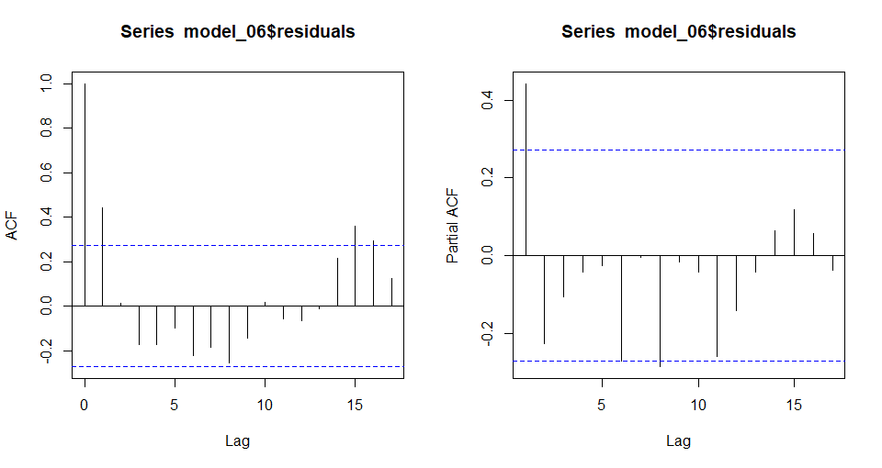
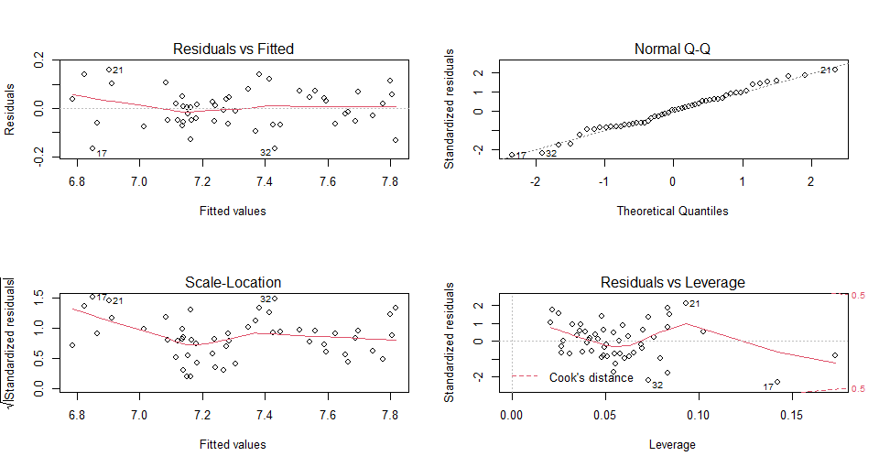
Qualitative Test

Slide 19
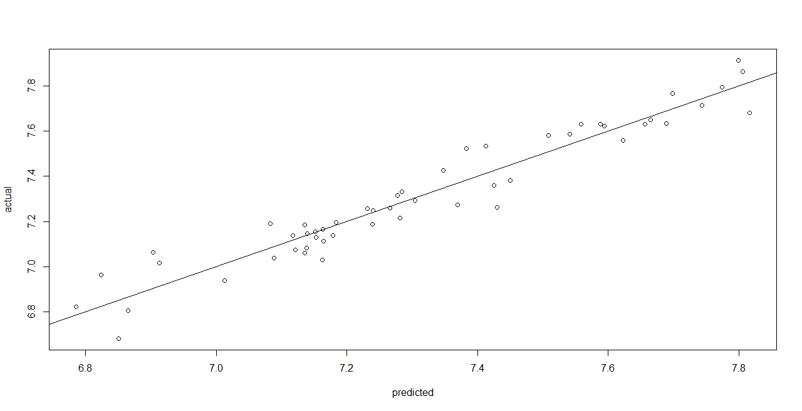
Actual vs Predicted
(In-Sample)
Residual Analysis
MSE | 14491.18
RMSE | 120.38
MAPE | 6.28

Slide 20
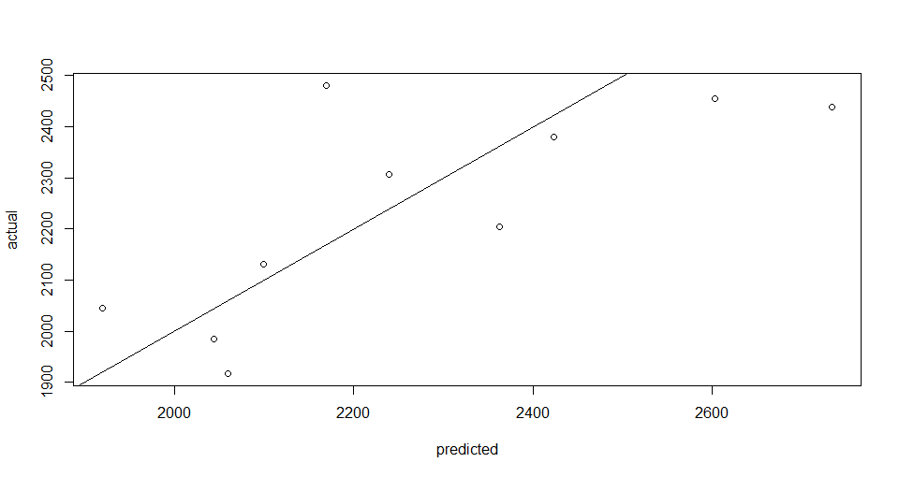
Actual vs Predicted
(Out of Sample)
Residual Analysis
MSE | 27832.86
RMSE | 120.38
MAPE | 6.02

Slide 21
Scenario Analysis
Portfolio Value
Quarter | Baseline | Adverse | Severely Adverse
Q1 2018 | ₹ 2,415.34 | ₹ 2,481.22 | ₹ 1,435.30
Q2 2018 | ₹ 2,355.25 | ₹ 2,204.38 | ₹ 1,203.11
Q3 2018 | ₹ 2,335.04 | ₹ 2,058.96 | ₹ 1,070.06
Q4 2018 | ₹ 2,323.47 | ₹ 1,932.14 | ₹ 976.24
Q1 2019 | ₹ 2,312.47 | ₹ 1,829.27 | ₹ 898.69
Q2 2019 | ₹ 2,294.55 | ₹ 1,807.16 | ₹ 877.70
Q3 2019 | ₹ 2,284.71 | ₹ 1,823.52 | ₹ 884.81
Q4 2019 | ₹ 2,275.34 | ₹ 1,855.86 | ₹ 925.34
Q1 2020 | ₹ 2,216.09 | ₹ 1,855.86 | ₹ 970.25
Q2 2020 | ₹ 2,236.99 | ₹ 1,932.43 | ₹ 1,038.17
Q3 2020 | ₹ 2,215.48 | ₹ 1,977.15 | ₹ 1,107.90
Q4 2020 | ₹ 2,229.19 | ₹ 2,023.76 | ₹ 1,199.92
Q1 2021 | ₹ 2,249.75 | ₹ 2,123.19 | ₹ 1,325.85

Slide 22
Capital Requirement Calculation
Base value = 2,733.48
CRP = (0.5*(bas_value-2216.089)+0.35*(bas_value-1855.857)+0.15*(bas_value-970.2475))*0.2
CRP = 166.07
Therefore, the capital requirement of portfolio is 166.07

Slide 23
Thank You

