Slide 1





Calculus In Sports
-By Roll No (13-18)

Slide 2
Calculus In Golf
BY : Arpit Chowdhary (13)

Slide 3

Introduction
Calculus has many real-life applications
Golf is one of these applications
We can use Calculus to find certain aspects of golf from having the balls initial velocity and its launch angle.

Slide 4
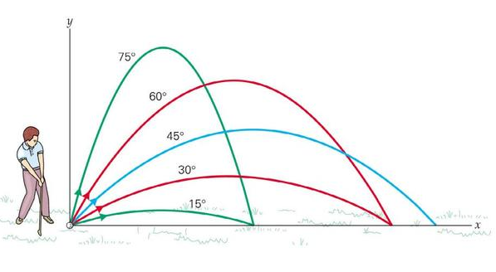
Why would you want to know this information?
1. Golf is a major sport today, and analysis of the way in which a ball moves helps professionals to better their performance
2. This shows how calculus can be used in a contemporary application, and thus helps to keep an interest in calculus.

Slide 5
Equation
By using trigonometry and the initial velocity and launch angle we are able to set up a triangle and solve for the C’s which in each case will be the velocity in their respective components.
The ball speed of Jace's drive at an angle of 11 degrees is 125 mph. To convert that speed to m/s multiply it by 0.44704, which gives you an initial velocity of 55.88 at 11 degrees. Using trig rules we can solve for the other sides which will be 10.66 in the y and 54.85 in x.
By splitting the second antiderivative into Cosine and Sine equations we come to the final equations. One for distance ViCosθt and one for height which is Visinθt-4.9t^2
θ is the launch angle, t is the time in seconds

Slide 6
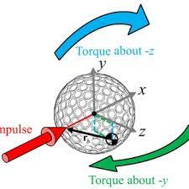
Calculations
To find the time we use the velocity formula in the y which is Vi= 9.8t + C. Since it is y we use the initial velocity of 55.88 and the y component of 10.66. When plugged into the equation and solved for t we get 4.61s, which is slightly longer that the tested time of 4.4s. The max height time can be solved for by dividing by 2 which is half the parabola so 2.31s.

Slide 7
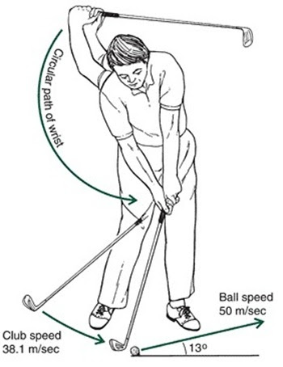
Since the shape is a parabola the height will be the same on either side at the same time. Meaning that at 1 second it will have the same height at the line x=1 on each side of the apex if you treat the apex as “0”.
Plugging in our found data in time, launch angle and Vi we find a distance of 240.3 metres and height of 27.8 meters. These Calulations are slightly off the practical tests for a few reasons.

Slide 8
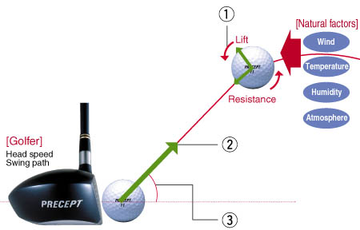
Conclusion
Things that affect ball flight
-Air resistance: lower pressure cause a longer flight times which makes for a longer drive. Courses closer to sea level have shorter drives than in mountain courses because of the pressure different. The change can be up to 10-15 yards or “one club”
-Terrain: landing spot or elevation of the tee box will create a longer hang time and longer drive or vice versa for a lower one.

Slide 9
CALCULUS IN CRICKET
BY : RAGHAV CHUGH (14)

Slide 10
THE CALCULUS OF BATTING AVERAGE
The batting average is a misleading indicator. How about a scale that is more representative of batting performance?????

Slide 11
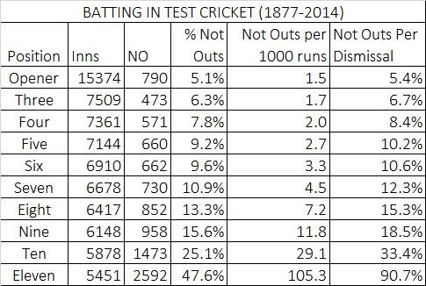
The batting average in cricket is the number of runs made by a player per dismissal. Not-outs inflate averages. To get a sense of the extent of this problem, compare the records of Brian Lara and Steve Waugh. The former had six not-outs in 232 Test innings. The latter had 46 in 260. Lara batted most frequently at No. 4, and had one not-out in 148 innings at that position. Waugh batted most frequently at No. 5, and had 22 not-outs in 142 innings there. This makes it basically meaningless to compare the batting averages of Waugh and Lara. Yet this is commonly done with Test batsmen.

Slide 12
I propose a different measure for a batsman's quality and consistency. This measure is in the form of a scale.
Team success also affects the likelihood of not-outs. In wins, batsmen remain not out about 15% of the time. In defeats, this drops to about 9%. To some extent, this explains why Lara remained not out at a rate well below the average for a No. 4, while Waugh remained not out at a rate well above the average for No. 5. At the very least, this basic fact about the different rates for not-outs depending on batting position illustrates the limits of comparing an opener's batting average to that of a middle-order batsman. A look at batting in Test cricket by batting position shows that the problem is systematic.
The average also does not indicate how many runs a player is likely to score in a given innings. The median innings in Test cricket produces 13 runs. The median Test innings for Lara is 34, while for Waugh it is 26. As a descriptor of a batsman's record, the average is a limited measure.

Slide 13
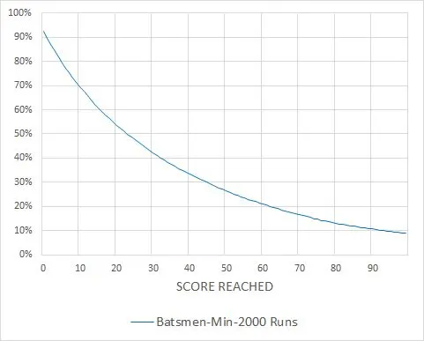
Consider the first 100 runs made by a batsman. The chart above shows the probability of a batsman (with at least 2000 career runs) reaching any score from 1 to 100. Two hundred and seventy-five batsmen have scored at least 2000 Test runs, from Dilip Sardesai with 2001 to Sachin Tendulkar with 15,921. These batsmen have played a combined 32,409 innings. They score a century nine times in 100 innings. They reach double figures 71 times out of 100. A batsman's batting score can be given simply by calculating the area under this curve.
Here is a simple example to illustrate the difference between the score and the batting average. In the 2003-04 season, Tendulkar made 659 runs at 54.91 in nine Tests and 15 innings. The distribution of scores over 15 innings was peculiar, though: 495 of the 659 runs came in three innings, each not out. Tendulkar's median score over those 15 innings was 8. In these 15 innings, Tendulkar reached 100 twice, 60 thrice, 37 six times, 8 eight times and 1 13 times. His score over those 15 innings is 28.

Slide 14
The score provides a more representative picture of Tendulkar's performance that season compared to his batting average. To get a sense of how low a score of 28 is, the batting average for the 275 batsmen who made at least 2000 Test runs is 41; their collective score is 34.
It is a matter of some surprise that this method of measurement has not been used yet in cricket. Even the basic idea of measuring runs per innings, instead of runs per dismissal, has gained little currency. The method described in this post could be extended by using a different upper limit, say 150 or 200, or even 400 (the current highest Test score). With an upper limit of 400 it would simply provide the runs per innings (total runs divided by total innings).

Slide 15
A CALCULATION OF CRICKET BALL TRAJECTORIES
One of the most important facets of fast bowling in cricket is the ability of bowlers to make the ball ‘swing’ or deviate laterally from its course between leaving the bowler’s hand and arriving at the position of the batsman. Experience suggests that this is associated with the way in which the ball is bowled and in particular with the position of the ‘seam’ relative to the bowling direction. This seam holds the outer surfaces of the two sides of the ball together and the stitches of the seam protrude above the surface of the ball. Swing bowlers will bowl the ball with the seam in a vertical plane inclined at an angle to the bowling direction. The roughness of the ball is also known to be of importance, and bowlers will polish one side of the ball (the side that is ‘leading’ the seam through the air) to help achieve swing. Over the last few decades a number of investigators have carried out experiments on cricket balls to understand this phenomenon, mainly through force measurements on stationary balls, with and without spin, in wind tunnels of different types.

Slide 16
Baker [5] sets out equations for the flight of both com- pact debris (with the three length dimensions broadly comparable with each other) and sheet debris (with two major and one minor length dimension) under extreme wind conditions, such debris having recently been recognized as one of the major causes of building damage in severe windstorms. These winds acceler- ate the debris from zero velocity to velocities close to the wind velocity. In Quinn et al. [6], the authors utilize the compact debris equations further to inves- tigate the flight of ballast under high-speed trains, an issue that is becoming to be of increasing con- cern for high-speed train operators. This involved the specification of the air velocity underneath the trains. Again the air movements under the train accelerate the ballast from stationary to velocities close to the train-induced air velocities. In studying cricket ball trajectories it is appropriate to again use the com- pact debris equations, but with the difference that this time the object under consideration is moving much faster than the prevailing air velocities due to natu- ral wind. Applying Newton’s Law in the x (along the pitch), y (across the pitch), and z (vertical) directions and suitably non-dimensionalizing, one obtains the basic trajectory equations for cricket balls

Slide 17

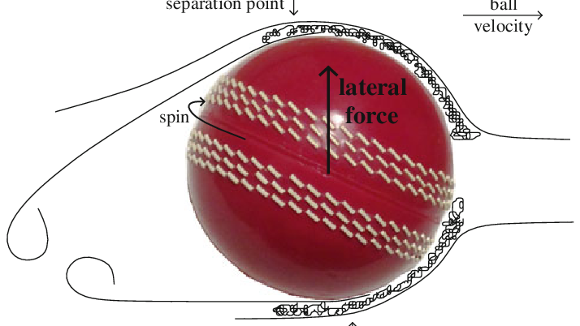

Slide 18
Calculus In Running
By roll no.15
Aarya Dantara

Slide 19
What does math have got to do with running?
Face it: There's math in everything
One can use math do things such as improve their running form and figure out how to achieve a faster running time.

Slide 20
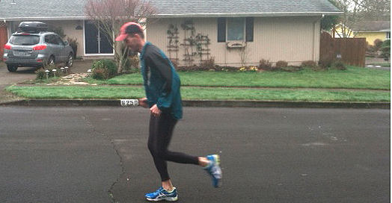


What do all of them have in common?
Is it the slouching?
Are they all tired?
Is their form bad?

Slide 21
The answer is that they all have atrocious posture. But this can easily be fixed. Let's jump into the math!!!

Slide 22

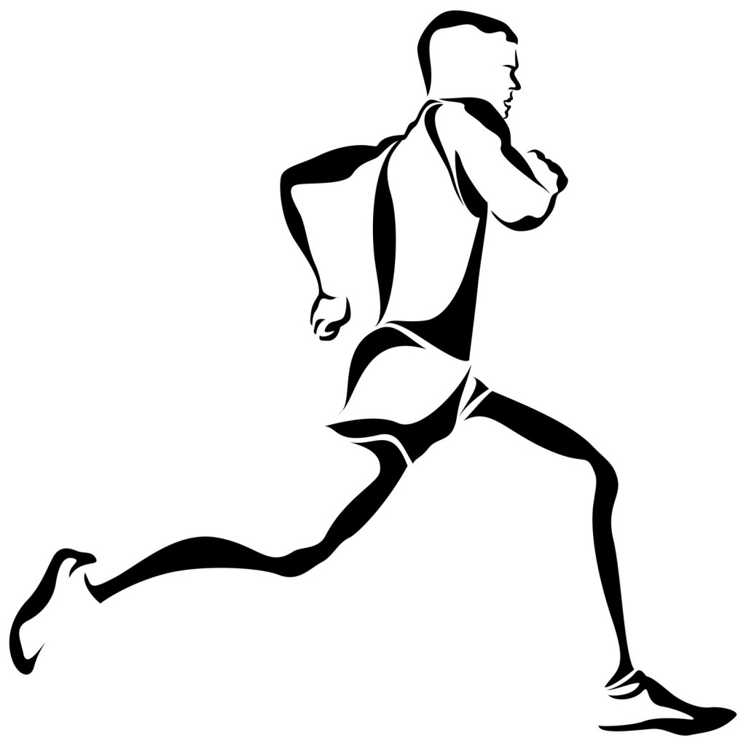
Symmetry
Humans are naturally bilaterally symmetrical.
But when you run, you disrupt this symmetry.
You have to find a way to make up for the symmetry and balance you lost

Slide 23
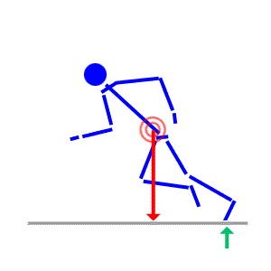
Proper Posture of Running
This is your center of mass.
When that foot hits the ground, it should be where the red arrow is pointing to (The center of mass). this keeps you balanced.
His knee needs to be at the proper angle so that his foot can hit the center of mass and propel him forward faster.
This angle is different for everyone, due to different leg sizes, center of masses, etc.

Slide 24
Now that we've covered posture, it's time to get into some more technical stuff.
You need more oxygen to produce energy >>
You breathe heavier.
The measurement of the maximum amount of oxygen your body is able to take in is called VO2 max.
VO2 max formula based on 1 mile walk time:
132.853- 0.0769W- 0.3877A+ 6.315G- 3.2649T- 0.1565H

Slide 25
So you've seen the formula, now you need to understand it.
132.853- 0.0769W- 0.3877A+ 6.315G- 3.2649T- 0.1565H
W= weight (lbs)
A= age
G= gender (female=0, male=1)
T= your 1 mile walk time
H= heart rate after you finish the mile

Slide 26




There is a series of 7 equations that can be used together to figure out how to run a given distance in the shortest amount of time.

Slide 27
What each equation means/ determines:
The time taken to run a race related to it’s distance.
The velocity/speed (This is the equation of motion).
V is the initial velocity, so it is 0 because the runner is initially still.
The exerted force from the runner has to be less than or equal to the maximum force they have.
Equation of energy/oxygen balance in the runner.
The energy equivalent of the available oxygen (E) times 0 equals the initial amount of energy (Eo).
The energy equivalent of the oxygen can never be negative.

Slide 28
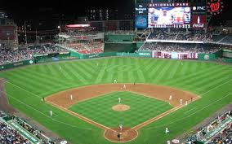
Calculus in Baseball By Pratik Dhakate
Calculus In baseball : calculus can be used to optimize the pitcher’s throw to achieve maximum efficiency. Also, calculus can be used to calculate the projectile motion of baseball’s trajectory and to predict if runners can make it to the next base on time given their running speed and the speed of a hit ball. Calculus in baseball showing the use of calculus in sports

Slide 29
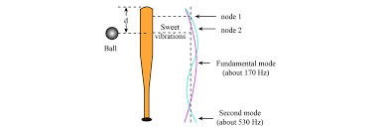
Baseball is a game where the ball hits the bat, and the batter or the hitter places it far in the ground. So there are many forces included in this game. We can estimate the force of impact on the bat, kinetic energy of the baseball hitting the bat, the energy of the spin of the bat, and so on. These are closely relate to physics. There is a sweet spot on the bat where the batter feels less impact than other batter sites. This spot occurs because the vibration of the bat at that point is not excited at all.

Slide 30
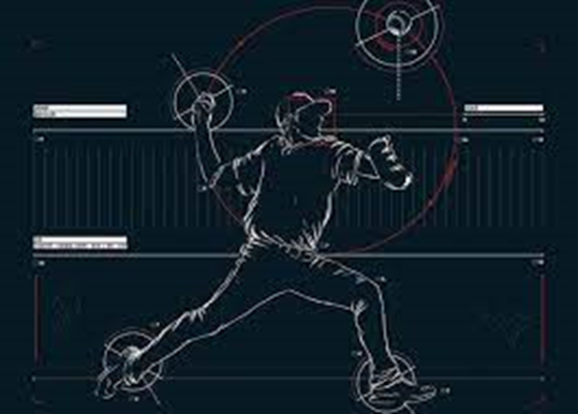
The Work Required to throw the Baseball
The work done W on a moving ball from a position s0 to s1 is equal to the change in ball’s kinetic energy. The kinetic energy K of a baseball of mass m and velocity v is given by K=12mv2.W=∫s1s0F(s)ds=12mv21−12mv20
Where v0 and v1 are initial and final velocities. Using this, baseball players can figure out how much force they need to exert on the ball to reach the place where they want the ball to go.

Slide 31
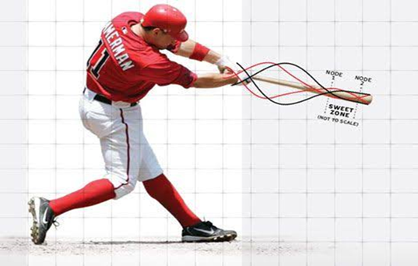
The Average force on the bat during the collision
We can calculate the average force on the bat during this collision by first calculating the change in the ball’s momentum.
We know that the momentum p of an object is the product of its mass m and its velocity v, that is, p=mv. Suppose an object, moving along a straight line, is acted on by a force F=F(t) which is a continuous function of time t.
The change in ball’s momentum over a time interval [t0−t1] is equal to the integral of force F from time t0 to t1.
p(t1)−p(t0)=∫t1t0F(t)dt
Using the above formula, one can find the average force on the bat during the collision F=ma where a=Δvt. The application of calculus in sports does not end with running and baseball, now let’s see how it can be applied in basketball too.

Slide 32
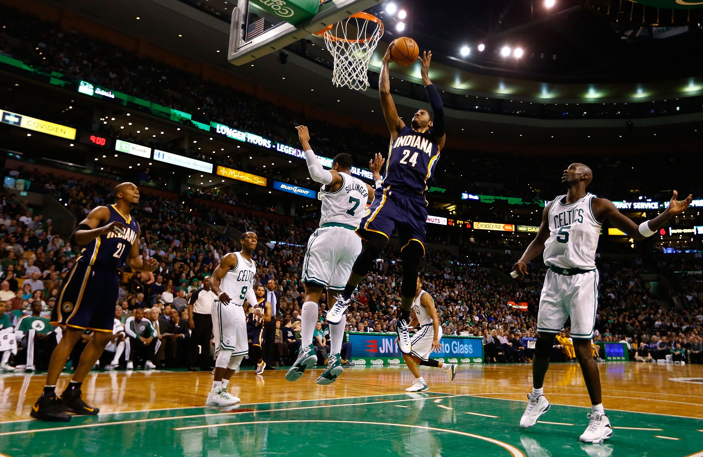
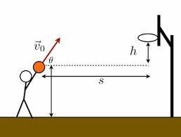
Calculus In Basketball By Moksh Doshi

Slide 33
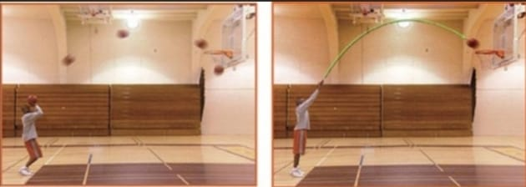
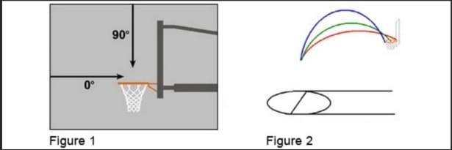
ARC & Angles.
The arc is the path the basketball flies from the time it leaves the shooter's hand until it arrives at the basket.After the shot, given the strength of release and the angle of release, a mathematician can accurately predict the path and arc length because gravity is the only force affecting the ball.
Photo 1 shows the parabolic path that the ball takes from the shooter's hand to the basket.
Photo 2 shows the arc formed over time with the green line.
Figure 1: Extreme Entry Points: 90° Arc enters directly from above, 0° Arc enters directly from the side
Figure 2: (Red) 30˚, (Green) 45˚ and (Blue) 60˚ Arcs

Slide 34
KEY TERMS
Hoop Size is 18 inches, which is the diameter of the hoop ring.
Because a basketball size is smaller than the hoop, there is a constant hoop margin.
Hoop Margin is the amount of open space left after the ball enter the 18 inch ring of the hoop. If a ball enters the hoop directly from above, since a men's ball is 9.7 inches in diameter, the amount of open space left in the hoop is 18 – 9.7 = 8.3 inches.
Jump shots, free throws, and three pointers enter at an, which makes the hoop more of an oval entrance. This changes the Hoop Margin.
Apparent Hoop Size is the apparent opening of the hoop to the ball. The flatter the arc, the smaller the ellipse.
Because there are various ways a shot can be taken and many angles the ball can fly the Apparent Hoop Margin also varies.
Apparent Hoop Margin is the Apparent Hoop Size minus the diameter of the ball. The greater the margin, the greater the error of margin that a shooter can take.

Slide 35



Velocity
Let r(t) be a differentiable vector valued function representing the position of a particle. Then the speed of the particle is the magnitude of the velocity vector. In one variable calculus, we defined the acceleration of a particle as the second derivative of the position function. Jerk is the third derivative. In our case, the basketball is the particle.
EQUATIONS
Velocity of a 3 Point Shot
Equation at which player must shoot a basketball in order for it to land perfectly in the basket.
Formula for solving for the range of the basketball
Ideal Angle: 45 degrees

Slide 36
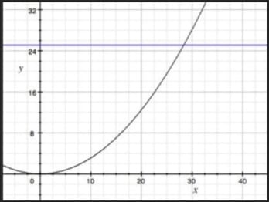
Graph of the Range Function of How Hard the Player Must Shoot the Ball

Slide 37
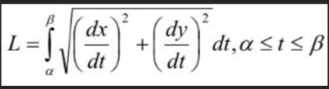
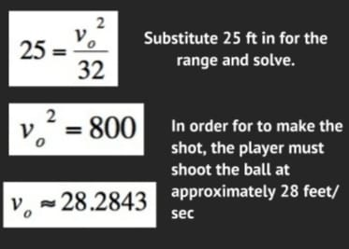
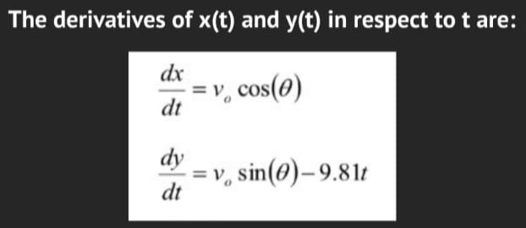
Finding the arc length needed to make a 3 point shot:
Solving for velocity:

Slide 38
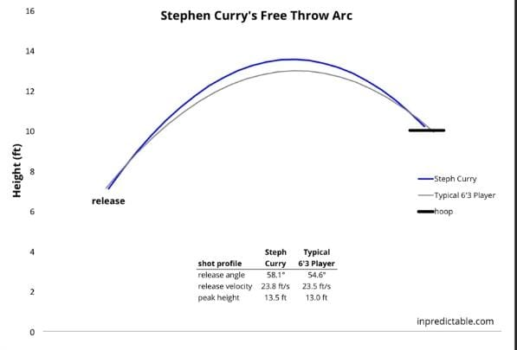
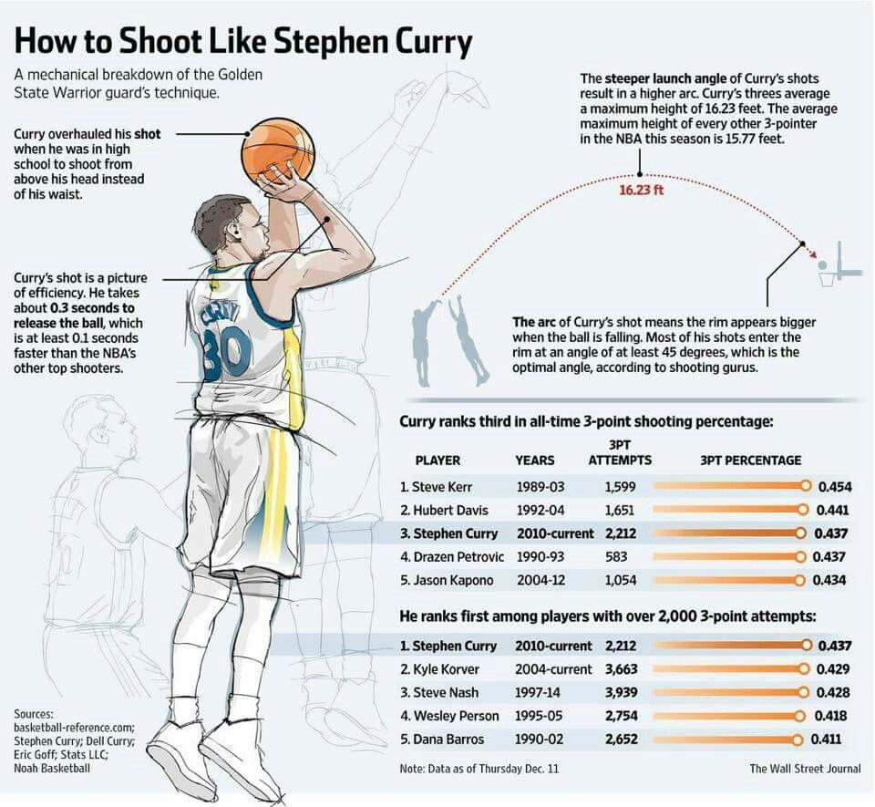
Stephen Curry’s perfect throw.

Slide 39


