Slide 1
R PROJECT Case Study 1- Econometric Models in the Banking Industry
Name – Sannidhya Upadhyay
New Roll. No – 4

Slide 2


STEP 1
DATA MINING

Slide 3

DATA EXTRACTION
Equity portfolio data was extracted from : Bank'sEquityPortfolio1.csv
Macroeconomics data was extracted from : Macroeconomics.csv
Baseline Data : baseline.xlsx
Adverse Data : adverse.xlsx
Severely Adverse Data : severely adverse.xlsx

Slide 4

STEP 2
DATA CLEANING

Slide 5
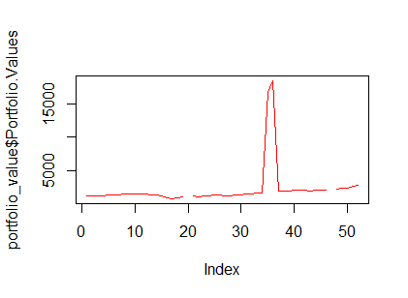
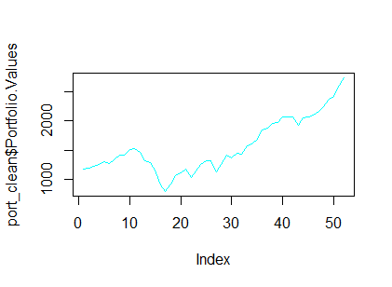
DATA CLEANING
BEFORE
Portfolio dataset had some missing values and some outliers which needed to be rectified:-
I used interpolation for finding out the missing values.
For outliers I replaced those value with the values with correct decimal places.
In Macroeconomic data, the time frame were not matching as per portfolio values so I removed dates from Q1 2000 to Q4 2004 from macroeconomic data.
AFTER

Slide 6

STEP 3
DATA ANALYSIS

Slide 7

Chosen variables with a correlation coefficient of higher than absolute value of 0.6
Commercial Real Estate Price Index | 0.78270767
Money Supply | 0.86038344
Consumer Confidence Index | 0.80824163
Business Confidence Index | 0.63483374
BBB Corporate Yield | -0.72499391
X USD euro | -0.61541115

Slide 8
Regress dependent variable against total set of chosen independent variables

Slide 9

STEP 4
DATA VISUALIZATION

Slide 10
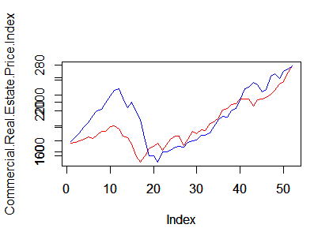
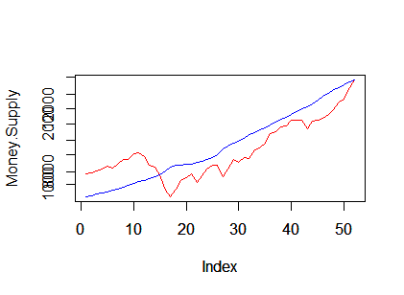
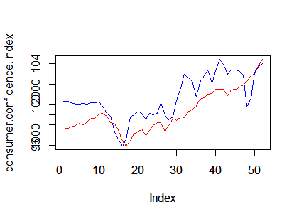
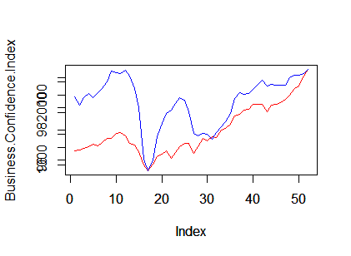
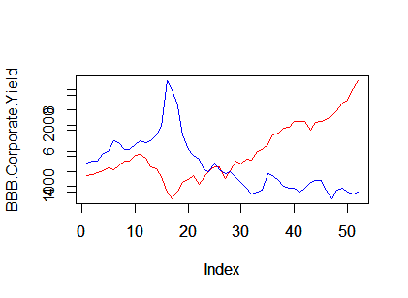
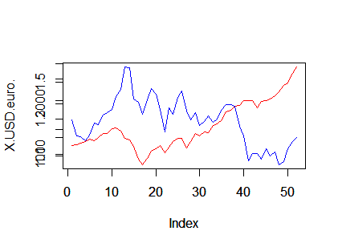
PLOTS

Slide 11

STEP 5
MODELING

Slide 12
MODEL BUILDING AND PREDICTION
ITERATION 1
Commercial Real Estate Price Index
ITERATION 2
ITERATION 3
Business Confidence Index
Consumer Confidence Index
BBB Corporate Yield
X USD euro
Commercial Real Estate Price Index
Consumer Confidence Index
BBB Corporate Yield
Commercial Real Estate Price Index
BBB Corporate Yield
0.9139
0.9193
0.917

Slide 13
FINAL MODEL
Adjusted R-squared: 0.9252

Slide 14
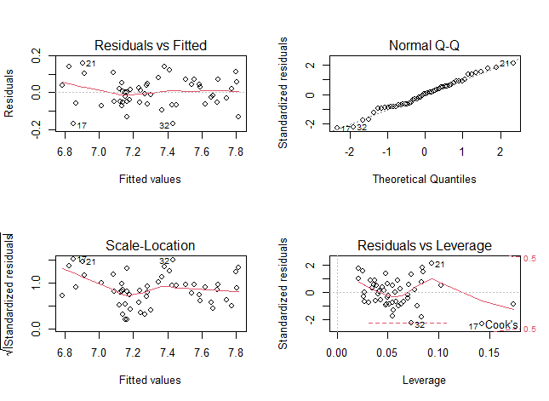
PLOTS

Slide 15
QUANTITATIVE TEST

Slide 16
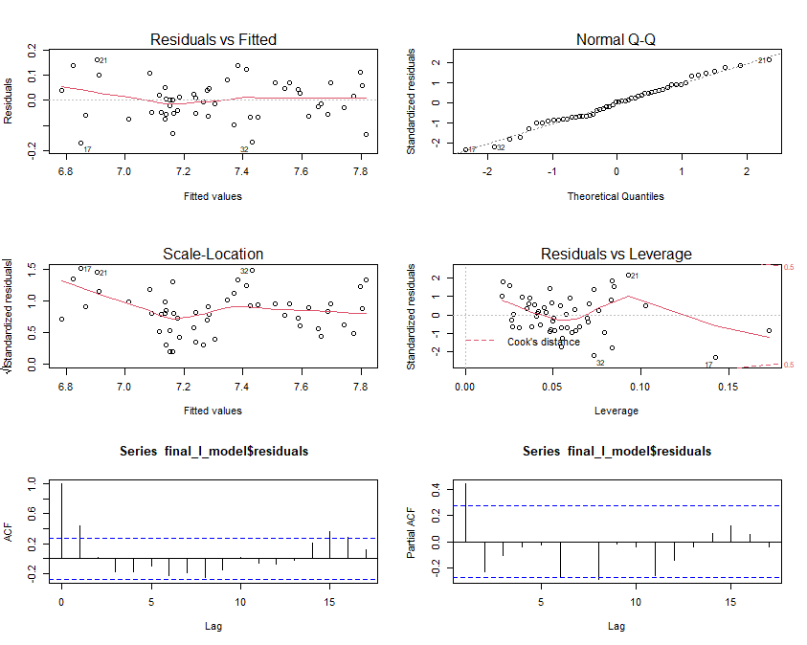
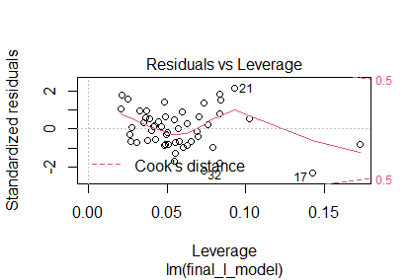
QUALITATIVE TEST

Slide 17
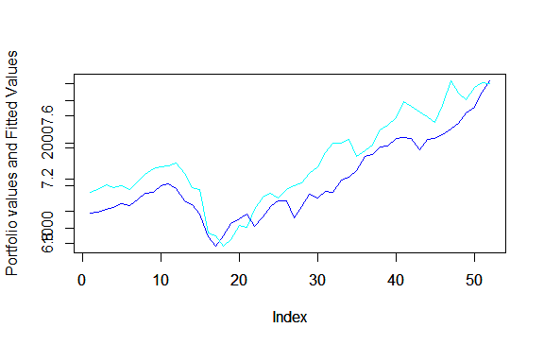
IN SAMPLE RESIDUAL ANALYSIS

Slide 18
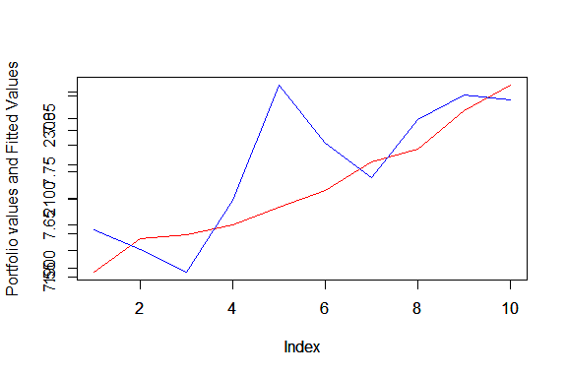
OUT OF SAMPLE

Slide 19
FORECAST

Slide 20
REQUIRED CAPITAL

Slide 21
THANK YOU!

