Slide 1

Applications of Econometric Models in the Banking Industry
R Project
Kshitij Srivastava

Slide 2

Index
Introduction
Objectives
Data Analysis
Data Cleaning
Model Iterations
Statistical Tests
In-Sample Analysis
Out-of-Sample Analysis
Forecasts
CRP Calculation

Slide 3

Introduction
What are Econometric Models?
An econometric model specifies the statistical relationship that is believed to hold between the various economic quantities pertaining to a particular economic phenomena.
These models are usually based on economic theories that assume optimizing behavior on the part of economic agents.

Slide 4

Objectives
In order to comply with regulations, a bank’s equity portfolio has to be forecasted so that there is adequate capital reserve.
We have been provided with historical macroeconomic variables and their forecasts in baseline, adverse, and severely adverse scenarios. The historical portfolio values of the bank have also been provided.
The objective will be to forecast the portfolio values in all 3 scenarios on the basis of the macroeconomic variables so that the capital reserve can be calculated.

Slide 5
Datasets
We have been provided with 3 datasets -
Bank’s Equity Portfolio – contains 52 rows and 2 columns, showing the portfolio values quarter wise from Q1 2005 to Q4 2017.
Historical Macroeconomic Variables – contains 72 rows and 26 columns, showing the macroeconomic variables from Q1 2000 to Q4 2017.
Forecasts for Macroeconomic Variables – 3 sheets each containing 13 rows and 26 columns, showing the baseline, adverse, and severely adverse predictions for the macroeconomic variables from Q1 2018 to Q1 2021.

Slide 6
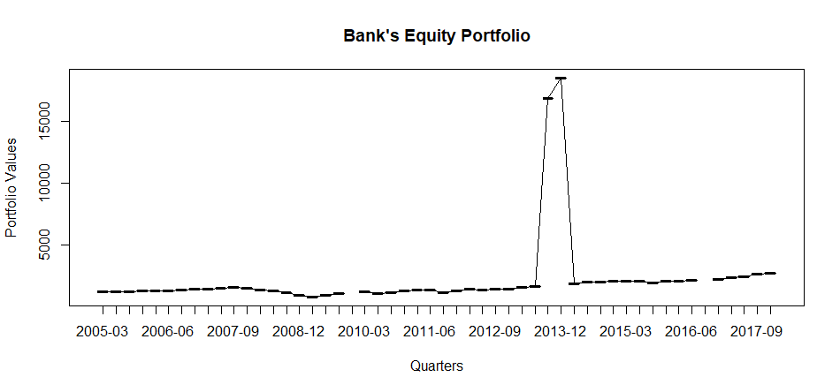
Data Cleaning
The data provided to us was tested for missing values and outliers.
Through graphical analysis, we see that we have missing values in 2 instances –
  Q4 2009
  Q3 2016
We interpolate these values to their nearest values

Slide 7
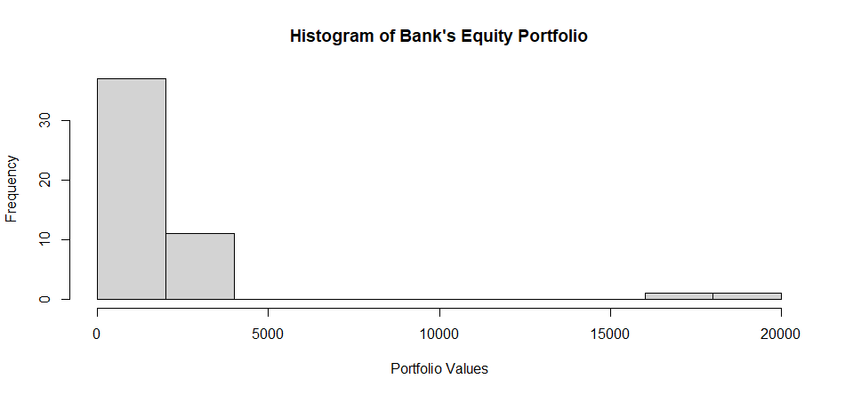
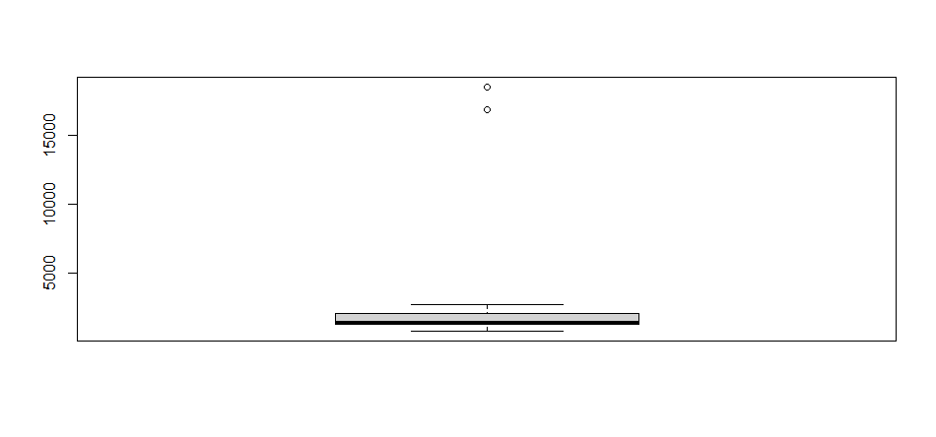
Data Cleaning (2)
The presence of outliers is also noticed, and is further illustrated via this histogram and boxplot.
Upon further investigation, we find that the outliers are in Q3 2013 and Q4 2013.
It is observed that we need to shift the decimal point towards the left in order to correct the outliers.

Slide 8
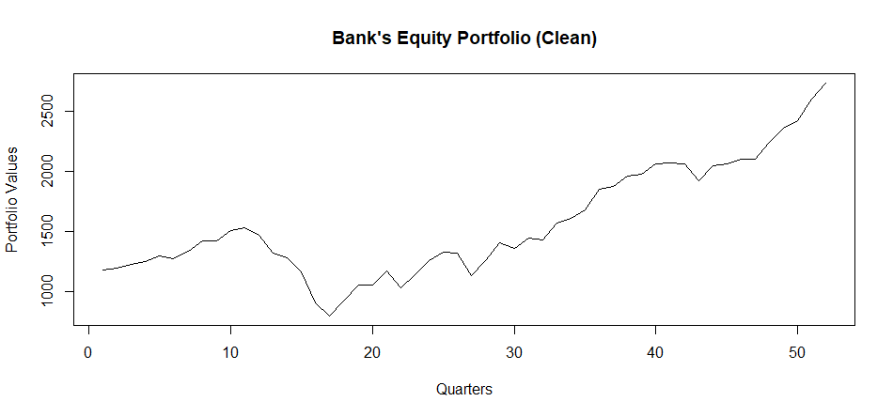
Cleaned Data
Voila! Our data has been cleaned of outliers and missing values.

Slide 9
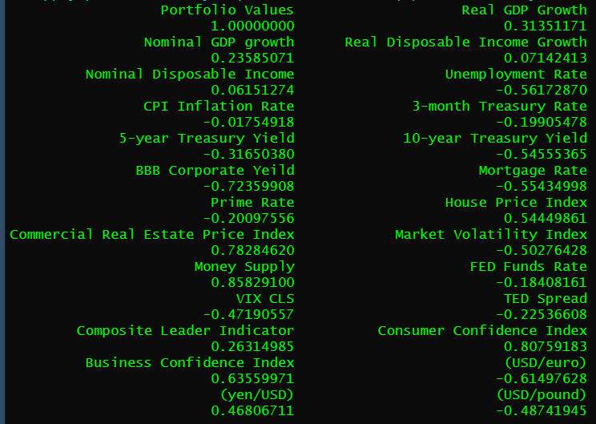
Correlation analysis
The macroeconomic variables which have an absolute value of correlation greater than or equal to 0.6 with the portfolio values are as follows-
BBB Corporate Yield
Commercial Real Estate Price Index
Money Supply
Consumer Confidence Index
Business Confidence Index
(USD/euro)
The following slide contains a graphical analysis of all these variables with the quarterly portfolio values

Slide 10
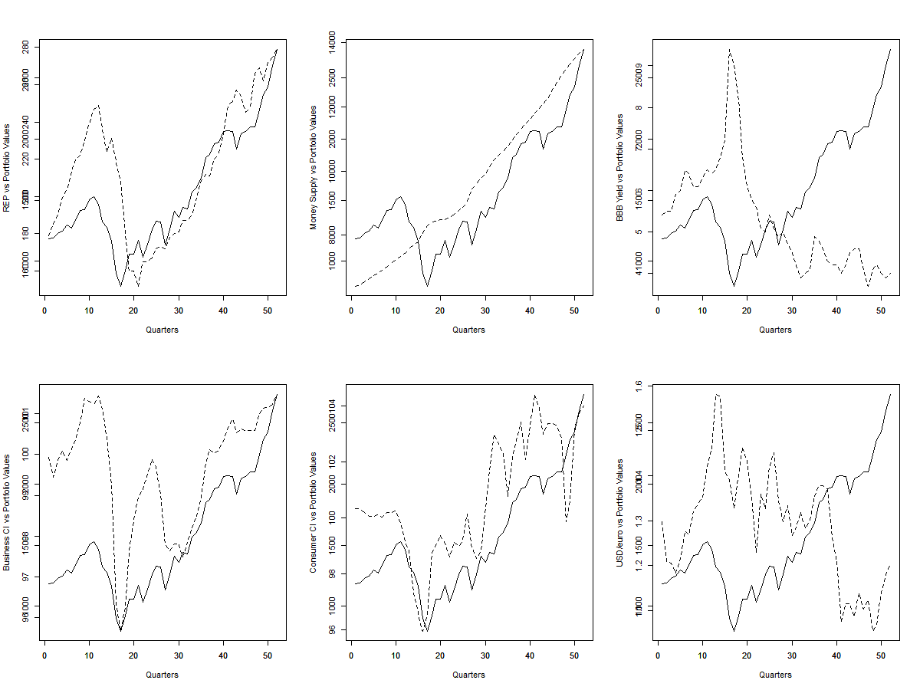

Slide 11
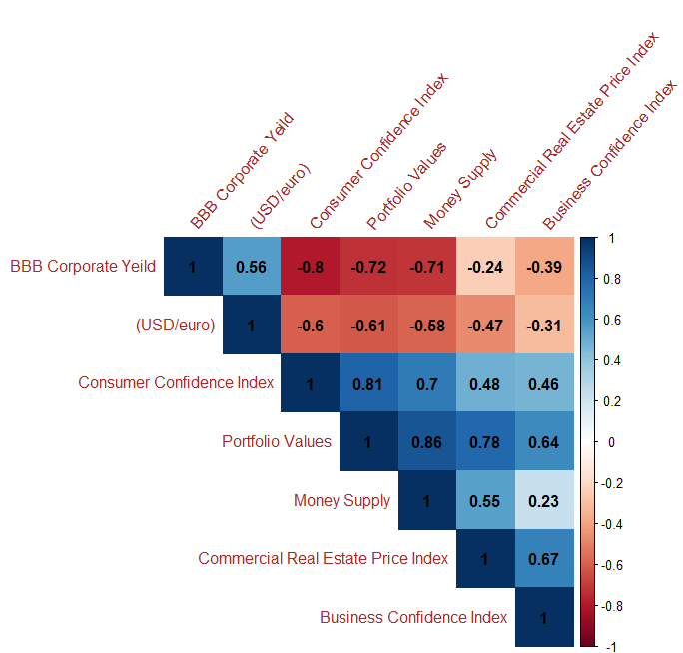
Linear regression
We will now regress the dependent variable “Portfolio Values” against the independent variables.
Looking at the correlation plot, we see that the predictor variable “Money Supply” has high correlation with “BBB Corporate Yield” and “Consumer Confidence Index”
Therefore, we remove this variable on the grounds of multicollinearity, as its effects are already reflected in other predictor variables.

Slide 12
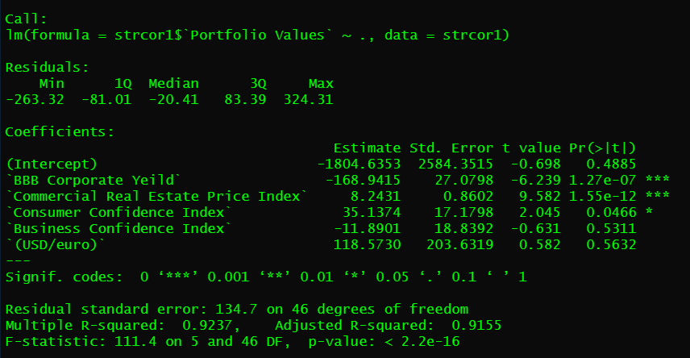
Model Iteration 1
For the 1st iteration of the model, we regress portfolio values against
  BBB Corporate Yield
  Commercial Real Estate Price Index
  Consumer Confidence Index
  Business Confidence Index
  (USD/euro)
The Adjusted R-squared value of the model is 91.55%

Slide 13
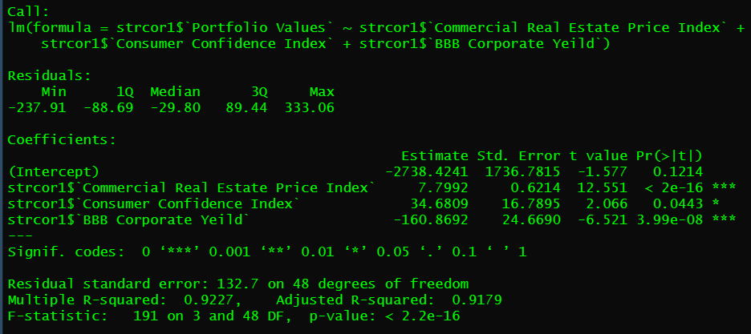
Model Iteration 2
For the 2nd Iteration of the model, we remove the variables “Business Confidence Index” and “(USD/euro)”, as they did not have a significant influence on the previous model.
The adjusted R-squared value of the model is 91.79%

Slide 14
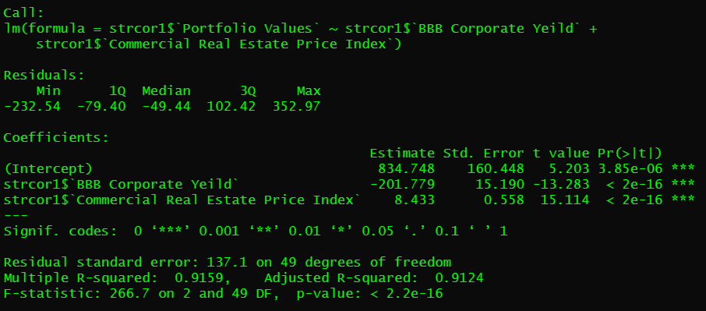
Model Iteration 3
We remove “Consumer Confidence Index” from the model as it did not have a very high influence on the previous model.
Moreover, it is highly correlated with “BBB Corporate Yield”, so its effects will already be incorporated.
The adjusted R-squared value of this model is 91.24%

Slide 15
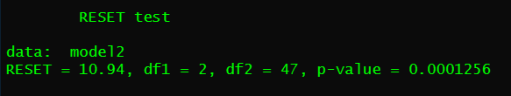
Ramsay RESET Test
The Ramsay RESET test checks the linearity of the model
H0 : The model is linear
H1 : The model is not linear
Since p-value < 0.05, we reject the null hypothesis and conclude that the model is not linear.

Slide 16
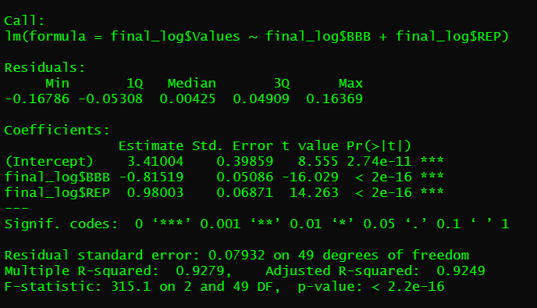
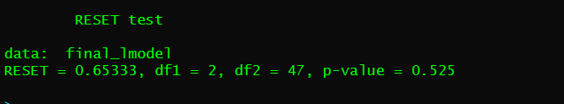
Model Iteration 4
Applying log transformation to model variables in order to increase linearity.
The final (log-transformed) model passes the RESET test which indicates linearity in the model.
The final model has an adjusted R-squared value of 92.79%.

Slide 17
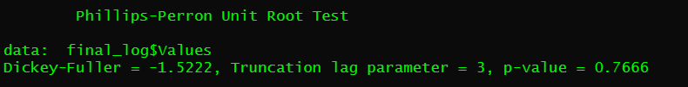
Phillips-Peron Test
We assess Stationarity of the values using the Phillips-Perron Test
H0 : The model values are stationary
H1 : The model values are not stationary
We fail to reject the null hypothesis, i.e., the model values are stationary.

Slide 18
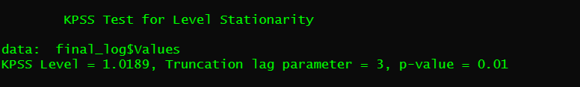
Kwiatkowski–Phillips–Schmidt–Shin (KPSS) test
The Kwiatkowski–Phillips–Schmidt–Shin test is used for testing a null hypothesis that an observable time series is stationary around a deterministic trend.
H0 : The model values are stationary
H1 : The model values are not stationary
We reject the null hypothesis, i.e., the model values are not stationary.

Slide 19
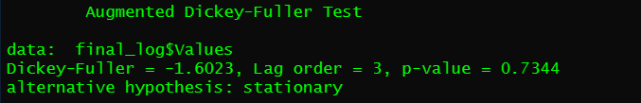
Augmented Dickey-Fuller (ADF) Test
ADF Test is a common statistical test used to test whether a given Time series is stationary or not.
H0 : The model values are not stationary
H1 : The model values are stationary
We fail to reject the null hypothesis, i.e., the model values are not stationary.

Slide 20

Variance Inflation Factor (VIF)
Variance inflation factor (VIF) is a measure of the amount of multicollinearity in a set of multiple regression variables.
The VIF values are < 5, and thus we conclude that multicollinearity does not exist.

Slide 21
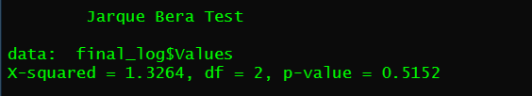
Jarque Bera Test
the Jarque–Bera test is a goodness-of-fit test of whether sample data have the skewness and kurtosis matching a normal distribution.
H0 : Skewness and kurtosis match a normal distribution.
H1 : Skewness and kurtosis do not match a normal distribution.
We fail to reject the null hypothesis, i.e., the data appears to be normally distributed.

Slide 22
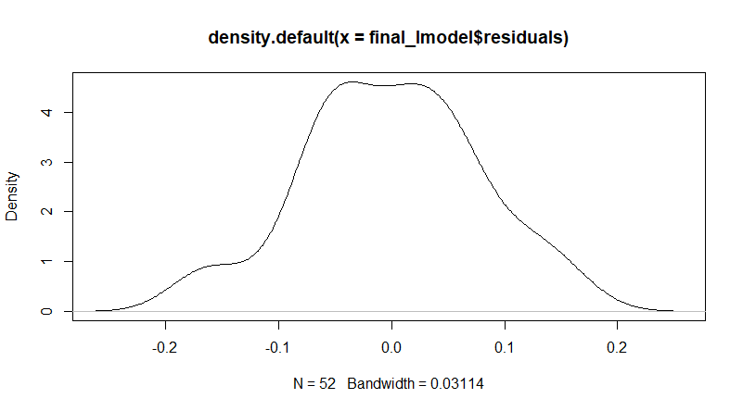

Shapiro Wilk Test
The Shapiro-Wilk test is a way to tell if a random sample comes from a normal distribution.
H0 : The random sample comes from a normal distribution.
H1 : The random sample does not come from a normal distribution.
We fail to reject the null hypothesis, i.e., the random sample comes from a normal distribution.

Slide 23
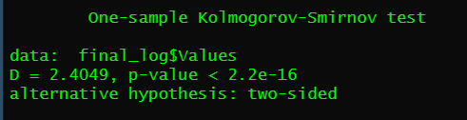
Kolmogrov-Smirnov (KS) Test
The Kolmogorov-Smirnov test is used to decide if a sample comes from a population with a specific distribution. Here, we have tested it with a normal distribution.
H0: Sample comes from a normal distribution.
H1: Sample does not come from a normal distribution.
We fail to reject the null hypothesis, i.e., it indicates that the values are not from a normal distribution.

Slide 24
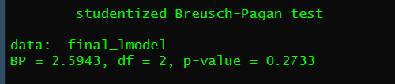
Breusch Pagan Test
The Breusch-Pagan Test is used to test for heteroscedasticity in a linear regression model.
Heteroscedastity - when the standard deviations of a predicted variable, monitored over different time periods, are non-constant.
H0: Values are Homoscedastic (constant standard deviation)
H1: Values are not Homoscedastic (they are heteroscedastic)
We fail to reject the null hypothesis, and conclude that the residuals are homoscedastic.
-

Slide 25

Durbin-Watson Test
The Durbin Watson (DW) statistic is a test for autocorrelation in the residuals from a statistical model or regression analysis.
H0 : There is no autocorrelation between residuals
H1 : There is autocorrelation between residuals.
We reject the null hypothesis, i.e., there is evidence of autocorrelation between residuals.

Slide 26
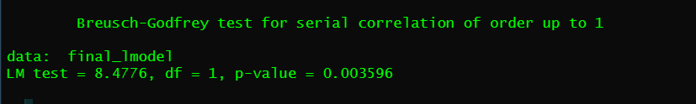
Breusch Godfrey Test
One of the key assumptions in linear regression is that there is no correlation between the residuals.
H0 : There is no autocorrelation.
H1 : There exists some autocorrelation.
We reject the null hypothesis, i.e., there is evidence of autocorrelation between residuals.

Slide 27
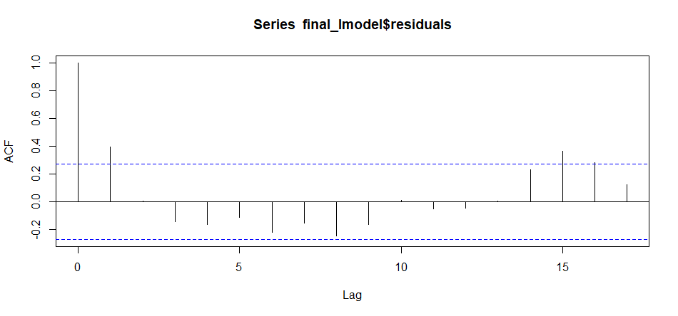
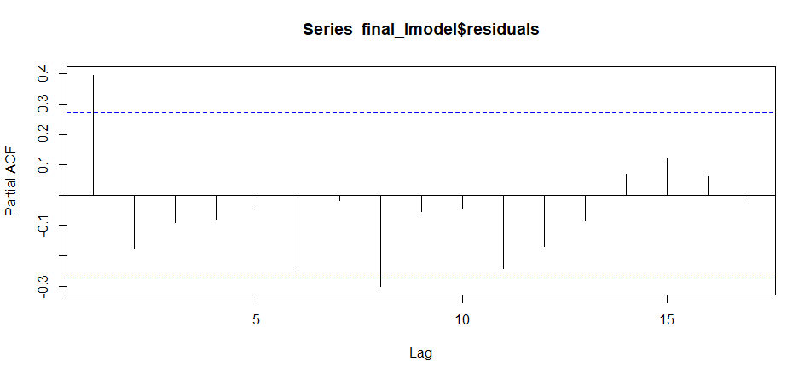
Auto Correlation Function (ACF) and Partial ACF Plot
ACF values die out at lag 1.
PACF values die out at lag 8.

Slide 28
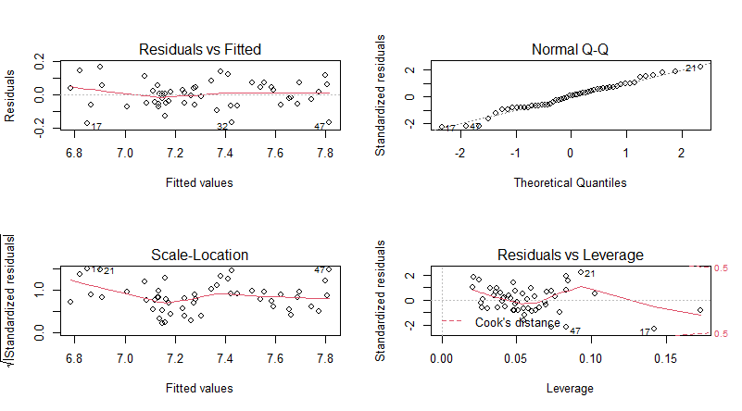
Model analysis
There is a straight line between residuals and fitted values indicating that there is a linear relationship between them.
Model residuals have passed normality test.
Plot shows presence of heteroscedasticity.
There is no significant outlier present.

Slide 29
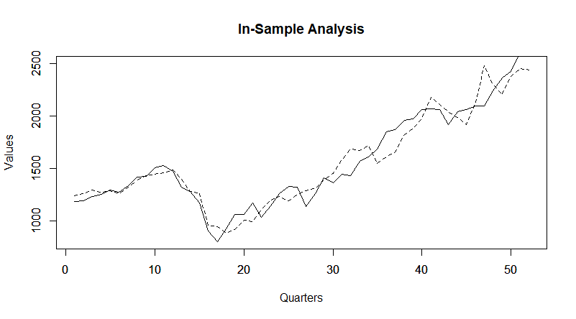
In-Sample Analysis
The solid line represents the actual values, and the dotted line represents the fitted values.
MSE (Mean Squared Error) = 15227.82
RMSE (Root Mean Squared Error) = 123.4011
MAPE (Mean Absolute Percentage Error) = 6.25%
The major upward and downward movements in the actual values are reflected in the fitted values.
The model has an MAPE less than 10%, which makes it a reasonable fit.

Slide 30
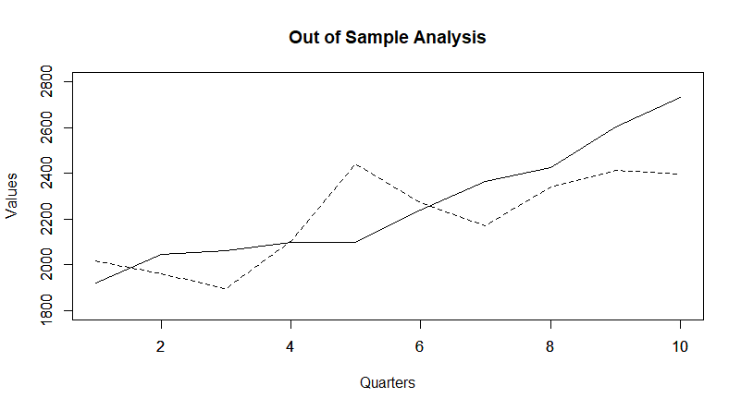





Out-of-Sample Analysis
The solid line represents the actual values, and the dotted line represents the fitted values.
MSE (Mean Squared Error) = 35380.15
RMSE (Root Mean Squared Error)= 188.0961
MAPE (Mean Absolute Percentage Error) = 6.62%
The predicted values hover around the actual values in most of the areas.
The model has an MAPE less than 10%, which makes it a reasonable fit.

Slide 31
Test | Summary
RESET Test | Linear
Phillips Peron Test | Stationary
ADF Test | Not Stationary
KPSS Test | Not Stationary
VIF | No multicollinearity
Jarque Bera Test | Normal
Shapiro Wilk Test | Normal
KS Test | Not Normal
Breusch Pagan Test | Homoscedastic Residuals
Durbin Watson Test | Autocorrelation between residuals
Breusch Godfrey Test | Autocorrelation between residuals
In-Sample Analysis | MSE = 15227.82 RMSE = 123.4011 MAPE = 6.25%
Out-of-Sample Analysis | MSE = 35380.15 RMSE = 188.0961 MAPE = 6.62%

Slide 32
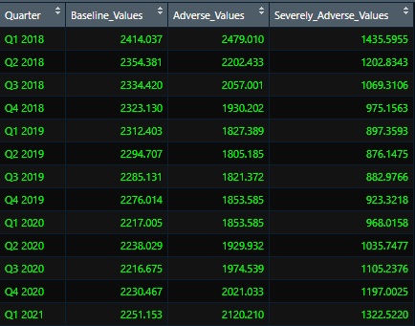
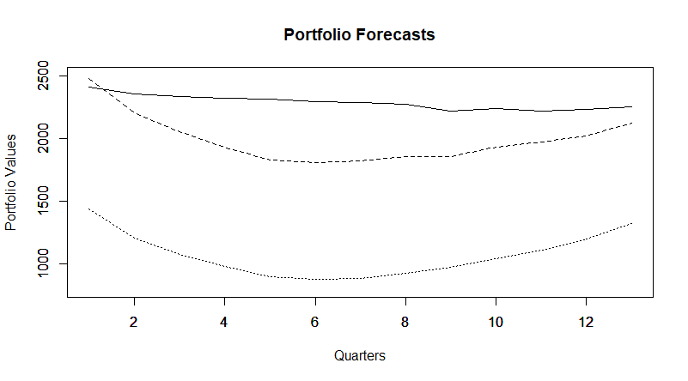
Portfolio Forecasts
The solid line represents the baseline predictions, the dashes represent the adverse predictions, and the dotted line represents the severely adverse predictions.

Slide 33


Capital Requirement at Portfolio Level (CRP)
On the basis of this,
CRP = USD 166.2034 Million

Slide 34
Thank You!!
R Project
Kshitij Srivastava

