Slide 1

Statistical modelling in R
Project on
Comprehensive Capital Analysis Review (CCAR)
D Gunavanth Mahendra

Slide 2

process
Model Testing
Final Deployment
Correlation Analysis
Model Building
Data Cleaning and Exploratory Data Analysis
Exploratory Data Analysis

Slide 3
Data cleaning and
Exploratory data analysis

Slide 4
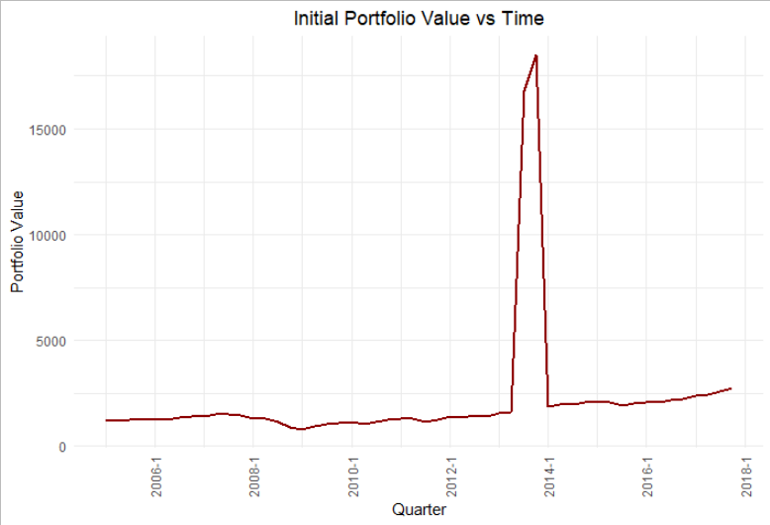
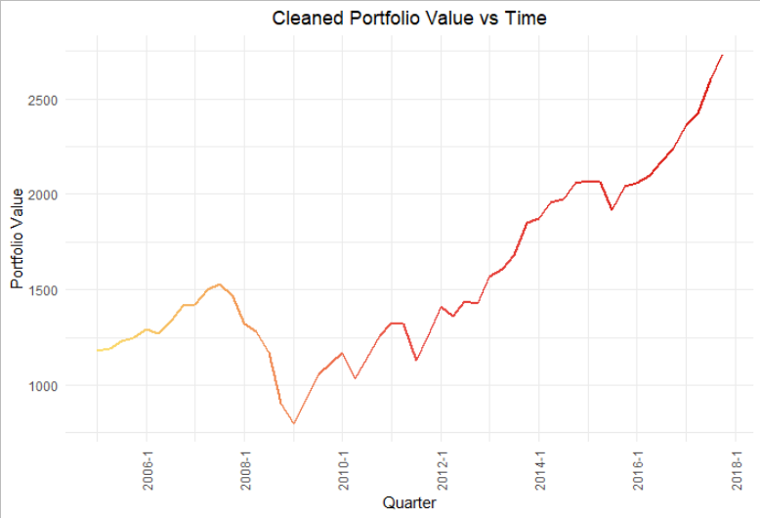
The initial graph has some discrepancies.
Missing values at Q4 2009 and Q3 2016 obtained by interpolation.
Irregular values at Q3 and Q4 2013 normalised by moving decimal point.

Slide 5
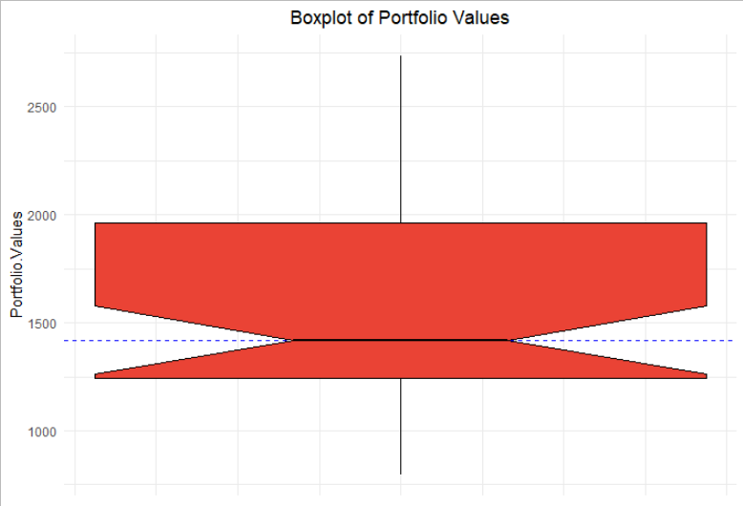
Summary Statistics of the data are as follows:
Mean: $1562.934
Median: $1419.58
Standard Deviation: $463.7314

Slide 6
Correlation Analysis

Slide 7
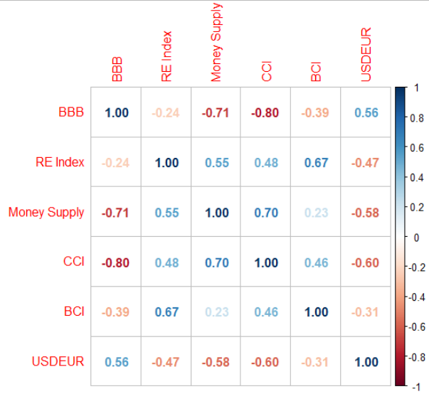
Upon initial analysis we see that these variables qualify the correlation threshold barrier of 0.6:
  BBB Corporate Yield (BBB)
  Real Estate Index (RE)
  Money Supply (MS)
  Consumer Confidence Index (CCI)
  Business Confidence Index (BCI)
  USDEUR Exchange Rate (USDEUR)
On further analysis in relation to multicollinearity within the variables, we find that the pairs (BBB, MS), (BBB, CCI), (CCI, MS), and (BCI, RE) breach the 0.6 threshold.

Slide 8
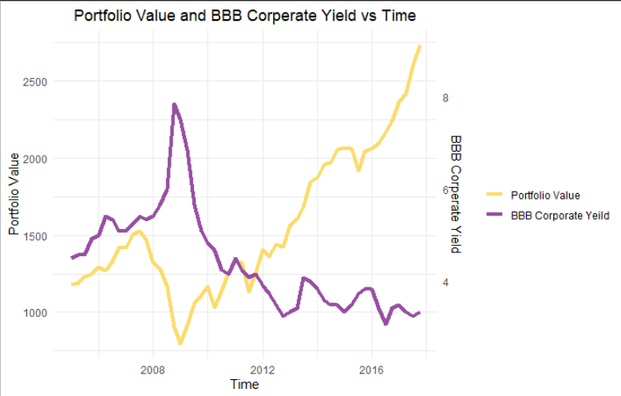
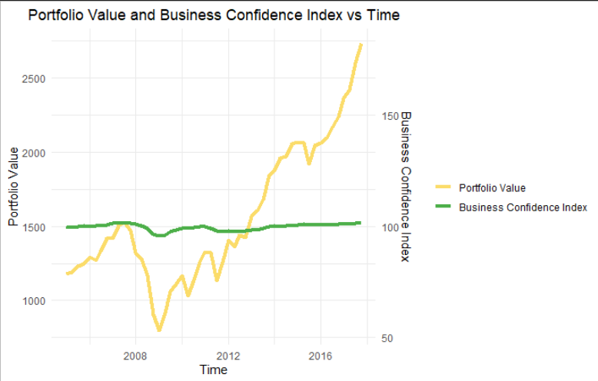
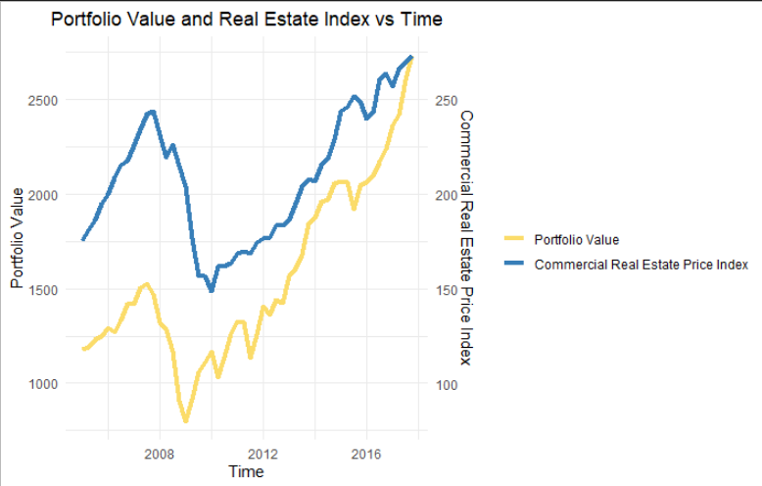
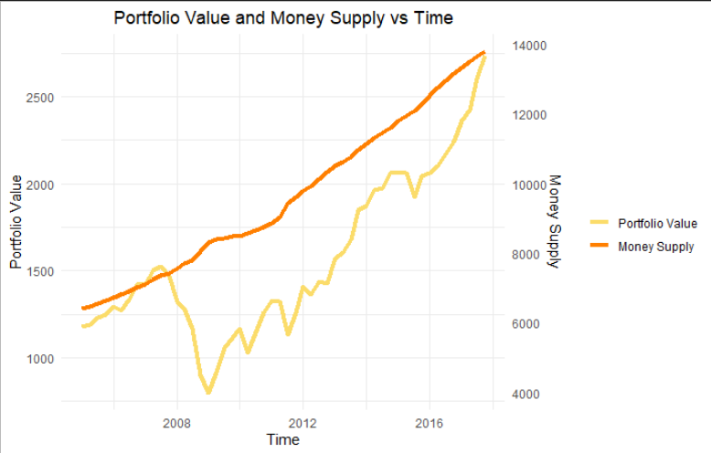
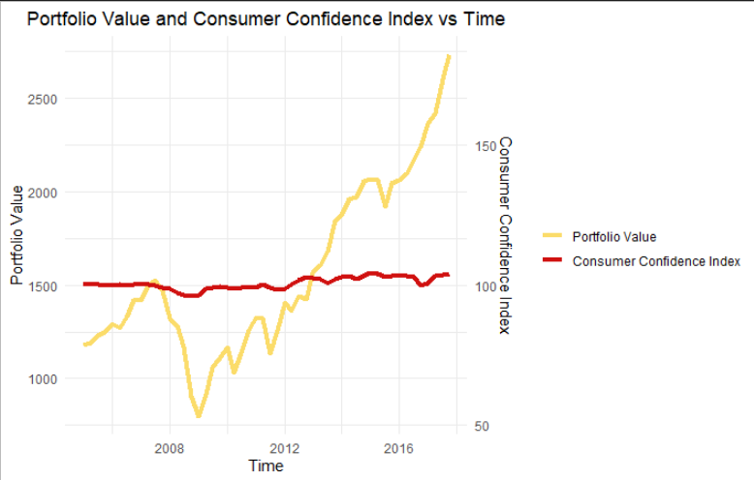
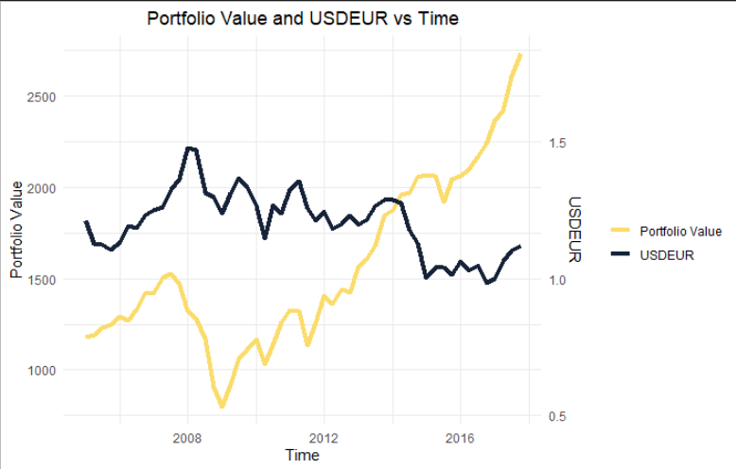
Highly correlated variables vs portfolio value

Slide 9
Model Building

Slide 10

Model 1
Model summary
Initial model made by discarding Money Supply as covariate.
Model Formula:
$PV= α+ β_{1}BBB+ β_{2}RE+β_{3}CCI+ β_{4}BCI+ β_{5}USDEUR$
 | Estimate | Standard Error | P – value
Intercept | -1707.4132 | 2563.7383 | 0.5087
BBB | -170.3159 | 26.8638 | 8.94e-08 ***
RE | 8.2727 | 0.8534 | 1.08e-12 ***
CCI | 34.9014 | 17.0428 | 0.0463 *
BCI | -12.6256 | 18.6890 | 0.5027
USDEUR | 121.0510 | 202.0077 | 0.5520
Adjusted R Squared: 0.917

Slide 11

Model 2
Model summary
Removing insignificant variables USDEUR and BCI.
Model Formula:
$PV= α+ β_{1}BBB+ β_{2}RE+β_{3}CCI$
 | Estimate | Standard Error | P – value
Intercept | -2710.5448 | 1724.1416 | 0.1225
BBB | -161.9066 | 24.4895 | 2.9e-08 ***
RE | 7.8067 | 0.6169 | < 2e-16 ***
CCI | 34.4669 | 16.6673 | 0.0441 *
Adjusted R Squared: 0.9193

Slide 12

Model 3
Model summary
BBB is more significant than CCI.
We exclude CCI to remove any multicollinearity.
Model Formula:
$PV= α+ β_{1}BBB+ β_{2}RE$
Ramsay Reset Test p-value: 4.228e-05 (Indicates misspecification).
 | Estimate | Standard Error | P – value
Intercept | 840.582 | 159.295 | 2.97e-06 ***
BBB | -202.564 | 15.081 | < 2e-16 ***
RE | 8.437 | 0.554 | < 2e-16 ***
Adjusted R Squared: 0.9139

Slide 13

Model 4
Model summary
Model 3 does not pass the Ramsey RESET test. Hence, we perform a log transformation on the dependent variable.
Model Formula:
$log PV= α+ β_{1}BBB+ β_{2}RE$
Ramsay Reset Test p-value: 0.2115
 | Estimate | Standard Error | P – value
Intercept | 7.000177 | 0.083387 | < 2e-16 ***
BBB | -0.139067 | 0.007895 | < 2e-16 ***
RE | 0.004934 | 0.000290 | < 2e-16 ***
Adjusted R Squared: 0.9393

Slide 14

Model summary
Final Model
 | Estimate | Standard Error | P – value
Intercept | 3.44342 | 0.39744 | 1.88e-11 ***
Log BBB | -0.81726 | 0.05071 | < 2e-16 ***
Log RE | 0.97473 | 0.06851 | < 2e-16 ***
Building on model 4, we perform further transformations to better out model.
Model Formula:
$log PV= α+ β_{1}log(BBB)+ β_{2}log(RE)$
Ramsay Reset Test p-value: 0.5181
Adjusted R Squared: 0.9252
anova
 | DF | Sum of Squares | Mean Sum of Squares | P – value
Log BBB | 1 | 2.69092 | 2.69092 | < 2.2e-16 ***
Log RE | 1 | 1.26633 | 1.26633 | < 2.2e-16 ***
Residuals | 49 | 0.30653 | 0.00626

Slide 15
Model testing

Slide 16
Condition | Test | DF | P-Value | Conclusion
Stationarity | ADF Fuller | NA | 0.9355 | Not Stationary
Linearity | Ramsey RESET | (2, 47) | 0.5181 | Linear
Multicollinearity | Variance Inflation Factor | NA | NA | No Multicollinearity
Normality | Jarque Bera | 2 | 0.8392 | Residuals are normally distributed
 | Shapario Wilk | NA | 0.7 | Residuals are normally distributed
Heteroskedasticity | Breush Pagan | 2 | 0.113 | No heteroskedasticity is present
Auto – Correlation of errors | Durbin - Watson |  | 0 | Autocorrelation is present
Quantitative tests

Slide 17
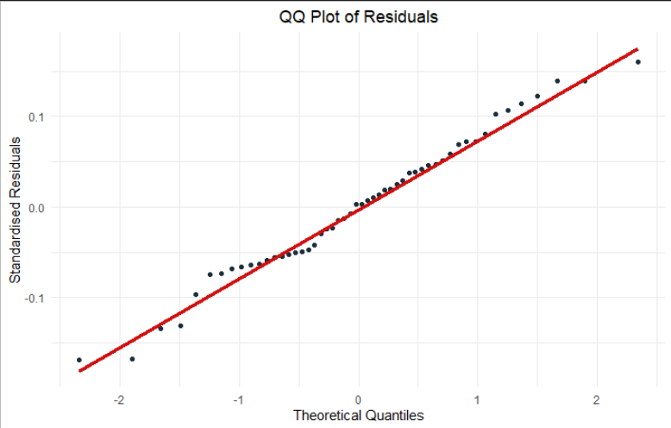
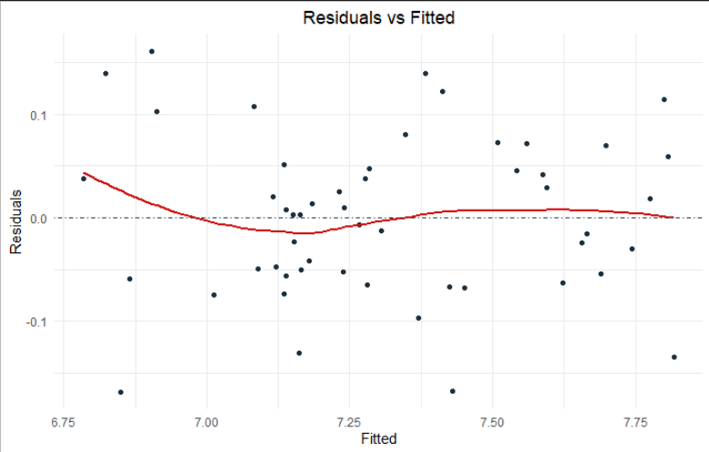
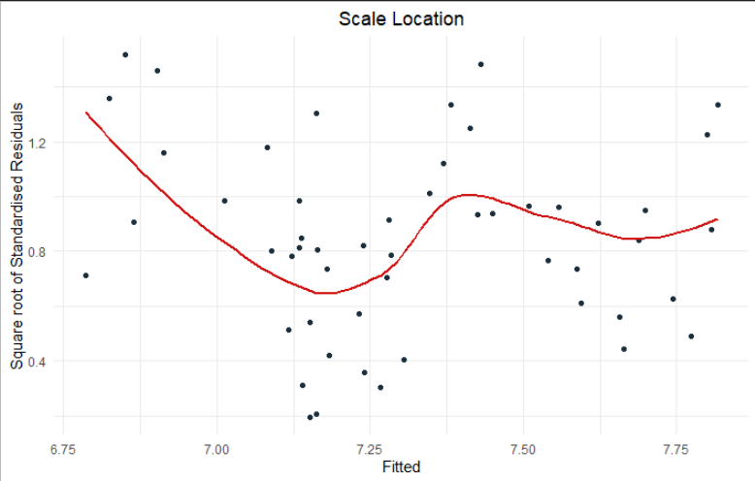
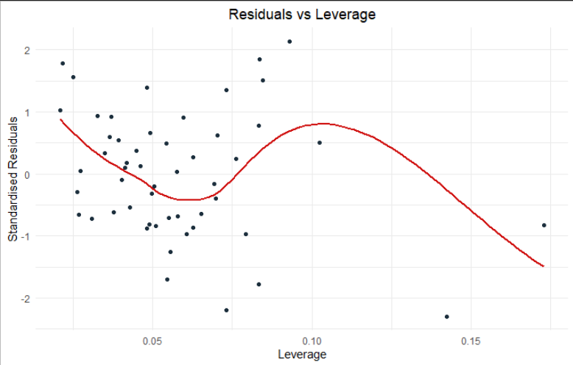
Qualitative tests

Slide 18
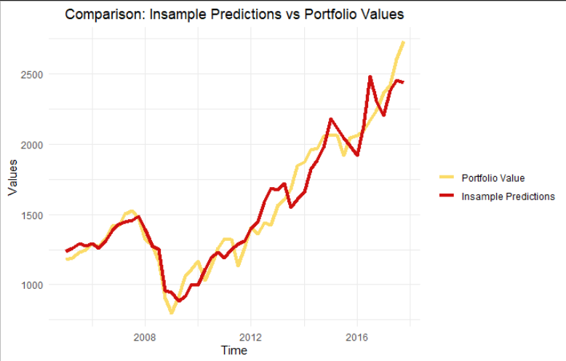
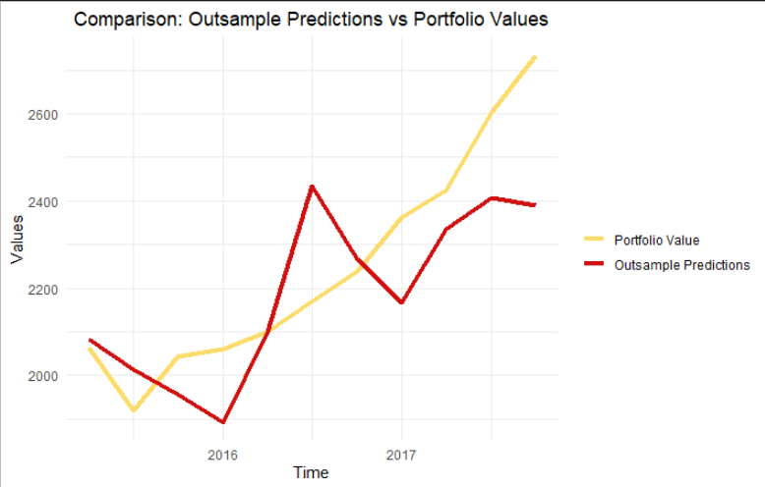
In-sample Analysis:
Used same data as training for prediction.
MAPE = 6.279519%
MSE = 14491.18
RMSE = 120.3793
Out-sample Analysis:
Split data into training and testing sets.
Training: Up to Q1 2015
Testing: Q1 2015 to Q4 2017
MAPE = 5.793201%
MSE = 28990.97
RMSE = 170.2674

Slide 19
Final deployment

Slide 20
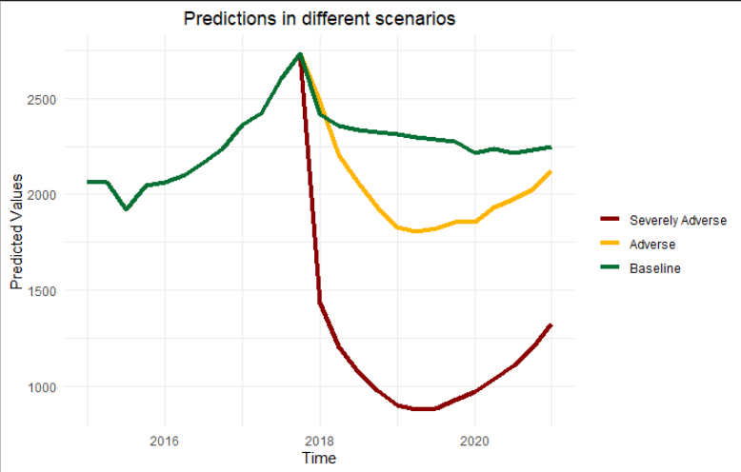

results
Using Q4 2017 as the base value we get the following predictions:
 | Baseline | Adverse | Severely Adverse
Base Value | 2733.48
Expected Value (after 9 Quarters) | 2216.089 | 1855.857 | 970.2475
Expected 9 Quarter Loss | 517.3909 | 877.6234 | 1763.233
Using the formula:
$$CRP = 0.2 \left[\begin{aligned}0.5 ∗E9Q\left(Baseline\right)+ \\ 0.35 ∗E9Q\left(Adverse\right)+ \\ 0.15∗E9Q\left(Severely Adverse\right)\end{aligned}\right]$$
The Capital Requirement for the portfolio is
$166.0697 Million.

Slide 21
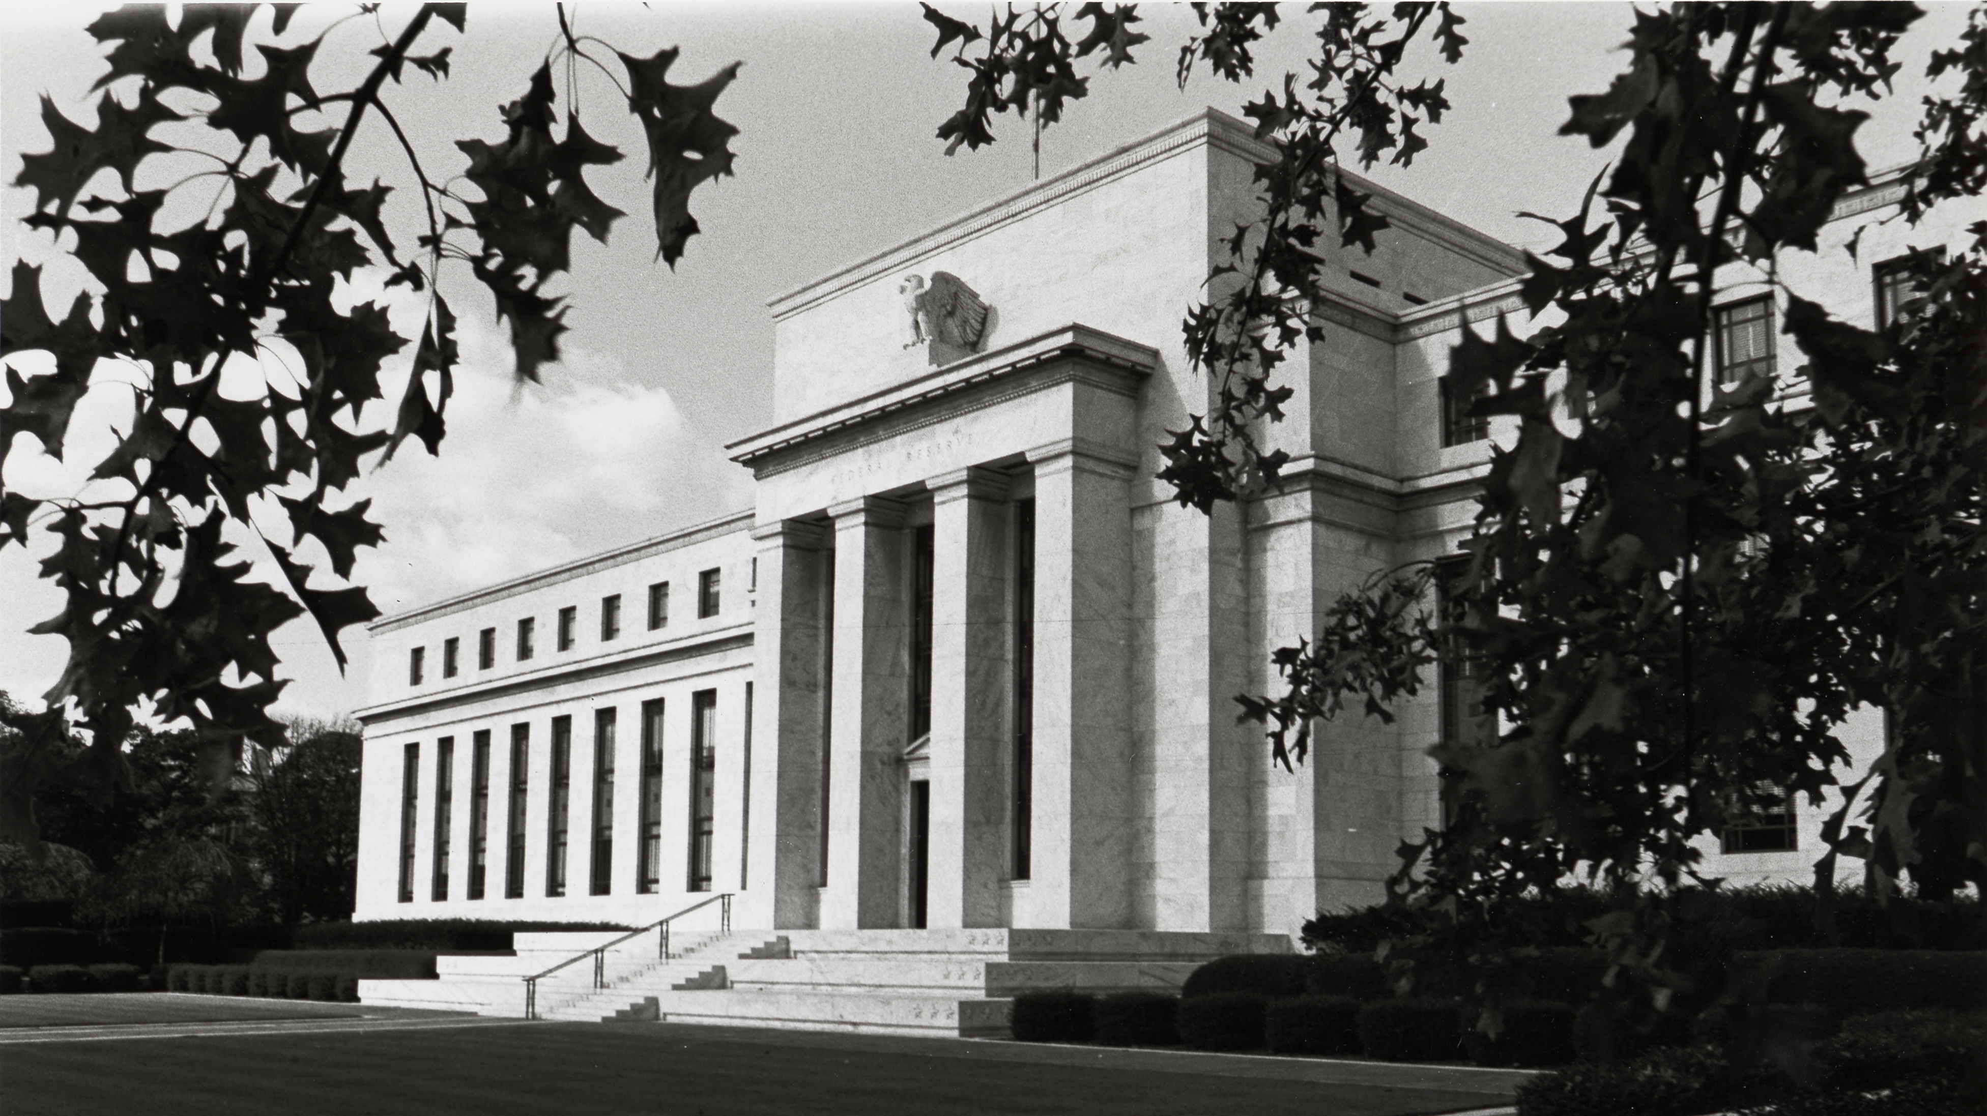
Thank you

