Slide 1
Use of Calculus in Calculating time of death of a dead body during post mortem report
Calculus Project

Slide 2
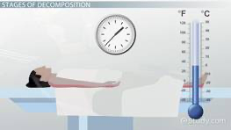
Intro- Algor Mortis
When someone dies there are several stages a body goes through as it decomposes over the first 24 to 48 hours. These stages assist medical examiners in determining how long a body has been dead. Algor mortis is the second stage and means ''coldness of death''. This is where the body starts to cool down in temperature and this stage lasts for a few hours. The stage does not start till 30 minutes to an hour after death.
A measured rectal temperature can give some indication of the time of death. The rate of change is affected by several key factors, including:
Fluctuation of the ambient temperature
Thickness and body coverage of clothing or similar materials.
Thermal conductivity of the surface on which a body lies.

Slide 3
Procedure
Algor Mortis, alongside Rigor and Livor Mortis, is a sign that appears within the first 24 hours after death, and for it to be considered a proof is important to be exploited and assessed as diligently as possible. Needless to say, the more time has elapsed between the time of death and the acknowledgement of Algor Mortis, the less reliable this method will be in providing an answer.
In opposition to the remaining two stages, Algor Mortis is considered to be the most useful single indicator in the post-mortem interval during the first day after death.
Algor Mortis stands for the gradually cooling off of the body until reaching equilibrium with the ambient environment, whether this is the ground, the water or an indoor location and from here conclusions over the method’s range of applicability can be easily drawn.
In terms of body’s decline until matching the surrounding temperature, common sense has it, a body will register a distinctive evolution if it is found in Pskov, Russia at -22° C, in comparison to one found in Abu Dhabi, United Arab Emirates at +35°C. As stated, thus the use of this method is only possible in cool and temperate climates, because in tropical regions there may be a minimal fall in body temperature post-mortem, and in some extreme climates, such as desert regions, the body temperature may even rise after death.

Slide 4
Estimating the time of death
Following Newton’s cooling rate rule as adapted for estimating the time of death, we can showcase this with a few dummy applications of Algor Mortis as a measurement tool in calculating the time of death. According to Algor Mortis table reference for bodies submerged under water, for the first twelve hours, the body’s temperature drop is of 1.6° Celsius per hour, and after the first twelve hours, the loss is of 0.8° C per hour. The difference in degrees between a corpse that has been found after twelve hours or under twelve hours since its death is that of a specific temperature loss of 19.2° C registered after twelve hours. This stands for a starting point to relate to when estimating the time the person passed away. Any higher temperature drop will subsequently lead to the suspicion of a death occurred at least twelve hours earlier.Adding the normal body temperature of 37°C, a formula takes shape. The post-mortem interval would equal the normal body temperature minus the internal temperature of the cadaver when found, and the result will be divided according to the rate of temperature fall per hour. As an example, let us suppose a body was found underwater and when brought to surface had a temperature of 29°C.The difference of 8° C lost will be divided using the 1.6° C rate drop since the degrees lost show us that the death has happened recently, in less than twelve hours ago. The calculation should approximate five hours’ time since death.Let us suppose another body was found in the same conditions and had a temperature of 13°C. First and foremost, in this advanced stage of Algor Mortis easily recognizable due to the significant temperature drop, it is obvious that the body has been dead for more than twelve hours. We prove this as we find out the difference between the normal body temperature and the one measured last. The result is 24°C. Because the degrees lost are greater than 19.2°C we can assume that the human died more than twelve hours ago and now it is time to find out in how much time the body has lost the remaining 4.8°C degrees. Since the loss per hour after the first twelve hours is of 0.8°C, in this case, the degrees were lost in around six hours’ time. Bringing both results together would mean a total of eighteen hours period since the death of the second body.

Slide 5
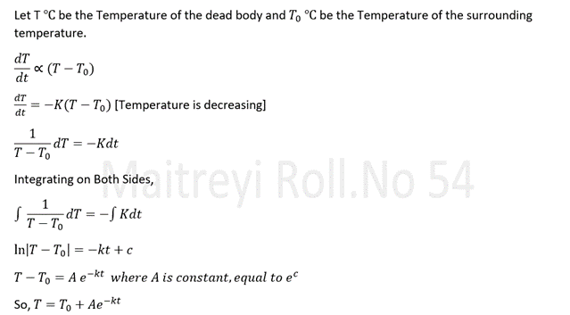
Examples of Algor Mortis
Let’s take an example of dead body whose temperature was found to be 31 degree Celsius.One Hour later the temperature of the body was 30 degree Celsius. The Temperature of the Room at that time of calculations was 22 degree Celsius. With this readings taken, the Time of Death can be calculated by Algor Mortis as follows:

Slide 6
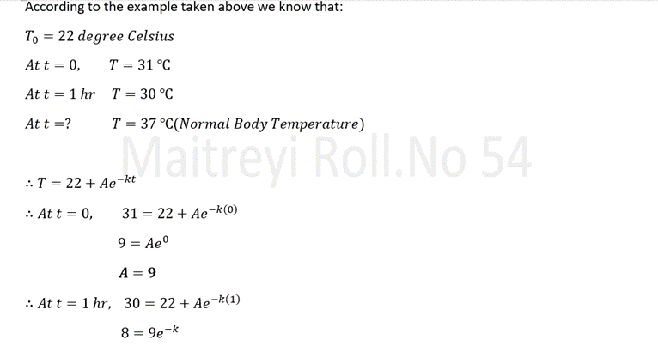
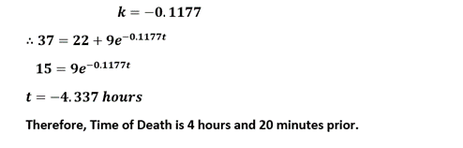
Example of Algor Mortis [Contd]

Slide 7
Examples of Algor Mortis[Contd]
2.
After a busy evening of income calculations an accountant was found dead in his office. At 10:00 a.m. the coroner measured the body temperature to be 85.6 degree fahrenheit,then again at 12:00 p.m.it was 82.6 degree fahrenheit. The room temperature was measured to be constant 70 degree fahrenheit.
*Assuming the body temperature at death was 98.6 degree fahrenheit.What would the estimated time of death to the nearest minute be?

Slide 8
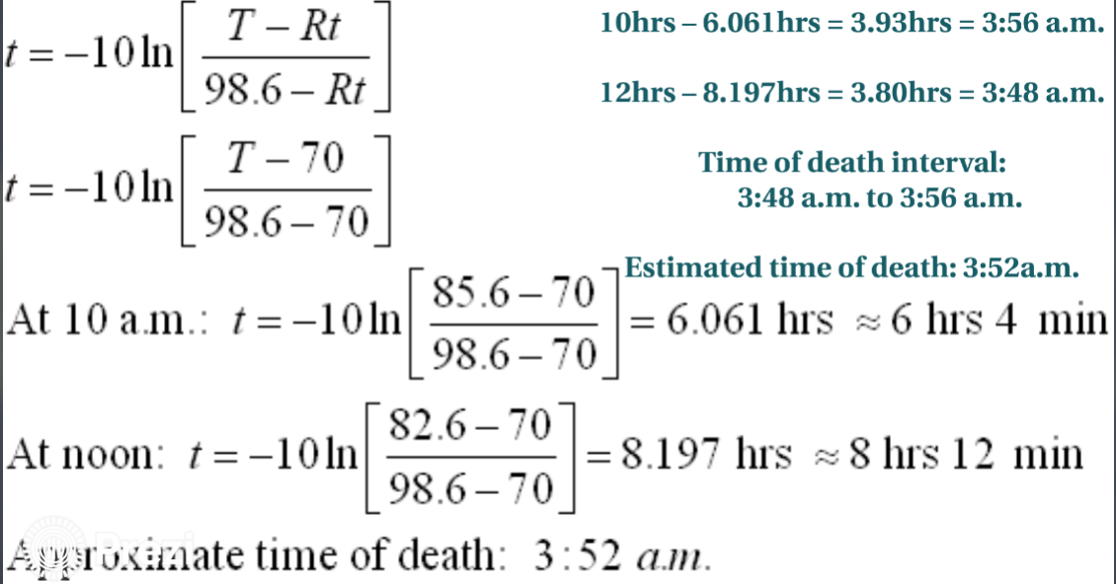
Examples of Algor Mortis[Contd]

Slide 9
Conclusion:Algor Mortis
As we know that,in Algor Mortis,the time of death is determined by the temperature of the body.
The temperature of the body is maintained by the blood vessels in the inner layer of skin.when the heart stops beating,the blood does not flow through the vessels and the temperature of the body keeps dropping by certain amount.
Immediately after death,the temperature of the body keeps dropping by 2 degrees and drops by 1 degrees every hour(only if the surrounding temperature is less than 37 degrees).Algor Mortis does not tell the exact time of death because of different external conditions such as temperature,clothing,position of death,etc.though the time segment can be found out.
This concludes that,exact time cannot be found by Algor Mortis.

Slide 10
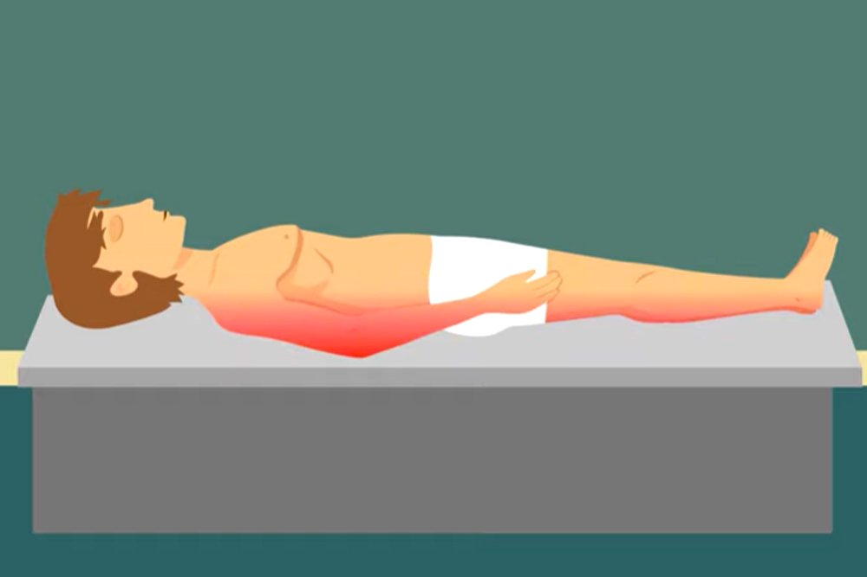
Livor Mortis
Livor mortis, also known as post-mortem lividity or post-mortem hypostasis, refers to the pooling of blood in the lower portion, or dependent parts, of the body after death. This results in a dark purple discoloration of the skin. Livor mortis is one of the post-mortem signs of death and occurs as a result of the heart no longer pumping and moving blood through parts of the body. Consequently, gravity causes the red blood cells to sink and pool in the dependent parts of the body.

Slide 11
Conclusion:Livor Mortis
After Death,blood is subject to the force of gravity as the heart is not moving it around any longer.It pools wherever the forces of gravity is strongest.This starts 15-30 mins after death and is visible 2 hours after death.The blood vessels breakdown after some time and the blood starts to collect.8-12 hours after death the blood becomes purple in colour.Once this happens the blood does not move and gets fixed at a place even when the body is moved.
Livor Mortis makes it easy to determine the perfect time of death and even the cause of death can be found out.Blood accumulated at the fingers and foot tells that the death occured when the body was straight upright,blood accumulated at the back tells us that the death occured when the body was lying on the back.
Livor Mortis makes it easy to find the exact time and cause of death.

Slide 12
Details of Group
Roll No. 51– -
Roll.No.52-Tirth Parmar- Slide No. 3 and 4
Roll. No 53-Aaradhya Patil-Slide No. 9 and 11
Roll No. 54- Maitreyi Pawar- Slide No. 5 and 6
Roll.No.55- Tanishtha Poddar- Slide No. 7 and 8
Roll. No 56- Mahe Popat Slide No. 2 and 10

