Slide 1


Application of interpolation in banking system
Roll Number : 19-24

Slide 2
GROUP MEMBERS
19. Rohit Dubey
20. Disha Dubhir
21. Devin Gupta 22. Kunal Gupta
23. Priyansh Gupta
24. Tarush Gupta

Slide 3
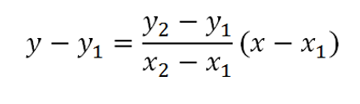
Definition
Interpolation is a type of estimation, of constructing (finding) new data points based on the range of a discrete set of known data points.
A method of fitting the data points to represent the value of a function.
A general formula for linear interpolation:

Slide 4
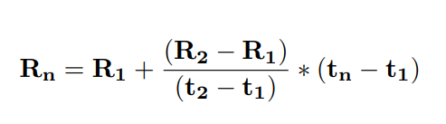
Linear Interpolation of Interbank Offered Rates
Interbank offered rates (Ex: SOFR) are benchmark interest rates at which a selection of banks can borrow and lend to one another in a given currency on a short-term basis.
However, these rates are only available for certain tenors thereby creating the need to interpolate rates for tenors without directly observable rates.
Given two known rates and their maturities, the following formula can be used to determine the unknown rate:
Where R1 is the shorter rate with known maturity, t1 is the number of days to maturity R1, R2 is the known rate with longer maturity, t2 is the number of days to maturity R2, Rn is the unknown rate between R1 and R2, and tn is the number of days to cashflow at time n.

Slide 5
Example
Today’s date is May 27th, 2022.
A bank needs to determine a SOFR rate with a maturity of July 8th, 2022, which is approximately 1.5 months from today.
Rate source is taken from www.sofracademy.com.
There is no current SOFR quote available for the required maturity,
Therefore, it is necessary to estimate the unknown rate by means of linear interpolation.
SOFR stands for Secured Overnight Financing Rate.

Slide 6
Solution
Rn= unknown SOFR, with maturity n.
The closest designated maturities available - one month (R1) and three months (R3),
Days to maturity of unknown rate (tn): 42
Today’s 1-month SOFR (R1): 0.63549%
Maturity date of R1: June 24th, 2022
Days to maturity of R1 (t1): 28
Today’s 3-month SOFR (R3): 0.35070%
Maturity date of R3: August 19th, 2022
Days to maturity of R3 (t3): 84
Rn = ((R1+R3-R1 ) / (t3 – t1)) x (tn-t1)
= 0.63549% + ((0.35070%- 0.63549%) / (84 – 28)) x (42-28)
= 0.5642925%
The interpolated rate is 0.5642925%, which lies between the two known rates.

Slide 7
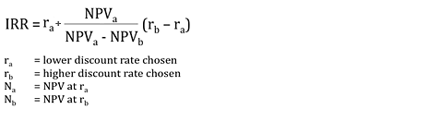
Internal Rate of Return (IRR)
Internal rate of return (IRR) is one of the capital budgeting techniques.
It is the discount rate at which the net present value of future cash flows becomes zero.
The percentage term of IRR can easily be compared with Weighted Average Cost of Capital (WACC). As the WACC or cost of capital is the base to decide, any rate of return greater than WACC would be acceptable.

Slide 8
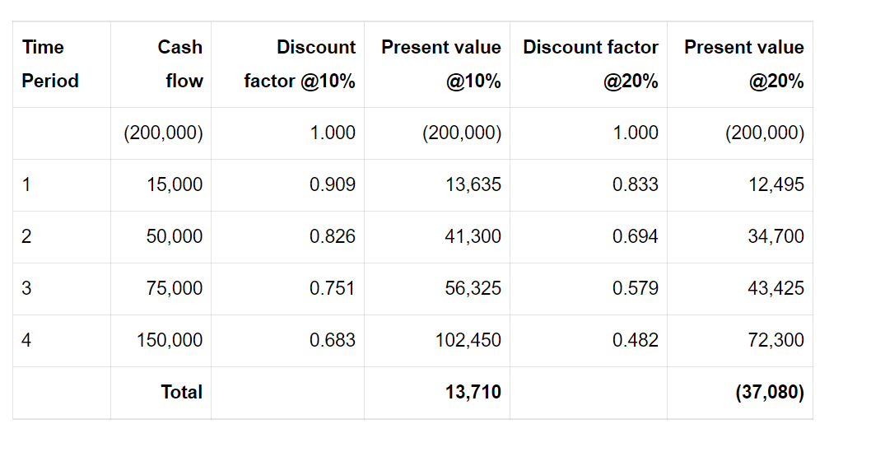
EXAMPLE
From the present value table above, we can calculate the IRR by using the above IRR formula as below:
IRR = 10% + [13,710 / (13,710 – ( – 37,080)] × (20%-10%)
IRR = 10% + [13,710 / 50,790] × 10%
Hence, IRR = 12.70 %

Slide 9
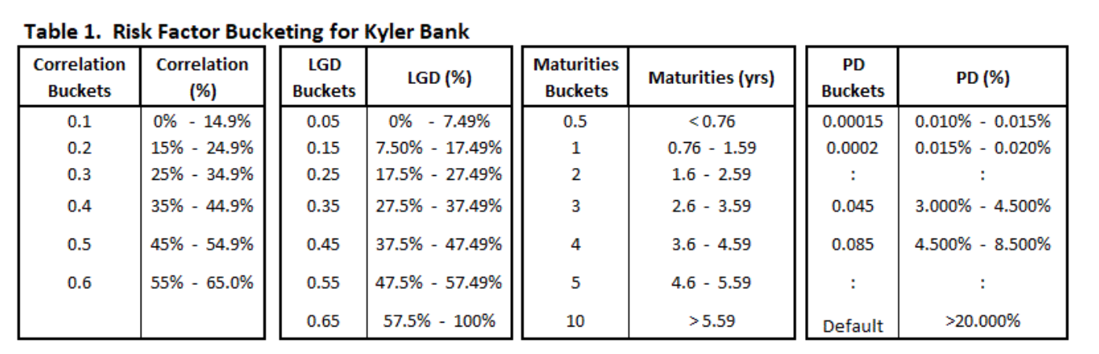
Using Multidimensional Linear Interpolation
to find Economic Capital Rates
In banking, Economic Capital (EC), is an internal measure of capital required to absorb unexpected losses while remaining solvent at a targeted solvency level. It provides a common basis for comparing risk-adjusted profitability and relative economic value of lines of business and asset classes with varying degrees and sources of risk.

Slide 10
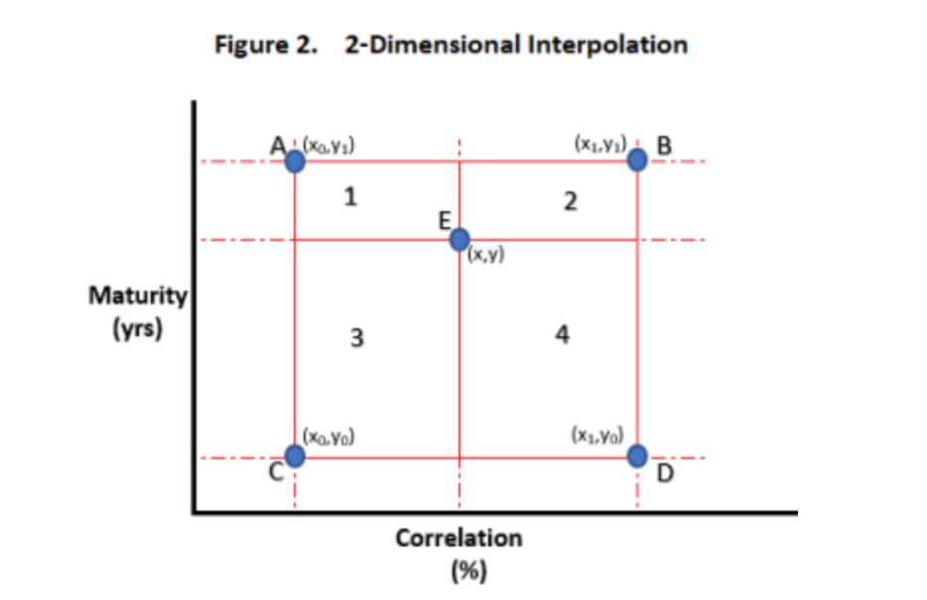
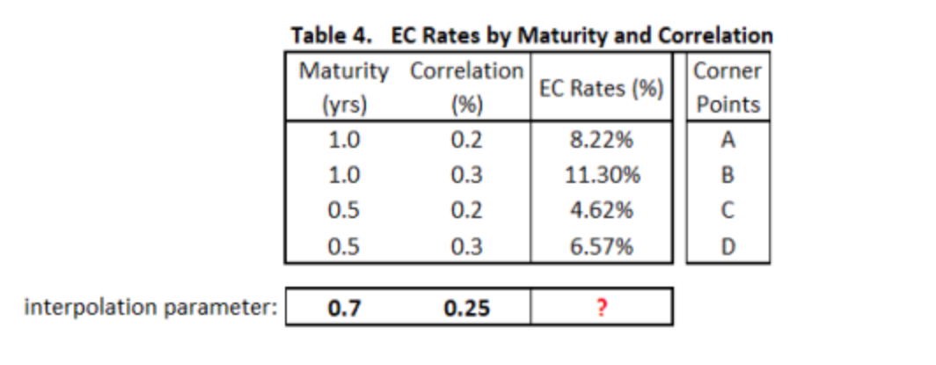
1) Bi-linear Interpolation
Bi-linear interpolation is an extension of linear interpolation applied to a two dimensional rectangular grid. A bi-linear interpolation is essentially a linear interpolation of 2 values that are already linearly interpolated values.

Slide 11
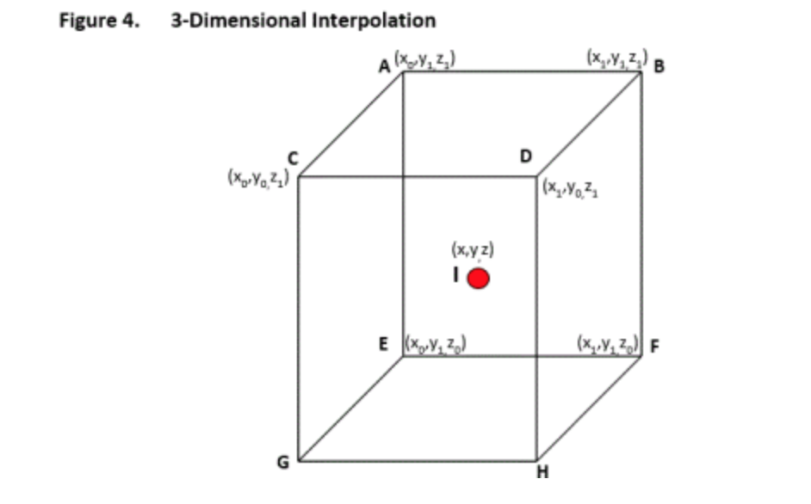
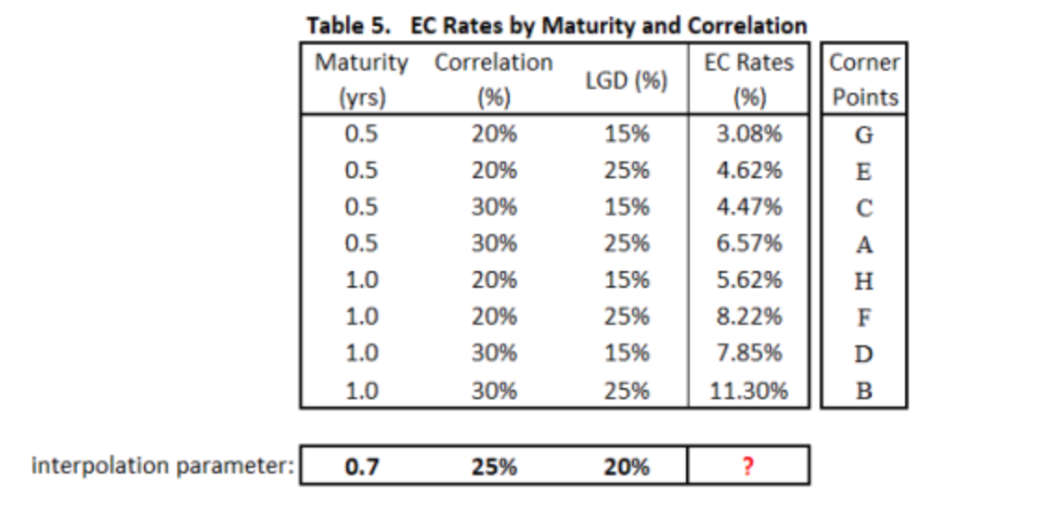
2) Tri-linear Interpolation
Tri-linear interpolation is a further extension of linear and bi-linear interpolation applied to a three dimensional rectangular prism. A tri-linear interpolation is a linear interpolation between 2 already bi-linear interpolated values. Tri-linear interpolation is a weighted average of 8 neighbouring points.

Slide 12
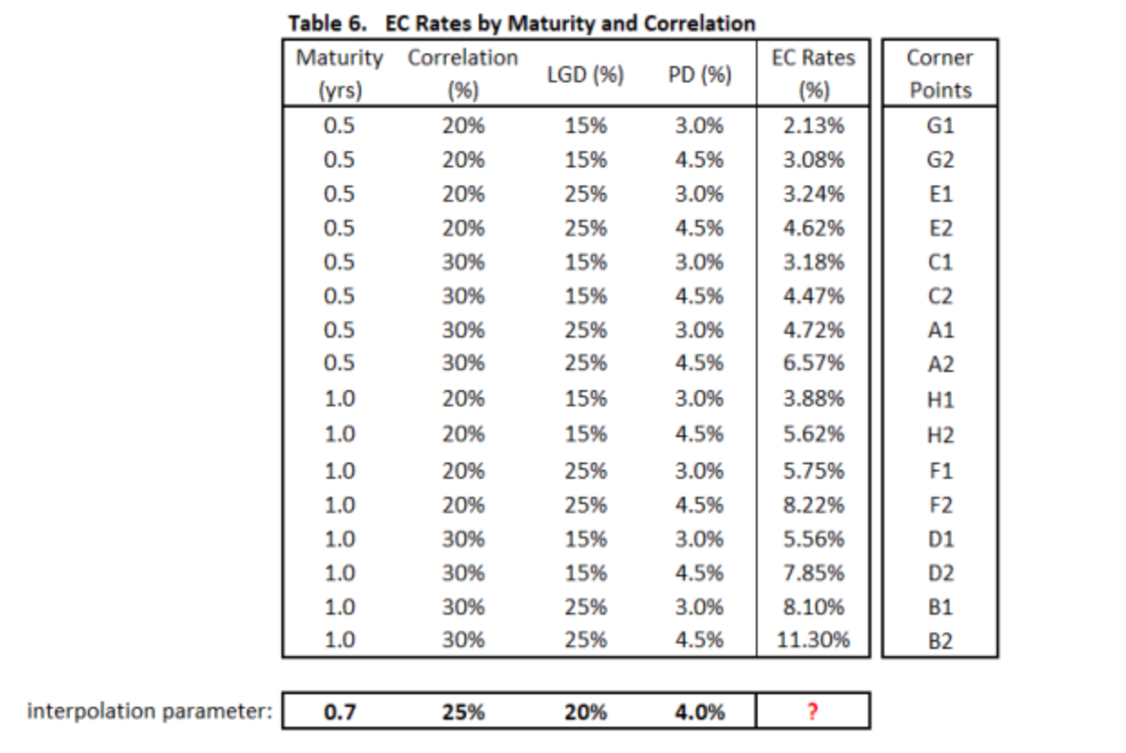
3) N-Dimensional Linear Interpolation
By now it is clear that the simple linear interpolation can be extended to much higher the
dimensions. While the same principles hold, at higher dimensions it becomes harder to visualize
The problem/solution and much more difficult to illustrate In closing, we show how to quickly
implement an example where we interpolate across four continuous variables: Term-to-Maturity,
Correlation, LGD, and PD.

Slide 13
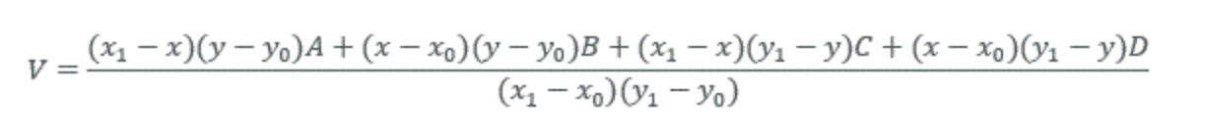
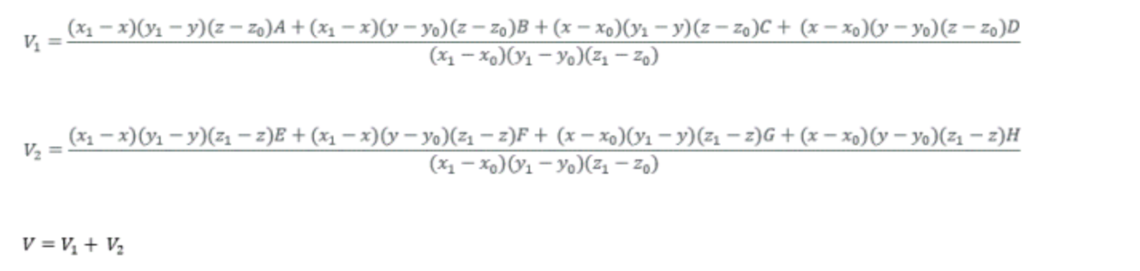
FORMULAS
1) Bi-linear Interpolation
2) Tri-linear Interpolation

Slide 14
Cubic Spline Interpolation
The idea of a spline interpolation is to extend the single polynomial of linear interpolation to higher degrees.
But unlike with piece-wise polynomials, the higher degree polynomials constructed by the cubic spline are different in each interval
Cubic spline interpolation is used along with linear interpolation to achieve “Smooth” Interest rate. "Smooth" means that the cubic spline interpolation is a continuously differentiable function, whereas the linear interpolation is merely a continuous function better Interest rate.

Slide 15

Formula for Cubic Spline Interpolation
If you compare the above expression with the linear interpolation, you will see that we have added two terms to the rhs. It is these extra terms that should allow us achieve greater precision.
Its is an alternative method to Linear Interpolation to estimate Interest Rates in Banks.

Slide 16
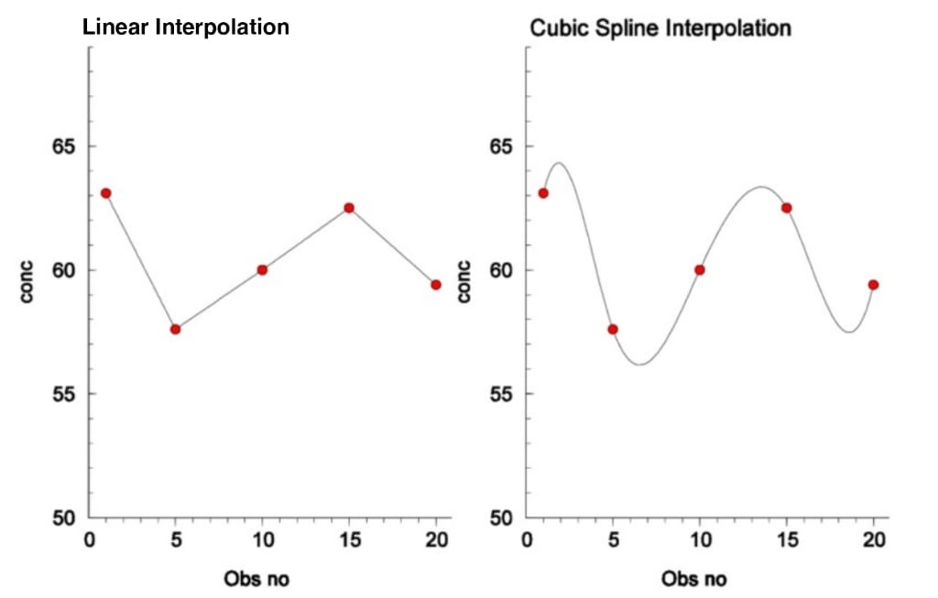
Linear Interpolation Vs Cubic Spline Interpolation

Slide 17
BIBLIOGRAPHY
https://papers.ssrn.com/sol3/papers.cfm?abstract_id=2908468
https://www.accountinghub-online.com/how-to-calculate-internal-rate-of-return-irr/
https://analyticsrusers.blog/2018/05/07/using-multidimensional-linear-interpolation-to-find-economic-capital-rates/
https://www.econstor.eu/bitstream/10419/100789/1/wp1997-10.pdf

Slide 18
THANK YOU!

