Slide 1
Geometric Progress in Population Forecasting
Roll No- 37 to 43

Slide 2
Index
Intro to Geometric Progression
Basic formulas
Population Growth and Forecasting
Application of gp in population growth
Numericals and Example
Source
Group Details

Slide 3


Geometric Progression
A geometric progression or a geometric sequence is the sequence, in which each term is varied by another by a common ratio.
The next term of the sequence is produced when we multiply a constant (which is non-zero) to the preceding term.
It is represented by :

Slide 4
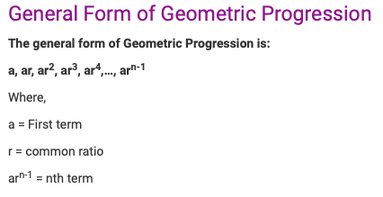
General Form of Geometric Progression

Slide 5
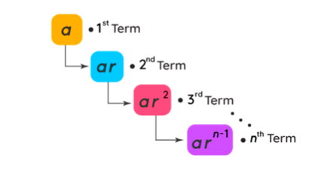

Slide 6
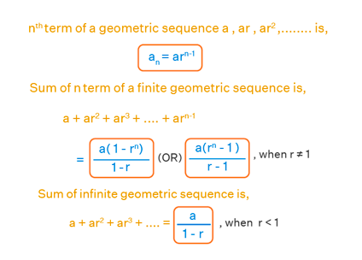
Formulas for Geometric Progression

Slide 7
Population Forecasting
Population forecasting is a method to predict/forecast the future population of an area.
It aids government and other organizations in future planning and proofing its services when developing them
Example,
“Design of water supply and sanitation scheme is based on the projected population of a particular city, estimated for the design period. Any underestimated value will make system inadequate for the purpose intended; similarly overestimated value will make it costly. “

Slide 8
Population Forecasting
The present and past population record for the city can be obtained from the census population records.
After collecting these population figures, the population at the end of design period is predicted using various methods as suitable for that city considering the growth pattern followed by the city.

Slide 9
Use of Geometric Progression In Population Forecasting
Geometric Increase Method is one such method that uses the principles of Geometric Progression in estimating the level of population.
In this method the percentage increase in population from decade to decade is assumed to remain constant.This method gives highest values of estimate
The constant rate assumed is called the population growth rate which acts as the ‘r’ in the GP

Slide 10
Example1 (For Finding Constant Growth Rate)
Example:
Suppose a town’s new population is 5,000,000, if the original population was 4,500,000, calculate the population growth rate.
Calculate Population Growth Rate.
Therefore, the population growth rate is 11%.

Slide 11
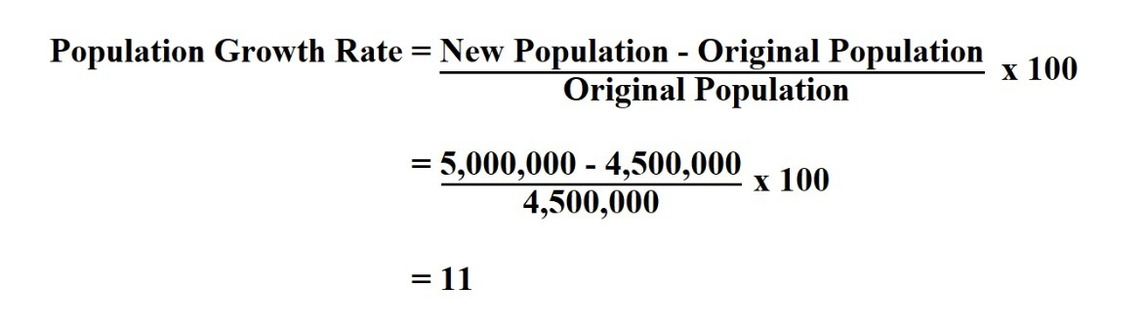
Example 1

Slide 12
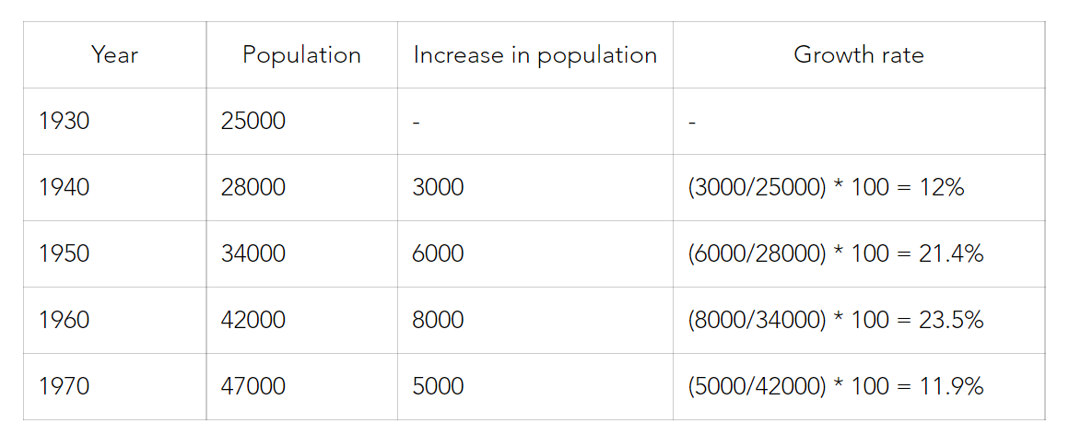
Example 2(Geometric Mean method in use)
Question: With the help of the common data find the population for the year 2020 using the Geometrical increase method.
Solution:
Step 1: Find the increase in population each decade.
Step 2: Find the growth rate.

Slide 13
Example 2
Step 3: Find the average growth rate (r) using geometrical mean.
r = ∜(12 * 21.4 * 23.5 * 11.9)
r = 16.37 %
Step 4: Find the number of decades (n) between the last known year and the required year
n = 5 (5 decades elapsed between 1970 and 2020)
Step 5: Apply the formula Pn = Po[1 + (r/100)]^n
P[2020] = P[1970][1 + (16.37/100)]^5
P[2020] = 47000[1.1637]^5
P[2020] = 1,00,300. Therefore, population at 2020 will be 1,00,300.

Slide 14
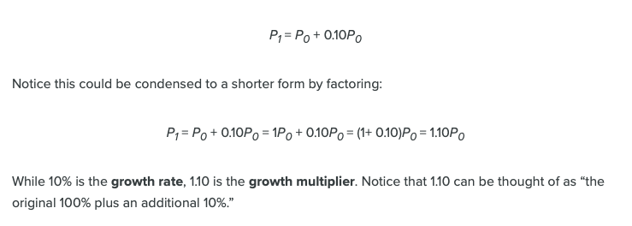
Example 3(Geometric Mean Method in use)
Suppose that every year, only 10% of the fish in a lake have surviving offspring. If there were 100 fish in the lake last year, there would now be 110 fish. If there were 1000 fish in the lake last year, there would now be 1100 fish. Absent any inhibiting factors, populations of people and animals tend to grow by a percent of the existing population each year.

Slide 15
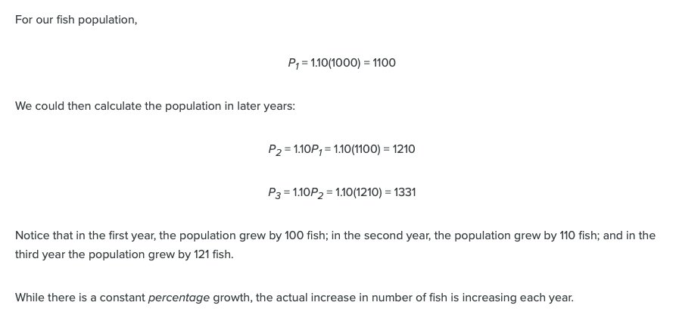
Example 3

Slide 16
Analysis Of Example
The first example above shows how growth rate is calculated using past data and which is a key figure as it is the ratio at which the population increases year on year.
The 2nd and 3rd example are application of GP method in real life on small assumed data sets.
Its interesting to note that the population forecasting using GP follows same trend as compound interest which is just another example of GP

Slide 17
Sources
https://courses.lumenlearning.com/waymakermath4libarts/chapter/exponential-geometric-growth/
https://courses.lumenlearning.com/waymakermath4libarts/chapter/exponential-geometric-growth/
https://study.com/academy/lesson/population-growth-rate-definition-formula-examples.html
https://opentextbc.ca/conceptsofbiologyopenstax/chapter/population-growth-and-regulation/
https://byjus.com/maths/geometric-progression/#Definition
https://byjus.com/question-answer/population-growth-rate-follows-progression/
https://www.apsed.in/post/population-forecasting-methods-formulas-example-problems-practice-problems
https://scetcivil.weebly.com/uploads/5/3/9/5/5395830/m5_l5-population_forecasting.pdf

Slide 18
Name of Group Members
Devanshu Jindal
Drishti Kakkar
Mitali Katira
Avani Khatri
Tisha Kothari
Suhani Kulkarni
Sarthak Maloo

