Slide 1
NMA Project
By Roll No: 13-18
Topic -Application of vector algebra in understanding flow of water in a river, specially during high tides/ tsunami.

Slide 2
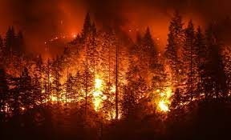
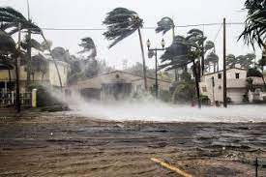
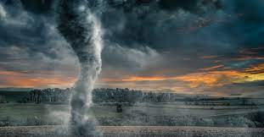
Introduction
A natural disaster is an adverse event resulting from natural processes of the Earth that leads to the destruction of human, animal, aquatic lives, and property.

Slide 3
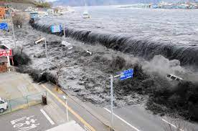
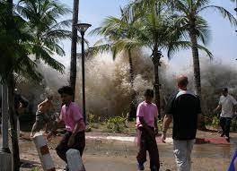
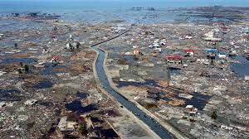
Introduction-Tsunami
Tsunamis are giant sea waves generated by sudden and large disturbances of seafloor. The word “tsunami” has a Japanese origin, which means harbour (tsu) wave (nami).

Slide 4
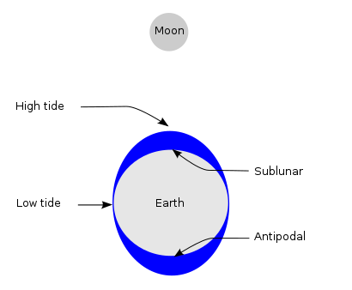
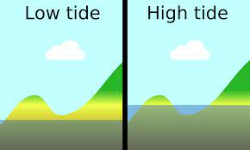
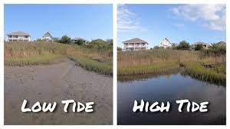
High Tides
Tides are the rise and fall of sea levels caused by the combined effects of the gravitational forces exerted by the Moon and the Sun, and the rotation of the Earth.

Slide 5
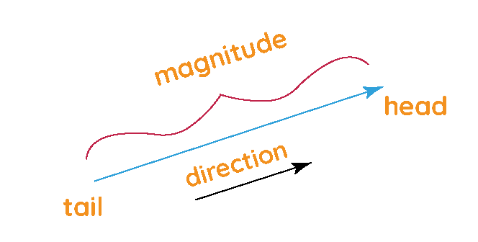
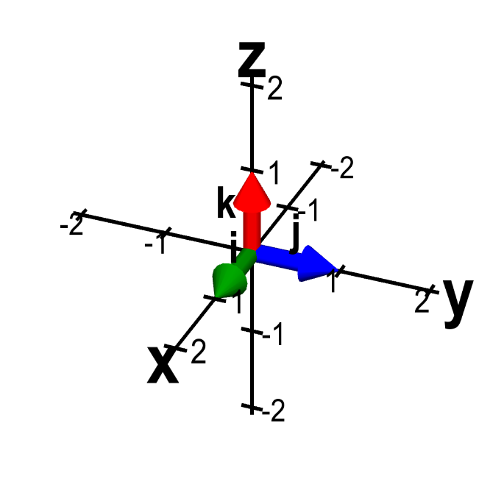
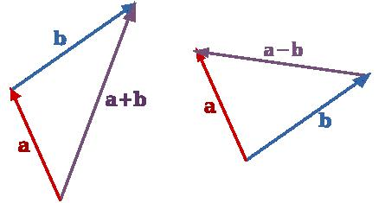
INTRODUCTION TO VECTOR ALGEBRA
A vector is a mathematical quantity having both magnitude and direction.
For example -Velocity.
VECTOR ADDITION AND SUBTRACTION : -
VECTORS IN 3D SPACE

Slide 6
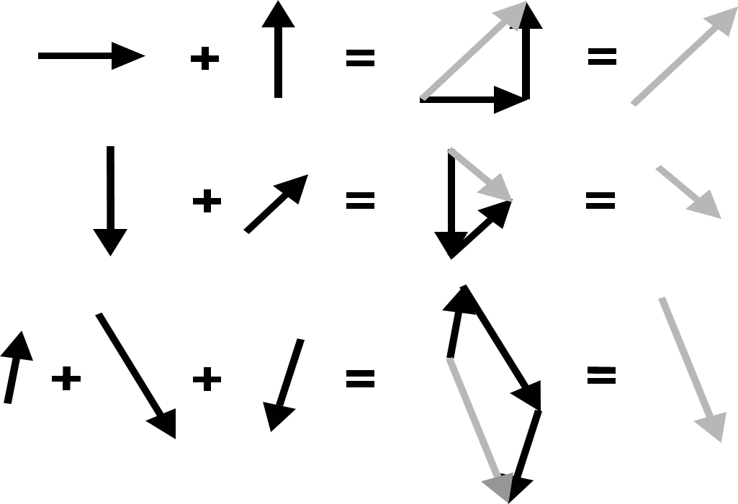
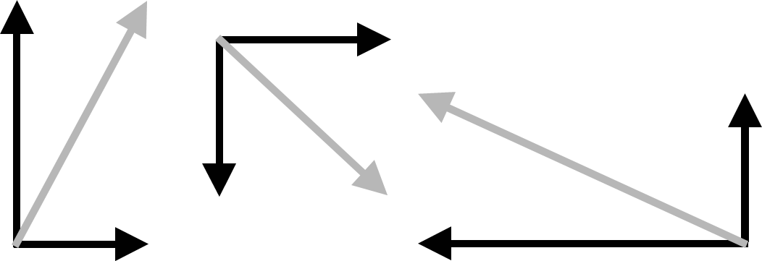
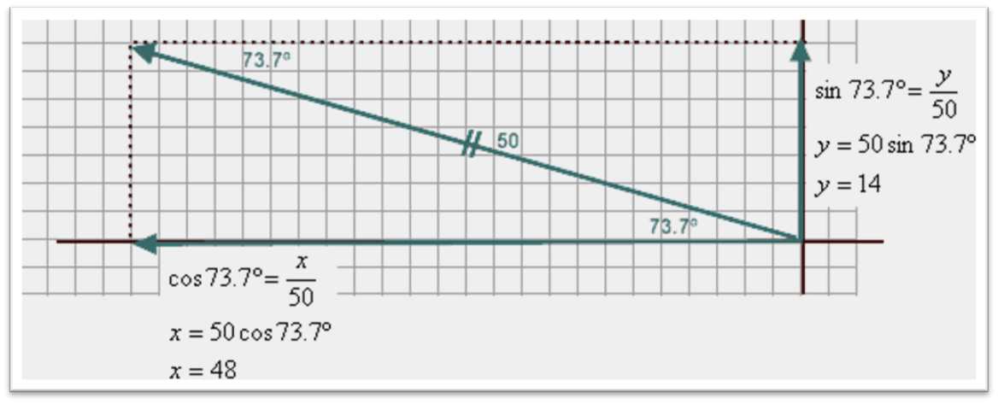
VECTOR RESOLUTION
Vectors may be resolved into perpendicular components. The vector composition of each pair of components yields the original vector.
Trigonometric Vector Resolution

Slide 7
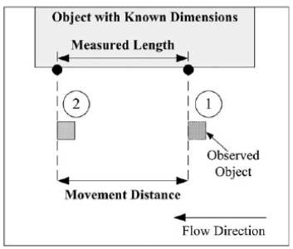

Vector Algebra during Tsunamis
TSUNAMI FLOW VELOCITY

Slide 8


Incompressible flow
Incompressible flow occurs when the density of a fluid is constant. In this case, the continuity equation for flow of a fluid with density (ρ) and velocity has concentration (C) and flux (J→) given by :
The concentration and density are scalar fields, and the velocity and flux are vector fields. The continuity equation without source or sink terms becomes :

Slide 9

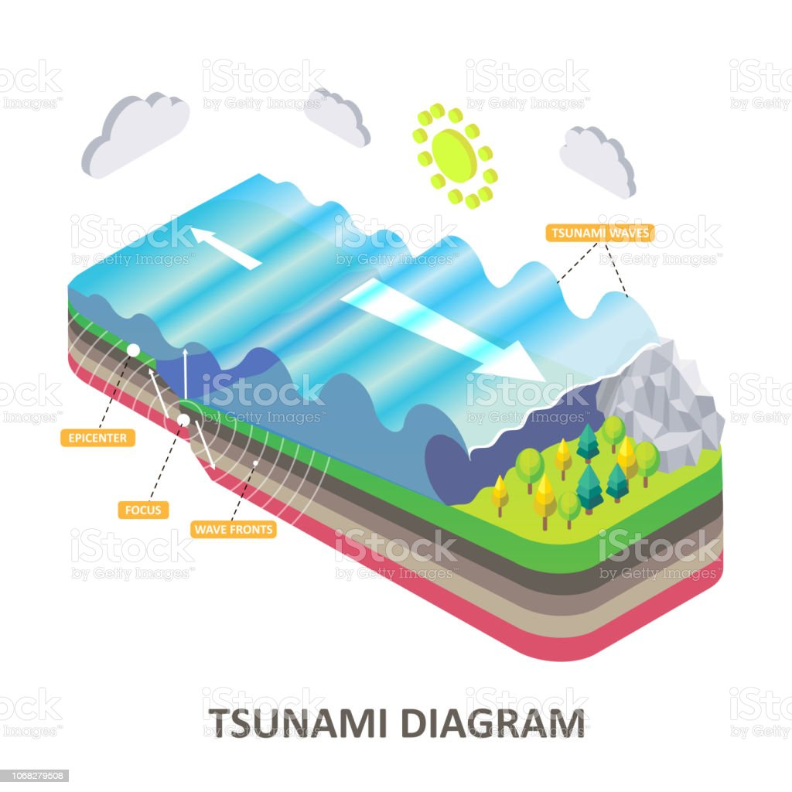


A more suitable form of the continuity equation for describing incompressible fluid flow is obtained by substituting the differential operator :
In the case of incompressible fluid flow, density is constant, so :

Slide 10
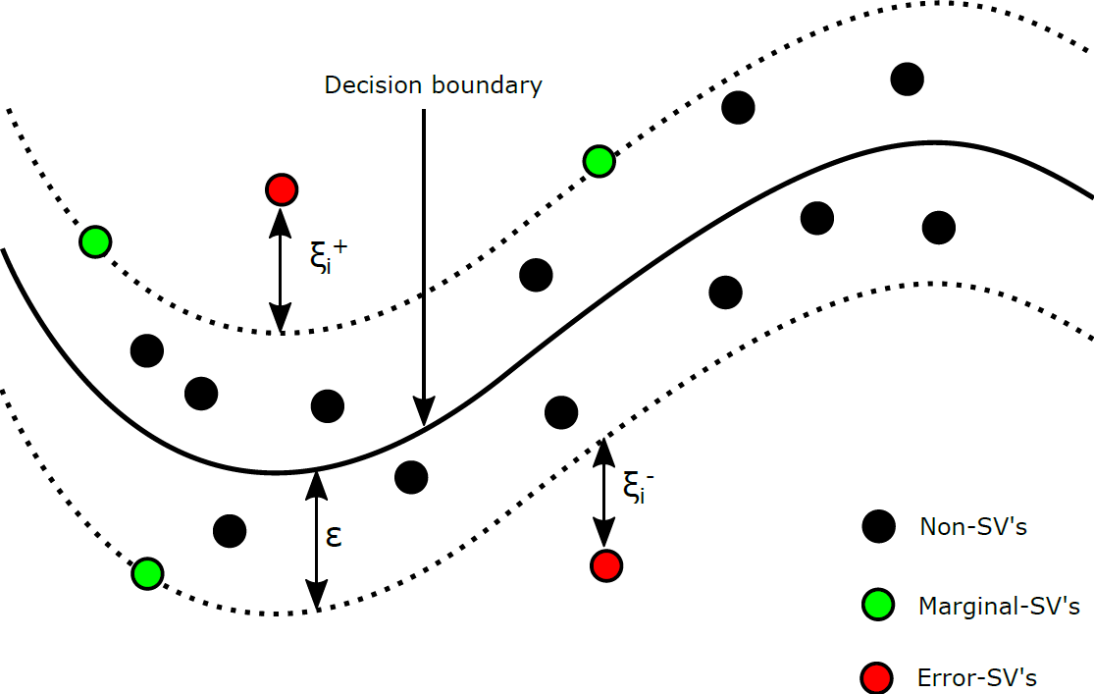
VECTOR MODEL TO PREDICT HIGH TIDES
THE SVR METHOD USING SUPPORT VECTOR REGRESSION.
SUPPORT VECTOR REGRESSION: Support vector regression (SVR) is a powerful technique for solving the regression problem, which is used to estimate a regression function.

Slide 11
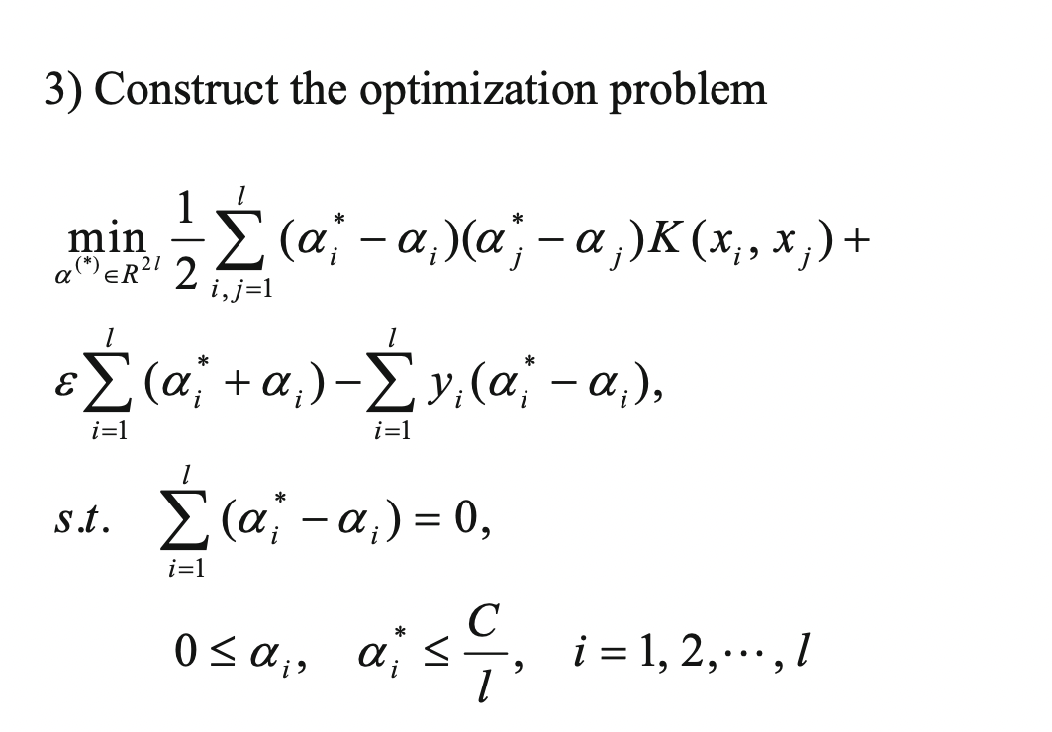
HOW DOES THE ALGORITHM GO ?
STEP I : Determining the input and output of the svr prediction. Understanding the various factors that could affect the tide frequencies.
STEP II : Establishing the samples using various vector sets that reflect the tidal frequencies and designing the parameters of the model.

Slide 12
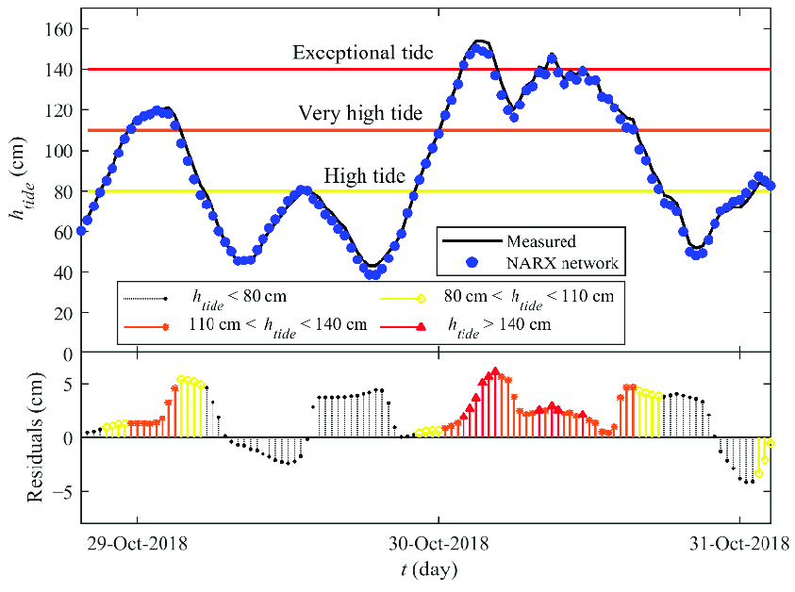
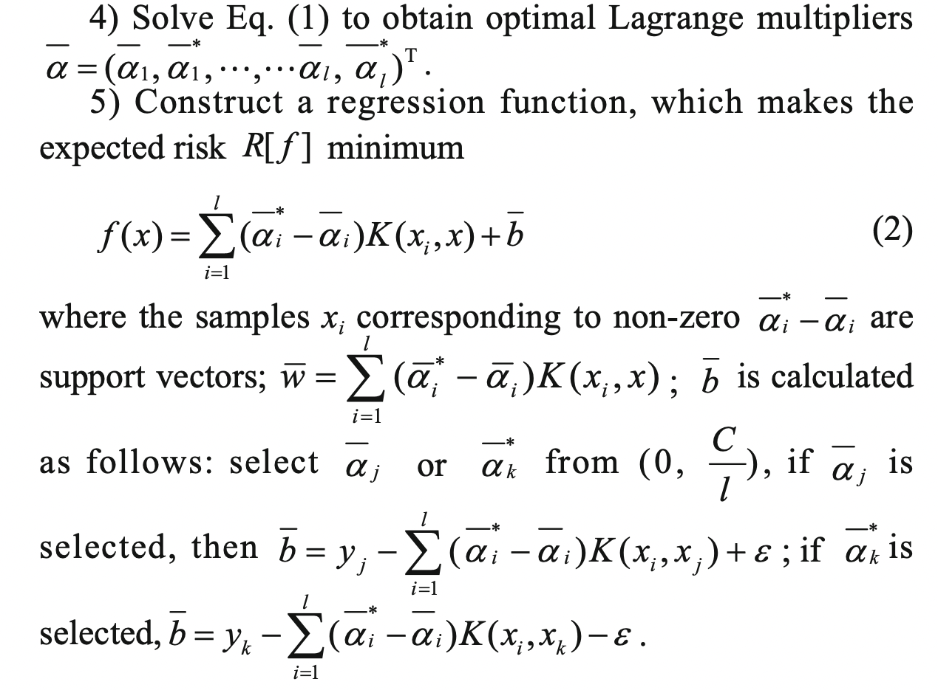

Slide 13
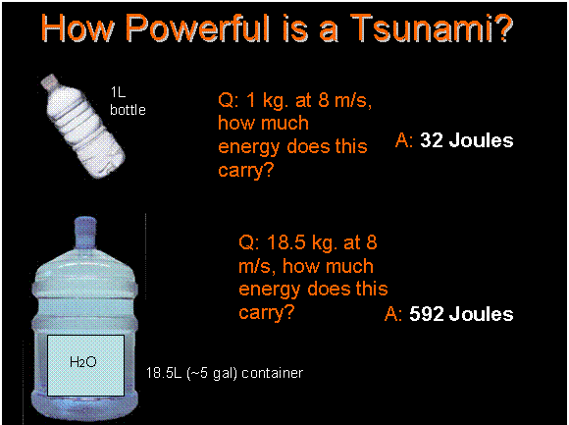
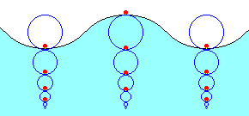
What makes Tsunamis force so dangerous that it changes directions and vector calculation is needed?
The force by which tsunamis challenges every attraction force and waves directions changes than mixture of force unit and vector calculation decides the height and angle and distance of reaching.

Slide 14

What is Mathematical Height of Tsunami Waves ?
As the Tsunami approaches shore, the water depth decreases, causing the Tsunami to slow down, at a rate proportional to the square root of the depth.
Unfortunately, “wave shoaling” then forces the Amplitude (Height) to increase at the opposite rate of which is decided by vector product and finding angle between both the water depth and height directions to measure the intensity following gravitational and tidal force.

Slide 15
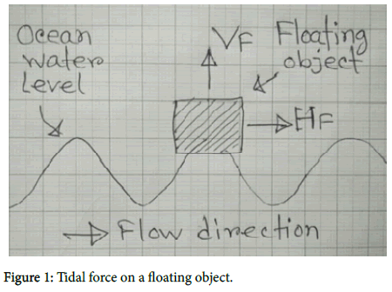
What is directional elements connecting and leading for vectors to conclude water flotations ?
Tidal force on a floating object has two elements: 1) Horizontal force (HF): Is a one-directional force creates by tidal flow/current. 2) Vertical force (VF): Is a bidirectional force creating by tidal wave (with gravity).
Tidal horizontal force (HF) (and with others external any kind of wind forces) on a floating object can be opposed by anchor it properly (by using minimum four long-distance anchors) so that the vertical force (VF) remain almost same. This vertical force (VF) is useful and it can be very much useful as easily increase this vertical force (VF) by increasing the size of the object. This bidirectional vertical force (VF) is very much suitable for pumping purpose .

Slide 16
REFERENCES :-
https://mathinsight.org/vector_field_overview
https://courses.fortlewis.edu/courses/17334/pages/kinetics?module_item_id=491744
https://passyworldofmathematics.com/tsunami-mathematics/
https://phys420.phas.ubc.ca/p420_05/anthony/The%20Physics%20of%20Tsunamis.htm
https://www.scitechnol.com/peer-review/tidal-wave-energy-large-scale-conversion-technology-hr26.php?article_id=9649
https://petrowiki.spe.org/Vector_analysis_of_fluid_flow

Slide 17


