Slide 1
Calculus Project
Automobiles: application
of calculus in car design
(70-75)

Slide 2
Introduction
Whether you realize it or not, math is a fundamental function of life and we use it on a daily basis. We use math for everything from balancing a checkbook, to computing fuel mileage, to purchasing aftermarket goodies, to counting the number of cars ahead of you at the stoplight. Even more impressive is that it's the only universal language in the world. Calculus plays a major role in the process of the making of automobiles, some of which are discussed ahead in detail.
Topics covered:-
1.Exterior design(73)
2.Interior design(75)
3.Manufacturing(72)
4.Frontal crash mechanism(71)
5. Mechanism of brakes and Airbags(70)

Slide 3
Exterior design (roll no. 73, Deepika S.)
The usual perception today is that mathematics only came into auto manufacture in the 1980s, when computer-aided design and modeling hit the scene. But in reality, every car ever produced has been a machine made of numbers -- from beginning to end.Automobile bodies might be born in the imagination of designers, but the car itself starts out with market analysis. Every car sold has to fit into a certain niche, and compete with others in that niche if there are any. A product planner's job is to analyze market data, figure out what's selling, where it's selling and for how much. Product planners have to look at horsepower, weight, fuel economy, and dimensional data and send their ideal specifications the engineering and design departments. In a very big way then, it's the product planner's heavily math-intensive market analysis that dictates almost every critical dimension and specification of the finished product.

Slide 4
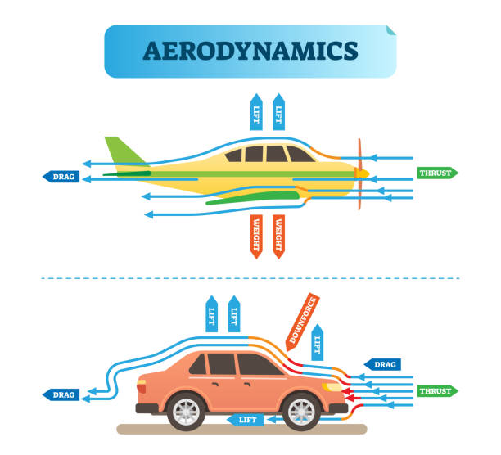
You'd think that exterior design was a purely artistic process -but it's a type of artistry heavily blended with science and math. You may have heard the phrase, possibly derogatorily that a car "looks like it was designed in a wind tunnel." Designers these days will often take advantage of tremendously sophisticated computer fluid flow modeling to figure out how the air will flow around, under and even through a car's body. They'll make tweaks to the car's design to enhance its aerodynamic characteristics in the computer before ever producing a scale model of it. Again, like computer-aided crash-testing in the chassis department, advanced algorithms and calculus play a critical role in the way the finished product looks and behaves.

Slide 5
Interior design (Ibhaan Swamy Roll-no:75)
The designer responsible for the vehicles' interior develops the proportions, shape, placement, and surfaces for the instrument panel, seats, door trim panels, headliner, pillar trims, etc. Here the emphasis is on ergonomics and the comfort of the passengers.
Interior design of a car has more than what meets the eye.Everything from the engine to the door hinge is designed and engineered using calculus and physics.did you know that- the shape and the foam of the seat head rest of the car is designed using calculus to distribute as much force as possible to prevent neck snaps due to whiplash in an accident . which saves millions of life every year while accounting for the comfort of the passenger

Slide 6


Most cars nowadays are covered with screen on
Dashboard. Those screen’s/ tablets are able to
Function because of the software design
Which is heavily based on calculus and
Algebra

Slide 7
Manufacturing (Manav Shivalkar Roll-no:72)
For each part of a car - which is an assembly of many thousands of parts, there are mechanical engineering disciplines, each in itself highly mathematical, which are applied in its design and in its construction, and then further in its testing and validation :
Strength of Materials
Thermodynamics
Friction and adhesion analysis
Mechanics (in this case, not fixing the car, but perhaps better understood as the physics of moving objects, in a gravity field)
Electronics and Electricity (especially important in modern electric cars)
Chemistry : for paint, engine parts, interiors, lubricants, tyres, batteries and almost everything else - it's a very mathematical science)
Statistics
Fluid mechanics - for both aerodynamics, and fluid flows in engines, and air conditioners

Slide 8
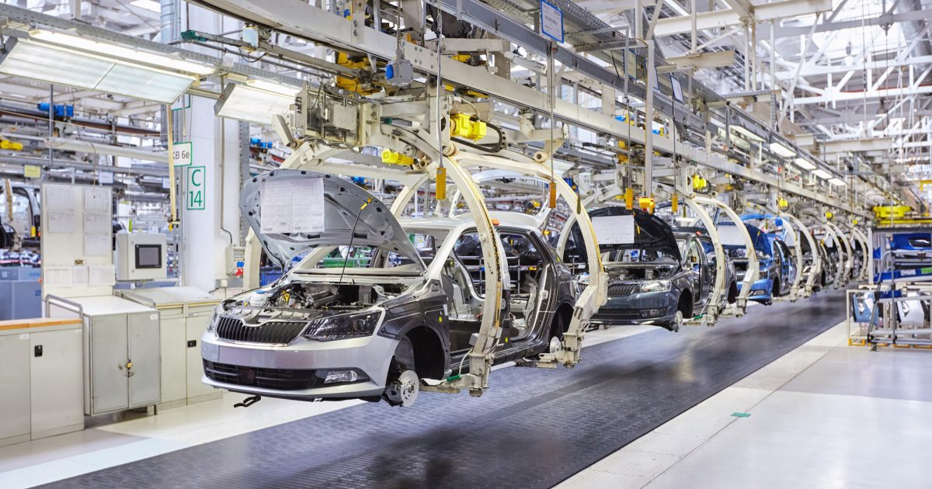
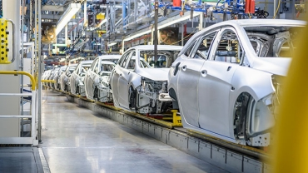
CAD/CAM - using computers to keep it all together, and allow the design to be executed with high precision. Literally the application of mathematics made into a physical device, the digital computer.
Computational Analysis : An offshoot of CAD/CAM, and known as CAE these days.
3D Printing - usually SLS of metals and plastics, taking CAD design and rendering it in industrial materials, including CFRP (Carbon-Fibre Reinforced Plastics, typically lightweight nylon grains) : this allows Audi AG to produce most of a Lamborghini Aventador specialised parts and body panel formers cheaply - so although you pay $500k for the car, it only costs them $100k to make it !

Slide 9
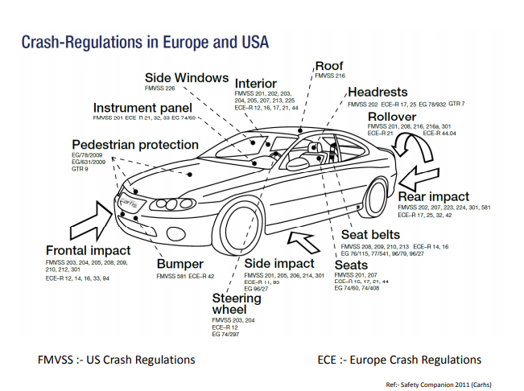
Frontal Crash Modeling (Roll no. 71 Poorva Shinde)
An engineer's primary job is to build a chassis and components to meet the product planner's specifications -- which is a tad more involved than it sounds. Computer-aided modeling has done a lot for chassis engineers, who can now digitally "build" a chassis in a computer, and "crash test" it over and over again using sophisticated calculus and physics algorithms. Physics modeling has become a field of mathematics and science in its own right, and the results of that modeling affect every aspect of chassis design and material use. Geometry and trigonometry are all-important elements of suspension design, as they are pretty much everywhere else a load-bearing component has to bolt to another one.

Slide 10
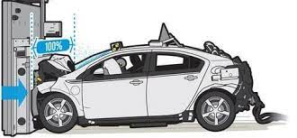
Fractional derivative viscoelastic model is used in the analysis of a frontal impact of a vehicle against a rigid obstacle. The frontal part of the vehicle is first modeled as a viscoelastic fractional rod and then it is modeled as two different viscoelastic fractional rods with a different length. In the second model also the friction is taken into account. A motion is analyzed during several phases because of both different lengths of the rods and the presence of a dry friction force in the later model. Governing systems of differential equations together with the corresponding initial conditions are derived. Parameter identification is done on the basis of the existing experimental results using the solution of a posed impact problem. What makes the problem more complex, regarding the second model, is the fact that it belongs to the class of nonsmooth fractional order systems, which require special treatment when dealing with deformation history during different motion phases.

Slide 11
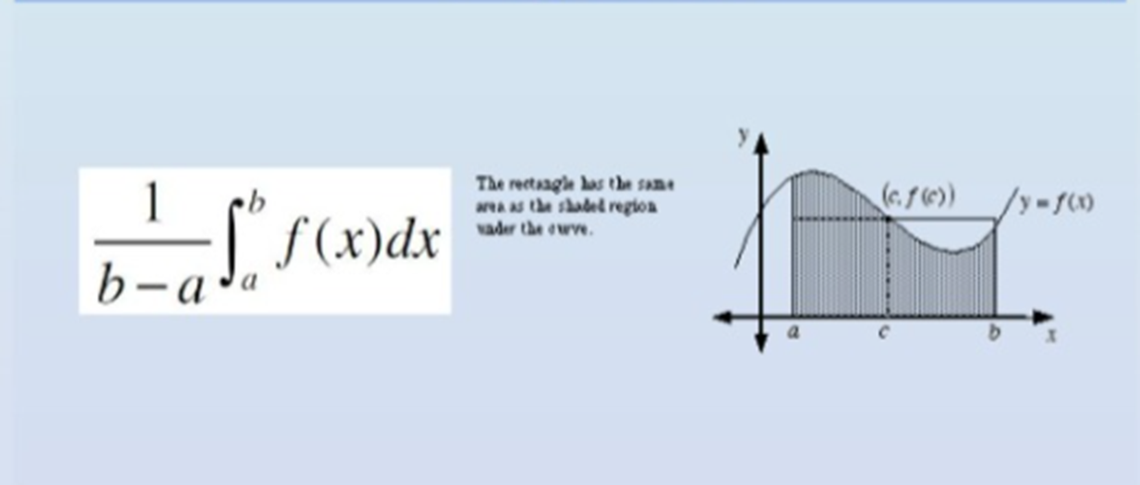
Mechanism of brakes and Airbags -Divya Sharma (70)
Normal breaking in a street car: 10 ms^-2 (or about 1 g).Normal breaking in a racing car: 50 ms^-2 (or about 5 g). This is due to aerodynamic styling and large tires with special rubber.

Slide 12
Severity Index
•All cars today are equipped with airbags to prevent brain damage .
•Safety experts use the HIC, or the Head Injury Criterion, to assess the likelihood of a head injury during an accident.
•This is so that the U.S. National Highway Traffic Safety Administration can give star ratings for each vehicle based on overall safety for consumers
•Head Injury Criterion (HIC) is a way of measuring the likelihood of a head injury arising from impact
•A value of 700 is the maximum allowed under the provisions of the U.S. advanced airbag regulation
•A lower value of gives the car a better star rating
•To describe the severity of a head injury in a car crash, we use a number. It is calculated using:

Slide 13
HEAD INJURY CRITERION(HIC)
Head Injury Criterion(HIC) is a way of measuring the likelihood of a head injury arising from impact.
A value of 700 is the maximum allowed under the provisions of the U.S. advanced airbag regulation.
A lower gives the car a better star rating.

Slide 14
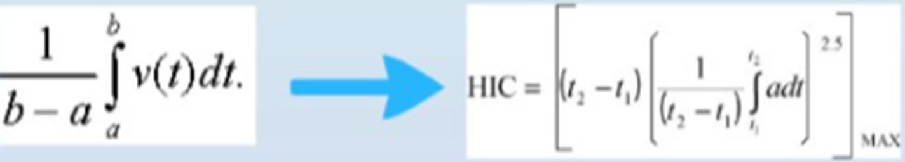
How HIC is Calculated
T= duration of the deceleration during the crash
A= the deceleration at time t
You cannot hold a child firmly in your arms during car crash
Safety belts save lives
Airbags save lives and head
The HIC is the maximum value over the critical time period t1 to t2 for the expression in braces, { }. The index 2.5 is chosen for the head, based on experiments.

