Slide 1
Application of Geometric Progression to study population growth
- By Roll Nos. : 86,87,88,89.

Slide 2
Group Details
Sr.no | Name | Roll Number
1) | Kshiti Vartak | 86
2) | Monisha Vaswani | 87
3) | Sujoy Banerjee | 88
4) | Shrunkhala Kambale | 89

Slide 3
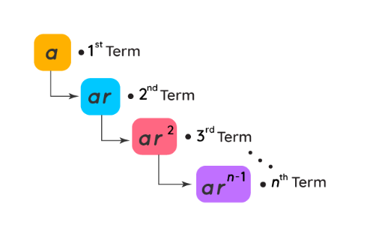

Introduction
What is GP?
A sequence is said to be a geometric progression or G.P., if the ratio of any term to its preceding term is same throughout.
First term of a G.P. by a and its common ratio by r.
The sum Sn of the first n terms of G.P. is given by the formula to your right.
This constant factor “r” is called the common ratio.

Slide 4
Applications of GP in Real Life
In real life, Examples are:
-A population growth in which each people decide not to have another kid based on current population then population growth each year is geometric
-Each radioactive independently disintegrates so each will have its fixed decay rate so it’s also geometric
- Given the rate of travel, it is possible to apply this formula to determine the number of miles a vehicle travels in a given amount of time, and to calculate the distance at any time along the trip.

Slide 5
Population growth
Radioactive component decay rate
Interest rates
Email chains
Tumour growth- In detection of tumour hypoxia
Time value of money to value future cash-flows.
Where is geometric progression applied in real life?

Slide 6
Use of Geometric Progression in Population Growth
Arithmetic progression means that a quantity increases linearly as time proceeds; geometric progression means that it increases as the square of time.
Malthus' theory claims that populations always tend to increase in geometric progression, while the means of subsistence increase in arithmetic progression.

Slide 7
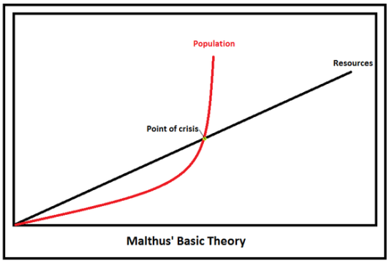
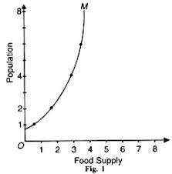
Malthusian theory
Thomas R. Malthus pointed out the geometric growth of populations in 1798.
In his treatise on population growth he stated that populations increase geometrically.
Thus, while food output was likely to increase in a series of twenty-five year intervals in the arithmetic progression.
This scenario of arithmetic food growth with simultaneous geometric human population growth predicted a future when humans would have no resources to survive on.
To avoid such circumstance, population growth should be controlled.

Slide 8

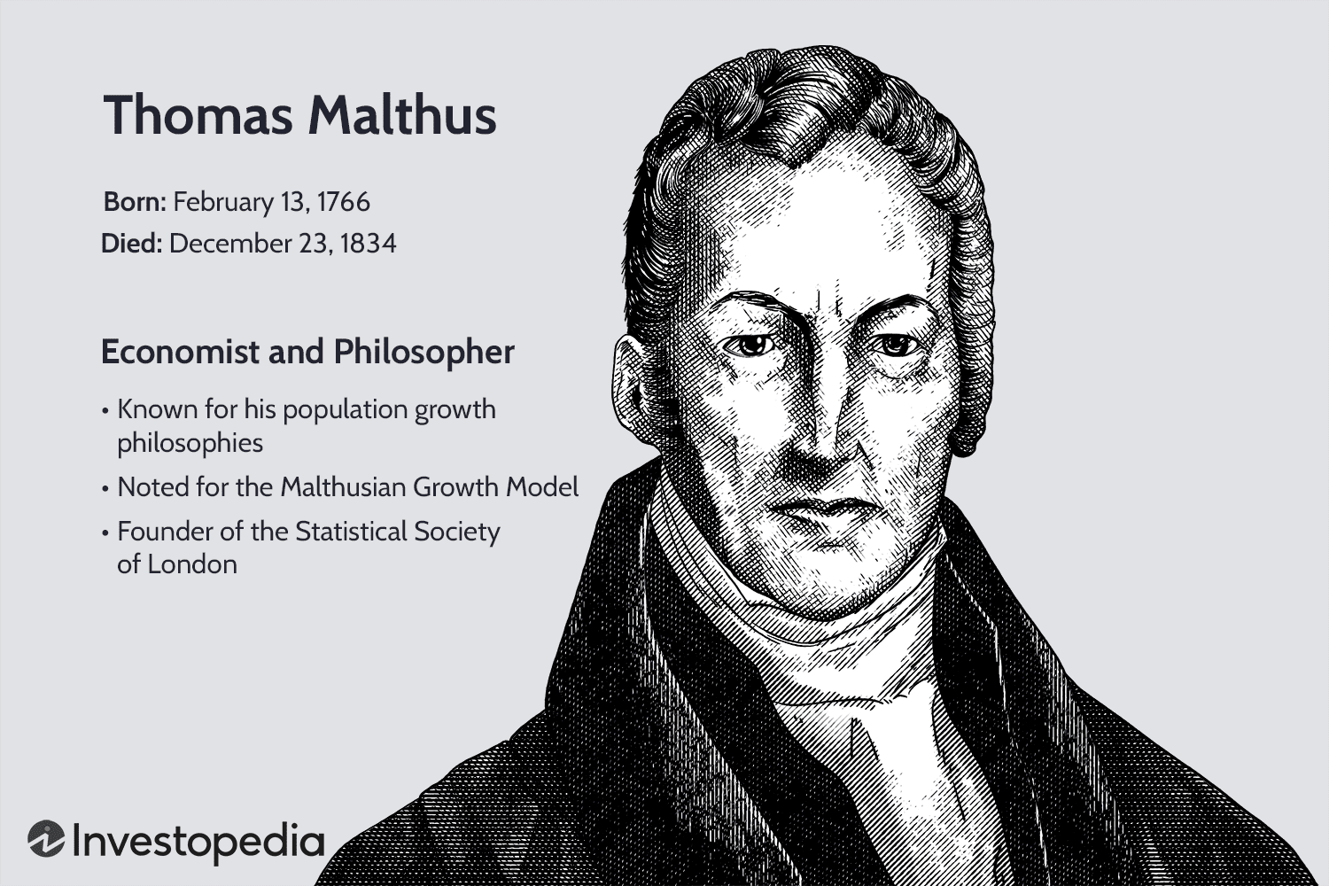
Conclusion of Malthusian Theory:
Malthus stated that population increased in a geometric progression while food production increased in arithmetic progression.
He wrote; unless humans can limit reproduction voluntarily through self-restraint, population would be reduced by catastrophic events such as diseases, starvation, misery and wars.

Slide 9
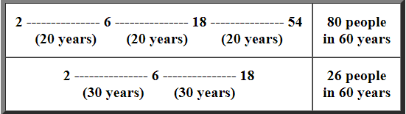
The following examples of population growth with six children per couple compare generation times of 20 years and 30 years:
I. With a 20 year generation interval, the total number of people at the end of 60 years is 80 (2 + 6 + 18 + 54).
II. With a 30 year generation interval, the total number of people at the end of 60 years is 26.
III. Increasing the generation interval from 20 to 30 years reduces the population growth from 80 to 26 during a 60 year period, a percent decrease of 67.5%.
IV. A longer generation interval significantly slows the growth of a population.

Slide 10
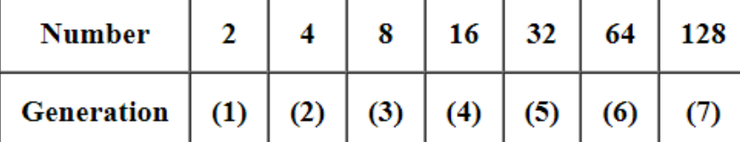
A geometric progression is a simplified way to show exponential population growth.
Starting with one couple, assume that every female has 4 children (2 boys and 2 girls).
The following table compares the population growth in 7 generations.
The 7th generation has a population of 27 or 128.

Slide 11
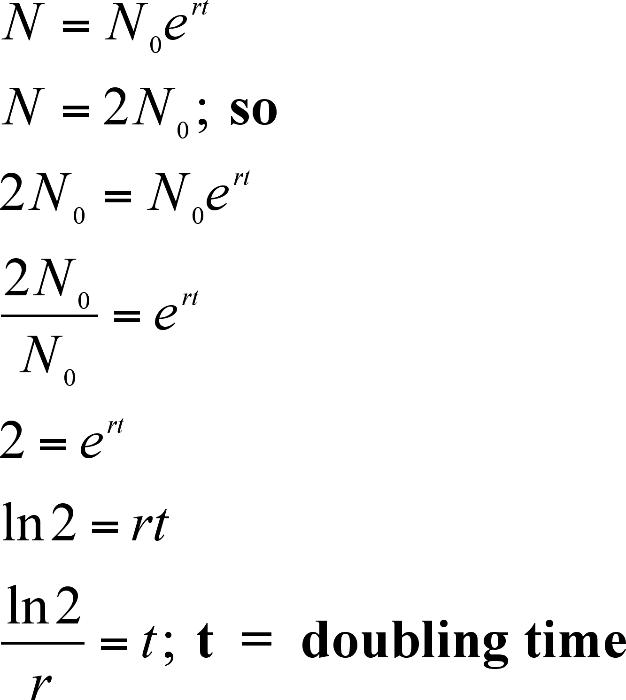
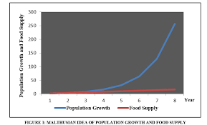
Few more applications of Geometric Progression in real life
I’ll give you a handful of examples: When each person decides not to have another child based on the current population, population growth is geometric.
Use sequences in real life
Sequences are useful in both everyday life and higher mathematics. For example, sequences include the interest component of monthly payments made to pay off an automotive or home loan, as well as a month’s worth of maximum daily temperatures in one place.

Slide 12
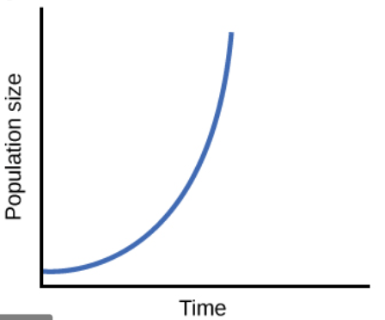
Population Growth Rate
The Geometric population growth is the same as the growth of a bank balance receiving compound interest.
The interest is calculated each year with reference to the principal plus previous interest payments.
The geometric population growth rate in demography is calculated using the ‘Compound Interest formula’.
The population totals for successive years form a geometric progression in which the ratio of adjacent totals remains constant.
In geometric series the population increases or decreases at the same rate during each unit of time, usually a year.

Slide 13
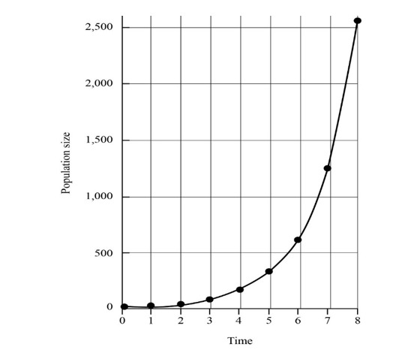


If this constant rate of change is represented by r and the initial population is represented by P0 , then after t years the final population is given by the following equation :
So that, the geometric growth rate r can be expressed in the following equation:

Slide 14
Conclusion
The Malthusian theory concluded that if the rate of food production is slower than the rate of population growth would be higher.
And using geometric progression in real life situations just like population growth, it is easier to not only draw conclusions but also is helpful in analysing useful results and do the needful.
Hence, Geometric Progression is an useful way of finding Population Growth.

Slide 15
References
https://en.wikipedia.org/wiki/Geometric_progression
http://www.zohry.com/cdc103/Lecture%2010%20-%2022%20Apr%202012.pdf
https://www.investopedia.com/terms/t/thomas-malthus.asp#:~:text=Malthus%20specifically%20stated%20that%20the,by%20economists%20and%20ultimately%20disproved.
https://www.investopedia.com/terms/t/thomas-malthus.asp#:~:text=Malthus%20specifically%20stated%20that%20the,by%20economists%20and%20ultimately%20disproved.
https://www2.palomar.edu/users/warmstrong/lmexer9.htm#geometric
https://www.quora.com/How-is-geometric-progression-applied-in-real-life
https://courses.lumenlearning.com/waymakermath4libarts/chapter/exponential-geometric-growth/

Slide 16
THANK YOU !

