Slide 1
Application of Matrices in Robotics
Presentation by
Sahil Maniyar
Amalu Manu
Roshan Mehta
Vishvavardhan Singh
Jatin Modi
Mucharla Harsha Vardhan
Vedika Mundra
Tanishka Singh

Slide 2
Table of Contents
Orientation and Positional Representation
1
Homogeneous Transformations
3
Frame Interpretation of Transformations
2
How Transformation works
4

Slide 3
Table of Contents
Rotational Matrix for Robotics Arm
5
Graphical Representation
7
Displacement Vectors for Robotics Arm
6
Theoretical Explanation
8

Slide 4
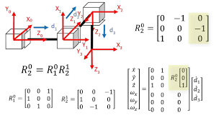
Homogeneous Transformation Matrices
In robotics, Homogeneous Transformation Matrices (HTM) have been used as a tool for describing both the position and orientation of an object and, in particular, of a robot or a robot component.

Slide 5
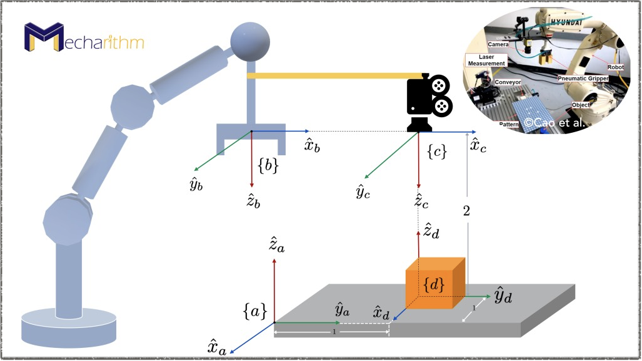
How transformation works in Robotics
To describe the angle that the servos need to reach the desired position in space
For example, how an autonomous underwater vehicle needs to reach or align itself with several different obstacles inside water
It helps us to determine the movement of the parts of the robots with respect to one another

Slide 6
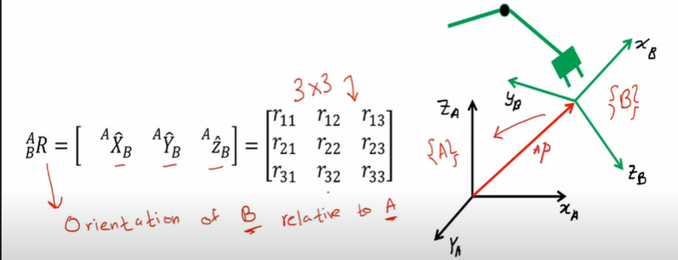
Orientation and Positional Representation
•A fundamental requirement in robotics is to represent the position and orientation of objects in an environment. such objects include robots, cameras, workpieces, obstacles, and paths. position and orientation together are referred to as pose.
• The columns of the rotational matrix form an sub-orientation matrix while the vector is the frame’s origin offset.

Slide 7
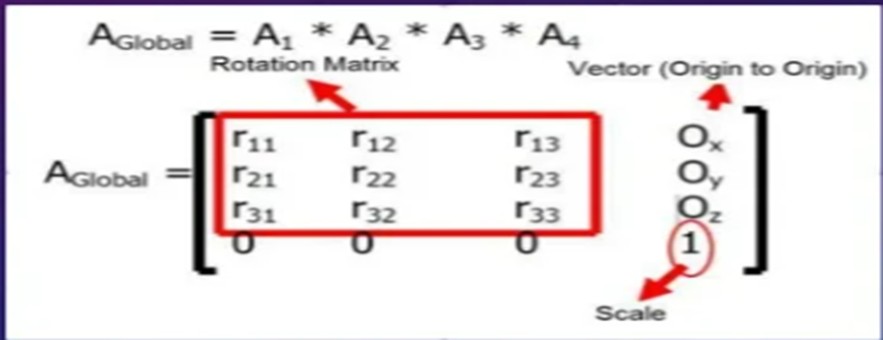
•Now here, column 1 is a vector that orients the frames’s axis respectively. similar interpretations are made for the frame’s y and z axes represented by columns 2 and 3.
•Also, the origin vector with three components represents the frame’s origin relative to the reference axis.

Slide 8
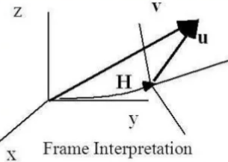
Frame Interpretation of Transformation.
Here, we have been given a vector “u”, and its transformation.
Transformation is represented by v = Hu
Now, this vector has components as Ux, Uy and Uz in a column, and it as to be extended to 4*1.

Slide 9
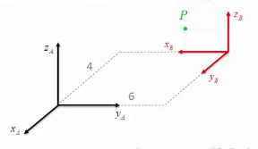
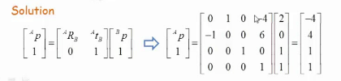
Graphical Representation
Considering frame {A} and {B}. Point P is given by (2,0,1), its coordinates with respect to frame {A] using homogeneous transformation matrix is :

Slide 10
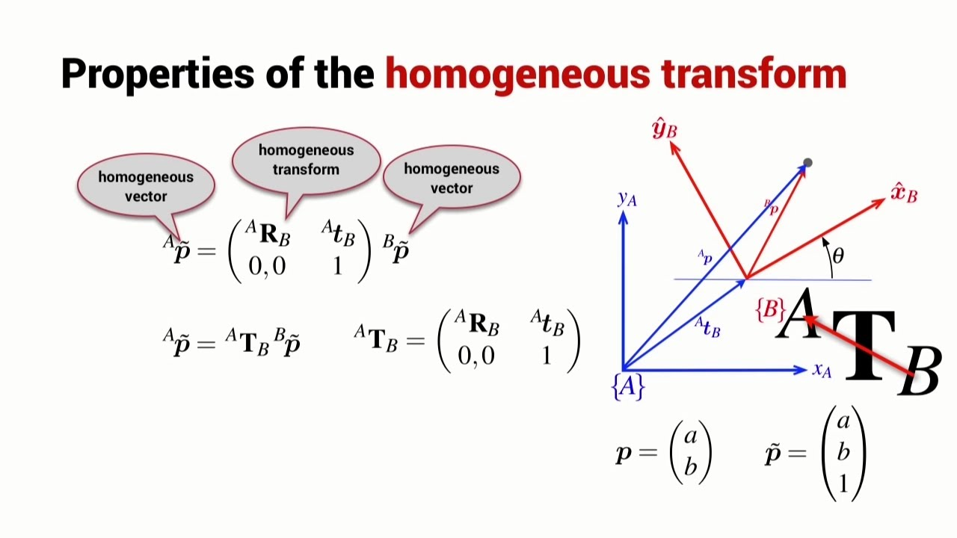
Theoretical Explanation
The homogeneous Transformation effectively merges a frame orientation matrix, and frame translation vector into one matrix.
The order of the operation should be viewed as rotation first, then translation.

Slide 11

It can be viewed as position or orientation relationship of one frame relative to another frame called the reference frame.
It can be interpreted as frame A described relative to the first or base frame while frame B is described relative to frame A. We can also interpret B in the base frame transformed by A in the base frame. Both the interpretations give the same result.

Slide 12
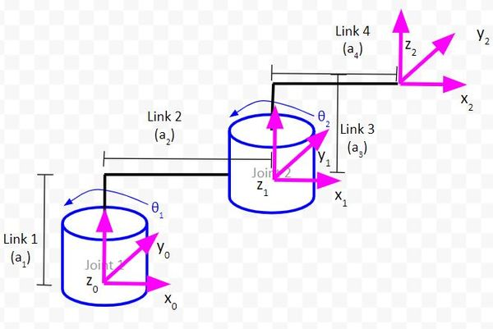
How to find Rotation Matrices for Robotic Arms
In the case of a two degree of freedom robotic arm, we have three coordinate frames (i.e. reference frames)
. the base coordinate frame (x0, y0, and z0 axes in the image below) could be our global reference frame
. We then have a local reference frame (x1, y1, z1) that is rotated at an angle from the global reference frame.
After that, we have another local reference frame (x2, y2, z2) that is rotated relative to the local reference frame before it (x1, y1, z1)

Slide 13

Imagine the base reference frame (x0, y0, z0) is a person. Our base frame might ask, ”Hey, I see the (x2, y2, z2) reference frame is rotated.
we would need to convert the (x2, y2, z2) frame to the (x1, y1, z1) frame using a rotation matrix. We would then convert the (x1, y1, z1) frame to the (x0, y0, z0) frame using another rotation matrix.
This is particularly useful for applications where you need the gripper to point a particular direction (e.g. a robotic arm painting an automobile).

Slide 14
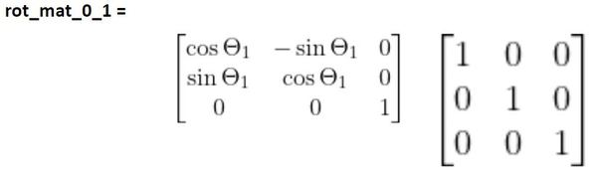
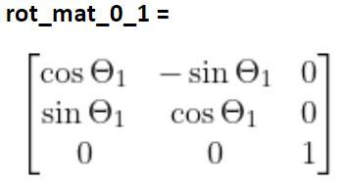
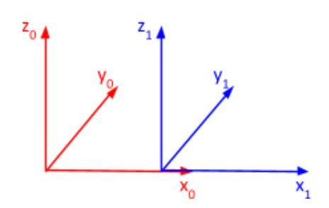
How to find Displacement Vectors for Robotic Arms
Displacement in the x direction
Rotation Matrix - You can see that frame 1 has no rotation relative to frame 0. Therefore, the first term we’ll use to calculate the rotation matrix from frame 0 to 1 will be the identity matrix.
This rotation matrix shows how the axes of frame 1 project onto the axes of frame 0 when there is no rotation.1 is a rotation around the z0 axis.
We therefore need to multiply the matrix we found above by the standard form of z matrix.

Slide 15
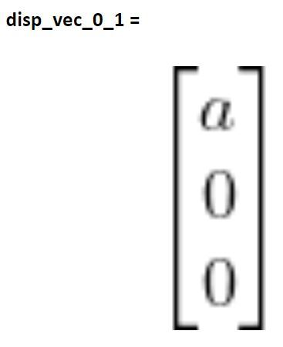
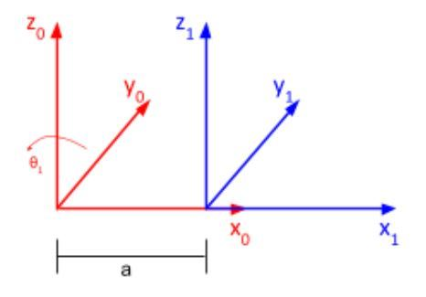
Here is the displacement vector:
Displacement Vector - Now that we know how frame 1 is rotated relative to frame 0, we now need to know how frame 1 is displaced relative to frame 0.
Our displacement vector needs to have three elements:
Change in the position along the x-direction
Change in the position along the y-direction
Change in the position along the z-direction
For example, let’s say that the distance from the origin of frame 1 to the origin of frame 0 is a. There is no displacement in the y and z directions.

Slide 16
Reference
https://www.researchgate.net/publication/322337716_Application_of_Homogeneous_Transformation_Matrices_to_the_Simulation_of_VLP_Systems
https://www.slideshare.net/SIMRANPARDESHI/use-of-matrix-in-robotics#:~:text=Transformation%20matrices%20can%20be%20used,different%20obstacles%20inside%20the%20water
https://automaticaddison.com/how-to-find-the-rotation-matrices-for-robotic-arms/#:~:text=In%20robotics%2C%20the%20orientation%20of,coordinate%20axes%20of%20another%20frame.

Slide 17
Thank You

