Slide 1
Calculus Project
Applications of Calculus in Car Design
By Roll No. 19-24

Slide 2
Index
Introduction
Use of calculus in
  Nuts and Bolts
  Torque and engine displacement
  Selecting a carburetor
  Measuring Displacement
  Tire diameter and Gear Ratio
Safe distance Formula
Average Value
Severity Index
Head Injury Criterion (hic)
  How HIC is calculated

Slide 3
Introduction
Whether you realize it or not, math is a fundamental function of life and we use it on a daily basis.
We use math for everything from balancing a checkbook, to computing fuel mileage, to purchasing aftermarket goodies, to counting the number of cars ahead of you at the stoplight.
We can use some simple math formulas to calculate relationships between tires and rpm for ideal gear ratios, compression ratios, the exact engine displacement with various bore and stroke combinations, and even to project quarter-mile and top-end speeds.
Mechanics use mathematics all the time in their daily routine of repairing and modifying internal-combustion automobiles.
The point is, math is a precise, consistent, and invaluable tool for all gearheads when applied properly.

Slide 4
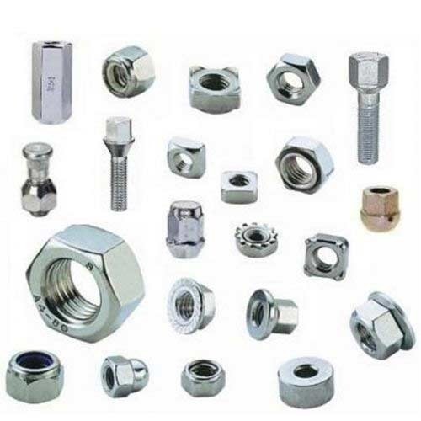
Nuts and Bolts
Every bolt or nut in an engine or car body has a certain designated size. The head of a bolt is usually six-sided, but on occasion, you might find one that is square, with only four sides. (The battery terminal has square bolts.)
If you are using the English system, the smallest
unit of measurement is the inch. Anything less than
1 inch is referred to in fractions. In auto mechanics,
this is a common occurrence, as most bolts that go
into the making of a modern engine average around
1/2 inch to 5/8 inch.
The metric system is designed so that fractions are almost unheard of. Instead of using fractions, one simply drops down to the next level. For instance, there are approximately 2 1/2 centimeters in 1 inch. If you have a bolt with a head that is less than 1cm, which is a common occurrence, instead of using a fraction to designate the size, you merely go to the next level, which is measured in millimeters.

Slide 5
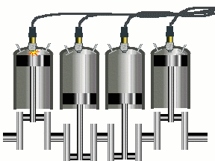
Torque and Engine Displacement
Calculus also come into play in many other ways, such as calculating torque, engine size and displacement, horsepower and firing sequence.
Torque is expressed in foot-pounds, and is a measurement of the force needed to tighten a bolt.
Engine size is the volume of the engine. It is the
combination of the volume of all 4, 6 or 8 cylinders
(whichever may be the case). This is also called
engine displacement.
The firing sequence refers to the order in which each cylinder is ignited (or fired); it is determined by the manufacturer. The sequence is not random, but occurs in a highly researched order, designed to give maximum power and efficiency to the engine.

Slide 6
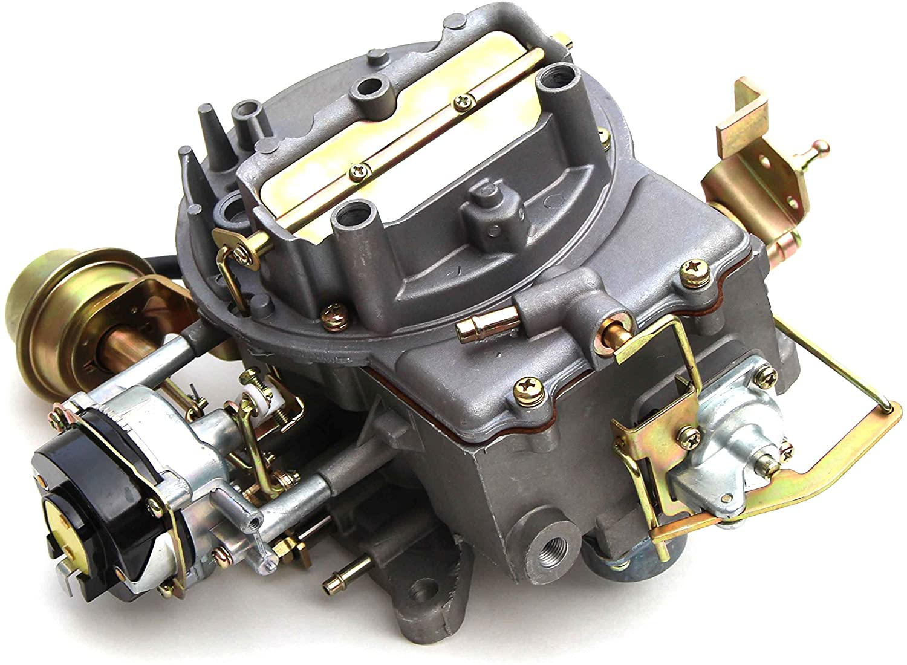
Selecting a Carburetor
Gearheads generally tend to over-carburetor most engine combinations, but here's a simple formula that'll help make the selection process a little easier. Keep in mind that all combinations will vary.
For mild street cars, take the maximum rpm
and multiply it by the engine displacement. Next
divide that number by 3,456 and multiply it by
0.85. For a more dragstrip-oriented vehicle,
replace the 0.85 constant with 1.1.
For example, if you plug in a maximum 6,000 rpm and a 350ci displacement, you end up with 516 cfm for the mild combo, and 670 cfm for the higher-horsepower version. These are just estimates, but it does offer suggestions on carburetor sizing if you're just getting started.

Slide 7
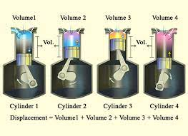
Measuring Displacement
To calculate cubic-inch displacement, you'll need to know the bore and stroke of the engine, the number of cylinders, and the handy constant of 0.7854, which is a shortcut representing a portion of the volume equation of a cylinder-3.1417 (pi) divided by 4.
For example, to find the displacement of a 350ci
small-block Chevy with a 4.00-inch bore and
3.48-inch stroke, merely multiply bore times
bore times stroke times 0.7854 times the
number of cylinders.
Displacement = bore x bore x stroke x 0.7854 x number of cylinders
Displacement = 4.00 x 4.00 x 3.48 x 0.7854 x 8 = 349.84 ci.
If we wanted to build a 383 stroker out of a small-block Chevy 350, it's easily done with either a standard 4.00-inch bore block or even with a 0.030-overbored block.

Slide 8
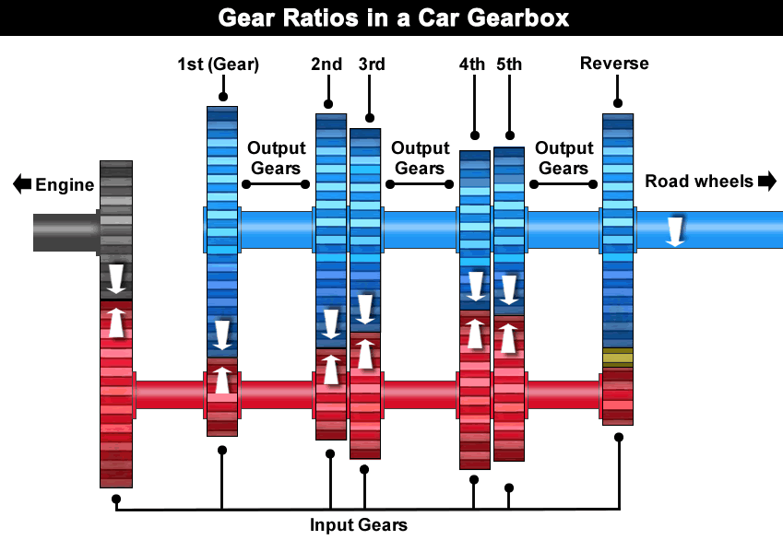
Tire Diameter and Gear Ratio
Big tires may be cool, but swapping taller or shorter tires will affect the final drive ratio. Taller tires effectively change the rear gear ratio, making it "taller“ or numerically less. Shorter tires create the opposite effect.
Imagine you're building a Pro Street show car,
and the 9-inch is already set up with 3.08 gears
based on a typical 26-inch-tall tire. Obviously, the
car will look killer with a set of monster 33-inch-tall
tires, but this swap to the much taller tires instantly
transforms the final drive ratio from 3.08 to 2.42! The high gearing is great for the likes of Silver State runners but will be absolutely horrendous for this big-tire street cruiser.
To calculate your own configurations, simply take the current tire diameter and divide it by the new (taller) tire and multiply that by the current gearing. Effective Gear Ratio = (original tire diameter / new tire diameter) x gear ratio

Slide 9
Safe distance formula
Intel proposed a mathematical formula for self-driving car safety.
Safe Distance Formula -
dmin = L + Tf(ʋr - ʋf + 𝝳(ɑɑ + ɑᵦ) - 𝝳2ɑᵦ/2+ (Tr - Tf)(ʋr + 𝝳ɑɑ - (Tf - 𝝳)ɑᵦ)/2
• L is the average length of the vehicles
• 𝝳 is the response time of the rear vehicle
• ʋr,ʋf are the velocities of the rear/front vehicles
• ɑɑ,ɑᵦ as are the maximal acceleration/braking of the vehicles
• Tf is the time for the front car to reach a full stop if it would apply maximal braking
• Tr is the time for the rear car to reach a full stop if it would apply maximal acceleration during the response time, and from there on maximal braking.

Slide 10
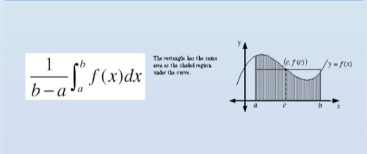
Average Value
Normal breaking in a street car: 10 ms^-2 (or about 1 g).Normal breaking in a racing car: 50 ms^-2 (or about 5 g). This is due to aerodynamic styling and large tires with special rubber.

Slide 11

Severity Index
All cars today are equipped with airbags to prevent brain damage .
Safety experts use the HIC, or the Head Injury Criterion, to assess the likelihood of a head injury during an accident.
This is so that the U.S. National Highway Traffic Safety Administration can give star ratings for each vehicle based on overall safety for consumers
Head Injury Criterion (HIC) is a way of measuring the likelihood of a head injury arising from impact
A value of 700 is the maximum allowed under the provisions of the U.S. advanced airbag regulation
A lower value of gives the car a better star rating
To describe the severity of a head injury in a car crash, we use a number. It is calculated using:

Slide 12
HEAD INJURY CRITERION(HIC)
Head Injury Criterion(HIC) is a way of measuring the likelihood of a head injury arising from impact.
A value of 700 is the maximum allowed under the provisions of the U.S. advanced airbag regulation.
A lower gives the car a better star rating.

Slide 13

How HIC is Calculated
T= duration of the deceleration during the crash
A= the deceleration at time t
You cannot hold a child firmly in your arms during car crash
Safety belts save lives
Airbags save lives and head
The HIC is the maximum value over the critical time period t1 to t2 for the expression in braces. The index 2.5 is chosen for the head, based on experiments.

Slide 14
Conclusion
As mentioned above, Mathematics is the bases of most of the scientific inventions. In this project we learnt how is calculus, an integral part of mathematics is used in designing of a car. Starting right from the smallest unit that is a nut or bolt, calculus is used for designing the most complex portions of the car, that is the engine.
Calculus is also used for providing safety features like airbags and safe distance formulae for auto pilot cars
Therefore, this project shows the importance and one of the many applications of calculus.

Slide 15
Thank You!!!
Made by:
Rohit Dubey (19)
Disha Dubhir (20)
Devin Gupta (21)
Kunal Gupta (22)
Priyansh Gupta (23)
Tarush Gupta (24)

