Slide 1

Members
Numerical Method & Algebra Project (25-30)
Topic: Application of Interpolation in estimation of live weight of a child or adult based on age.
Name | Roll. No
Harsh Gupta | 25
Trupti Hichkad | 26
Mrinmayee Hole | 27
Harshal Jagtap | 28
Deepali Gupta | 29
Grisha Jain | 30

Slide 2
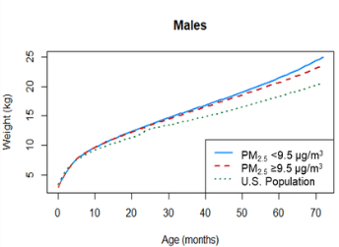
INTRODUCTION
Intermediate value also known as Interpolation can be used to demonstrate or estimate live weight of a child and adult.
Interpolation, also known as intermediate value, is a scientific term that could be defined as arriving at an unknown intermediate value or values of a function by using known values. Interpolation is implemented within the range covered by data

Slide 3
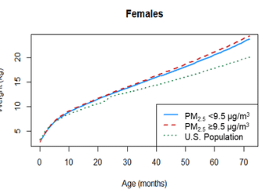
INTRODUCTION
In this project we use interpolation to estimate the weight of child and adult.
Different types of interpolation methods are: rational interpolation, polynomial interpolation, spline interpolation, and trigonometric interpolation.
For this project we use Regula-Falsi , Newton-Rapson method and Bisection method / dichotomy method / interval halving method.

Slide 4
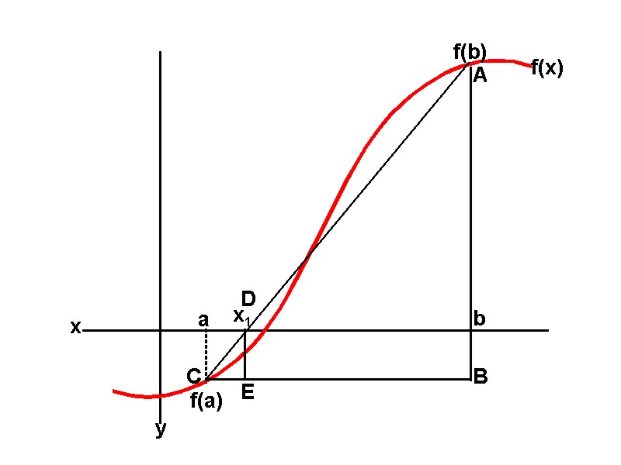
Different types of interpolations
1.Regula Falsi method .
Regula Falsi method is also known by the name of false position method. Interpolation is the approach of this method to find the root of nonlinear equations by finding new values for successive iterations. In this method, unlike the secant method, one interval always remains constant.

Slide 5
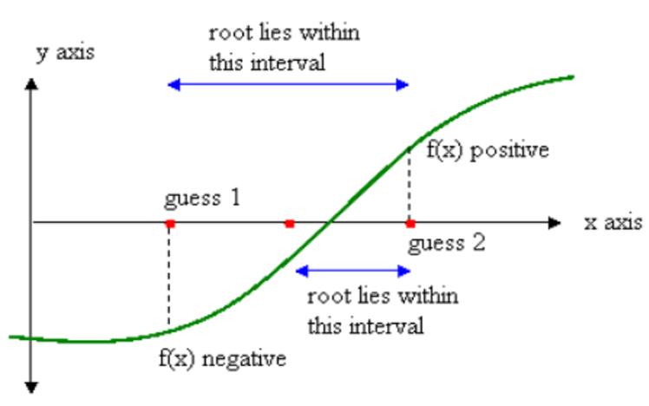
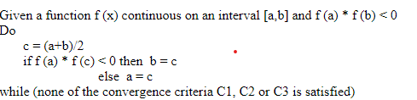
2.Bisection method / dichotomy method / interval halving method
The bisection method is a root-finding method that applies to any continuous functions for which one knows two values with opposite signs. The method consists of repeatedly bisecting the interval defined by these values and then selecting the subinterval in which the function changes sign.

Slide 6
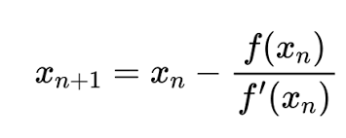
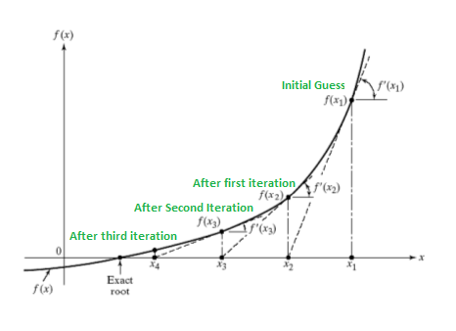
3.Newton – Raphson Method
The Newton-Raphson method (also known as Newton's method) is a way to quickly find a good approximation for the root of a real-valued function
f(x) = 0
f(x)=0. It uses the idea that a continuous and differentiable function can be approximated by a straight line tangent to it.

Slide 7
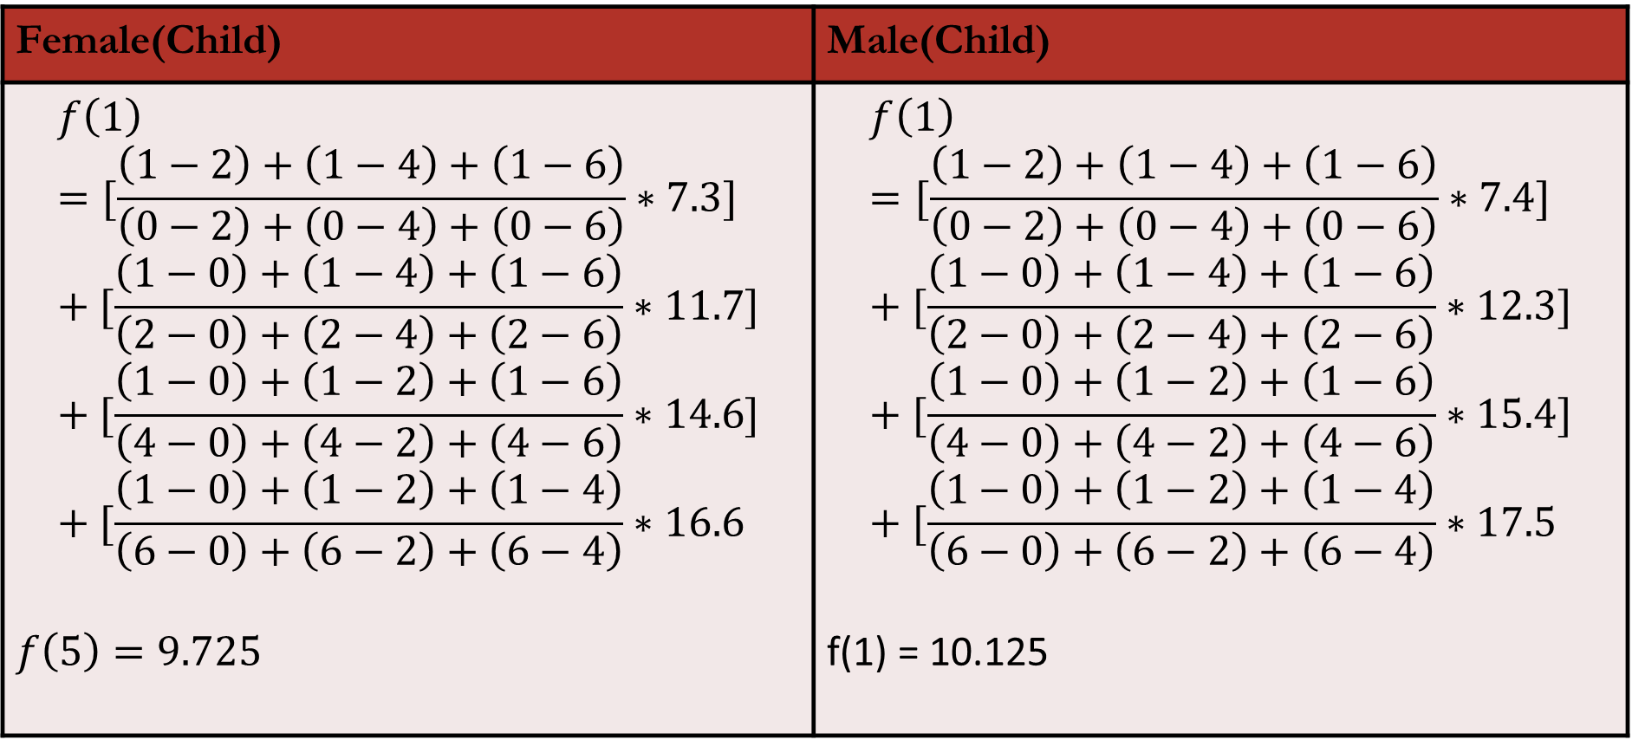
Calculation: Estimation of live weight of a child based on age
Female(Child) | Male(Child)
$$f\left(1\right)=[\frac{\left(1−2\right)+\left(1−4\right)+\left(1−6\right)}{\left(0−2\right)+\left(0−4\right)+\left(0−6\right)}∗7.3]+[\frac{\left(1−0\right)+\left(1−4\right)+\left(1−6\right)}{\left(2−0\right)+\left(2−4\right)+\left(2−6\right)}∗11.7]+[\frac{\left(1−0\right)+\left(1−2\right)+\left(1−6\right)}{\left(4−0\right)+\left(4−2\right)+\left(4−6\right)}∗14.6]+[\frac{\left(1−0\right)+\left(1−2\right)+\left(1−4\right)}{\left(6−0\right)+\left(6−2\right)+\left(6−4\right)}∗16.6$$ $$f\left(5\right)=9.725$$ | $$f\left(1\right)=[\frac{\left(1−2\right)+\left(1−4\right)+\left(1−6\right)}{\left(0−2\right)+\left(0−4\right)+\left(0−6\right)}∗7.4]+[\frac{\left(1−0\right)+\left(1−4\right)+\left(1−6\right)}{\left(2−0\right)+\left(2−4\right)+\left(2−6\right)}∗12.3]+[\frac{\left(1−0\right)+\left(1−2\right)+\left(1−6\right)}{\left(4−0\right)+\left(4−2\right)+\left(4−6\right)}∗15.4]+[\frac{\left(1−0\right)+\left(1−2\right)+\left(1−4\right)}{\left(6−0\right)+\left(6−2\right)+\left(6−4\right)}∗17.5$$ f(1) = 10.125

Slide 8
Sex | Age | Live weight
Female(Child) | 1 | 9.725
Female(Child) | 3 | 13.3
Female(Child) | 5 | 15.675
Female(Child) | 7 | 17.45
Female(Child) | 9 | 19.225
Female(Child) | 11 | 21.6

Slide 9
Sex | Age | Live weight
Male (Child) | 1 | 10.125
Male(Child) | 3 | 14.025
Male(Child) | 5 | 16.525
Male(Child) | 7 | 18.425
Male(Child) | 9 | 20.525
Male(Child) | 11 | 23.6875

Slide 10
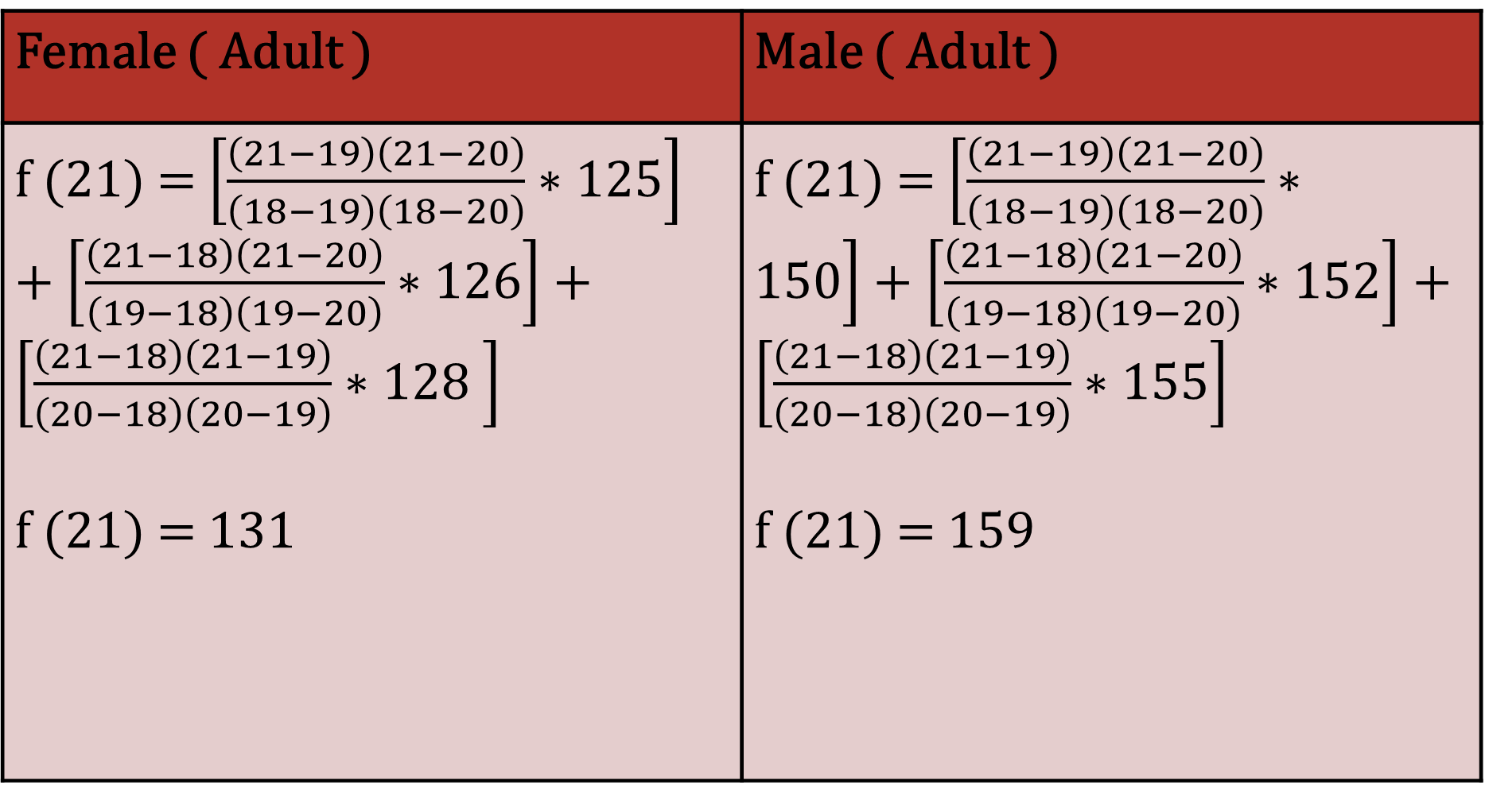
Calculation: Estimation of live weight of a Adult based on age
Female ( Adult ) | Male ( Adult )
f (21) = $\left[\frac{\left(21−19\right)\left(21−20\right)}{\left(18−19\right)\left(18−20\right)}∗125\right]$ + $\left[\frac{\left(21−18\right)\left(21−20\right)}{\left(19−18\right)\left(19−20\right)}∗126\right]+\left[\frac{\left(21−18\right)\left(21−19\right)}{\left(20−18\right)\left(20−19\right)}∗128 \right]$ f (21) = 131 | f (21) = $\left[\frac{\left(21−19\right)\left(21−20\right)}{\left(18−19\right)\left(18−20\right)}∗150\right]+\left[\frac{\left(21−18\right)\left(21−20\right)}{\left(19−18\right)\left(19−20\right)}∗152\right]+\left[\frac{\left(21−18\right)\left(21−19\right)}{\left(20−18\right)\left(20−19\right)}∗155\right]$ f (21) = 159

Slide 11
Sex | Age | Live Weight
Female ( Adult ) | 21 | 131
Female ( Adult ) | 22 | 135
Female ( Adult ) | 23 | 140
Female ( Adult ) | 24 | 146
Female ( Adult ) | 25 | 153

Slide 12
Sex | Age | Live Weight
Male ( Adult ) | 21 | 159
Male ( Adult ) | 22 | 164
Male ( Adult ) | 23 | 170
Male ( Adult ) | 24 | 177
Male ( Adult ) | 25 | 185

Slide 13
Visual Representation of Age and Live weight and Age of Children

Slide 14
Visual Representation Of Live Weight and Age of Adults

Slide 15
References
1. Regular Falsi Method :https://www.goseeko.com/blog/what-is-regula-falsi-method/#:~:text=The%20regula%2Dfalsi%20method%20is,a%20polynomial%20f(x).
2. Bisection Method: https://byjus.com/maths/bisection-method/#:~:text=The%20bisection%20method%20is%20used,intermediate%20theorem%20for%20continuous%20functions.
3. Calculation: Estimation of live weight of a child or adult based on age : https://www.disabled-world.com/calculators-charts/height-weight-teens.php

Slide 16
Thank You

