Slide 1

STATISTICAL
MODELLING IN R
Application of
Econometric Models
in the Banking Industry
Presented by – Aarushi Deepak Shinde

Slide 2







PROJECT OBJECTIVE AND STEPS
The 2008 financial crisis has compelled the US regulator to impose a new regulation to ensure institutions have a well-defined and forward-looking capital planning process that account for their unique risks and enough capital to continue operations through times of economic and financial stress.
Computing Capital Requirement at a Portfolio level
Accurately Forecasting Equity Portfolio
Model Accuracy and Stability Assessment
Statistical Testing, Model Finalization
Model Development
and Optimization
Analysis, Transformation
and Cleaning on the Raw Data
Data Collection
| For Educational Purposes Only |
2

Slide 3
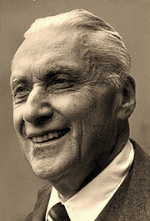


Slide 2
ECONOMETRICS AND ECONOMETRIC MODELLING
Econometrics is the unification of the theoretical-quantitative and the empirical-quantitative
approach to economic problems.
Econometric models are constructed from historical economic data with the aid of mathematical and
statistical concepts and tools, and intuition.
Policy formulation, reserve computation,
business research, decision making, and
international marketing
3
| For Educational Purposes Only |

Slide 4








Slide 2
DATA UNDERSTANDING AND ANALYSIS
There were 2 time series data sets provided in ‘.xlsx’ format excel files, named ‘Bank’s Equity Portfolio’ and ‘Historical Macroeconomic Data’. They were imported in RStudio using the function ‘read_excel’
Bank’s Equity Portfolio
Macroeconomic Data
2 Variables
26 Variables
52 Observations
72 Observations
Time Series Data
Time Series Data
2 Missing Values
25 Numeric, 1 Character
After importing the data in RStudio, it was discovered that portfolio values were categorised as a ‘character’ variable. Thus, changing the variable type to ‘numeric’ using the function ‘as.numeric’
| For Educational Purposes Only | Package used: excelxl
4

Slide 5


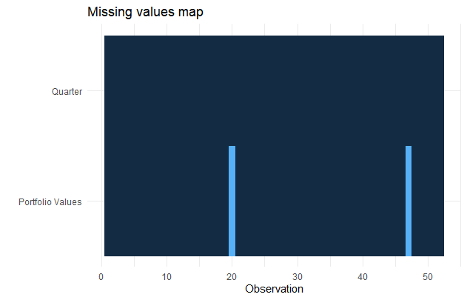
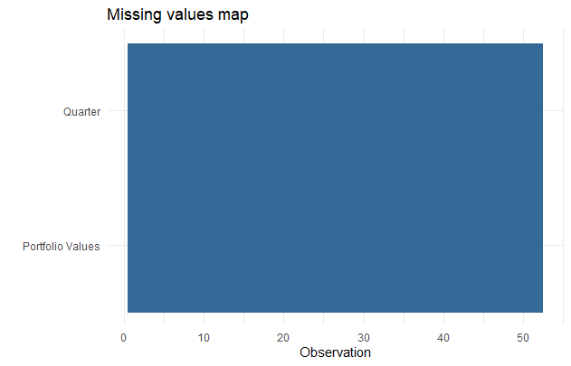
Slide 2
DATA PROCESSING I – MISSING VALUES
STEPS
OUTPUT
Checking for
missing values
equityport %>% missing_plot()
Replacing missing values by Interpolation
na.approx()
5
| For Educational Purposes Only |

Slide 6
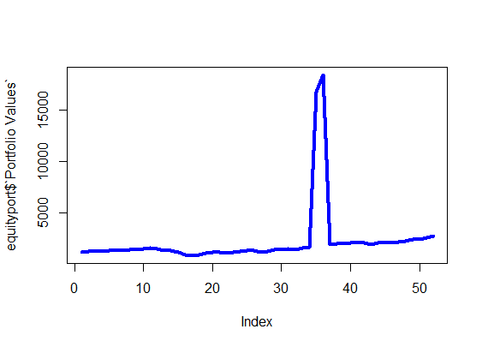
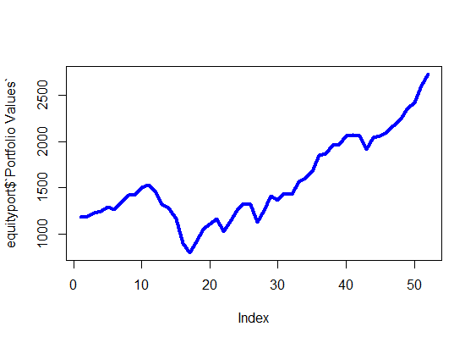
Slide 2
DATA PROCESSING II – INVALID VALUES
STEPS
OUTPUT
Investigating for invalid values
Decimal point error observed
equityport$`Portfolio Values`[equityport$`Portfolio Values`==16815.500]=1681.550
Fixing invalid values to obtain the real data
equityport$`Portfolio Values`[equityport$`Portfolio Values`==18483.600]=1848.36
| For Educational Purposes Only |
6

Slide 7
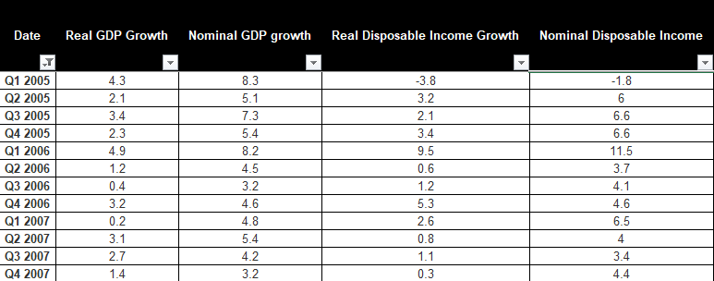
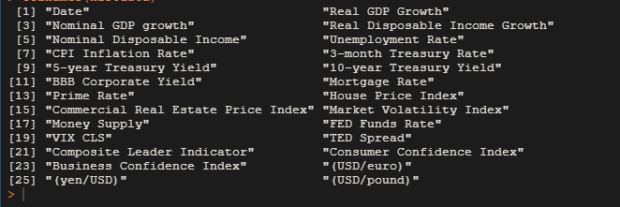
Slide 2
DATA PROCESSING III – DIMENSIONS & SPELLING ERROR
STEPS
OUTPUT
Excluding data from 2000 to 2004
histdata=histdata[-c(1:20),]
colnames(histdata)[11]=“BBB Corporate Yield”
Identifying and rectifying spelling error
colnames(histdata)[22]=
“Consumer Confidence Index”
7
| For Educational Purposes Only |

Slide 8
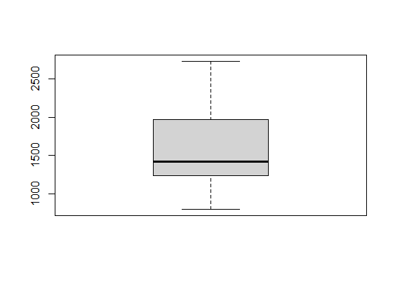
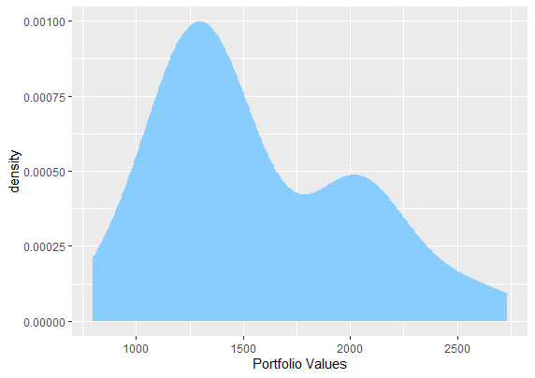
Slide 2
DATA VISUALIZATION
BOX PLOT
DENSITY PLOT
LINE GRAPH
Five-point summary and skewness of a set of data
Density, extremes, gaps, unusual values, distribution
Patterns, trends and outliers in the form of a line graph
Observed that the data is skewed.
Observed that the data is tending towards normal.
Observed that the data is tending towards normal.
| For Educational Purposes Only | Package used: ggplot2
8

Slide 9




CORRELATION ANALYSIS
WHAT IS IT?
USEFULNESS
It is a statistic that measures the degree to which two or more variables move in relation to each other
To identify trends between dependent and the independent variables for the model building process.
CORRELATION
CRITERION FOR SELECTION
REASONS FOR CRITERION
|0.6| indicates moderate correlation and choosing variables above |0.7| will leave us with a limited number of variables
The variables which had a correlation of greater than |0.6| with the ‘portfolio value’ variable were chosen for the model building process
9
| For Educational Purposes Only |

Slide 10
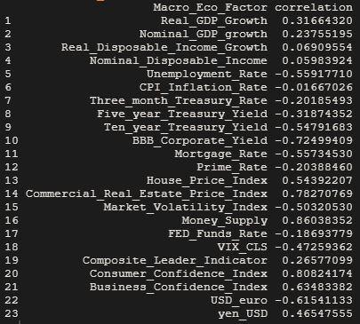
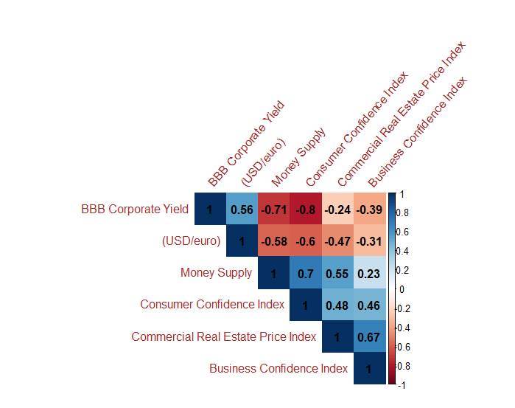
Slide 2
CORRELATION MATRIX
The variables selected based on the aforementioned criterion are BBB Corporate Yield, Commercial Real Estate Price Index, Money Supply, Consumer Confidence Index, Business Confidence Index, and USD/Euro
| For Educational Purposes Only | Package used: Hmisc
10

Slide 11
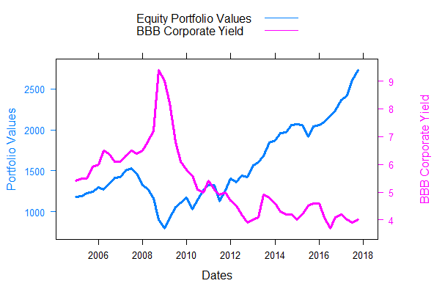
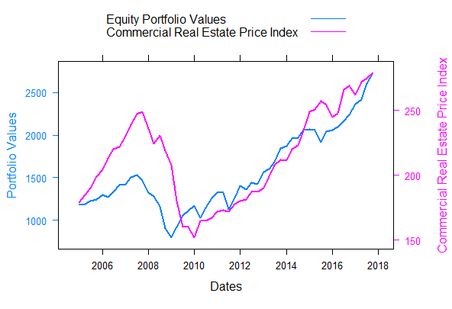
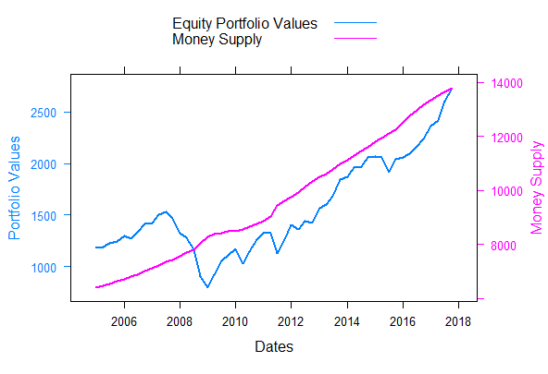
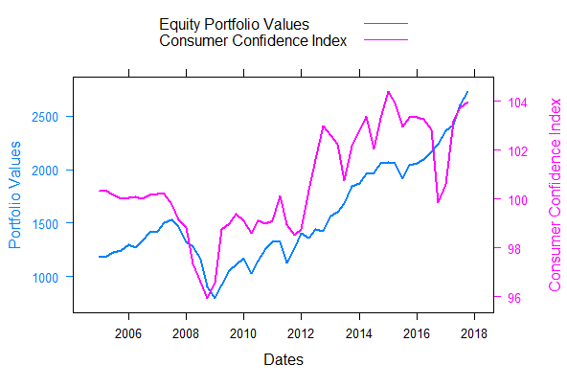
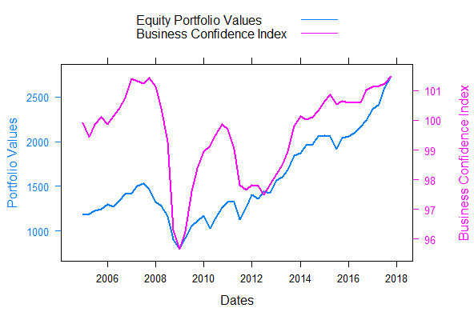
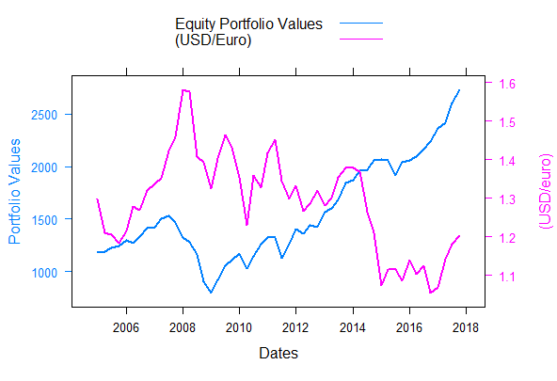
PORTFOLIO VALUES Vs. DEPENDENT VARIABLES
PV Vs. BBB Corporate Yield
PV Vs. CRE
PV Vs. Money Supply
PV Vs. CCI
PV Vs. BCI
PV Vs. USD/Euro
| For Educational Purposes Only |
11

Slide 12
MODEL SELECTION CRITERIA
1.
Maximum accuracy or least error
2.
Conveys maximum information
3.
Minimum mean squared error
4.
Best prediction results
12
| For Educational Purposes Only |

Slide 13
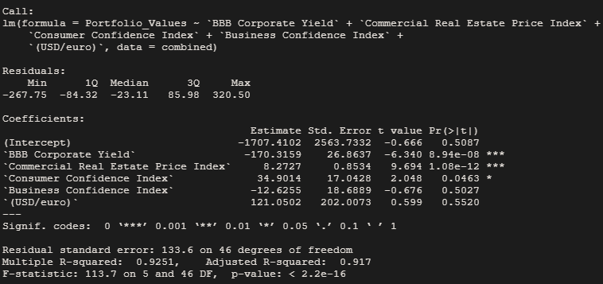
MODEL BUILDING PROCESS
Reasons for the Model
ITERATION 1
Interpretation of the Outcome
Correlation of the variables with the portfolio value
Exclusion of money supply using intuition
P-values of Business Confidence Index and USD/euro were not significant suggesting a weak relationship with the response variable
Constituents of the Model
Response Variable:
Portfolio Values
Explanatory Variables :
BBB Corporate Yield, Commercial Real Estate Price Index, Consumer Confidence Index, Business Confidence Index, (USD/euro)
Data used: combined
| For Educational Purposes Only |
13

Slide 14
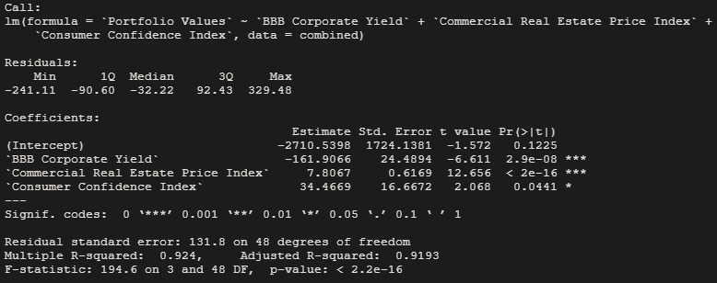
MODEL BUILDING PROCESS
Reasons for the Model
ITERATION 2
Interpretation of the Outcome
Model with the significant variables were taken into consideration.
Improvement in Adjusted R-squared and residual standard error
Linearity of the model: FAILED p-value = 0.0001458
Constituents of the Model
Response Variable:
Portfolio Values
Explanatory Variables:
BBB Corporate Yield, Commercial Real Estate Price Index, Consumer Confidence Index
Data used: combined
| | For Educational Purposes Only | Package used: lmtest
14

Slide 15
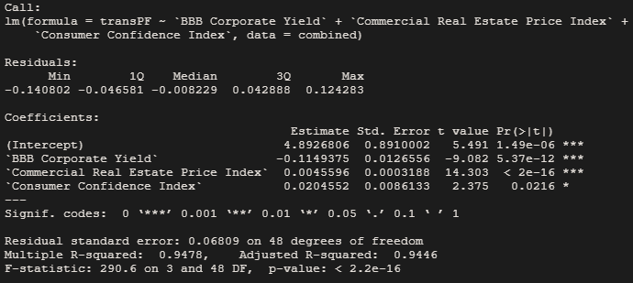
MODEL BUILDING PROCESS
Reasons for the Model
ITERATION 3
Interpretation of the Outcome
Since the linearity test fails in the previous model, log transformation of response variable is executed to check if the model is a better fit
Improvement in Adjusted R-squared and residual standard error
Log transformation and the passing of linearity test
For Ramsey-reset test,
p-value = 0.6693
Constituents of the Model
Response Variable:
transPF (transformed portfolio values)
Explanatory Variables :
BBB Corporate Yield, Commercial Real Estate Price Index, Consumer Confidence Index
Data used : combined
15
| For Educational Purposes Only |

Slide 16
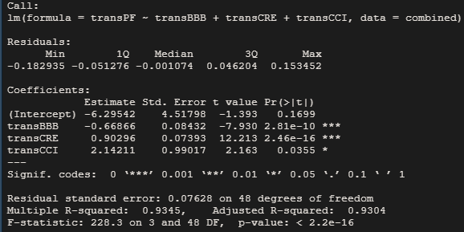
MODEL BUILDING PROCESS
Reasons for the Model
ITERATION 4
Interpretation of the Outcome
Log transformation of the explanatory variables to check if the model shows further improvement
Negative impact on the model since the residual standard error increased while the adjusted r squared reduced
Constituents of the Model
Response Variable:
transPF (transformed portfolio values)
Explanatory Variables :
log(BBB Corporate Yield), log(Commercial Real Estate Price Index), log(Consumer Confidence Index)
Data used : combined
16
| For Educational Purposes Only |

Slide 17
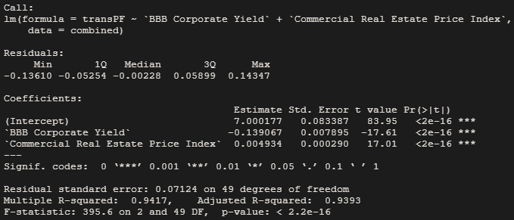
MODEL BUILDING PROCESS
Reasons for the Model
ITERATION 5
Interpretation of the Outcome
Presence of multicollinearity.
Commercial real estate price index is not that significant
Improvement in the Adjusted r-squared, and residual standard error compared to model 4
Passed the linearity test. The p-value = 0.2115
Constituents of the Model
Response Variable:
transPF (transformed portfolio values)
Explanatory Variables :
BBB Corporate Yield, Commercial Real Estate Price Index
Data used : combined
| For Educational Purposes Only | Package used: lmtest
17

Slide 18
QUANTITATIVE TESTS – I
Normality
Jarque Bera Test
Shapiro Wilk Test
Anderson Darling Test
R Programming : jarque.bera.test()
P-value : 0.4556
Outcome for residuals : Normally Distributed
R Programming : shapiro.test()
P-value : 0.475
Outcome for residuals : Normally Distributed
R Programming : ad.test()
P-value : 0.007776
Outcome for residuals : Non- normally Distributed
| For Educational Purposes Only | Packages used: tseries and goftest
18

Slide 19
QUANTITATIVE TESTS – II
Stationarity
Phillips Perron Test
KPSS Test
Augmented Dickey Fuller
R Programming : pp.test()
P-value : 0.01
Outcome for Dependent Variable : Stationary
R Programming : kpss.test()
P-value : 0.1
Outcome for Dependent Variable : Stationary
R Programming : adf.test()
P-value : 0.08096
Outcome for Dependent Variable : Not Stationary
| For Educational Purposes Only | Package used: tseries
19

Slide 20
QUANTITATIVE TESTS – III
Auto-correlation of Errors
Durbin Watson Test
Breusch Godfrey Test
R Programming : dwtest()
P-value : 0.0002175
Outcome for residuals : auto-correlated
R Programming : bgtest()
P-value : 0.003178
Outcome for residuals : auto-correlated
| For Educational Purposes Only | Package used: lmtest
20

Slide 21
QUANTITATIVE TESTS – IV
Linearity
Heteroskedasticity
Multicollinearity
Ramsey Reset Test
Breush Pagan Test
Variance Inflation Factor
R Programming : resettest()
P-value : 0.2115
Outcome : Linear
R Programming : bptest()
P-value : 0.1139
Outcome for residuals : Homoskedastic
R Programming : vif()
VIF-value : 1.0623
Outcome : No correlation
| For Educational Purposes Only | Packages used: lmtest and DAAG
21

Slide 22
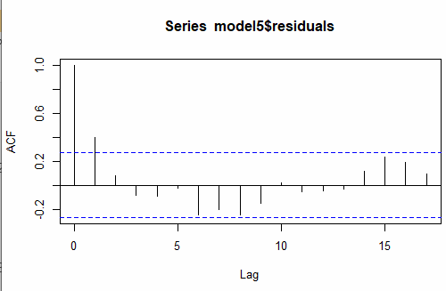
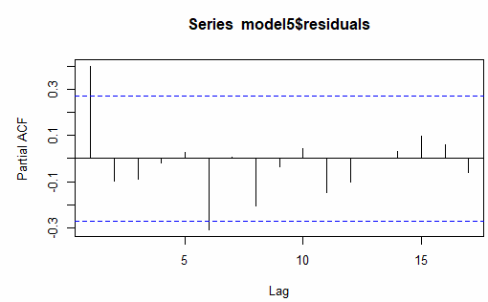
QUALITATIVE TESTS – I
Stationarity
Stationarity
ACF Test
PACF Test
R Programming : acf()
Comment : Lag in ACF dies out at 1
R Programming : pacf()
Comment : Lag in PACF dies out at 6
22
| For Educational Purposes Only |

Slide 23
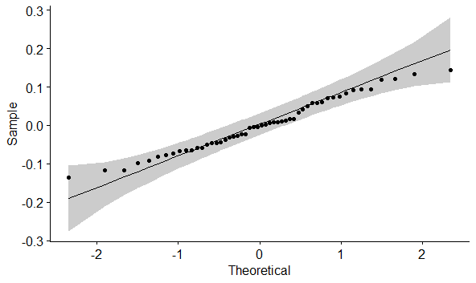
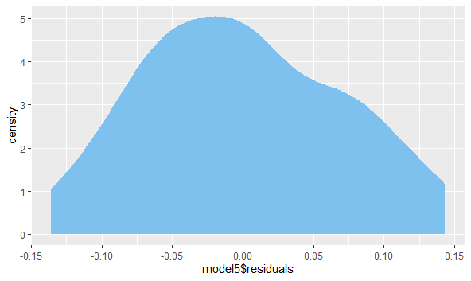
QUALITATIVE TESTS – II
Normality
QQ Plot
Density Plot
R Programming : ggqqplot()
Comment : All the data points are around the qq line
R Programming : ggplot() + geom_density()
Comment : Shape is fairly normally distributed
| For Educational Purposes Only | Packages used: ggplot2 and ggpubr
23

Slide 24
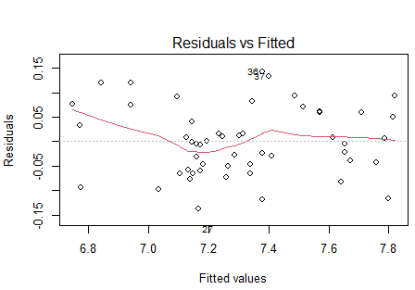
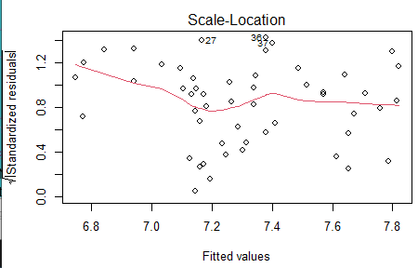
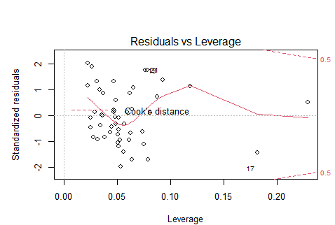
QUALITATIVE TESTS – III
Linearity
Heteroskedasticity
Outlier – Analysis
Residual vs Fitted Test
Scale – Location Test
Residual – Location Test
R Programming: plot()
Comment: Linear relationship between dependent and independent
R Programming: plot()
Comment: Number of errors above and below the red line are equal
R Programming: plot()
Comment: No significance of outlier present
| For Educational Purposes Only |
24

Slide 25
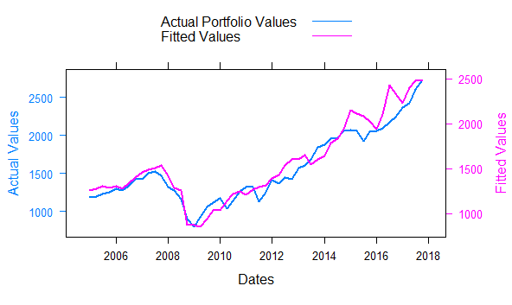
IN-SAMPLE ANALYSIS
Snapshot of In - Sample Analysis (first 9 quarters)
Dates | Actual Values | Fitted Values | Errors | Squared Errors | Absolute % Errors
01/01/2005 | 1180.59 | 1251.793 | -71.203 | 5069.856 | 6.03%
01/04/2005 | 1191.33 | 1271.595 | -80.265 | 6442.428 | 6.74%
01/07/2005 | 1228.81 | 1303.353 | -74.543 | 5556.588 | 6.07%
01/10/2005 | 1248.29 | 1288.805 | -40.515 | 1641.485 | 3.25%
01/01/2006 | 1294.83 | 1302.749 | -7.919 | 62.717 | 0.61%
01/04/2006 | 1270.2 | 1270.418 | -0.218 | 0.048 | 0.02%
01/07/2006 | 1335.85 | 1333.475 | 2.375 | 5.643 | 0.18%
01/10/2006 | 1418.3 | 1404.070 | 14.230 | 202.495 | 1.00%
01/01/2007 | 1420.86 | 1460.595 | -39.735 | 1578.874 | 2.80%
Residual Analysis
Close approximation of movements in Portfolio Values
Major upward and downward movements are of the fitted values is moving along with trends of the actual data
MAPE less than 10%
MSE | 12140.383
RMSE | 110.18
MAPE | 5.69%
| For Educational Purposes Only |
25

Slide 26
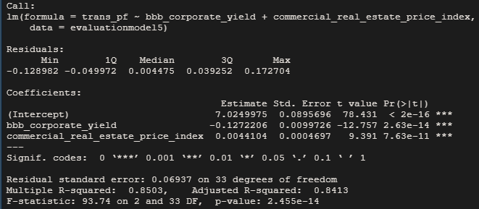
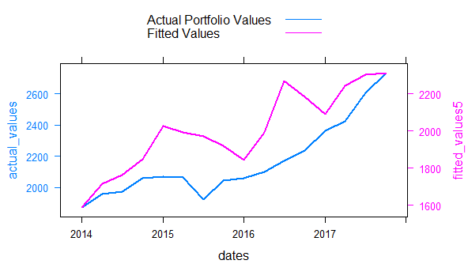
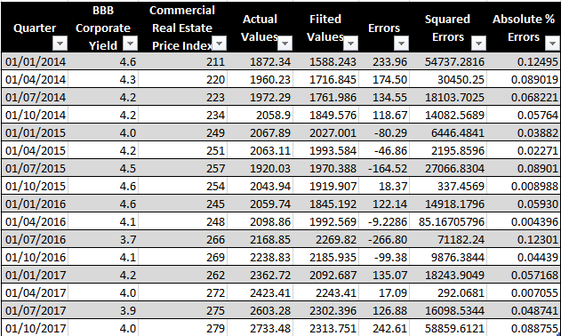
OUT-OF-SAMPLE ANALYSIS
Fitted values revolve around the actual portfolio values - indication of the prediction power of the model
In general, will predict the value correctly
MAPE less than 10%
Residual Analysis
MSE | 43422.29
RMSE | 208.380
MAPE | 8.17%
Forecast of Values in Validation Period (4 years)
| For Educational Purposes Only |
26

Slide 27
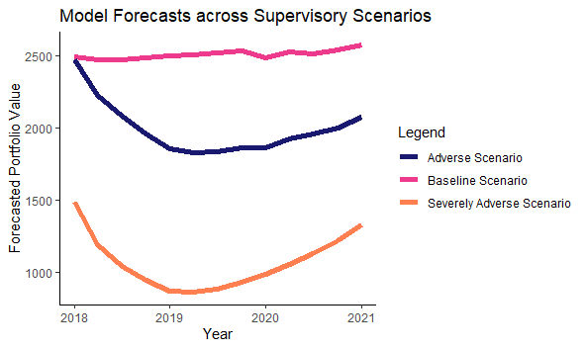
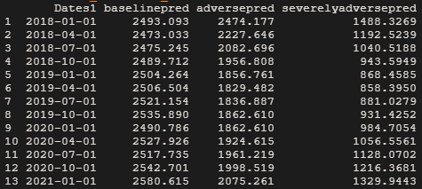
Slide 2
FORECASTING PORTFOLIO VALUES
Using the final model, I forecasted portfolio values under the 3 scenarios for the given time period. Graphed the forecasted values under all the scenarios to make sure that they have been predicted like one would expect.
| For Educational Purposes Only |
27

Slide 28
Slide 2
CAPITAL REQUIREMENT AT A PORTFOLIO LEVEL
CRP = 0.2*[(0.5*b)+(0.35*a)+(0.15*sa)]
Where;
b = initial_portoflio_value-forecasted_portfolio_value$baselinepred[9]
a = initial_portoflio_value-forecasted_portfolio_value$adversepred[9]
sa = initial_portoflio_value-forecasted_portfolio_value$severelyadversepred[9]
$ 2.42690 M
Expected 9-quarter loss in
Baseline Scenario
$ 8.70867 M
Expected 9-quarter loss in
Adverse Scenario
$ 1.37693 M
$ 17.48771 M
Capital Requirement at a
Portfolio Level
Expected 9-quarter loss in
Severely Adverse Scenario
29
| For Educational Purposes Only |

Slide 29

Slide 11
THANK YOU

