Slide 1
R Project
Case Study-1
Econometric model in Banking Industry
Sahil Minocha
Roll - 5

Slide 2
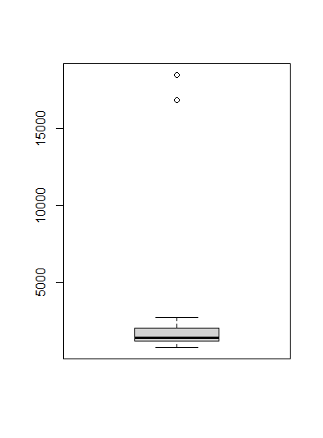
Data Cleaning
It was found that data consist of missing values and as well as outliers
Interpolation was used for the missing values
Boxplot helped to spot the outliers and the decimals of the values were shifted like the other values.

Slide 3
Data Analysis
(correlation test)
Correlation of independent and dependent variables are carried out and those which exhibit correlation coefficients greater 0.6 (absolute values) are selected.
Particular | Correlation coefficient
BBB Corporate Yield | 0.7249941
Commercial Real Estate Price Index | 0.7827077
Money Supply | 0.8603835
Consumer Confidence Index | 0.8082417
Business Confidence Index | 0.6348338
(USD/euro) | 0.6154113

Slide 4
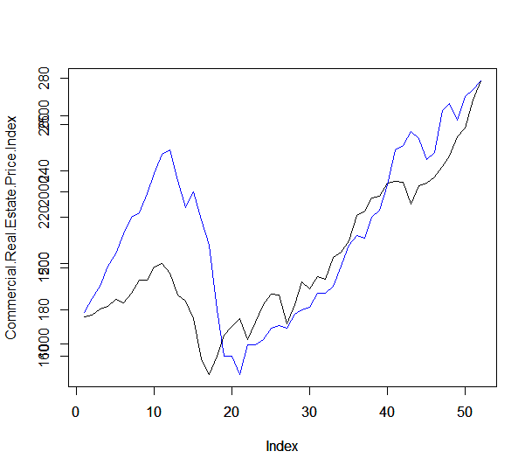
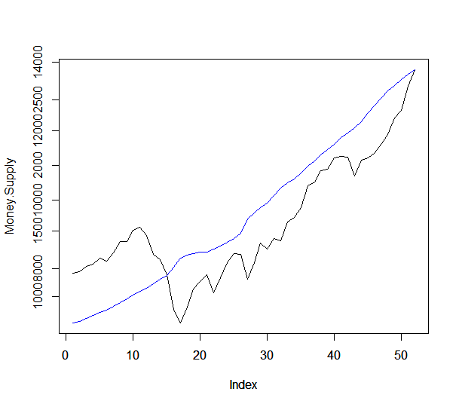
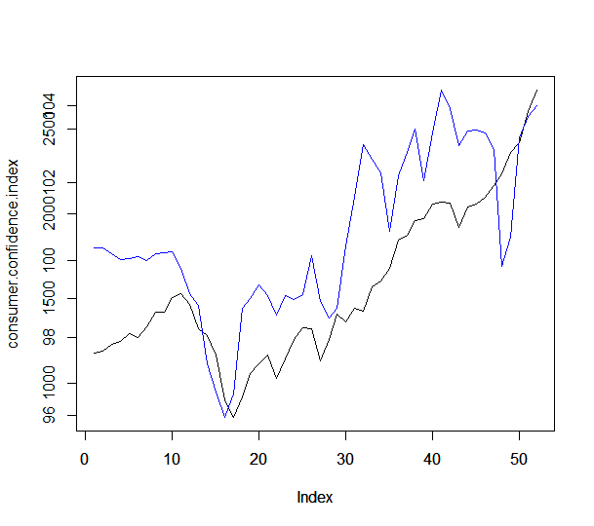
Commercial Real estate price index
Money supply
Consumer confidence index
Portfolio values are the X axis values and the Y axis values are there respective heading

Slide 5
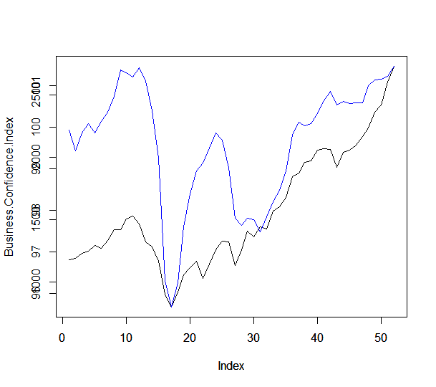
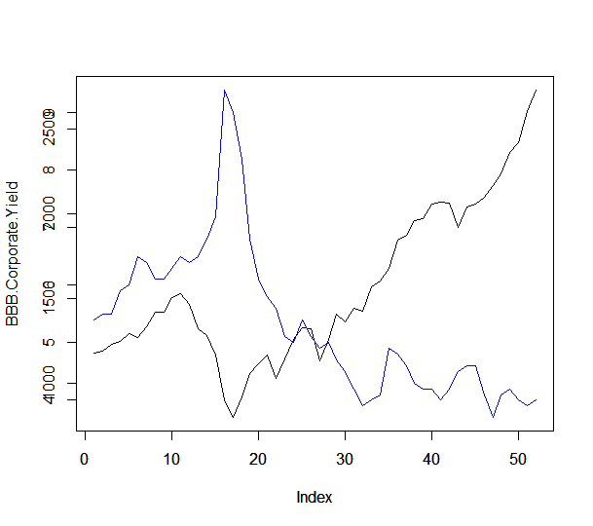
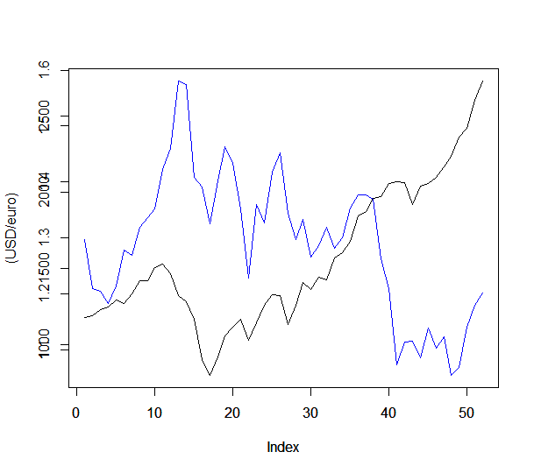
Business confidence index
BBB Corporate Yield
(USD/euro)
Portfolio values are the X axis values and the Y axis values are there respective heading

Slide 6
Regress dependent variable with the set of independent variables
 | Portfolio values | BBB Corporate yield | Commercial real estate price index | Money Supply | Consumer confidence index | Business Confidence index | USD/euro
Portfolio values | 1 | -0.7249941 | 0.7827077 | 0.8603835 | 0.8082417 | 0.6348338 | 0.6154113
BBB Corporate yield | -0.7249941 | 1 | -0.24208095 | -0.712751484 | -0.799259575 | -0.389217052 | 0.556927831
Commercial real estate price index | 0.7827077 | -0.24208095 | 1 | 0.547108537 | 0.4815388 | 0.6720982 | -0.473500714
Money Supply | 0.8603835 | -0.712751484 | 0.547108537 | 1 | 0.702080145 | 0.225853114 | -0.580477635
Consumer confidence index | 0.8082417 | -0.799259575 | 0.4815388 | 0.702080145 | 1 | 0.46223295 | -0.5960609
Business confidence index | 0.6348338 | -0.389217052 | 0.6720982 | 0.225853114 | 0.46223295 | 1 | -0.31397835
USD/euro | -0.6154113 | 0.556927831 | -0.473500714 | -0.580477635 | -0.5960609 | -0.31397835 | 1

Slide 7
Modelling
Money supply was removed prior modelling
Iteration 1:- Commercial Real Estate Price Index, BBB Corporate Yield, Consumer confidence Index, Business Confidence Index, (USD/euro)
Iteration 2:- Commercial Real Estate Price Index, BBB Corporate Yield, Consumer confidence Index
Iteration 3:- Commercial Real Estate Price Index, BBB Corporate Yield

Slide 8
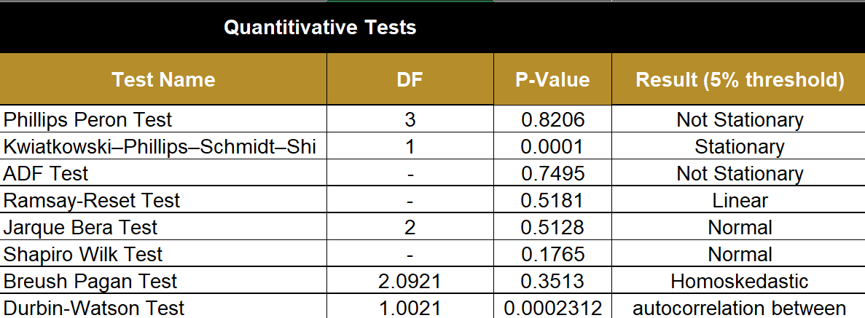
Quantitative tests

Slide 9
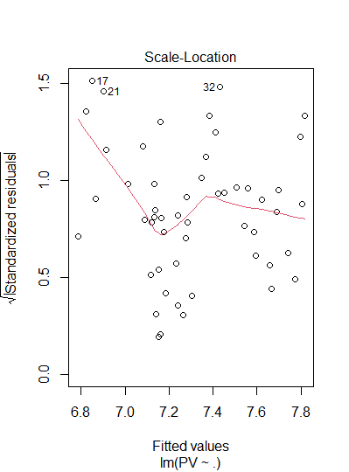
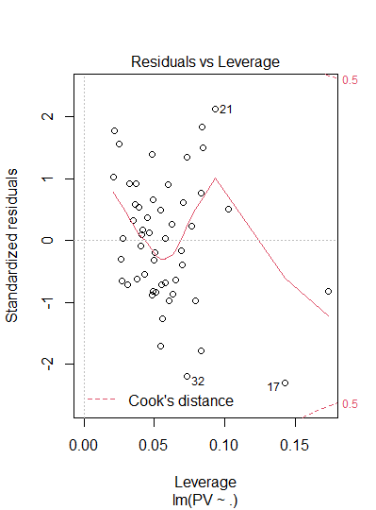
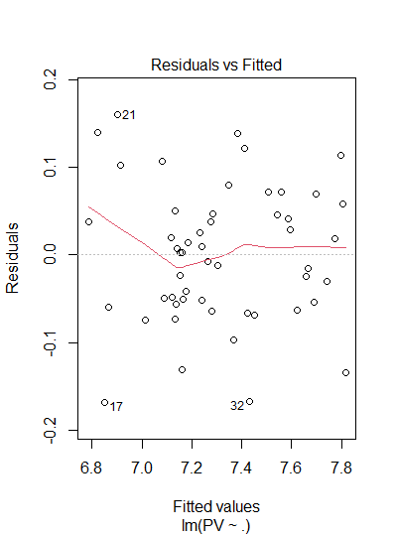
Qualitative test
Heteroscedasticity
Outliers Analysis
Linearity

Slide 10
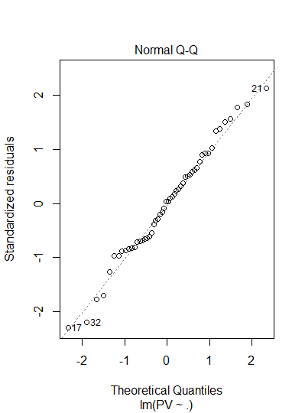
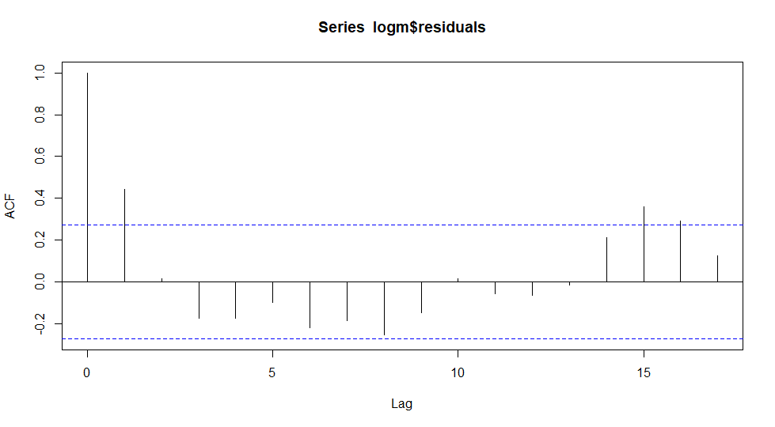
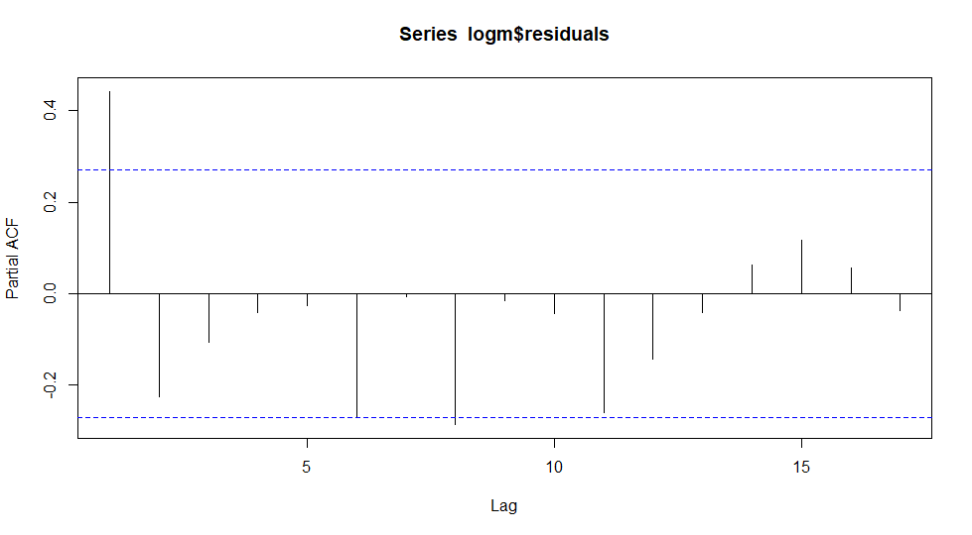
Normality
Stationarity(ACF)
Stationarity(PACF)

Slide 11
Sample Analysis
Out of sample
RMSE | 166.8309
MSE | 27832.54
MAPE | 0.06024562
In sample
RMSE | 14491.13
MSE | 120.3791
MAPE | 0.06279515

Slide 12
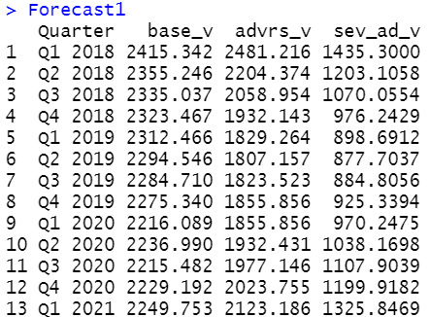
Forecast

Slide 13
Required Capital
Baseline loss = 517.3882
Loss Adverse = 877.6204
Severely Adverse = 1763.229
Required Capital = 142.2797

